Slide 1
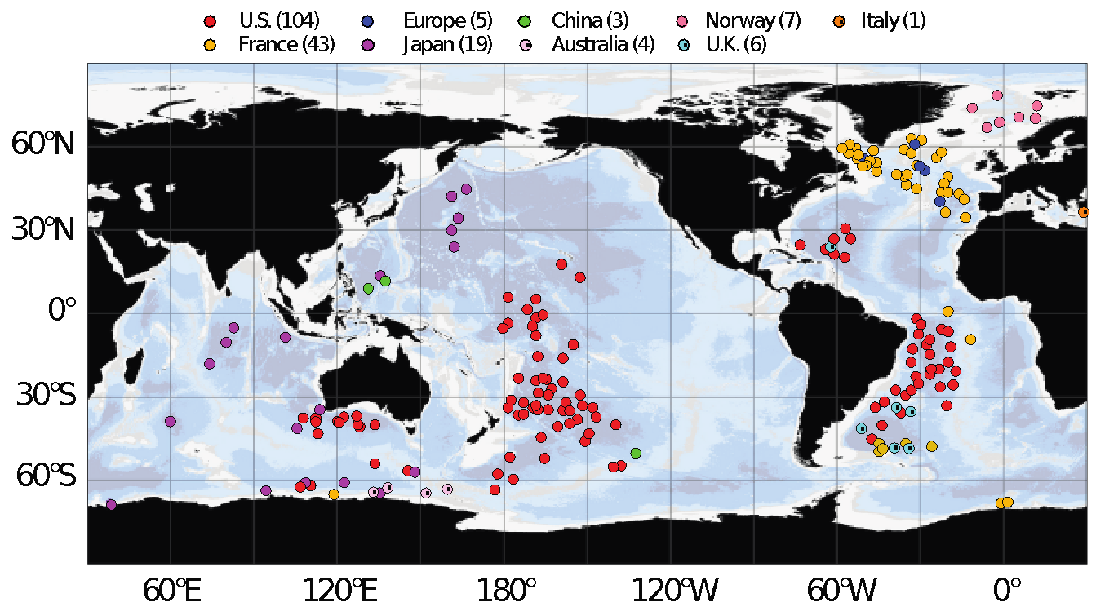
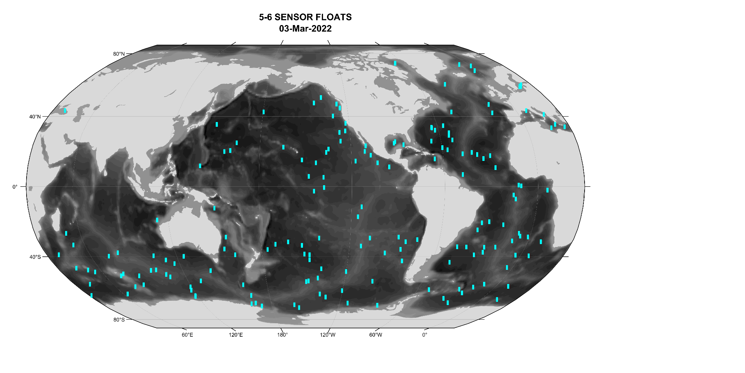
Present Status: OneArgo – High Technical Readiness
Deep Float Pilot Arrays, 2022
Active BGC floats, 2022
2019: OneArgo design articulated at OceanObs’19, approved by GCOS/GOOS
2015-22: successful deep and BGC pilot arrays. Float and sensor development well along.
Projected Cost for total 4700 float array $120M/year. Present funding model will not work.
20XX: OneArgo design implemented?

Slide 2
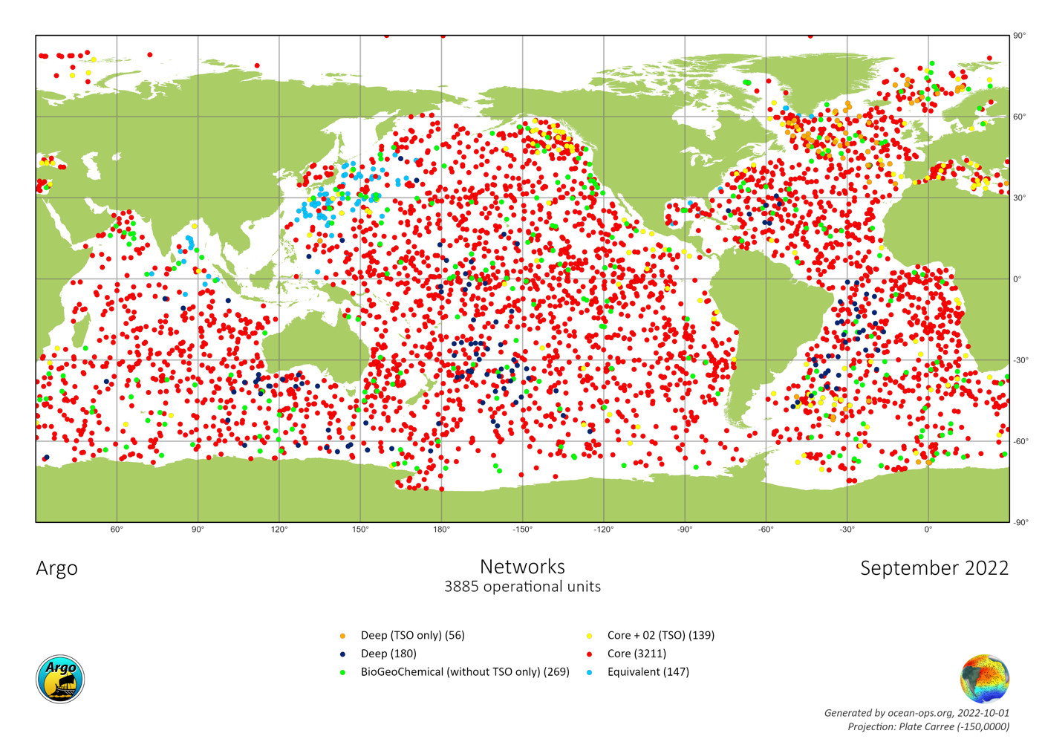
OneArgo – Successful pilot arrays,
stalled global implementation
Total = 3885/4700 (83%)
Deep = 180/1250 (14%)
Biogeochemical (>=5 params) = 269/1000 (28%)
Presently the Argo system is starting significant net decline

