Slide 1
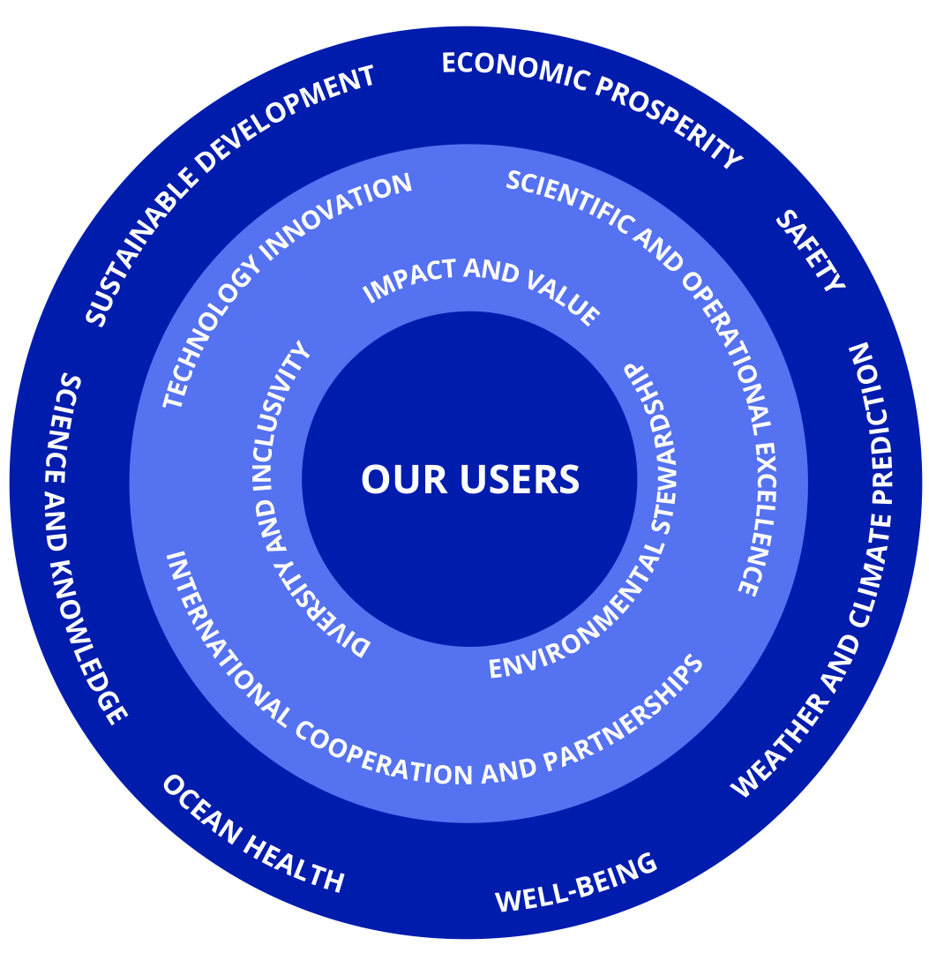
DBCP 38
Data Buoy Cooperation Panel 38th Annual Session
1-4 November 2022, Geneva, Switzerland
The DBCP strategy - its first year of implementation

Slide 2
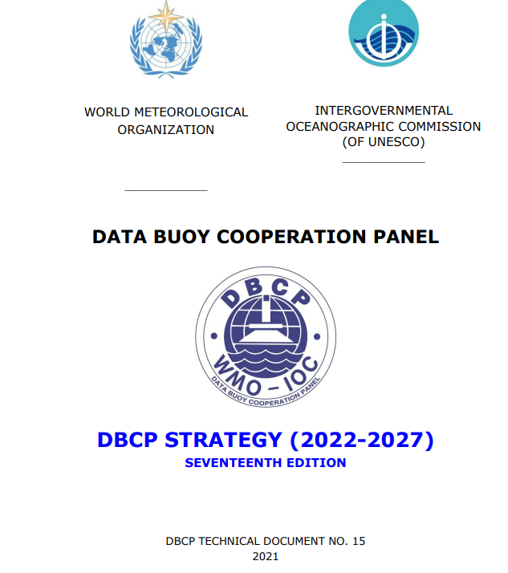
The DBCP Strategy 2022-2027
https://www.ocean-ops.org/dbcp/doc/DBCP%20Strategy/DBCP%20Strategy%202022-2027.pdf

Slide 3
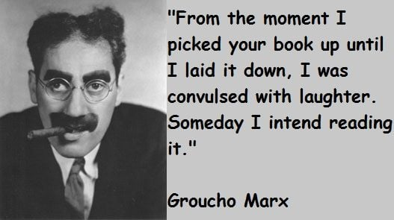

Slide 4
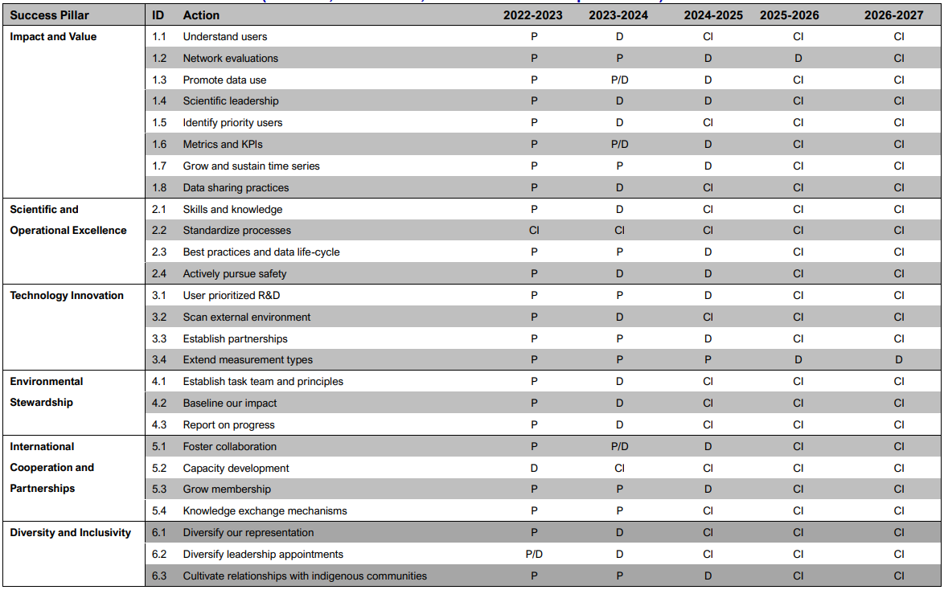
DBCP Strategy Implementation
✓
✓
✓
✓
✓
✓
✓
✓
✓
✓
✓
✓
✓

Slide 5
DBCP Strategy Implementation
Impact and Value
100 scientific papers using drifter data (GDP) published this year! (MBs ?)
Tsunami buoys underpinning tsunami warnings in Pacific and Indian Ocean regions
Early warnings for severe weather
Coriolis data products – easier access to information
MB Metadata format and template updated – more work but incorporated into OceanOps (Val happier!)
Scientific and Operational Excellence:
Data mapping - clarifying data flows for easier data management and better access for users
Drifters continue to meet global design target
MEDS visualisations of drifter gaps
OceanOps metadata system maturing and we encourage full use
Data availability and MB BUFR migration variable
OCG Data strategy implementation
Technology Innovation
A-size drifters for hurricanes
Independent evaluations of newer platforms e.g. wave mini buoys
Biodegradable buoys and sensors in development stages
Drone usage and trackers for icebergs

Slide 6
DBCP Strategy Implementation
Diversity and Inclusivity
New Executive Board – 3 (4) female , 3 Male, RA II, IV, V, VI, a few younger, a few older!
First Mediterranean CB Workshop – Tunisia 9-11 Nov & 11-13 April 23
Sponsored 3 Members to attend DBCP 38 in person - RA I and V
Wave drifter deployment in Solomon Islands planned
Backyard Buoys
(Get engaged and embedded)
International Cooperation and Partnerships
New TPOS governance formed.
Plans to re-establish Indian Ocean data throughput in 2023 to 70%!
Workshop on Operational Wave Measurements 11- 12 October 2022
Dialogues with Industry
Environmental Stewardship
Established new Task Team
Baseline survey prepared for release (in Jan 23)

Slide 7
DBCP Strategy Implementation
Fantastic effort by you all!
A big year with more to come!

