Slide 1
IAPSO Tidal Analysis Best Practice Study Group
Andy Matthews and others
National Oceanography Centre, United Kingdom
Notes:
Previous study groups:
Moored CTDs
pH measurement

Slide 2
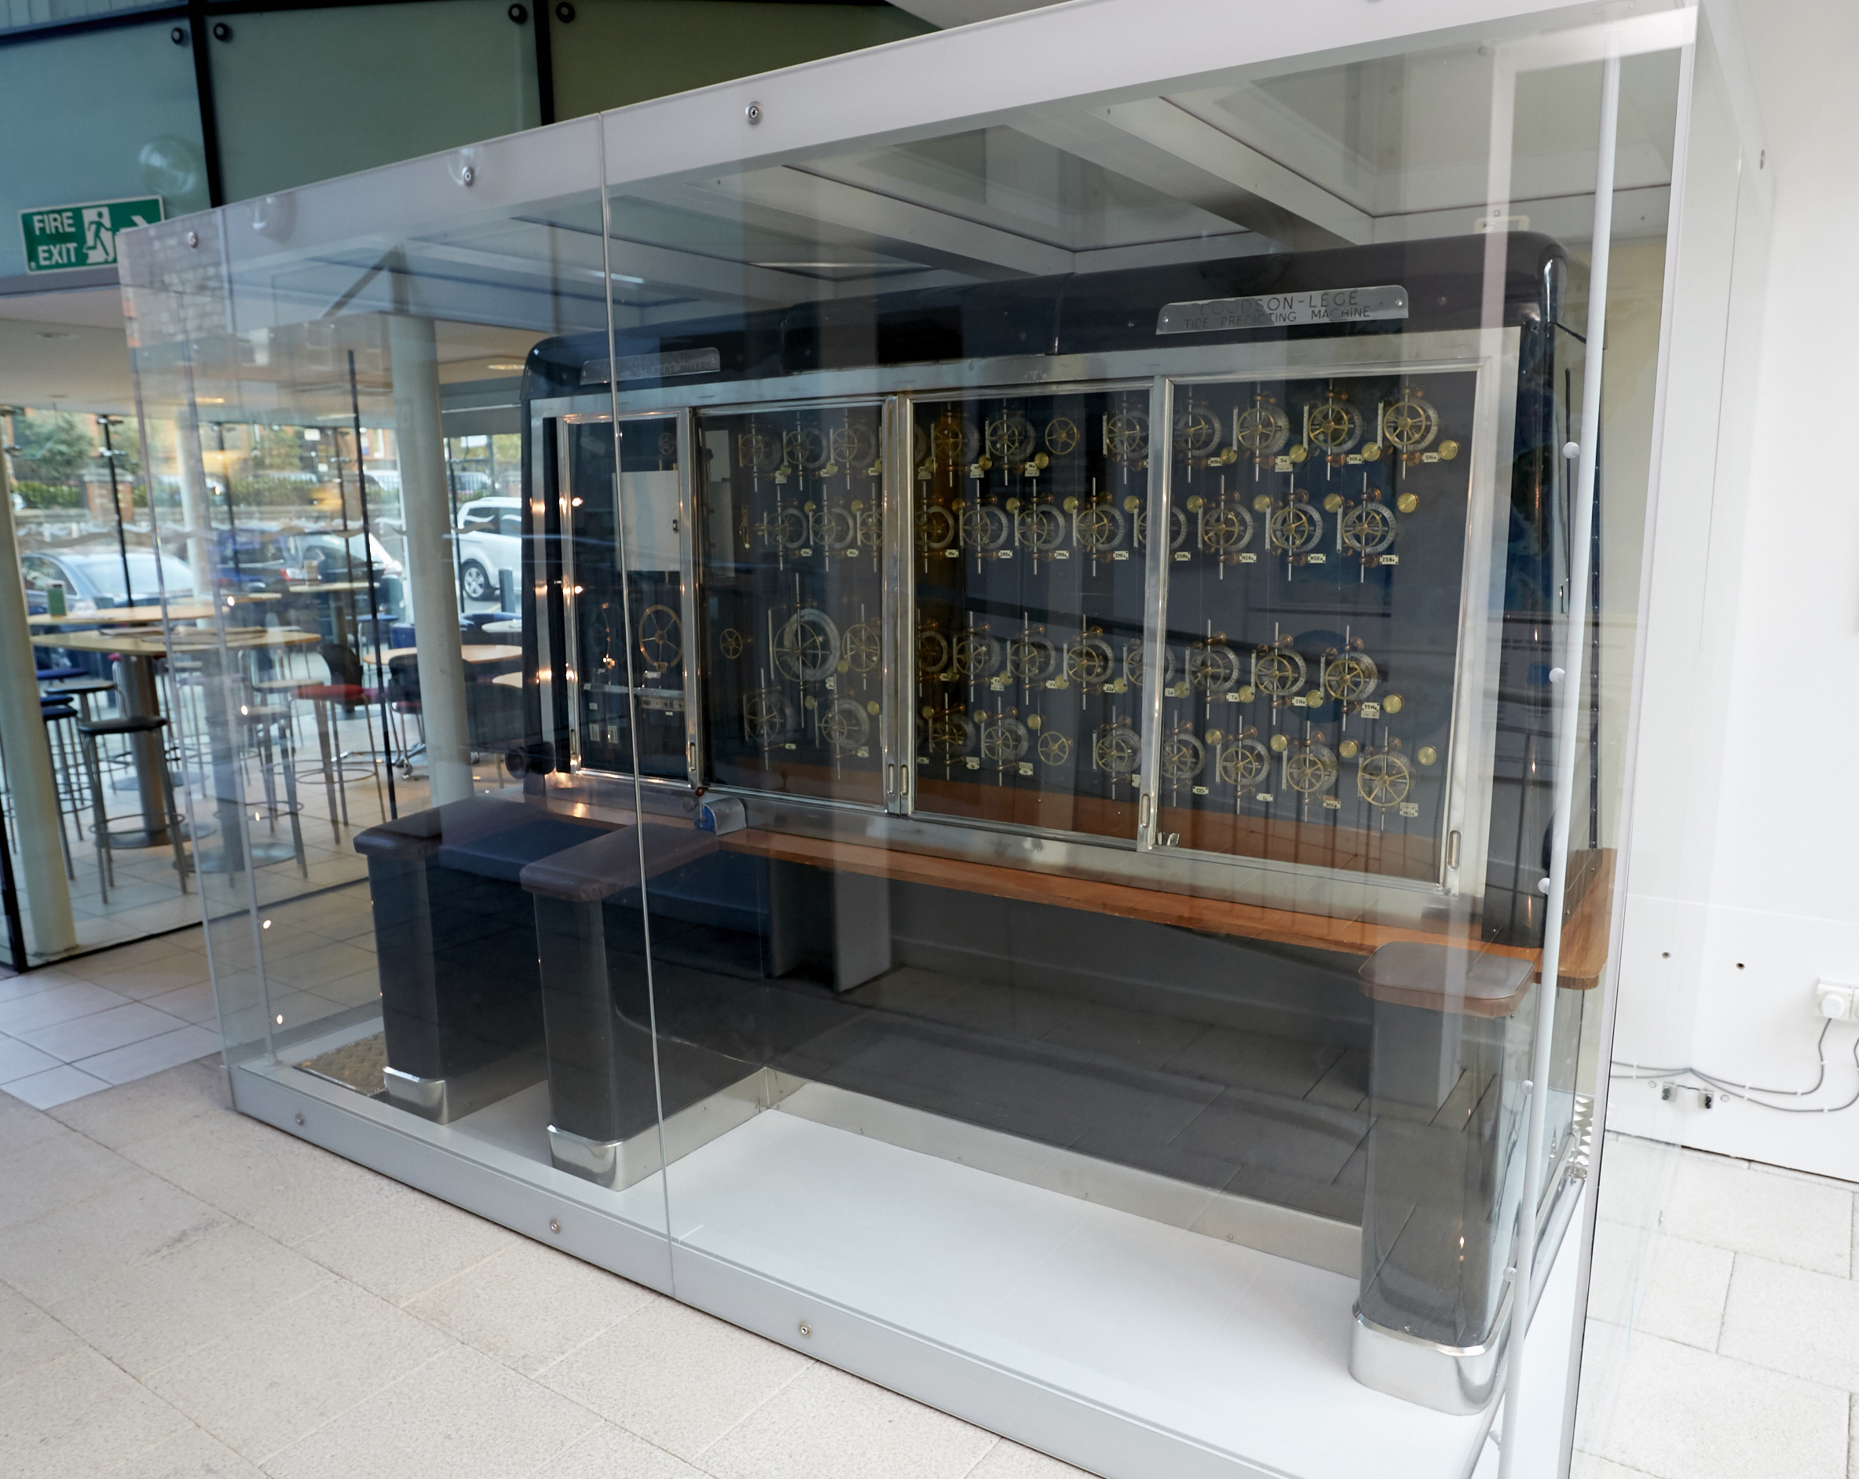
What kind of questions are we considering?
Theory
Tidal constituents
Solving equations
Nodal cycle
Alternative methods
Notes:
How are tidal constituents derived?
How do we choose the subset of constituents we should use?
How do we account for variations over time?, e.g.
Nodal cycle in constituents
Secular trend in data
What method do we use to fit the constituents?
How is uncertainty estimated? (if it is)
Alternative methods?

Slide 3
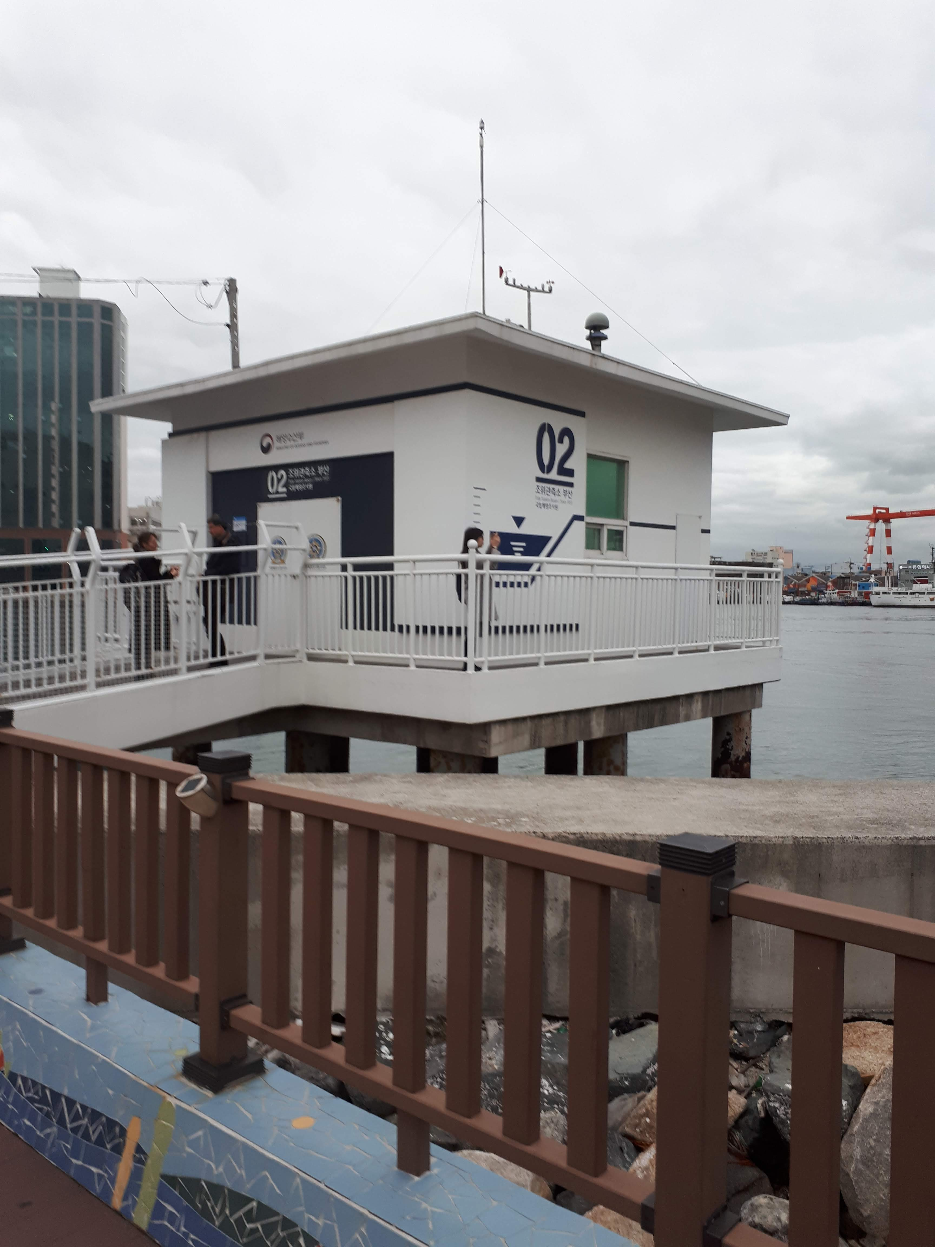
What are our goals?
Current state of tidal analysis
Where are the dangers?
Study of current software packages
Making analyses repeatable
The future:
What needs more study?
How can we fund it?

Slide 4

What is the study group?
Funding towards a meeting
Likely location: Berlin, July 2023
(IUGG General Assembly)
Required output: an ‘IAPSO guideline’
Aim: a formal best practice document
IOC have offered additional support
Contact: antt@noc.ac.uk

