Slide 1
PSMSL Report to GLOSS GE XVII, Paris, 2022
Liz Bradshaw, Andy Matthews
National Oceanography Centre, United Kingdom

Slide 2
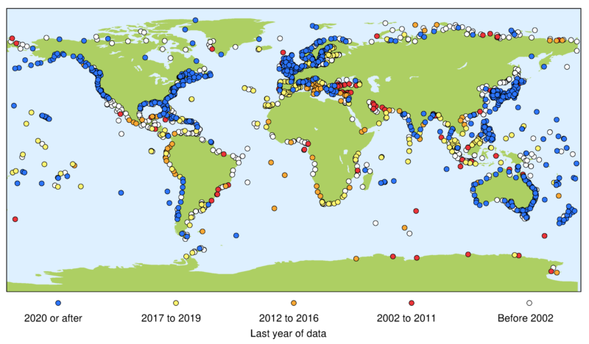
What is the Permanent Service for Mean Sea Level (PSMSL)?
Global databank for long term mean sea level data, with history dating back to 1933
GLOSS data centre for monthly mean sea levels
Service of both the International Association of Geodesy (IAG) and the International Association for the Physical Sciences of the Oceans (IAPSO)
Hosted by the UK’s National
Oceanography Centre (NOC)
Update since last GLOSS meeting:
in November 2019, NOC moved from
being a government owned laboratory
to being a charitable company limited
by guarantee.

Slide 3
What does the PSMSL do?
Collect monthly mean sea level data from around the world
Redistribute in a common format
Produce and distribute sea level related products (e.g. estimates of trends, land movement)
Work with other people on improving the provision of tide gauge data of all types across the world (GLOSS, IOC, IAPSO, IAG, EuroGOOS, UHSLC, GESLA, VLIZ, IHO, and many more)
Training programmes
Act as a focal point for questions about tides and sea levels

Slide 4
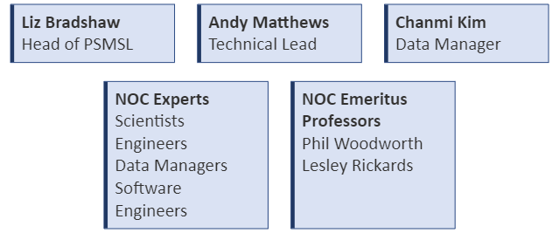
Who are PSMSL?

Slide 5
David Pugh (1943 – 2022)

Slide 6
Achievements since
GLOSS GE XVI
(April 2019)

Slide 7
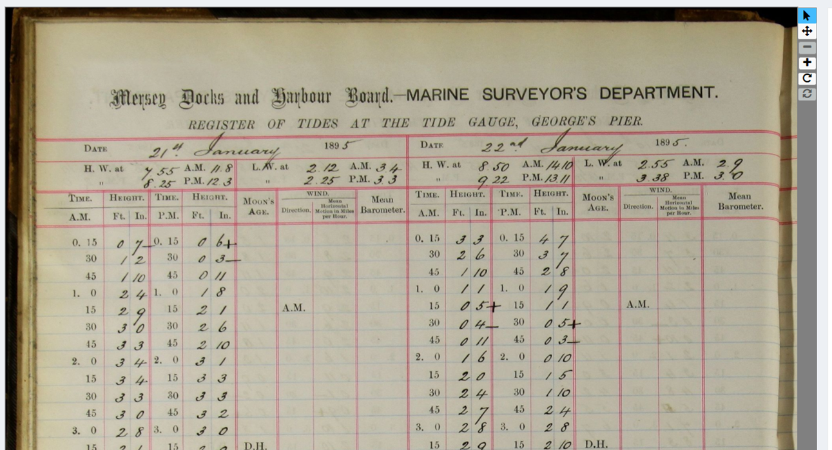
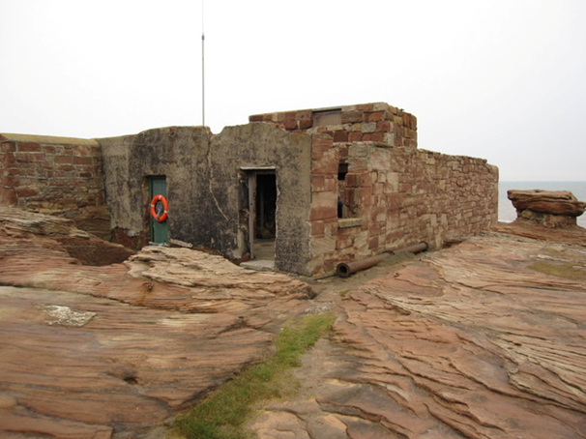
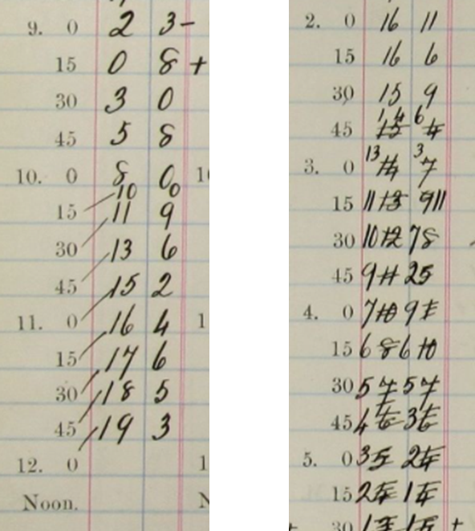
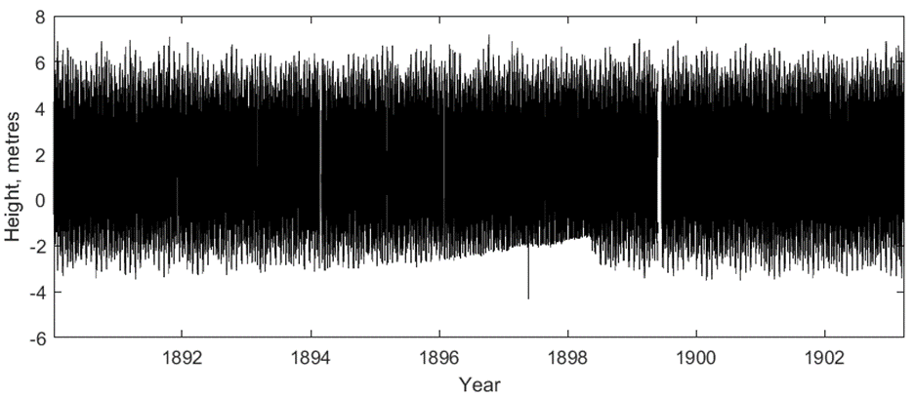
Using citizen science to rescue tide gauge data
Andy Matthews, Liz Bradshaw, Joanne Williams and over 3,000 volunteers
National Oceanography Centre, UK (antt@noc.ac.uk)
15 minute sea level height data from 1853 - 1903
Two sites in North West England
About 16,000 scanned pages
Values entered by volunteers at Zooniverse.org
Launched January 2021, finished January 2022
Currently quality controlling data
Valuable data for studying how tides have changed
Data already used to validate storm surge events
Project website: https://www.zooniverse.org/projects/psmsl/uk-tides

Slide 8
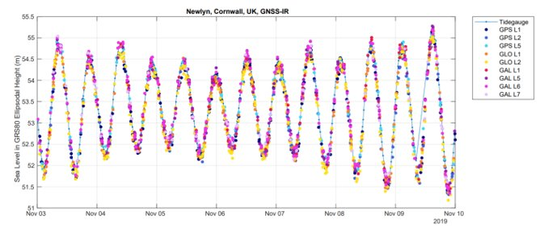
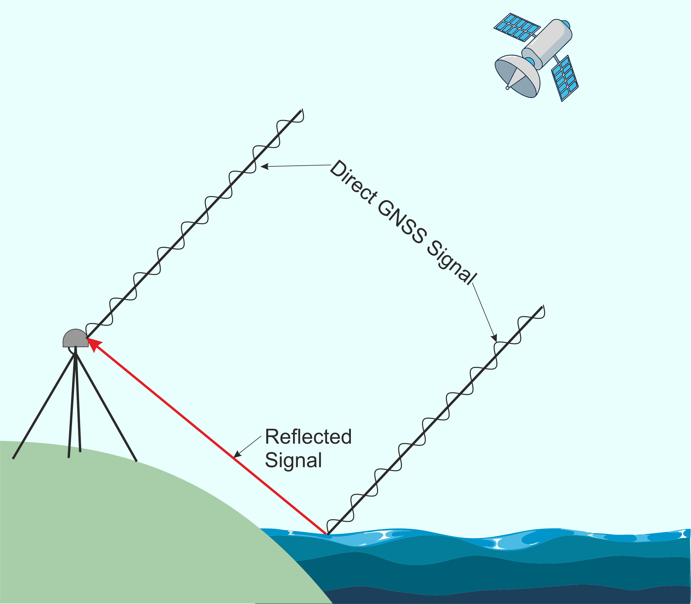
GNSS Interferometric Reflectometry (GNSS-IR)
The emerging technology of GNSS-IR gives us the opportunity to measure sea levels without getting out feet wet
This technique allows sea level to be measured using only a GNSS receiver.
As well as a receiving a direct signal from a GNSS satellite, the GNSS receiver detects a reflected signal off the surface of the water. The phase delay between the direct and reflected signal will vary as the height of the water changes.

Slide 9

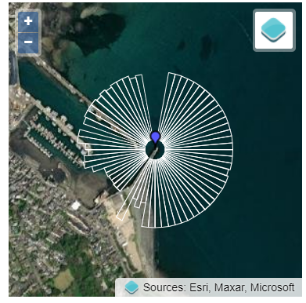
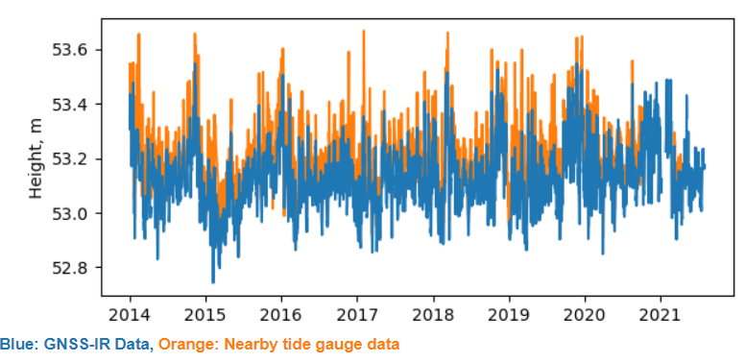
Data portal at https://psmsl.org/data/gnssir
Notes:
About 250 sites

Slide 10
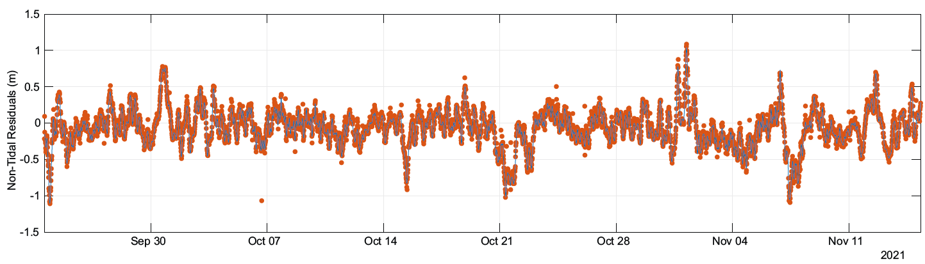
Dual tide gauge / GNSS-IR installations
Notes:
Sheerness and Birkenhead
Some due to be installed for EuroSea

Slide 11
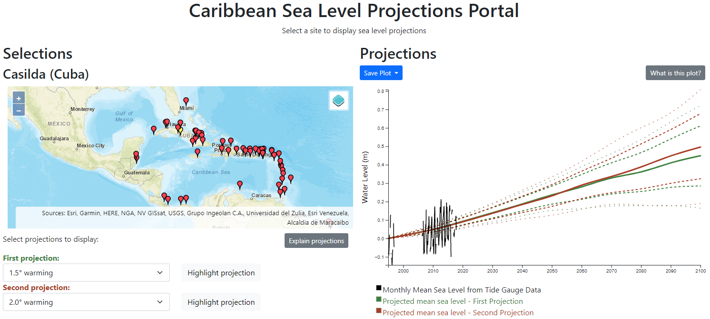
International Development Work https://psmsl.org/accord/projections.html
Notes:
More from Sveta

Slide 12
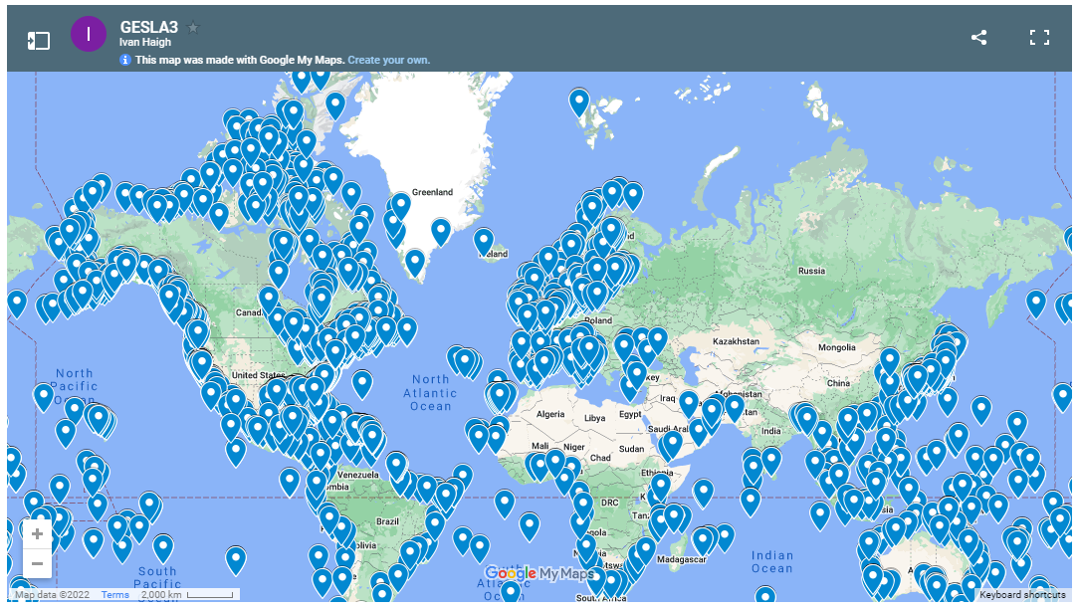
Involvement in new GESLA release: https://gesla.org/
Assisted with contacting suppliers
Advice on metadata and formats
Banked at BODC for long time archiving
Assigned a DOI

Slide 13
Sea Level REP: progress compared to plans
Product definition, including required metadata, procedures and datasets
Review of history files in INSTAC NRT quality status with the regions and data providers
Upgrade of automatic qc/validation
New Sea Level REP product based on INSTAC NRT time series (Nov. Release): 2 datasets: one for hourly values and one for data in their original sampling
Centralized distribution from PdE and Nologin
Roadmap for inclusion of stations from the global network, through interaction with external providers (GLOSS/EMODnet/SeaDataNet) – Ongoing activity
Feasibility study of a dedicated coastal sea level REP product of tide gauge data (including Global Navigation Satellite System (GNSS) land vertical motion corrections) . First contact with GLOSS GNSS data centre (SONEL). Deadline: December 2022
2022:
Temporal extension
Selection of detiding strategy (in agreement with on-going initiatives in GLOSS/IAPSO and the MFC's)
New detiding tools in SELENE software (already implemented in 2022)
New dataset for hourly sea levels including astronomical tide and non-tidal residuals in the IBI region
2023:
2024:
Temporal extension
Increased spatial coverage of the product with hourly dataset including stations from the global network

Slide 14
Data / Metadata Improvements
Work with EuroGOOS TGTT and EuroSea to produce metadata inventory for European sites
Work with BODC / RDA on possibility of using tide gauges as a use case for persistent identifiers for sensors
https://www.rd-alliance.org/groups/persistent-identification-instruments-wg
Continued working with BODC and others to develop suitable identifiers, vocabularies and data structures for distributing sea level data via ERDDAP data servers.
Developed API allowing direct submission of binary data from sensors into ERDDAP in situations where there are requirements for keeping power and data transfer sizes low.
Various working group memberships including:
DOIs for Geodetic Data Sets for Global Geodetic Observing System (GGOS)
IOC data policy working group?
EuroGOOS Data Management, Exchange, and Quality Working Group (DATAMEQ)

Slide 15
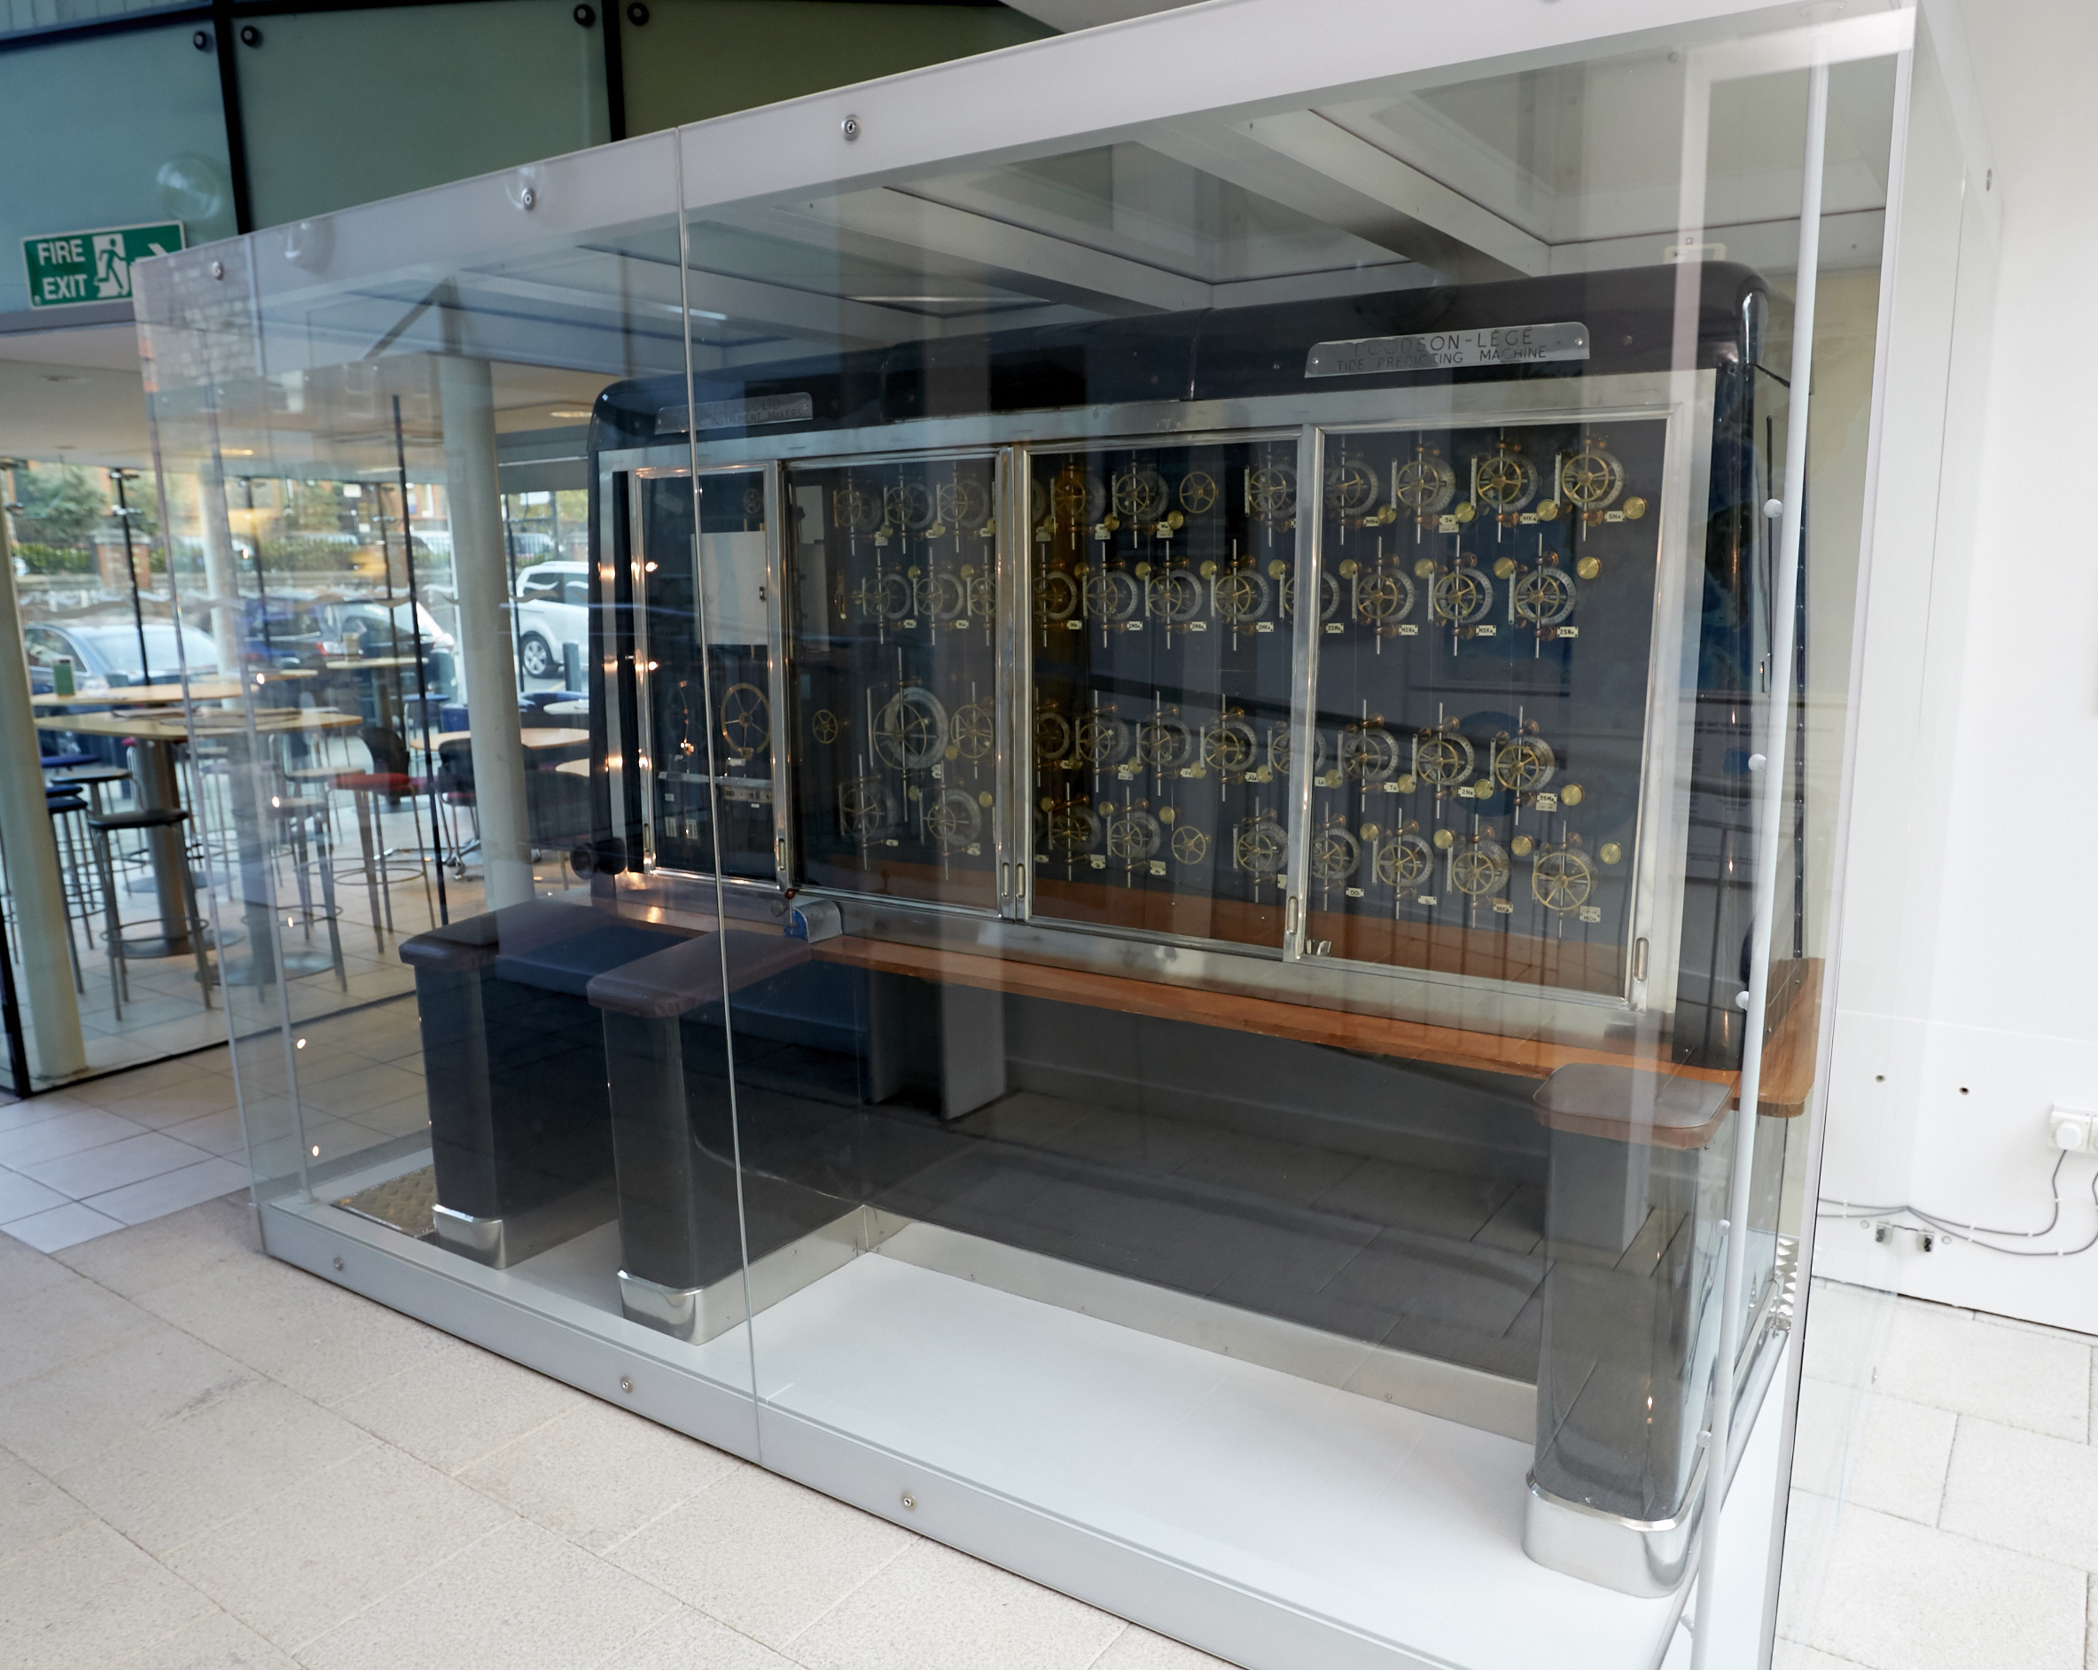
IAPSO Tidal Analysis Best Practice Study Group
Theory
Choosing constituents
Methods
Software
Repeatability
Dangers

Slide 16

What is the study group?
Funding towards a meeting
Likely location: Berlin, July 2023
(IUGG General Assembly)
Required output: an ‘IAPSO guideline’
Aim: a formal best practice document
IOC have offered additional support
Contact: antt@noc.ac.uk

