Slide 1
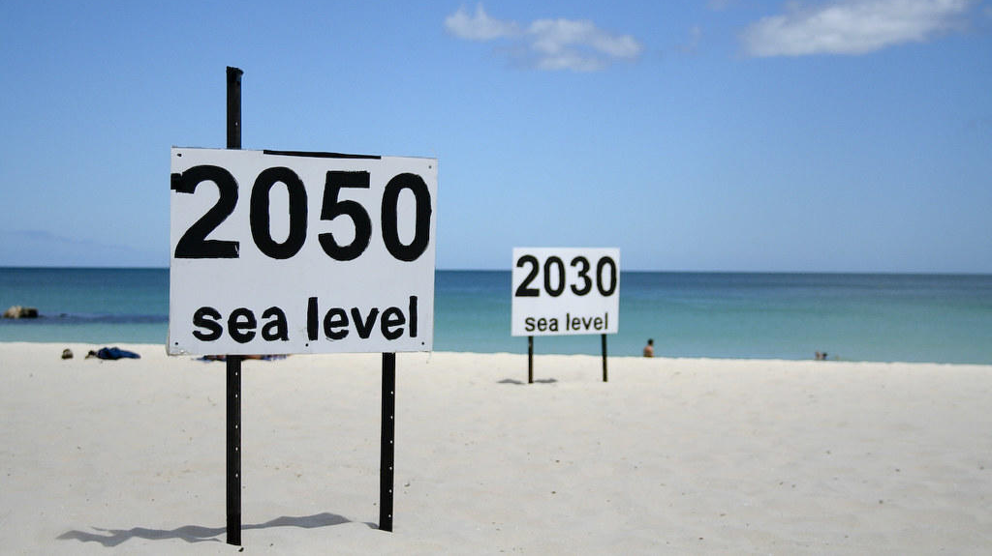
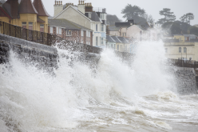
GESLA-3: A major update to the global high-frequency sea level dataset
Phil Woodworth
on behalf of
Ivan Haigh, Marta Marcos and Others
GLOSS Experts Meeting Paris November 2022

Slide 2

0. Introduction
Background:
Global datasets of time varying monthly and annual mean sea level (MSL) have been available since 1933 (90 years) from the PSMSL;
The PSMSL has always had good coverage globally because historically tide gauge operating agencies have been more willing to share monthly mean data, rather than higher-frequency data.
However, higher-frequency data is required for the study of ocean tides, storm surges, extreme sea levels, and other coastal processes on a global scale.
Notes:
2

Slide 3

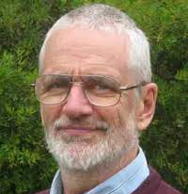

1. GESLA-1
GESLA-1, was assembled in 2009 by Philip Woodworth, John Hunter and Melisa Menéndez;
21,197 station-years of high frequency measurements from 675 station records;
GESLA-1 was first used in a study of sea level extremes by Woodworth and Menendez (2010).
Subsequently around a dozen publications were based on GESLA-1 (e.g., Woodworth et al., 2010, 2011; Hunter, 2012; Hunter et al., 2013; Nicholls et al., 2014; Mawdsley et al., 2015; Marcos et al., 2015; Mawdsley and Haigh, 2016) and IPCC.
Notes:
3

Slide 4
1. GESLA-1
GESLA-1: 21,197 station-years from 675 station records
Notes:
4

Slide 5
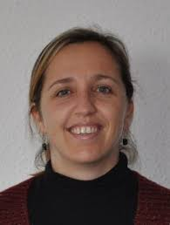

2. GESLA-2
GESLA-2, which was assembled in 2015 and 2016 by the three people mentioned above, in addition to Marta Marcos and Ivan Haigh;
39,151 station-years of high frequency measurements of sea level from 1,355 station records;
30 data sources;
Described in detail in Woodworth et al. (2017).
Used in around 50 published studies for a much wider range of applications including IPCC.
Notes:
5

Slide 6
GESLA-2 paper published 2017

Slide 7
2. GESLA-2
GESLA-2: 39,151 station-years from 1,355 station records
Notes:
7

Slide 8



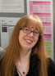

3. GESLA-3
Notes:
8

Slide 9
3. GESLA-3
GESLA-3 was assembled in 2020 and 2021 led by Ivan Haigh, Marta Marcos and Stefan Talke – Phil Woodworth and John Hunter – inputs from Ben Hauge, Arne Arns, Elizabeth Bradshaw and Philip Thompson;
86,665 station-years of high frequency measurements of sea level from 5,388 station records;
  Two fold increase in station years;
  Four fold increase in sites – compared to GESLA-2;
33 data sources;
  All data sources from GESLA-1/2 plus lots of extra sites;
  12 new data sources;
Described in detail in Haigh et al. (2022).
Notes:
9

Slide 10
GESLA-3 paper published 2022

Slide 11
3. GESLA-3
12 new data sources:
Copernicus Marine Environment Monitoring Service (CMEMS);
United States Geological Survey (USGS);
German WasserstraBen-und Schifffahrtsverwaltung des Dundes (WSVDE;);
California Department of Water Resources (CDWR);
Geospatial Information Authority of Japan (GIAJ);
Japanese Ports and Harbours Bureau (PAHB);
South Florida Water Management District (SFWMD);
National Autonomous University of Mexico (NAUM);
Irish Marine Institute (MI);
UK Coastal Channel Observatory (CCO);
North West Florida Water Management Department (NWFWMD)
North Carolina Department of Emergency Management (NCDEM).
Notes:
11

Slide 12



3. GESLA-3
For 5 of the 33 sources (i.e., UHSLC, NOAA, NHS; MI-C, MI-R), we were able to download the sea level records automatically via an API (application programming interface), which greatly saved download time.
For 6 of the 33 sources (i.e., DA, DMI, NOC, ESEAS, ICG, UZ), we obtained the data directly from the data provider or copied the data from GESLA-2.
For the remaining 22 of the 33 sources, we manually downloaded the data from the provider web-sites.
Notes:
12

Slide 13
3. GESLA-3
GESLA-3: 86,665 station-years from 5,388 station records
Notes:
13

Slide 14
3. GESLA-3
Notes:
14

Slide 15
3. GESLA-3
Number of records per country
Notes:
15

Slide 16
3. GESLA-3
Stations in GESLA-3 that are more than 50km from a station in GESLA-2
Notes:
16

Slide 17
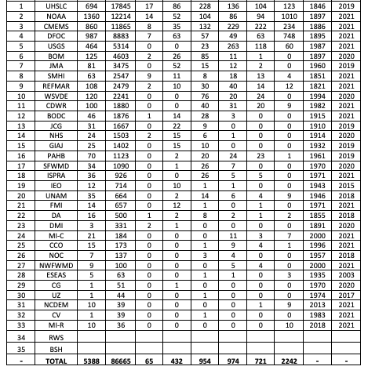
Notes:
17

Slide 18
3. GESLA-3
Notes:
18

Slide 19
3. GESLA-3
Notes:
19

Slide 20
>100 yrs
50-100 yrs
20-50 yrs
10-20 yrs
5-10 yrs
< 5 yrs
Notes:
20

Slide 21
< 1850
1850-1900
1900-1950
1950-2000
2000-2015
>2015
Notes:
21

Slide 22
3. GESLA-3
GESLA-3: 86,665 station-years from 5,388 station records
Notes:
22

Slide 23
GESLA-3
Twice the number of station-years, and four times the number of stations, as in GESLA-2
Sampling often still only hourly but many records higher rates e.g. 6, 10, 15 min. (We did not download 1-min data from French sites for example cf. MISELA data set of Zemunik et al.)
Data paper published this year
Now a big data set (37 GB expanded) but manageable
Already being used in scientific studies
Commitments made to keep the data set updated (as far as one can make such commitments)

