Slide 1
SEA LEVEL STATION MONITORING FACILITY
Intro and report
Francisco Hernandez (tjess@vliz.be)
Bart Vanhoorne
info@ioc-sealvelmonitoring.org
Flanders Marine Institute (VLIZ)
Belgium
www.ioc-sealevelmonitoring.org

Slide 2
Content
Sea level station monitoring facility summary
Data flow
Operational Interface
Station metadata management
Webservices & API
Sea Level Station Catalogue
Plans & projects
Report 2020 - 2022

Slide 3
Summary
The sea level station monitoring facility (http://www.ioc-sealevelmonitoring.org/) collects and processes in real time data from 1028 sea level measuring stations operated by 164 institutes (station operators) world wide.
The objective of this service is
to provide information about the operational status of global and regional networks of real time sea level stations
to provide a display service for quick inspection of the raw data stream from individual stations.
The system was build and is operated by Flanders Marine Institute (VLIZ) for UNESCO as part of the GLOSS program of IOC.

Slide 4
Summary
The station operators push the raw data to the SLMF using different data protocols : the WMO GTS, FTP push, HTTP and even Email. The data is parsed in real-time and stored in the database. The SLMF redistributes the parsed real time data through a series of interfaces ( webpages, a rest API, or the GTS) to the different users, including the Tsunami warning centers, the station operators and the scientific community.
The SLMF database contains the sealevel data, but also metadata, contact information and configuration data about the different stations and their sensors. The team at VLIZ, the station operators and the Tsunami warning centers, maintain the configuration data.

Slide 5
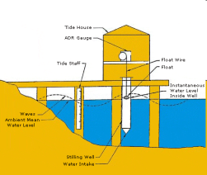
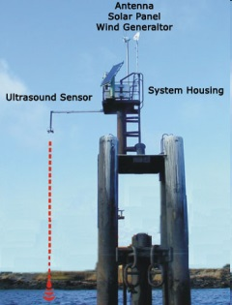
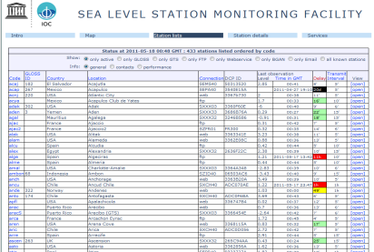
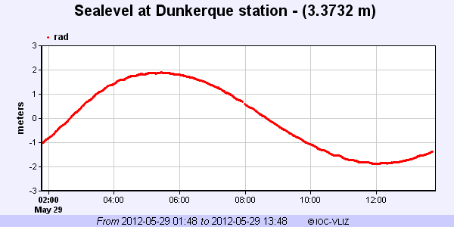
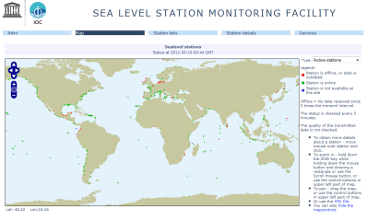
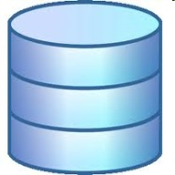
Data flow
GTS
Belgian
MetOffice
BGAN
FTP upload
VLIZ server (1x/min)
FTP/HTTP/Email
Push/pull to VLIZ
server (5min-1h)
Website
±730 stations: parse & insert into database
Tsunami centers
Station operators
Webservice / REST API
Database
Script(s)

Slide 6
Data ingestion
 | GTS | FTP | HTTP API | Webservice
Transmit interval (min) | 5 ..15 | 1 .. 60 | 1..60 | 5
Total station | 541 | 225 | 325 | 58
Typical delay (min) | 2 .. 15 | 2..12 | 1..15 | 1-5
Ratio expected/arrived (%) | ~100% | << 80% | ~100% | ~100%
Mechanism | Push to GTS of WMO | Push to FTP server at VLIZ or pull from station operator FTP | Pull from web api | Push to HTTP server at VLIZ
Notes | Many formats , some standards CREXX, OTT, GOES, | Mostly 1 new file per day per station, updated constantly | Many formats | Almost no delay

Slide 7
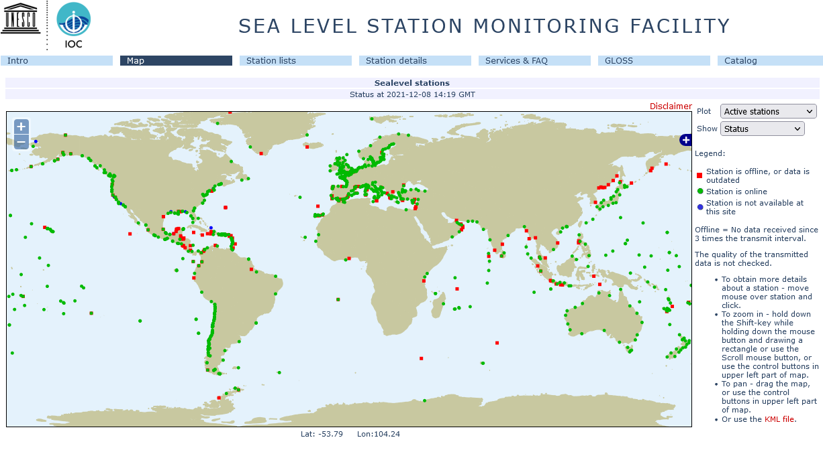
What stations are operational or offline.
For which data flow GTS / FTP / HTTP /.. ?

Slide 8
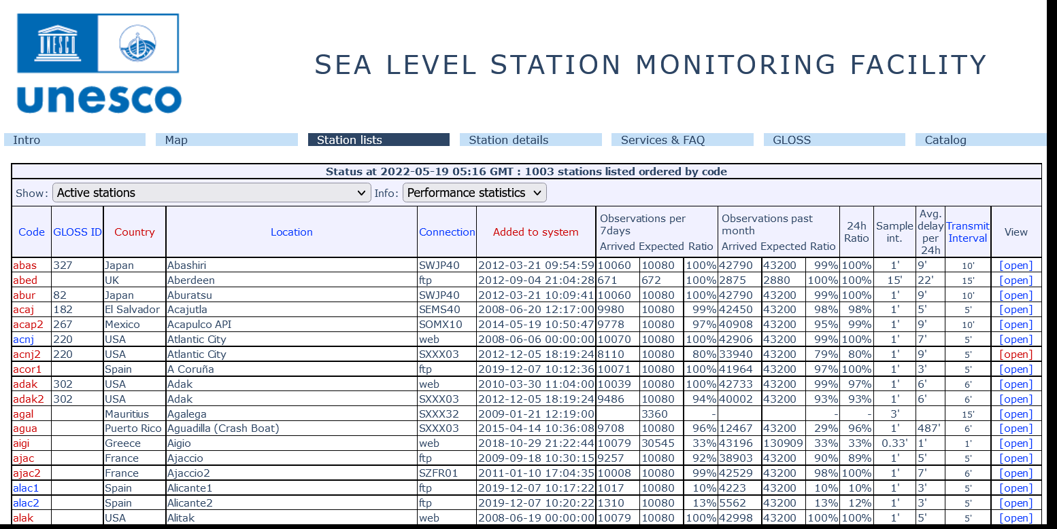
List of stations

Slide 9
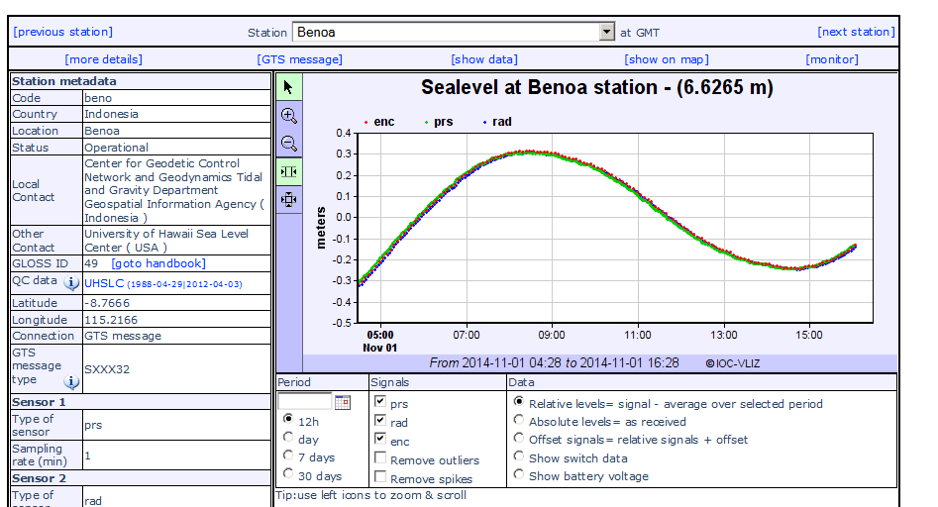
Station details

Slide 10
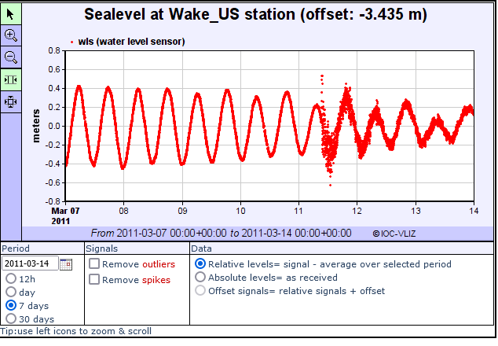
Tsunami signals

Slide 11
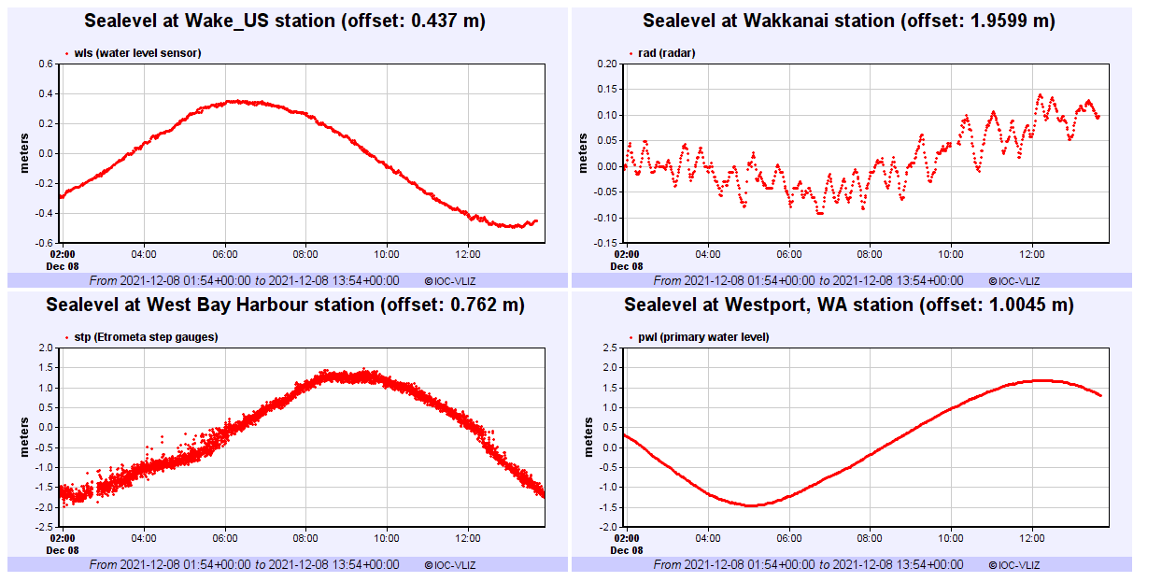
Real Time monitoring multiple stations

Slide 12
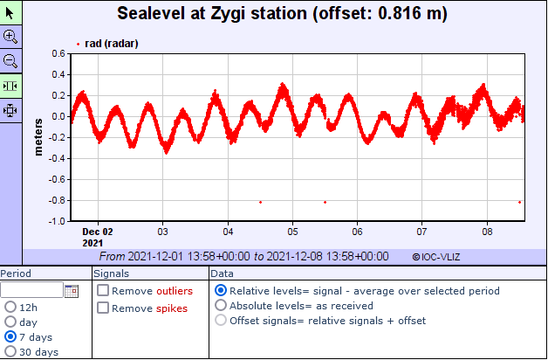
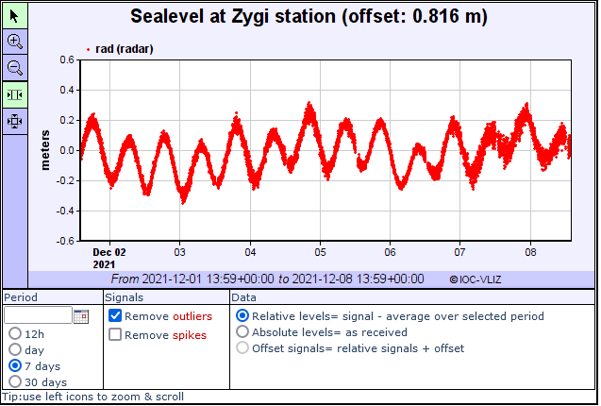
Optional quality control

Slide 13
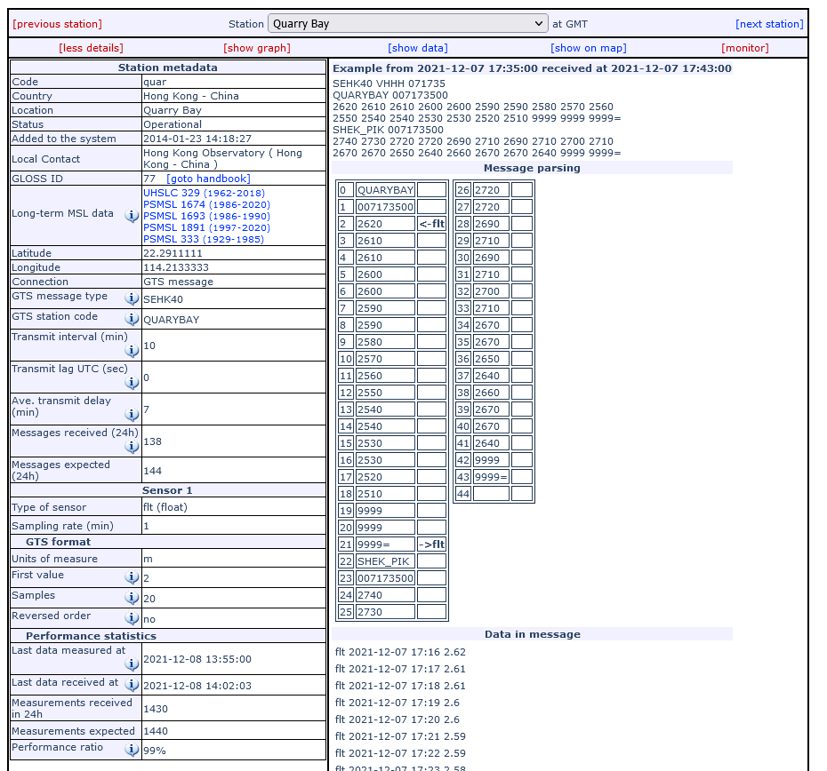
Parsing GTS messages

Slide 14
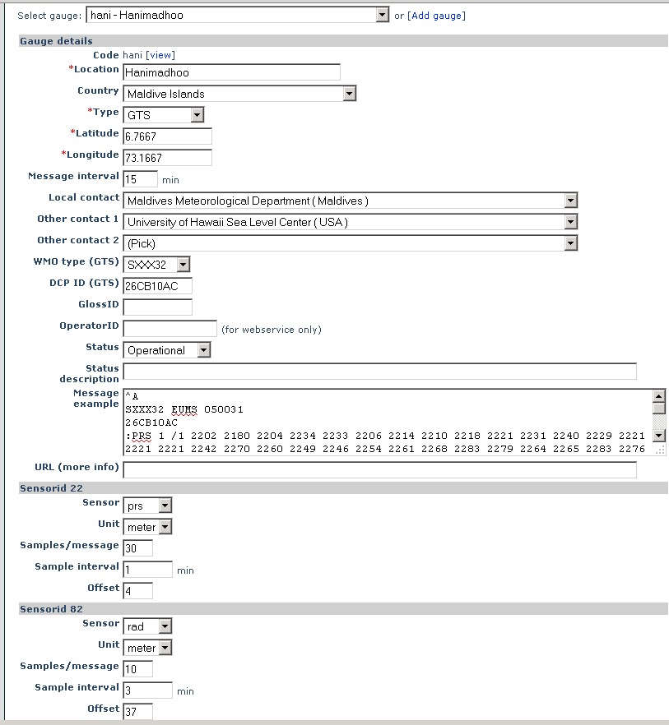
Edit metadata
Edit most station metadata
Add/edit sensors
Add/edit GTS parsing parameters

Slide 15
Webservice API users
“Official”/registered users:
Centre national d'alerte aux tsunamis (CENALT), France
EU Joint Research Centre (JRC), Europe
GEMPA, Germany
Indian National Centre for Ocean Information Services (INCOIS), India
Instituto de Meteorologia, Departamento de Sismologia e Geofísica, Portugal
Marinel-Eareth Science and Technology (JAMSTEC), Jampan
NOAA Center for Tsunami Research, US
NOAA, NGDC, US
Pacific Islands Ocean Observing System (PacIOOS)
Permanent Service for Mean Sea Level (PSMSL), UK
Service Hydrographique et Océanographique de la Marine (SHOM), France
University of Tasmania
=> users@ioc-sealevelmonitoring.org

Slide 16
Webservice API
Machine to machine
REST
Standard format: JSON/XML/ASCII
Registration
Simple: 4 data types:
data
stationlist
sensorlist
station

Slide 17
Query parameters

Slide 18
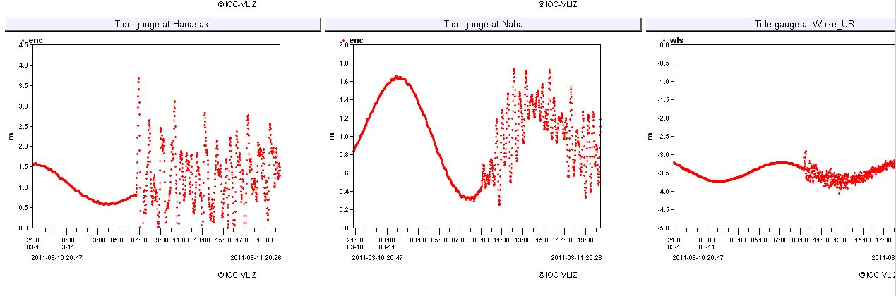
Japan Tsunami 2011-03-11 impact on performance
2,901,945
44,150

Slide 19
Sealevel Station Catalog (SSC) http://www.ioc-sealevelmonitoring.org/ssc
Goal
Central point for station metadata updated by datacenters and/or gauge operators
By
Linking station identifiers of #datacenters (UHSLC, PSMSL, SONEL, ...) and any other identifier (GLOSS, PTWC, …)

Slide 20
SSC Core fields
Very limited fields
(4-5) stored in SSC
Unique Identifier
Station name
Country
Region (optional)
Lat/lon
Identifiers (1-n)

Slide 21
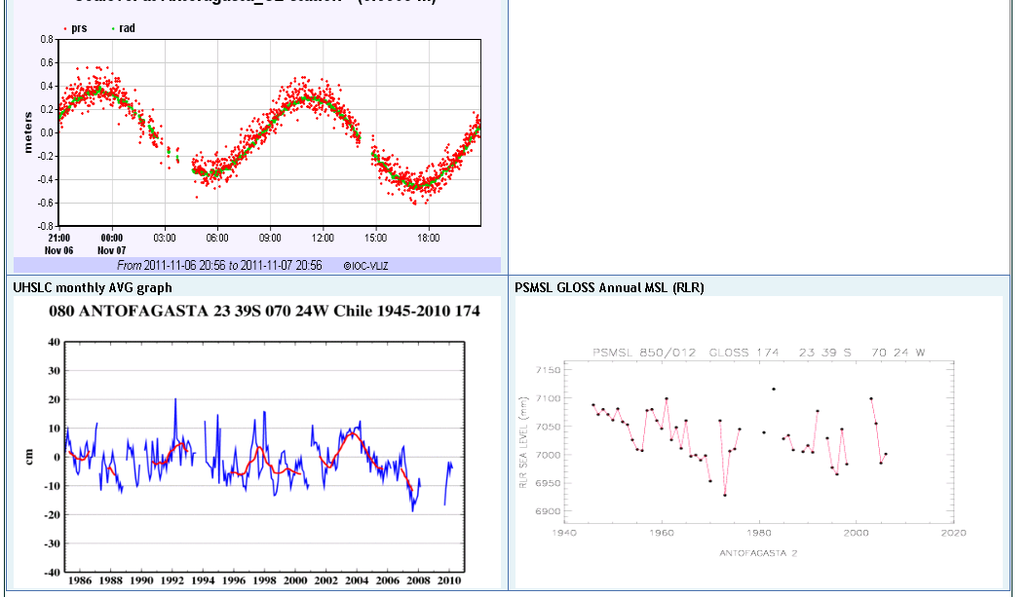
SSC Station detail
Stored
in SSC
Compare
metadata
Linked
via
Web-service

Slide 22
SSC functionalities
Live search
RSS feeds
Anyone can go in and edit
Cache linked data (performance)

Slide 23
Sea Level Station Monitoring Facility- timeline (1/3)
2007: VLIZ develops and maintains the real-time station monitoring system as an in-kind service to IOC
2008: raw data inspection
Display graph
Download data
Tsunami evaluation
Notes:
The Sea Level Station Monitoring Facility (SLSMF) was setup in 2007 after a request from IOC to have a monitoring system for the GLOSS stations
The initial setup system and subsequent developments was done as an in-kind service of VLIZ to IOC, occasionally following user feedback
In 2008 it was possible to visualize and download the data and information on tsunami evaluation added. NOTE_> This is not an operational Tsunami warning system

Slide 24
Sea Level Station Monitoring Facility- timeline (2/3)
2011: performance evaluation
Expected vs arrived
Feedback to operators
2013: data archival and webservices
Provides redundancy
Data available via webservices
2015: links to data centres (PSMSL, UHSLC)
Notes:
In 2011 a system to assess delays and procedures to report this to operators was implemented. If the # of expected messages doesn’t match what has arrived, there is a problem that needs investigation. It is also possible to assess whether the problem is with the transmission protocol (e.g. if there is a delay for all stations that use a BGAN connection (Broadband Global Area Network (BGAN) is a global satellite network with telephony owned by Inmarsat using portable terminals.), the problem will most likely not be in the stations themselves)
2013 saw VLIZ as the official archive for the real time data. Webservices were also implemented (e.g. REST services)
In 2015, upon user request, the links to the QC-ed data (PSMSL and UHSLC) were added

Slide 25
Sea Level Station Monitoring Facility- timeline (3/3)
Expanded to a global station monitoring service that includes:
GLOSS Core Network (~300 stations)
Networks under regional tsunami warning systems (IOTWS, NEAMTWS, PTWS and CARIBE-EWS)
Total number of stations monitored is ~1000
Notes:
The service/website has since been expanded to a global station monitoring service for real time sea level measuring stations that are part of IOC programmes
the Global Sea Level Observing System Core Network (~300 stations)
(ii) the networks under the regional tsunami warning systems in the Indian Ocean (IOTWS), North East Atlantic & Mediterranean (NEAMTWS), Pacific (PTWS) and the Caribbean (CARIBE-EWS)

Slide 26
Since 2020 110 + 23 new stations

Slide 27
Since 2020 new stations

Slide 28
Workshops in 2022
2nd World Conference on Meteo Tsunamis, Menorca 2022
GLOSS data center workshop, Oostende 2022
SHOA - IOC workshop on realtime data provisioning and data tools, Valparaiso 2022

Slide 29
Taller
“Acceso compartido a datos de Nivel del Mar:
Herramienta para una respuesta Regional
efectiva ante Emergencias de Tsunami”.
27 al 30 de septiembre
Valparaíso - Chile

Slide 30
SHOA workshop results
@ 2022-09-29

Slide 31
SHOA workshop results
23 new stations

Slide 32
SHOA workshop results
During workshop
Peru
Add station metadata for Peru
Add webservice connection to Peru website
Add GOES connection for Hormigas de Afuera
Ecuador
Add station metadata for Ecuador
Add webservice connection to INOCAR : https://coos.inocar.mil.ec/visores/red_mareografica/
Date time problem to be solved, Script to 5min
Colombia
Add station metadata for Colombia
Add ftp connection
Solve OTT binary problem for GOES connection
Chile
Remove duplicate stations, update positions
Investigate data delay problems

Slide 33
SHOA workshop results
Short term after the workshop
Peru : 1 GOES -> GTS
Columbia : Binary OTT
Ecuador : TimeStamp, 5min script
Chile : solve delay problems
In 2023
IDSL : 4 stations in test ?
Project to fund IDSL or GOES transmitters (IOC?)
Antarctica ?

Slide 34
Projects started in 2022
European Plate Observation System (EPOS)
Tsunami Core Thematic Service [ ? €] : Station metadata in the EPOS central data catalogue (OGC, WFS, )
EU funded projects
Geo Inquire [ 1 FTE/3y ] : improve SLSMF services & tools
Geophysical extremes Digital Twin [1 FTE/1y] : data to HPC
VLIZ funded projects :
Operations [1 FTE/5y ] : improve services, research tools & redundancy
Hardware [50k€] : inexpensive sealevel stations

Slide 35
Plans
Research tools:
API 30day limit
Online QC & detiding
Cloud (Rstudio/Rshiny) & HPC
Archive data not via server
Filling gaps :
Africa 50k€, IDSL
S-America SHOA : Chile, Peru, Ecuador, Columbia
DART
Operationality :
Mirrors :
2 data hubs
2 websites
# timezones
Split research data

Slide 36
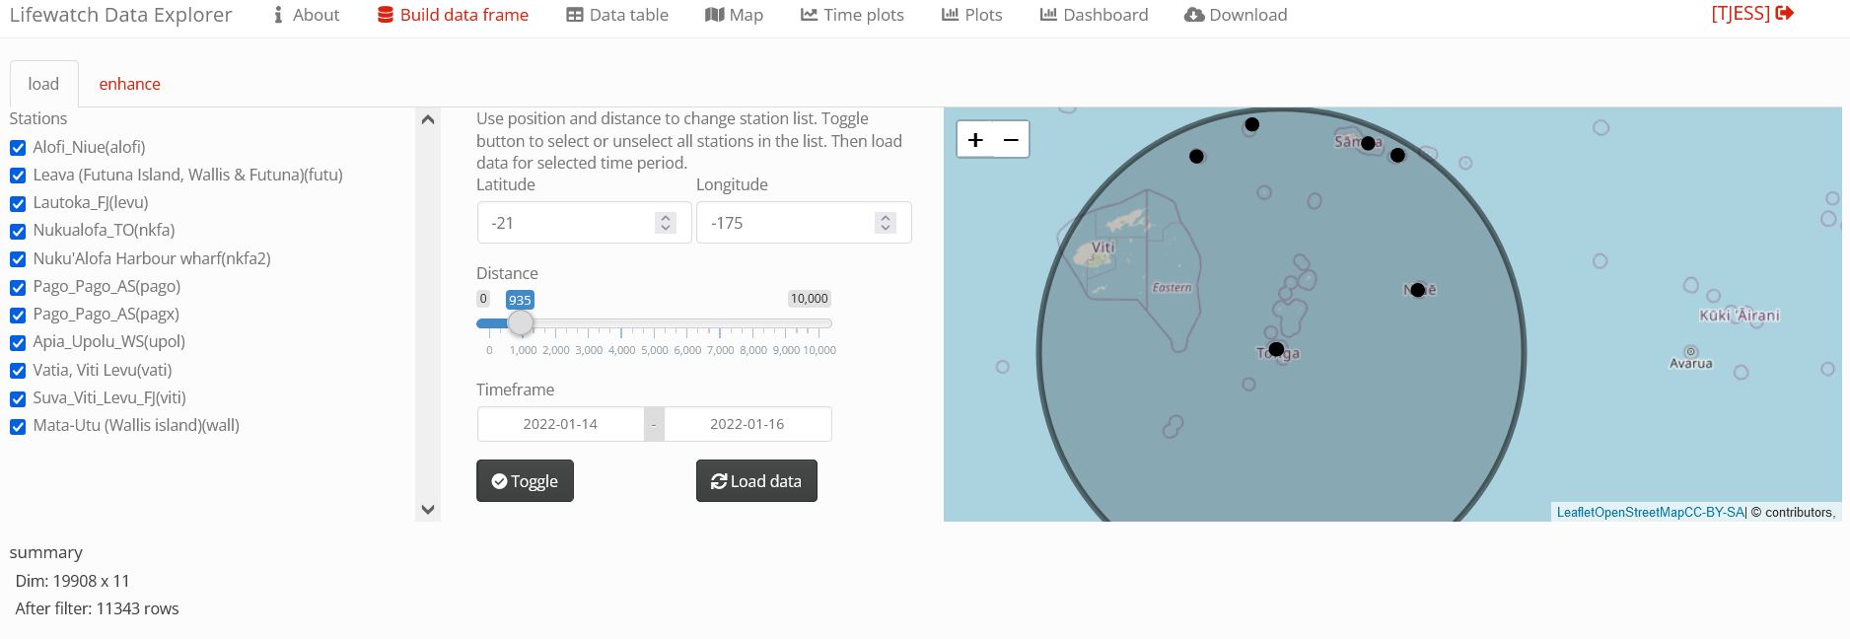
New research tools

Slide 37
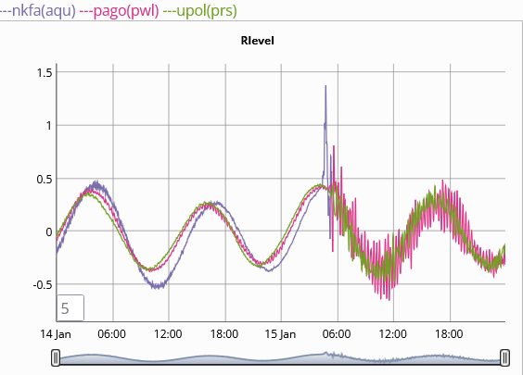
Tonga

Slide 38
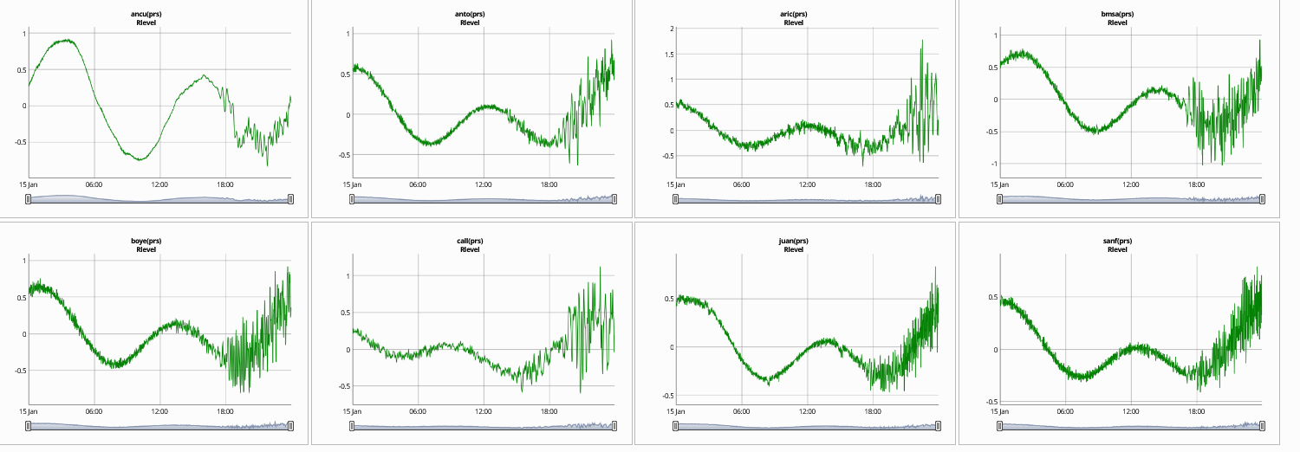
Tonga waves Chile

Slide 39
Thank you
www.ioc-sealevelmonitoring.org
info@ioc-sealevelmonitoring.org

