Slide 1
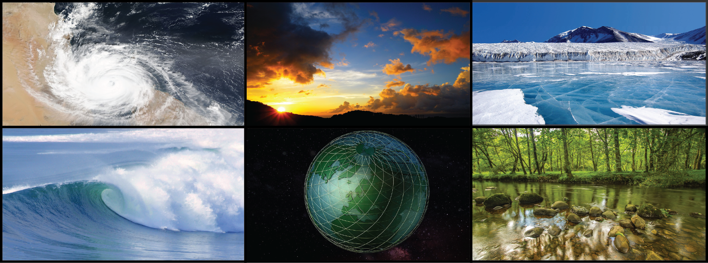
WORLD CLIMATE RESEARCH PROGRAMME
Safe Landing Climates Lighthouse Activity - Sea Level Rise
Svetlana Jevrejeva, National Oceanography Centre
sveta@noc.ac.uk

Slide 2
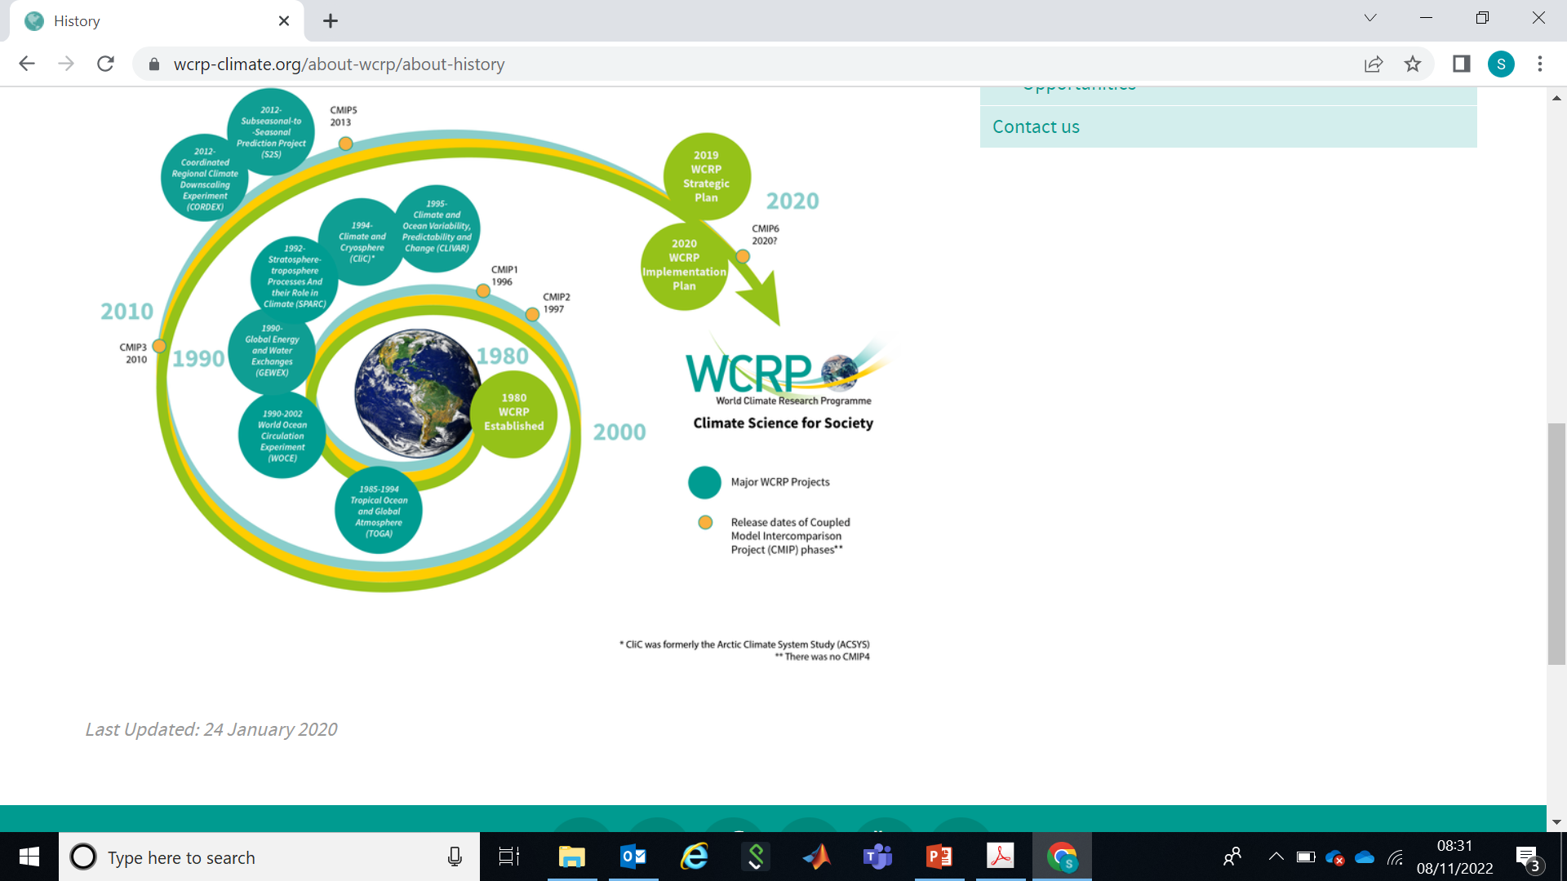
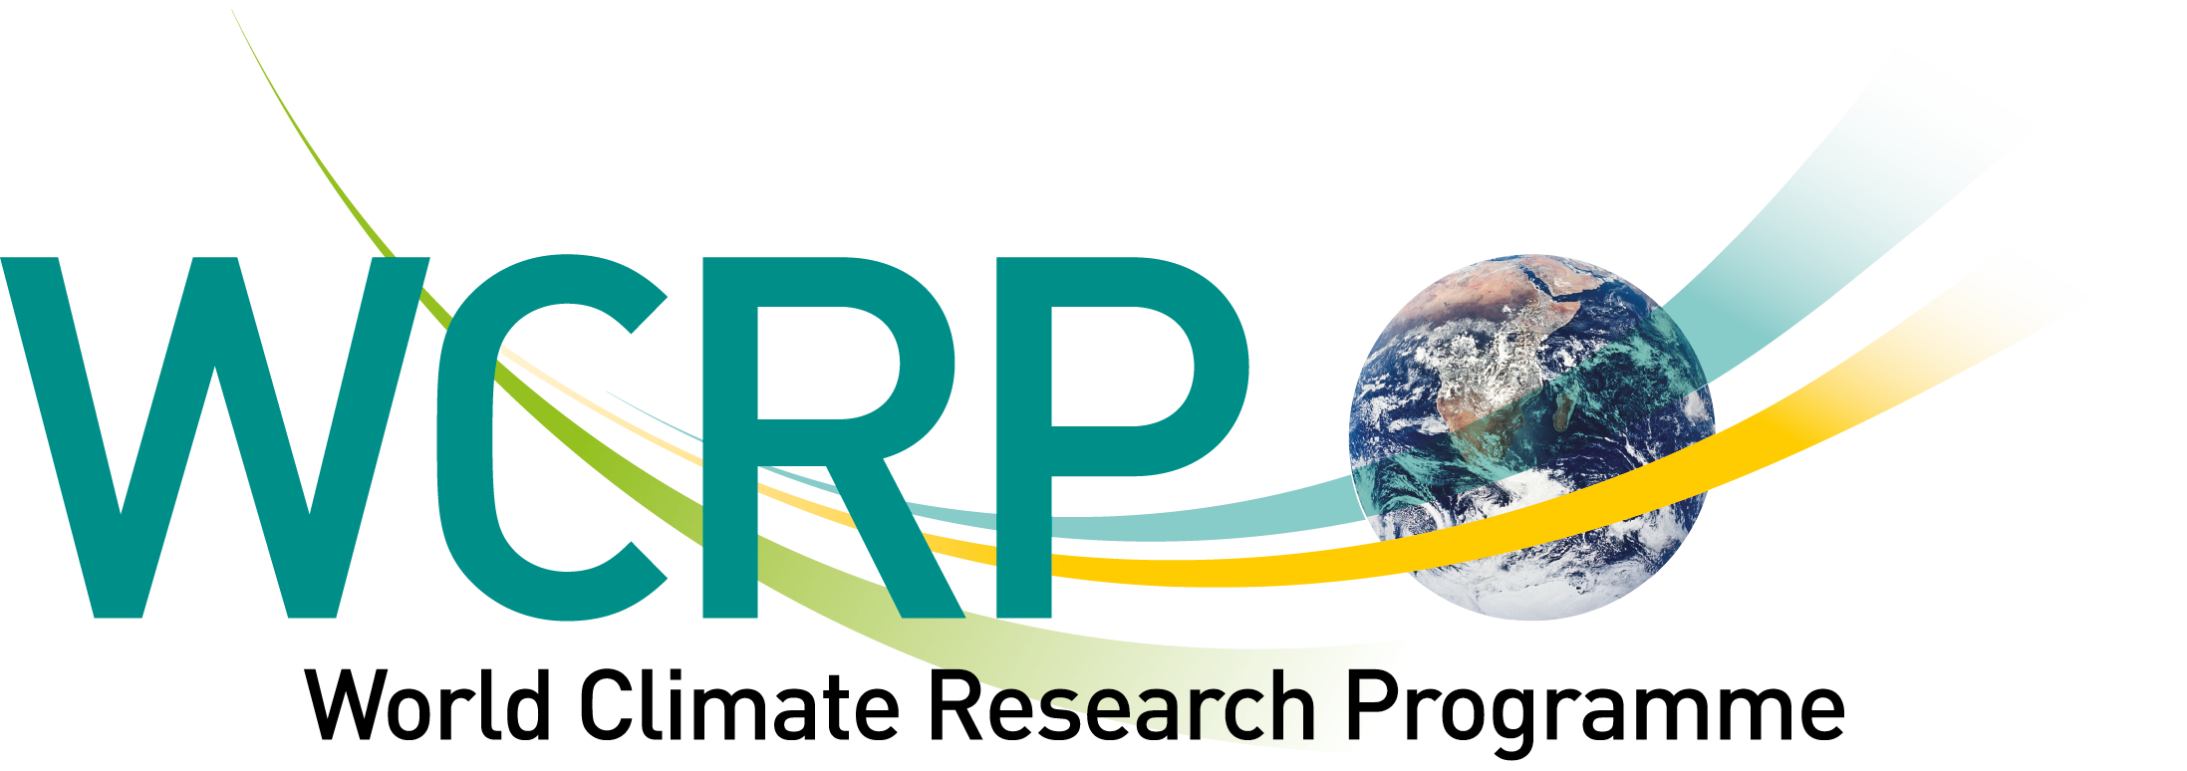

Slide 3
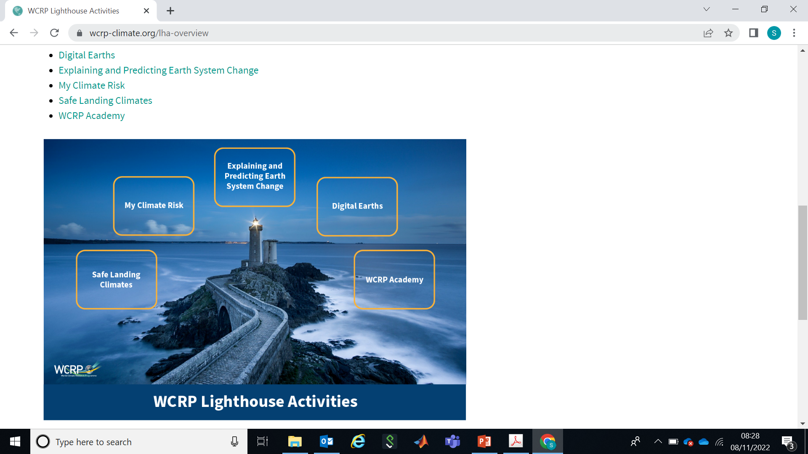


Slide 4

Safe Landing Climates Lighthouse Activity - Sea Level Rise
Scope
Coastal protection practitioners and decision makers require localized actionable science information to manage adaptation measures to future sea-level rise
This comprises projections of regional sea-level, storm surges and cyclones and their inherent uncertainties
Combining and communicating this information requires better coordination between modelling of global climate, the cryosphere, and coastal processes
Safe landing in terms of sea level means that adaptation measures can keep pace with the rate of regional sea-level rise, which requires adaptable solutions and regularly updated robust information
Notes:
Can say that we build on science developed under the Grand Challenge, but that we frame the research under the safe landing idea as given in the last point.
Mention that many atoll islands are already at the limits of inhabitability because of sea-level rise. So the overall long term safe landing perspective (where will we land) is challenged by these.

Slide 5
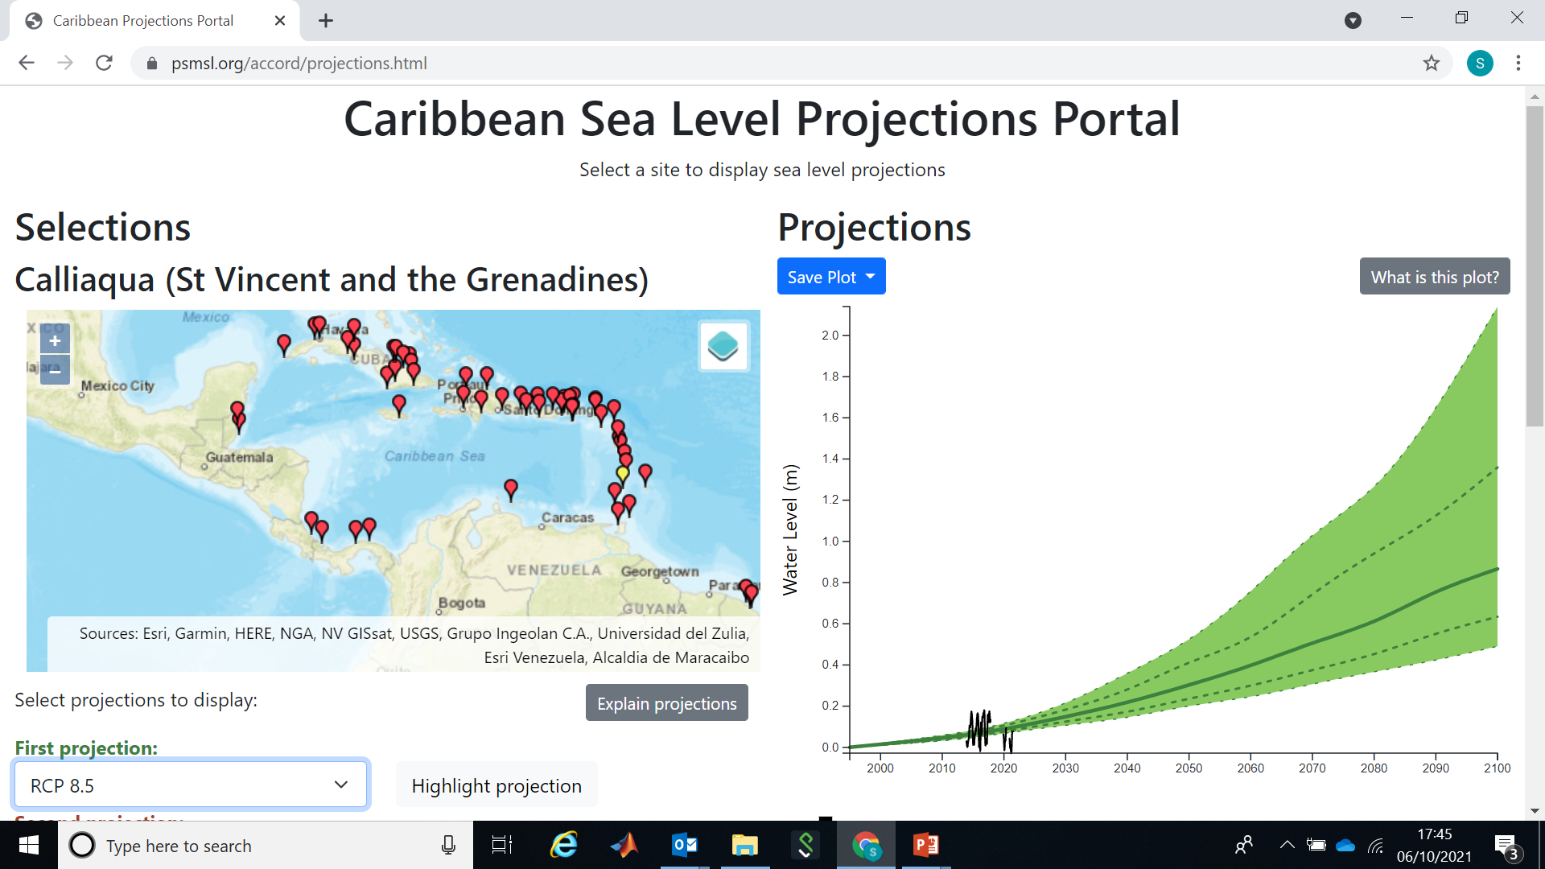
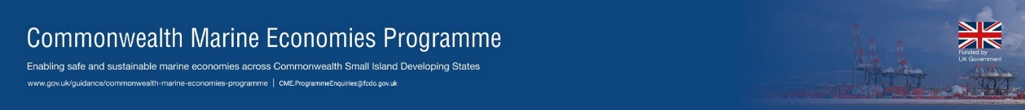

Slide 6

Safe Landing Climates Lighthouse Activity - Sea Level Rise
https://www.wcrp-climate.org/slc-themes/slc-sealevel

