Slide 1
Webinar on Tsunami Risk Perception Studies Within the NEAM Region
9 November 2022
Denis Chang Seng Programme Specialist and ICG/NEAMTWS Technical Secretary
UNESCO IOC
Contributions from
Derya Vennin
Claire JAFFRÉZIC
Fiona Schmitz
Alejandro Aldana
Servin Kim
Esmeralda Borja
WGs and TTs/ SC/ CoastWAVE partners

Slide 2
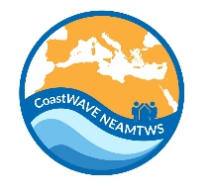
IOC UNESCO EU DG ECHO CoastWAVE Project Sep 2021-Mar. 2024 Strengthening the Resilience of Coastal Communities in the North East Atlantic, Mediterranean Region to the Impact of Tsunamis and Other Sea Level-Related Coastal Hazards
AN ENDORSED UN OCEAN DECADE PROJECT

Slide 3
ICG/NEAMTWS 2030 Strategy
Understanding perceptions of coastal hazards

Slide 4
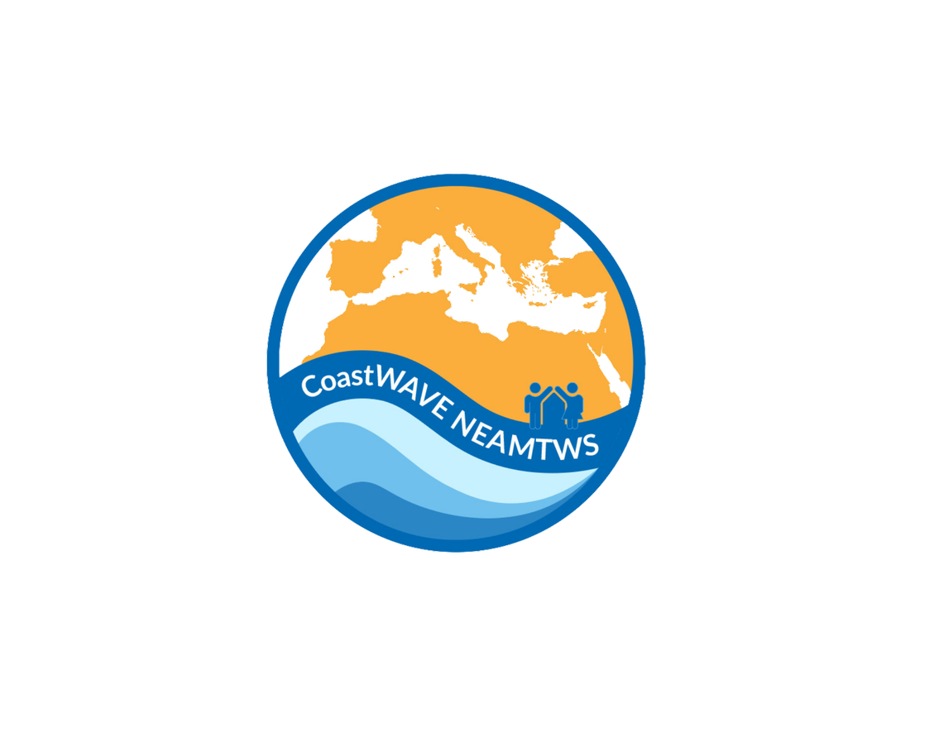
IOC-UNESCO EU DG-ECHO
CoastWAVE PROJECT
(Sep. 2021-Mar. 2024)
Tsunami Ready Recognized Communities
Alerting Systems
Detection & Monitoring Systems
Risk Perception & Communication
At the end of the project selected communities will have:
Improved understanding of tsunami and sea-level related risks;
Better communication strategies to govern sea-level related risk,
Recognized Tsunami Ready communities (7);

Slide 5
SEA LEVEL HAZARD RISK PERCEPTION AND COMMUNICATION STRATEGIES
Sea level hazard risk perception literature completed
Survey questionnaire developed with inputs from WGs/ TTs /CoastWAVE project partners for implementation in:
Cyprus (Larnaka)
Malta (Marsaxlokk) )
Morocco (El Jadida)
Egypt (Alexandra)
Spain ( Chipiona)

Slide 6
Examples of Survey Questionnaire
Personal Information

Slide 7
Awareness and Knowledge

Slide 8
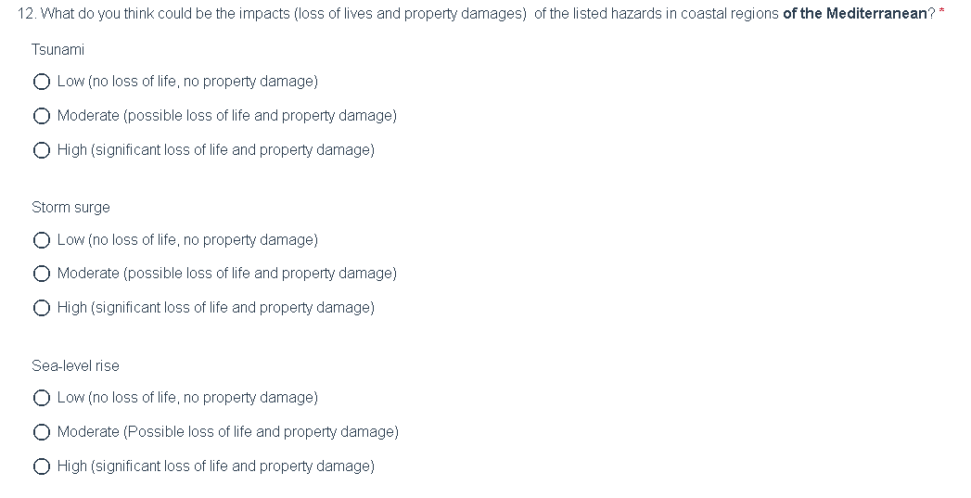
Awareness and Knowledge

Slide 9
Exposure and Sense of Exposure

Slide 10
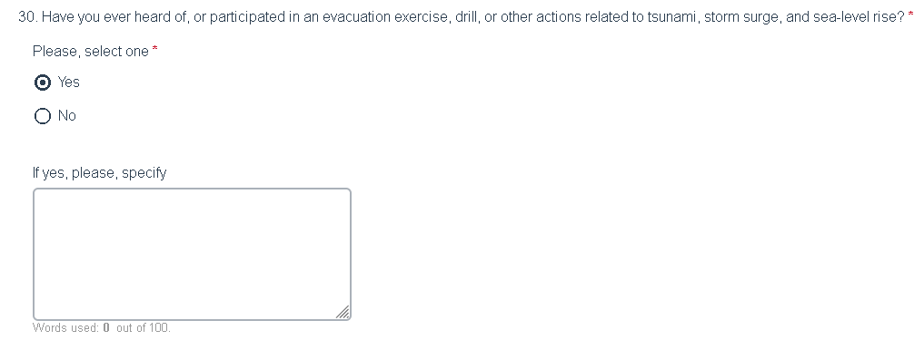
Preparedness and Response Component

Slide 11
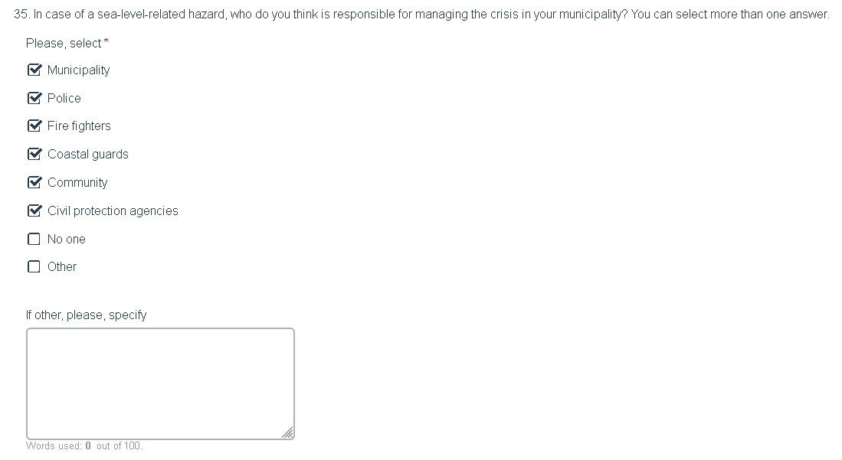
Governance

Slide 12
Sea Level Related hazard Risk Perception
Questionnaire
Four Target Groups
Education
Tourism
Emergency responders
Public

Slide 13
Recommended methods of Implementation:
Online surveys
Focus groups
Cati Surveys
Online surveys
Booth/street surveys

Slide 14
Translation of survey questions
Roll out in project countries in August/Sep 2022
Surveys to be completed by end of Dec 2022?

Slide 15
Consultant : Claire JAFFRÉZIC
IOC ICG/NEAMTWS SECRETARIAT FUNDED
CONTRIBUTING TO CoastWAVE / ICG/NEAMTWS 2030 STRATEGY/ ACTIONS

Slide 17
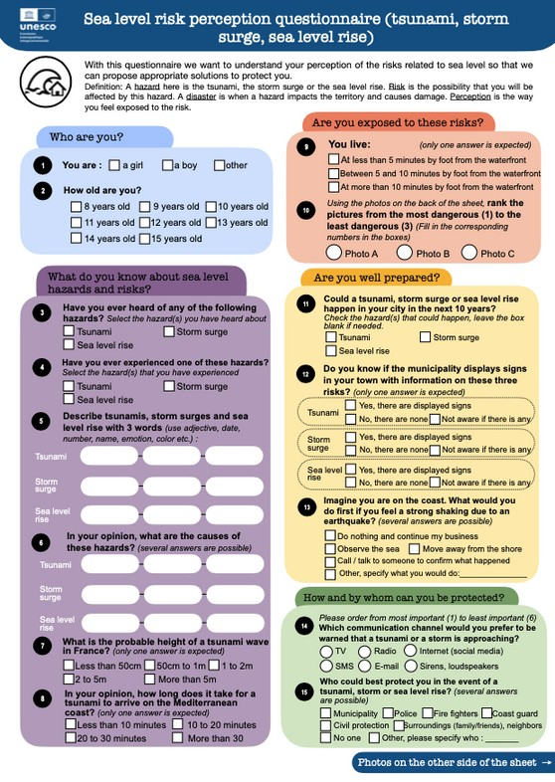
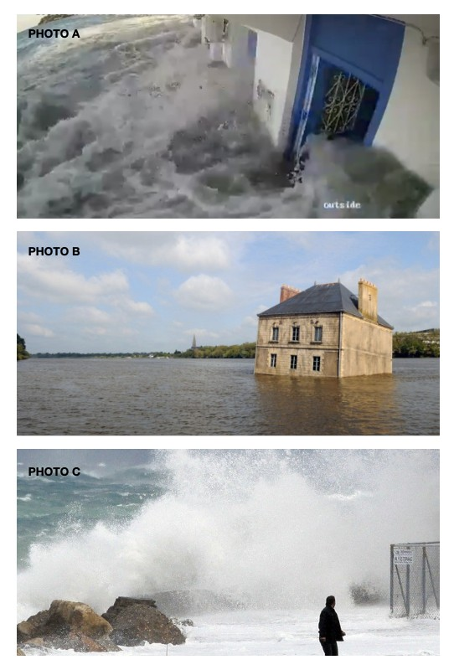
Survey method
FOCUS GROUP IN SCHOOLS
Sessions of 1h30 conducted in class groups (25/30 children at the same time) in 4/5 steps :
An introduction to present the objectives of the intervention
An interactive questionnaire (15 questions)
A short awareness lesson to help children understand the coastal risks they are exposed to
Discussion and test questions to understand the evolution of the children's perception during the intervention
For Cannes only: Field excursion with the French Civil Protection to observe the Tsunami signs installed in the city.
Questionnaire validated by education and childcare professionals

Slide 18
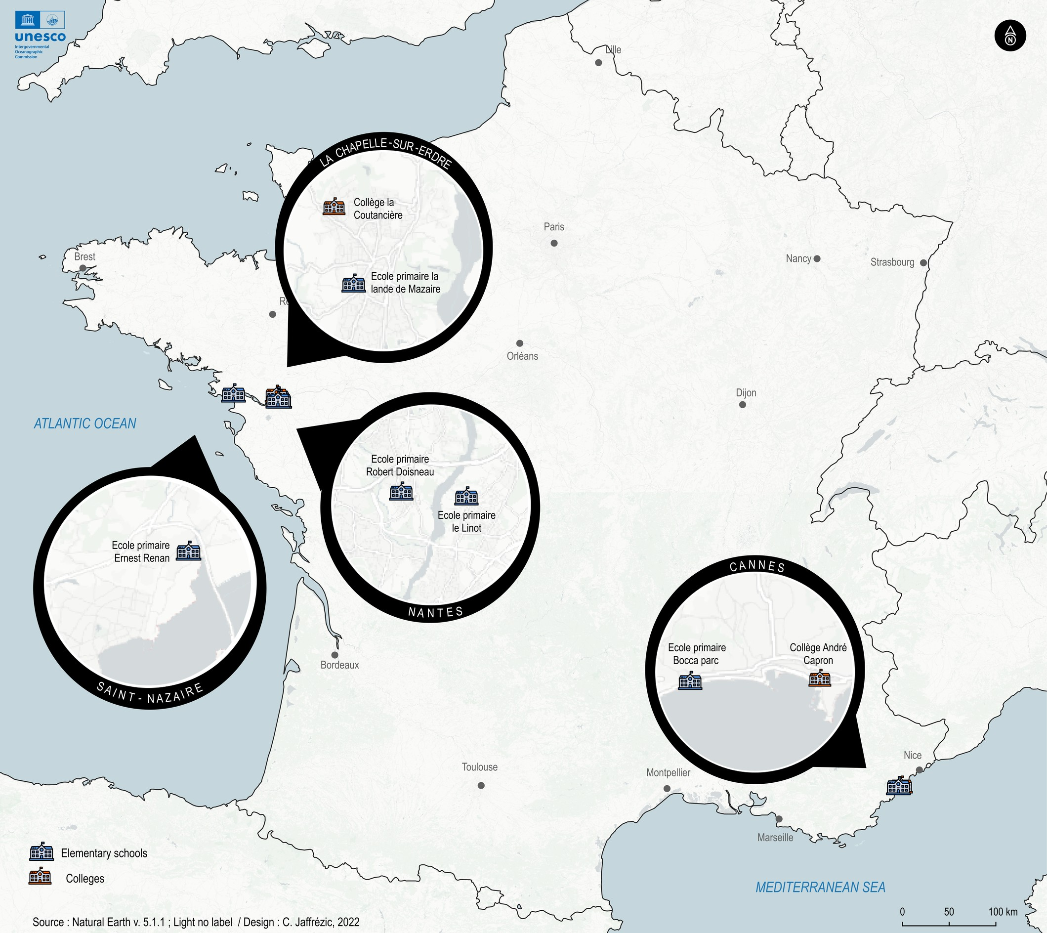
Pilot sites
Project conducted in 7 schools (2 middle schools, 5 elementary schools)
3 criteria used to select participating schools
different geographic locations (Atlantic and Mediterranean coasts, direct proximity to the coast or not);
effective engagement of the school in actions related to UNOD's SDGs, climate change, and coastal hazards;
at least one community that wishes to be recognized as Tsunami Ready.

Slide 19
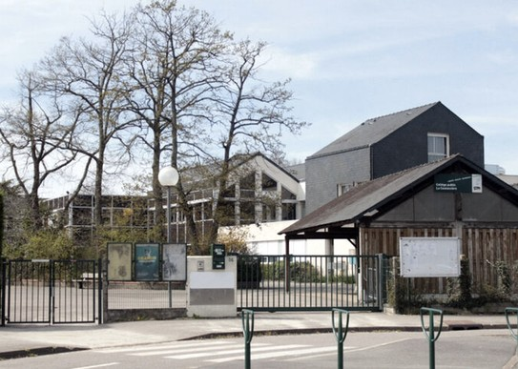
Progress of the project
Since octobre 2022
Octobre 2022
Novembre 2022
180 children sensitized and questionnaires distributed
10/11/22 - Field day with the children to observe the tsunami signs set up in Cannes with the support of the Cannes town hall and the French civil protection.
At least 230 additional children reached
Press release promoting the project published by the city of Cannes for WTAD 2022
More than 400 children (8-14 Yrs) sensitized
and participated in the survey

Slide 20
Next Steps
Country Reports and Recommendations by Jan-Feb 2023.
Synthesis of Reports by next SC meeting
Application/streamline findings
Preparedness
Education
Communication and
Implementation of UNESCO IOC Tsunami Ready Recognized Communities

Slide 21
THANK YOU

