Slide 1
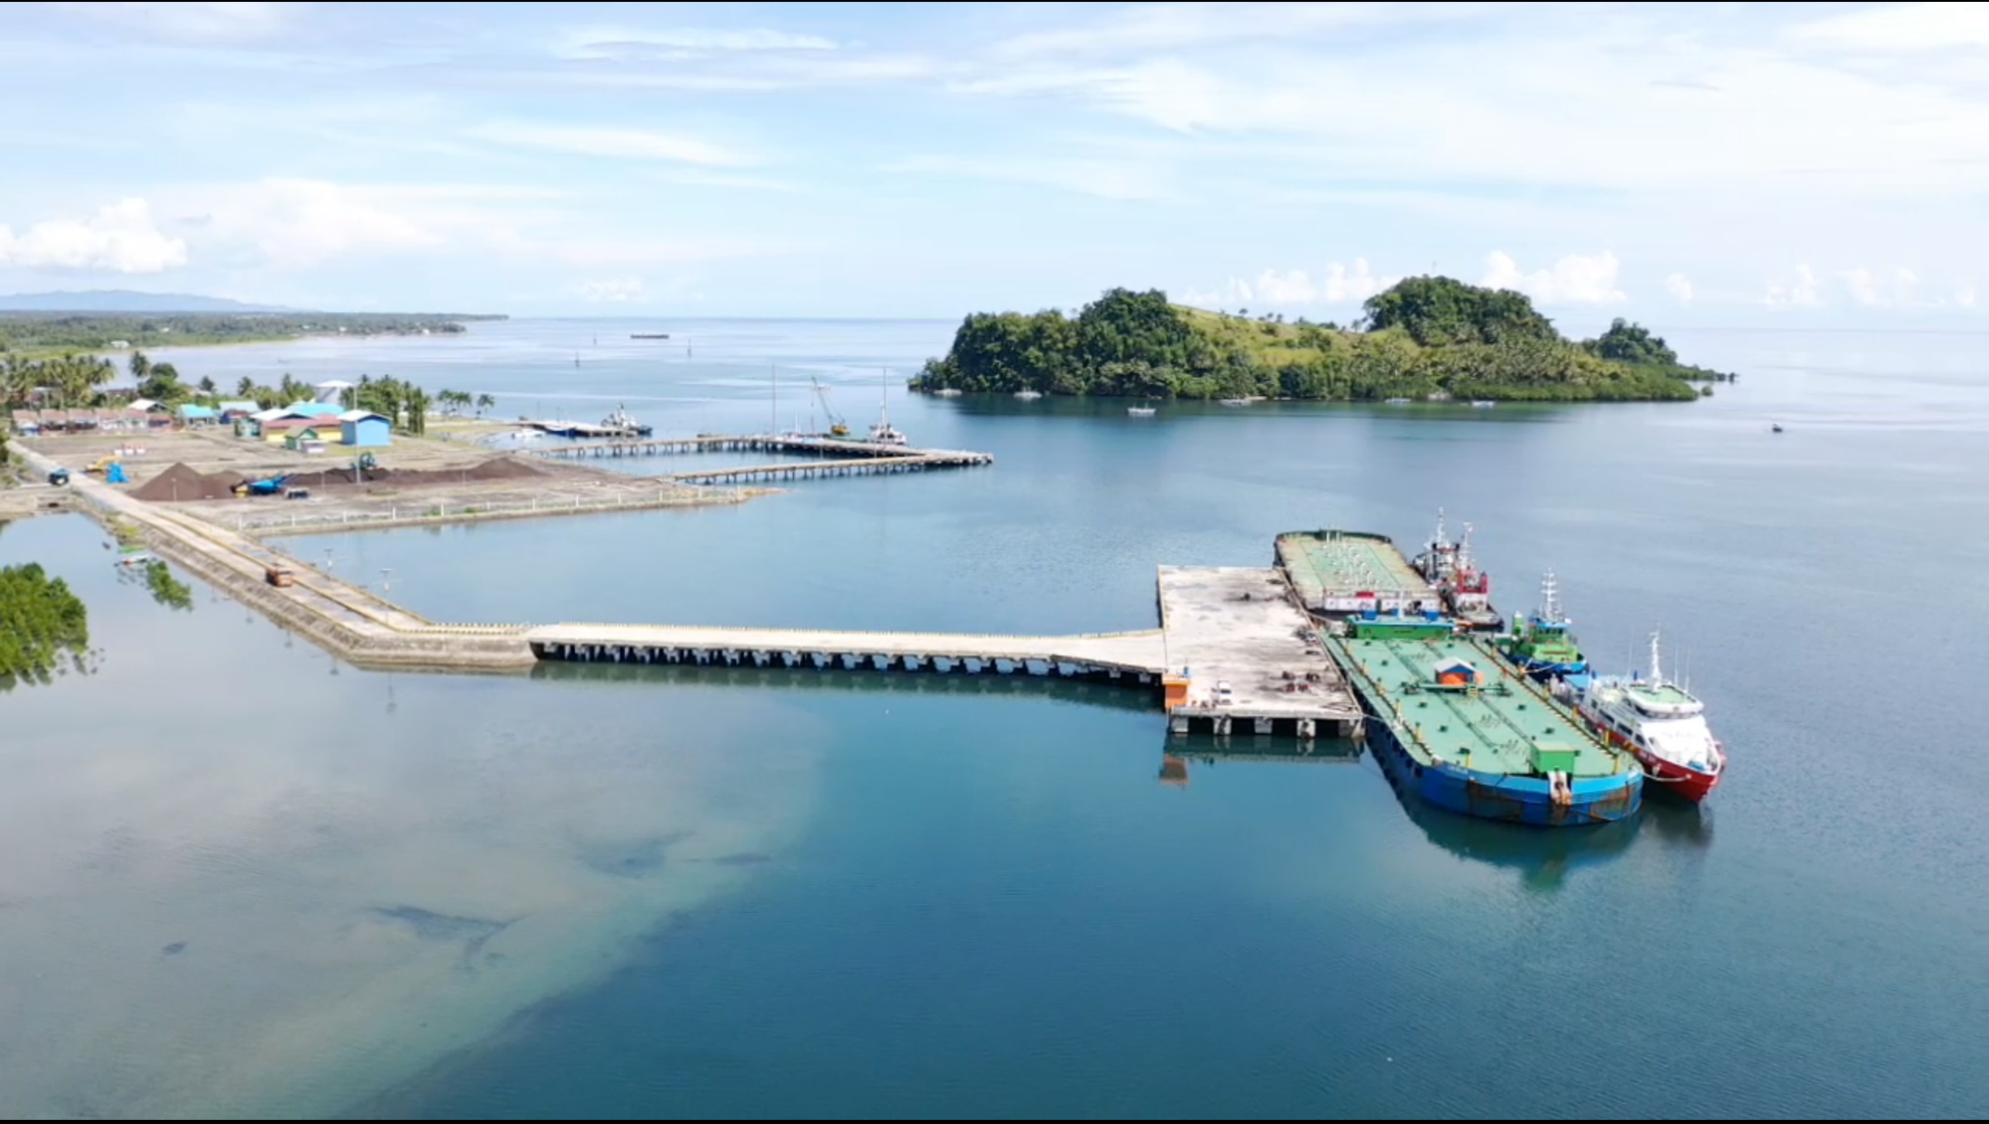
INDONESIAN TIDE GAUGES SYSTEM
Center for Geodetic Control Network and Geodynamics
GEOSPATIAL INFORMATION AGENCY OF INDONESIA (BIG)
Bayu Triyogo Widyantoro
bayu.triyogo@big.go.id
2022

Slide 2
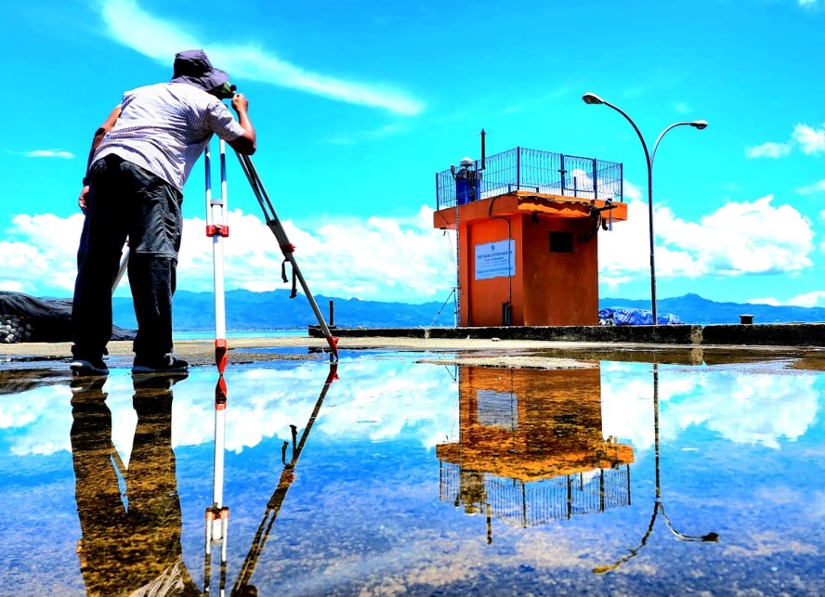
Sea Level Monitoring Programs
Purpose of real time monitoring:
Mainly for mapping activities: mean sea level (MSL) for land mapping and chart datum for bathymetric mapping
Tide prediction for coastal management
Sea level rise monitoring
Tsunami Early Warning System

Slide 3
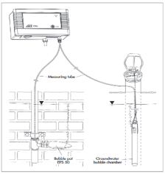
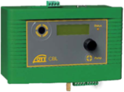

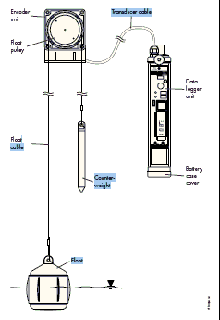
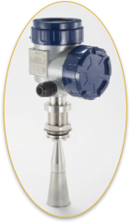

Tide Gauge Instrumentations
Buble gauge, located in small or big ports capable for tsunami
Digital float gauge, mainly for stations located in small ports not prone to tsunami.
Radar gauge, mounted in tsunami capable stations

Slide 4
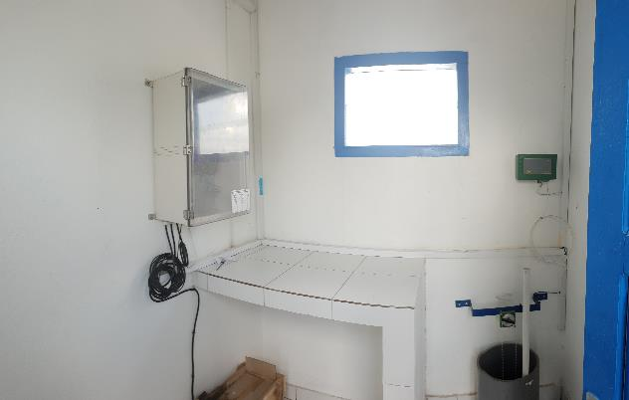
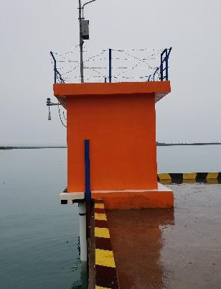
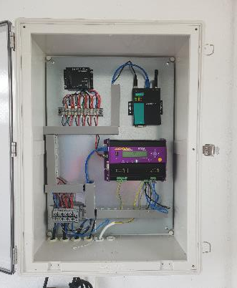
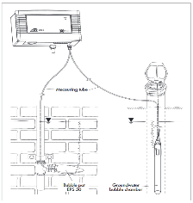
Ina-Tide Gauge System
NOTE: Some TG’s has 2 sensors Bubble and 1 sensor Radar
Modem
Data Logger
Float Gauge
Bubble Gauge
Radar Gauge
BIG-Tide Gauge System:
Sensor 1 : Bubble Gauge
Sensor 2 : Float Gauge
Sensor 3 : Radar Gauge

Slide 5
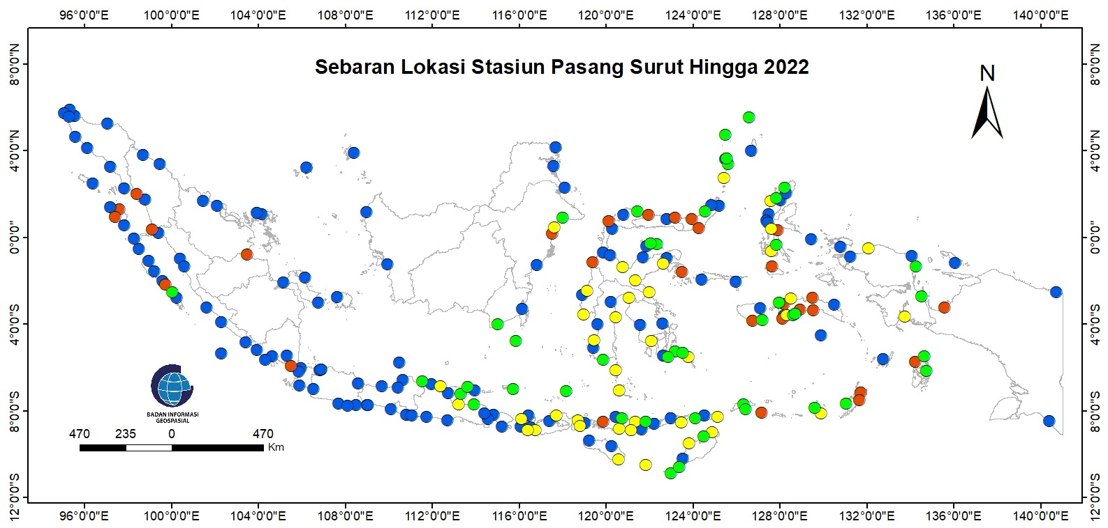
BIG’s Tide Gauges Network until 2022
129 Stations
Data available >5 years
29 Stations
Data available <5 year
40 Stations
Developed in 2021 (data available <1 year)
40 Stations
198 + 40 St
Developed in 2022

Slide 6
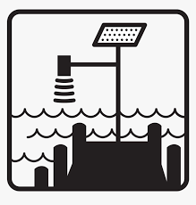
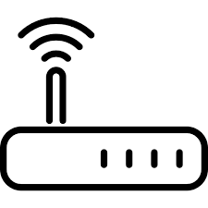
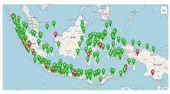
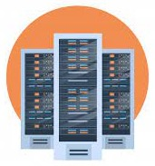



Tide Data Flow
Service as streaming
Recorded by
Connect to
Directly send
Service as File Based
Data Acquisition
Data Logger
Data Communication
Data Center
Data Sharing

Slide 7
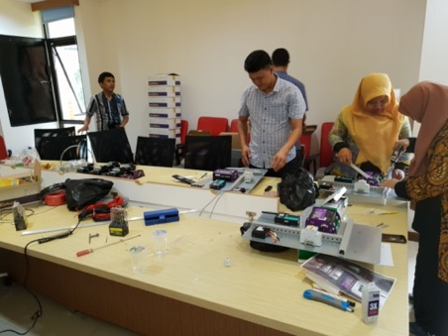
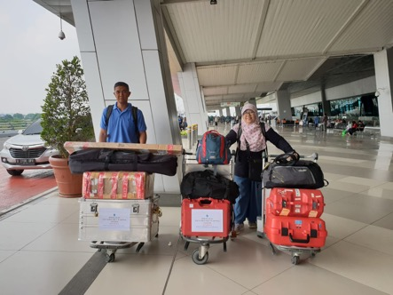
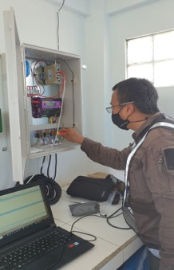
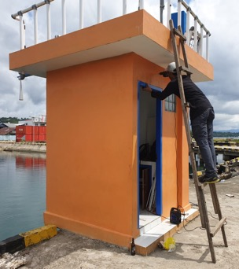
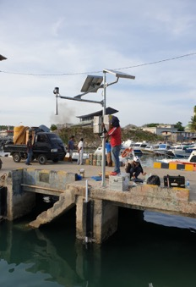
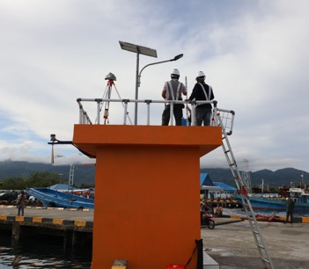
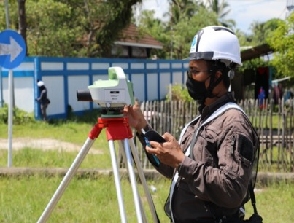
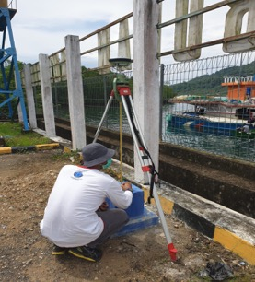
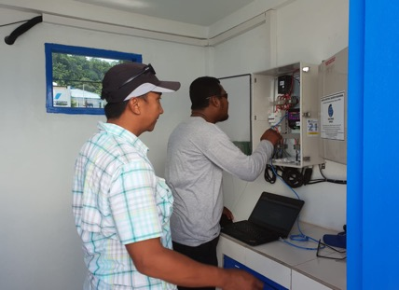
Installation Procces
Assembling Procces at Officce
Travel to the field
Installation Procces
Leveling Process from Tide Rod to BM and GNSS Antenna
GNSS Observation on BM
Checking Communication

Slide 8
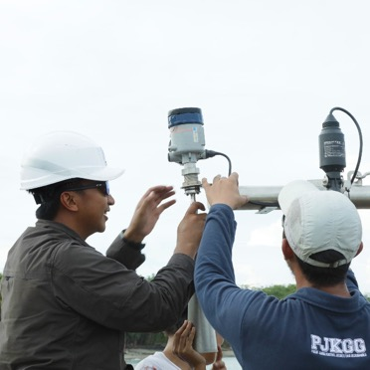
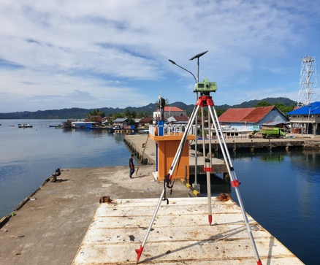
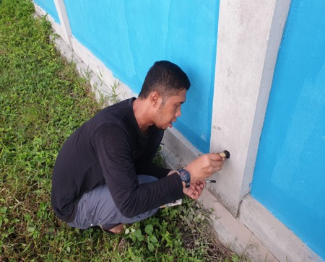
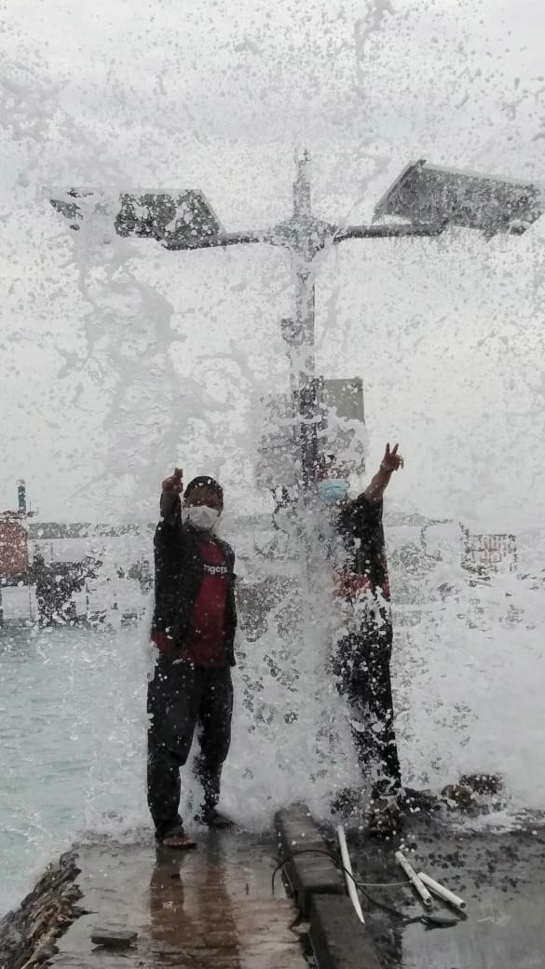
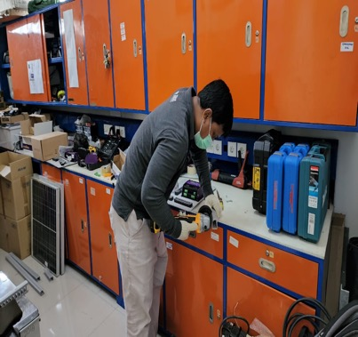
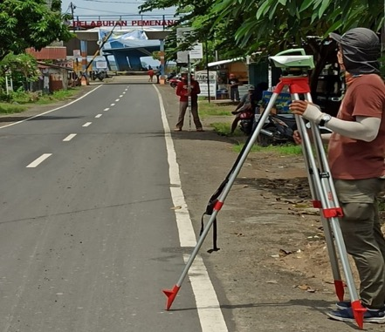
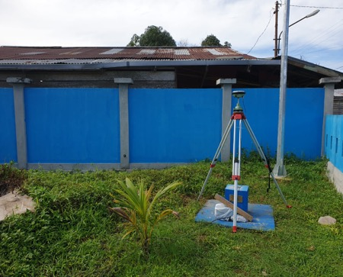
Maintenance TG

Slide 9
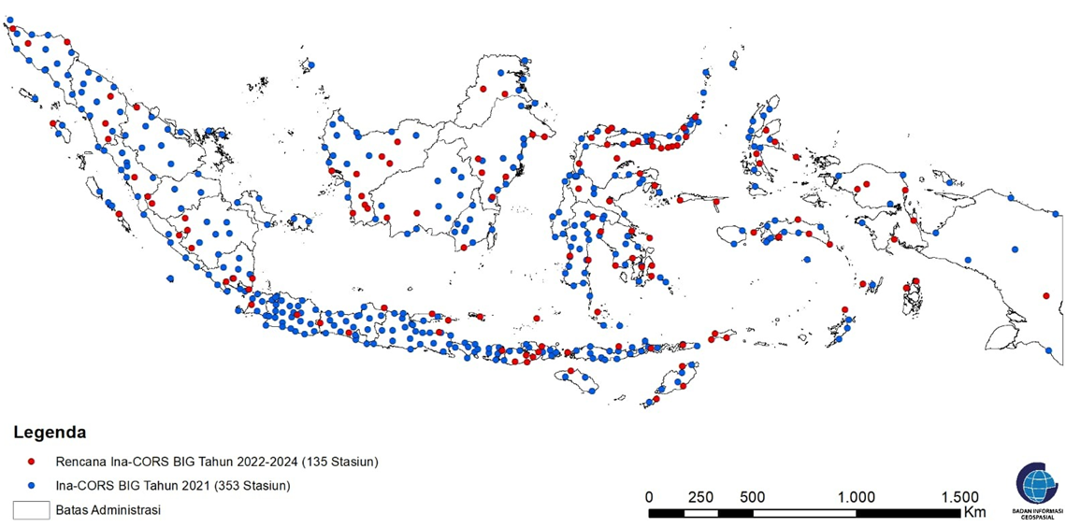
Ina-CORS Distribution (Existing & Plan 2024)
Notes:
Currently, we manage 353 Inacors stations covering the whole of Indonesia. about 250 stations are multi gnss. and we will continue to strengthen the inacors network until 2024. In the picture, we can see from the picture, the blue circle is the existing condition, while the red circle is the development plan from 2022 to 2024.

Slide 10
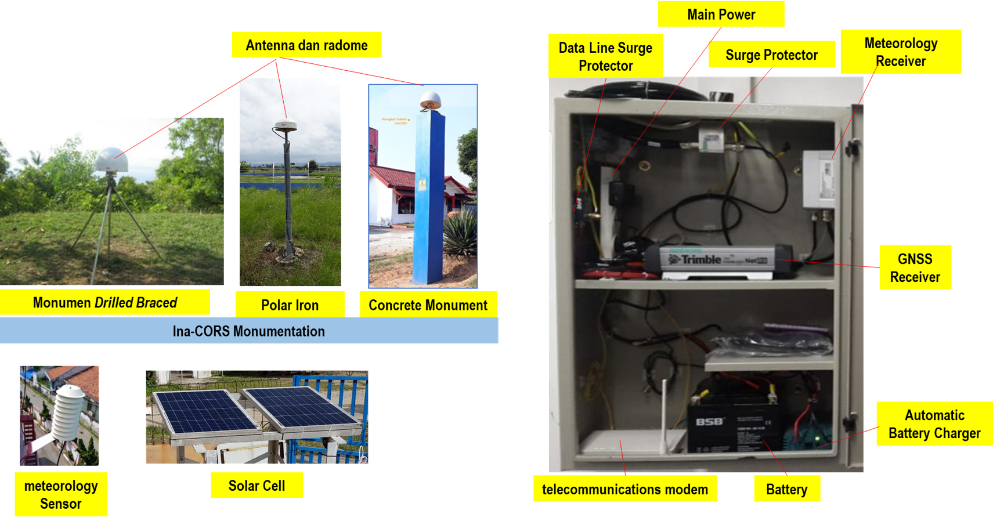
Station Components
Notes:
This is the components of a station. divided into indoor and outdoor components. indoor components consist of device box, GNSS receiver, meteorology receiver, main power, battery as backup power, telecommunication modem, etc. outdoor components consist of pilar and the GNSS antenna, meteorology sensor and solar cell. all GNSS receivers and antennas used are geodetic types with a logging rate capability 1 Hz or higher.

Slide 11
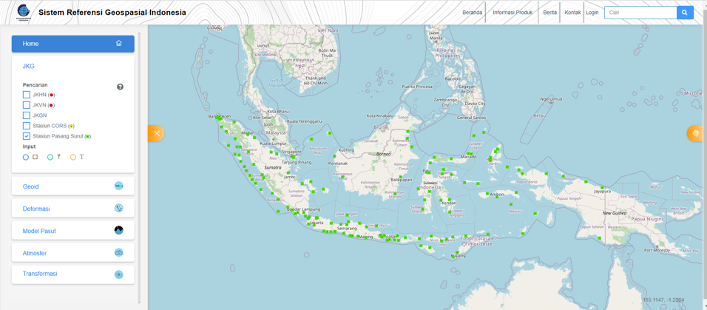
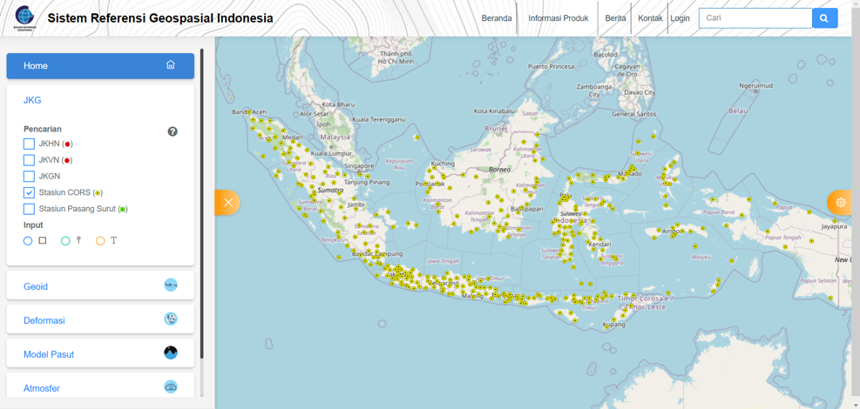
Acces Data
https://srgi.big.go.id

Slide 12
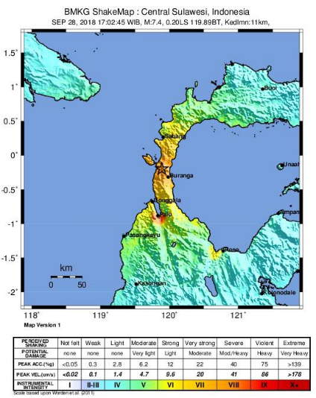
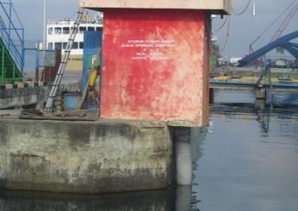
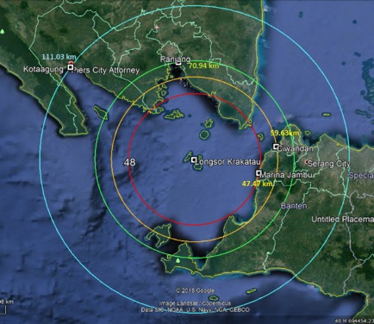
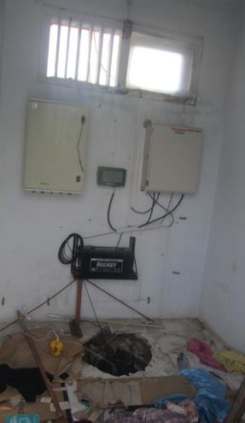
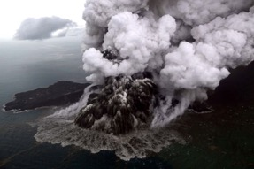
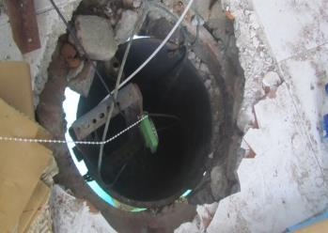
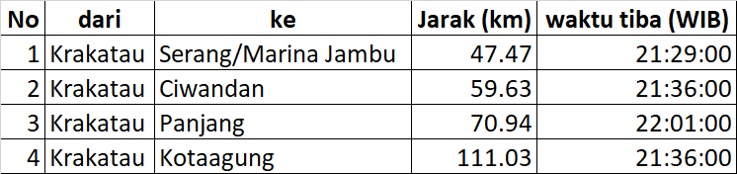


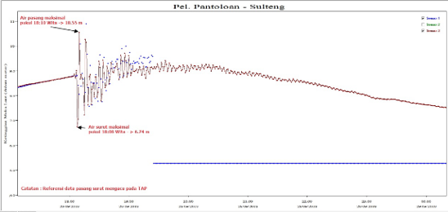
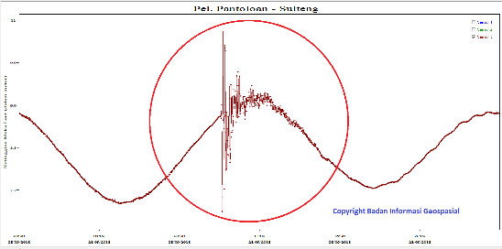






Palu EQ, 28 Sept 2018
Tide gauge for disaster monitoring
Sunda Strait, 22 Des 2018
Son of Krakatoa Mt
Eruption
Marina Jambu (Serang)
Ciwandan
Panjang
Kota Agung
Tsunami
Tsunami

Slide 13
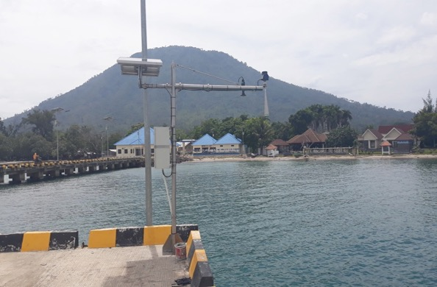
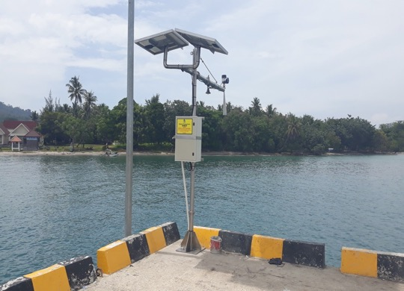
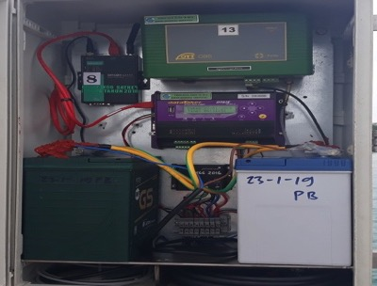
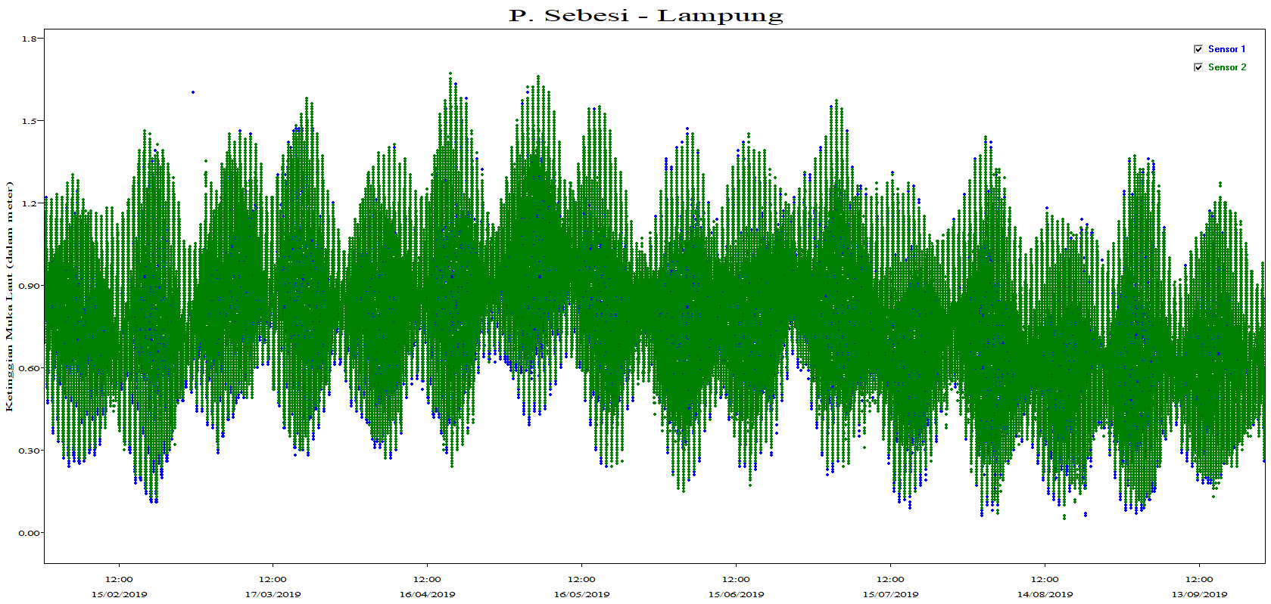
Tide gauge for disaster monitoring
Sebesi “Extra”Tide Gauge → Installed 29/01/2019

Slide 14
