Slide 1
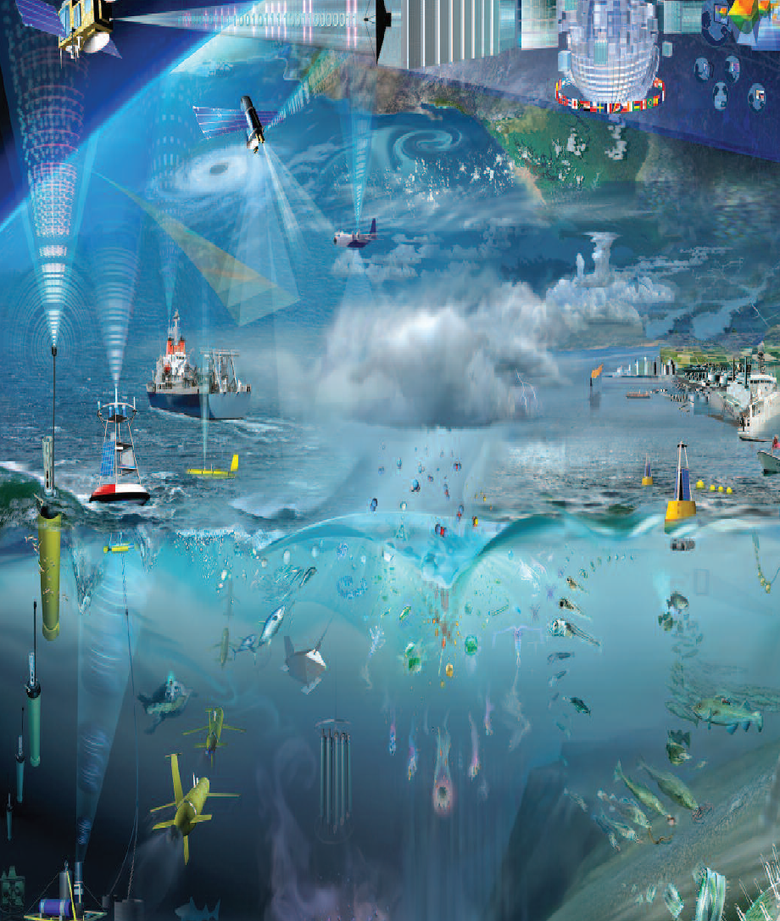




OOPC report
The GOOS Task Team on ocean indicators
Presenter: Karina von Schuckmann
OOPC meeting, 21. October 2022, EUMETSAT, Darmstadt, Germany

Slide 2
Boundary Systems
GOOS Task Team on Ocean Indicators: Development…
A GOOS cross panel activity…
Sept. 2020: proposal on the development of an international global ocean indicator framework submitted to GOOS as part of OOPC (Karina von Schuckmann, Marjolaine Krug, Sabrina Speich, Weidong Yu, Maria Hood). GOOS Strategic Objective 3 – Action 3.6 Global Ocean Indicators Framework
Nov. 2021: Establishment of cross-GOOS TT for an ocean indicator framework (co-chairs: K. von Schuckmann, N. Bax, E. Holland)
Dec. 2021: Complement working group with additional expertise such as policy links, social & political science; expert for local & indigenous knowledge; Consultation meeting with UNEP: GEMS-COAST
Jan-June: regular meetings & series of interviews with TT members
September-now: draft development

Slide 3
Boundary Systems
GOOS Task Team on Ocean Indicators: Current Members
Name | Affiliation | Contact | Role
Karina von Schuckmann | Mercator Ocean international, Toulouse, France | karina.von.schuckmann@mercator-ocean.fr kvonschuckmann@gmail.com | Co-chair
Sabrina Speich | LMD, IPSL, Paris, France | sabrina.speich@lmd.ipsl.fr | Member
Elisabeth Holland | USP, Suva, Fiji | eholland1@mac.com | Co-chair
Veronique Garcon | LEGOS, Toulouse, France | veronique.garcon@legos.obs-mip.fr | Member
Weidong Yu | Sun Yat-Sen University, Guangzhou, China | yuwd@mail.sysu.edu.cn | Member
Toste Tanuha | GEOMAR, Kiel, Germany | ttanhua@geomar.de | Member
Anya Waite (to be confirmed) | Dalhousie University (DAL), Halifax, Canada | Anya.Waite@dal.ca | Member
Emma Heslop | IOC/UNESCO, Paris, France | e.heslop@unesco.org | Support
Maciej Telszewski | IOC/UNESCO, Poland | m.telszewski@ioccp.org | Support
Belén Martin Miguez | WMO, Geneva, Switzerland | bmartinmiguez@wmo.int | Support/Mapping
Maria Hood | Mercator Ocean international, Toulouse, France | Maria.hood@mercator-ocean.fr | Support/ link to G7 future of the Sea
Alison Clausen | IOC/UNESCO, Paris, France | a.clausen@unesco.org | Support
Julian Barbière | IOC/UNESCO, Paris, France | J.Barbiere@unesco.org | Member / link to policy
Igor Polyakov | University of Alaska, Fairbanks, International Arctic Research Center, USA | ivpolyakov@alaska.edu | Member
Minhan Dai | State Key Lab of Marine Environmental science, Faculty of Earth Science & Technology, College of Ocean & Earth Sciences, Xiamen University, Xiamen, China | mdai@xmu.edu.cn | Member
Nora Loose | University of Colorado Boulder, USA | nora.loose@colorado.edu | Member
Agneta Fransson | Norwegian Polar Institute Department of Research - Ocean and Sea Ice, Tromsø, Norway | Agneta.Fransson@npolar.no | Member
Malcolm Clark | NIWA, New Zealand | Malcolm.Clark@niwa.co.nz | Member
Jillian Campbell | UN Convention on Biological Diversity | campbell7@un.org | Member
Joseph Appiott | UN Convention on Biological Diversity | joseph.appiott@un.org | Member
Ben Milligan | University of New South Wales, Australia | b.milligan@unsw.edu.au | Member
Veronique Creach | Cefas, UK | veronique.creach@cefas.co.uk | Member
Alex Godoy Faundez | Sustainability Research Center and Strategic Resource Management (CiSGER) Facultad de Ingeniería, Universidad del Desarrollo, Chile | alexgodoy@ingenieros.udd.cl | Member

Slide 4
Boundary Systems
GOOS Task Team on Ocean Indicators: Current Members
Name | Affiliation | Contact | Role
Karina von Schuckmann | Mercator Ocean international, Toulouse, France | karina.von.schuckmann@mercator-ocean.fr kvonschuckmann@gmail.com | Co-chair
Sabrina Speich | LMD, IPSL, Paris, France | sabrina.speich@lmd.ipsl.fr | Member
Elisabeth Holland | USP, Suva, Fiji | eholland1@mac.com | Co-chair
Veronique Garcon | LEGOS, Toulouse, France | veronique.garcon@legos.obs-mip.fr | Member
Weidong Yu | Sun Yat-Sen University, Guangzhou, China | yuwd@mail.sysu.edu.cn | Member
Toste Tanuha | GEOMAR, Kiel, Germany | ttanhua@geomar.de | Member
Anya Waite (to be confirmed) | Dalhousie University (DAL), Halifax, Canada | Anya.Waite@dal.ca | Member
Emma Heslop | IOC/UNESCO, Paris, France | e.heslop@unesco.org | Support
Maciej Telszewski | IOC/UNESCO, Poland | m.telszewski@ioccp.org | Support
Belén Martin Miguez | WMO, Geneva, Switzerland | bmartinmiguez@wmo.int | Support/Mapping
Maria Hood | Mercator Ocean international, Toulouse, France | Maria.hood@mercator-ocean.fr | Support/ link to G7 future of the Sea
Alison Clausen | IOC/UNESCO, Paris, France | a.clausen@unesco.org | Support
Julian Barbière | IOC/UNESCO, Paris, France | J.Barbiere@unesco.org | Member / link to policy
Igor Polyakov | University of Alaska, Fairbanks, International Arctic Research Center, USA | ivpolyakov@alaska.edu | Member
Minhan Dai | State Key Lab of Marine Environmental science, Faculty of Earth Science & Technology, College of Ocean & Earth Sciences, Xiamen University, Xiamen, China | mdai@xmu.edu.cn | Member
Nora Loose | University of Colorado Boulder, USA | nora.loose@colorado.edu | Member
Agneta Fransson | Norwegian Polar Institute Department of Research - Ocean and Sea Ice, Tromsø, Norway | Agneta.Fransson@npolar.no | Member
Malcolm Clark | NIWA, New Zealand | Malcolm.Clark@niwa.co.nz | Member
Jillian Campbell | UN Convention on Biological Diversity | campbell7@un.org | Member
Joseph Appiott | UN Convention on Biological Diversity | joseph.appiott@un.org | Member
Ben Milligan | University of New South Wales, Australia | b.milligan@unsw.edu.au | Member
Veronique Creach | Cefas, UK | veronique.creach@cefas.co.uk | Member
Alex Godoy Faundez | Sustainability Research Center and Strategic Resource Management (CiSGER) Facultad de Ingeniería, Universidad del Desarrollo, Chile | alexgodoy@ingenieros.udd.cl | Member
!

Slide 5
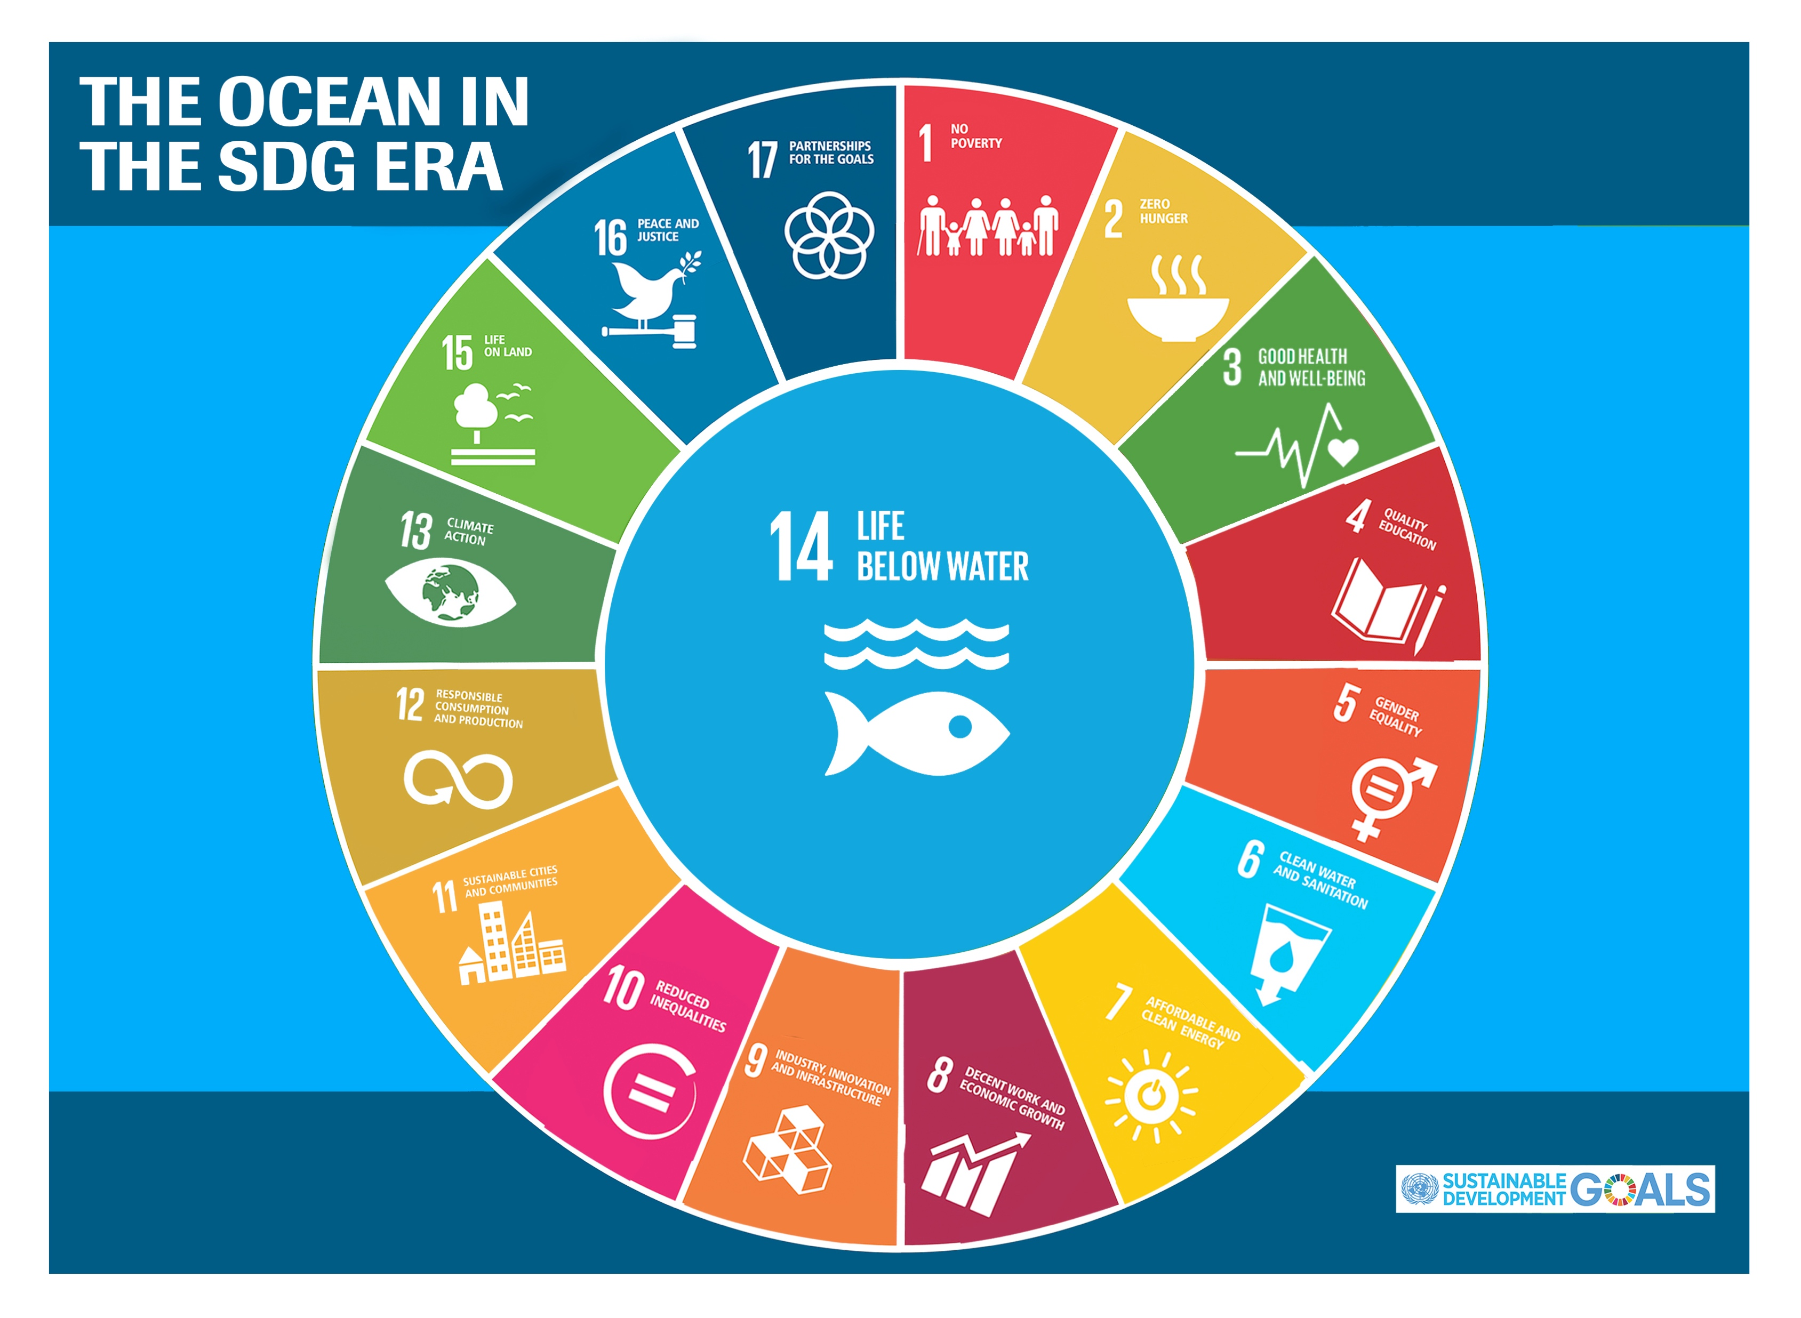
The central role of the ocean for sustainable development
All SDGs are interconnected, and SDG14 supports the UN 2030 Agenda and the SDGs as a whole.
The Ocean offers opportunities to face causes and consequences of climate change, globally and locally, calling for a dramatic scaling up of efforts towards ambitious mitigation and adaptation
von Schuckmann et al., 2020
The outcome statement of the UN’s first Ocean Conference titled ‘Our ocean, our future: call to action’ called for an ‘integrated, interdisciplinary and cross-sectoral approach based on the best available science to support sustainable development and provide stewardship of the one ocean on the blue planet.’ (https://digitallibrary.un.org/record/1291421?ln=en )

Slide 6
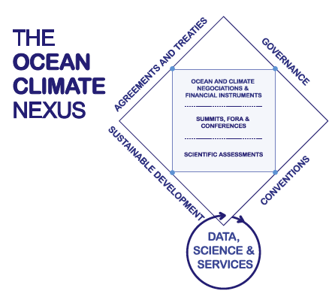
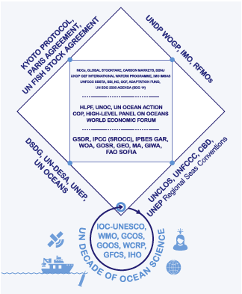
The ocean climate nexus
Growing ambition and action for the ocean at international level
von Schuckmann et al., 2020
➔ COP27: Integration of the ocean into UNFCCC, and agreement for an annual ocean and climate dalogue

Slide 7
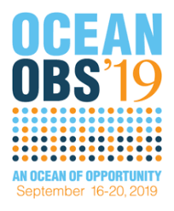

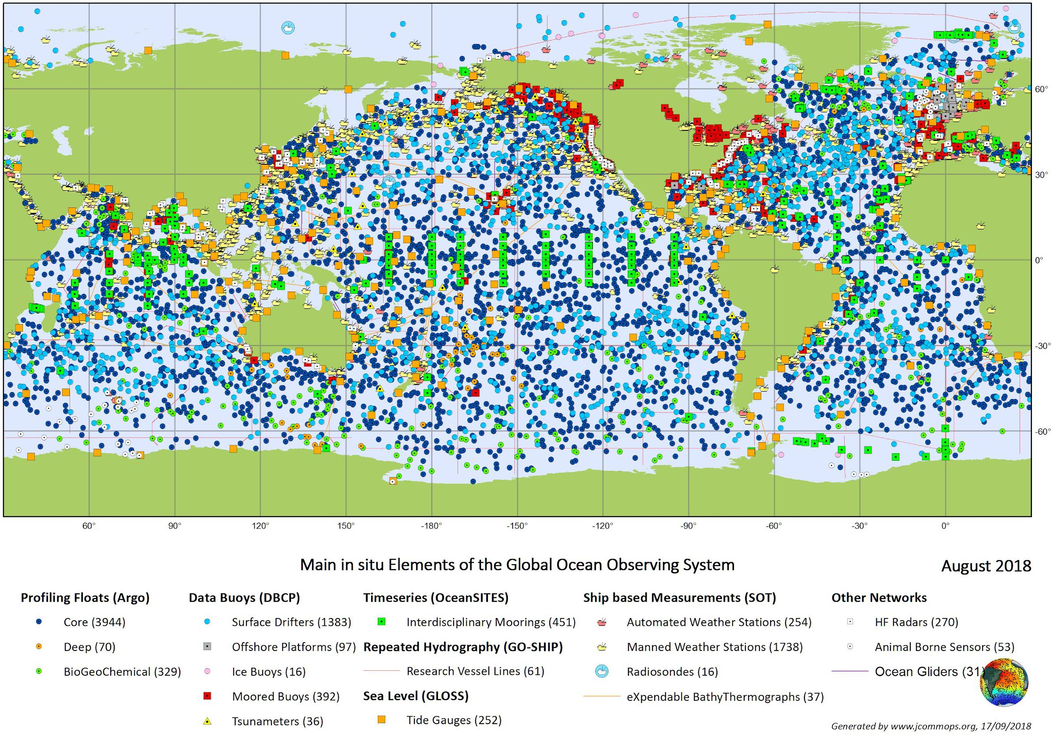

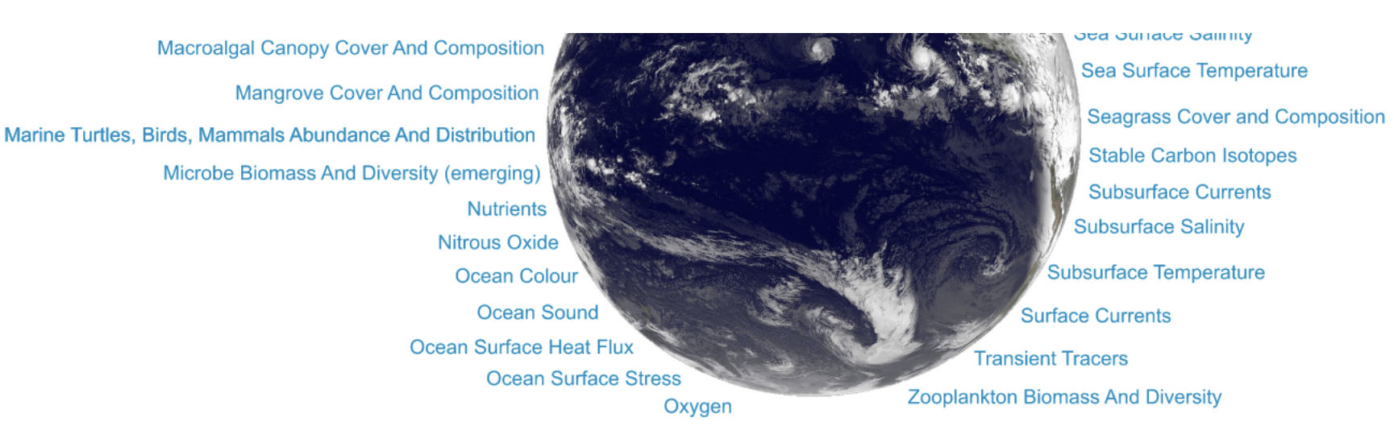
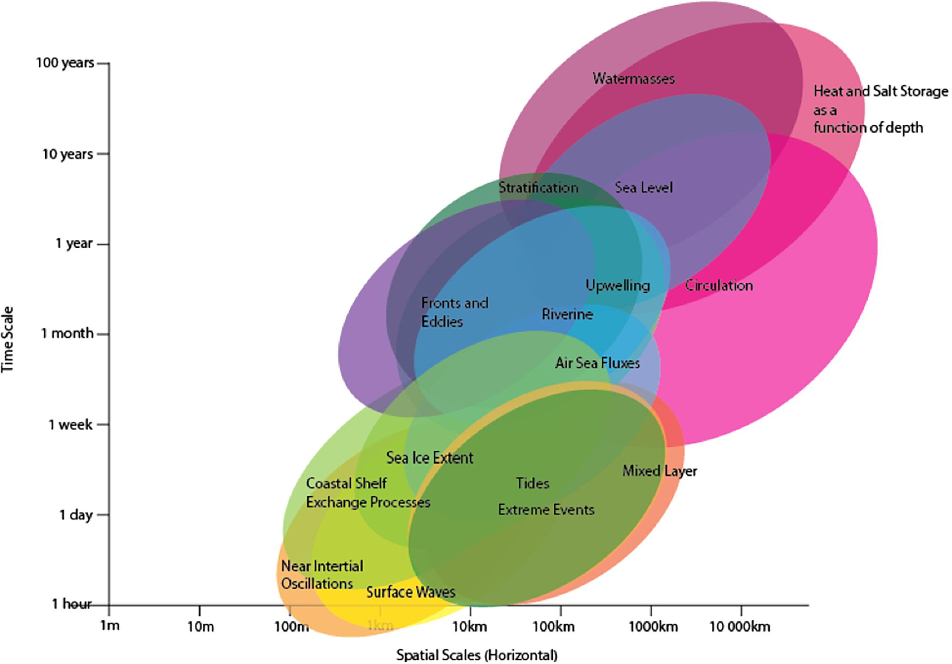
What can we do?
The OceanObs19 conference statement includes: ‘Indicators based on ocean observations help nations meet national goals and targets of the United Nations 2030 Agenda on Sustainable Development, the Paris Climate Agreement, the Sendai Framework for Disaster Risk Reduction, the Convention on Biological Diversity, and the Small Island Developing States Accelerated Modalities of Action Pathway. Ocean observations are fundamental to increase the scientific and information content of indicators, contribute to the United Nations Decade of Ocean Science for Sustainable Development (2021–2030) and are coordinated by Global Ocean Observing System (GOOS) and Group on Earth Observations (GEO).’
Essential Ocean Variables
GOOS TTOIF
goosocean.org
goosocean.org
OCEAN INDICATORS
Sloyan et al., 2019

Slide 8
What can we do?
The OceanObs19 conference statement includes: ‘Indicators based on ocean observations help nations meet national goals and targets of the United Nations 2030 Agenda on Sustainable Development, the Paris Climate Agreement, the Sendai Framework for Disaster Risk Reduction, the Convention on Biological Diversity, and the Small Island Developing States Accelerated Modalities of Action Pathway. Ocean observations are fundamental to increase the scientific and information content of indicators, contribute to the United Nations Decade of Ocean Science for Sustainable Development (2021–2030) and are coordinated by Global Ocean Observing System (GOOS) and Group on Earth Observations (GEO).’
ENGAGE
Essential Ocean Variables
GOOS TTOIF
goosocean.org
goosocean.org
BRIDGE
OCEAN INDICATORS
Sloyan et al., 2019

Slide 9
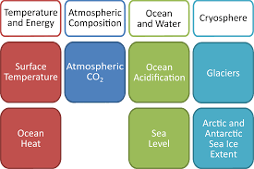
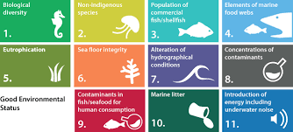

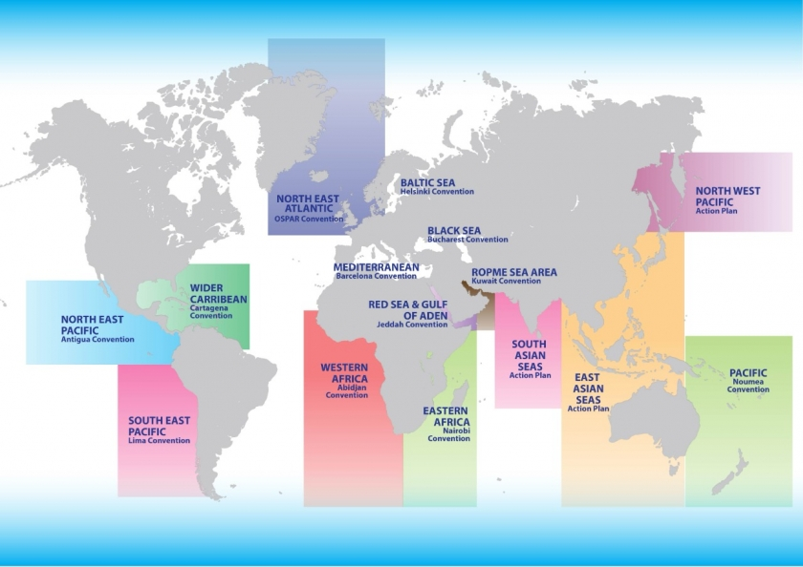
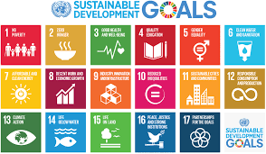
Ocean Indicators: international applications & use
Wide range of initiatives for ocean indicators for a diversity of applications
cbd.int
gcos.wmo.int
emodnet-chemistry.eu
➔ Major challenge, as ‘current uptake of ecosystem-based indicators … is uncoordinated and confused from the point of view of a global overview, although individual regions have their own agendas and in some cases well-developed indicator sets.’ (UNEP, 2014)
sdgs.un.org
unep.org

Slide 10
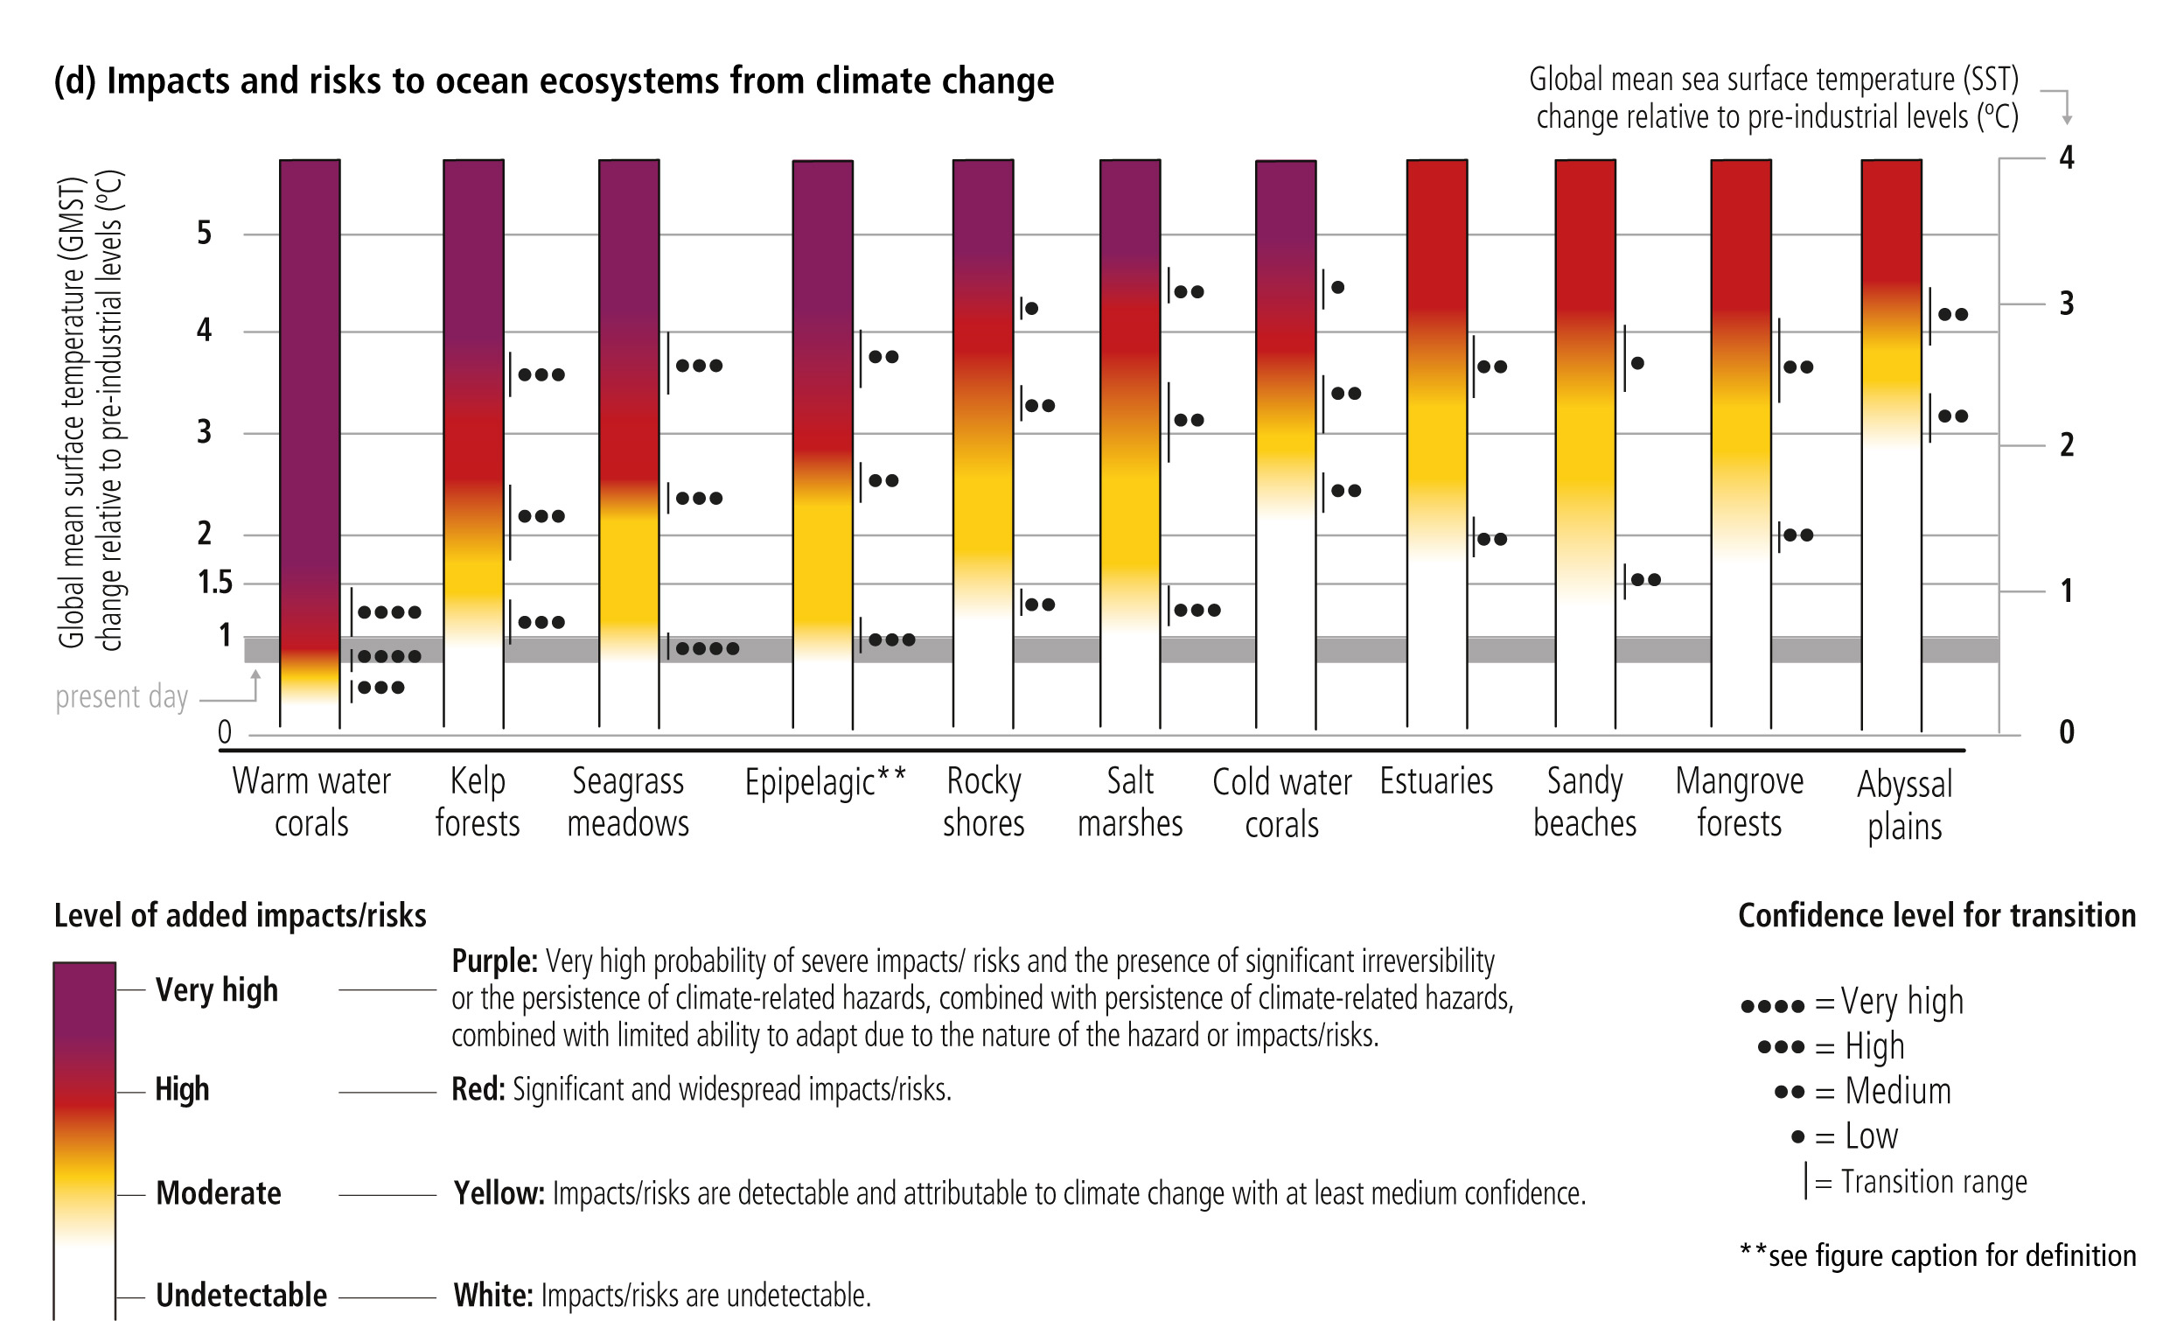
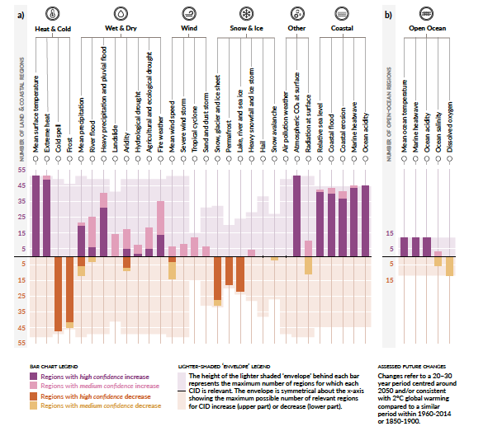
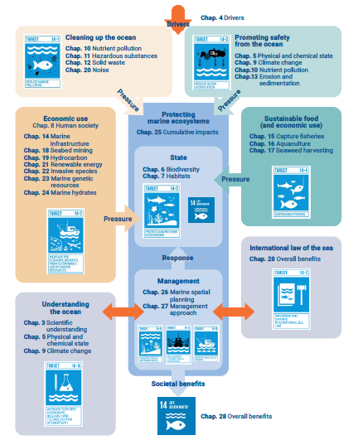
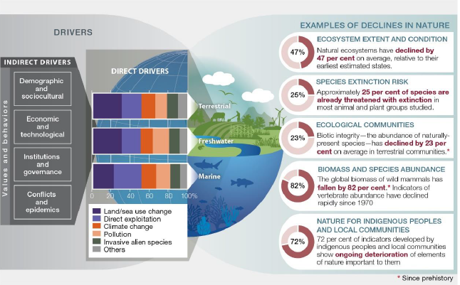
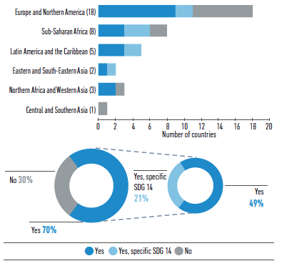
Ocean Indicators: international assessments & reporting
Risk assessment
Climatic Impact Drivers
World Ocean Assessment
IPCC SROCC, 2019
Global decline in nature
IPCC, 2021 (AR6, WG1, SPM)
WOA, 2021
SDG reporting
➔ A varity of global efforts demonstrating the cirtical need and value for assessing and synthesizing ocean knowledge
IPBES, 2019 (SPM)
IOC GOR, 2020

Slide 11
GOOS TTOIF: Interviews: Diverse perceptions, alerts, risks & challenges
Concerns raised during the individual interviews
Challenge to navigate through the ‘big data & information world’, and challenge to sustain the ‘scientific voice’ within future digital developments
The scientific world is becoming more and more complex, not understandable by people, even also not between different expertise
Confusion about the definition of an indicator & challenge to reply to all needs, and across all pillars
Challenge to ‘put the ocean’ at the front of priorities
Risk for the provision of a ‘rigid approach’: Assure to not lower down momentum of existing activities & observing system investments & developments, and do not ‘reinvent the wheel’; Challenge to address both, advancements in science, and evolving political priorities & targets
Challenge to connect different knowledge systems, and to build trust: not possible to move forward with a ‘top-down approach’, and need to understand the social expectation; Need for a comprehensive approach, and to bound together different aspects

Slide 12
GOOS TTOIF: Interviews: Diverse perceptions, alerts, risks & challenges
Concerns raised during the individual interviews
Challenge to navigate through the ‘big data & information world’, and challenge to sustain the ‘scientific voice’ within future digital developments ➔ Assure science driven blue knowledge
The scientific world is becoming more and more complex, not understandable by people, even also not between different expertise ➔ Assure clear and engaged blue knowledge
Confusion about the definition of an indicator & challenge to reply to all needs, and across all scales ➔ Assure a comprehensive new indicator definition & approach
Challenge to ‘put the ocean’ at the front of priorities ➔ Assure a comprehensive view for the ocean across the pillars for sustainable development
Risk for the provision of a ‘rigid approach’: Assure to not lower down momentum of existing activities & observing system investments & developments, and do not ‘reinvent the wheel’; Challenge to address both, advancements in science, and evolving political priorities & targets ➔ Assure a flexible approach for guidance
Challenge to connect different knowledge systems, and to build trust: not possible to move forward with a ‘top-down approach’, and need to understand the social expectation; Need for a comprehensive approach, and to bound together different aspects ➔ Provide a thematical guidance for achieving a continued dialogue and connection between different knowledge systems, and establish co-construction frameworks

Slide 13
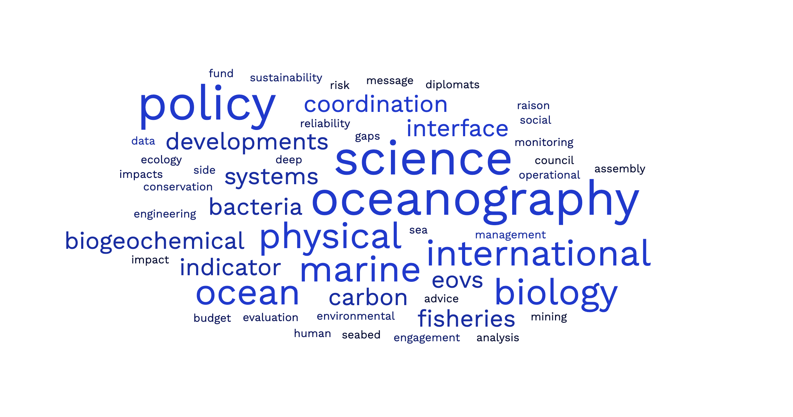
GOOS TTOIF: WHAT CAN INDICATORS DO?
GOOS Task Team for an ocean indicator framework
An international & multidisciplinary think tank on ocean indicators
Gathering together a wide range of knowledge
A varity of examples, expectations, prioirities & ambitions
Diverse perceptions, alerts, risks & challenges
The perspective paper:
What can ocean indicators do ? - A pacemaker towards a resilient life supporting ocean

Slide 14
GOOS TTOIF: WHAT CAN INDICATORS DO?
Science & Innovation: Identify priority areas.
ENVIRONMENT | SOCIETY | ECONOMY
Ocean & Biosphere | Ocean climate nexus & governance | Ocean & Finance
Ocean & Climate | Ocean Indigeneous and local knowledge systems | Ocean & Legal Framework
Ocean & Atmosphere | Ocean & Risk, Vulnerability | Ocean accounting
Ocean & Land | Ocean & Health | Ocean pollution
Ocean & Cryosphere | Ocean & Food | Ocean & Research
ONE OCEAN

Slide 15
GOOS TTOIF: WHAT CAN INDICATORS DO?
Science & Innovation: Identify priority areas.
ENVIRONMENT
Ocean & Biosphere
Ocean & Climate
Ocean & Atmosphere
Ocean & Land
Ocean & Cryosphere
➔ Create a scientfic think tank for the recommendation on existing indicators and development needs to reply to priority areas
ONE OCEAN
Solicit the 3 OOPC panels to put forward a short (~5?) list of champion indicators as a proof of concept. This recommended list will become the starting element for the environemental pillar

Slide 16
GOOS TTOIF: WHAT CAN INDICATORS DO?
A first step forward to connect ocean indicators across the three pillars of sustainable development…
SOCIETY | ECONOMY
Ocean climate nexus & governance | Ocean & Finance
Ocean Indigeneous and local knowledge systems | Ocean & Legal Framework
Ocean & Risk, Vulnerability | Ocean accounting
Ocean & Health | Ocean pollution
Ocean & Food | Ocean & Research
ONE OCEAN
➔ Effort under the way in collaboration with members to assess and synthesize current indicators and initiatives (global scale level) for ocean indicators across the other two pillars.

Slide 17
GOOS TTOIF: WHAT CAN INDICATORS DO?
Bridge the added value chain: GOOS & capacity of production
➔ Way forward: Develop a clear definition for an ocean indicator
An ocean indicator can be defined as:
A simple easy to understand tool to describe, measure and monitor a complex Ocean phenomenon. The Ocean indicator may change globally to locally, at different time scales, and can be utilized for Ocean literacy, and to build a sustainable Ocean observing system for holistic scientific assessment and stewardship.’
ONE OCEAN

Slide 18
GOOS TTOIF: NEW CRITERIA
Proposed new criteria
1) Scientifically justified. The indicator should be a synthesized representative for a complex ocean phenomenon triggering environmental, societal or economic change backboned by a peer-reviewed scientific rationale, including a fully traceable indicator method.
(2) Scientifically significant. The indicator should be associated to a comprehensive, scientific-sound and easy to understood uncertainty framework to allow for reliability check of the ocean change of environmental, societal or economic relevance.
(3) Scalable & attributable: The Indicator should be scalable from global, regional, to local scale, and its environmental, societal or economic relevance should be attributable across all scales, and to emergent ocean change.
(4) Measurable & operational: The indicator should be derived from one or more Essential Ocean Variables for the environmental pillar, and from other information for the societal & economic pillar in a practical, consistent and cost-effective way. The indicator should be calculated regularly and provide information in near-term, and allow for guiding the ocean observing system. (with the EOVs only, societal & economic data / info are excluded !!!)
(5) Accessible & clear: The indicator should translate the complexity of an ocean phenomena of environmental, societal or economic relevance into a simple way to become understandable for a wide audience, and reflecting how well our ocean observing system can capture this ocean change.

Slide 19
GOOS TTOIF: NEW CRITERIA: Score the indicator !
Scientific driven & feasible ocean indicators

Slide 20
GOOS TTOIF: NEW CRITERIA: Score the indicator !
Science driven & feasible ocean indicators
50%
60%
80%
100%
30%
40%
60%
80%
10%
20%
40%
60%
0%
10%
30%
50%
Feasible:
High (50%)
Medium (30%)
Low (10%)
No (0%)
Science-based
Robust (50%)
Reasonable (30%)
Adverse (10%)
Modest (0%)

Slide 21
GOOS TTOIF: THE OCEAN INDICATOR WHEEL
Indicator:
Pillar:
EOV used:
GLOBAL
Observing system recommendations:
Global
Regional
Local
XX%
REGIONAL
XX%
LOCAL
XX%
Emergence / alerts:
Global
Regional
Local

Slide 22
GOOS TTOIF: THE OCEAN INDICATOR WHEEL: EXAMPLE
Indicator: Ocean heat content
Pillar: Environment
EOV used: Surface & Subsurface temperature
Emergence / alerts:
Global: Ocean warming, Status & climate change commitment, sea level rise
Regional: Ocean warming, sea level change, species migration; storm pathways
Local: Ecosystem health, coastal protection & infrastructures (coastal flooding, hazards)
➔ need to add uncertainty level information (eg IPCC)
Recommendations (Science / Feasibility):
Global: Refine uncertainty framework, foster international collaborations; Sustain & extent (deep, polar, shallow (< 2000m depth bathy))
Regional: Advance in research, and refine uncertainty framework; Sustain & increase measurement density
Local: Establish new research opportunities; Extent observing system to coastal & EEZ level.
GLOBAL
80% (Robust / Medium)
REGIONAL
80% (Reasonable / Medium)
LOCAL
40%
(Reasonable / Low)

Slide 23
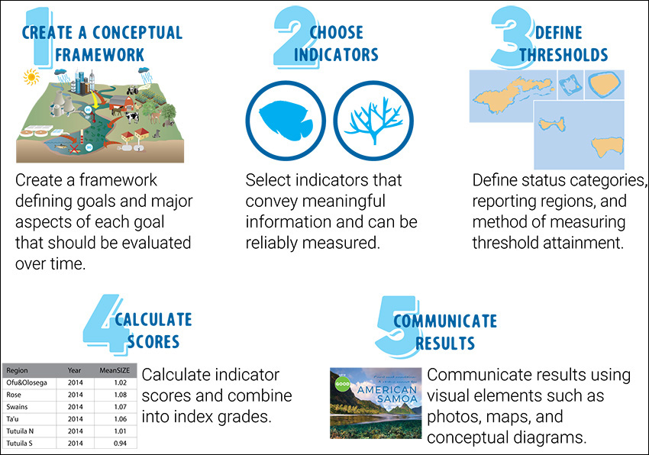
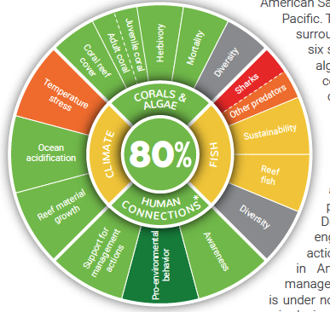
GOOS TTOIF: WHAT CAN INDICATORS DO?
Dialogue across knowledge systems: Co-construct, transfer and exchange.
National Coral Reef Monitoring Program (NOAA)
Report for Samoa
OCEAN INDICATORS
https://www.coris.noaa.gov/monitoring/status_report/docs/AmerSamoa_status_report_forweb.pdf
https://www.coris.noaa.gov/monitoring/status_report/

Slide 24
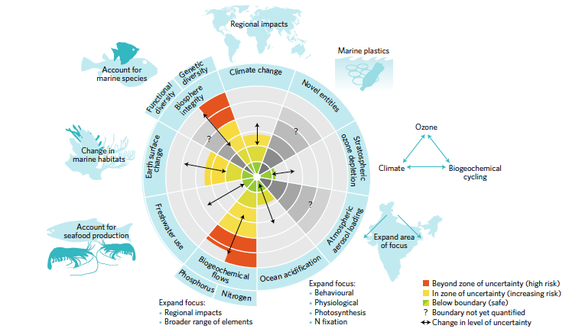
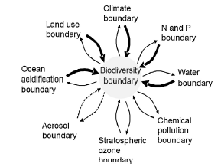
GOOS TTOIF: WHAT CAN INDICATORS DO?
Sustainable ocean boundaries: Guidance across ocean resilience
➔ Linkage of indicators to ocean resilience boundaries across the three pillars of sustainable development
OCEAN INDICATORS
➔ Research urgently needed for a comprehensive view of ocean relience boundaries & linkage of indicators to thresholds crossing those boundaries
Mace et al., 2014
Nash et al., 2017

Slide 25
GOOS TTOIF: WHAT CAN INDICATORS DO?
Ocean climate nexus: Blue knowledge transfer to policy.
Towards a resilient life supporting ocean: Connecting indicators, other information (e.g. EOVs) from different knowledge systems of all three pillars for sustainable development, desgined to reply to ‘ocean targets’ priorisized in the blue diaologue (e.g. UNFCCC ocean & climate dialogue) ➔ foster an ‘Ocean Information Day’
OCEAN INDICATORS
Blue knowledge mobilization based on best available science cutting across the three pillars of sustainable development, scales and knowledge systems is one of the most urgent and innovative opportunity for enabling a sustainable future pathway for, and from a resilient life supporting ocean.

Slide 26

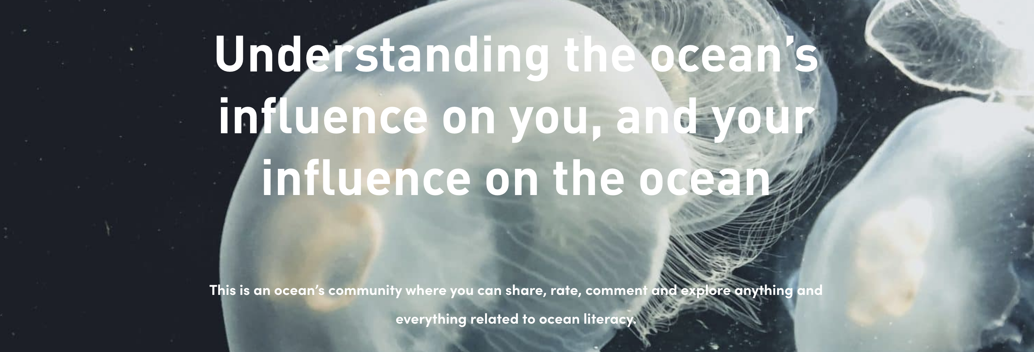
GOOS TTOIF: WHAT CAN INDICATORS DO?
Ocean literacy & communication: Engagement with a broad audience
OCEAN LITERACY PORTAL
OCEAN INDICATORS
https://oceanliteracy.unesco.org
➔ Support of topical foci provision through ocean indicators in support of ocean literacy

Slide 27
GOOS TTOIF: WHAT CAN INDICATORS DO?
Science & Innovation: Identify priority areas.
Bridge the added value chain: GOOS & capacity of production
Dialogue across knowledge systems: Co-construct, transfer and exchange.
Sustainable ocean boundaries: Guidance across ocean resilience
ONE OCEAN
Ocean climate nexus: Blue knowledge transfer to policy.
Ocean indicators:
Identify
Bridge
Dialogue
Guide
Transfer
Engage
Ocean literacy & communication: Engagement with a broad audience

Slide 28
GOOS TTOIF: Ocean Indicators – a way forward: A one ocean initiative
THE ONE OCEAN INITIATIVE
An international call for a long-term program under the ocean deacade
Ocean indicators: A pacemaker for a resilient life supporting ocean
GOOS TTOIF
Ocean indicators:
Identify
Bridge
Dialogue
Guide
Transfer
Engage
ONE OCEAN

Slide 29
GOOS TTOIF: Next steps
Collaborate with GOOS panels for the lsit of ‘champion indicators’
Paper drafting (submission now envisaged for April 2023), including a perspective/roadmap elevating a long-term strategy
Need to find new co-chairs
Discuss on possibility for a workshop with support from G7 Future of the Sea to shape the long-term perspective
Collaboration with Alex Godoy Faundez (visit of 1 month in Q1 2023 at Mercator Ocean international) for collaboration on indicators, and evaluation of potential fund raising opportunities.

Slide 30
THANK YOU
Date, venue, event

