Slide 1
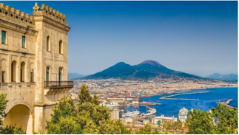
INGV Tsunami Alert Center NEAMTWS Experts Meeting Implementing NEAMTWS 2030 Strategy Opportunities and Actions to Explore 28-30 November, Naples, Italy

Slide 2
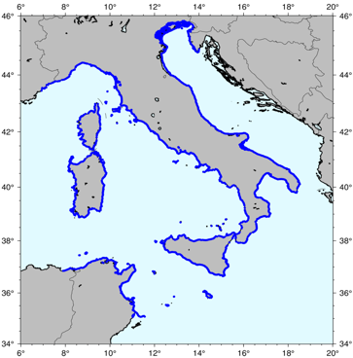
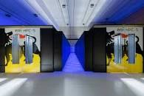
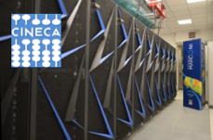
Pillar 1. New Tsunami Hazard Assessment for Italy
New Probabilistic earthquake model
Points of interest
List of earthquake scenarios (almost 9 Million)
Tsunami modeling (Tsunami-HySEA)
waveforms at point of interest
10 m isobath
5 km spacing
- - - >
+ local high resolution studies on specific targets
Distribution of tsunami height for all scenarios at all target points
Computationally heavy task performed thanks to
High Performance Computing on GPU clusters
Hazard aggregation &
uncertainty quantification
HPC5@ENI
MARCONI100@CINECA
Hazard curves and maps for tsunami height at all target points and related uncertainty

Slide 3
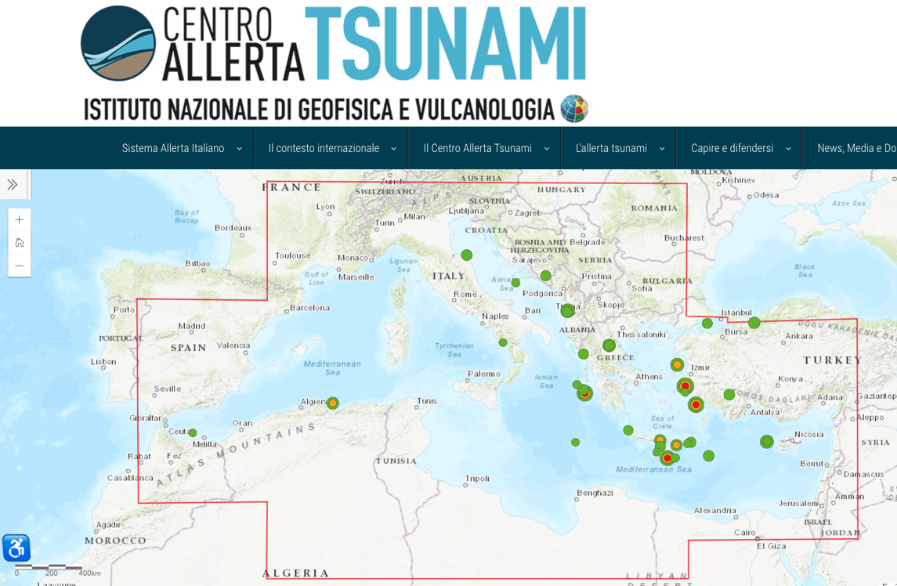
Pillar 2. Warning – last events
6 minutes time for issuing the most recent messages
Criticality:
Black Sea event of last Nov. 23
(problems with areas of monitoring) to be discussed in the TT-Operations

Slide 4
Pillar 2. Warning – Ongoing developments (on sea level monitoring)
Two DART-like buoys in the Ionian Sea (TUO project, coord. S. Lorito)
One DART-like buoy with INGV-made technology (G. D’Anna, EMSO-MedIt project)
Pressure sensors on EMSO Observatories and SMART cables
Pressure sensors on oil/gas offshore platforms (Ionian, Adriatic)
ISPRA: New generation tide gauges in Italy (some new)
GNSS monitoring for rapid source characterization

Slide 5
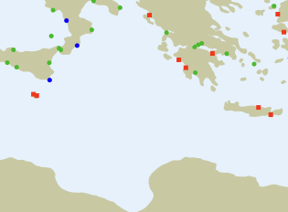
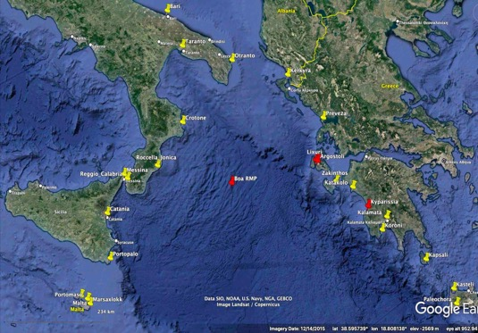
WP 8 Coordinator Stefano Lorito INGV
+
TUO
TsUnami Observation
2 (+1) DARTs in the Ionian Sea - exact positions to be determined (+ 1)
Assigned Budget: 3 M€

Slide 6
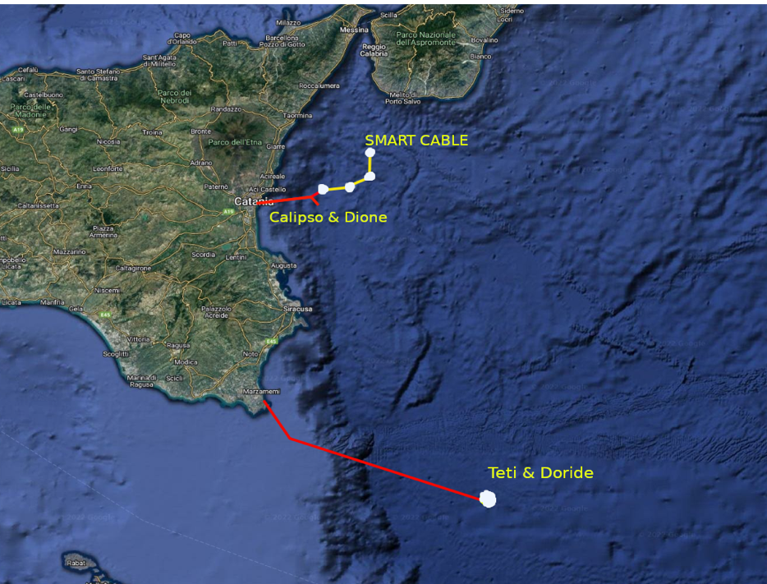
Installations of pressure sensors ongoing in the Ionian Sea at observatories PON INSEA & SMART Cable (G. Marinaro)
Pressure sensors to be installed on
CALIPSO & DIONE (-2100 m)
TETI & DORIDE (-3500 m)
3 Pressure sensors to be installed on the SMART CABLE
(at about 6 km NE)
CATANIA
PORTOPALO

Slide 7
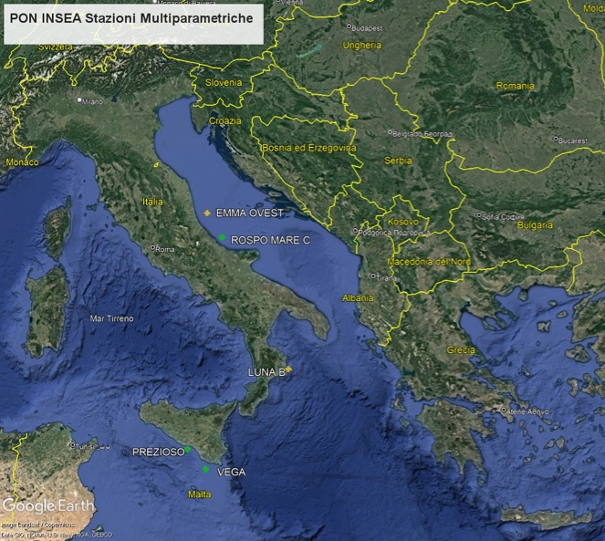
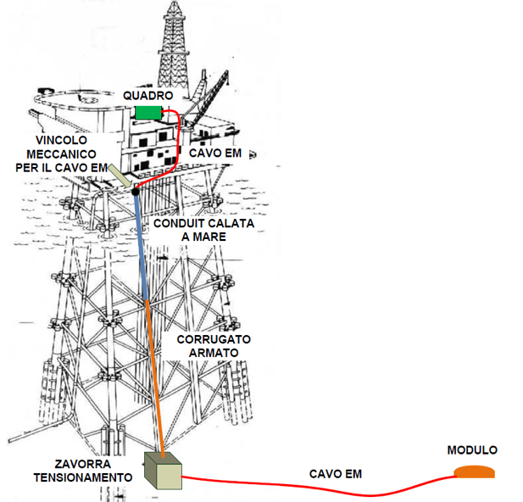
Pressure sensors on 5 oil / gas platforms in the Adriatic, Ionian seas and Sicily channel
Test: October 2022
Installation: March/April 2023

Slide 8
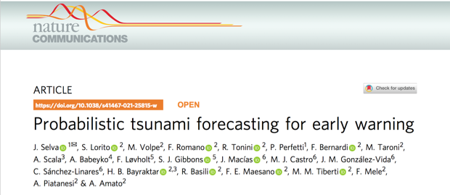
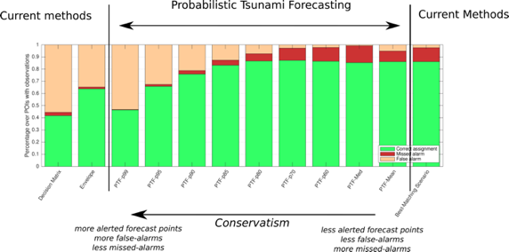
Alert Levels: Probabilistic Tsunami Forecasting
- PTF treats explicitly data and forecast uncertainties
- PTF enables alert level definition according to any predefined level of conservatism
MAIN STEPS TOWORDS OPERATION
Procedure is currently under continuous test in parallel with the Decision Matrix - at least 6 months
Reducing Computation time
Review ongoing by INGV Scientific Committee through a selected panel of international reviewers (3)
Evaluation by the Italian CP Department - Decisions on thresholds
Review by other TSPs including operational aspects

Slide 9
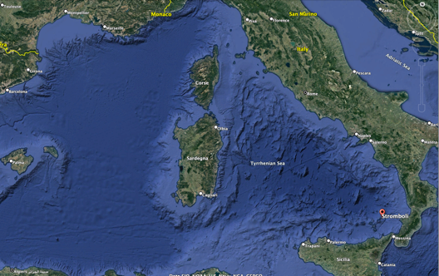
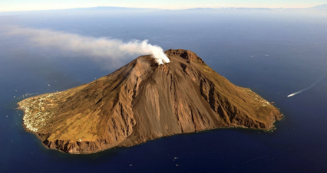
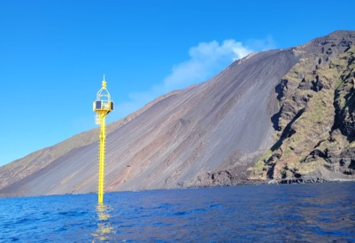
New Task: Local system at Stromboli Island (Univ. Of Florence)
Stromboli is a volcanic island belonging to the Aeolian Archipelago
The Northern flank called «Sciara del Fuoco», because of continuous accumulation of ashes and debris from the frequent eruptions, is prone to sub-aerial and submarine landslides and to pyroclastic flows
Recent events triggering tsunamis: 2002 (landslide), 2019 (pyroclastic flow), small events in 2022
During the last 10 years the University of Florence installed a monitoring and alerting system for local tsunamis, consisting of 2 elastic beacons (equipped with pressure sensors).
Starting from September 2022, CAT-INGV has the responsibility of managing and developing this system (in close collaboration with the University of Florence) and of integrating it with the National and, hopefully, with the NEAM Tsunami Warning System.
Aeolian Archipelago
Sciara del Fuoco
Talk by M. Ripepe on Nov. 29
Elastic Beacon

Slide 10
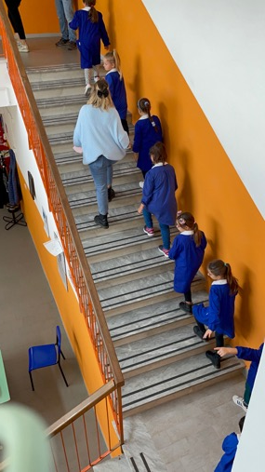
Pillar 3- Awareness and Response
Risk perception studies
A study on global RP studies (Cugliari et al., Frontiers, in press 2022)
New regions + a national sample (NHESS, in press 2022)
Specific studies in schools and other stakeholders (online questionnaire – mobile phones)
Tsunami Ready
Advancements in the 3 Italian candidates
New requests
CAT website updates
24 News in 2022 (Italian and English)
New features on the home page map and on contents
WTAD 2022 activities
Report in WG4 (Nov. 30)

Slide 11
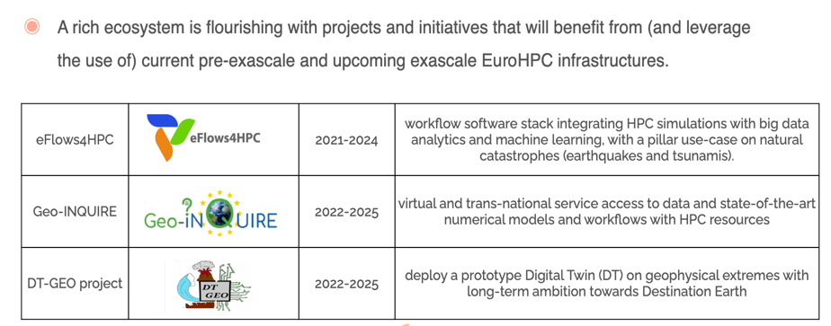
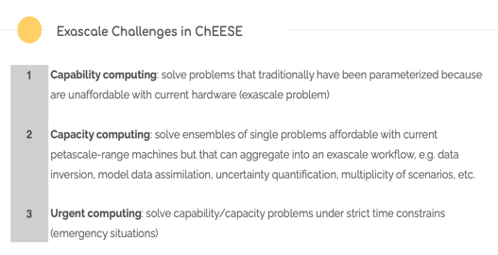
Participation in ongoing projects
ChEESE 2

