Slide 1
Tsunami Service Provider Hellenic National Tsunami Warning Centre
Institute of Geodynamics
National Observatory Athens
NEAMTWS Experts Meeting - Implementing NEAMTWS 2030 Strategy Opportunities and Actions to Explore
28-30 November 2022, Naples, Italy

Slide 2
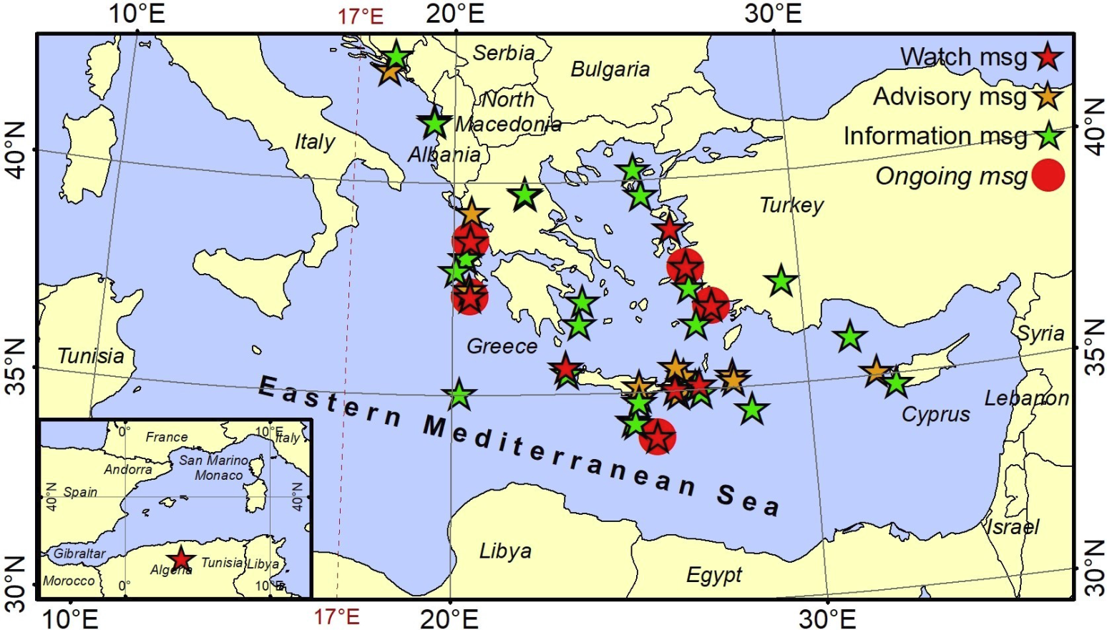
Operational activities
4 Tsunami Warning Messages since the last Steering Committee meeting in April 2022
no | Date | Time (UTC) | Region | Lat | Lon | Magnitude | Alert Level
46 | 22-Apr-22 | 21:07:49 | Bosnia and Herzegovina | 43.00 | 18.16 | 5.8 | Information
47 | 31-Aug-22 | 10:10:11 | Dodecanese Isl. | 37.42 | 26.83 | 5.7 | Information
48 | 08-Sep-22 | 07:36:24 | Ionian Sea | 37.94 | 20.11 | 5.6 | Information
49 | 02-Oct-22 | 04:04:01 | Crete | 34.3 | 26.21 | 5.5 | Information

Slide 3
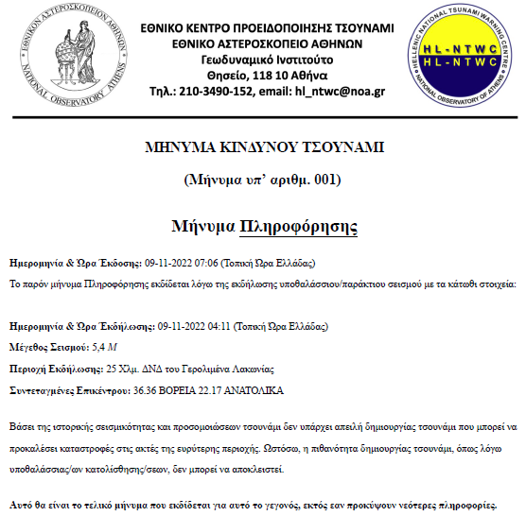
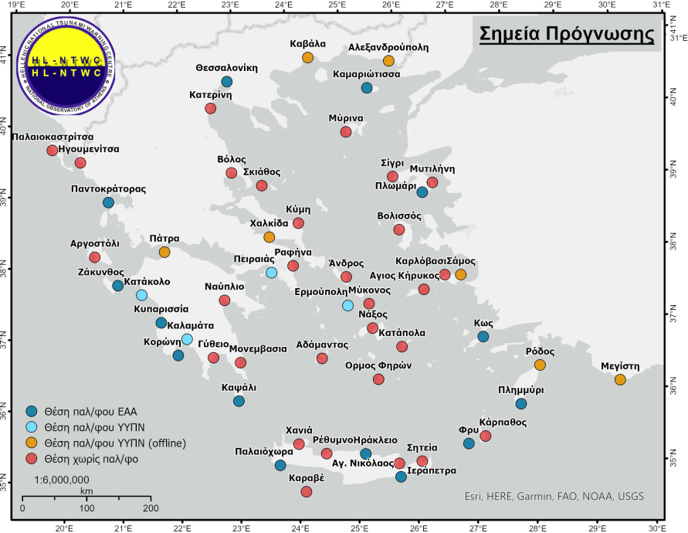
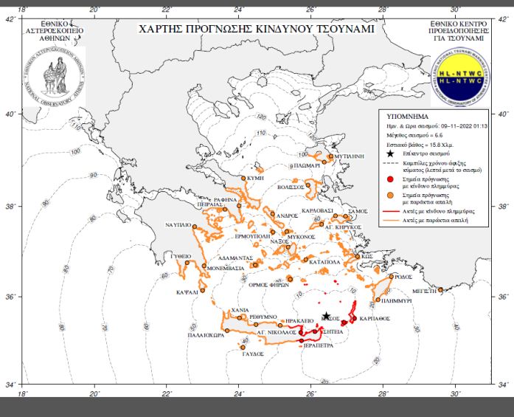
Operational activities
Finalized and in operational use since August 2022:
National messages in Greek language with map.
Updated Forecast Points list.

Slide 4
Scientific/Research activities
HL-NTWC is participating in the following projects and initiatives:
• Aristotle-eENHSP (2020-)
• CoastWAVE (2022-2024)
• Geo-INQUIRE (2022-2025)
• EPOS Tsunami TCS (2021-)
• BALANCE (2021-2022)
• new project submissions….

Slide 5
Participation
HL-NTWC participated in the following workshop and meetings:
NEAMTWS TSPs meeting, 27-28 September 2022, Paris & online two meetings.
Scientific workshop dedicated to the CENALT 10 year anniversary CENALT, 29-30 September 2022
Workshop on the Requirements, Challenges, Opportunities for Local Tsunami Warning Systems in the Context of Multi-Hazard Disaster Risk Mitigation in the North-Eastern Atlantic and Mediterranean Region, 4–5 October 2022, Ispra, Italy.
CoastWAVE project ”Tsunami Warning and Emergency Management SOP workshop”, 5-6 October 2022, Ispra, Italy, organized by IOC-UNESCO.
WTAD 2022
A table-top exercise with the National CPA was initially scheduled for November but was postponed for January 2023.
Nicosia Risk Forum 2022, Larnaka, Cyprus. This year’s theme of #NRF2022 was focused on “Challenges of the Effects of Climate Crisis”. Invited talks about risk related projects and initiatives:
NEAMTWS from the Greek Tsunami Service Provider perspective
CoastWAVE Greece

Slide 6
Developments
Operational challenges
• Proximity of tsunamigenic faults to coastal communities -> small available time window for warning.
• Absence of deep-water sensors - long delay in confirming tsunami generation by the Tsunami Service Providers if TGs not available in the near field.
Ongoing developments
• A tender for the purchase of 12 new tide gauges is underway for 2023.
• Preparation of local SOPs, following the guidelines and recommendations
of the National SOP.
• Use of Emergency Communication Service for message dissemination to
the public, through 112 - already operational, fine tuning is needed.
• Development of a national tsunami warning page to publish information related to tsunami
events for the public.
Future developments in NEAM
• Deploy regional deep water sensors – take advantage of smart cable initiatives.
• Improve tsunami forecasting capabilities using region-specific methodologies.
• Create framework for tsunami warning for non-seismic sources.

Slide 7
*
NEAMTWS Experts Meeting - Implementing NEAMTWS 2030 Strategy Opportunities and Actions to Explore
28-30 November 2022, Naples, Italy

