Slide 1
ICG/NEAMTWS 2030 Strategy
Pillar 2: Detection, Warning and Dissemination
NEAMTWS Experts Meeting: Implementing NEAMTWS 2030 Strategy
Opportunities and Actions to Explore
28-30 Nov 2022, Naples, Italy

Slide 2
PILLAR 2: SKETCH OF THE MAIN COMPONENTS
DETECTION
WARNING
DISSEMINATION
Detection involves the implementation and development of seismic and sea-level observing systems that enable rapid assessment and verification of the threat.
Warning involves the forecasting of wave propagation and potential impacts for tsunamis and conveying that information in interoperable message formats.
Dissemination involves timely and accurate distribution of threat and warning information from and between Tsunami Service Providers and National Tsunami Warning Centres, and from NTWCs to civil protection authorities and the community.

Slide 3
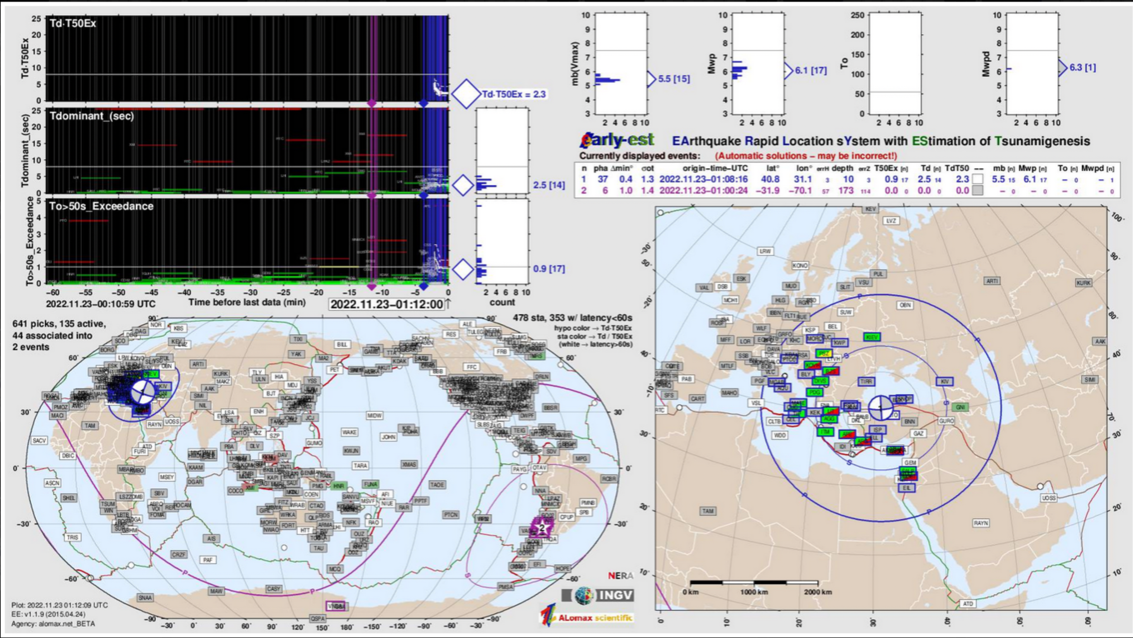
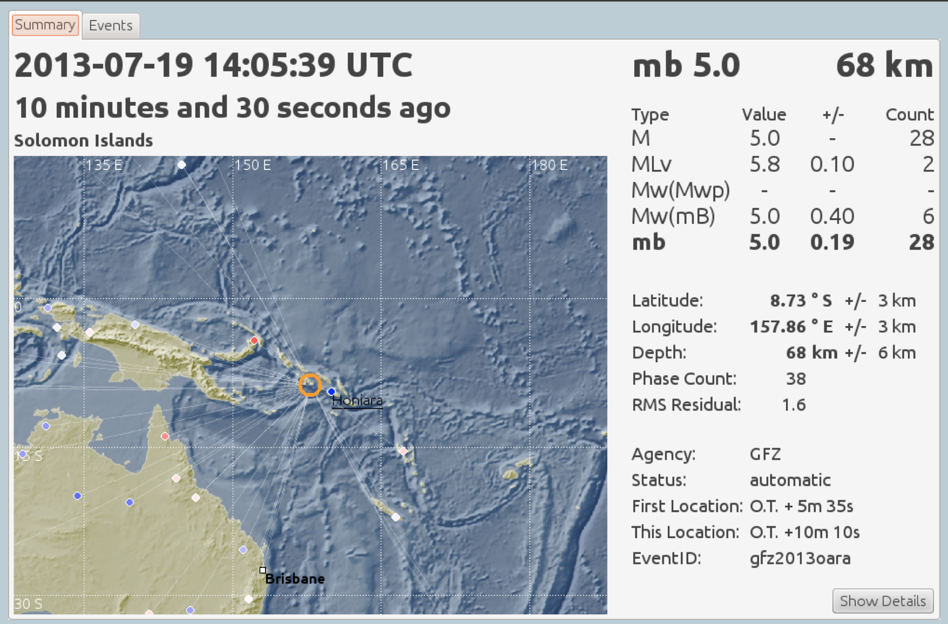
DETECTION: monitoring systems
EARLY-EST
KEY POINTS
Considering the short travel time to many near-source coasts in the NEAM region, the adoption of fully automatic solutions for earthquake location and magnitude is encouraged. Actually all TSPs use automatic monitoring systems to assess earthquake parameters
However, well-trained personnel on duty at TSPs monitoring room are needed for evaluation of automatic solutions
Earthquake location and magnitude after few minutes from OT (6-10 minutes)
SEISCOMP3
Complemented by other systems (e.g. Earthworm, etc…)

Slide 4
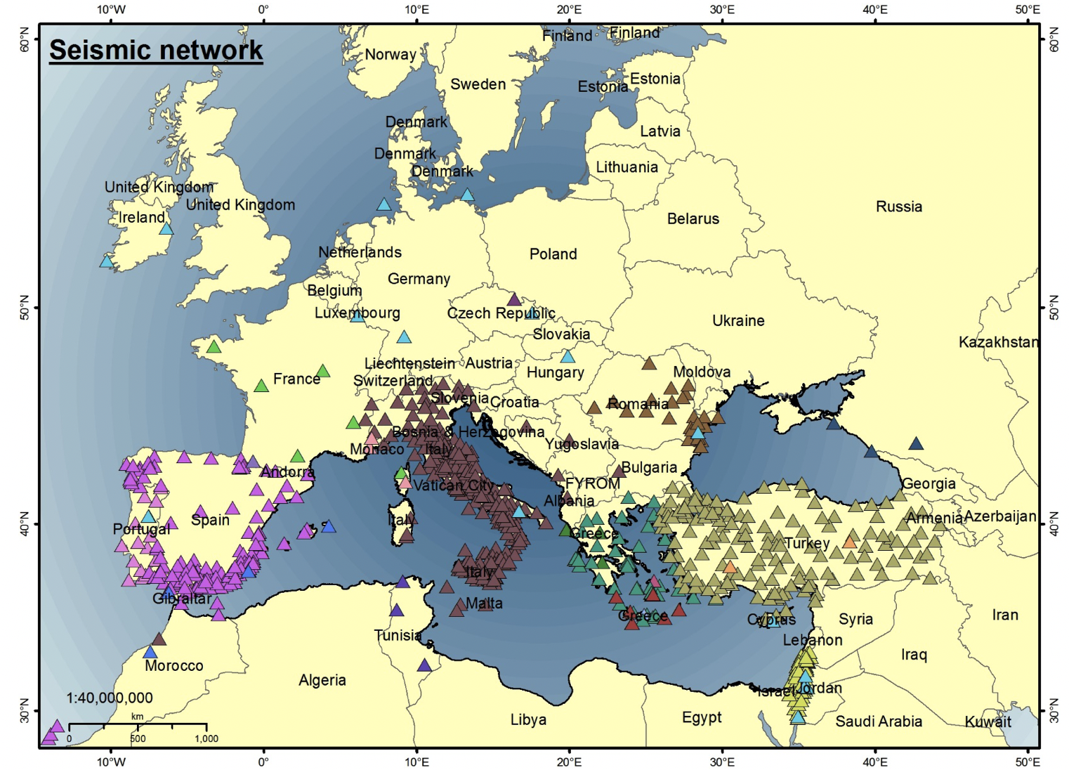
DETECTION: seismic network
KEY POINTS
All automatic monitoring systems need a continuous stream of seismic data in real time
These data comes from National Networks complemented by various real-time networks operated by agencies such as IRIS, CTBTO, GFZ, MedNet-INGV etc…
The distribution of existing stations that meet the requirements of NEAMTWS in terms of data quality and real time transmission is strongly heterogeneous, with a crucial gap in northern Africa countries
Source: The North-eastern Atlantic, the Mediterranean and connected seas Tsunami Early Warning and Mitigation System (ICG/NEAMTWS) 2030 Strategy, IOC Technical Series

Slide 5
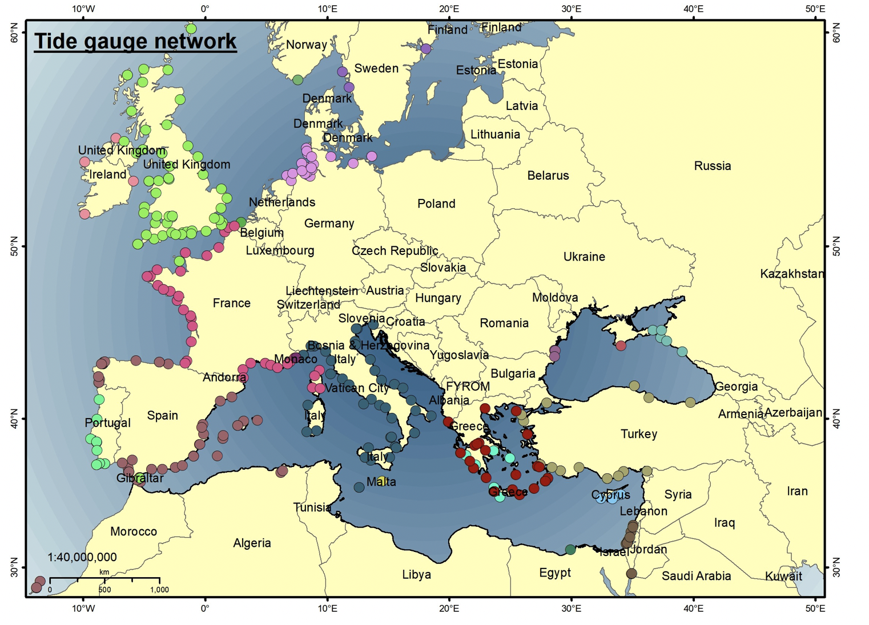
DETECTION: sea-level network
KEY POINTS
Real time sea-level data are needed to confirm or cancel alert messages. Such data typically comes from tide-gauge stations operated in the NEAM region by National Agencies and Research Institutions.
The sea-level stations used by TSPs in the NEAM region have low latency (<few minutes) and high frequency sampling (1 sample per minute or less, TOWS-WG recommends 1 sample per second to record tsunami waves of all origins)
Recent tsunamis have shown that sea-level information is not dense enough: denser network are required close to tsunamigenic zones and in complex areas with many islands.
Source: The North-eastern Atlantic, the Mediterranean and connected seas Tsunami Early Warning and Mitigation System (ICG/NEAMTWS) 2030 Strategy, IOC Technical Series

Slide 6
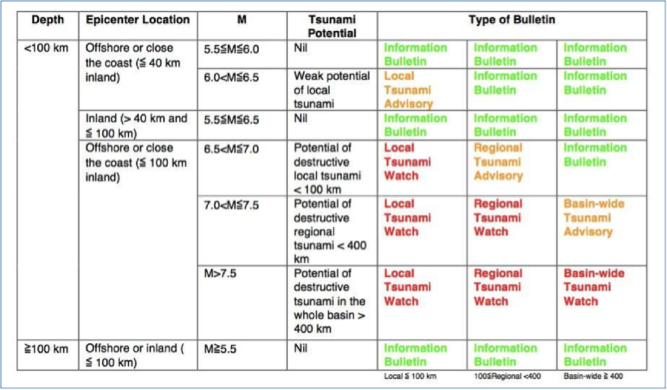
WARNING
KEY POINTS
All TSPs in the NEAM region are using Decision Matrices (DM) to define the tsunami alert levels at predefined Forecast Points (FP)
DMs have strong limitations:
  take into account only earthquake magnitude, depth and distance from the epicentre to the FPs;
  could lead to imprecise assessment of tsunami impact;
  may feature undesired strong variations in alert levels across pre-defined thresholds;
Need to develop better forecast methods, more precise and able to quantify the intrinsic uncertainty associated to the forecast
Example of Decision Matrix (in use at INGV)

Slide 7
DISSEMINATION
English text message
National text message
KEY POINTS
This is a crucial part of an end-to-end warning system
Depending on the alert levels and whether or not tsunami generation is confirmed, a series of standard messages are disseminated according to the evolution of the event
Various dissemination channels are used: email, GTS, FAX, SMS, Webservices, Smartphone Apps, other computer based platforms, etc…
Electronic formats:
JSON
XML
CAP-TSU
Communication test message

Slide 8
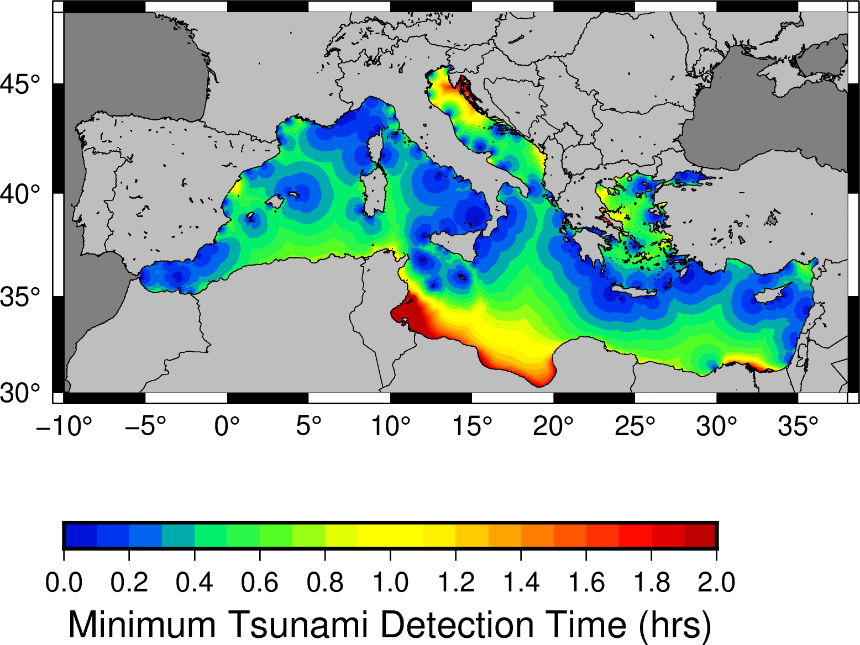
OBJECTIVE 2.1: Increase, densify and ensure sustainability of the
detection networks
KEY POINTS
Where stations exist, ICG and IOC are promoting effective data-exchange policies by reinforcing the international cooperation with the common goal of protecting the coast of all countries of the NEAM region.
From the Figure we can spot the areas with large detection time (e.g. T > half an hour)
North Africa is still almost devoid of seismic and tide gauge stations while it is difficult to foreseen and initiate concrete actions.
Some recent tsunamigenic events during the last few years (Aegean sea and Central-Eastern Mediterranean sea) have shown that no sea level data were recorded close to the epicentre. Actions by some Member States are in progress and/or planned to densify national networks to fill the gaps.
Source: INGV
Computed on the basis of the sea-level network in use at INGV, considering theoretical arrival time, assuming all stations are functioning and no latency in the data (very optimistic situation).

Slide 9
OBJECTIVE 2.2: Installation of multi-hazard observation systems
KEY POINTS
This objective is in line with the target (G) of the Sendai Framework for Disaster Risk Reduction which points to substantially increase the availability of -and access to- multi-hazard early warning systems and disaster risk information and assessments to people by 2030.
In the NEAM region most tsunamigenic offshore earthquake sources are close to land so that tsunami hazard is strongly related to seismic hazard. There may be a possibility that Seismic Early Warning Systems, that are based on dense accelerometric networks, could work together with TWSs to reduce the time delay of issuing tsunami alert messages, at least at local scale.
Furthermore, the presence of volcanoes in or near the sea naturally leads to the development of multi-hazard warning systems (volcanic-tsunami). An experimental system of this type has been developed for Stromboli (volcanic island in the Tyrrhenian Sea).

Slide 10
OBJECTIVE 2.3: Plan and implement an “Inter-Operability Tool”
KEY POINTS
In the NEAM region we have 5 TSPs operating with slightly different procedures that are based on their best-practices, covering different geographical areas, with partial overlap.
This can result in different solutions of both earthquake parameters and alert levels
A need emerged among these TSPs to become more interoperable, in order to improve efficiency and handle the intrinsic uncertainty deriving from independent and simultaneous real-time analysis.
The first steps towards the development and implementation of the Inter Operability Tool (IOT) have been taken. The IOT will allow TSPs and NTWCs to exchange data, compare solutions and report results, maps and other products.
The concept of the IOT has been discussed among TSPs representatives and co-chairs of TT on Operations. TSPs started to share the first information (e.g. the list of Forecast Points and sea-level stations, bathymetric data to compute theoretical travel time, etc.). A WEB-based tool has been developed to visualize and download some of those data.

Slide 11
OBJECTIVE 2.4: Develop and implement additional monitoring tools
KEY POINTS
Seismo-geodesy, real-time GNSS and joint seismic/GNSS surface deformation measurements could allow TSPs to quickly quantify fault ruptures. A German project (EWRICA) deals with this topic and 2 NEAM TSPs are participating as end-users with the aim of implementing the new tools for earthquake monitoring and analysis developed during the project.
Concerning new instrumentation, some national initiatives are underway to install deep sea pressure recorders in the Ionian Sea (deployment foreseen during 2023-2025).
Emergent technologies, such as Laser Interferometry (LI) and Science Monitoring and Reliable Telecommunications (SMART) cable offer new perspective for seismic and tsunami detection. Portugal is implementing a new ring of telecommunications submarine cables connecting the Portuguese mainland, Madeira and Azores.

Slide 12
OBJECTIVE 2.5: Implement Probabilistic Tsunami Forecasting
KEY POINTS
We have already seen that all TSPs in the NEAM region use Decision Matrices to assess the alert levels and some limitations they have (e.g. imprecise assessment of tsunami impact, undesired strong variations in alert levels across pre-defined thresholds, no treatment of uncertainty)
A way to overcome these problems is to implement a Probabilistic Tsunami Forecasting.
  It is based on a large database of pre-calculated tsunami scenarios
  It propagates the uncertainty of the source parameters at a given instant in time after the occurrence of the earthquake up to the forecast tsunami intensity
  It easily gives the opportunity to define the desired level of protection as the probability that a given tsunami intensity is overcome
This forecast method is running in “testing mode” at a TSPs monitoring room to be validated and calibrated against observations

Slide 13
OBJECTIVE 2.6: Threat levels
KEY POINTS
TSPs in the NEAM region release messages specifying alert levels (Information, Advisory, Watch) at a suite of Forecast Points (FPs). However, TOWS-WG recommend alert level terms should be replaced by threat level terms, in order to make more clear that alert levels are the responsibility of national/local authorities.
During some meetings (TT on Operations/ Documentation, TSPs, SCs) the transition to threat levels was discussed but several concerns were raised and a final decision has not yet been taken.

Slide 14
OBJECTIVE 2.7: Additional sources of tsunami observations
KEY POINTS
As a matter of fact, during recent tsunami events, amateur and/or surveillance video observations of tsunami waves are becoming more and more available.
TT on Operations/ Documentation and TSPs started discussing if and how to report such information during the warning process. Questions raised are about:
  the authoritativeness of the sources
  the opportunity to rely only on instrumental data (at least for TSPs)

Slide 15
THANK YOU FOR YOUR ATTENTION!

