Slide 1
The ICG/NEAMTWS Strategic Plan 2021-2030 an introduction
NEAMTWS Experts Meeting
Implementing NEAMTWS 2030 Strategy Opportunities
and Actions to Explore
28-30 Nov, Naples, Italy
Alessandro Amato Centro Allerta Tsunami - INGV Task Team on Documentation (with Brian McConnell, GSI)

Slide 2
ICG/NEAMTWS 2021-2030 Strategy
The new ICG/NEAMTWS 2021-2030 Strategy outlines key objectives for a continuously improving NEAMTWS to meet stakeholder requirements during the period 2021–2030.
It will also contribute to the UN Decade of Ocean Science for Sustainable Development 2021-2030, in particular by responding to the needs of society for a “safe ocean” where people are protected from ocean hazards.
Strategy seeks to capitalise on the Ocean Decade societal benefits in order to further improve monitoring, detection and data-sharing among Member States and partners.

Slide 3
The vision
Coastal communities around the North-eastern Atlantic, Mediterranean and connected seas are resilient to tsunamis and other sea-level related hazards, with an effective tsunami warning and mitigation system that is based on Member State participation.

Slide 4
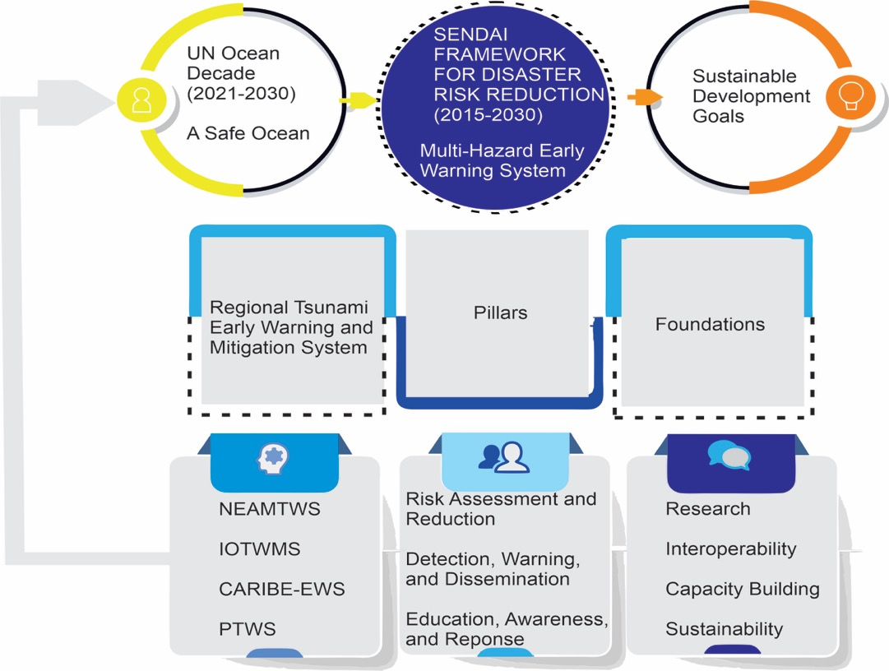
The general framework

Slide 5
The three pillars
The Strategy of the North-eastern Atlantic, Mediterranean and connected seas Tsunami Warning and Mitigation System is founded on three pillars:
1. Tsunami Hazard and Risk Assessment
2. Detection, Warning and Dissemination
3. Awareness and Response
These pillars require a foundation of interoperability and sustainability and the enabling activities of research and capacity-building

Slide 6
PILLAR 1: Tsunami Hazard and Risk Assessment
Objective 1.1: Implementation of probabilistic methodologies in tsunami hazard and risk assessment
Objective 1.2: Member states to develop specific tsunami hazard and risk assessments for vulnerable national sub-regions
Objective 1.3: Develop regional hazard assessment for landslide-generated tsunamis
Objective 1.4: Multi-source tsunami hazard assessment

Slide 7
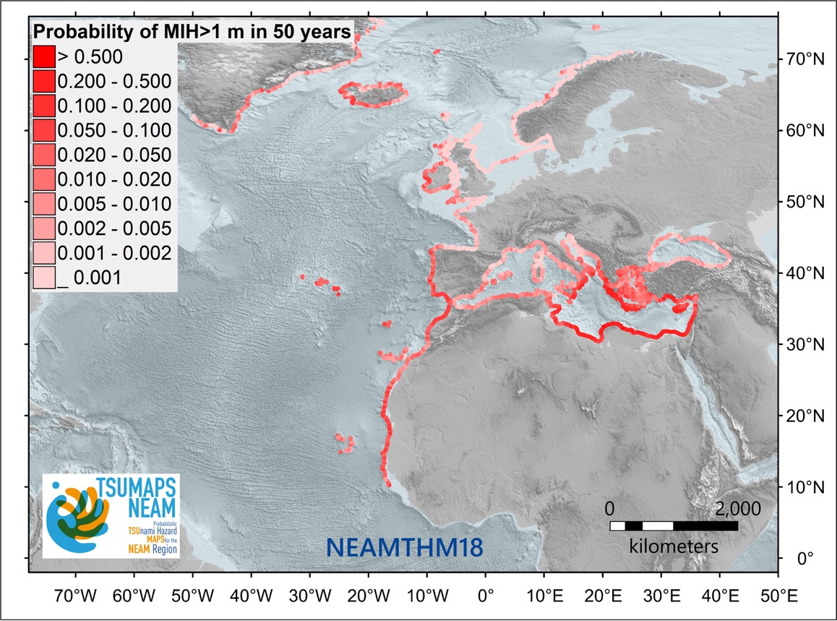
Probabilistic tsunami hazard assessment of the NEAM region: the NEAMTHM18 (Basili et al. 2021)
Probability of an earthquake-generated tsunami exceeding a maximum inundation height (MIH) of 1 m in 50 years evaluated every ~20 km on the NEAM region coastlines. The map was derived from the NEAM Tsunami Hazard Model 2018 (NEAMTHM18; Basili et al., 2021), which is a product of the TSUMAPS-NEAM project funded by the European Civil Protection and Humanitarian Aid Operations (DG-ECHO). For more details of the model, see http://www.tsumaps-neam.eu. The map presented here was produced with the best information available at the time of modelling. The accuracy of these maps is subject to limitations in the accuracy and completeness of available bathymetry and topographic information, and in the current knowledge of the tsunami sources and characteristics. In the last few years, MIHs greater than 1 meter have been observed during at least three earthquake-generated tsunamis (Kos-Bodrum in 2017, Crete and Samos in May and October 2020), which caused damage and one fatality.

Slide 8
PILLAR 2: Detection, Warning And Dissemination
Objective 2.1: Increase, densify and ensure sustainability of the seismic and sea-level detection networks, particularly to include regions/Member States with low coverage
Objective 2.2: Realise installation of multi-hazard observations systems composed of co-located tide-gauge/accelerometer/GNSS sensors
Objective 2.3: Plan and implement an “Inter-Operability Tool”
Objective 2.4: Develop and implement additional monitoring tools
Objective 2.5: Implement Probabilistic Tsunami Forecasting
Objective 2.6: Threat levels
Objective 2.7: Additional sources of tsunami observations

Slide 9
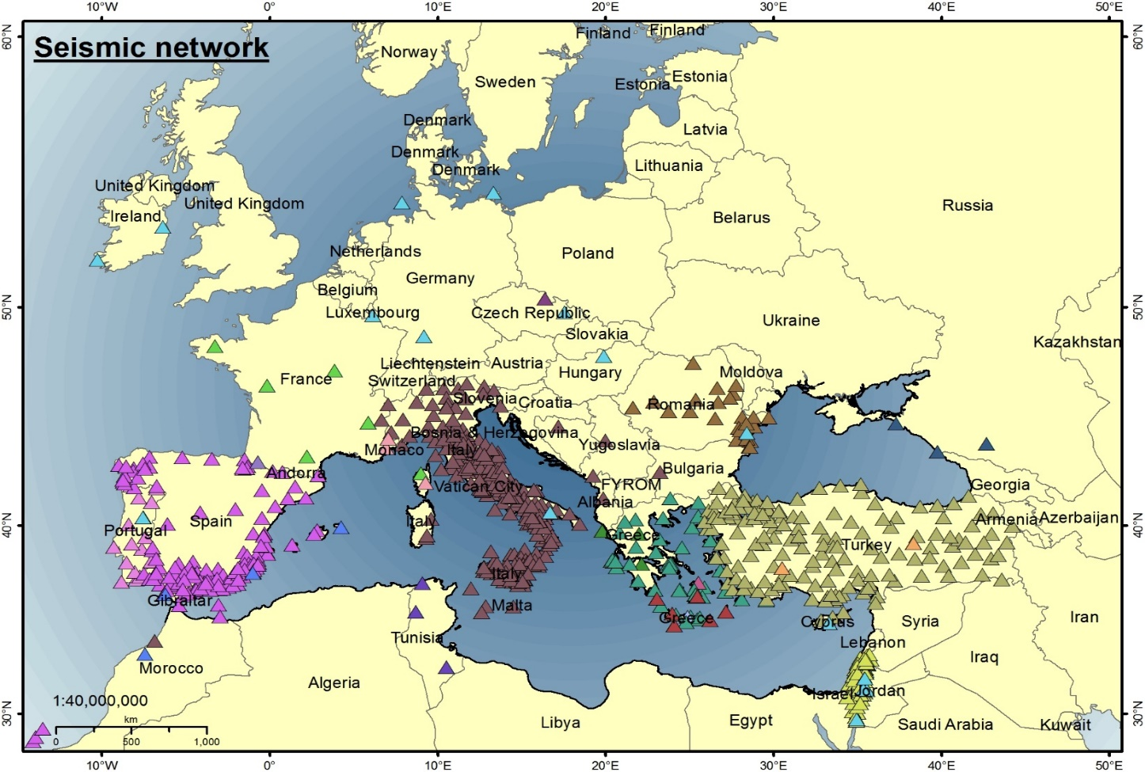
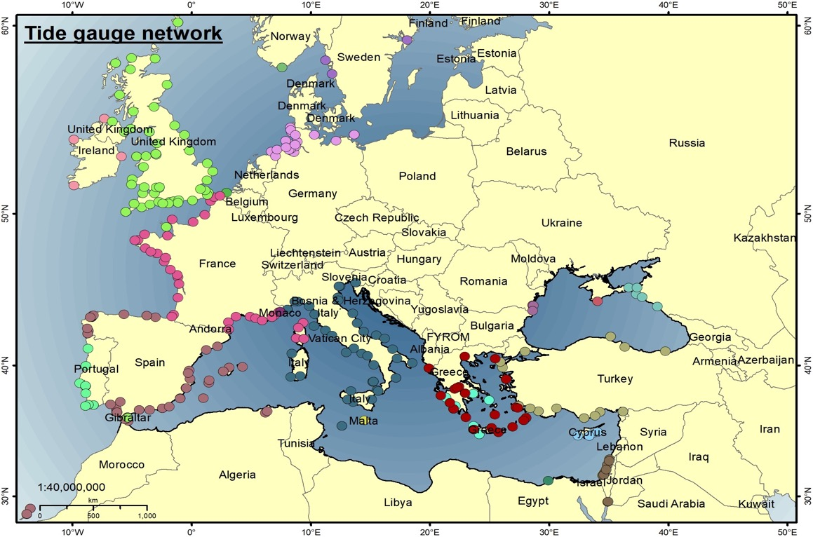
Improving seismic and sea level networks

Slide 10
PILLAR 3: Awareness and Response
Objective 3.1: Understanding perceptions of coastal hazards and risks
Objective 3.2: Strengthen public and local authority awareness of tsunami and associated hazards and how to prepare to respond
Objective 3.3: Develop tsunami-related curriculum programmes for all levels of education
Objective 3.4: Develop and deliver suitable and sustainable capacity-building programmes to facilitate effective and efficient response and coordination
Objective 3.5: Develop and maintain the NEAMTIC tsunami information website
Objective 3.6: Establish rapid and effective evacuation mechanisms given the risk assessment guidance and data
Objective 3.7: Develop and conduct regular exercises to test early warning systems and evacuation mechanisms
Objective 3.8: Roll out the “Tsunami Ready” initiative in coastal communities

Slide 11
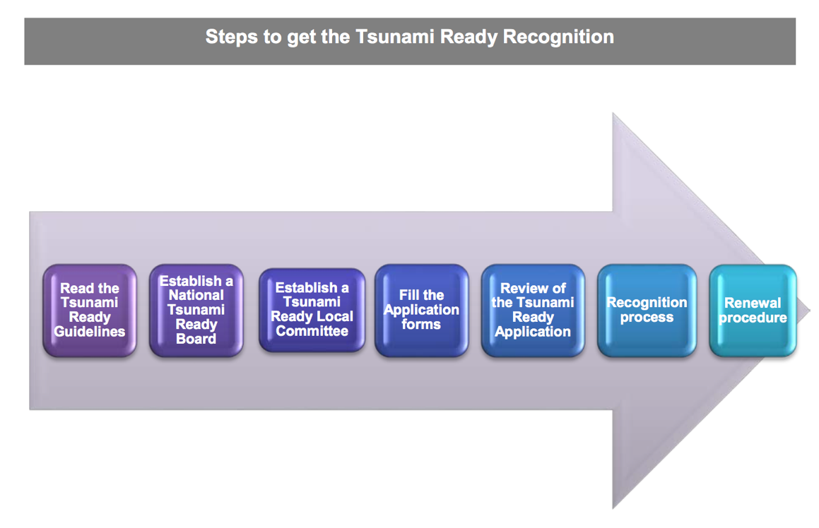
NEAMTWS Towards being Tsunami Ready
 | TSUNAMI READY INDICATORS | Date of evaluation:
 | Stage of achievement | Initial stage | Medium stage | Final stage
I | MITIGATION (MIT)
1 | MIT-1. Tsunami hazard zones are mapped and designated
2 | MIT-2. The number of people at risk in the tsunami hazard zone is estimated
3 | MIT-3. Available economic, infrastructural, political, and social resources are identified
4 | MIT‑4. Tsunami information is publicly displayed.
II | PREPAREDNESS (PREP)
5 | PREP‑1. Easily understood tsunami evacuation maps are developed.
6 | PREP‑2. Outreach and public awareness and education resources are available and distributed.
7 | PREP‑3. Outreach or educational activities are held at least 3 times a year.
8 | PREP‑4: A Tsunami community exercise is conducted at least every two years
III | RESPONSE (RESP)
9 | RESP-1. A community tsunami emergency operations plan (EOP) has been prepared
10 | RESP-2. The capacity to manage emergency response operations during a tsunami has been established.
11 | RESP-3. Redundant and reliable means to timely receive 24-hour official tsunami alerts have been identified.
12 | RESP-4. Redundant and reliable means to timely disseminate 24-hour official tsunami alerts to the public have been identified.
Several pilot communities in Italy, France, Spain, Greece, Turkey, Portugal…

Slide 12
3. PERFORMANCE MONITORING
The concept of performance monitoring and reporting is an approved element of the IOC Intergovernmental Coordination Groups for Tsunami Early Warning and Mitigation activities since 2015, when it was requested that all ICGs report to the IOC Governing Bodies on their performance against targets of the Sendai Framework for Disaster Risk Reduction 2015–2030.
Three sets of KPI:
Functions and Requirements defined in the ICG/NEAMTWS Procedures for the Accreditation of Tsunami Watch Providers;
Communication Test Exercise Performance Indicators defined by the TT-CTTE in 2012;
Operational Performance Indicators defined here by the TT-O in 2015, based on Performance Indicators defined by the Inter-ICG Team on Tsunami Watch Operations and presented in the Global Service Definition Document n. 130 (Intergovernmental Oceanographic Commission technical series, Tsunami Watch Operations, 2016).
ICG/NEAMTWS will develop and implement Key Performance Indictors (KPIs) similar to other ICGs based on the three key pillars, and also implement the TOWS–WG -XIV recommendation to include International Cooperation in its KPIs.

Slide 13
4. FOUNDATION ACTIVITIES
Interoperability
Among TSPs
With other ICGs (TOWS)
With other ocean hazards warning and mitigation systems
Sustainability
TSPs Countries, member States, ESFRI / EPOS / EMSO
Research
Building capacity
Implementation
Annual Plans of Action of the ICG/NEAMTWS WGs and TTs
TT on Operations guides the interoperability of the system (new OUG ongoing)

Slide 14
Thank you
Grazie
Merci
Gracias
Obrigado
Ευχαριστώ
Teşekkürler
شكرًا لك
ありがとうございました
多謝

