Slide 1
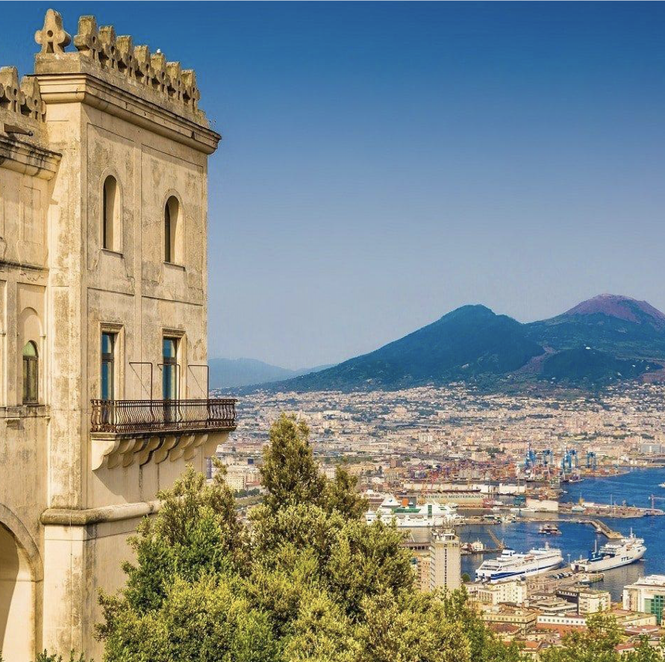
Working Group 4 Public Awareness, Preparedness and Mitigation Chair: Cecilia Valbonesi (University of Florence – INGV)
NEAMTWS Experts Meeting
Implementing NEAMTWS 2030 Strategy
Opportunities and Actions to Explore
28-30 Nov, Naples, Italy

Slide 2
PILLAR 3: Awareness and Response
Objective 3.1: Understanding perceptions of coastal hazards and risks
Objective 3.2: Strengthen public and local authority awareness of tsunami and associated hazards and how to prepare to respond
Objective 3.3: Develop tsunami-related curriculum programmes for all levels of education
Objective 3.4: Develop and deliver suitable and sustainable capacity-building programmes to facilitate effective and efficient response and coordination
Objective 3.5: Develop and maintain the NEAMTIC tsunami information website
Objective 3.6: Establish rapid and effective evacuation mechanisms given the risk assessment guidance and data
Objective 3.7: Develop and conduct regular exercises to test early warning systems and evacuation mechanisms
Objective 3.8: Roll out the “Tsunami Ready” initiative in coastal communities

Slide 3
Objective 3.1: Understanding perceptions of coastal hazards and risks
Webinar on Tsunami Risk perception in NEAM region, on 9 November 2022
Ongoing studies in different Countries:
Review paper on global+NEAM risk perception studies – to be prensented on 30 Noc 2022 (Cugliari et al., FRONTIERS in Earth Science, 2022)
CoastWAVE in several NEAM countries
New results from several Italian regions (NHESS in press) (Cugliari et al., 2022)
France: the TASAOMA project - https://arcg.is/0ifqmH, led between 2019 and 2021. 750 questionnaires on 6 communes in the French Mediterranean. The results are not published yet (M. Péroche).
Others?

Slide 5
Objective 3.1: Understanding perceptions of coastal hazards and risks
March 2023 ICG NEAM General Assembly:
1. Preparatory meeting (February 2023)
b. Collect and publish Astarte Project’s results on NEAMTIC
c. Share published scientific papers on NEAMTIC
d. Ask France (Hélène and Matthieu) more details about TASAOMA project;
e. Identifying someone in WG, TT and TSPs who report to NEAMTIC constantly about ongoing activities.
f. Make another survey in Municipalities after TR recognition (after 1-2 years)

Slide 6
Objective 3.2: Strengthen public and local authority awareness of tsunami and associated hazards and how to prepare to respond
Exercises and drills
NEAMWAVE 2023 (30 Nov. Presentation «The Next NeamWAVE exercise» (Marinos Charalampakis, NOA, Greece, Ceren Ozer Sozdinler, GTU, Turkey)
National/Local Campaigns e.g. «Io Non Rischio» in Italy
WTAD activities in different Countries
NEAM Secretariat presentation (30 Nov.)
SismaExe (D’Angelo 29 Nov.)
Translation into English of the document “Tsunami Risk Prevention in Italian Municipalities through the Application of Tsunami Ready Guidelines: Influences of the International Paradigm on the Regulatory Framework and Criminal Liability”

Slide 7
Objective 3.2: Strengthen public and local authority awareness of tsunami and associated hazards and how to prepare to respond
Translation and dissemination of TR Guidelines (especially the indicators) in other languages
Analyse different channels and means for a better institutional communications

Slide 8
Objective 3.3: Develop tsunami-related curriculum programmes for all levels of education
Prepare and share educational and informative modules on tsunami science and risks for different school levels (in different languages);
Make ad educational video based on Indian Ocean example
Update the existing tsunami comic book

Slide 9
Objective 3.4: Develop and deliver suitable and sustainable capacity-building programmes to facilitate effective and efficient response and coordination
CoastWAVE project (Secretariat)
Share the database of CoastWAVE
Tsunami Ready related activities (3.8)

Slide 10
Objective 3.5: Develop and maintain the NEAMTIC tsunami information website
Since the ICG/NEAMTWS XVII Session to now, 14 news articles and two videos (WTAD 2022 and African Ocean Conference 10-12 May 2022) have been published.
Contributions requested to TSP’s
See next slide

Slide 11
Objective 3.5: Develop and maintain the NEAMTIC tsunami information website
Define the new terms of reference (including TR programme) for NEAMTIC
Create a communication strategy, possibly in agreement with TSP’s strategies.
Create a TT on Communication (to be discussed)
To find a «key person» for each Country who can publish activities and report to WG4
5. Increase interaction with TSPs

Slide 12
Objective 3.6: Establish rapid and effective evacuation mechanisms given the risk assessment guidance and data
From Probabilistic Tsunami Hazard Assessment to evacuation maps (see Lorito and Di Manna presentation tomorrow)
Stromboli (INGV-UNIFI)
Increase interaction with WG1. Share, together with WG1 all the results on inundation mapping and define ways to allow its use by local authorities and people.

Slide 13
STROMBOLI
Ongoing studies to understand the risk perception of residents and tourists;
Improve information on tsunami risk on the island (Project);
Develop a multi risk approach (volcano and the tsunami).

Slide 14
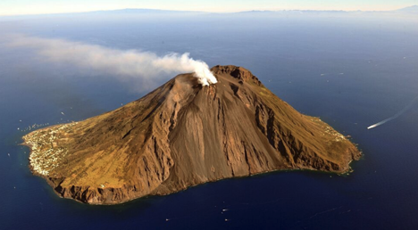
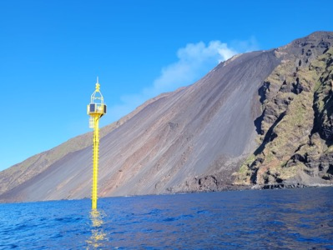
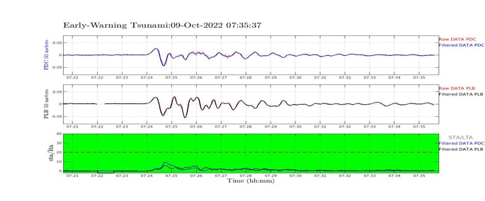
Sistema di Allerta tsunami locale a Stromboli (in collab. con UniFI)
Sciara del Fuoco
Elastic Beacon

Slide 15
Local tsunami alert system in Stromboli (in collab. With Univ. Firenze)
Sciara del Fuoco
Elastic Beacon

Slide 16
Objective 3.7: Develop and conduct regular exercises to test early warning systems and evacuation mechanisms
Monthly exercises by TSPs
Drills
WTAD
NEAMWave
Inform Secretariat in advance (two weeks) about future initiatives and report to the Secretariat in order to share information

Slide 17
Objective 3.8: Roll out the “Tsunami Ready” initiative in coastal communities
Establishment of the Task Team on Tsunami Ready - Co-chairs:Ignacio Aguirre Ayerbe (Instituto de Hidráulica Ambiental de Cantabria, Spain) and Elena Daskalaki (National Observatory of Athens, Greece)
Ongoing activities in several Countries (CoastWAVE)
Enhance the cooperation between WG4, TT on Tsunami Ready and CoastWAVE project in order to create a common framework for improving awareness and response.

Slide 18
Thank you
Grazie
Merci
Gracias
Obrigado
Ευχαριστώ
Teşekkürler
شكرًا لك
ありがとうございました
多謝

