Slide 1


Task Team on
Tsunami Exercise
Towards the preparation of
NEAMWave23
Co-chairs: Ceren Özer Sözdinler (Turkey)
Marinos Charalampakis (Greece)
NEAMTWS Experts Meeting - Implementing NEAMTWS 2030 Strategy Opportunities and Actions to Explore
28-30 Nov, Naples, Italy

Slide 2
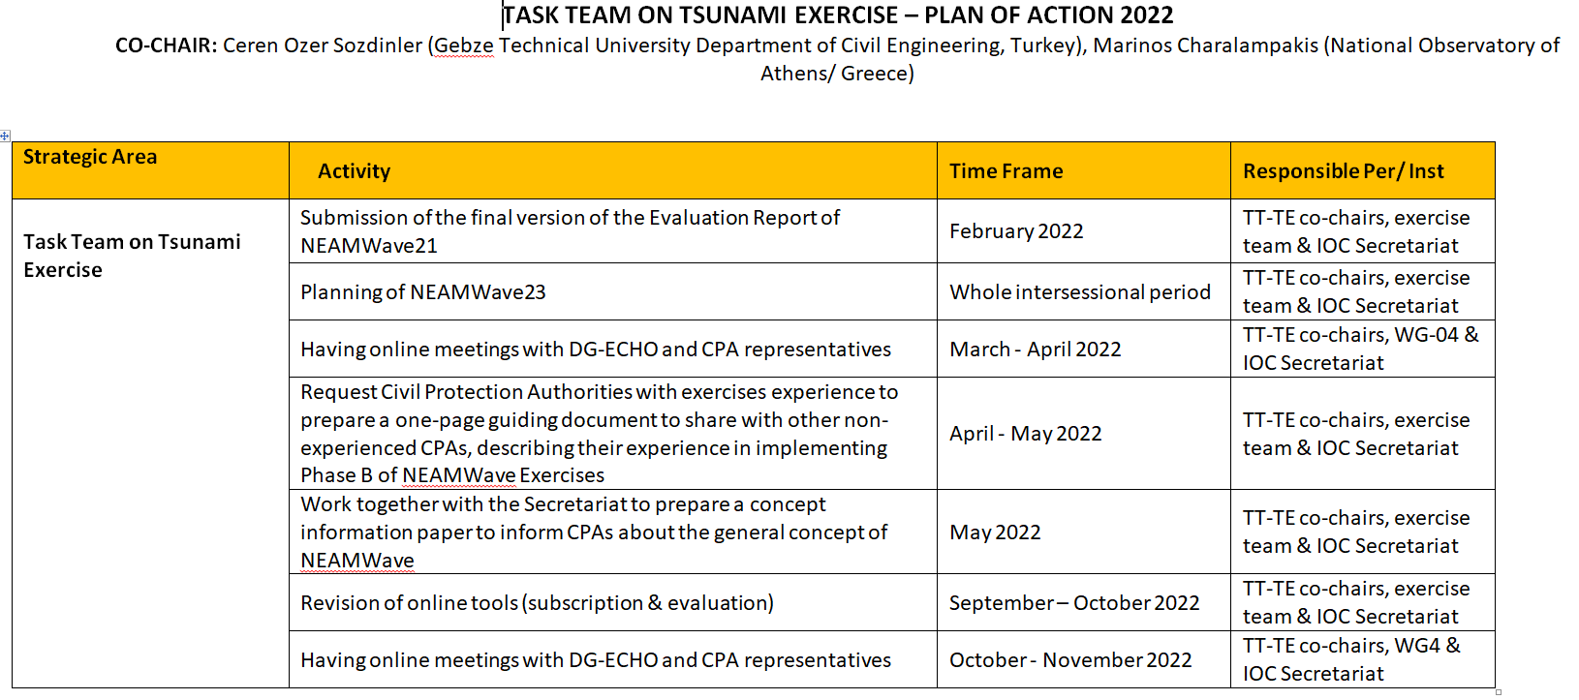
Plan of Actions

Slide 3
Ongoing Actions
The NEAMWave23 is planned to conduct in November or early December 2023.
TT-TE will start the preparation of NEAMWave23, especially the exercise scenarios, without waiting the official decisions.
A lot of preliminary work has to be done in advance, including the finalization of the scenarios, since there will be not enough time left from the ICG in March/April 2023 till November.

Slide 4
Ongoing Actions
Engaging as many CPAs as possible in the NEAMWAve exercises:
TT-TE is preparing informative material (like concept papers, best practices etc) to share with the national CPAs, as well as online meetings with the CPAs co-organized with the European Civil Protection Mechanism.
  Request Civil Protection Authorities to prepare a one-page guiding document to share with other non-experienced CPAs, describing their experience in implementing Phase B of NEAMWave Exercise

Slide 5
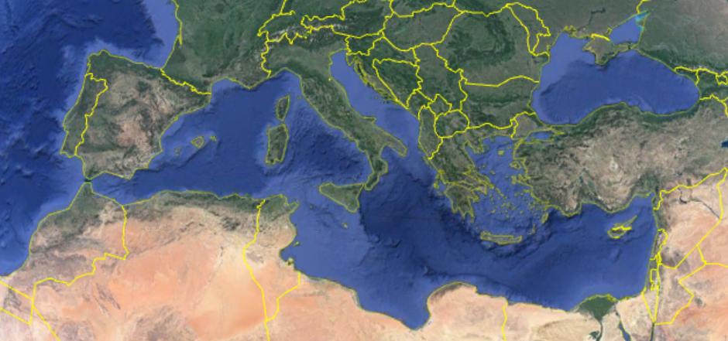
Decisions
IPMA and CENALT intend to make a joint scenario in NE Atlantic in the frame of COASTWave project (Spain, Morocco).
INGV-NOA-KOERI are willing to have a joint scenario in the Mediterranean Sea as a 3TSP joint scenario for the first time (Cyprus, Greece, Egypt, Malta?).
The countries can decide either they will make the NEAMWave23 as a COASTWave action or not.
The exercise team members will be decided in the next ICG. However, TT-TE will start the preparation of NEAMWave23 by contacting the TSPs. representatives till the ICG.
Name | Country | Institute
Pascal Roudil | France | CEA/CENALT
Nikos Kalligeris | Greece | NOA
Fabrizio Romano | Italy | INGV
Fernando Carrilho | Portugal | IPMA
Beatriz Gaite | Spain | IGN
Ocal Necmioglu | Turkey | KOERI (now JRC)
NE Atlantic
Mediterranean

Slide 6
Future Actions
Revision of online tools
Having online meetings with DG-ECHO and CPA representatives
Finalization of concept paper to distribute CPAs
Preparation of Scenarios in collaboration with TSP representatives

Slide 7
Timeline
New timeline for NEAMWave23
to be updated

Slide 8


*
NEAMTWS Experts Meeting - Implementing NEAMTWS 2030 Strategy Opportunities and Actions to Explore
28-30 Nov, Naples, Italy

