Slide 1
WTAD 2022
Minturno municipality
Tsunami Ready candidate

Slide 2
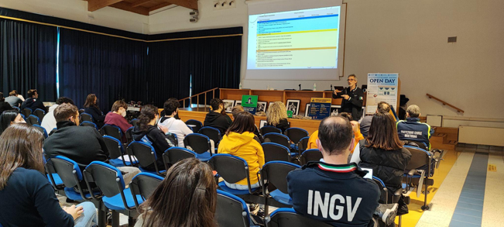

Slide 3
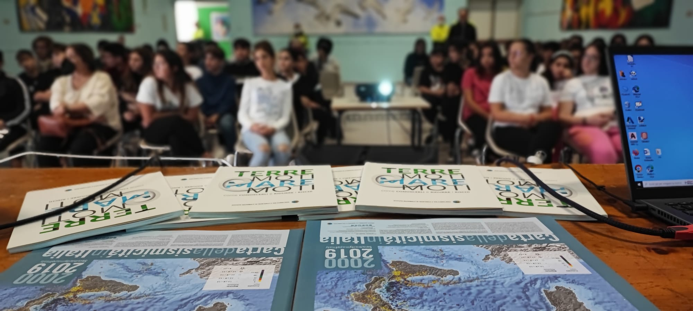

Slide 4
