Slide 1
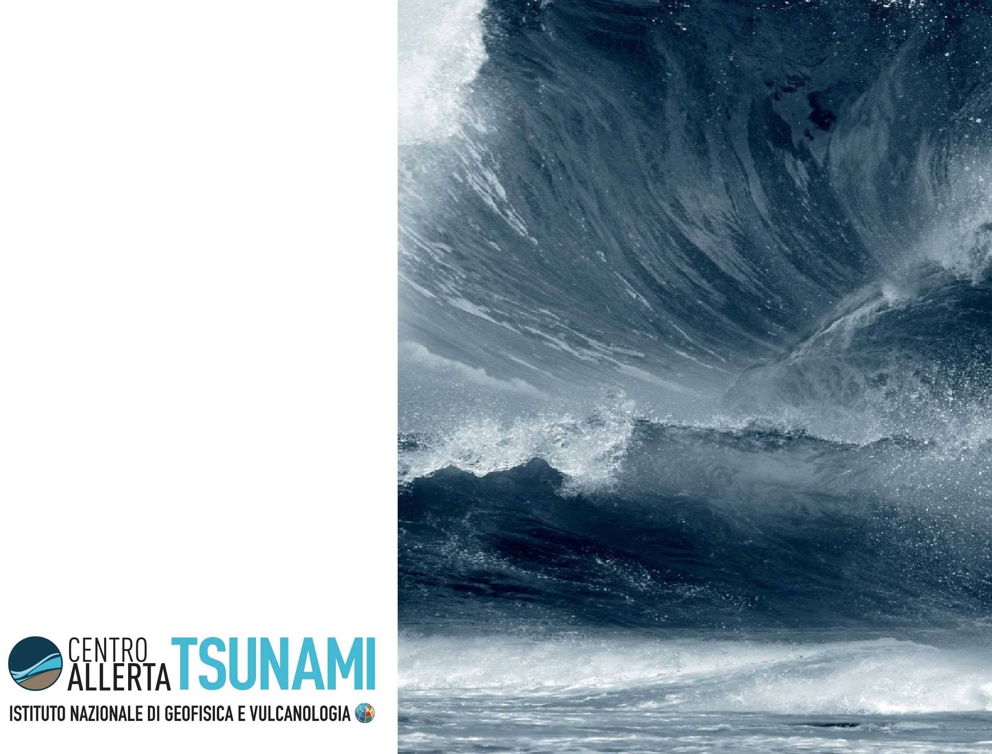
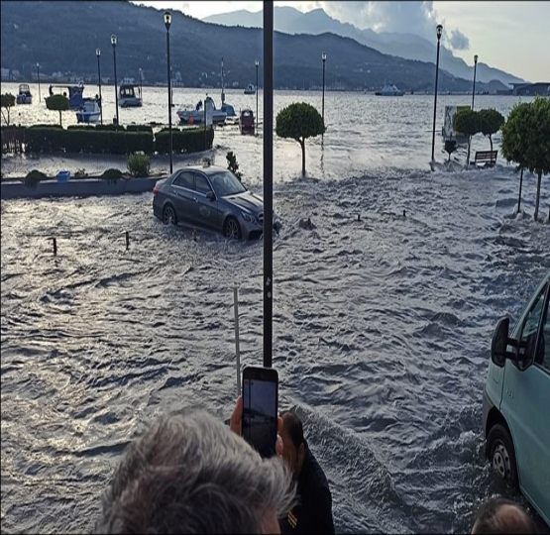
Tsunami risk perception
state-of-the-art
and
studies in the
NEAMTWS region
Notes:
First of all, and before to go through the tsunami risk perception, as previously mentioned by colleagues, I would like to thank you all for this fondamental meeting and also thank those who are following us via the web.

Slide 2
The interaction and integration between the social and hard sciences in the Mediterranean context
Natural science
(engineering, physics, geology, informatics, etc.)
Social science
(communication, sociology, psychology etc.)
Studies of active and capable faults
Modeling of tsunamigenic sources
Structural vulnerability studies
PTHA/PTRA
PTF
High Performance Computing
Analysis of the historical sources
Social analysis of territorial contexts
Studies on tsunami risk perception
Qualitative and quantitative assessment of tsunami knowledge and risk
Source of knowledge analysis
Cross-disciplinary knowledge available
Availability of multidisciplinary data and population information
Increased computational speed for a prompt community response
Addressing tsunami hazard in different socio-territorial contexts to mitigate the risk associated with lack of knowledge, preparedness and awareness in high uncertainty framework.
Notes:
The co-presence of social sciences and natural sciences in such an important meeting is indicative of an increasingly close collaboration between different disciplines in a single framework and with a single purpose like the mitigation of the effects that a tsunami could cause on the coasts of our countries and the commitment to raise awareness among the citizens who increasingly live in or frequent coastal areas but also of the tourists who stay for short periods in seaside locations.

Slide 3
No tsunami mitigation without studies on population
A key to mitigating tsunami risk effectively
Human behavior is driven by perceptions (Slovic, 1987) rather than scientific knowledge about "facts" (Renn, 1990).
Therefore, it becomes strategic for those involved in risk mitigation and communication to ground their strategies on data from in-depth studies on the process that influences our ability to assess the risk of different natural phenomena (Slovic, 1982) including tsunamis.
Community studies
Knowledge (informations)
Awareness
Preparedness
Mitigation
Notes:
I would start this brief presentation of our study on tsunami risk perception in the NEAM Region with this spot title.
“NO TSUNAMI MITIGATION WITHOUT STUDIES ON POPULATION”
It is not possible to effectively mitigate tsunami risk without studying and knowing the coastal community on which to intervene.
In fact, population studies provide the knowledge as information characterizing the local population, which facilitates the building of preparedness processes to increase awareness.
Therefore, human behavior is driven by perceptions that becomes strategic for those involved in risk mitigation and communication, to have in-depth studies on the process that influences our ability to assess the risk of a natural phenomenon like tsunamis

Slide 4
The increase in tsunami-related population studies.
Following the 2004 Indian Ocean tsunami, there has been a general increase in people-oriented tsunami studies.
A key boost:
Different losses by contexts due to different behavioral responses.
Different reactions due to cultural issues, knowledge preparedness and awareness of the phenomenon and warning systems in place.
We need more information about the population:
More robusts information, of various types, enables the development of more effective targeted interventions and policies.
The information collected, with mixed methodologies (standard and qualitative), facilitate the implementation of bottom-up, shared and more accepted interventions by local communities.
Notes:
1 - The 2004 Indian Ocean tsunami prompted tsunami studies, in particular people-oriented studies
2 - Why it happened? Because, in the different territorial contexts affected by the tsunami were observed different reactions by the population related to local cultural aspects, knowledge of the phenomenon, and warning systems in place.
3 - So, studying tsunami risk perception in coastal communities is of fundamental importance for example to reduce the lack of empirical data on the population in the NEAM area, to analyze and understand how citizens perceive tsunami risk and in specific contexts, as we have seen for Stromboli to assess tourists' knowledge of the context to find out the differences in perception according to some essential variables such as environmental and territorial, social and psychological context.
In order to have a wider overview of the state of the art of the existing literature on tsunami risk perception, with my colleagues Andrea Cerase e Alessandro Amato thought to condense the article into a paper review to provide an easy-to-use tool(like a toolbox) where to find useful insights and information for future studies. A specific article that was not already available. In the next slides I show some emerged outputs.

Slide 5
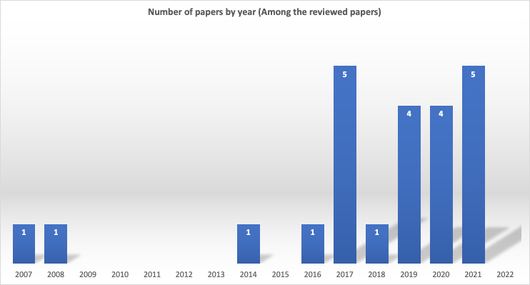
Time distribution of the studies
?
Notes:
This bar graph shows the global distribution of publications on tsunami risk perception. One among the paper outputs we conducted with.
We look forward to the data for this year but will not stop at this point because ongoing literature review is important for developing up-to-date local policies that use the right time-contextualized communication channels. And here I link back to one of the insights that emerged yesterday during the parallel session of WG4 as told by Cecilia yesterday. i.e., the need to plan an effective communication strategy that takes into account the most widely used communication channels such as social networks.

Slide 6
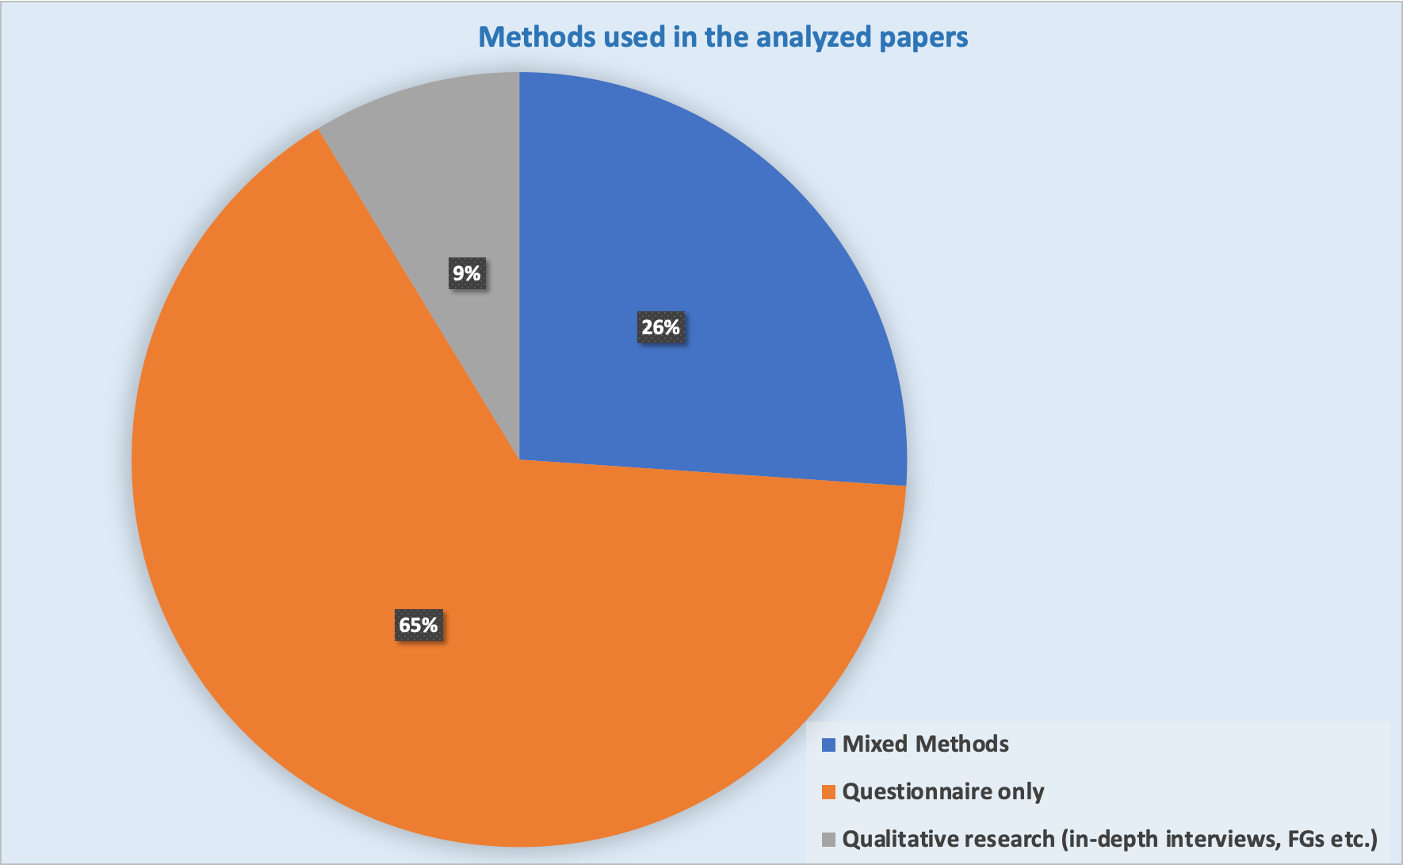
Methodologies distribution of the surveys
Questionnaire survey
65% of the analysed papers used the questionnaire tool
Mixed methods
26% used the Mixed methods
Qualitative methods
9% used Qualitative methods
Notes:
Here we see the survey methodologies used in the studies.
Questionnaire survey is the most used method to collect data.
26% used Mixed methods (based on the integration of both quantitative and qualitative tools integrating both quantitative and qualitative methods such as surveys with qualitative method such as “in-depth interviews”; “focus groups”; “document analysis”; “GIS data” and so on
9% of analysed papers used Qualitative methods that may provide valuable information on community perception and understanding.

Slide 7
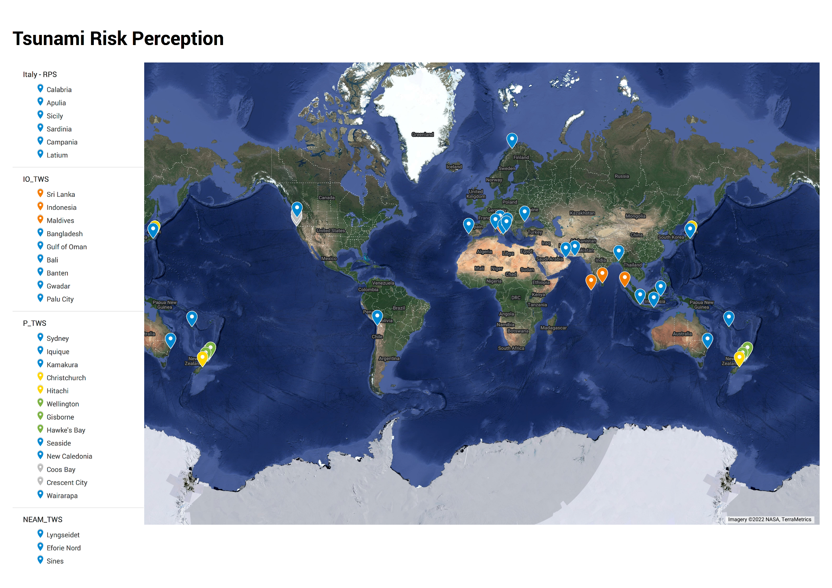
Global distribution of studies about tsunami risk perception
Seven surveys with focus on the Indian Ocean (IOTWS)
Ten surveys with focus on the Pacific Ocean (PTWS)
Six surveys with focus on the Mediterranean Sea (NEAMTWS)
(Cugliari et al., 2022)
Notes:
An international overview shows a rather fragmented distribution of publications. Most scientific publications are focused in the Pacific Ocean (PTWS). Next is the Indian Ocean and then comes us in the NEAM area with 6 presentations.

Slide 8
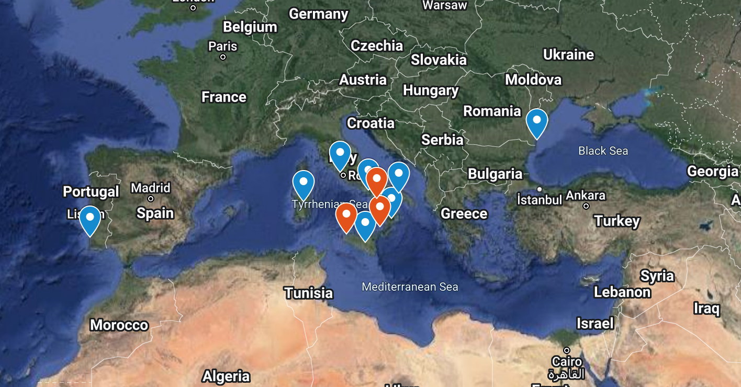
and in the NEAMTWS context.
Notes:
Focusing on the studies carried out in the NEAM area: the first studies were carried out during the European Project ASTARTE (started the November first of 2013) following, from 2018 started the study in Italy, which is not yet finished and will include several expansions experimenting also different methodologies in the near future and to conclude I think Denis will illustrate it better in a little while, there will be the study conducted for the COASTwave project which will cover other areas. The checkmarks on the map indicate the sites where surveys have been conducted to date (meaning we have population data for those sites).

Slide 9
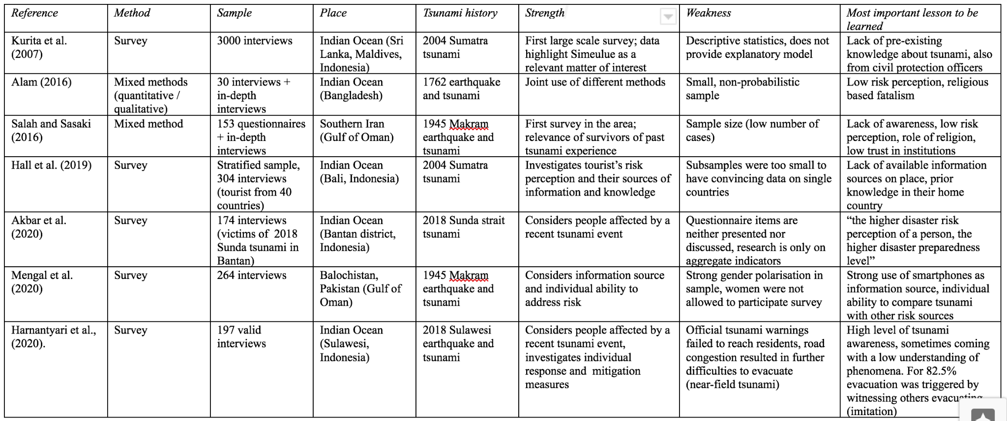
A summary table
Notes:
Here we have a sketch of the summary table in the paper that highlights some of the key expects that I just described to you - I cannot show the 23 papers in a slide BUT..
It is interesting to explore and certainly work on the aspects highlighted in the final 3 columns (Strength, weakness and most important lessons to be learned).

Slide 10
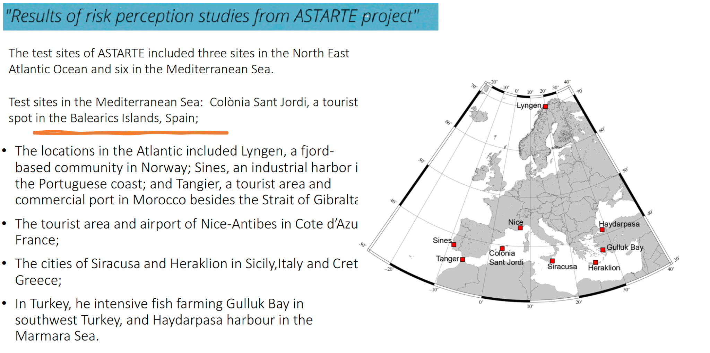
ASTARTE project in NEAM region

Slide 11
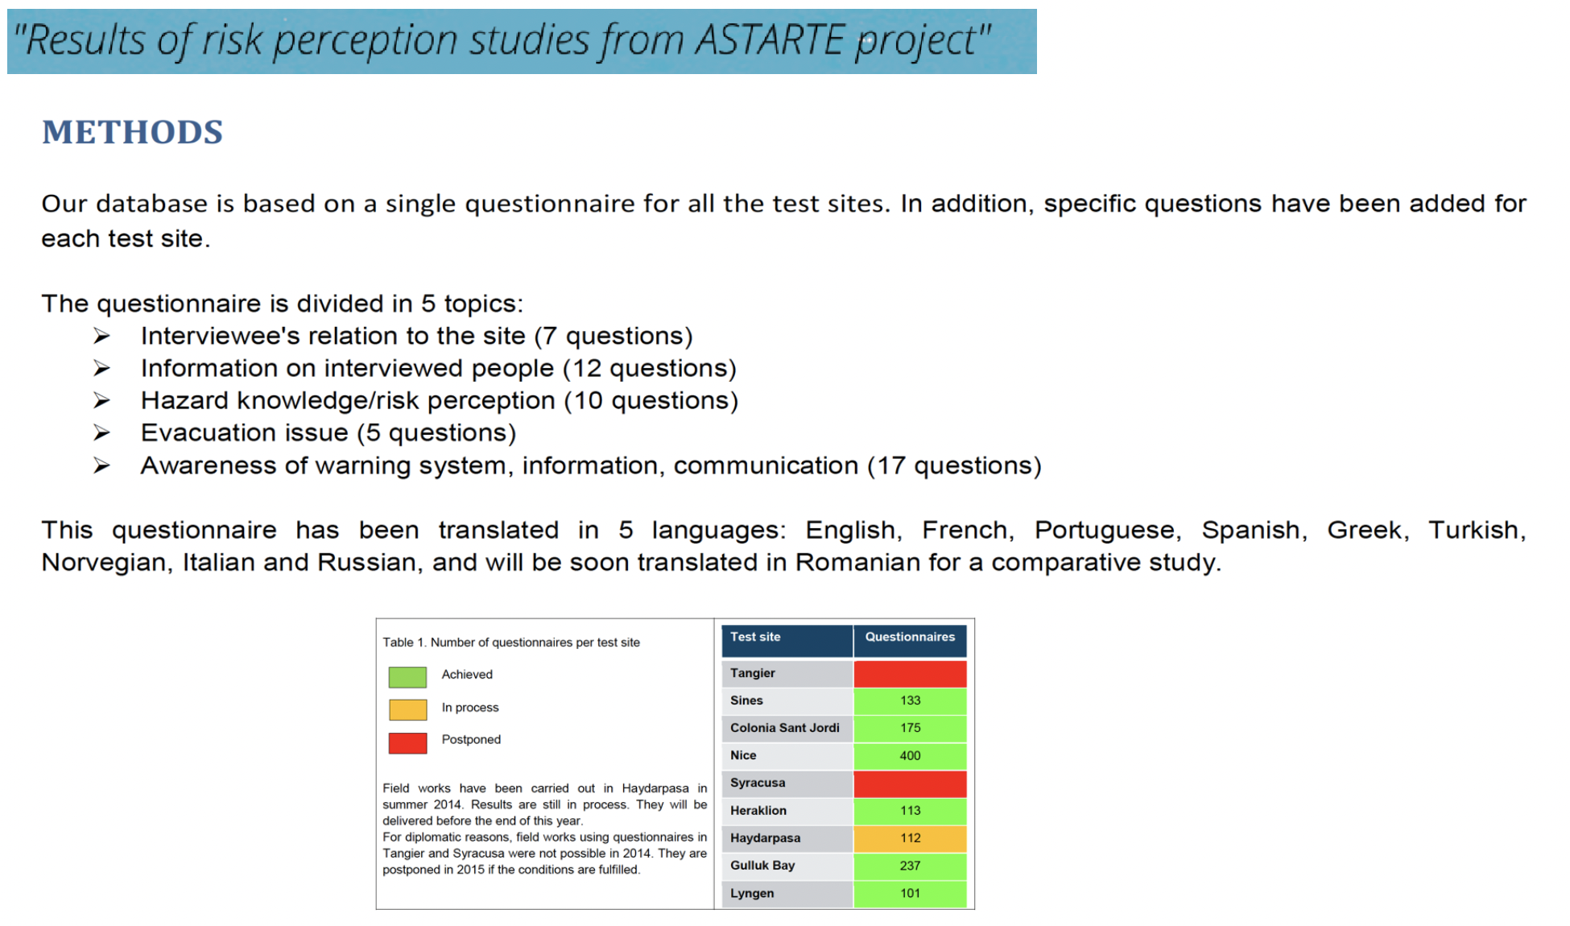
ASTARTE project in NEAM region
Notes:
IERI DURANTE LA SEZIONE PARALLELA DEL WG4 SI E PENSATO AI DATI

Slide 12
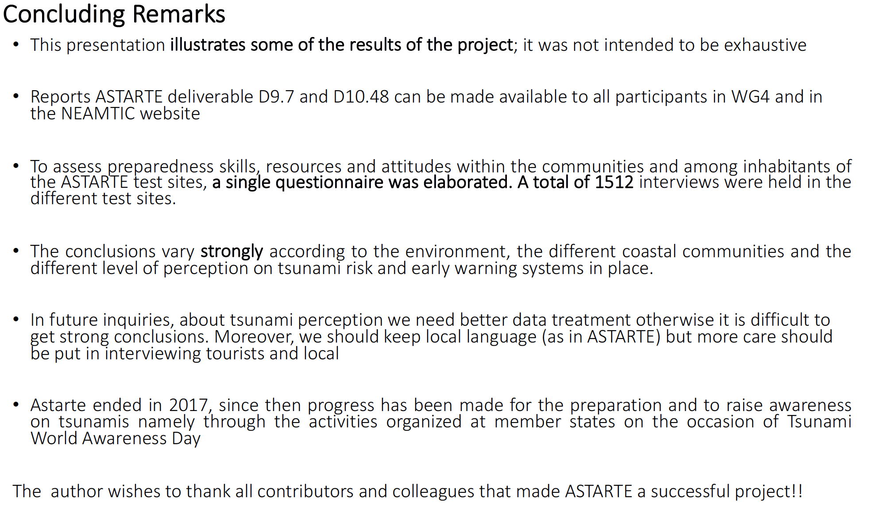
ASTARTE project in NEAM region

Slide 13
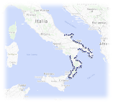
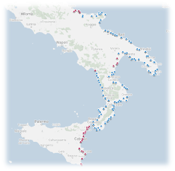
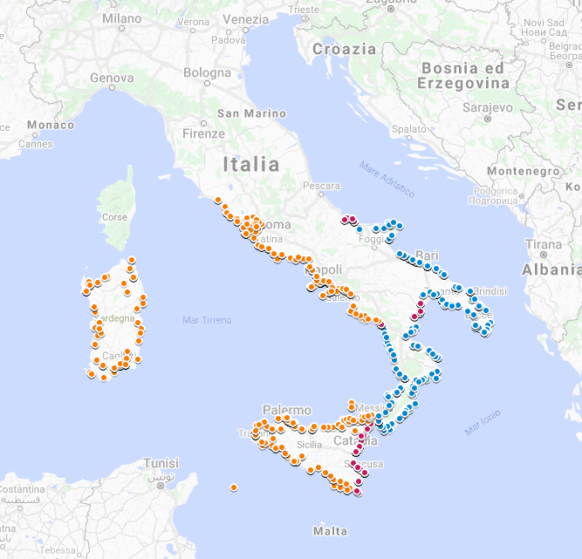
Tsunami Risk Perception in Central and Southern Italy
Blue shows interview distribution in the first phase of the survey
Red shows interview distribution in the second phase of the survey
In yellow, interview distribution in the third phase of the survey
2018
2021
2020
III^Phase (December 20/January 21)
Lazio
Campania
Sicilia
Sardegna
4207 CATI questionnaire
1500 Telepanel (national sample)
Preliminary analysis pres. @EGU 2021
(Cugliari et al.2021)
I^Phase
Calabria
Puglia
1021 questionnaire
Paper su NHESS (Cerase et al. 2019)
II^Phase
Eastern Sicilia
Ionian and Tyrrhenian Basilicata
Molise
614 questionnaire
Presentation of preliminary analysis and results at EGU 2020 (Cugliari et al.2020)
Notes:
In Italy, the INGV Tsunami Alert Center has been promoting the tsunami risk perception study since 2018. To date, we have conducted 3 survey phases through the administration of a structured questionnaire consisting of 5 sections and 27 questions to a representative sample of the population living along the coasts of 8 regions.
Here is the detailed distribution of interviews collected by CATI methodology (Computer assisted telephone interviews) by landline phone and implemented by cell phones in the three survey phases: 2018-19-21. The questionnaires were administered in coastal municipalities in 8 regions of Italy. The dots on the right map show the distribution of the three survey phases.
The first survey phase, carried out in 2018 covered Apulia and Calabria - 1021 questionnaires were collected.
The second survey phase, 2020 covered Molise, Basilicata and Eastern Sicily - 614 questionnaires were collected.
The third survey phase, 2021 covered Latium, Campania, Sardinia, southern and northern Sicily - 4,207 questionnaires were collected
We are planning the fourth phase to complete the coverage of the national coastal territory including a qualitative research for in-depth analysis
––––––––––––––––––––––––––––––––––––––––––––––––––––––––––––––––––––––––––––––––––––
Ecco, mostriamo la distribuzione delle interviste raccolte con metodologia CATI nelle tre fasi d’indagine: 2018-19-21. I questionari sono stati somministrati nei comuni costieri di 8 regioni italiane. I punti della mappa di destra mostrano la distribuzione delle tre fasi d’indagine.

Slide 14
The questionnaire
SECTION 1:
SOCIO-DEMOGRAPHIC DATA AND INFORMATION ON RESPONDENTS’ BELONGING TERRITORY
SECTION 2:
LEVEL OF AWARENESS AND SOURCES OF KNOWLEDGE ABOUT TSUNAMI HAZARD
SECTION 3:
CONTEXTUAL PERCEPTION OF TSUNAMI HAZARD
SECTION 4:
REPRESENTATION OF TSUNAMIS
SECTION 5:
CULTURAL ATTITUDES AND WORLDVISION
SECTION 6:
MESSAGES AND CHANNELS TO SPREAD TSUNAMI ALERT
Consisting of 6 sections and 27 items that allow us to detect respondents' opinions regarding tsunami knowledge, risk perception, representation, cultural attitudes toward risks and through which channels respondents have been informed about tsunamis and would like to receive an alert in case of tsunami.
Notes:
As a survey tool we used a questionnaire validated in Australia by Bird and Dominey-Howes in 2008 and used in other similar survey contexts for example in Pakistan by Mengal et al. to study tsunami risk perception in a district in the south of the country exposed to tsunamis that could be generated by the Makran Subduction Zone.
The questionnaire was drafted in a simple and non-technical language so as to be easily understood by lay people without any knowledge of seismology, geology, physics and related fields.

Slide 15
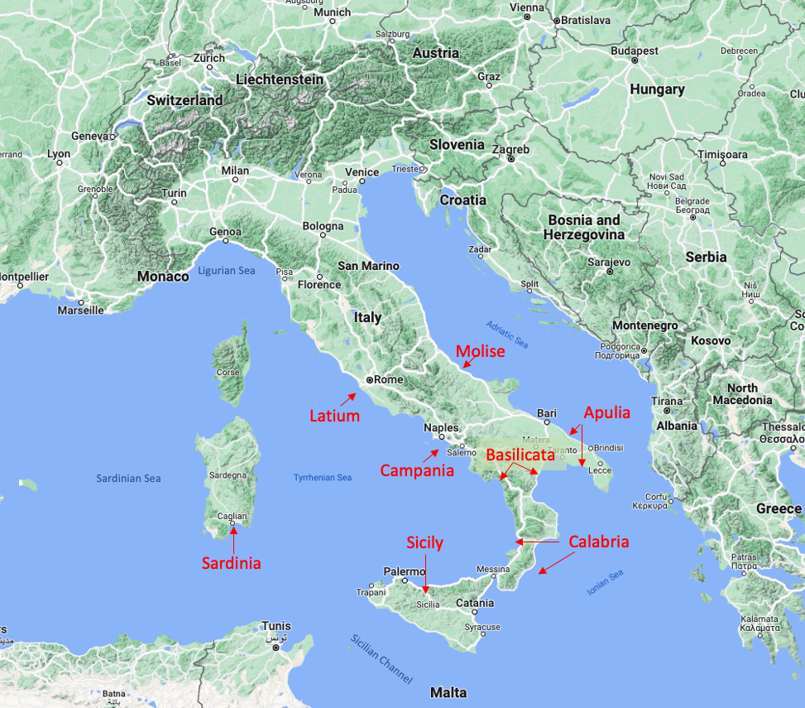
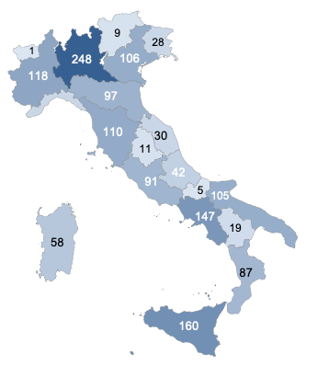
Italian regions surveyed Telepanel (National wide sample)
The sample was built in multiple waves, through a modular sample structure, between 2018 and 2020. In addiction a national survey using a telepanel was carried out in 2021.
Notes:
In the first image we show the regions where the CATI questionnaire was administered - in total 5,842 interviews, in the second one, we show the telepanel survey in total 1,500 interviews.
In fact, in the third survey phase a parallel survey of 1,500 interviews was carried out on the national territory using a telepanel, a selected group of respondents with characteristics similar to the national average population, to build a control and comparison sample.
Telepanel was used as a national control sample so we have also the tourists' opinions, from people who don't live on the coast.

Slide 16
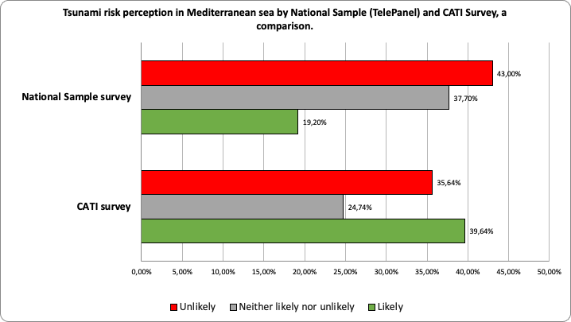
Global comparison with national and coastal survey
Notes:
The graph shows a comparison between the tsunami risk perception detected through the CATI survey and the perception detected through Telepanel to the national sample distributed throughout Italy.
The percentages show a higher perception by those living in coastal municipalities opposed to a low perception detected by the national sample.
The National Sample survey becomes of primary relevance to also investigate the risk perception of the population not living in coastal areas who might face this risk in a summer vacation context even in non-national territories. Moreover, these data can be considered representative of the national mean related to the tsunami risk perception and may be used for comparison with data related to the same specific groups of population living on the coasts.

Slide 17
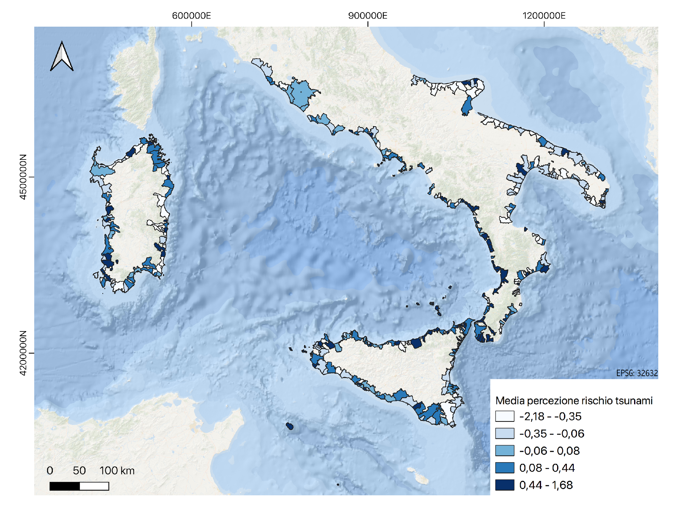
Municipality level: Tsunami risk perception in coastal municipalities
Adriatic Sea
Sardinian Sea
Tyrrhenian Sea
Ionian Sea
Notes:
In some coastal municipalities, for example in Calabria, there is a good degree of historical memory associated with the strong earthquakes and tsunamis that occurred in the past. This memory is alive and is celebrated in local rituals, often connected to religious events such as the one in Soriano Calabro where Our Lady of the Flagellum is venerated to remember the victims of the 1783 earthquake and tsunami. A very strong earthquake that changed the appearance of the territory.
Also in some villages in Eastern Sicily from Messina to the Val di Noto, for example, the Virgin of the Chain, who saved the population from the earthquake, is venerated. This specific aspect will be discussed by Andrea Cerase.
In this map, colors are associated with the tsunami risk perception index, dark blue higher, white lower.
What I would still like to emphasize is the importance of having indexed and detailed information by municipality. This makes targeted and more effective mitigation interventions possible.

Slide 18
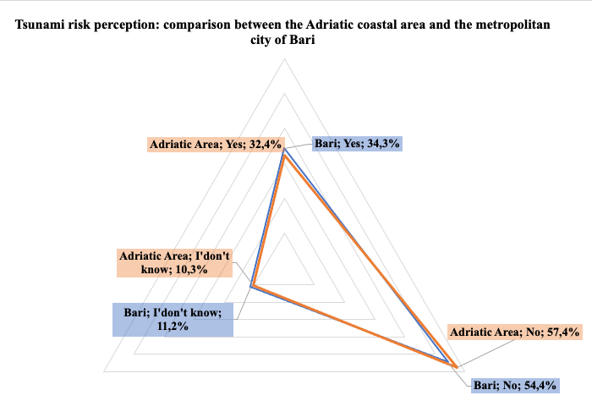
Area comparison level:
Adriatic coastal vs metropolitan city of Bari
Notes:
Comparisons with various cities are published in the article recently published in NHESS by Cugliari et al. Here I show some relevant comparisons.
For example: the average risk perception for the metropolitan city of Bari is low, in line with the Adriatic coast. where about 34 percent of respondents believe that a tsunami could hit their municipality, versus 32 percent of those residing in municipalities on the Adriatic coast.
The perception results appear to be low compared with the estimated hazard for the southern Adriatic coast and Bari metropolitan city, which is medium/high as we can see in TSUMAPS project by Basili, et al.
The estimated hazard takes into account the strong earthquakes occurring along the Hellenic arc, able to generate tsunamis that would hit the Adriatic coasts including Bari.
But…the low tsunami risk perception may also be influenced by the absence of recent tsunami events

Slide 19
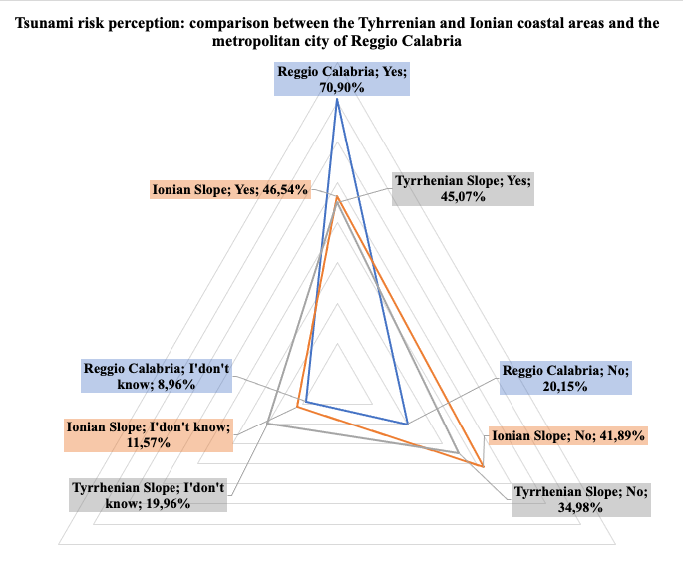
Area comparison level:
Tyrrhenian and Ionian coastal areas vs metropolitan city of Reggio Calabria
Notes:
The situation is different for Reggio calabria city where The tsunami risk perception is on average high.
In fact, the graph shows that about 71% of respondents believe that the city may be hit by a tsunami compared to the average of about 46% of respondents living in the Ionian sides’ remaining municipalities (Remaining because we removed data from the analyzed cities from the coastal data) and 45% of those living in the Tyrrhenian sides’ municipalities.
This percentage could indicate that residents of the metropolitan city of Reggio Calabria have a greater tsunami risk knowledge of their area, compared to the other metropolitan cities considered in the analysis. The high tsunami risk perception is likely related to the 1908 tsunami, which had a strong impact on the territory, causing widespread damage and about 2,000 casualties.
The same regions were also struck by a tsunami in 1783 that, according to historical sources, caused about 1,500 casualties

Slide 20

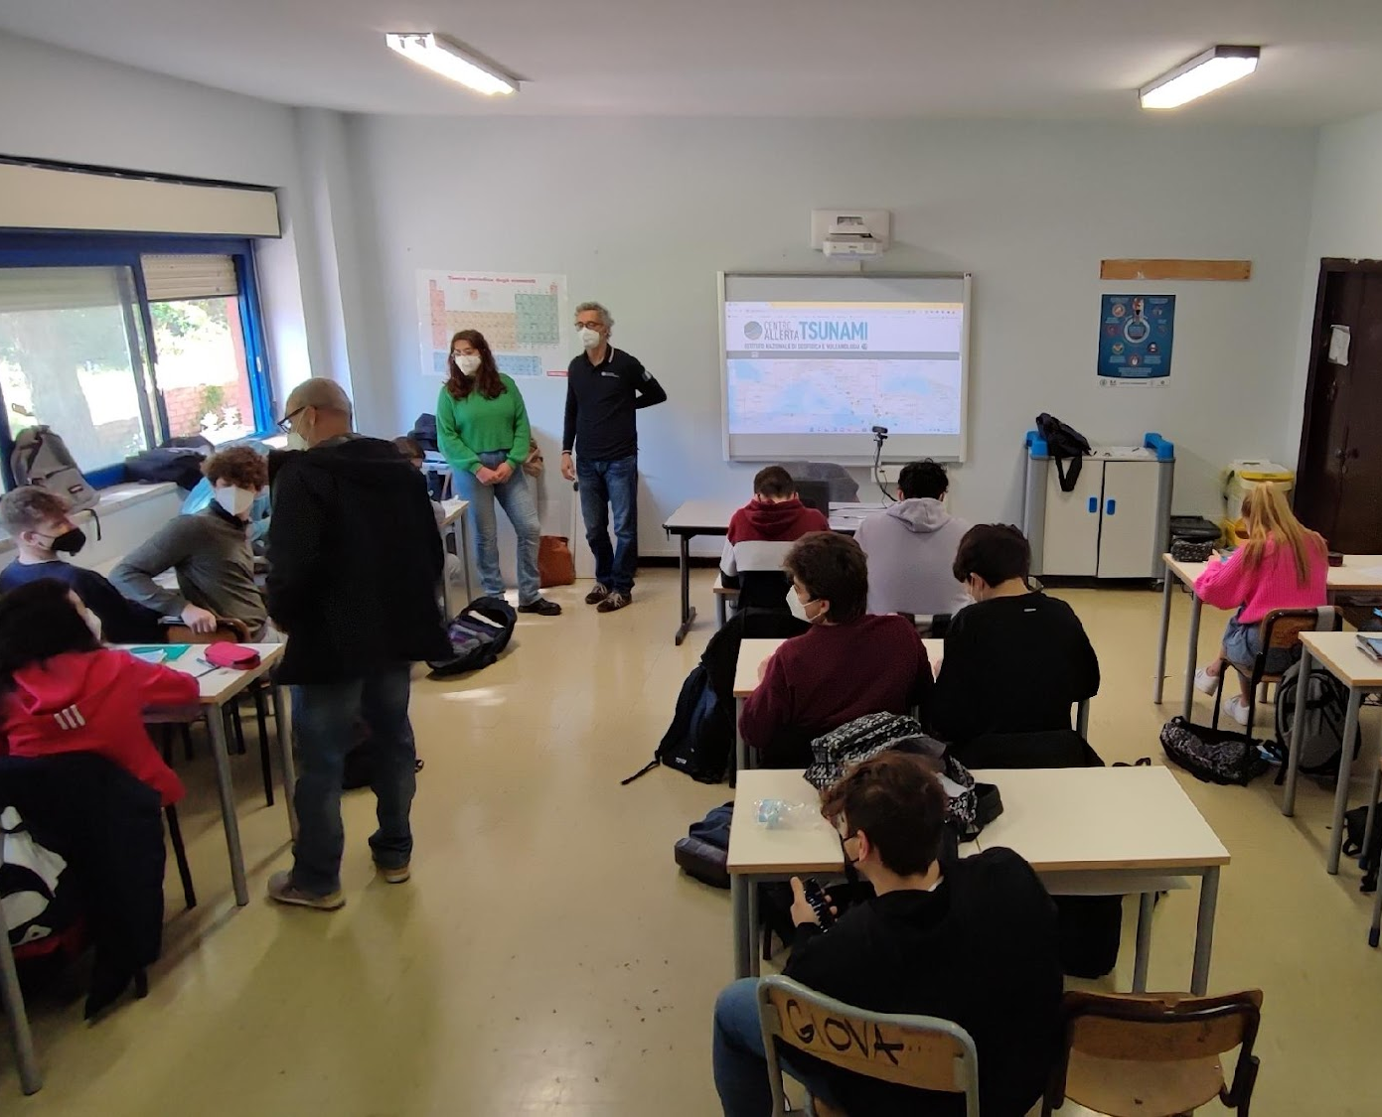
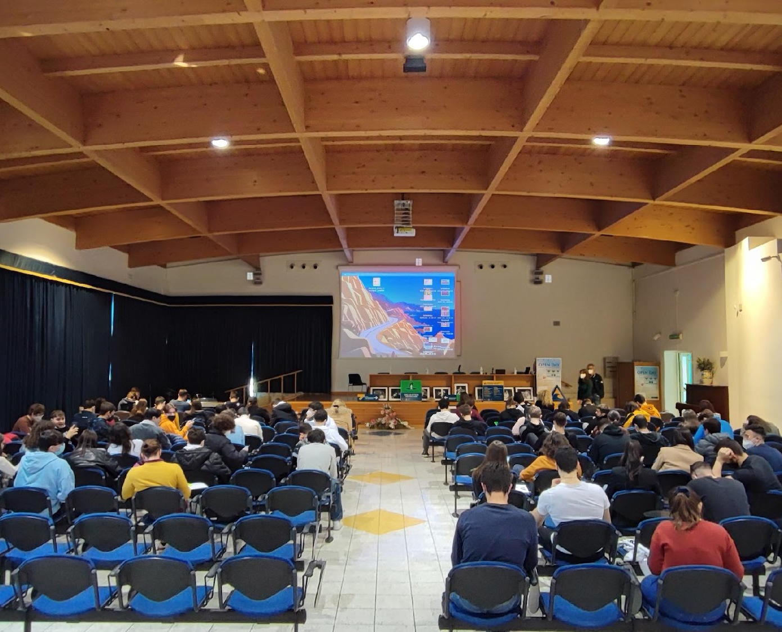
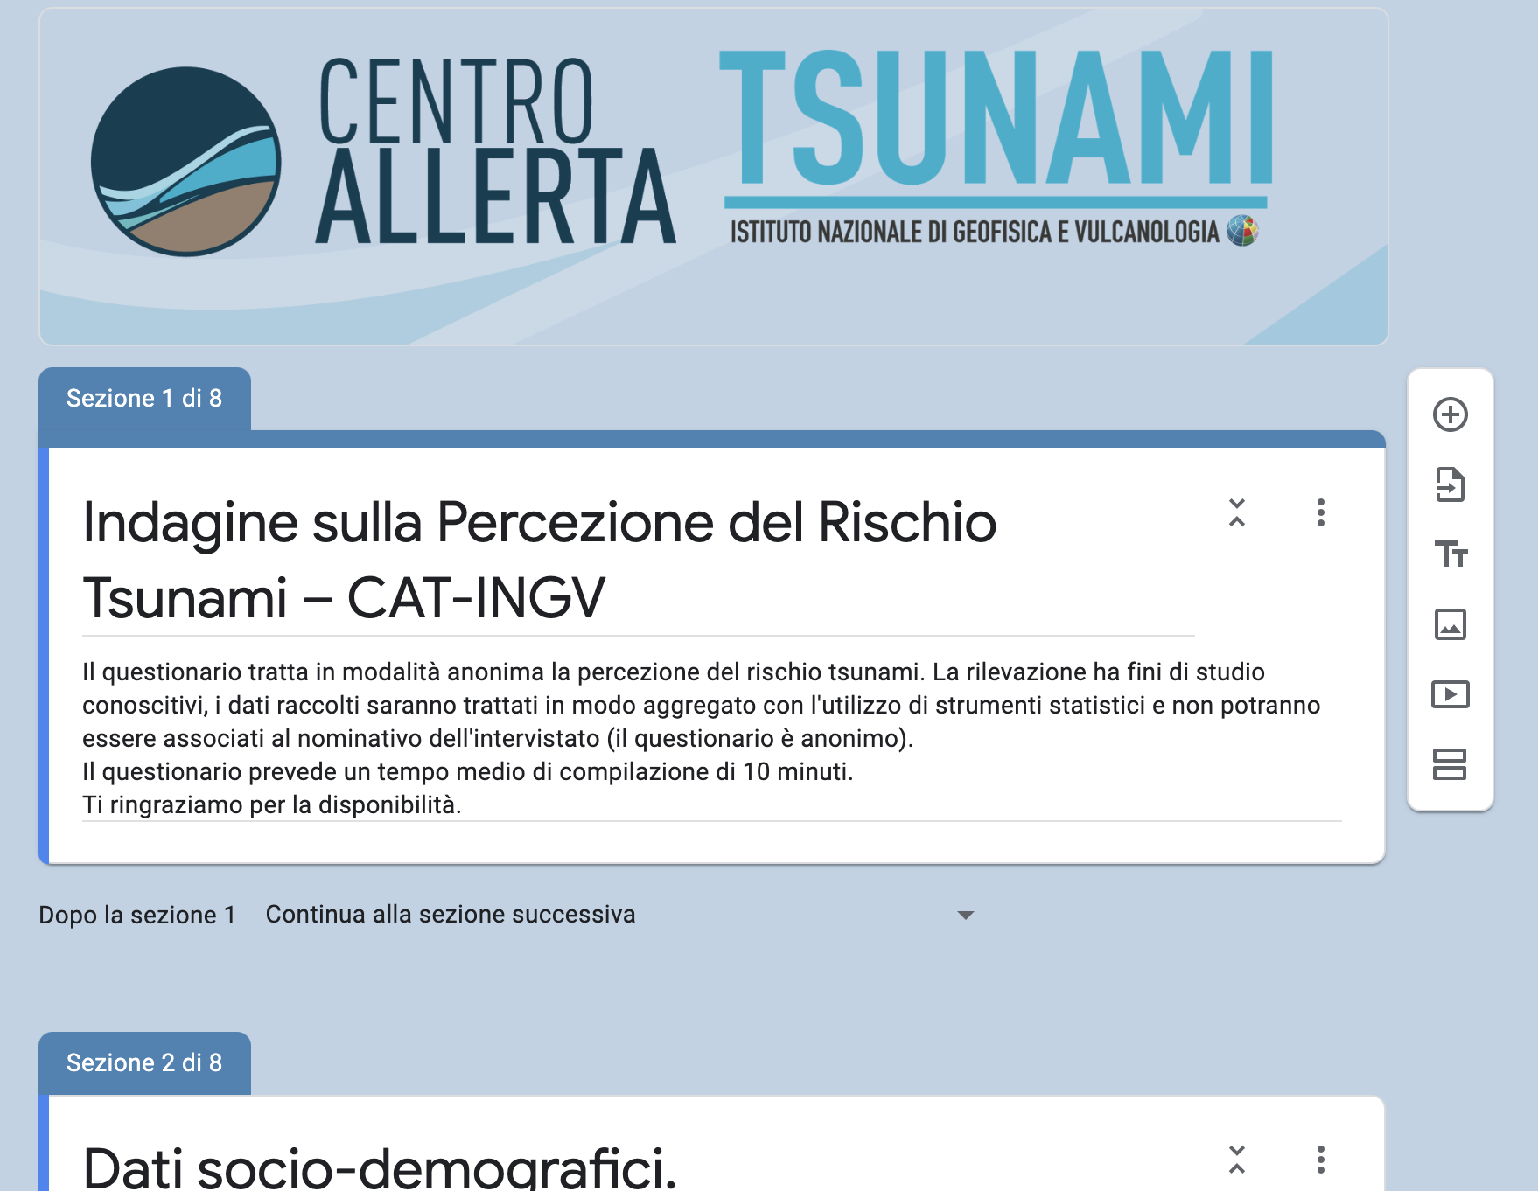
Awareness raising activities
Tsunami Risk Perception in School 2022
2022 - Online questionnaire on Google Form
Suitable version for school administration
81 Questionnaires collected in Minturno (Joining Tsunami Ready Program)
94 Questionnaires collected in Tivoli (Risk perception study pilot school)
Tivoli (RM) Classroom
Minturno (LT) Main hall
On Line questionnaire
Notes:
This year we included the online questionnaire and administered it in a pilot school in Tivoli a municipality near Rome. Actually in this school we do an interesting experiment. We administered the questionnaire a first time, then we conducted a lesson on tsunamis, and later we conducted another survey. In this way we evaluate the efficacy of our intervention a month or so later.
Minturno, on the other hand, is one of three Italian municipalities joining the tsunami ready program and, pictured is the main hall of a scientific high school where we carried out one of the activities included among the indicators to achieve the tsunami ready municipality title.
The online questionnaire, will soon be introduced on the Tsunami Alert Center website, also in English, to easily collect anonymous data on tsunami risk perception in different contexts.

Slide 21
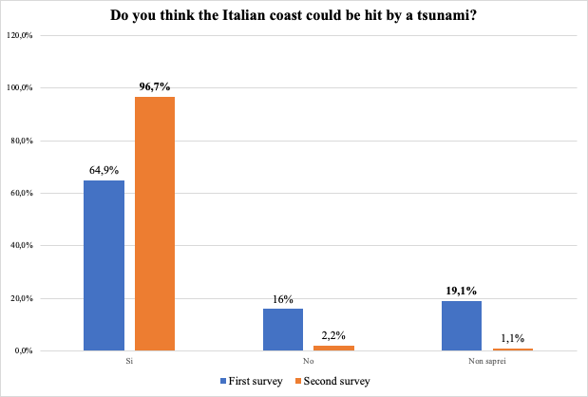
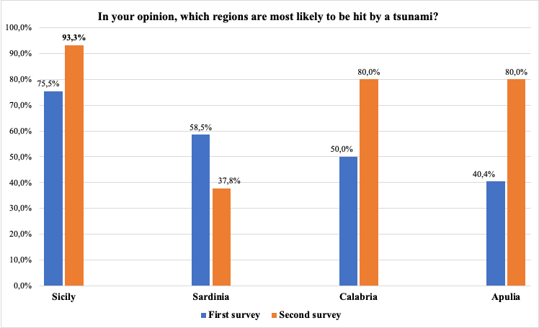
Awareness raising activities
Tsunami Risk Perception in School 2022
Notes:
We preliminarily analyzed the frequencies of responses found in the two administrations at Tivoli High School of Science. Before class (blue bars) and after class (orange bars).
The second questionnaire was administered a bit more than a month after the lesson conducted by INGV researchers at the school, and the results are satisfactory. After the lesson, the students showed greater tsunami risk perception in Italy and showed that they learned the regions that could easily be hit by a tsunami.

Slide 22
8 starting points to take in account
Low consideration of tsunami risk by people living in the coastal areas.
Tsunami risk is not homogeneously perceived even within the same community.
Tsunami risk perception is both related to psychological features of individuals and local cultures.
The “small” tsunamis are strongly underrated.
The term tsunami, depending on territorial contexts, is often associated with different magnitudes of the same phenomenon.
The importance of memory in people’s perception of tsunami risk.
Recognize the “natural signs” preceding and accompanying a tsunami.
The importance of broadcast media, mainly TV, as the main information source for people (New Zealand, Italy, Romania, Norway), and as one of the preferred ways to receive alert messages.
Notes:
What is emerged from the analysis of these papers? 8 starting points to take in account to consciously address future tsunami risk perception surveys. 8 useful points as a cue for future survey focuses.
•Among the generally emerged elements are certainly the low consideration of tsunami risk by people living in the coastal areas, independently from the region of the world and from the frequency of past tsunamis.
•Tsunami risk is not homogeneously perceived even within the same community, as it is affected by different socio-demographic variables such as gender, age, education level, average income and presence of child in the household/family as well as hazard proximity and social memory of past events.
•Tsunami risk perception is both related to psychological features of individuals and local cultures.
• In many regions the risk posed by “small” tsunamis is strongly underrated.
• Depending on different territorial contexts, the use of the term “tsunami” (as known, a Japanese language term) and of other terms traditionally used in the local language, such as for instance “maremoto” in Italian and Spanish, or "flodbølge" in Norwegian is often associated with different phenomena that are often partially representative of the same phenomenon.
• The importance of memory in people’s perception of tsunami risk. In this sense, the need for frequent drills has emerged in several areas as important tools for stimulating the response of citizens towards the tsunami risk.
• The recognized importance of the so-called “natural warnings” that come before or along tsunami events, and the need to make people aware of them.
• Another element emerging from some of the studies analyzed here is the importance of traditional media, mainly TV, as the main source of information for people (New Zealand, Italy, Romania, Norway), and as one of the preferred ways to receive alert messages.

Slide 23
COSTWAVE PROJECT AND MULTIRISK SURVEY
Notes:
COASTwave project will soon start with an interesting and extensive multi-risk survey that will also capture tsunami risk perception but I think Denis will tell us more about that later.
In the meantime, I leave the word to Andrea Cerase for an interesting focus on the area affected by the 1908 tsunami.

