Slide 1



SMART Cables
for monitoring PT Mainland-Azores-Madeira region
Fernando Carrilho
NEAMTWS Experts Meeting
Naples, 28-30 November 2022

Slide 2
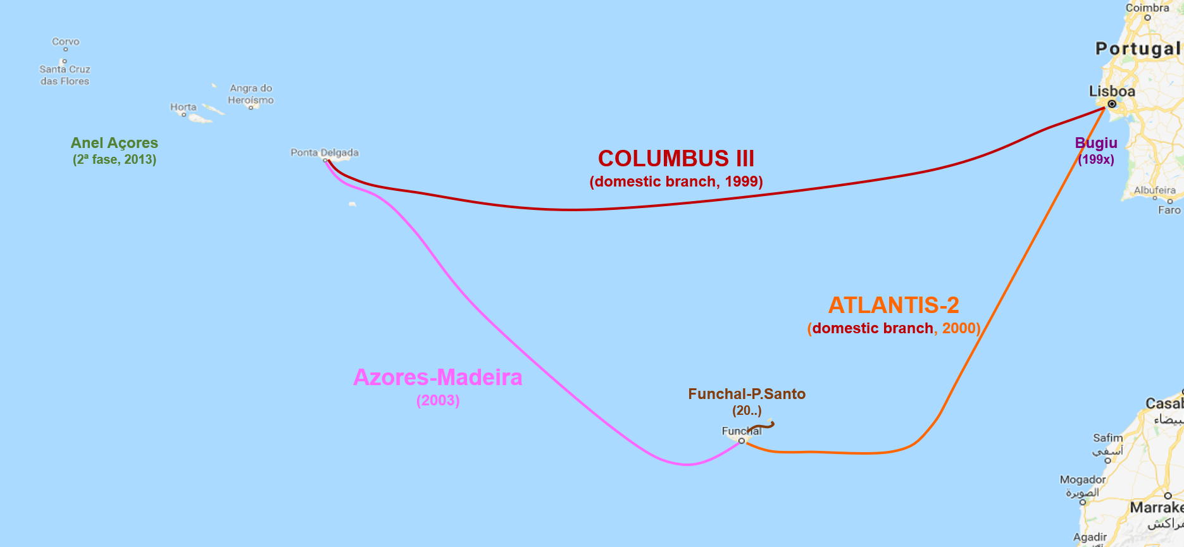
Present situation

Slide 3
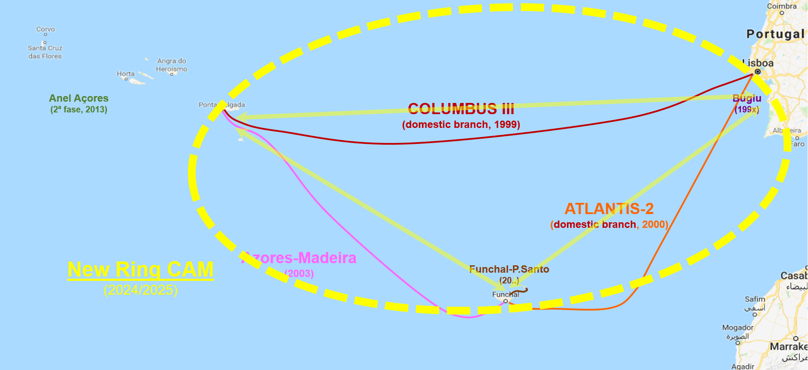
New PT Mainland-Azores-Madeira Ring of submarine cables (CAM)

Slide 4
LEA – Listening to the Earth Under the Atlantic
An initiative of IT, IPMA, and IDL, inspired by the vision of ANACOM on SMART cables and the CAM ring.
IT: Instituto de Telecomunicações
IPMA: Instituto Português do Mar e da Atmosfera
IDL: Instituto Dom Luiz [at the University of Lisbon]
Working together on seismological sensing with submarine cables since July 2018.

Slide 5
Opportunity
Deployment of the new CAM ring by 2024/2025, in the PT EEZ.
Portuguese state and ANACOM request additional services on the new infrastructure, namely public services for civil protection and scientific research.
Opportunity to attach geophysical sensors and other environmental sensors to the submarine telecommunication repeaters/cables
Advantages
Real-Time data allowing early warning for earthquakes and tsunamis
Power supply: permanent
Cost marginal, between 5% to 10% of the infrastructure
Coverage: wide coverage of relevant area of Atlantic (repeaters every 70/80km)

Slide 6
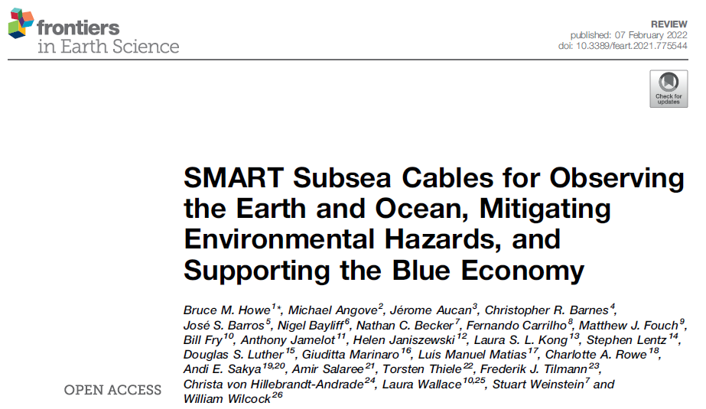
SMART stands for Science Monitoring and Reliable Telecommunications
The SMART approach to the geophysical monitoring of the oceans has been proposed and defended for more than 15 years by JTF, a Joint Task Force led by three U.N. agencies (ITU, WMO and UNESCO-IOC), Howe et al., 2019.

Slide 7
For SMART cable is important to keep unchangeable the current existing structure of the RfT document for a telecom submarine cable . It should be considered:
Telecom Submarine Cable System Part
Observer Part
Instrumentation Minimum set (JTF) Accelerometer Absolute pressure gauge Temperature sensor Additional sensors Broadband seismometer Hydrofone | Data aquisition/transmission: Resolution: 24bits Format: miniseed Protocol: seedlink

Slide 8
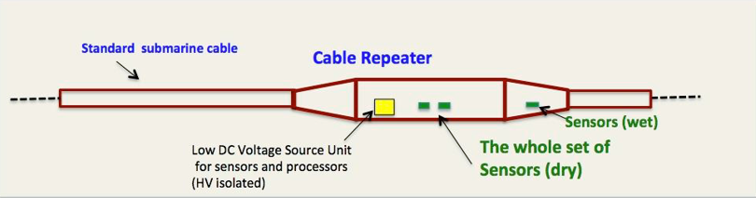
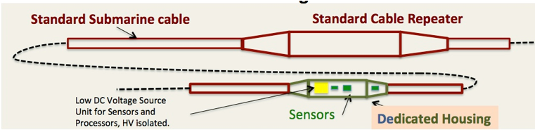
Possible configurations ....

Slide 9
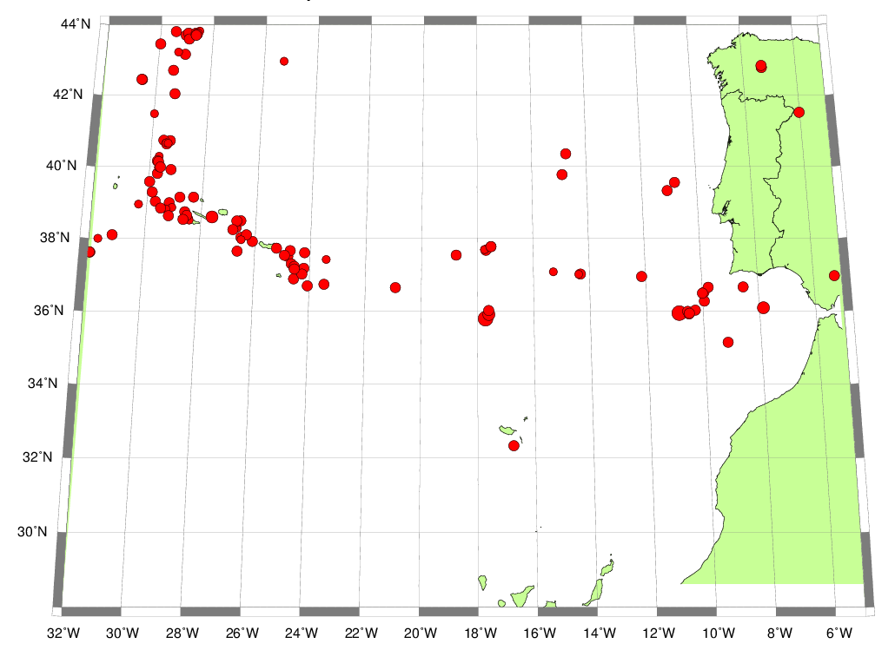
Seismicity 1961-2021, Mag>5.0

Slide 10
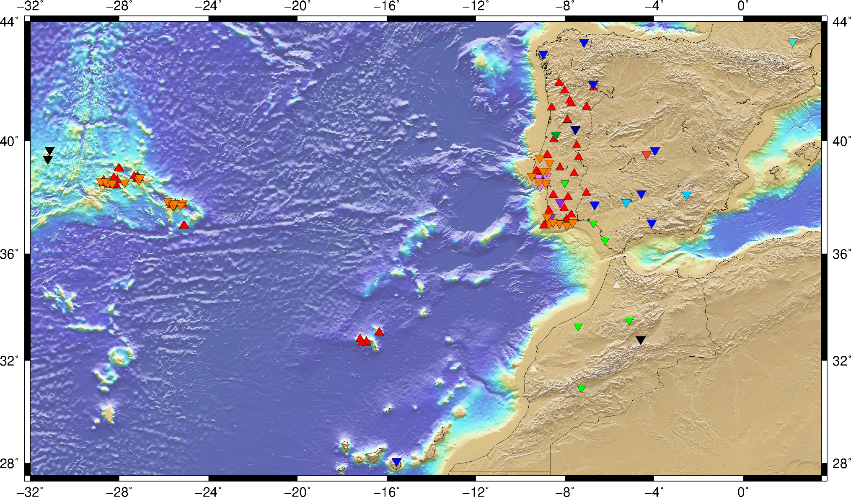
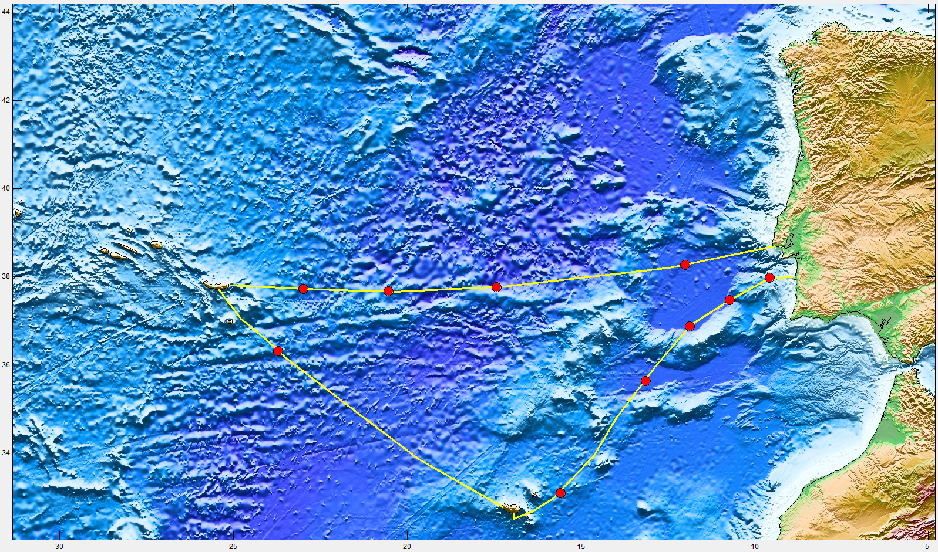
Regional Seismic Network
Scenario – 10 new sensors

Slide 11
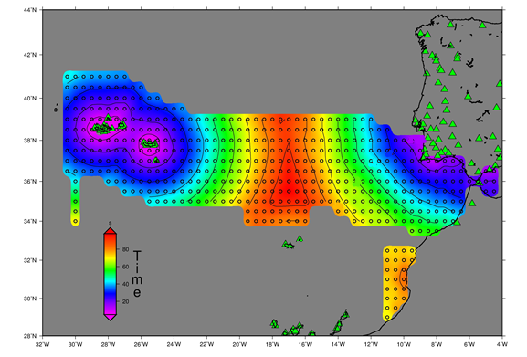
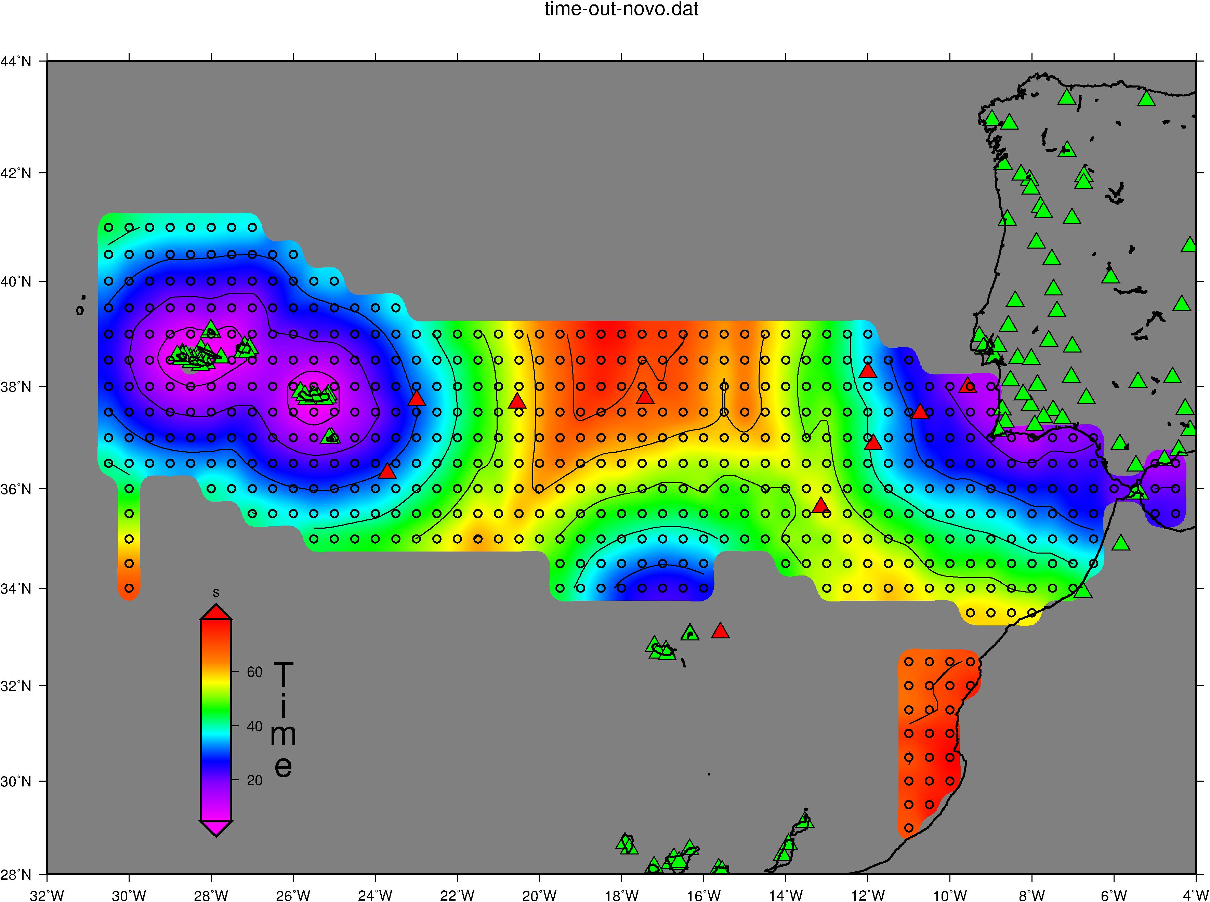
Seismic Detection Time
Existing IPMA stations (inland)
Existing IPMA stations (inland) + 10 stations within CAM
Relevant improvement in the SW San Vincent Cape área (>5 sec)
Very significant improvement at North Madeira (earthquake of 1975, Mag8.1)
Epicenters from IPMA tsunami scenario DB
Existing stations (at IPMA)

Slide 12
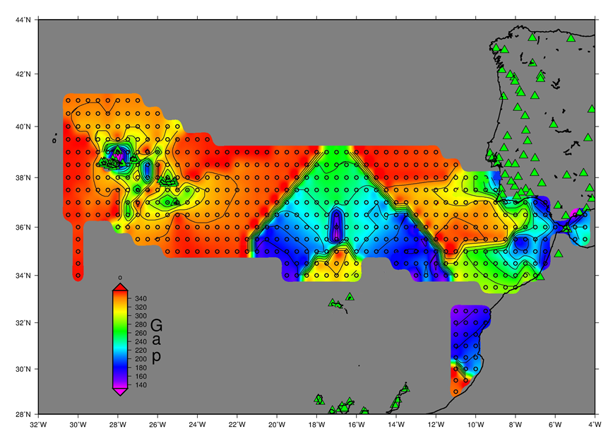
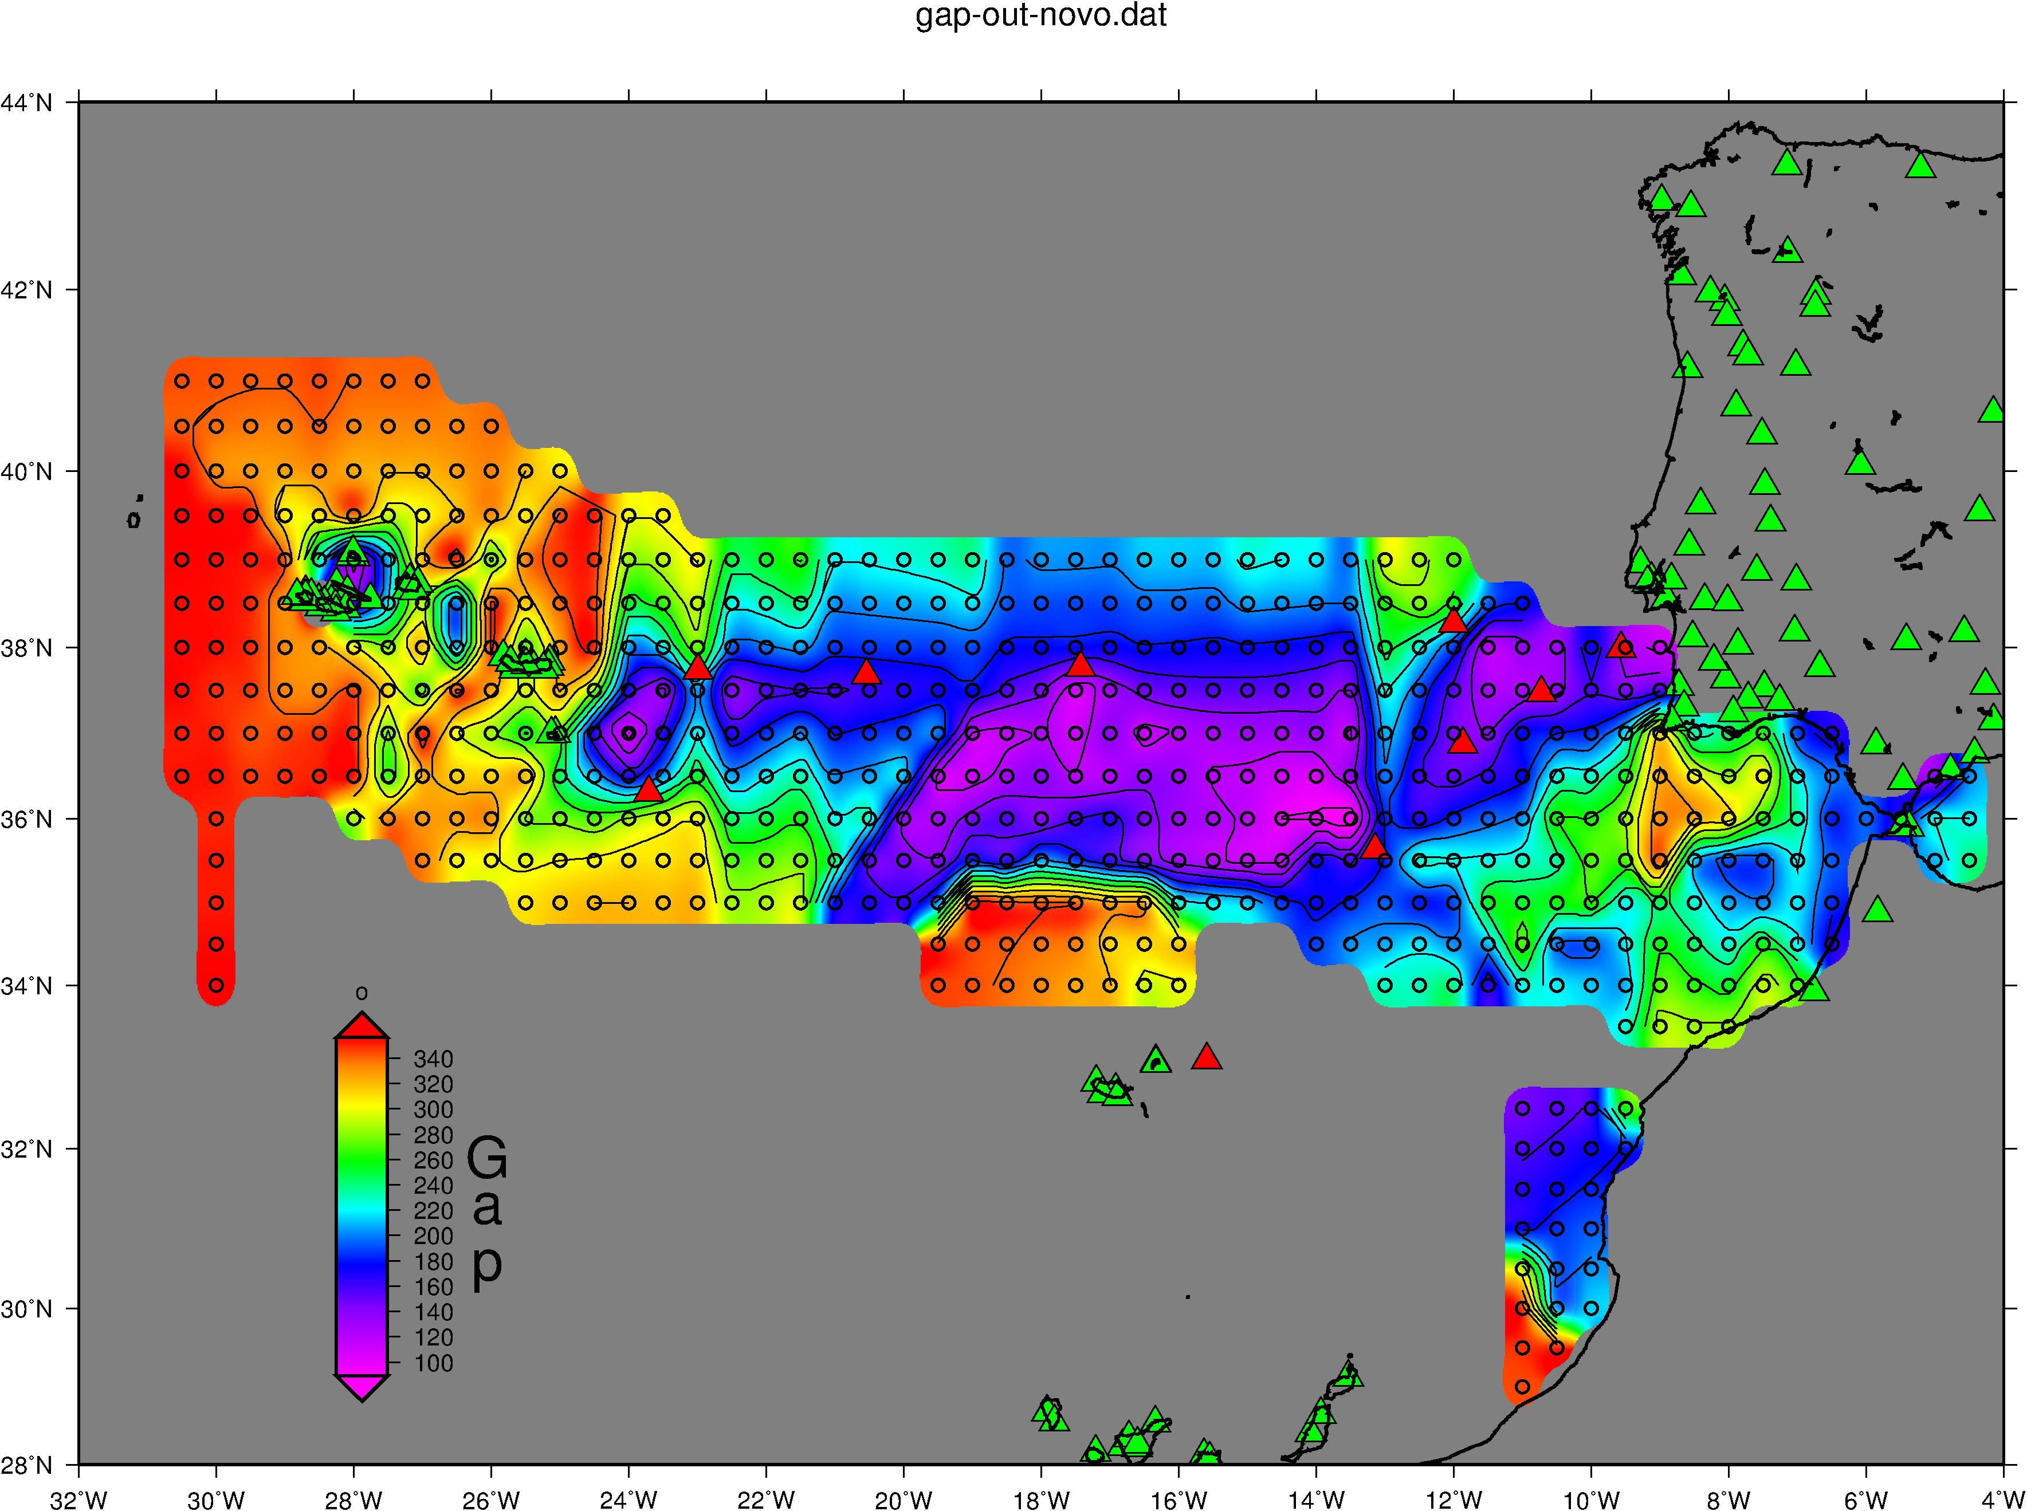
Quality (azimuth gap)
Existing IPMA stations (inland)
Existing IPMA stations (inland) + 10 stations within CAM
Significant improvement in the SW San Vincent Cape área
Major improvement along the Gloria fault region (earthquakes of 1939, 1941, 1975 ...)
Epicenters from IPMA tsunami scenario DB
Existing stations (at IPMA)
Proposed new stations (CAM)

Slide 13
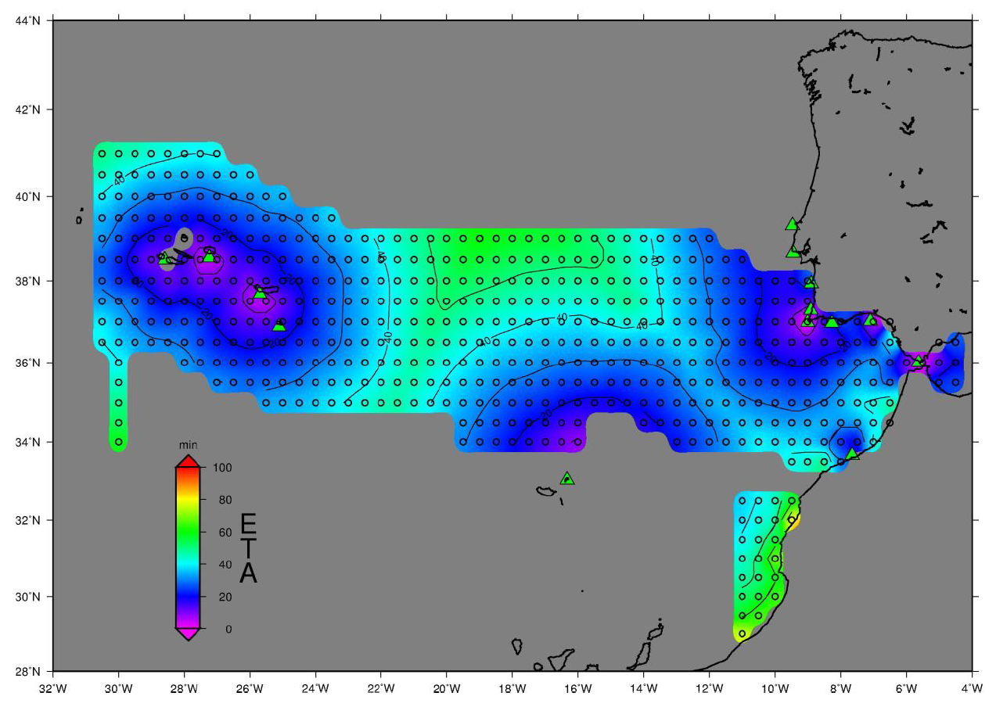
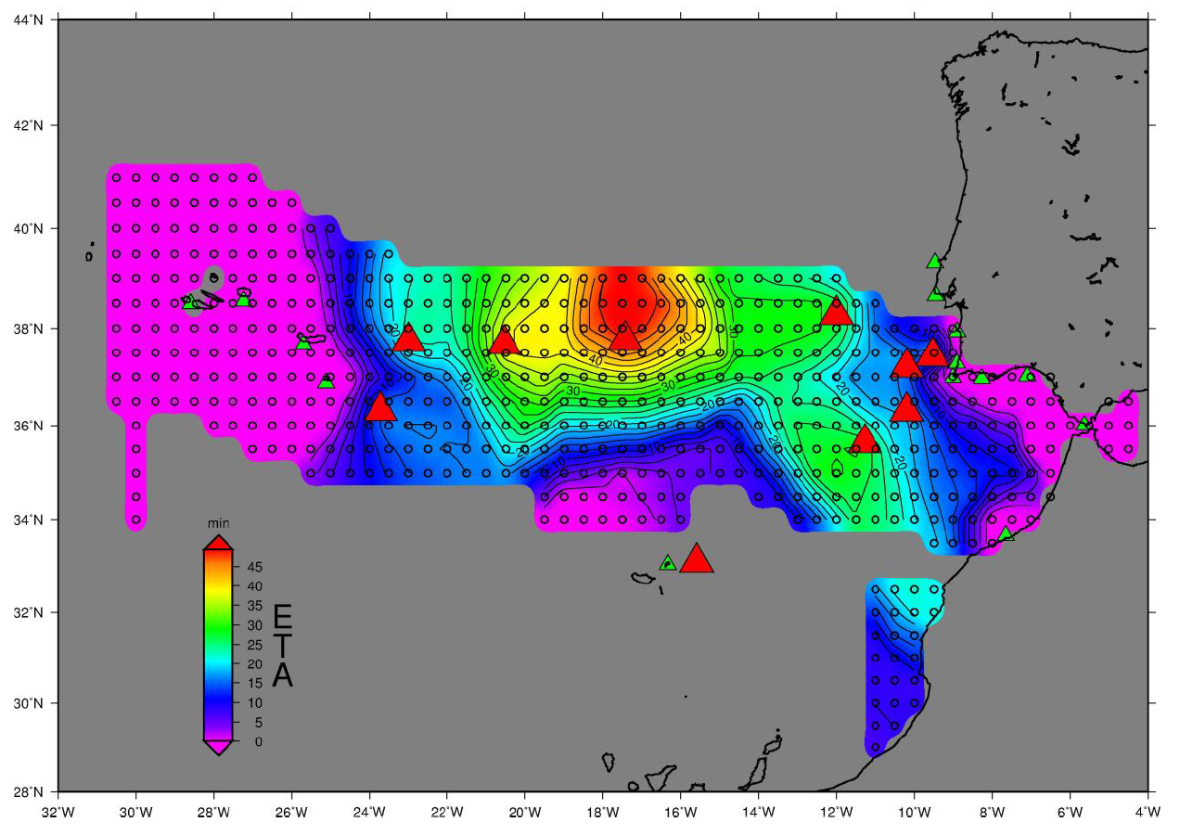
Gain in Early Warning Time for Tsunamis
Minimum TTT from each of the database locations
to 14 tide-gauges
- Significant improvement (>10min) in a wide area between 23ºW and Portugal and Morocco coasts
- For a large area of the Gloria fault and SW of Cadiz Gulf the gains are larger than 30 min

Slide 14
December 2019
  Working group nominated by the Government recommended the implementation of “....Seismic and Environmental Detection”
September 2020
  Government published the decision of Renew the CAM ring including “Seismic and Environement Detection”
October 2021
  Project included in the general budget of the state for 2022
  SMART funcionalities included
September 2022
  Public company, IP TELECOM, formally designated to implement the project
November 2022
  Resolution of the Council of Ministers (nr. 104/2022, 2nov)
  Total budget: ~154M€
  Public tender in preparation

Slide 15
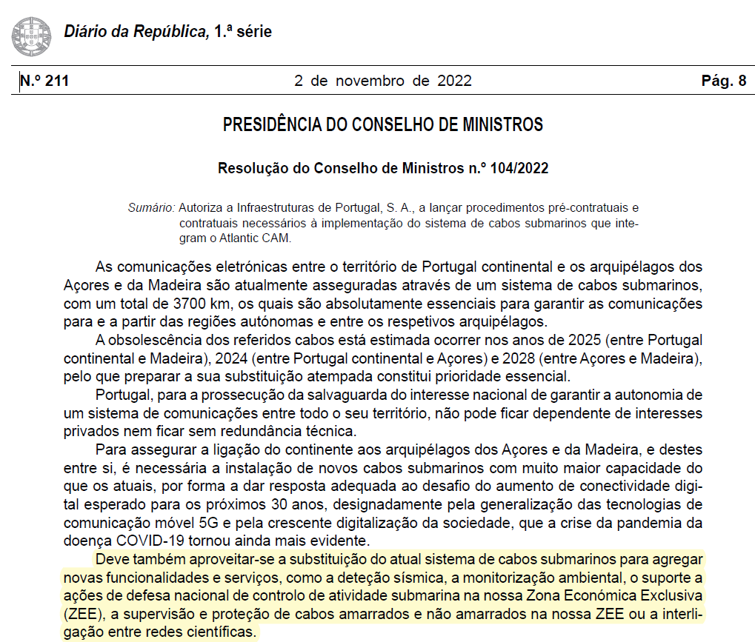

Slide 16
Thank you!

