Slide 1
Six new sea level observation stations for the Italian warning system for tsunamis generated by earthquakes
NEAMTWS Experts Meeting
Implementing NEAMTWS 2030 Strategy Opportunities and Actions to Explore
28-30 Nov 2022, Naples, Italy

Slide 2
INSTITUTIONAL CONTEXT
In 2009 Italy joined the Program of the Intergovernmental Coordination Group for early warning and tsunami mitigation systems in the North-Eastern Atlantic, the Mediterranean and connected seas (ICG-NEAMTWS) promoted and coordinated within the UNESCO Intergovernmental Oceanographic Commission (IOC/UNESCO) with an included alert system
Within NEAMTWS, sea level surveillance in the Mediterranean area is ensured through the tidal networks of coastal countries, whose data are collected and distributed by IOC/UNESCO (http://www.ioc-sealevelmonitoring.org ) and by the JRC of the European Commission
The Directive of the Italian President of the Council of Ministers, dated 17 February 2017, established the National Alert System for Tsunamis generated by earthquakes (SiAM). Published in the Italian Official Gazette (GU General Series n.128 SG of 05-06-2017) SiAM involves the National Institute for Geophysics and Vulcanology (INGV), the Department of Civil Protection (DPC) and the National Institute for Environmental Protection and Research (ISPRA)
The system operates through the functional integration of the technical skills and instrumental networks of the DPC, INGV, and ISPRA

Slide 3
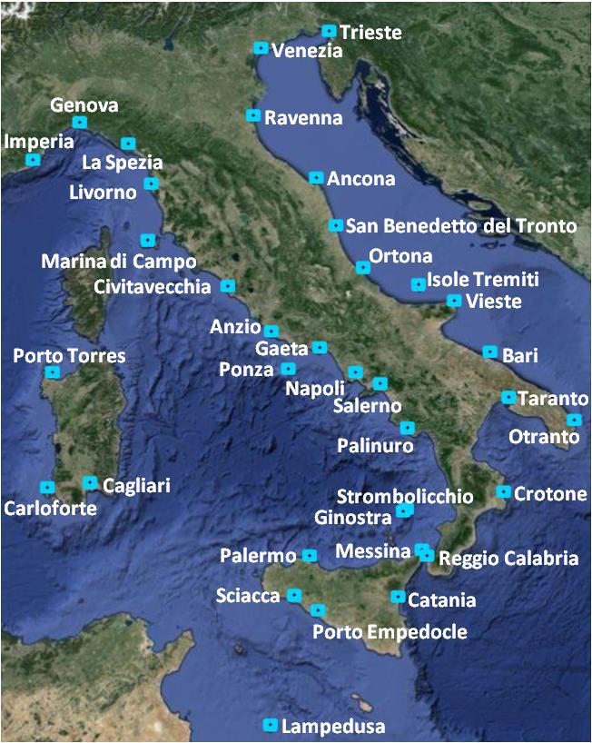
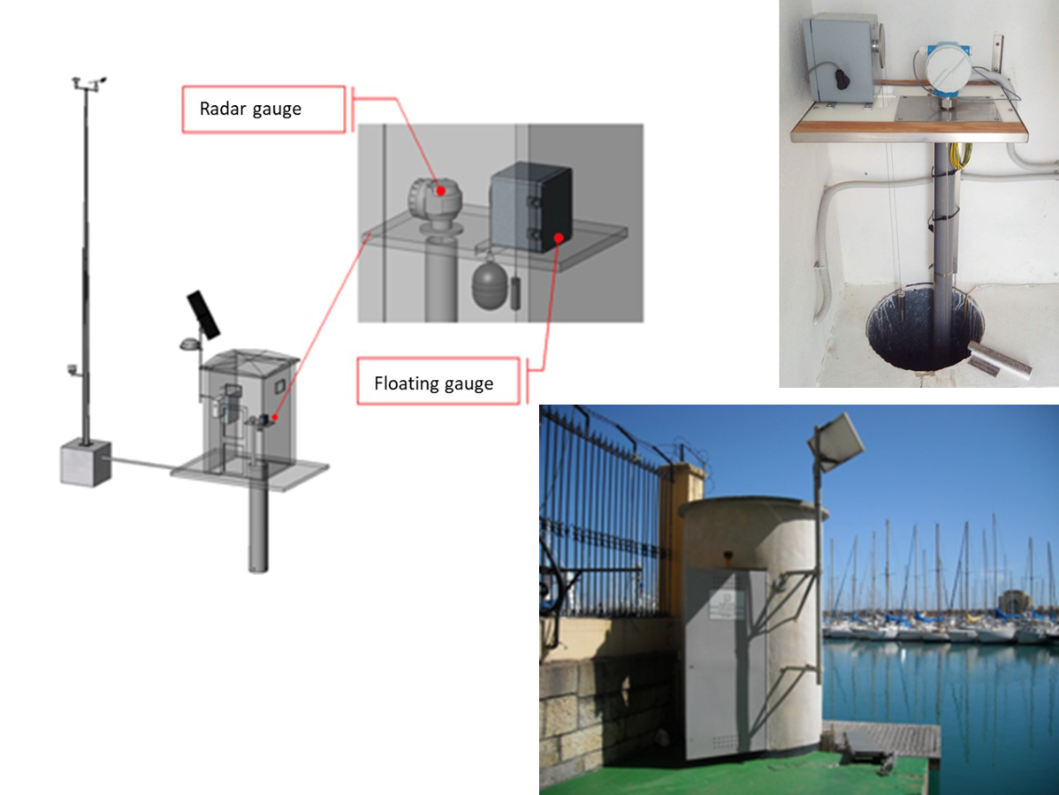
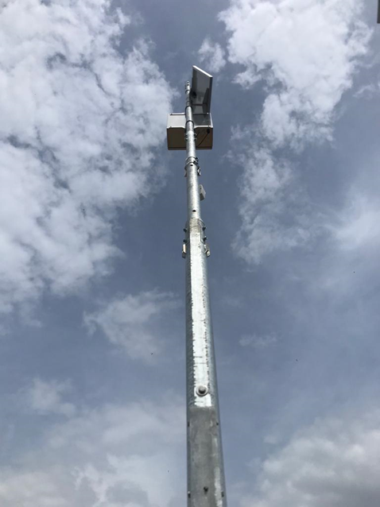
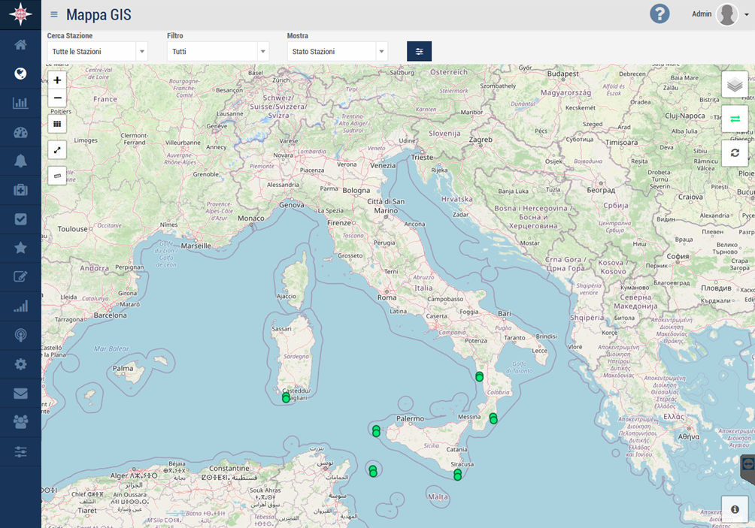
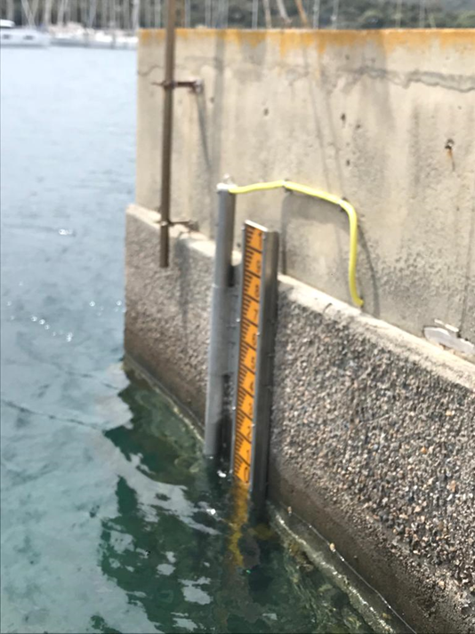
EVOLUTION OF THE ITALIAN TSUNAMI WARNING SYSTEM
From 2017 to 2021, tsunami detection was performed by the national tide gauges network (RMN) located in the main Italian ports
RMN is an important sea level measurement network in the Mediterranean that measures sea level to determine tides and includes the meteomarine network of the Italian coasts
Its measured parameters, common for all stations, are:
microwave level sensor,
shaft-encoder level sensor (float), barometric sensor, temperature/humidity sensor,
water temperature sensor, wind speed sensor, wind direction sensor (metereology sensors)
Since May 2021, a new generation network,
designed exclusively for the identification and
timely characterization of tsunamis, is operational

Slide 4
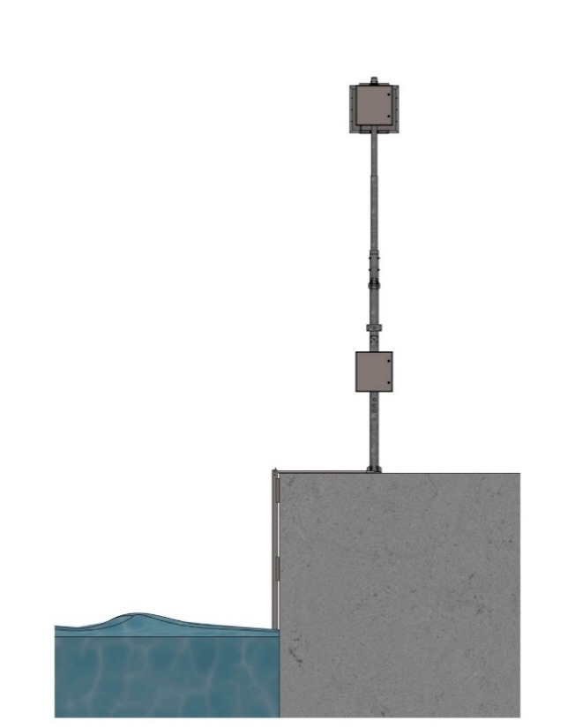
THE ITALIAN TSUNAMI MONITORING SYSTEM
ISPRA launched, within the SiAM framework, a program for the implementation of a high precision and high frequency long wave measurement network with the installation of 8 new stations
Located in the Central and Southern Tyrrhenian Sea, in the Sicilian Channel and in the Ionian Sea they can withstand severe operating conditions, supporting:
high precision and accuracy sea level monitoring
coastal defense
sea state monitoring
research
Each station is equipped with 2 piezometric sensors (redundancy)
and linked to the Italian national tide gauge network (RMN)

Slide 5
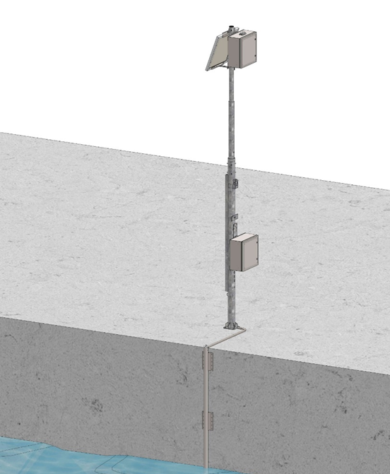
TOOLS & FACILITIES
Piezometric Sensor & Thermistor
Techinical Specifications
Measuring range | 0-10m o 0-20m
Precision | 0.002 %FS
Accuracy | 0.02 %FS
Serial output interfaces | RS485
Working temperatures | -20°C + 80°C
Degree of protection | IP 68
Temperature sensor | TP1000 precision = 0.1°C
Energy consumption | < 8mA
Water | sea level water temperature
Image | Video Monitoring
Position (GPS) | Latitude, longitude
Data trasmission | Satellite IRIDIUM (Short Burst Data) UMTS 4 or 5G xG channel IMEI Iridium

Slide 6
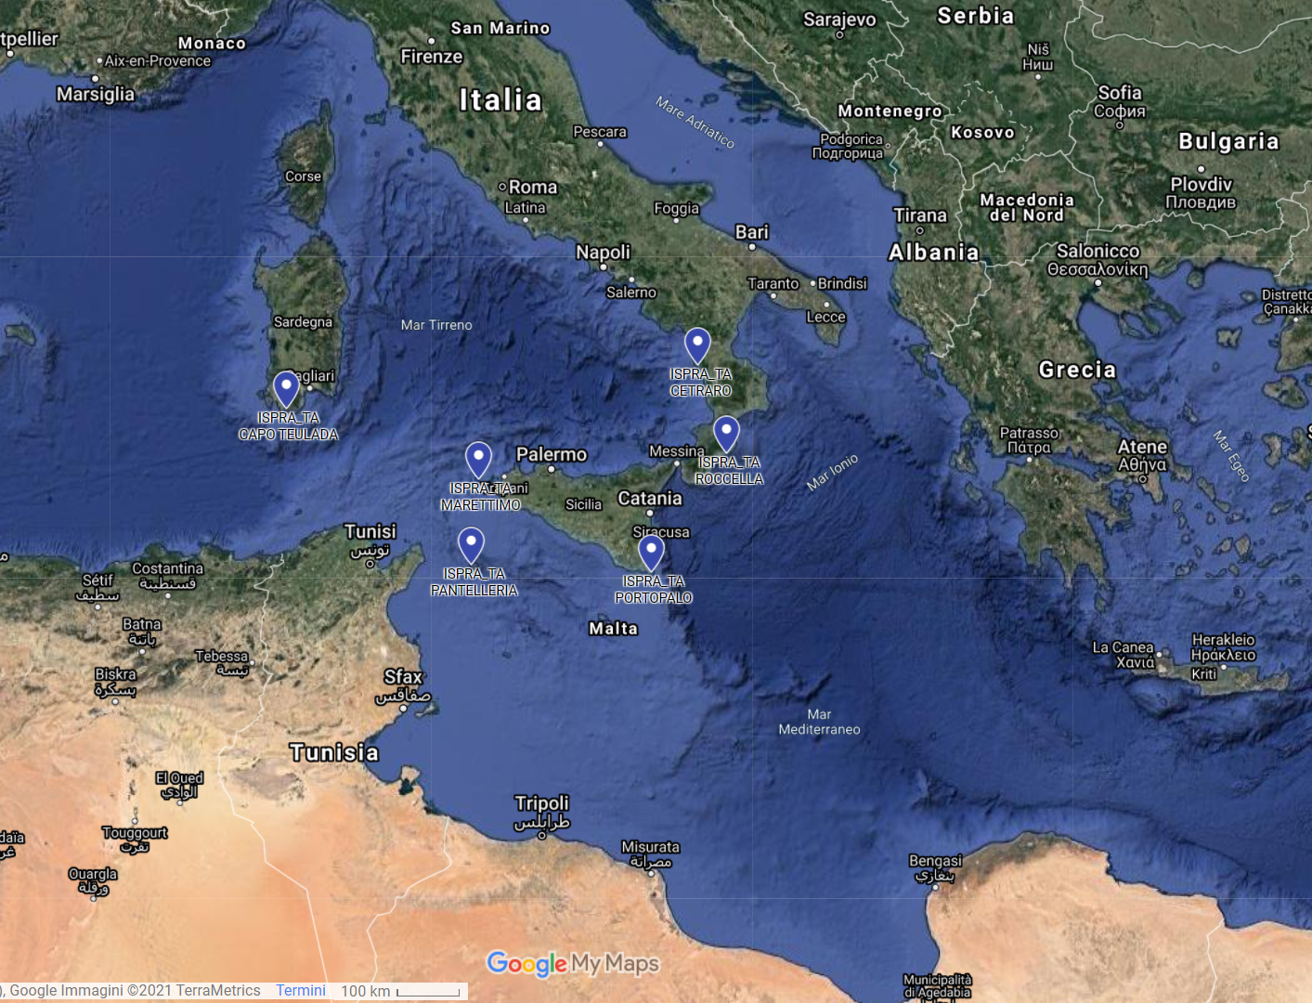
LOCATION OF ISPRA’s NEW STATIONS
In order to alert and confirm potential tsunami events caused by earthquakes
the sea level meter stations are located in
Cetraro Lido (Calabria),
Capo Teulada (Sardinia),
Portopalo di Capo Passero (Sicily),
Roccella Jonica (Calabria)
and on the small islands of Marettimo
and Pantelleria (Sicily)

Slide 7
SERVICE DELIVERY OF THE ITALIAN TSUNAMI WARNING SYSTEM
Observation in real time of sudden changes in the sea level through the new measuring stations with high sampling frequency, positioned in strategic venues;
Instantaneous detection of the physical parameter H (height of the sea level), and prompt notification to ISPRA in the event of deviations greater than 10% and 30%, with respect to the mean sea level expected, also considering both the astronomical and meteorological components;
Production of immediate operational reports on sea level data recorded after localised earthquakes to enable the launch of an alert for a following probable tsunami event;

Slide 8
SERVICE DELIVERY OF THE ITALIAN TSUNAMI WARNING SYSTEM
Technological improvement of observation stations and implementation through measurement sensors of other physical and environmental parameters (pressure, temperature, altitude localisation via GPS; image acquisition via photo-video camera, etc.);
Making available and public the recorded data of the new stations through open access to ISPRA-SiAM-TAD-Server
https://tsunami.isprambiente.it/TAD_Server/Home
which also includes the RMN registrations and data of other stations in the Mediterranean area, made available by other information suppliers (e.g. Joint Research Center of the European Commission, JRC).

Slide 9
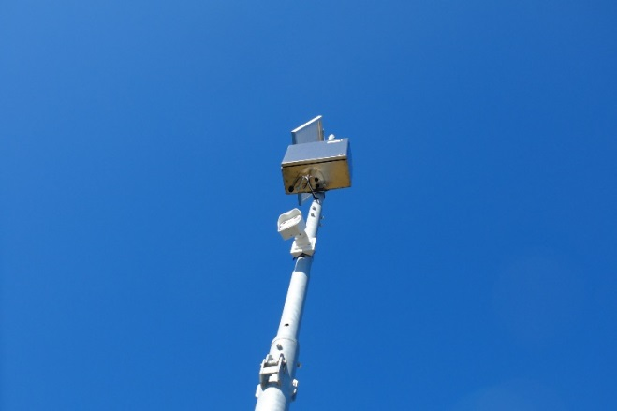
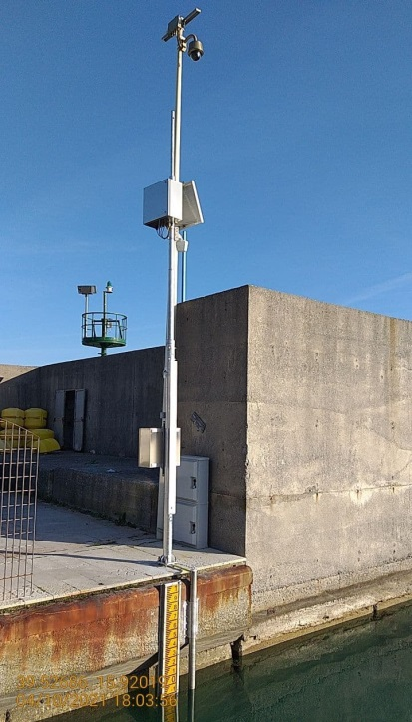
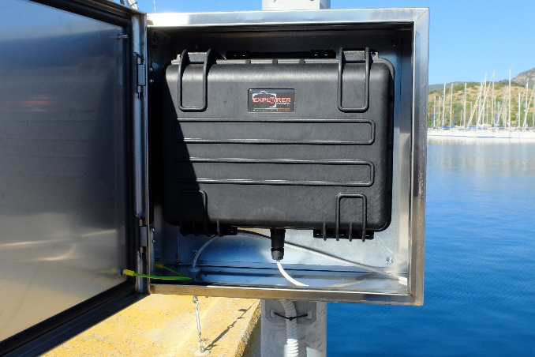
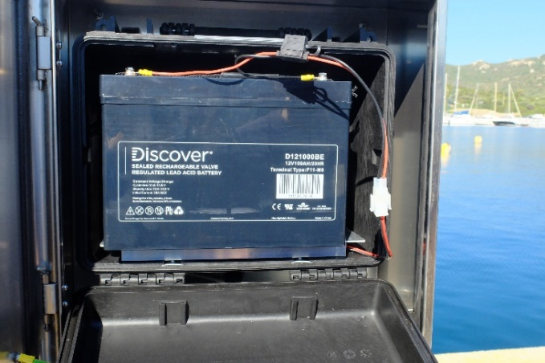
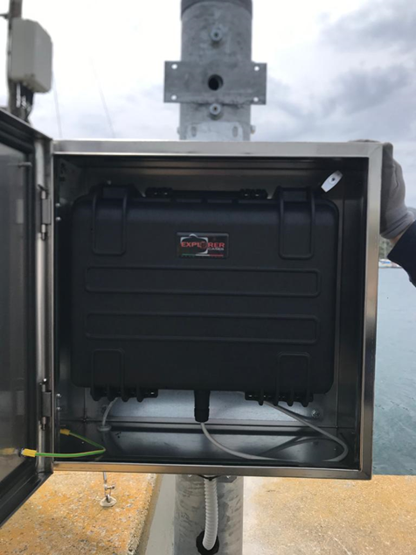
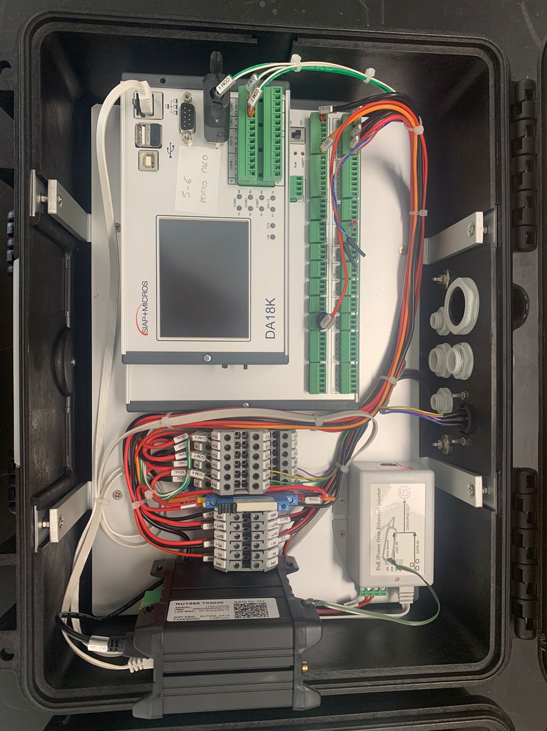
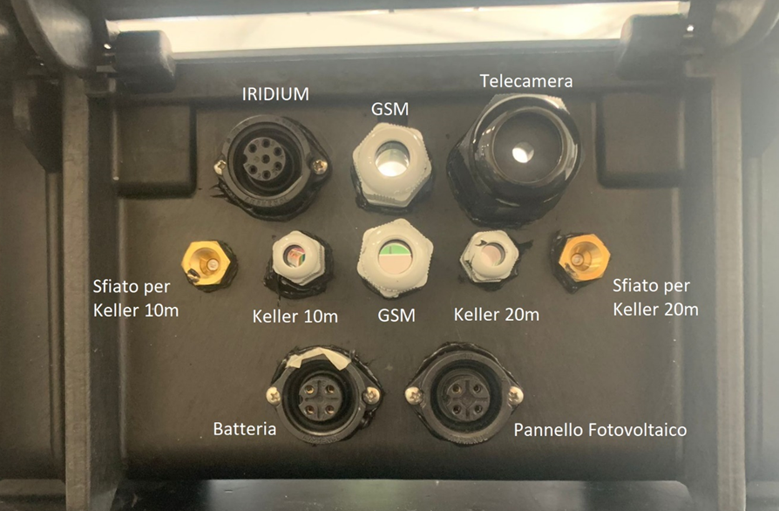
INSTRUMENTATION

Slide 10
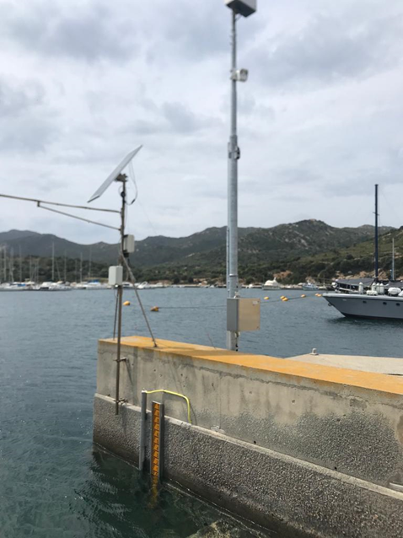
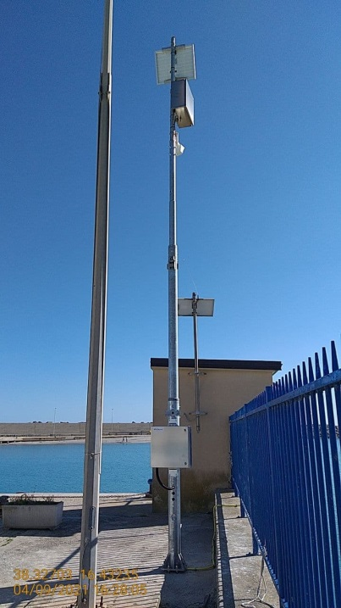
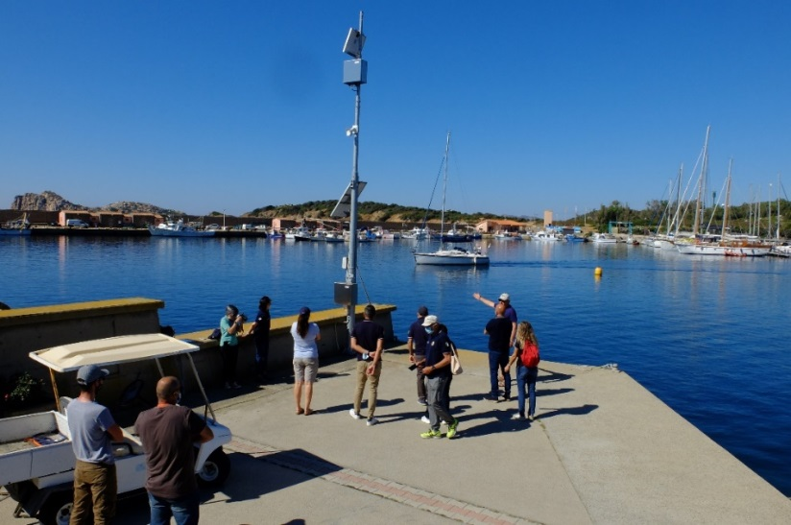
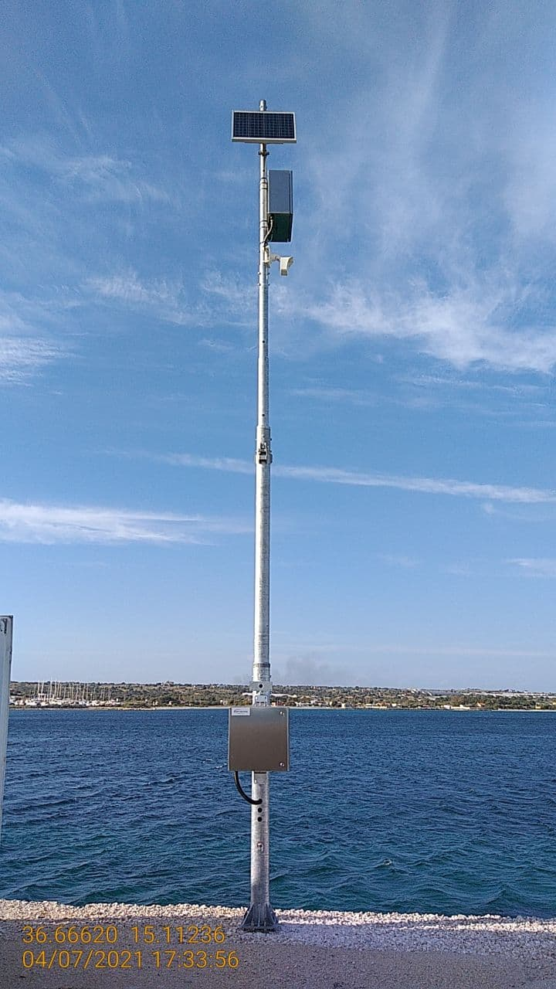
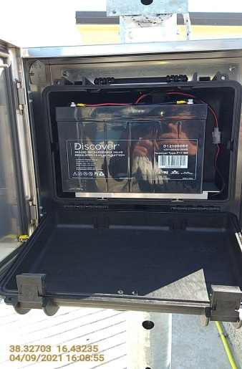
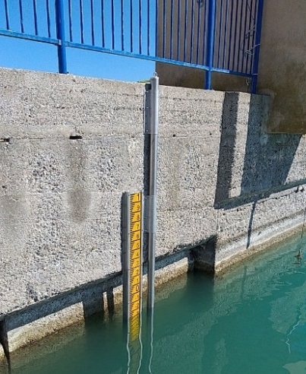
TOOLS & FACILITIES

Slide 11
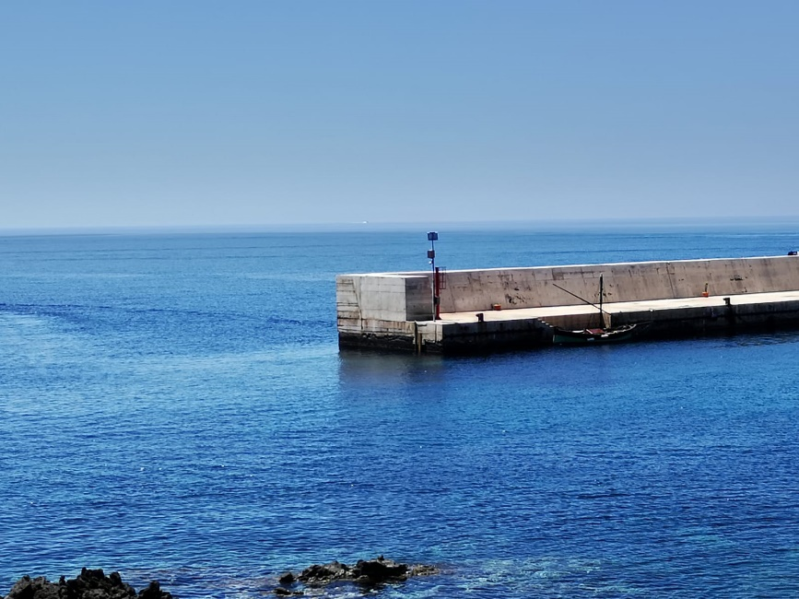
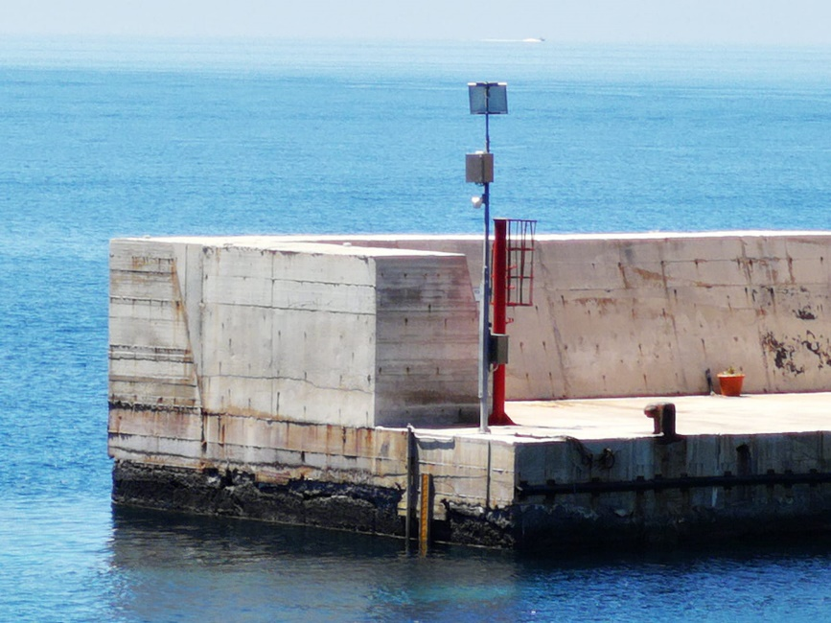
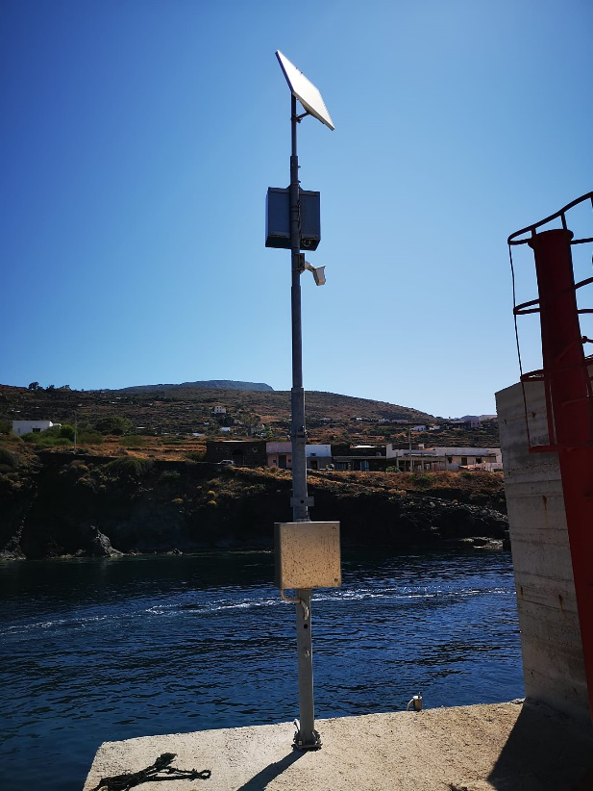
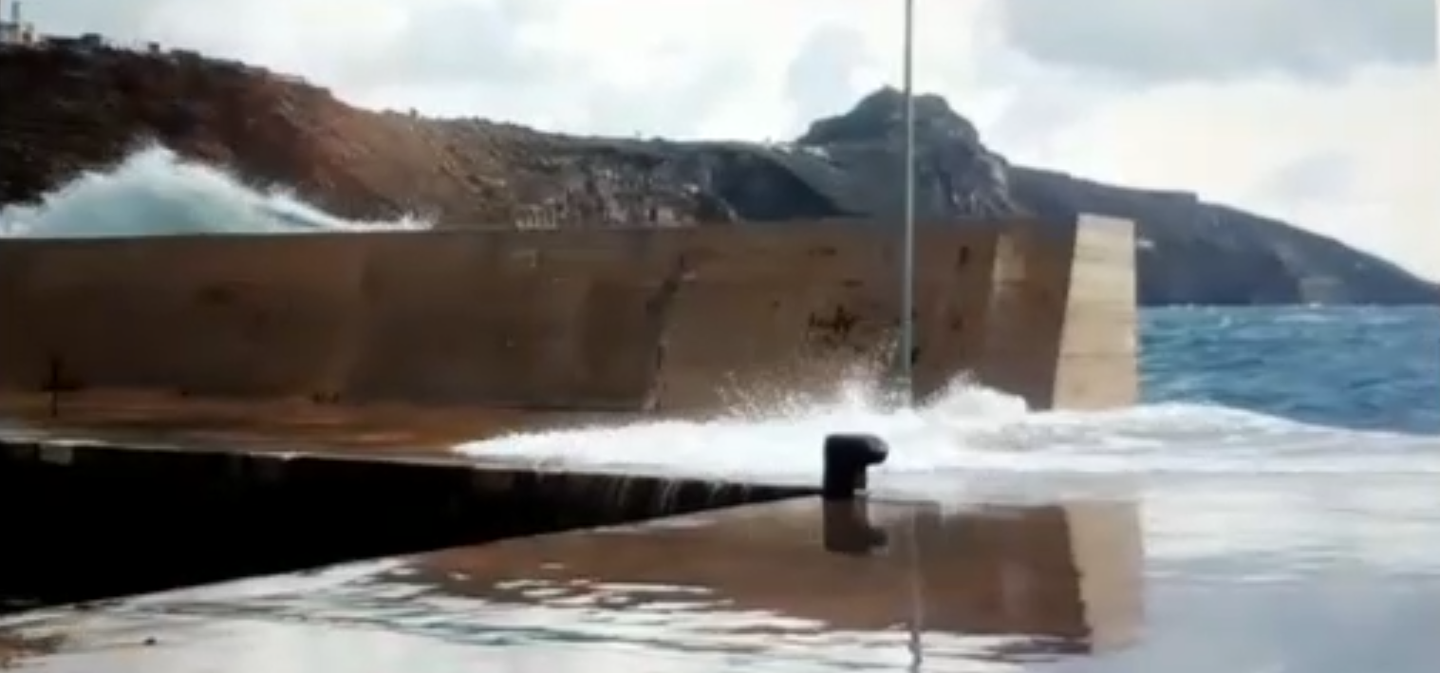
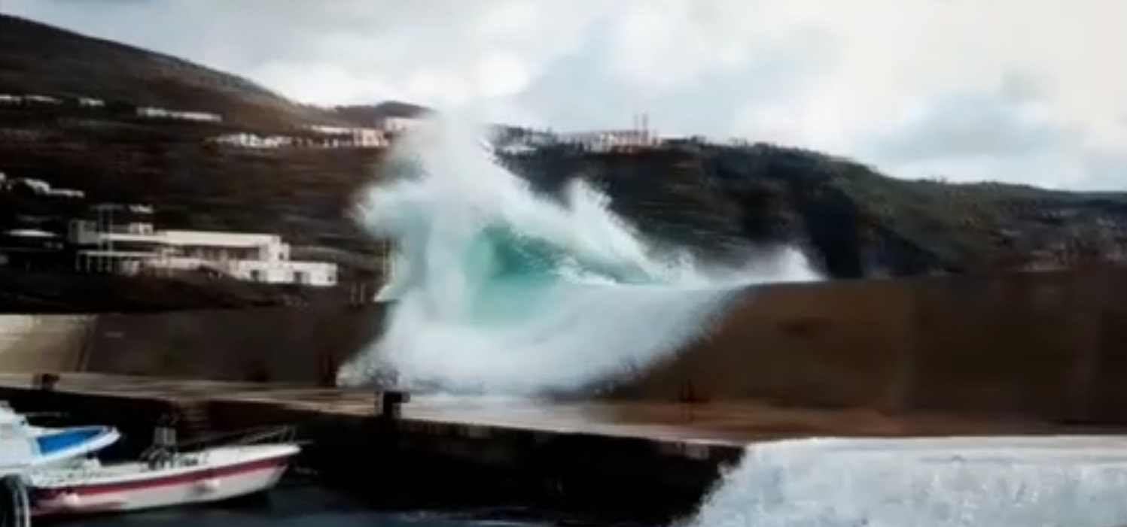
SCAURI PORT IN PANTELLERIA ON 11/29/2021

Slide 12
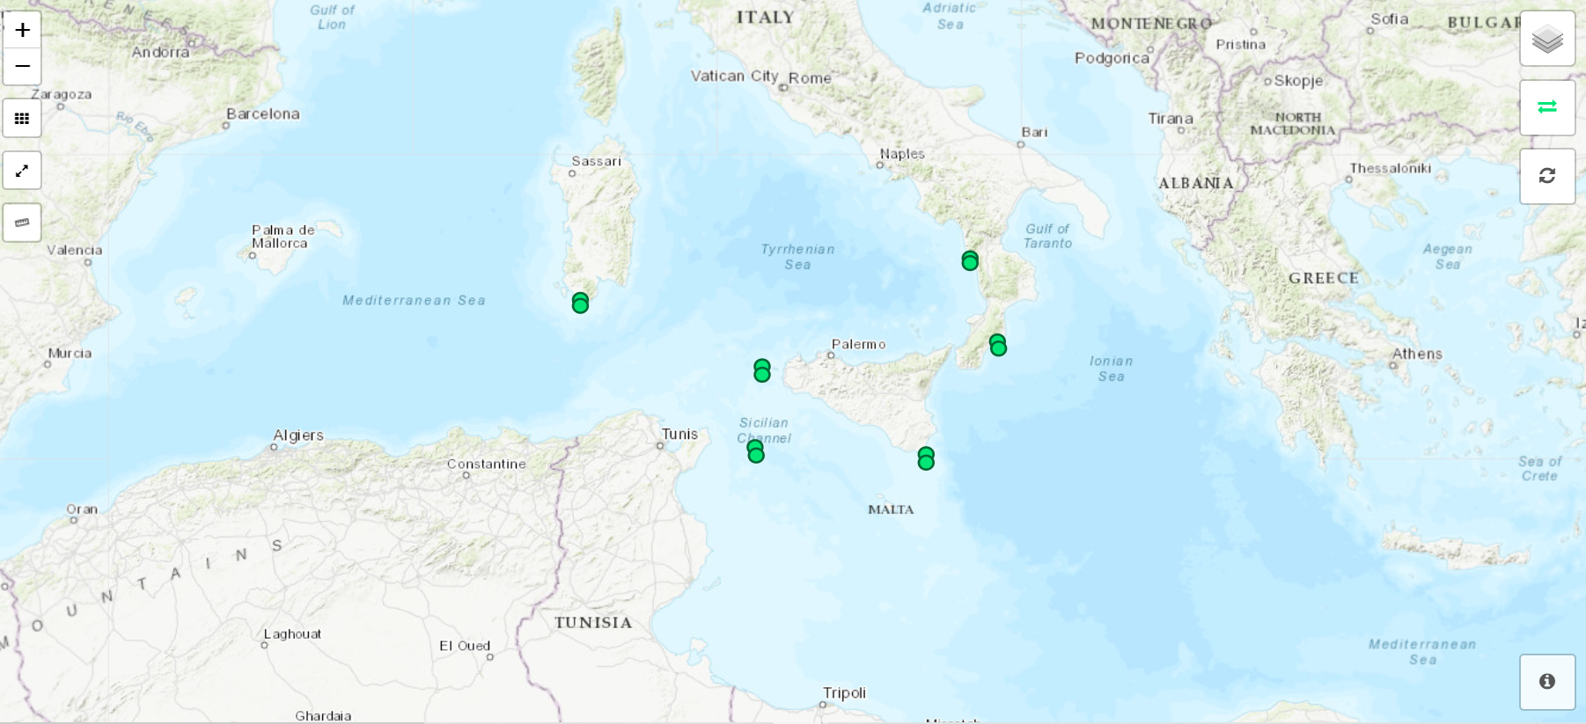
NEW STATIONS IN TSUNAMI ALERT DEVICE (TAD)

Slide 14
LINKED OPEN DATA (LOD) WEB SERVICE
ISPRA-SiAM TAD SERVER: https//tsunami.isprambiente.it
Each of the six new stations has two PRS sensors on board which transmit real-time sea level (m) measured every 15 seconds.
The data received is now also available in real time in the automatically generated file at the following link:
https://tsunami.isprambiente.it/polaris/LOD/hydrometric.realtime.SiAM.csv
The file includes sea level data recorded over the last 24 hours.
Station | Sensor1 | Sensor2
CETR - Cetraro | CETR.pr1 | CETR.pr.2
MRTM - Marettimo | MRTM.pr1 | MRTM.pr2
PRTP - Portopalo di Capo Passero | PRTP.pr1 | PRTP.pr2
PSCA - Pantelleria (Scauri) | PSCA.pr1 | PSCA.pr2
RCCL - Roccella Jonica | RCCL.pr1 | RCCL.pr2
TEUL - Teulada | TEUL.pr1 | TEUL.pr2
The header of the file is:
UTC;TEUL.pr1;TEUL.pr2;RCCL.pr1;RCCL.pr2;PRTP.pr1;PRTP.pr2;CETR.pr1;CETR.pr2;PSCA.pr1;PSCA.pr2;MRTM.pr1;MRTM.pr2
The integration of the data available through the LOD Web Service with the IOC-Sea Level Monitoring Facility platform is now operational at:
http://www.ioc-sealevelmonitoring.org/list.php?order=delay&dir=asc&operator=28

Slide 15
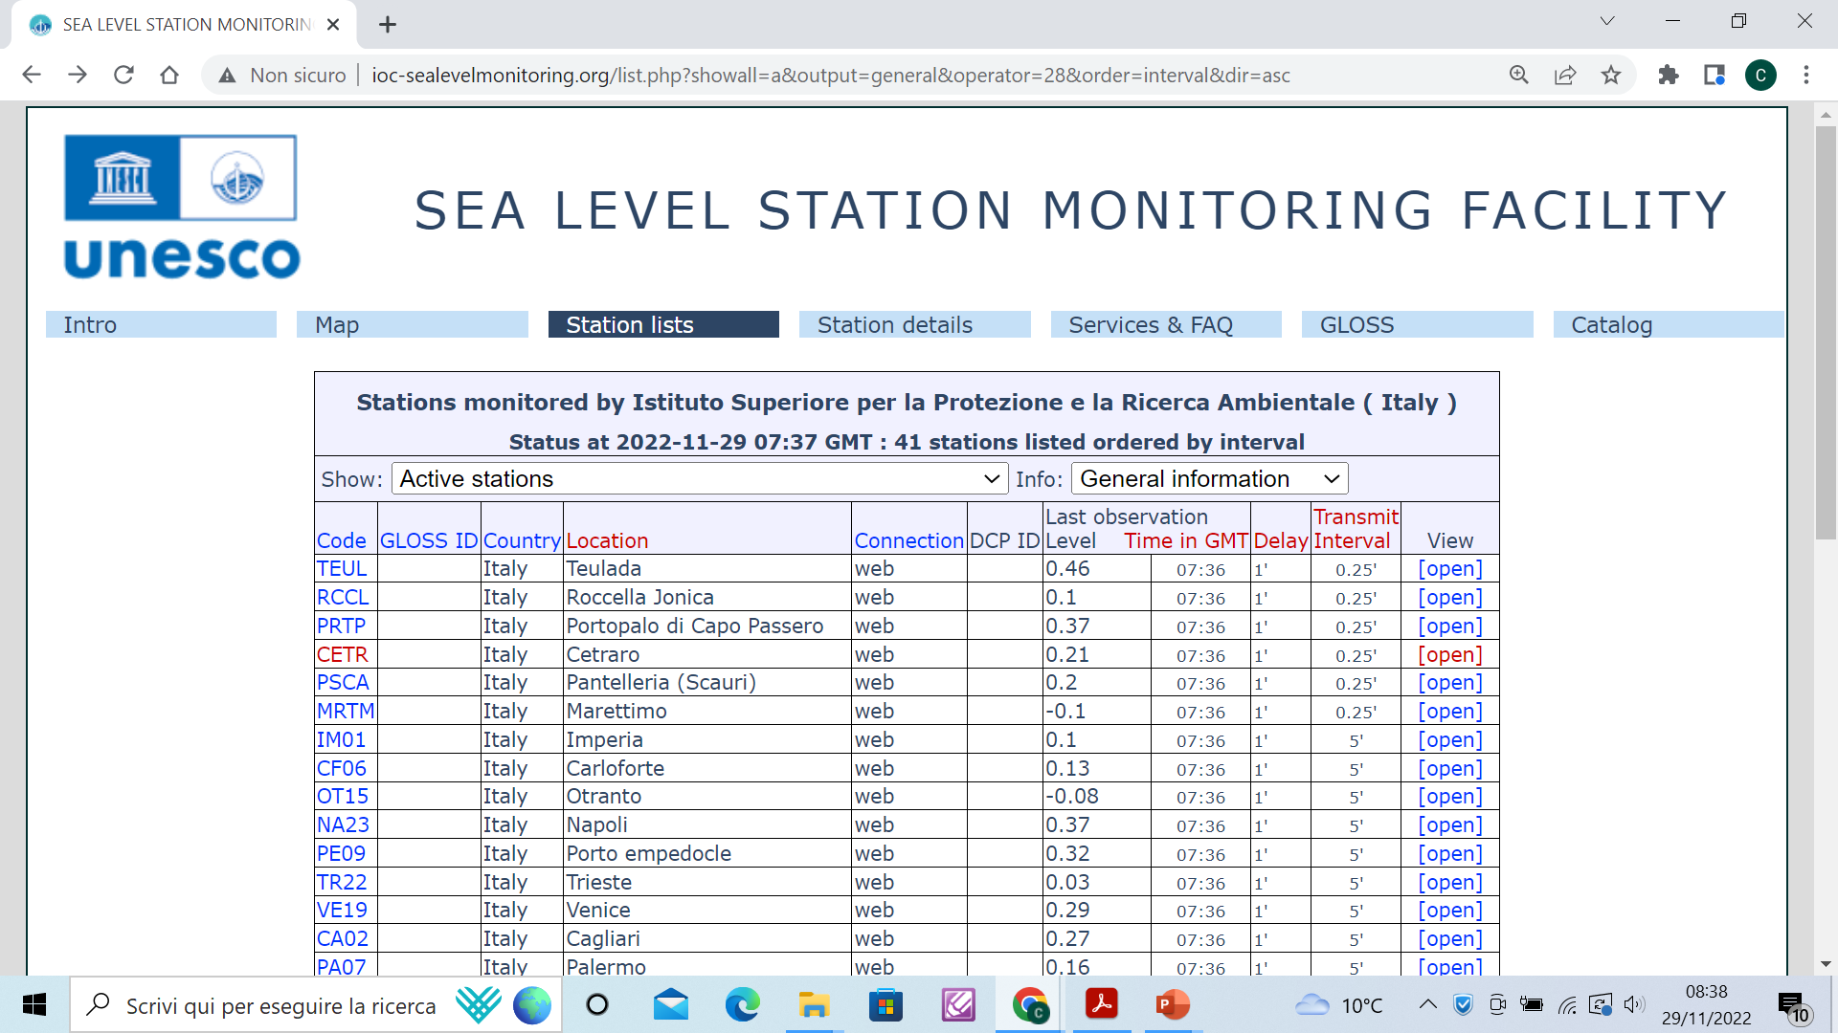

Slide 16
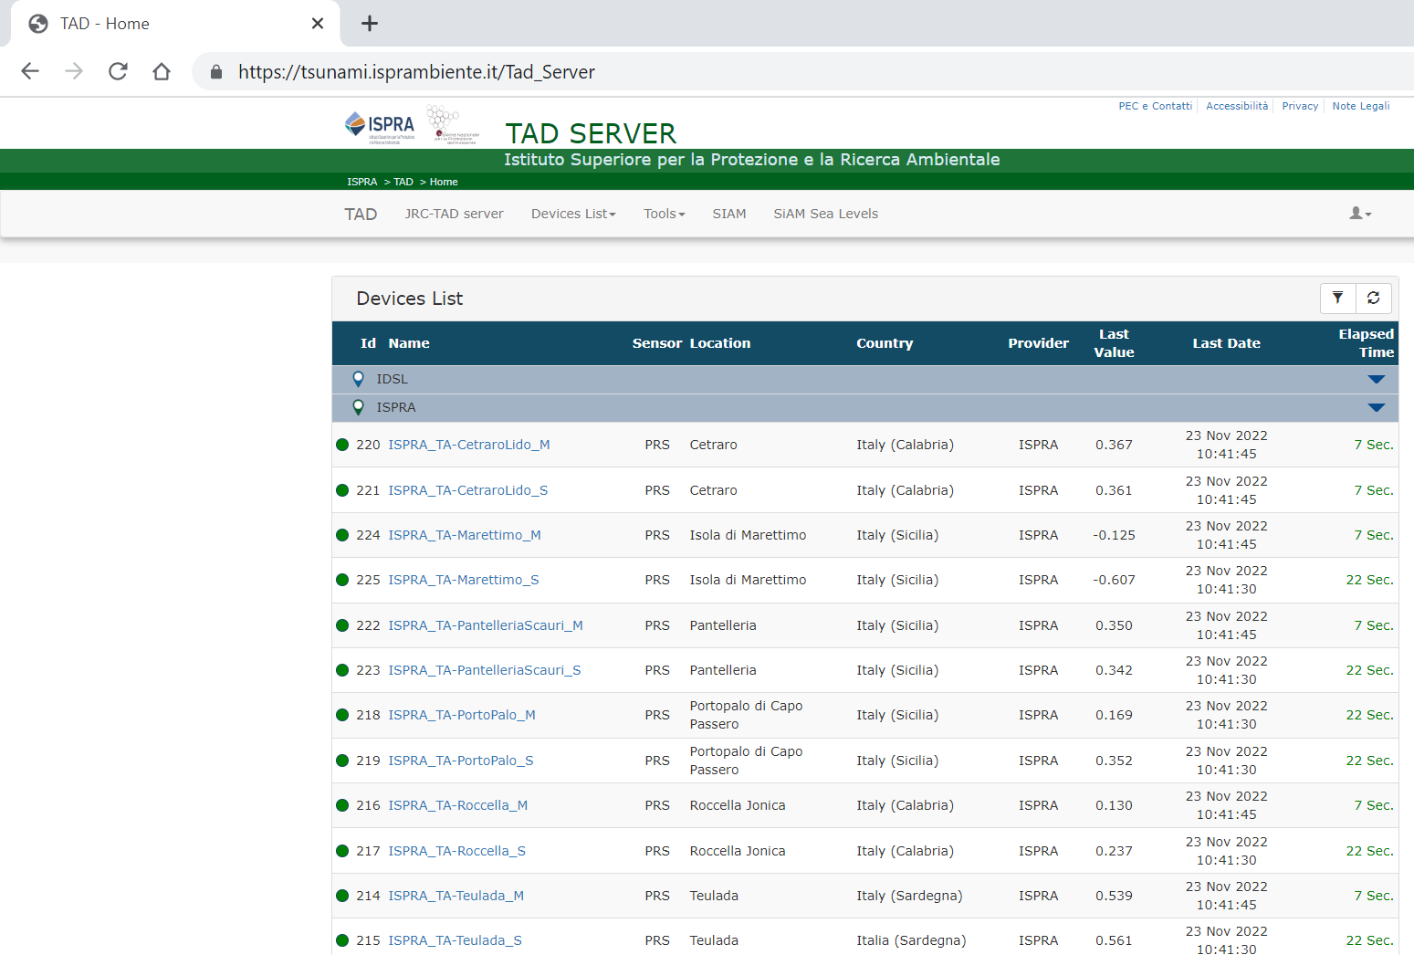
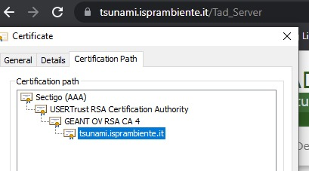
ISPRA TAD SERVER: https//tsunami.isprambiente.it
The digital platform: tsunami.isprambiente.it
is certified by the competent International Authority and the IN/OUT data traffic is encrypted with a 3072 bit RSA key.

Slide 17
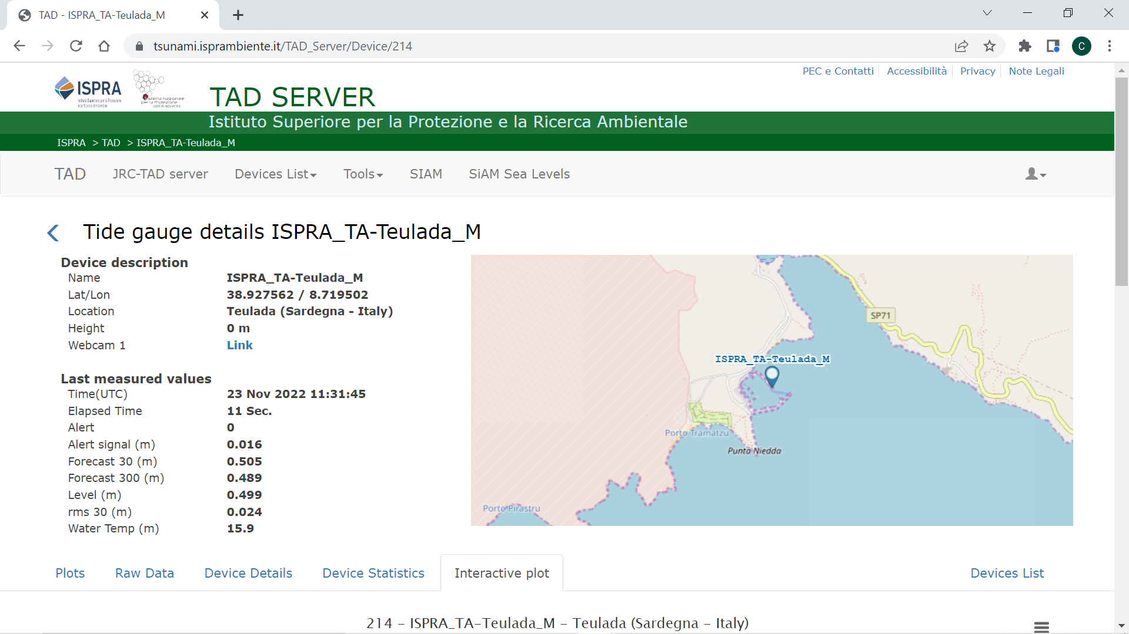
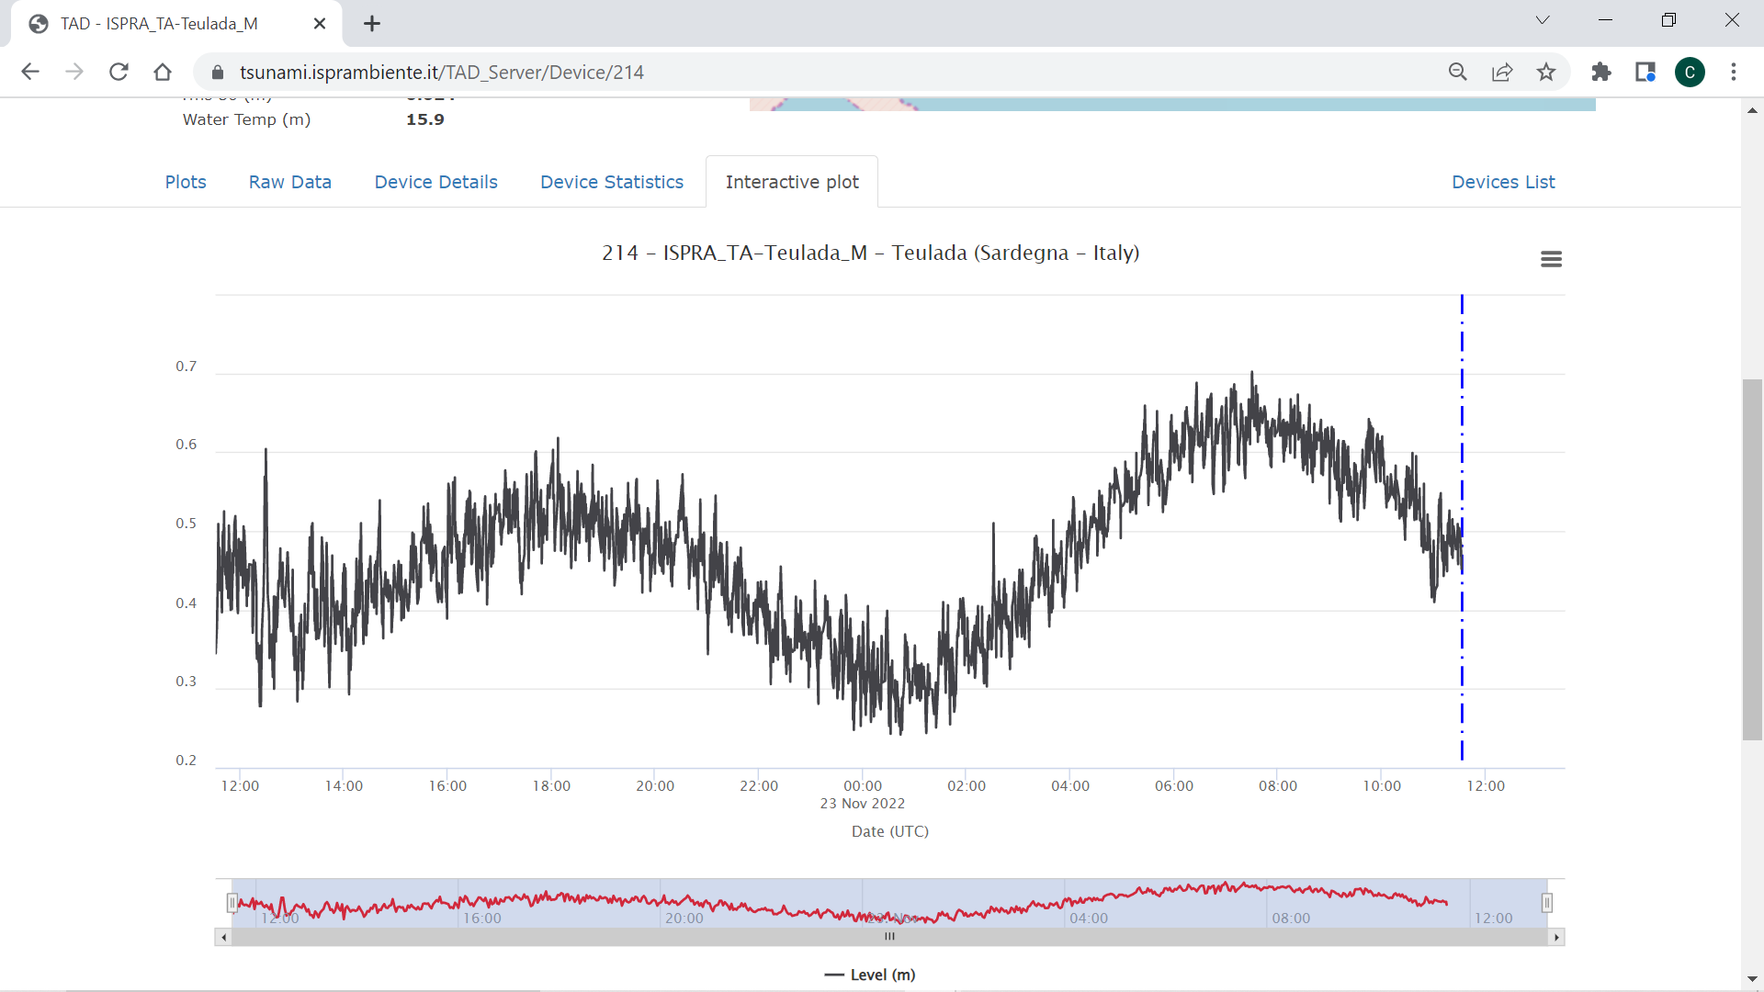
ISPRA TAD SERVER: https//tsunami.isprambiente.it

Slide 18
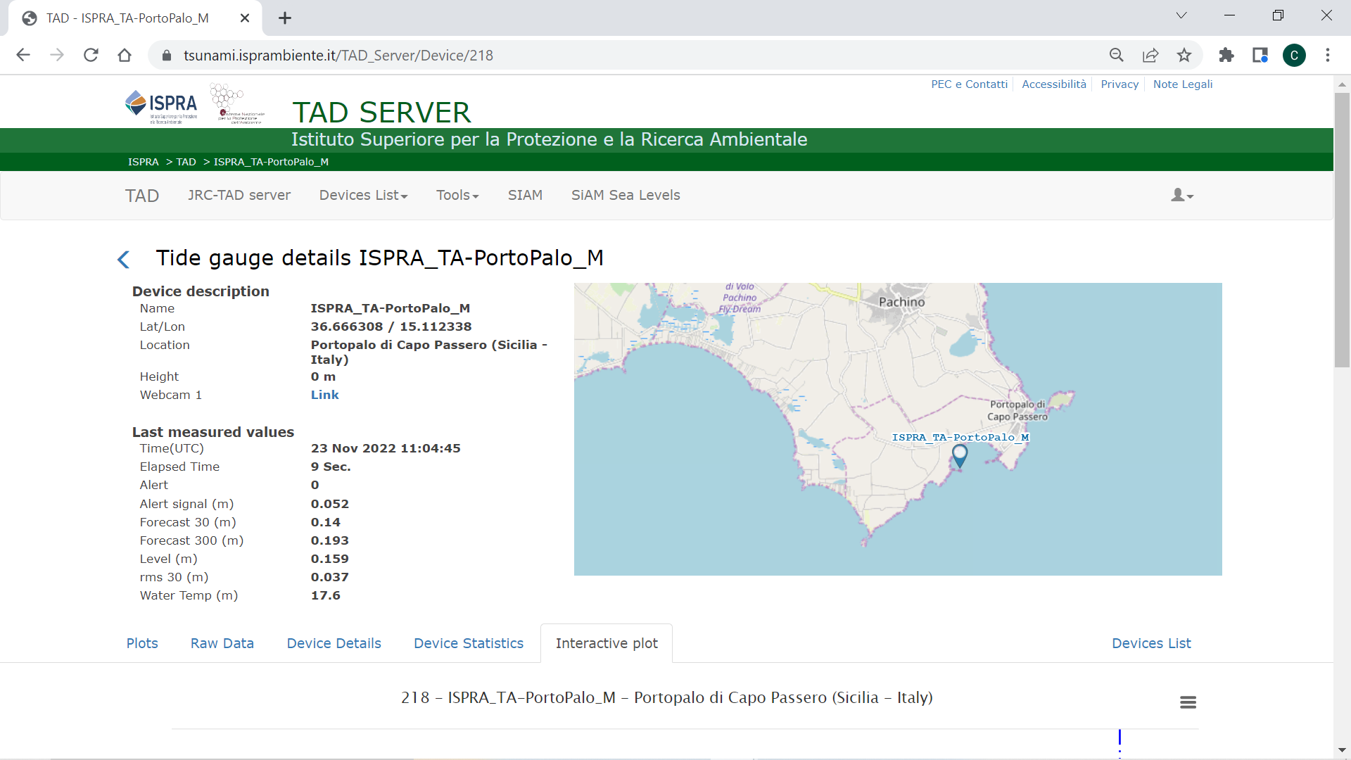
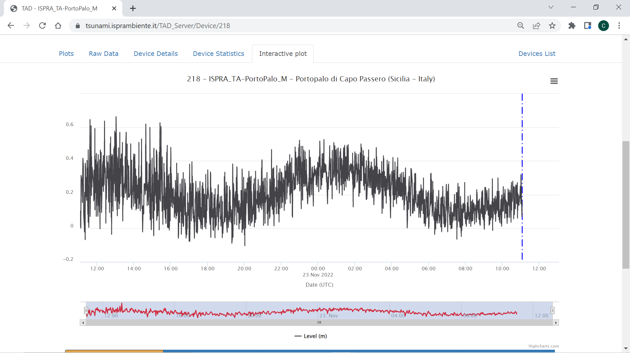
ISPRA TAD SERVER: https//tsunami.isprambiente.it

Slide 19
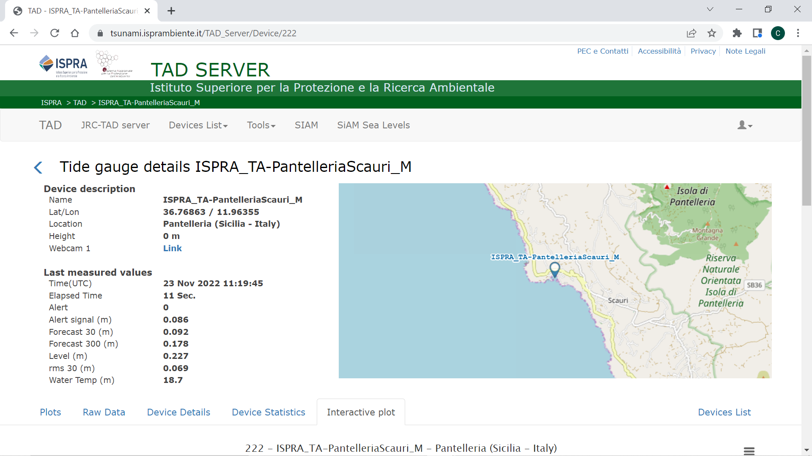
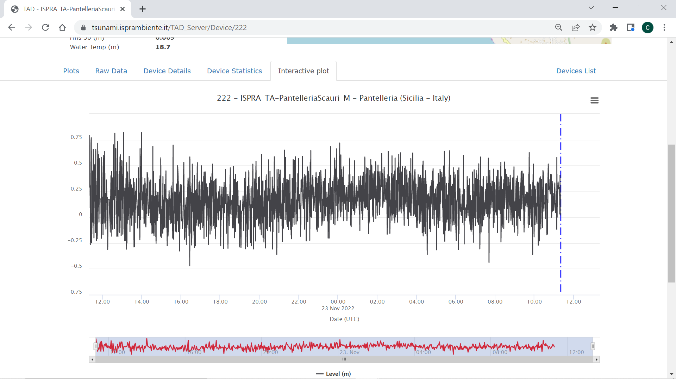
ISPRA TAD SERVER: https//tsunami.isprambiente.it

Slide 20
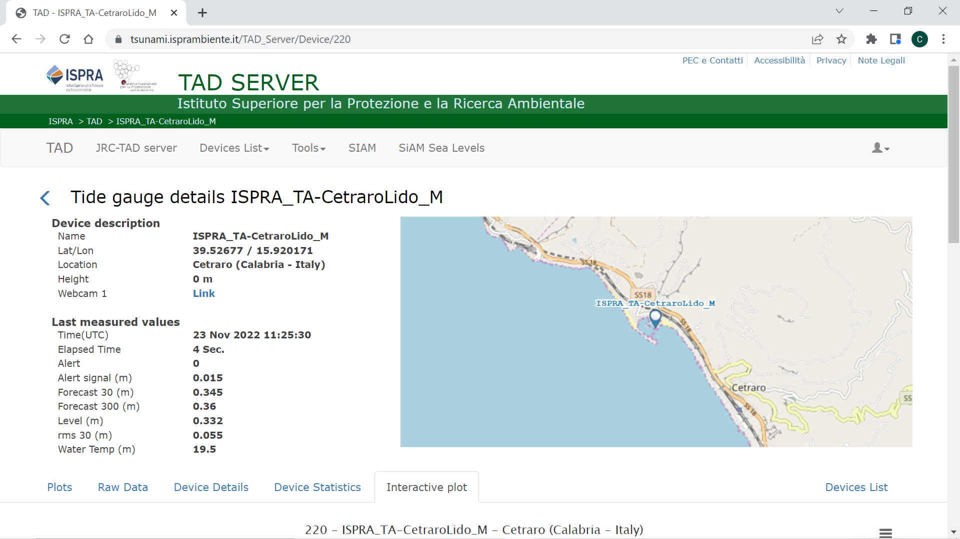
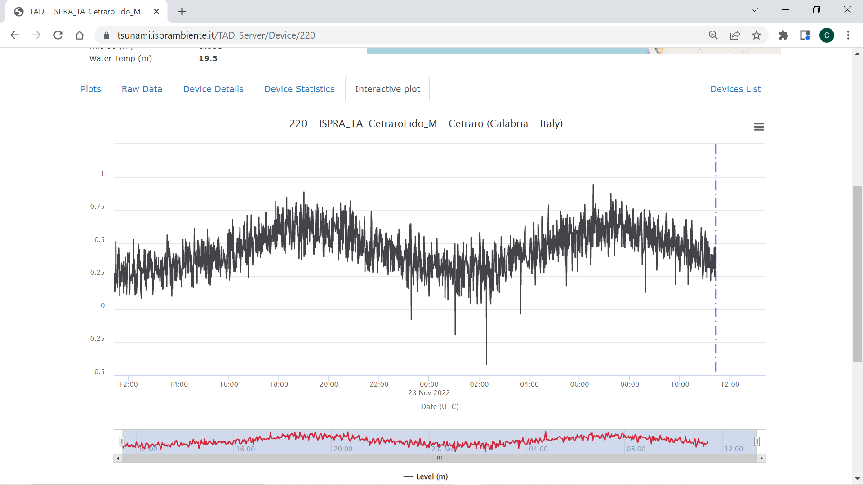
ISPRA TAD SERVER: https//tsunami.isprambiente.it

Slide 21
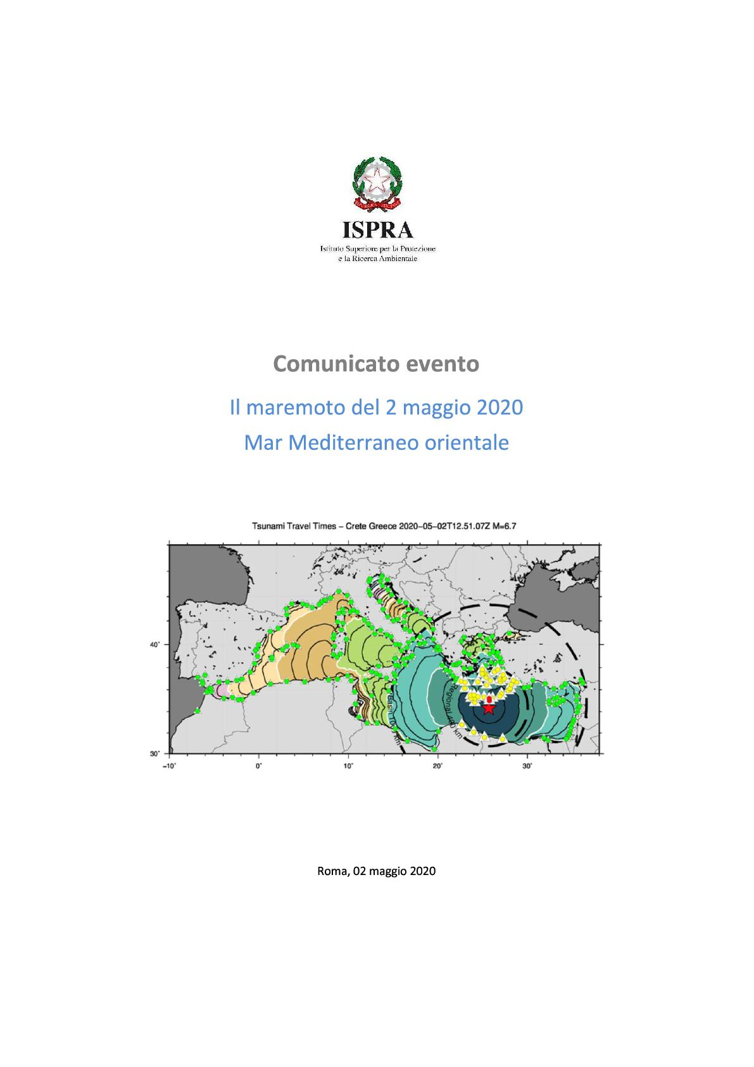
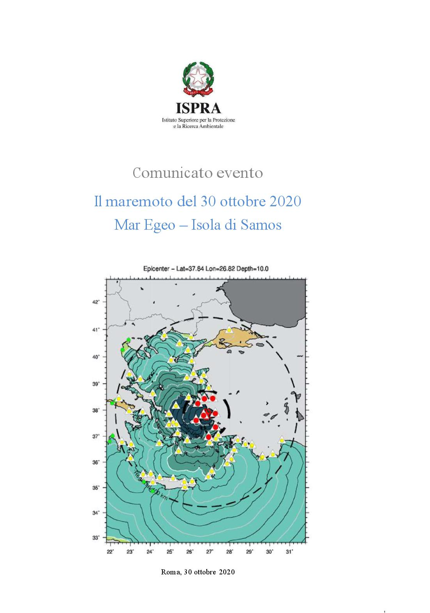
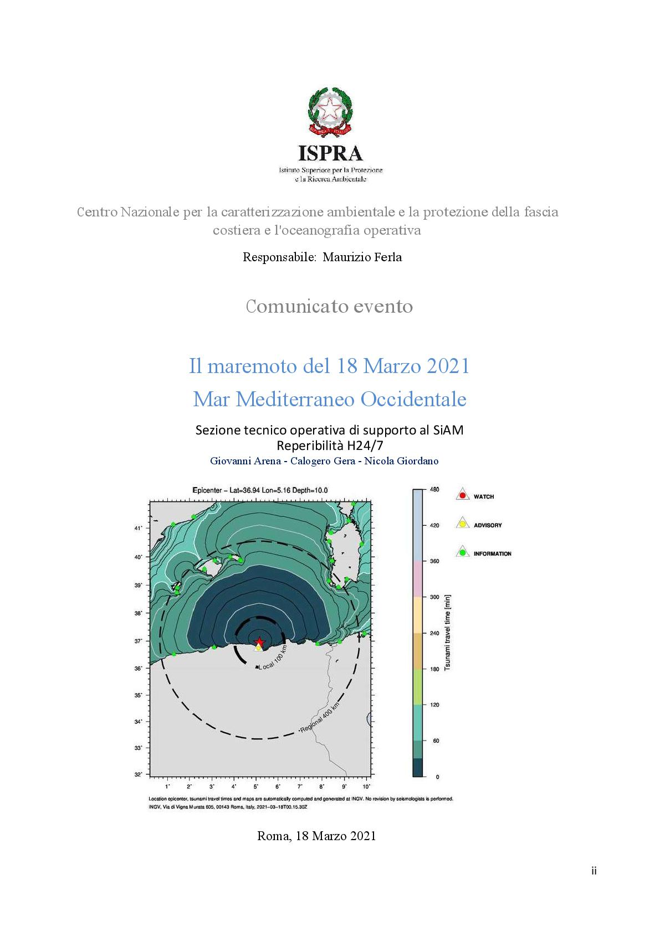
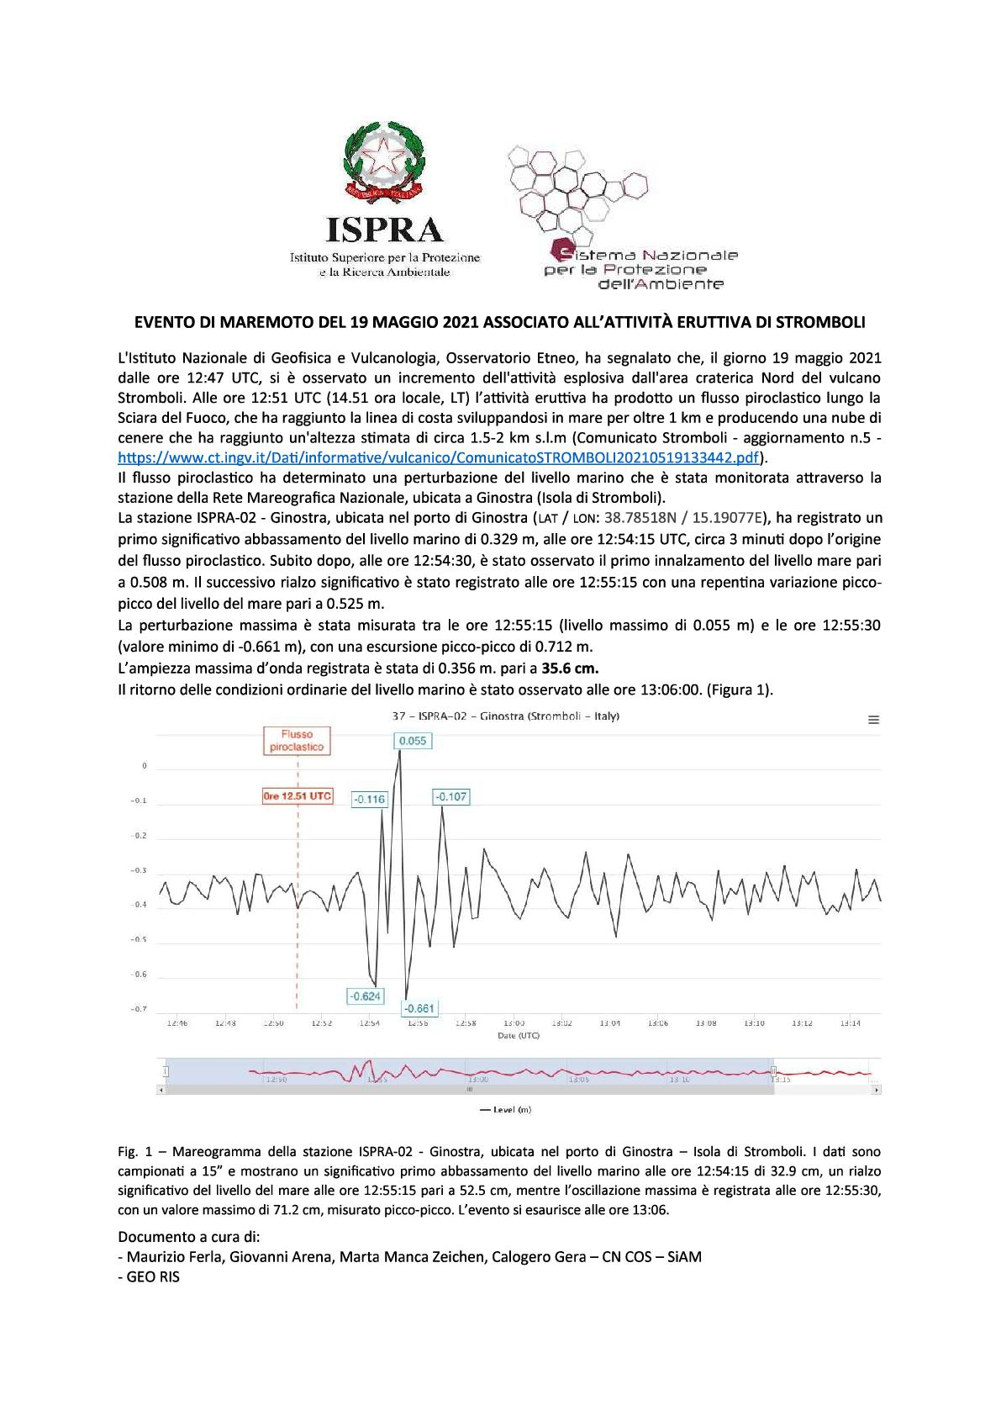
TECHNICAL REPORTS
www.isprambiente.gov.it/it/servizi/sistema-nazionale-di-allerta-maremoti-1

Slide 22
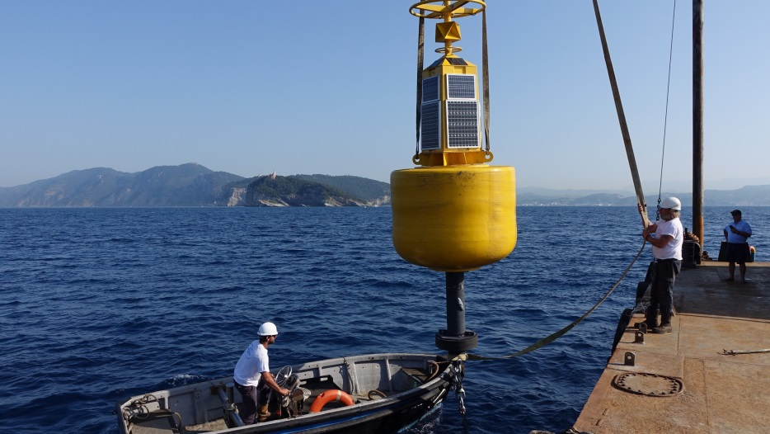
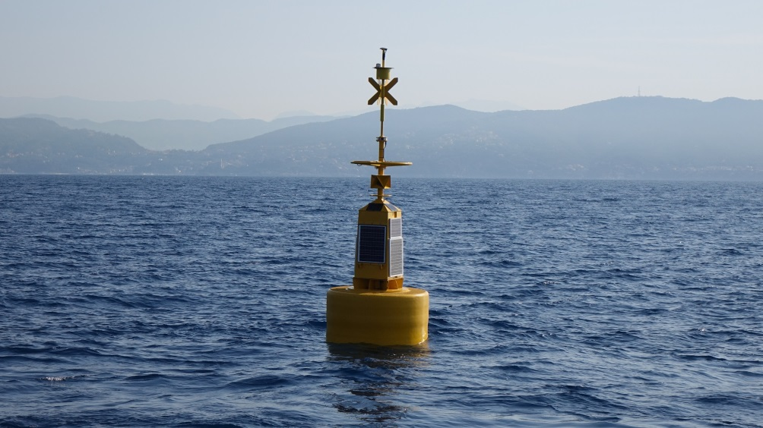
An experimental oceanographic buoy with a satellite data transmission system (GPS and Galileo) on board was installed off shore the Isle of Tino in front of La Spezia coastline in Liguria Region thanks to the collaboration between ISPRA and the European Commission’s Joint Research Center (JRC)
INNOVATIVE COMPONENT OF THE SYSTEM

Slide 23
Thank you very much for your kind attention!
Italian National Institute for Environmental Protection and Research (ISPRA)
National Centre for environmental characterization and protection of coasts,
marine climatology and operational oceanography
Director Maurizio Ferla
G. Arena, E. Giusta, C. Gera, P. Di Manna
(ISPRA-CN-COS & GEO-RIS)
tsunami.isprambiente.it/TAD_Server

