Slide 1

Seismic Early Warning Systems
NEAMTWS Experts Meeting
Implementing NEAMTWS 2030 Strategy
Opportunities and Actions to Explore
28-30 Nov, Naples, Italy
Reducing alert time for local system
A. Scala, A. Zollo, L. Elia, R. Rea, S. Colombelli, A. Amato

Slide 2
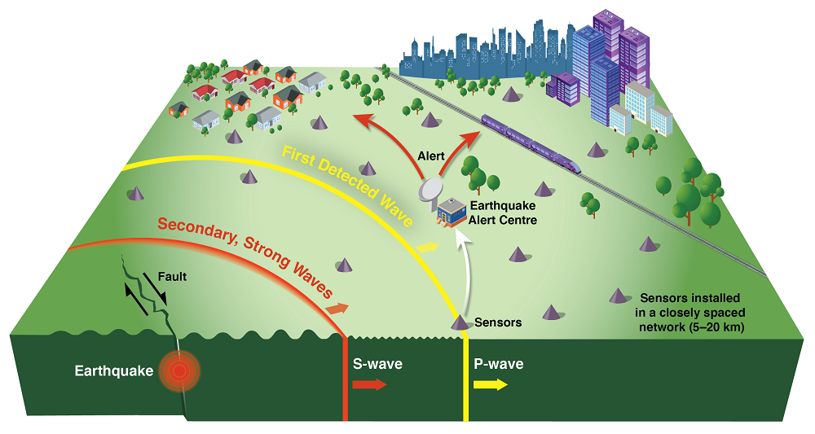
Earthquake Early Warning Systems
Earthquake
occurrence
Blind Zone
Data transmission
and processing
EEW
The EEWS identifies an ongoing earthquake and provides a warning before the ground shaking reaches the target site.
seconds
Alert
Emergency
actions
https://earthquakescanada.nrcan.gc.ca/eew-asp/system-en.php
Notes:
The development and operation of earthquake early warning systems are among the most effective strategies to mitigate in real-time the losses and damage caused by earthquakes. An EEWS grounds on the detection and analysis of early P-waves, it promptly characterizes the earthquake size and potential impact and issues a warning before the ground motion reaches the sites at risk.

Slide 3
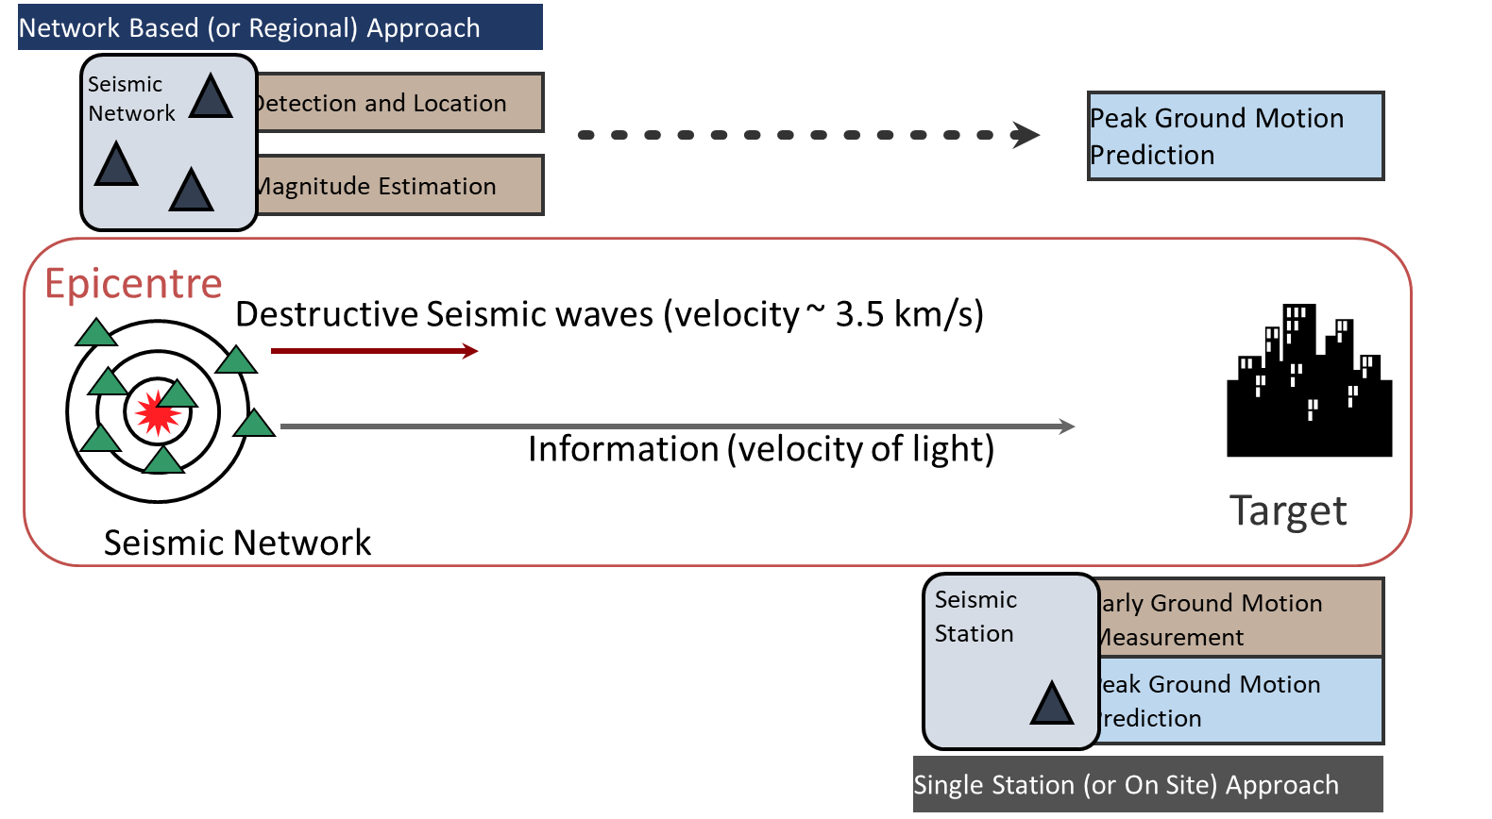
Basic Concepts & configurations of EEWS
EEWS: automatic system able to identify an ongoing earthquake and provide a warning before the ground shaking reaches the target site
Measure the P-wave amplitude (Pd,Pv,Pa) and/or characteristic period (Tc,Tp) on short, eventually expanded, time windows along the seismogram
Network-based or regional: Use P-wave amplitude (Pd,Pv,Pa) and characteristic period (Tc,Tp) to predict magnitude, given the real-time earthquake location.
Onsite or threshold-based: Use P-wave amplitude (Pd,Pv,Pa) to predict Peak Ground Motion (PGV,PGA)
Integrated regional-onsite: Use P-wave amplitude (Pd,Pv,Pa) and characteristic period (Tc,Tp) to produce P-wave-based «early shake map» for EW
Notes:
Let us review some basic definition about EEW and RR systems.
EEWS are automatic systems, able to fast detect an ongoing earthquake rupture and provide a warning based on the expected eqk impact at a target site
Most of current P-wave based EEWS
measure the P-amplitude and/or a characteristic period in an expanded P-wave time window
Regional/netw based: Use these proxies to estimate the location and magnitude → predict PGV/PGA through GMPES
Onsite: by-pass the estimate of magnitude/location →predict PGV/PGA from P-peak amplitude
Integrated R/OS: for network which densely cover the near and far source distance range, the two approached are mixed and jointly used depending on the time from the EQK orign and distance of the target

Slide 4
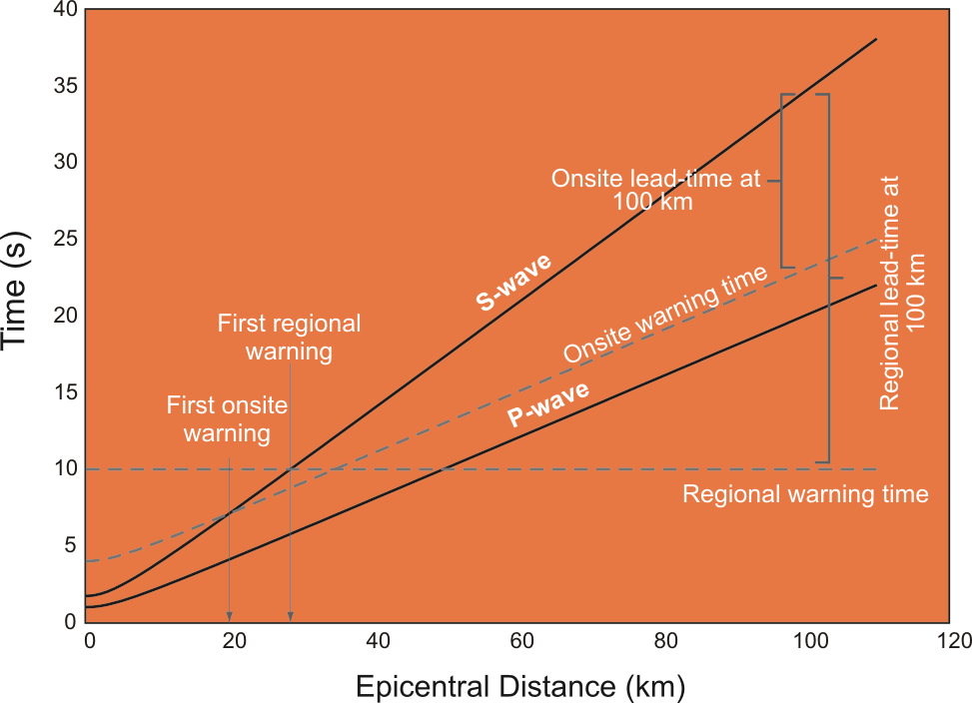
Warning-time and Lead-time:
EW network-based systems
The warning-time is the time needed to issue the first eqk info and alert
The blind-zone radius is the distance within which the first S waves arrive before the alert.
The lead-time is the time available for RT mitigation actions, e.g S-wave arrival time – warning time.
«Netw-Based» Early Warning
The network-based EWS issues an alert based on eqk location-magnitude-predicted shaking
The warning time depends on Pwave travel-time, telemetry and computations → travel-time at 4+ stations + telemetry + P-windows + data processing (ex. 6 sec)
The blind-zone radius depends on the warning time
The lead-time increases with the distance from the source
S-wave
lead-time
P-wave
Blind-zone
Data processing
warning-time 6 sec
Notes:
The netw-based EEWS issues an alert based on the rapid determination of the eqk-location and magnitude. For this reason they are also denoted source - based EW systems.
In aby EEWS three parameters are relevant for their application:
The warning-time, the time needed to issue the first eqk info and alert
The blind-zone radius, the distance within which the first S waves arrive before the alert.
The lead-time, the time available for RT mitigation actions, e.g S-wave arrival time – warning time.
While source-based EWS are designed to provide fast and accurate source parameter estimation, they are less reliable in the prediction of the potential ground shaking

Slide 5
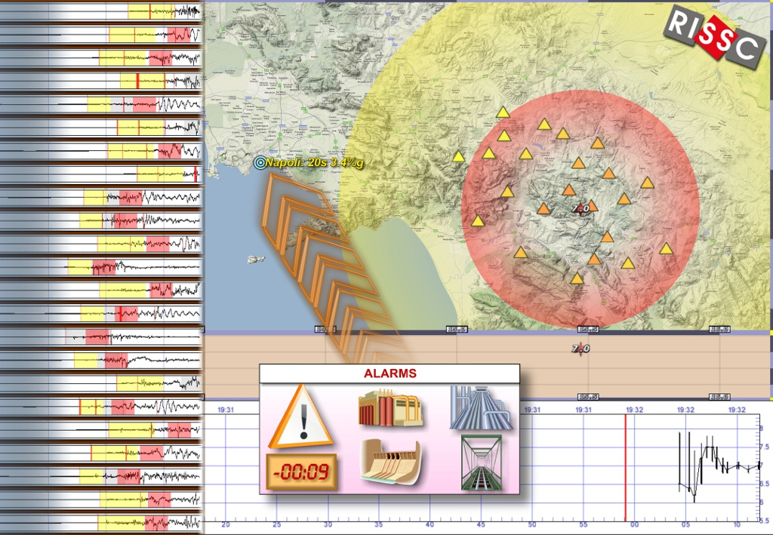
PRESTo: PRobabilistic and Evolutionary early warning SysTem
PRESTo is a free and open source software platform for network-based Earthquake Early Warning.
It integrates recent algorithms for real-time, rapid earthquake location, magnitude estimation and damage assessment.
Notes:
PRESTo is a free and open source software platform for Earthquake Early Warning.
It integrates recent algorithms for real-time, rapid earthquake location, magnitude estimation and damage assessment.

Slide 6
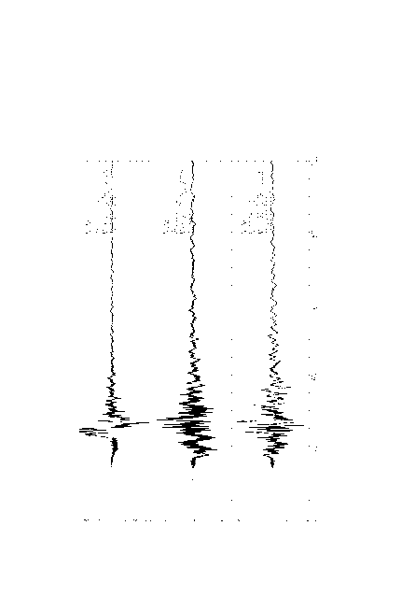
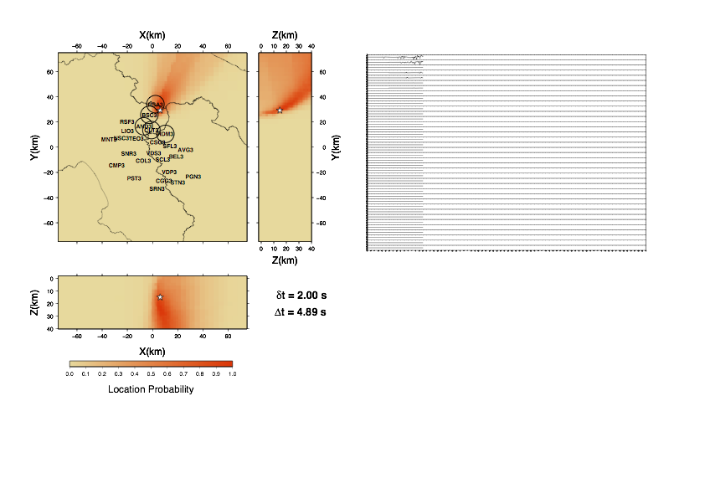
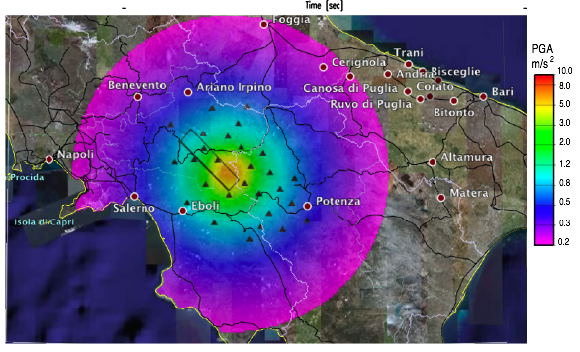
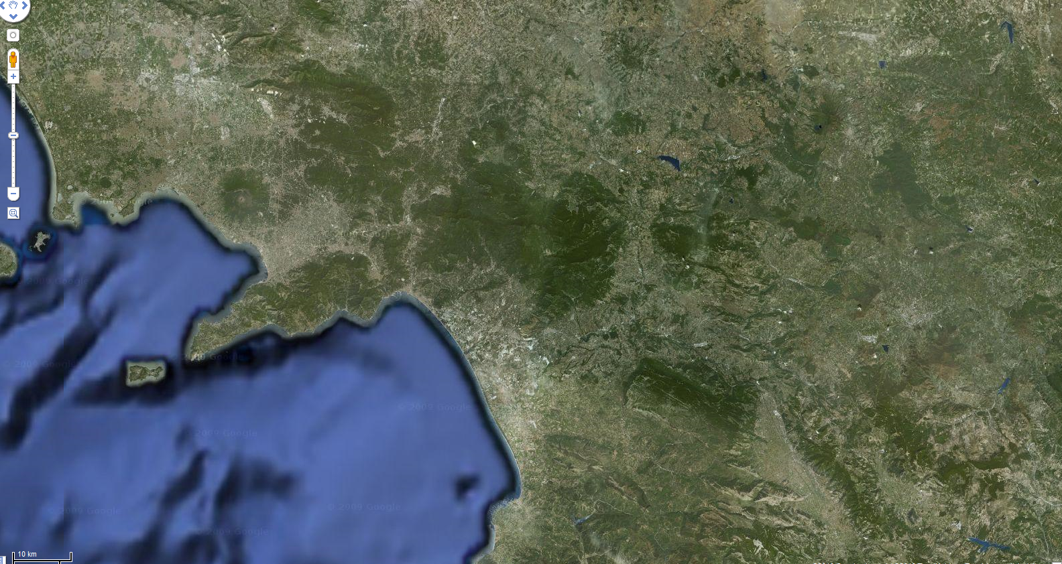
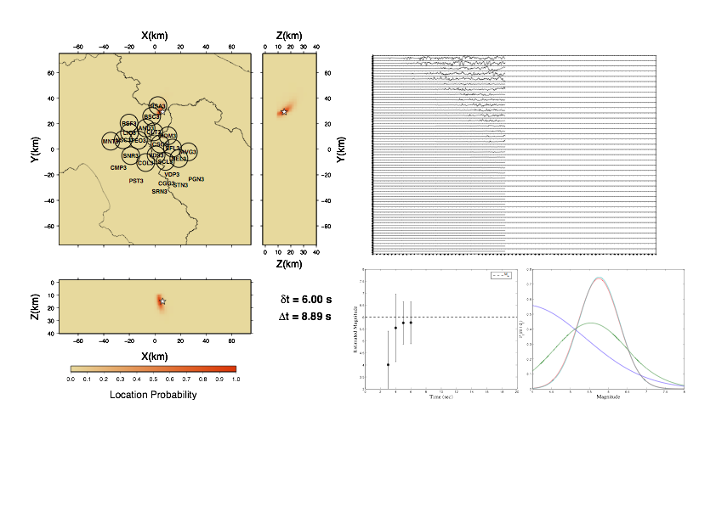
SECS AVAILABLE TO TARGET
 |  |  |  | 17 | 15 | 13 | 11 | 9 | 7 | 5 | 3 | 1
P-Waves at
1st Station
Probabilistic
Location
Regional Scale
Peak Ground Motion
PRESTo :
Source Based
Early Warning method
85 km
P
NAPLES
C
TARGET
Origin Time
Bayesian
Magnitude
S-Waves
At Target
0 | 2 | 4 | 6 | 8 | 10 | 12 | 14 | 16 | 18 | 20 | 22 | 24
SECS FROM ORIGIN TIME
Notes:
Here we show a typical time line of the PRESTo platform, as applied to the detection and warning of South Italy earthquakes in the Irpinia and Basilicata regions. At about 4-5 sec from the origin the first P-wave are recorded at the network, 2 seconds later the first location is available using a probabilistic method, then the magnitude is obtained through the measurement of the peak displacement amplitude in an expanded P-wave time window. Knowing the location and magnitude the Peak Ground velocity and acceleration is predicted at any site of the region using regional-calibrated GMPEs

Slide 7
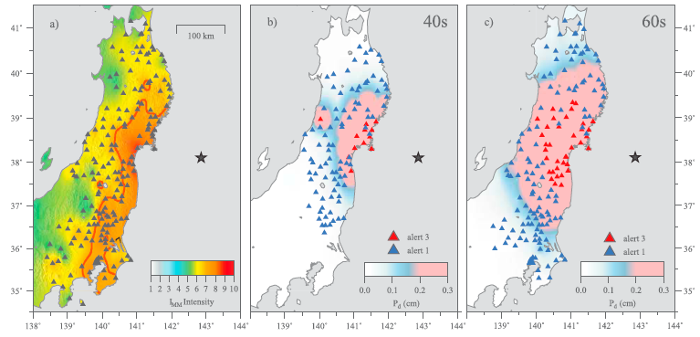
QUAKEUP EEW
Quake-UP
  P-wave contouring of the Potential Damage Zone
METHODOLOGIES: real-time signal processing, source modelling and impact prediction
  Finder (ETHZ)
  Data assimilation (JMA)
  PLUM (JMA, USGS)
  Quake-UP (UNINA)
Track the expected strong shaking zone while the earthquake rupture is still ongoing
Research developments at the University of Naples Federico II
Post-event
Intensity
Real-Time
PDZ
Notes:
A strong limitation of most of current EEW and RR systems are the simplifying assumption about the earthquake source and wave propagation. A number of new methodologie have been recently developed to allow the space-time tracking of the rupture and related strong shaking zone. Among these different techniques we have worked to a method which uses P-wave peak amplitudes and characteristic period to contour the potential damage zone as a function of the time

Slide 8
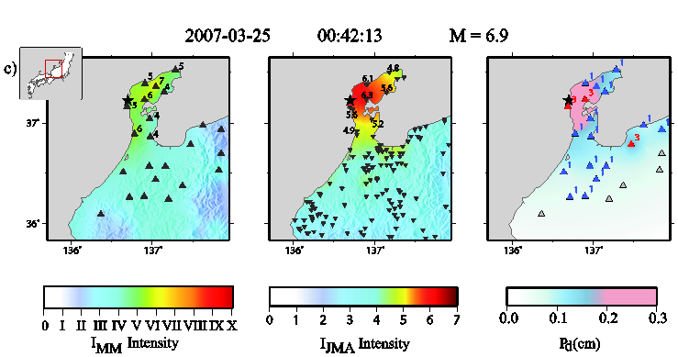

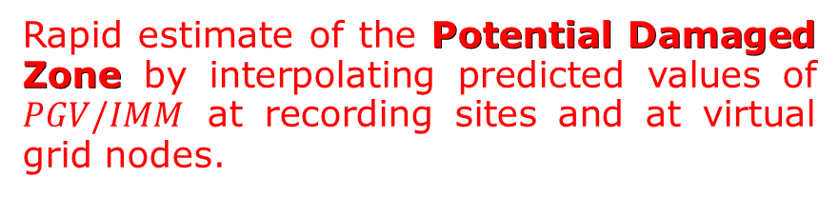
Rapid Damage Evaluation &
Potential Damaged Zone
QUAKEUP:
Impact-Based
Early Warning method
Rapid estimate of the Potential Damaged Zone by interpolating predicted values of $PGV/IMM$ at recording sites and at virtual grid nodes.
Potential Damaged Zone (PDZ)
PGV predicted by $measured P_{x}$
PGV predicted by GMPE
Scaling between Pd and PGV
The PDZ is the area delimited by an user-defined IMM/PGV potential damage countour level (e.g. IMCS>VII , PGV>6.37 cm/s. INGV Shakemap)
Colombelli et al., 2012 BSSA
Notes:
Along this direction our group has recently developed a new method, QuakeUp, that uses an impact-based strategy to issue the alert. The method calculate Potential Damage Zone the is the are where the peak ground motion is expected to exceed a threshold in PGV or Instrumental Intensity define by the user. This may correspond, for instance to IMM VII and PGV This is obtained by interpolating the PGV value predicted by P-wave amplitude at recording sites and PGV values predicted by the GMPE using the real-time determination of the earthquake location and magnitude

Slide 9
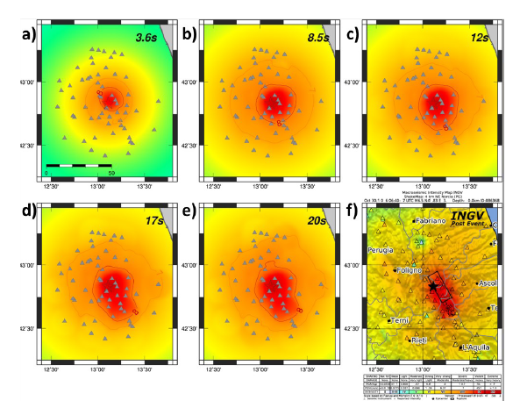
Case Study: 2016-10-30, M 6.5, Norcia (Italy) Eqk
Examples of the evolutionary, P-wave based early shake maps at different seconds from origin time.
Rupture directivity
Epicenter
Stations
P-wave predicted PDZ
Contour lines
Rupture directivity
Zollo et al., 2022
Earth & Space Science (under review)
Notes:
Examples of the evolutionary, P-wave based early shake maps at different seconds from origin time (reported in each panel). In each panel, stations are the gray triangles, the red star is the epicenter of the event and the contour lines for the predicted intensity levels VII and VIII are also shown. The bottom-right panel is the reference INGV shake map. This application shows clearly the effect of rupture directivity on the areal distribution of the peak ground motion which is well retrieved by the Quake Up method.

Slide 10
Offline application of presto & quake-up eew simulated M 7, Messina strait earthquake
In collaboration with the CAT-INGV research team
Notes:
Here I show the offline application of the two described early warning methods, the source-based PRESTo and the impact-based QUAKE to a simulated scenario for a M 7 events occurring in the Messina strait

Slide 11
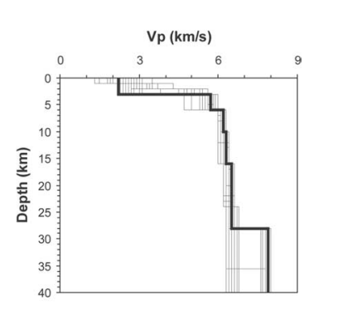
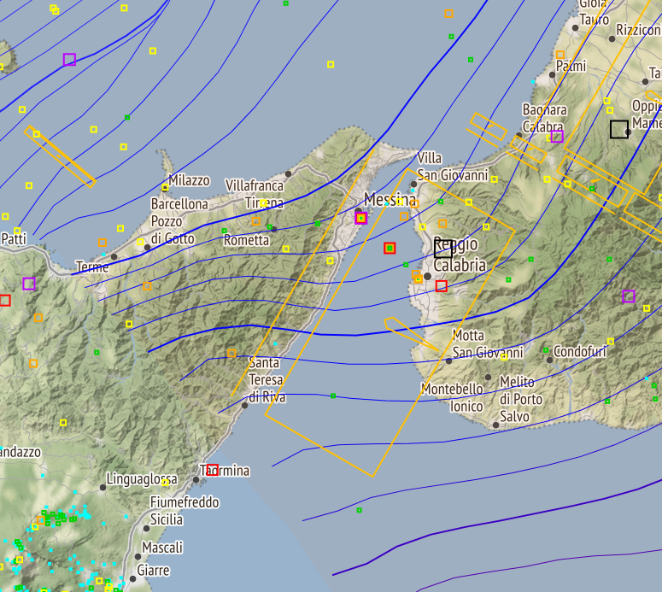
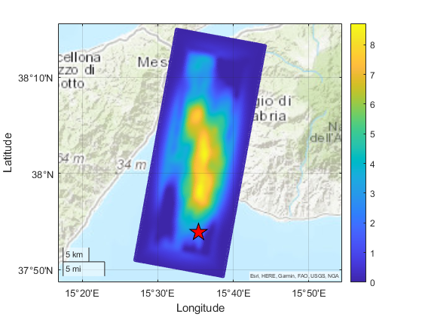
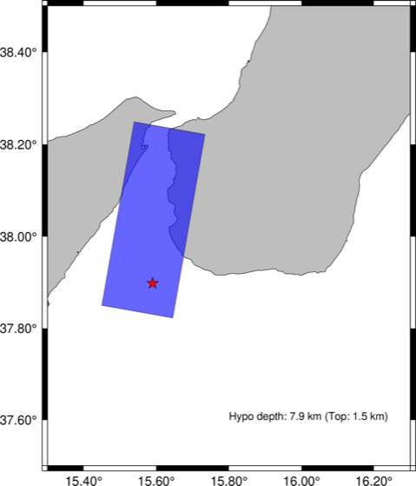
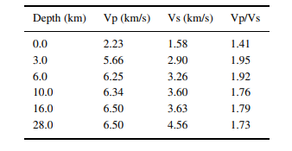
Source kinematic modelling
I – Source geometry
II – Source kinematics
III - 1D Velocity model
(Scala et al. 2018)
(Musumeci et al. 2003)
Strike 10°
Dip 30°
Rake 100°
<Slip> 2 m
V_{r} 2.5 km/s
Variable rise-time
k⁻² slip
INGV-CAT group (personal communication)
Notes:
We simulated the occurrence of a magnitude 7, average slip 2 m, along a 40x20 km^2 rectangular fault oriented N10°W, a low dip angle of 30° and a near-normal fault mechanism. The rupture nucleates from the left-bottom angle of the fault, with a dominant rupture direction toward the north. The slip model is assumed to have a k-square wavelength distribution with a main gaussian patch at the center summed to a number of small scale asperities, stocastically distributed to reproduce the high frequency content of seismograms. A 1D elastic , uniform Q model is assumed for wave propagation to the surface.

Slide 12
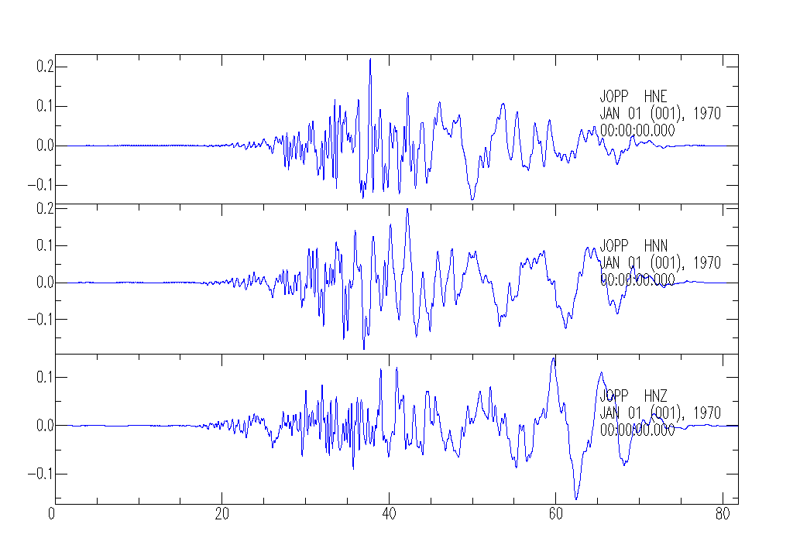
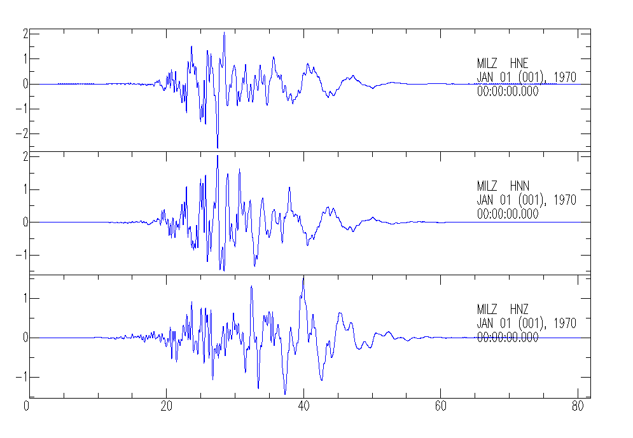
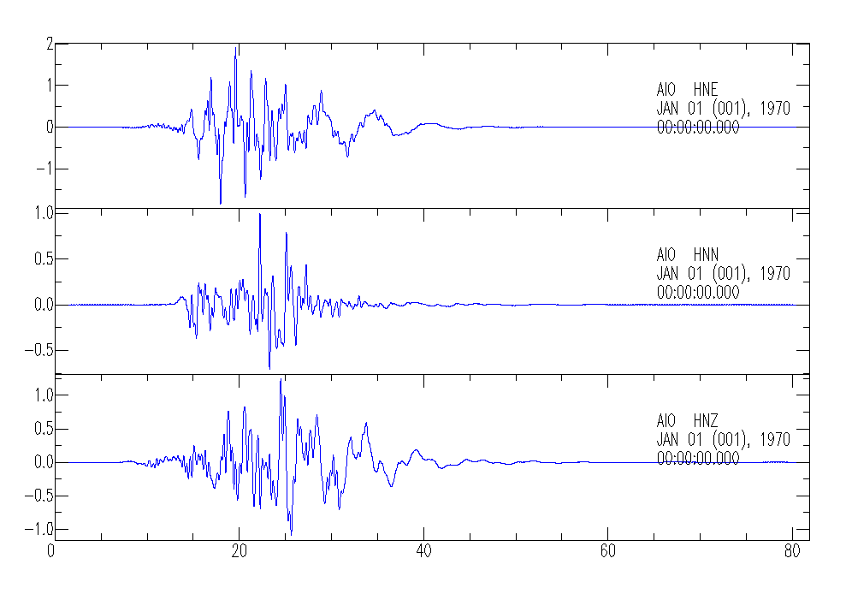
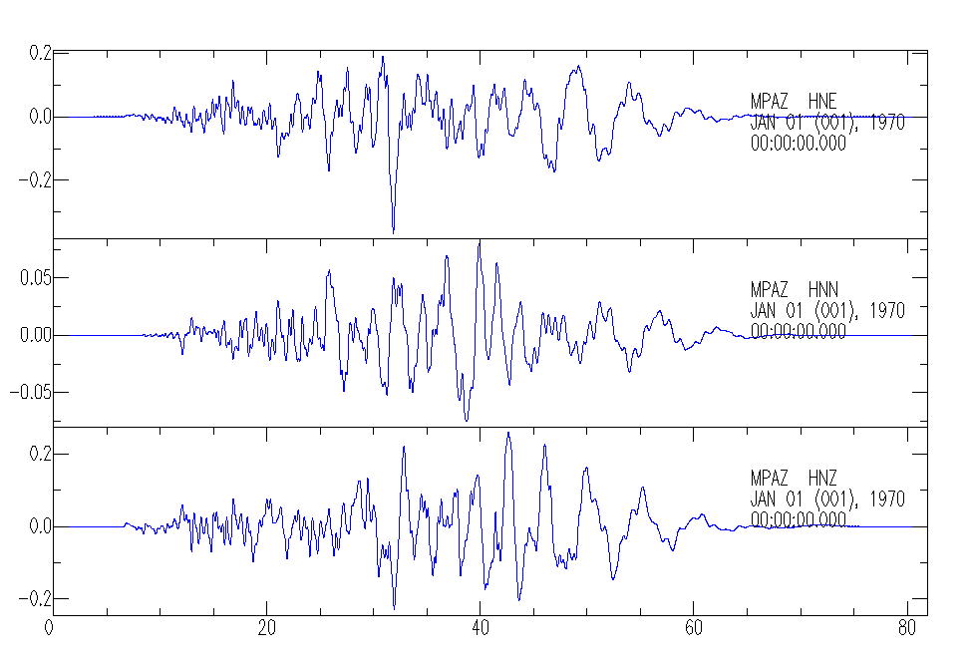
Synthetic seismograms
Acc (m/s²)
Acc (m/s²)
Time (s)
Time (s)
Acc (m/s²)
78 stations (max distance 125 km) of the INGV+DPC-RAN networks operating in RT in the region
Acc (m/s²)
Time (s)
Time (s)
Notes:
The complete wavefield method implemented in the code AXITRA is used to simulate the seismic radiation at 88 stations of the ING+DPC-RAN network, with a maximum epicentral distance of 125 km. 78 station are located within 100 km. Here we show example of the 3-component synthetic seismograms at station located at different azimuth from the source.

Slide 13
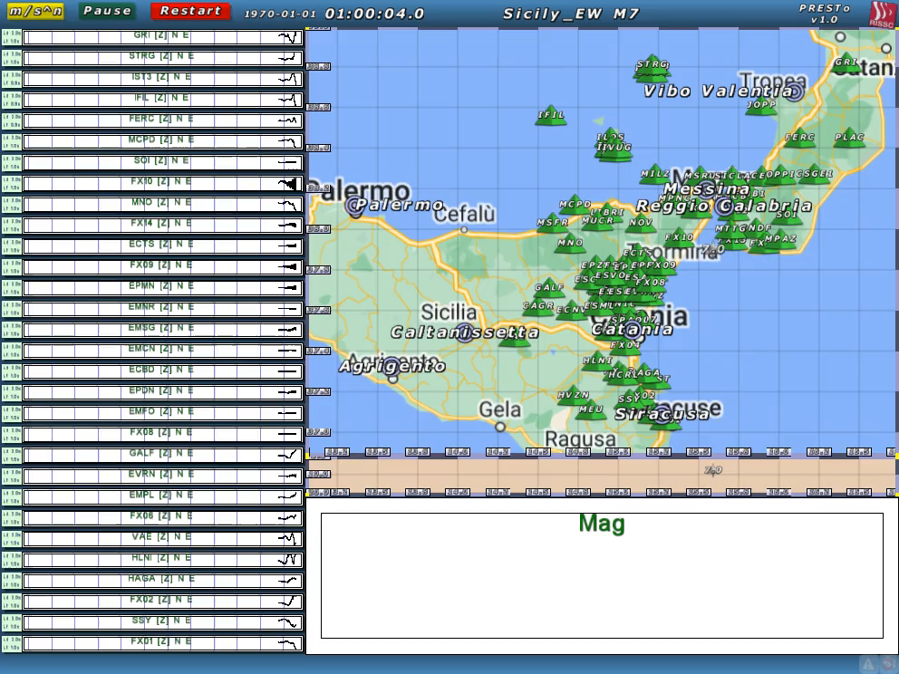
PRESTo: Playback Animation of Sicily M7 Scenario
Notes:
Here is an Animation showing the operation of the platform PRESTo. The first eqk location and magnitude estimation is available at about 7 sec after the OT. The initial magnitude is underestimated (6.5) but the use of progressive expanded Pwave windows at distant stations allows to converge at about 11 sec to a M about 7 which is the true magnitude of the event.

Slide 14
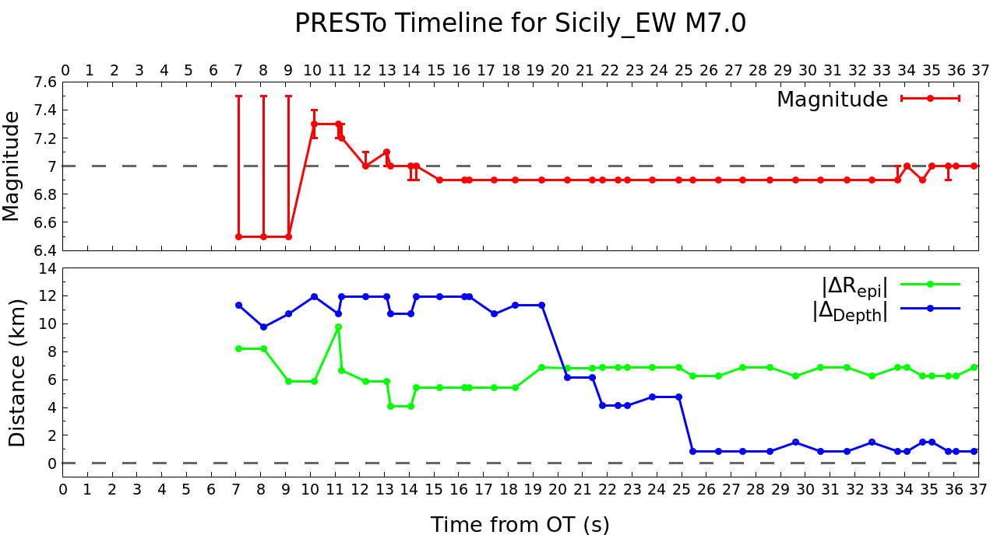
PRESTo: Timeline of Location and Magnitude Estimates
Notes:
Time evolution of the estimation of the magnitude and location as evaluated by the method Presto. The initial magnitude is underestimated due to the use of too short P-wave time window. The arrival of S waves at closest stations causes the increment of the Magnitude few sec later, then the value stabilizes at about 12 sec at the true magnitude (7). The bottom plot shows the error epicentral distance and depth, relative to the true location. We can se that even in case of large depth uncertainty the magnitude is relatively well determined. At about 20 sec the location stabilizes with at a location/depth close to the true one.

Slide 15
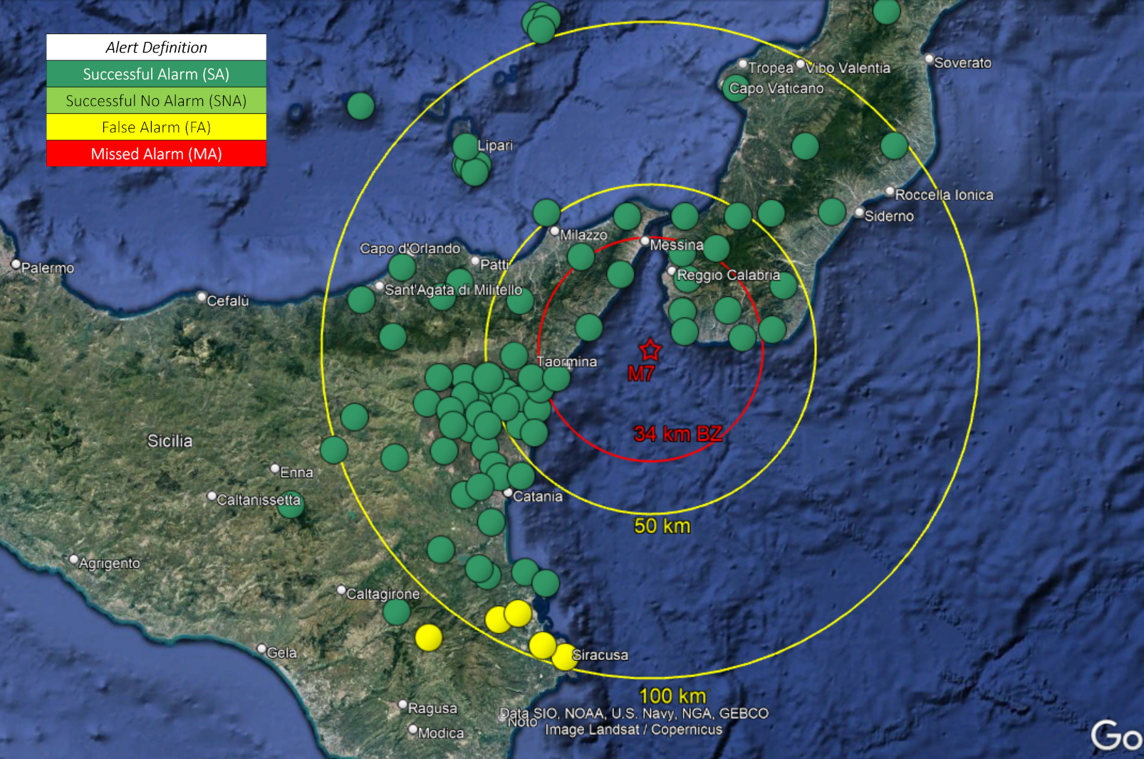
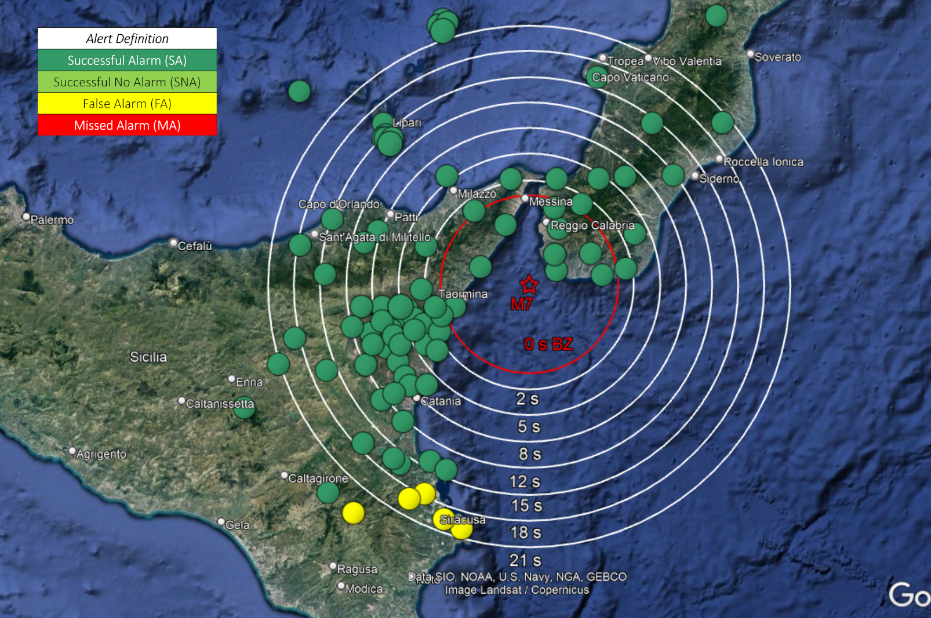
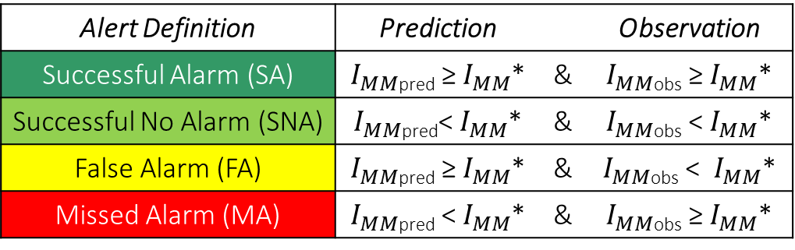
PRESTo: Performance of EW Alerts: Successful/False/Missed Alerts & Lead Times
Alert Definition | Prediction |  | Observation
Successful Alarm (SA) | $I_{MM}$_{pred} ≥ $I_{MM}$* | & | $I_{MM}$_{obs} ≥ $I_{MM}$*
Successful No Alarm (SNA) | $I_{MM}$_{pred}< $I_{MM}$* | & | $I_{MM}$_{obs} < $I_{MM}$*
False Alarm (FA) | $I_{MM}$_{pred} ≥ $I_{MM}$* | & | $I_{MM}$_{obs} < $I_{MM}$*
Missed Alarm (MA) | $I_{MM}$_{pred} < $I_{MM}$* | & | $I_{MM}$_{obs} ≥ $I_{MM}$*
Lead Time (s) at Target Site
=
Time of S-waves Arrival–Time of EW Alert
74 SA (95%)
4 FA (5%)
0 MA (0%)
Stable M/loc at time OT+11 sec
Stable M/loc at time OT+12 sec and OT+25 sec
BZ: 34 km radius
LT: 2 to 21 sec at
40-100 km distance
Notes:
The performance of the PRESTo EW system is evaluated in terms of the quality of the impact prediction (figure at the bottom left) and of the blind-zone extent and lead-time, the time available for safety emergency actions (figure at the bottom right). To quantify the quality of the impact prediction, we define 4 conditions for successful alert, successful no-alert, missed alert and false alert. At the time when PRESTo achieve a stable location and magnitude we observe 95% of SA and only 5% of false alerts in a radius of 100 km. The blind zone has a radius of 34 km, lead times varies bw 2 sec and 21 sec bw 40 and 100 km distance.

Slide 16
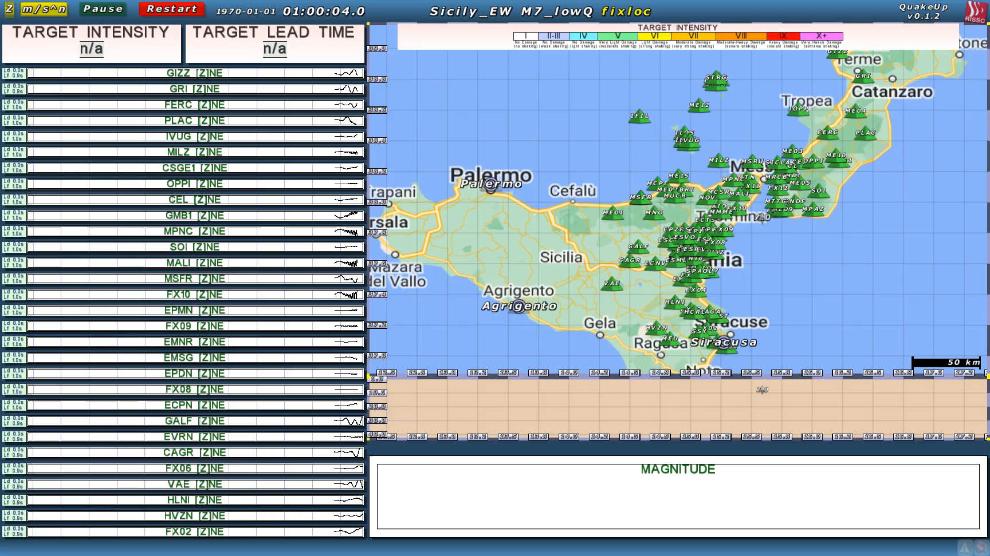
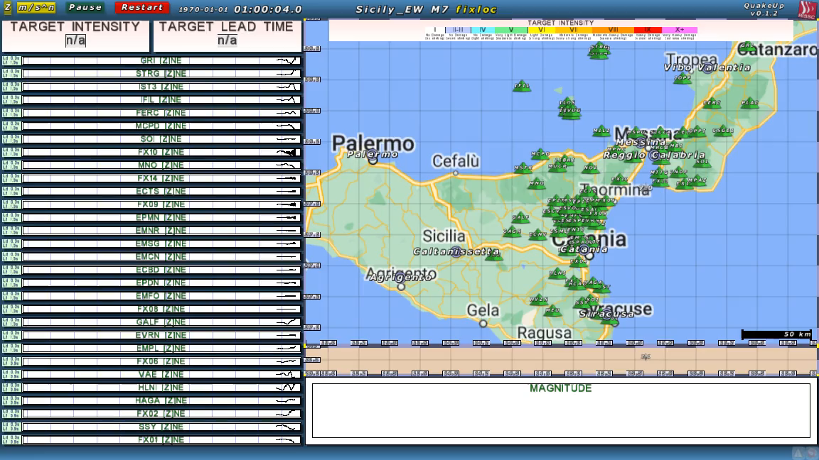
QuakeUp: Playback Animation of Sicily M7 Scenario
Notes:
This animation show the operation of the early warning method QuakeUp. The first location and magnitude are available at about 7 sec, with a preliminary near-circular traced Potential Damage Zone. As for PRESTO the initial magnitude is underestimated. As the time increase the shape of the Potential damage zone , here corresponding at a predicted Intensity greater than VIII-IX, show a clear rupture directivity twd Nord and a dominant elongation at N-NW. At about 17 sec the shape of the PDZ stabilizes maintaining an elongation in the N-Nw direction

Slide 17
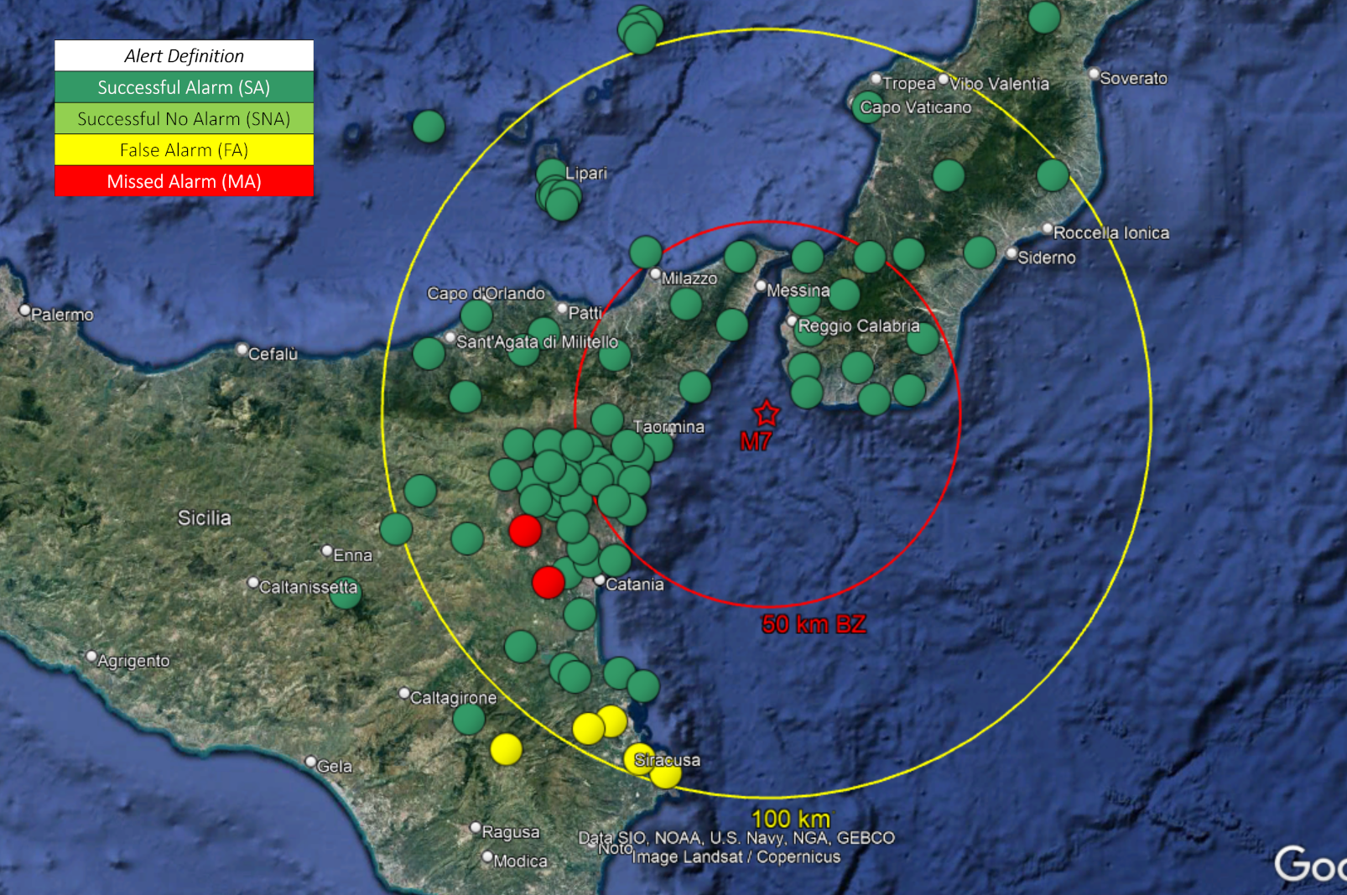
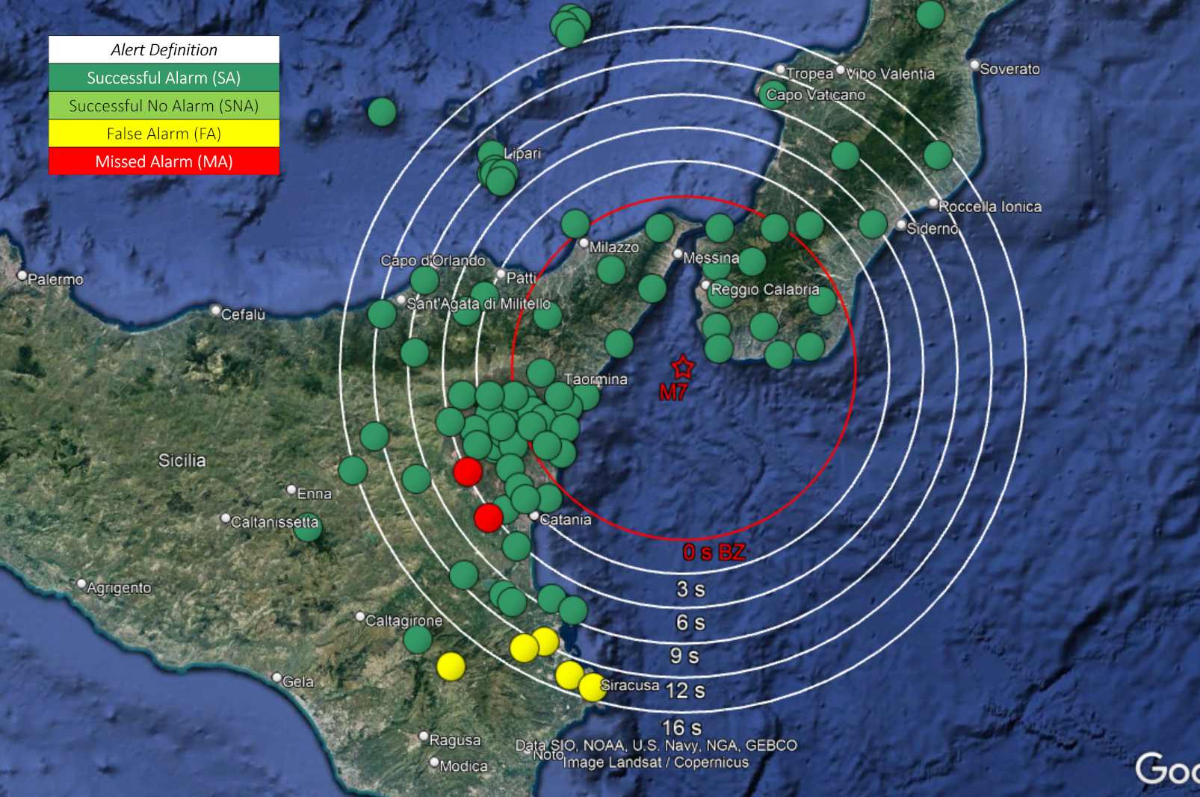
QuakeUp: Performance & Lead Times
(Stable Alert = OT + 17.1s = 1st + 10s, I_{MM}* = VII)
Within 100 km epi distance:
72 Successful Alert (92%)
2MA Missed Alerts (3 %)
4 FA False Alerts (5%)
Blind-zone : 50 km radius
Within 100 km epi distance:
Lead-times from 3 to 16 sec at distances bw 60 and 100 km
Notes:
The performance of QuakeUp. As for the quality of the impact prediction, in a radius of 100 km from the epicenter, at the time of stabilization (17 sec), we have a large majority of successufull alerts with 2 missed alerts and 4 false alerts. The blind-zone has a radius of 50 km, and lead-times vary bw 3 and 16 sec in a range of 60 to 100 km

Slide 18
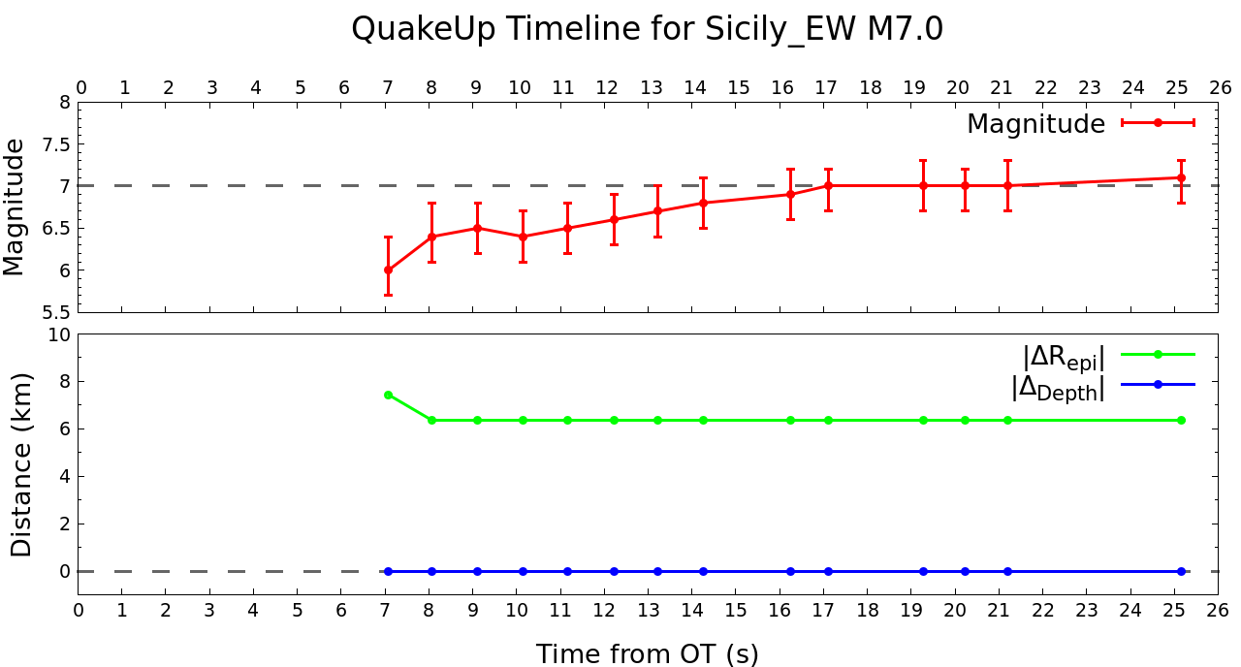
QuakeUp: Timeline of Location and Magnitude Estimates
Magnitude converge at stable (and true) value
6.0 at OT+7S → 7.0 AT OT+17S
Stable result despite of a larger uncertainty in the location estimate with respect to the PRESTo outcomes
TIMELINE
OT
7 s
11 s
17 s
25 s
60 s
First ALERT
M (PRESTo) 6.5
M (Quake-UP) 6.0
Stable
M (PRESTo) 7.0
Stable M
M (Quake-UP) 7.0
Preliminary ShakeMap
Stable location
PRESTo
Final ShakeMap
Quake-Up
Notes:
The time evolution plot shows a regular increase of the magnitude from an initial value of 6 to 7 in about 17 sec from the OT when it reaches the true value. In this simulation we fixed the depth at the true value for reasons of convergency. The final epicenter stabilizes at a distance of 6 km from the true one.

Slide 19
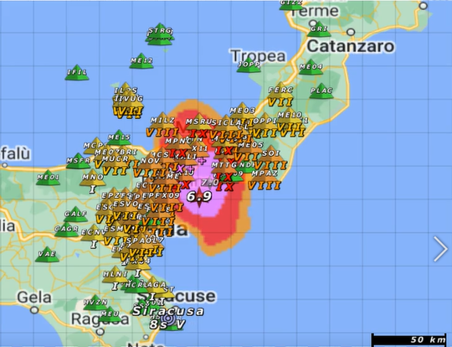
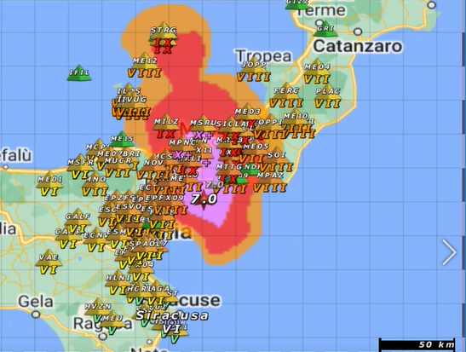
QuakeUp: Shake Map and Potential Damaged Zone (PDZ)
Early P-wave predicted shake map
Final shake map
OT + 17.0 s: M = 6.9
OT + 60.0 s: M = 7.0
Notes:
Here we compare the P-wave based “early” shake-map obtained after 17 sec from the OT, with the final shake map obtained from the PGV values measured at the end of the event. Especially for the Intensities larger than IX the two maps are very similar, both in the extension, direction and directive pattern of the rupture.

Slide 20
Conclusive remarks
Source-based Early Warning methods (PRESTo)
PROS: quickness, magnitude/location, impact prediction via GMPEs
CONS: point source approximation → no info about the extended source
Impact-based Early Warning methods (QUAKE-UP)
PROS: PDZ zone updated in real-time → source geometrical features???
CONS: Slower convergence towards the real location and magnitude
Simulation of the M 7 eqk Messina Strait (PRESTo + Quake-UP)
First alert after 6 s (Underestimated magnitude)
Stable magnitude after 12 s
Good location after 25 s
Geometrical source features → Can they be parametrized and used to reduce uncertainty in PTF???

Slide 21
NEAMTWS Experts Meeting
Implementing NEAMTWS 2030 Strategy
Opportunities and Actions to Explore
28-30 Nov, Naples, Italy
Reducing alert time for local system
Thank you for your attention

Slide 22
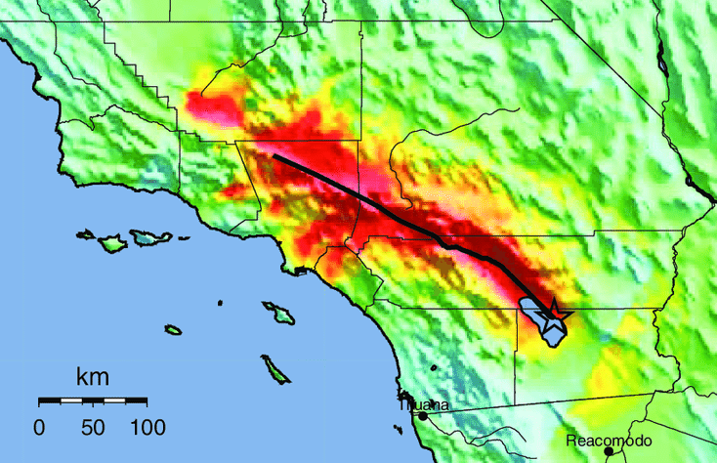
Earthquake Early Warning & Rapid Response Systems 2
Earthquake
occurrence
Blind Zone
Data transmission
and processing
EEW
The RRS provides information on strong ground shaking and potential damage for rapid emergency assistance, search, and rescue responses.
seconds
Alert
Satriano, C., Elia, L., Martino, C., Lancieri, M., Zollo, A., Iannaccone, G., 2011. PRESTo, the earthquake early warning system for Southern Italy: Concepts, capabilities and future perspectives. Soil Dynamics and Earthquake Engineering 31, 137–153. https://doi.org/10.1016/j.soildyn.2010.06.008
Zollo,A., Colombelli,S., Caruso, A. and L. Elia, 2022. An Impact-Based and Time-Evolutive Earthquake Early Warning Method , submitted to Earth and Space Science Open Archive JF , https://doi.org/10.1002/essoar.10512454.1 Y2
Emergency
actions
Shaking
minutes
RR
Impact and resilience
https://earthquakescanada.nrcan.gc.ca/eew-asp/system-en.php
Notes:
Few minutes later, the RRS , through the computation of ground shaking maps, provide information on the peak motion and estimate the potential damage cause by the earthquake. This information is vital during post-event emergency for assistance, search and rescue of people. The two systems operate on different time-scales (seconds to tens of seconds the EEW, minutes to several minutes the RRS). But they are naturally linked along the timeline of the earthquake source and wave propagation processes, so that in recent years the concerned scientific communities (seismologists and engineers) are working at fully integrating the technologies and methodologies underlying the two approaches and standardize the input and outputs.

Slide 23
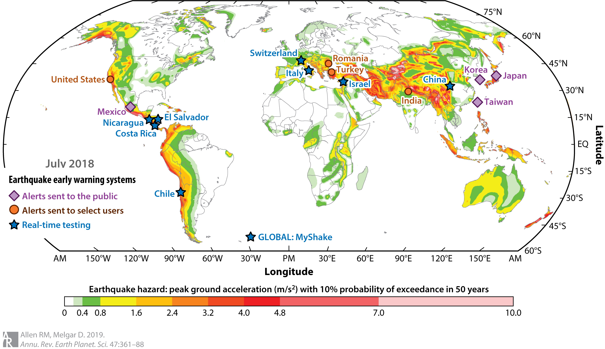
Status of earthquake early warning systems woldwide
Figure 2 Status of earthquake early warning systems in different regions of the globe. Shown are locations of systems that broadcast alerts to all members of the public (purple), systems distributing alerts to select users (orange), and systems undergoing real-time development and testing (blue). The background is the seismic hazard presented as peak ground acceleration with 10% probability of exceedance in 50 years. Allen & Melgar, Ann. Rev, 2019
Notes:
Status of earthquake early warning systems in different regions of the globe. Shown are locations of systems that broadcast alerts to all members of the public (purple), systems distributing alerts to select users (orange), and systems undergoing real-time development and testing (blue). The background is the seismic hazard presented as peak ground acceleration with 10% probability of exceedance in 50 years. Allen & Melgar, Ann. Rev, 2019

Slide 24
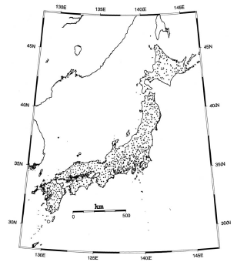
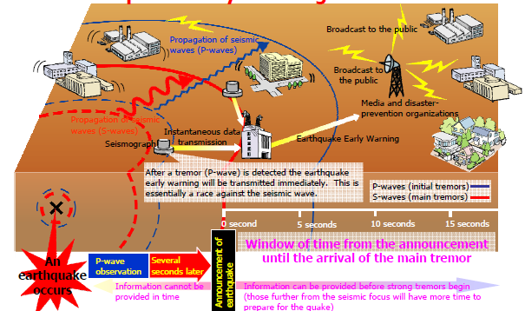
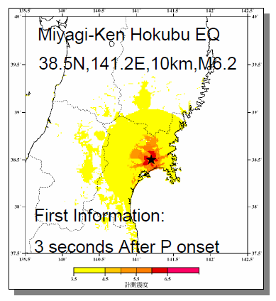
The Japan Meteorological Agency Early Warning System in Japan
JMA intensity
Notes:
The JMA system
The Earthquake Early Warning system provides advance announcement of the estimated seismic intensities and expected arrival time of strong shaking waves. These estimations are based on prompt analysis of the focus and magnitude of the earthquake using P wave form data observed by seismographs near the epicenter.
The Earthquake Early Warning is aimed at mitigating earthquake-related damage by allowing countermeasures such as promptly slowing down trains, controlling elevators to avoid danger and enabling people to quickly protect themselves in various environments such as factories, offices, houses and near cliffs

Slide 25
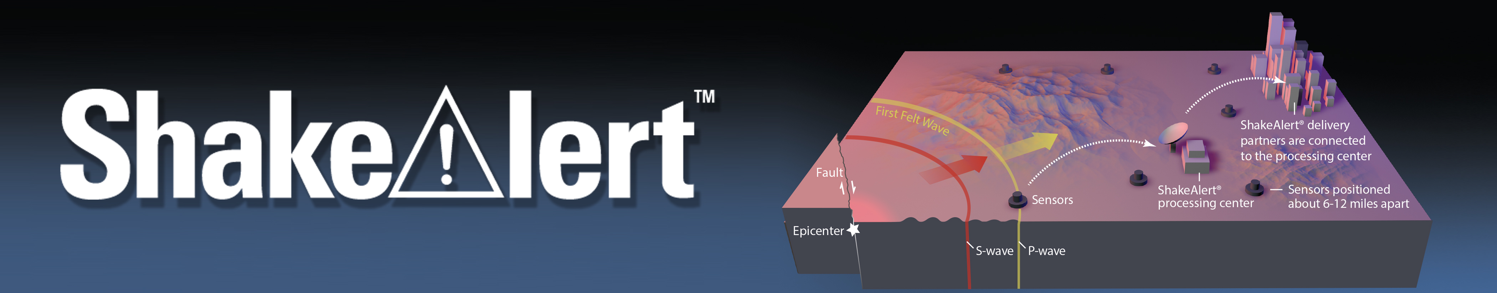
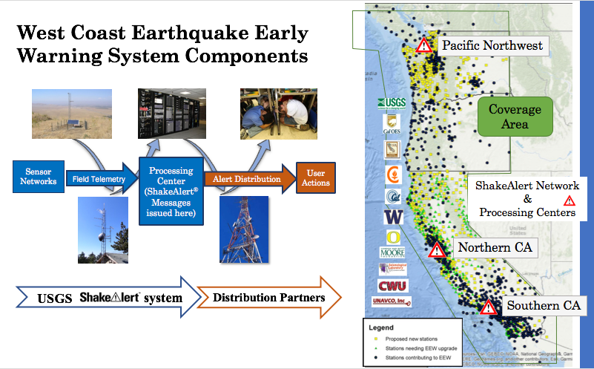
USA, ShakeAlert (since 2016)
ShakeAlert: An Earthquake Early Warning System for the West Coast of the United States
SA Integrates network-based and onsite algorithms
Notes:
The western USA system
The purpose of the ShakeAlert system is to identify and characterize an earthquake a few seconds after it begins, calculate the likely intensity of ground shaking that will result, and make alerts available for delivery to people and infrastructure in harm’s way. This can be done by detecting the first energy to radiate from an earthquake, the Primary (P) wave energy, which rarely causes damage.
25

Slide 26
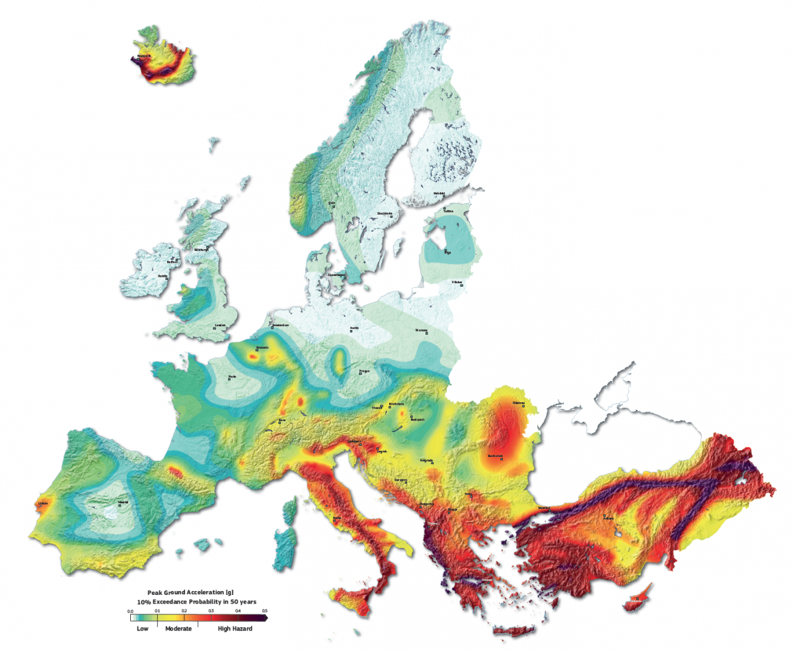
The EU Experience: Ongoing EW and Rapid Response system development
In the last decade, there has been a strong impulse to the development of EW & RR methodologies and technologies, mainly supported by EU research projects with the participation and involvement of researchers from different countries
Providing warnings
Iceland
Real-time testing
Feasibility study
C3RN
EU Projects:
SAFER
REAKT
EPOS-IP
SERA
RISE
TURN-KEY
Switzerland
Romania
Turkey
TABOO NFO
RRSM-based
ESM-based
RRSM -> ESM:
Updated location and magnitude, increased station density,
manually verified peak motions replace automatic readings
Spain
Irpinia NFO
Greece
EW: technologies are under testing and validation at Near Fault Observatory all over Europe
RR: Transition from a quasi-real-time Rapid Raw Strong Motion Portal to an EU SM-based one, including revised location, peak-motions and removal of outliers
Presently at:
shakemap-eu.ethz.ch
Notes:
In EU, during the last decade, there has been a strong impulse to the development of EW methodologies and technologies, mainly supported by EU research projects with the participation and involvement of researchers from different countries.
As a result, nowdays , a number of sites are still operating or experimenting for research purposes the EEWS technology, mainly in Italy, Switzerland, Romania, iceland, and so on.
(In the framework of EPOS , EW technologies are under testing and validation in a number of so-called Near Fault Observatory, aimed at investigating the earthquake preparation and large eartquke nucleation processes, through dense and multi-parametric observing systems)

Slide 27
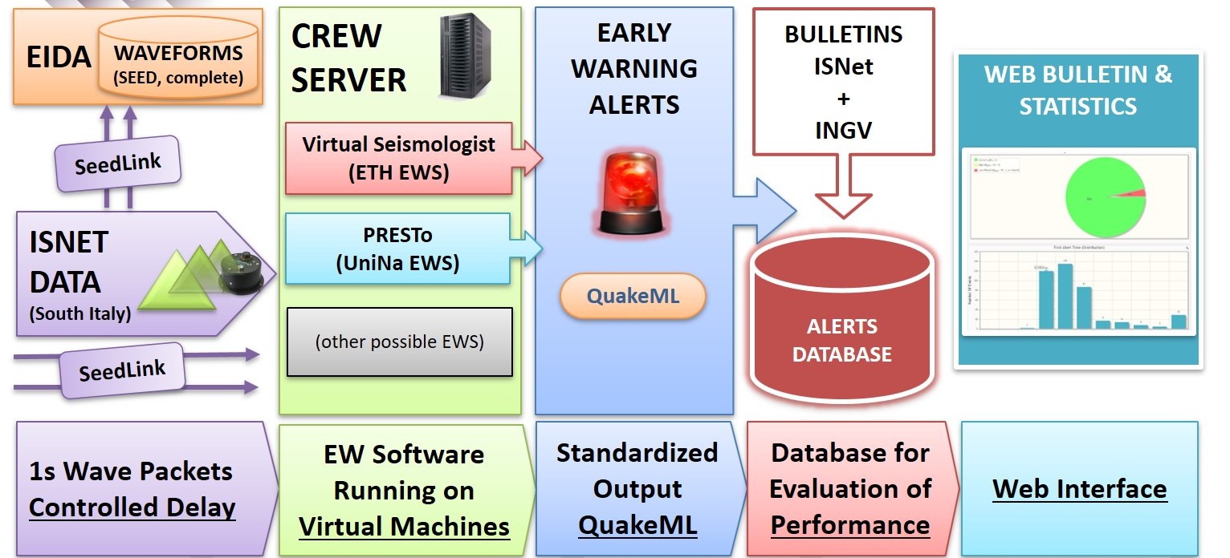
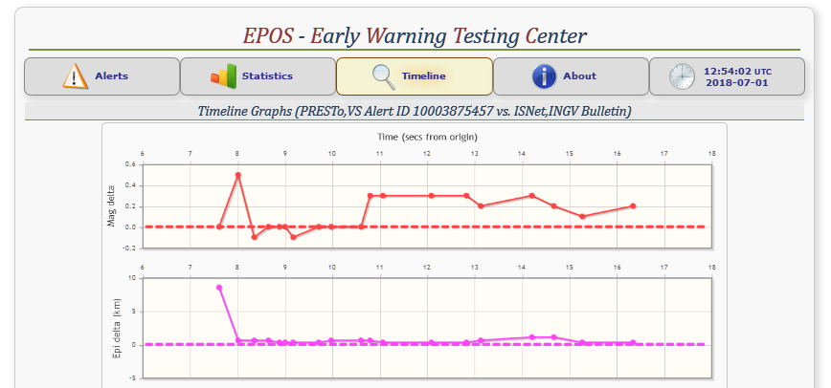

CREW (EU Testing Centre for Early Warning & source characterization) – EPOS: Near Fault Observatories
  CREW is a European-level testing facility for earthquake Early Warning systems
  CREW is the first Near Fault Observatory testing facility built on real-time high-resolution data
  CREW operates and benchmarks existing EEW methodologies, evaluating performances on community-based criteria
  CREW runs network-based EEW system only, onsite is under development
OPERATED at University of Naples, ISNET network
Notes:
As a follow up of this research effort, in the framework of EPOS we implemented CREW, an EU Testing center for EW
It is operated at the University of Naples and has ISNET as its core monitoring infrastructure
ISNET is a Near fault Observatory, aimed at the multi-parametric (seismic/geodetic) monitoring of seismicity related to the irpinia fault system
CREW operated and benchmark existing EEW methodologies, evaluate perfomance of community based criteria
Actually runs NB systems (VS and Presto) , onsite is under construction

Slide 28
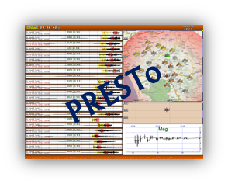
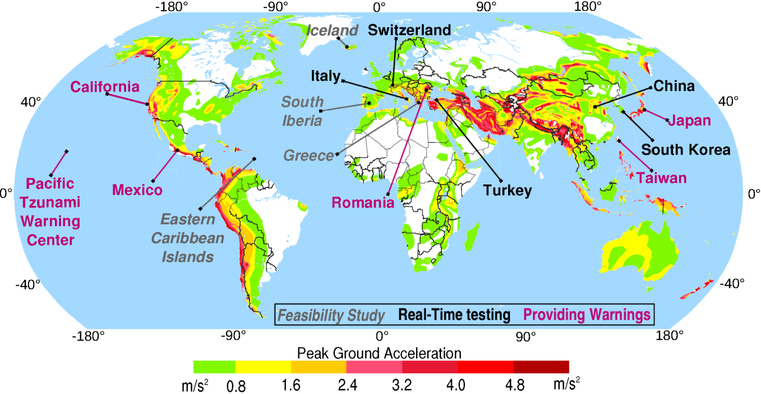
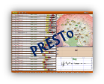
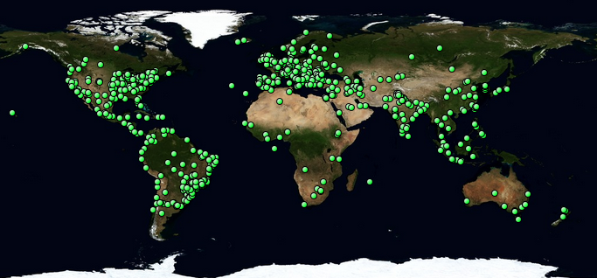
Worldwide Early Warning Systems & PRESTo
http://www.prestoews.org/
CE3RN
PRESTo is used/tested in:
Central & South Italy
CE3RN (ITA-AUT-SLO)
South Korea
Turkey
Romania
Spain
Greece
Israel
from Allen et al., SRL (2009)
Italy | 30.74%
USA | 9.59%
Brazil | 6.28%
Korea | 5.61%
India | 5.01%
China | 4.40%
Turkey | 2.35%
Greece | 2.26%
Ukraine | 1.97%
Israel | 1.95%
Taiwan | 1.79%
Canada | 1.59%
Iran | 1.52%
Indonesia | 1.43%
Romania | 1.39%
Download of
PRESTo
Notes:
World wide distribution and use of PRESTo. The software is used essentially for research purposes and as an alternative platform for event detection and P-wave magnitude determination

Slide 29
OT + 17.0 s: M = 6.9
OT + 60.0 s: M = 7.0

