Slide 1
Scientific Advisory board Meeting
20th October

Slide 2
PacMAN Pilot Project
1. Develop a marine “high risk” non-native invasive species monitoring plan
2. Build an easy to use (desk top) early warning decision support tool
PacMAN Video

Slide 3
PacMAN has 5 primary steps
4. Standardized bioinformatics and data management
5. A decision support tool for early warnings of invasive species presence
3. Training Program for local scientists and managers
1. Close work with partners
and stakeholders (co-development)
2. Establish baseline data and develop a monitoring Plan with eDNA analyses

Slide 4
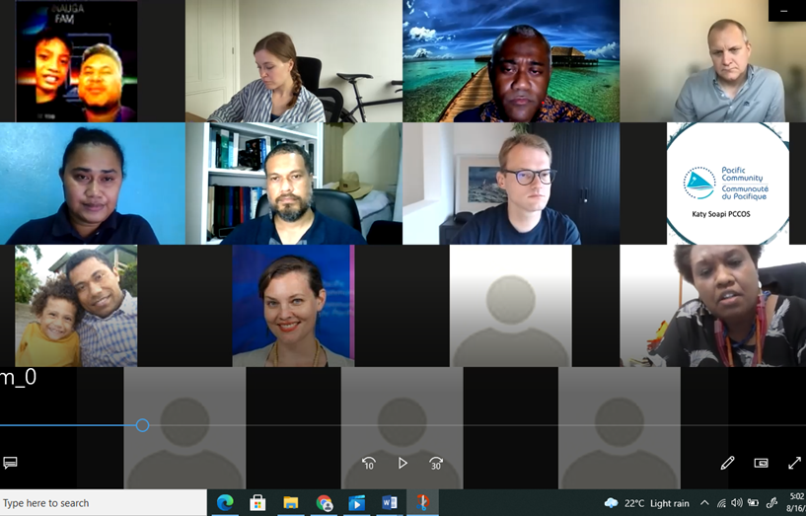
1. Close work with local stakeholders
Online survey (gap analysis) plus two stakeholder meetings were conducted virtually to capture information on stakeholder needs and expectations
Department of Environment (DoE) – Focal Point for CBD
Biosecurity Authority of Fiji (BAF) 8. International Union for the Conservation of Nature (Oceania office)
Fiji Ports Terminal Services + (FPTL, FSHIL) 9. Wider USP Academia (e.g. mariculture and aquaculture experts)
Maritime Safety Authority of Fiji (MSAF)
Fiji Ministry of Fisheries
Pacific Community (SPC)
Secretariat of the Regional Pacific Environment Programme (SPREP)
Online survey clarified misunderstandings of project scope in relation to ballast water and invasive species management expectations

Slide 5
4. Standardized bioinformatics and data management
5. A decision support tool for early warnings of invasive species presence
3. Training Program for local scientists and managers
1. Close work with partners
and stakeholders (co-development)
2. Establish baseline data and develop a monitoring Plan with eDNA analyses

Slide 6
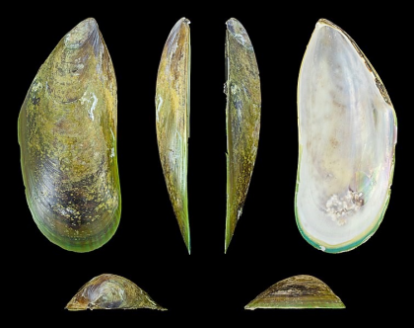
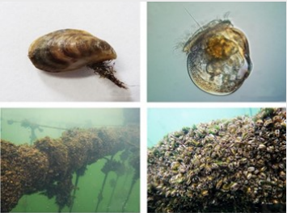
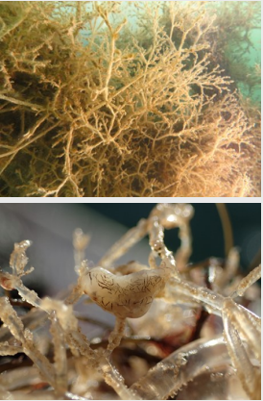
2. Co-Developing a Monitoring Plan
Identifying High Risk Taxa
Bysaal threads used to attach to substrate
Identified risk species and established a priority list from literature review and consultations with stakeholders and advisors
Nearly half of the 12 identified high risk target species of concern are bivalve mussels which attach to substrate (with byssal threads, not like an oyster)
Established and launched the draft monitoring plan in November 2021
Monitoring (sampling) now in trial phase with improvements and adjustments included to the final monitoring plan

Slide 7
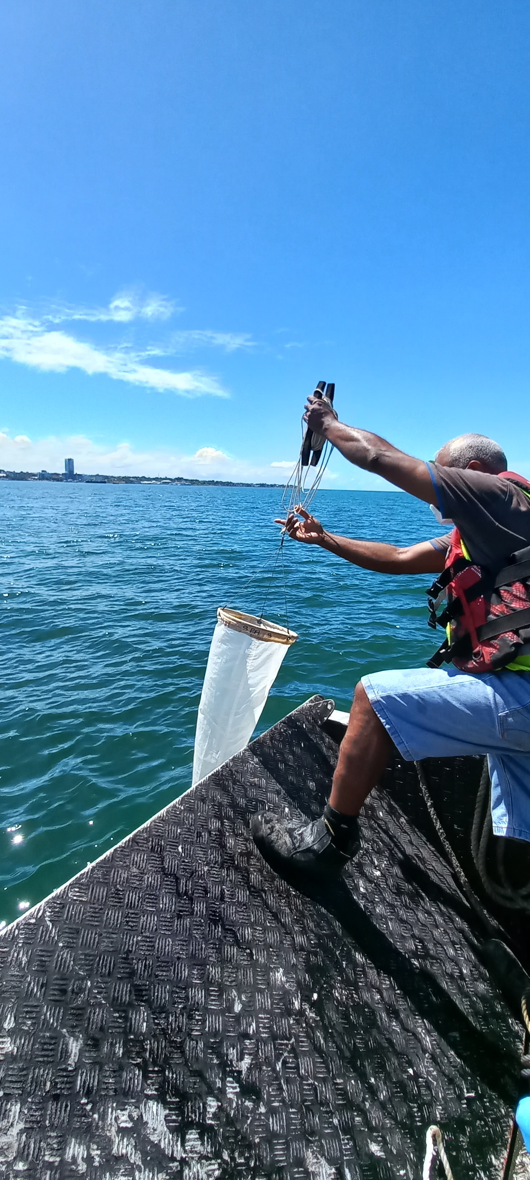
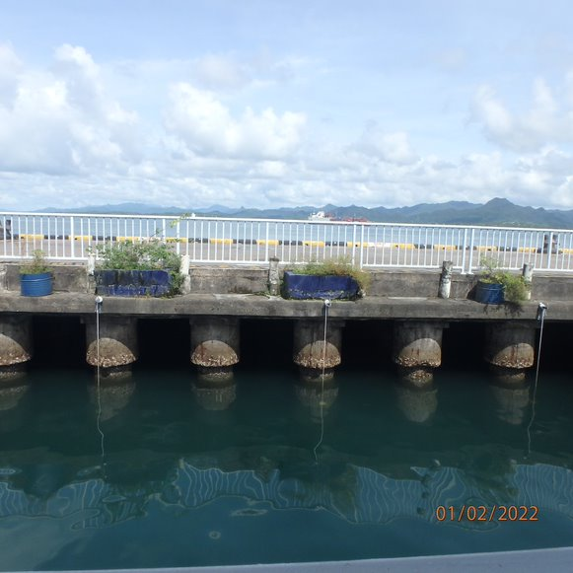
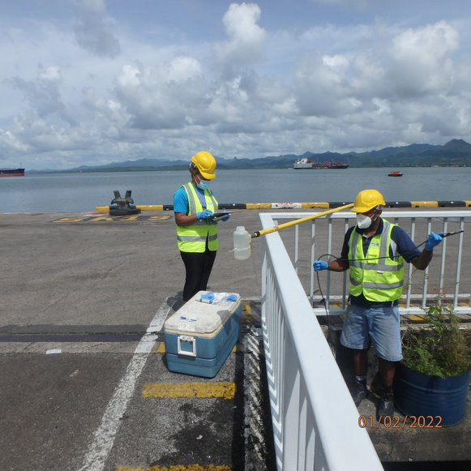
2. Co-Developing a Monitoring Plan
And Testing/Refining It
First phase: Initial Port Survey Aug 2021- Dec 2022-
Sample different sources (water, plankton, biofouling on settlement plates)
Focus on meta-barcoding development & specimen collection for reference material
Develop targeted qPCR probes for detecting selected species considered high risk if they enter

Slide 8
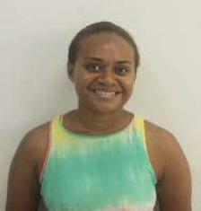
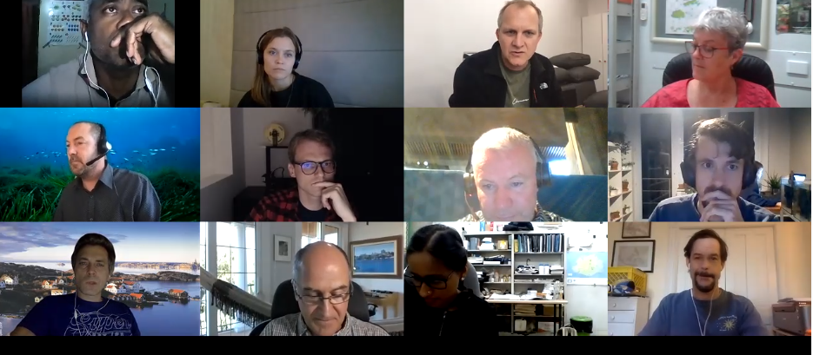
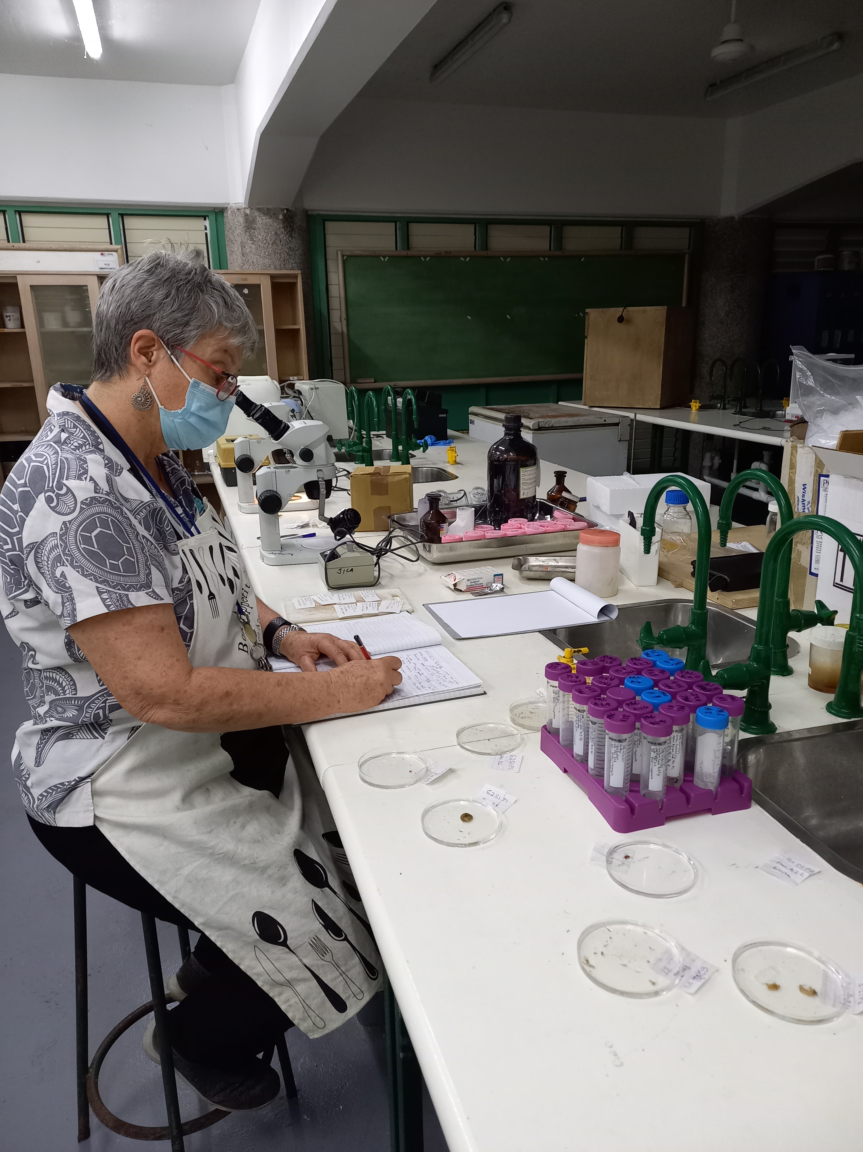
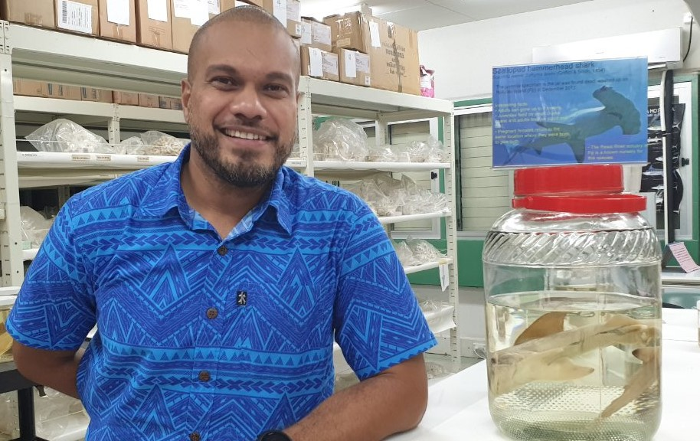
2. Co-developing a monitoring plan
Second phase: Implementation Jan 2023- Jan 2024
More frequent sampling & focus on rapid detection of high-risk species with morphology and qPCR

Slide 9
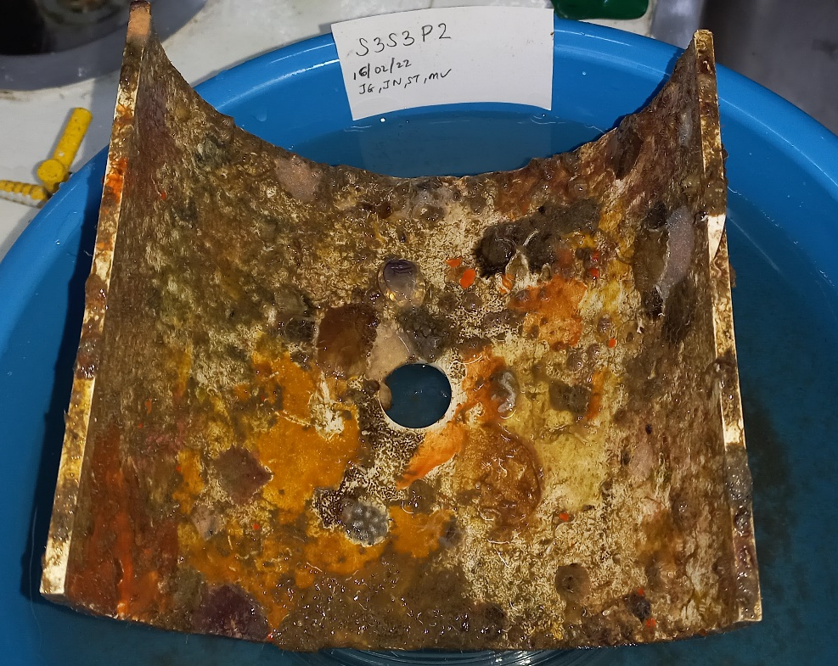
Preliminary results to date
First ever baseline survey of marine fauna of Suva Harbour
Only one other such survey has been conducted in the USP region (Apia, Samoa) but that did not use molecular tools or look at micro-organisims
Data only from Morphological Settlement Plates (not DNA analysis of plate scapings yet)
112 different morphotaxa identified but further resolution likely
Dominate taxa are phyla Bryozoa, Chordata (ascidians), Porifera (sponges), Arthropoda (barnacles and crabs), Mollusa (oysters)
No bivalves (mussels) with byssal threads found todate

Slide 10
Preliminary results to date
longitude | latitude | date | time | depth | temperature | salinity | dissolved oxygen | pH | turbidity | Pressure | TDS | DO%
decimal degrees | decimal degrees | YYYY-MM-DD | HH:MM | m | °C | ppt | mg/L |  | m | mmHg | mg/L | %L
GPS | GPS |  |  |  | YSI meter | YSI meter | YSI meter | pH | Secchi disk | YSI meter | YSI meter | YSI meter
178.423250 | -18.135130 | 2022-02-01 | 10:12 | 0.000 | 28.800 | 30.700 | 6.120 |  | 4.000 | - | - | 91.500
178.423250 | -18.135130 | 2022-02-01 | 10:12 | 2.500 | 28.700 | 30.700 | 5.510 |  | 4.000 | - | - | 85.000
178.423250 | -18.135130 | 2022-02-01 | 10:12 | 4.000 | 28.700 | 30.700 | 5.440 |  | 4.000 | - | - | 84.200
178.425500 | -18.131630 | 2022-02-01 | 10:45 | 0.000 | 29.200 | 28.400 | 4.360 |  | 1.500 | 750.000 | 28688.000 | 66.800
178.425500 | -18.131630 | 2022-02-01 | 10:45 | 2.500 | 28.700 | 29.800 | 5.030 |  | 1.500 | 750.100 | 30029.000 | 78.600
178.425500 | -18.131630 | 2022-02-01 | 10:45 | 3.500 | 28.700 | 30.900 | 5.030 |  | 1.500 | 750.100 | 30930.000 | 78.600
178.425933 | -18.129300 | 2022-02-16 | 10:57 | 0.000 | 29.300 | 26.300 | 6.820 | 8.300 | 5.500 | 751.100 | 27047.000 | 101.200
178.425933 | -18.129300 | 2022-02-16 | 10:57 | 2.500 | 29.300 | 28.700 | 5.980 |  | 5.500 | 750.900 | 29011.000 | 92.800
178.425933 | -18.129300 | 2022-02-16 | 10:57 | 4.000 | 29.200 | 29.100 | 5.760 |  | 5.500 | 750.800 | 29348.000 | 87.000
178.402850 | -18.136017 | 2022-02-16 | 10:05 | 0.000 | 29.100 | 26.500 | 6.410 | 8.700 | 5.000 | 751.000 | 22552.000 | 96.000
178.402850 | -18.136017 | 2022-02-16 | 10:05 | 2.500 | 29.000 | 27.200 | 6.220 |  | 5.000 | 751.100 | 27646.000 | 94.000
178.402850 | -18.136017 | 2022-02-16 | 10:05 | 4.000 | 28.800 | 29.200 | 6.030 |  | 5.000 | 751.200 | 29400.000 | 91.300
178.42550 | -18.13163 | 2022-05-25 | 09:20 | 0 | 27.100 | 30.200 | 4.970 | 7.600 | 4.200 | 759.200 | 30305.000 | 70
178.42550 | -18.13163 | 2022-05-25 | 09:20 | 2.500 | 27.200 | 30.600 | 6.050 |  | 4.200 | 759.200 | 30631.000 | 89.400
178.42550 | -18.13163 | 2022-05-25 | 09:20 | 4.000 | 27.300 | 30.600 | 5.620 |  | 4.200 | 759.100 | 30611.000 | 84.700
178.423250 | -18.135130 | 2022-05-25 | 10:08 | 0.000 | 27.300 | 30.000 | 5.270 | 7.900 | 5.000 | 759.100 | 30117.000 | 78.200
178.423250 | -18.135130 | 2022-05-25 | 10:08 | 2.500 | 27.300 | 30.100 | 5.460 |  | 5.000 | 759.100 | 30222.000 | 80.800
178.423250 | -18.135130 | 2022-05-25 | 10:08 | 4.000 | 27.300 | 30.300 | 5.460 |  | 5.000 | 759.100 | 30359.000 | 81.000
178.425933 | -18.129300 | 2022-06-20 | 10:16 | 0.000 | 26.600 | 31.000 | 6.600 | 8.000 | 4.000 | 754.300 | 30938.000 | 96.500
178.425933 | -18.129300 | 2022-06-20 | 10:16 | 2.500 | 26.700 | 31.100 | 6.210 |  | 4.000 | 754.000 | 30970.000 | 91.700
178.425933 | -18.129300 | 2022-06-20 | 10:16 | 4.000 | 26.800 | 31.000 | 6.020 |  | 4.000 | 754.000 | 31005.000 | 89.300
178.402850 | -18.136017 | 2022-06-20 | 10:58 | 0.000 | 26.700 | 30.000 | 6.090 | 7.900 | 12.000 | 753.800 | 30137.000 | 89.800
178.402850 | -18.136017 | 2022-06-20 | 10:58 | 2.500 | 26.800 | 30.300 | 5.920 |  | 12.000 | 753.800 | 30377.000 | 86.300
178.402850 | -18.136017 | 2022-06-20 | 10:58 | 4.000 | 26.900 | 30.500 | 5.770 |  | 12.000 | 753.600 | 30546.000 | 86.300
178.423250 | -18.135130 | 2022-10-03 | 11:28 | 0.000 | 27.200 | 30.000 | 6.070 | 8.200 | 5.000 | 751.300 | 30065.000 | 91.100
178.423250 | -18.135130 | 2022-10-03 | 11:28 | 2.500 | 27.200 | 29.800 | 6.020 |  | 5.000 | 751.200 | 29902.000 | 90.200
178.423250 | -18.135130 | 2022-10-03 | 11:28 | 3.000 | 27.200 | 29.800 | 5.870 |  | 5.000 | 754.100 | 29927.000 | 88.000
178.425500 | -18.131630 | 2022-10-03 | 12:10 | 0.000 | 27.200 | 28.900 | 7.480 | 7.900 | 4.000 | 752.300 | 29143.000 | 94.400
178.425500 | -18.131630 | 2022-10-03 | 12:10 | 2.500 | 27.100 | 28.900 | 6.200 |  | 4.000 | 752.300 | 29143.000 | 92.600
178.425500 | -18.131630 | 2022-10-03 | 12:10 | 3.000 | 27.100 | 28.900 | 6.410 |  | 4.000 | 752.200 | 29141.000 | 95.700

Slide 11
4. Standardized bioinformatics and data management
5. A decision support tool for early warnings of invasive species presence
3. Training Program for local scientists and managers
1. Close work with partners
and stakeholders (co-development)
2. Establish baseline data and develop a monitoring Plan with eDNA analyses

Slide 12
3. Training Workshop for
local scientists and managers
Two training workshops planned for November 2022 and November 2023
First training workshop: To train local experts on the monitoring methods
as well familiarize them with molecular tools (qPCR and eDNA analyses)
Total number of participants targeted- 25
1st training Course design (in progress)
Blended mode of virtual through Ocean Expert OTGA and F2F at USP
Sampling and sample/data handling for monitoring purposes
Familiarization of new scientific methods and hands on applications

Slide 13
4. Standardized bioinformatics and data management
5. A decision support tool for early warnings of invasive species presence
3. Training Program for local scientists and managers
1. Close work with partners
and stakeholders (co-development)
2. Establish baseline data and develop a monitoring Plan with eDNA analyses

Slide 14
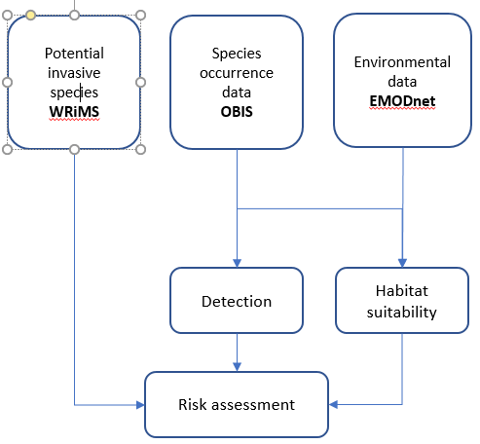
5. A decision support tool for early warnings of invasive species presence
Final outcomes of the project:
Provide early warnings of entry of identified cases of invasive species on priority “watch list”
A decision support tool to assist local stakeholders** in management actions through recommendations
Validation of priority lists for Fiji marine alien invasive spp
** e.g. Government Ministries, Boarder control (BAF), commercial sectors (mariculture)

Slide 15
5. Awareness and National Contributions
1. 22nd International Conference on Aquatic Invasive Species, hosted by IOC/IODE, Belgium. “Adoption of a routine marine invasive species monitoring plan using environmental DNA sampling in Suva, Fiji” presented by Dr. Saara Suominen, UNESCO Intergovernmental Oceanographic Commission, Belgium
2. National Consultation of the Invasive Alien Species Policy Review and the National Invasive Species Framework for Strategic Action Plan (NISFSAP) Validations workshop with Biosecurity Authority of Fiji and its GEF sponsored Invasive Alien Species Project. Presented by PacMAN project manager
3. The project team at USP have provided poster presentations at Fiji’s Seascape symposium in Suva from the 20-22 of April 2021 and SPREP’s Dialogue Forum on Traditional Knowledge for Biodiversity and Sustainable Development Goals (SDGs) in the Pacific from 30 May-1 June 2021. Presented by USP team
4. PacMAN represented in multiple webinars, including the CCLME invasive species webinar, and the IUCN and European Commission webinar on BBNJ as an example on capacity development for marine genetic resources
5. PacMAN also presented at the Empowering Biodiversity Research II conference in Brussels and the bioinformatics market with a stand.
6. PacMAN was represented at the Marine Biosecurity Research and Management for French Polynesia and the South Pacific Region Workshop in French Polynesia September 21-22, 2022
7. Dr. Brodie??
8. Dr. Isoa’s course??

Slide 16
Challenges and Lessons Learned so Far
Impact of COVID-19 at national and institutional levels
COVID19 - influence on countries national operations & priorities
Staff absences and national restrictions in movement and research operations (field & meetings)
Delays in arrival of overseas orders because of reduction in flights & carrier transport
Institutional “Survival Budget” produced new financial rules to manage finances caused delays
Shifts in institutional policy’s on finance (overseas ordering), HR appointments and new regulations on staff movement on Campus
Restructuring of institutional units to reduce costs created new approval processes
Measures put in place to mitigate
Keep communication lines active and open
Order required equipment and consumables from overseas as early as possible
Prudent financial measures to manage finances effectively
Utilisation of a global shift into the utilisation of virtual services for F2F meetings
Utilisation of social network tools e.g. Viber and Facebook Messenger to communicate in realtime

Slide 17
PacMAN Contributes to Fiji’s commitment to International Policy Frameworks via & National Planning & Reporting
Example for Convention on Biological Diversity (CBD)
Under Fiji Dept of Environment (DoE) Mandated Fiji National Biodiversity Strategy Action Plan (NBSAP) for focus area 4
Strategic Area MIS1: Target research to support improved knowledge on invasive alien species in Fiji
1a). To establish and maintain a national invasive alien species database. The bioinformatics pipeline assists validating target species
Strategic Area MIS2: Strengthen national legislation, policies and strategies to support effective prevention and management of invasive alien species
2b: Contribute to the development of the National Invasive Alien Species Strategy and Action Plan (NISSAP) now NISFSAP
2c: To strengthen the role and function of the Fiji Invasive Species Taskforce (FIST) as the multi-stakeholder coordination
mechanism by providing technical advice on Invasive Alien Species. Increased networking and catalyzing of experts within FIST. USP to host the 1st National Invasive Species Symposium in early 2023
Small Island Developing States Accelerated Modalities of Action (Samoa Pathway) https://
sustainabledevelopment.un.org/sids2014/samoapathway

Slide 18
Vinaka vakalevu For Your Listening
Any Questions?

Slide 19
Update on the monitoring plan
Plankton collections in triplicates rather then quadruplicates
PVC sheets have been replaced with PVC cut sections
Physicochemical measurements are limited by probe chord length (0,2,4m intervals)
Added Total Dissolved Solids (TDS) measurements to required pH, dissolved oxygen, turbidity
Sterilization steps – Autoclaving added (heating materials to bleaching steps)
Depth and plate distances have been adjusted equidistant if the site is shallow (below setup length) during peak low tide
Adjusting anchors according to sites helps to avoid rope tangling
Suggestions from Scientific Experts
Addition of nets below each rope setup to capture motile organisms e.g. Crabs
Use of precautionary principle to capture juveniles yet to develop adult features which are diagnostic
Keep multiple reserved samples for Biobanking with good book keeping for the metadata collected to link samples to origin
For the bioinformatics pipeline- Careful consideration on the layers chosen to include in modelling e.g ecological vs economical (Habitat vs Suitability modelling)
Risk species of wide tolerance limits should be undergo strict monitoring and modelling cycles to detect their presence
Importance of mapping hydrodynamic information or access geospatial work on the harbor to proactively predict hotspots that can be settlement sites
Importance of avoiding a silored approach for Fiji and to attract interest from other teams in the Pacific with similar strategies
eDNA for Ballast water may not be useful due to false positives and calibration time to detect positives or false positives. Risks of not declaring the uncertainties is real
Track and trace option and sustainable practices can be covered through citizen science complemented with other technical methods e.g. Bioinformatics pipeline
Potential risk species discovered in French Polynesia to be noted and incorporated into query searches

