Slide 1
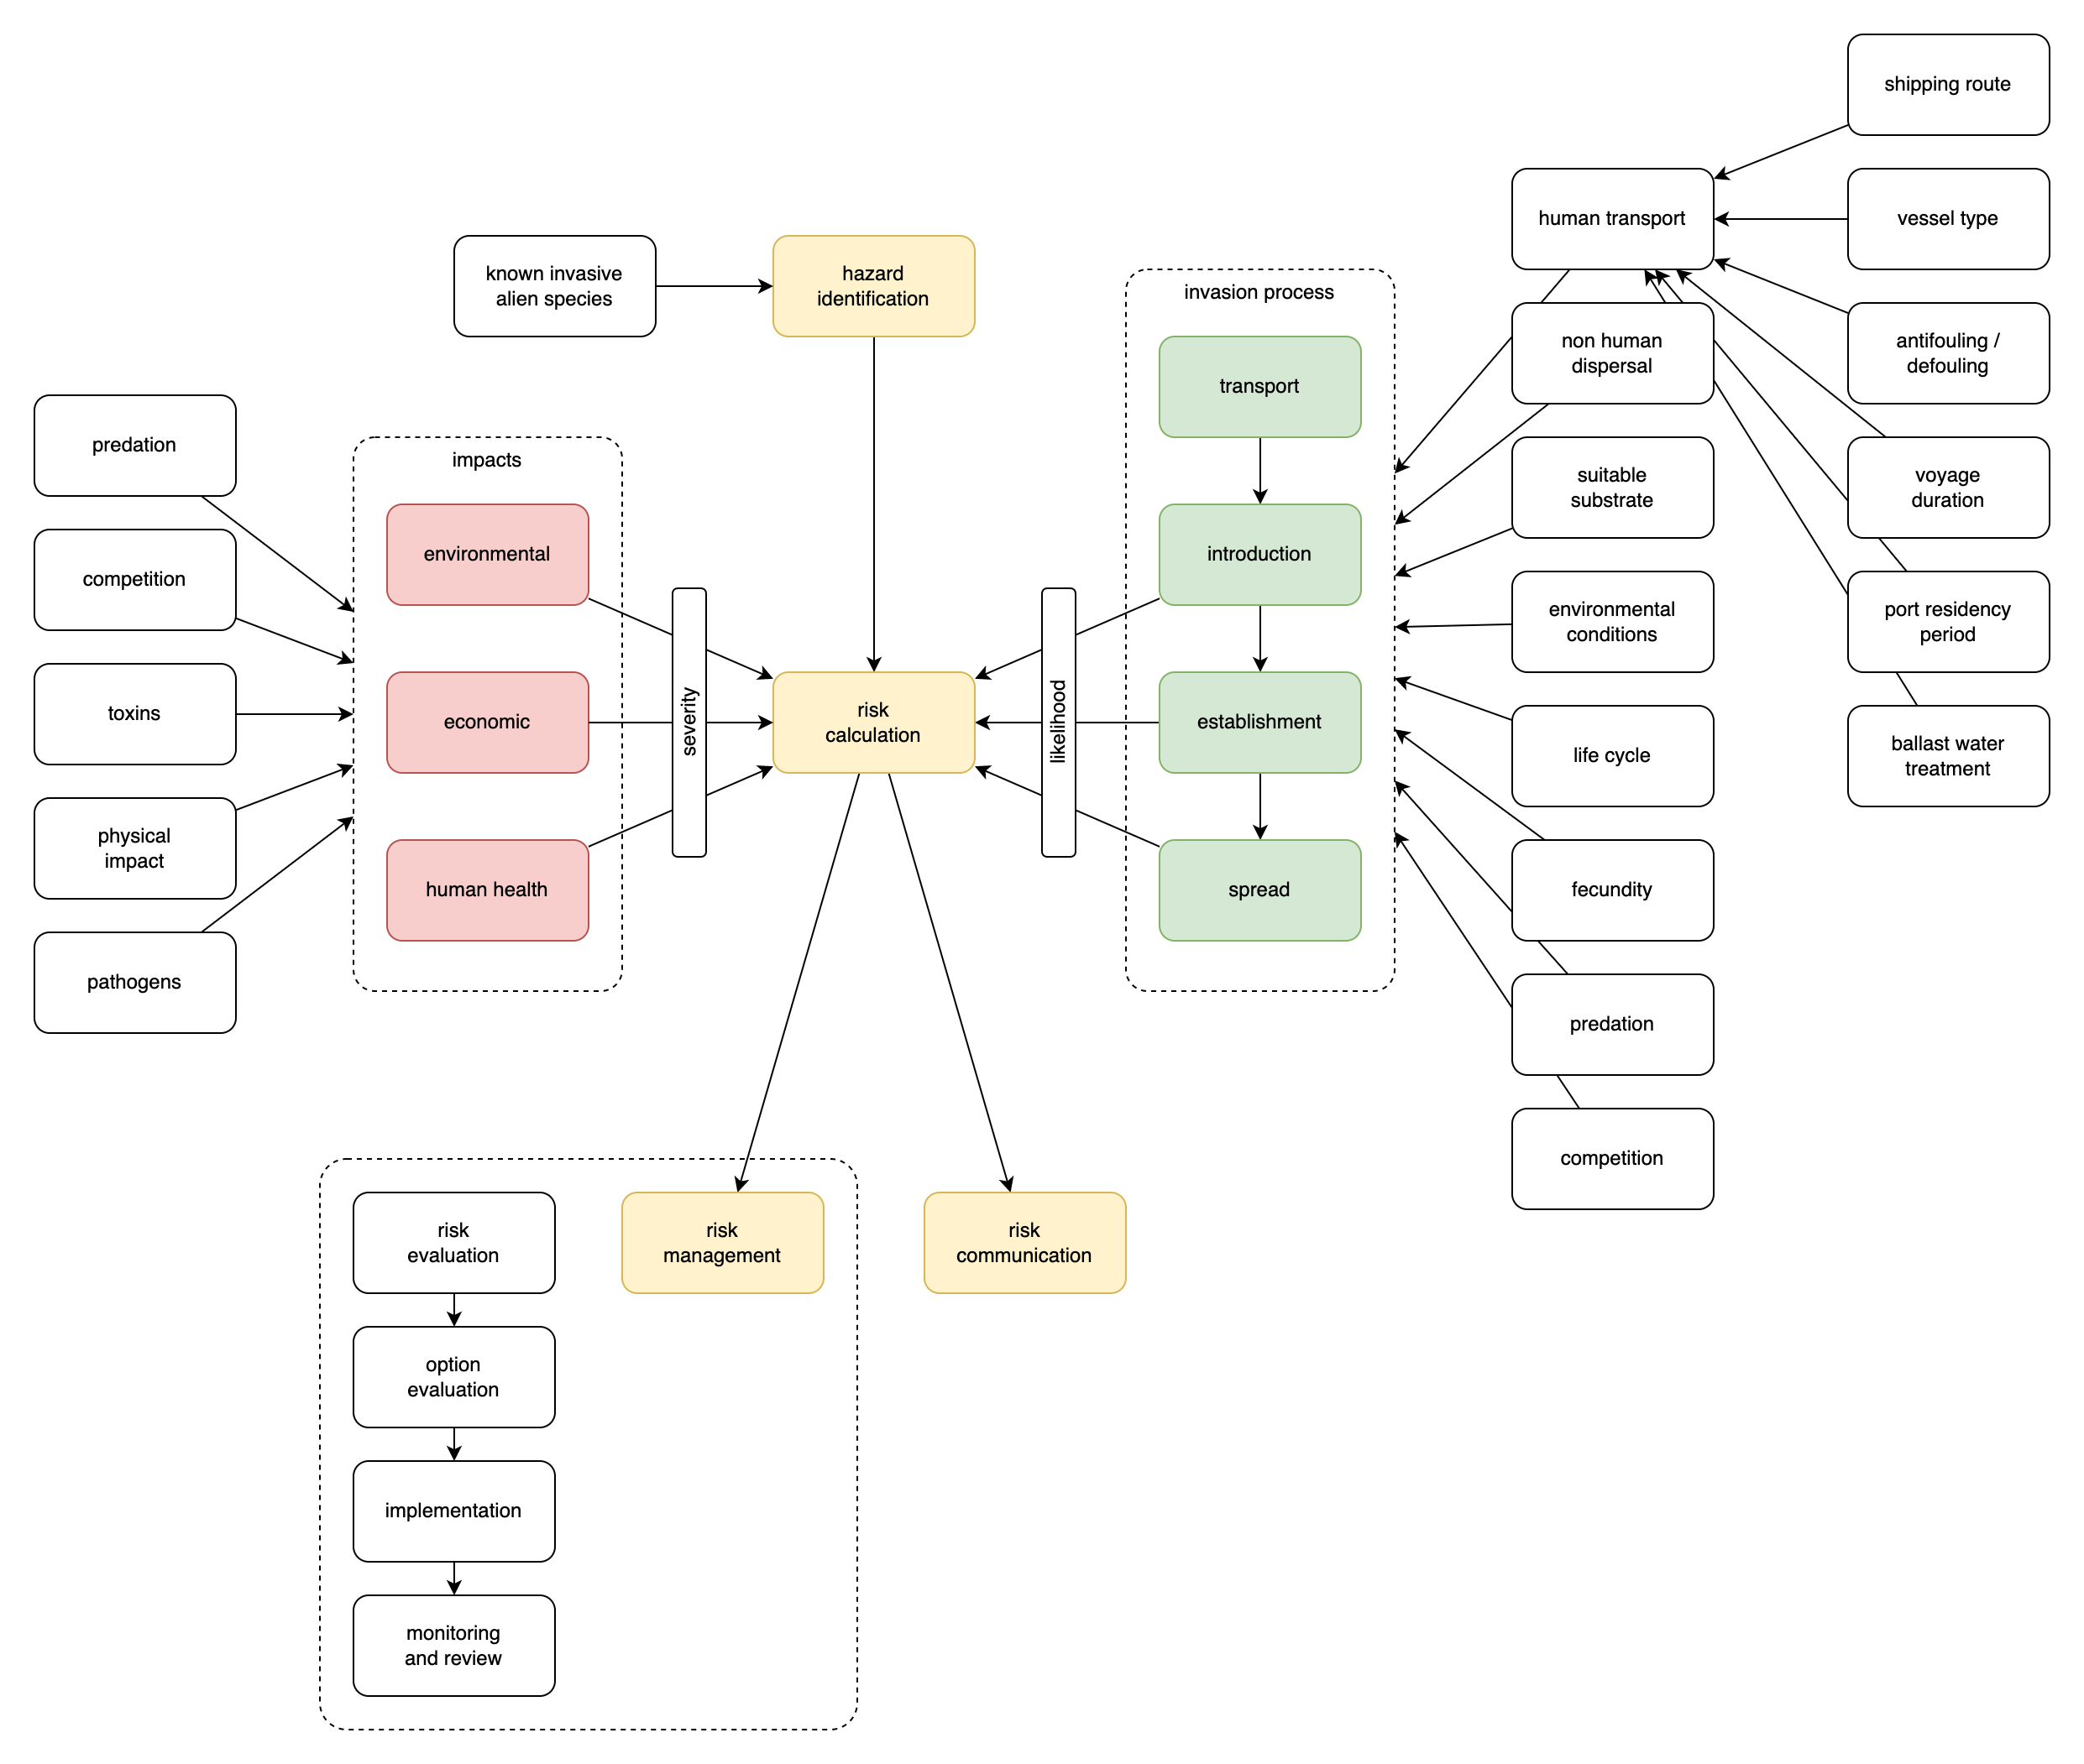
Risk analysis
and decision support
Notes:
Decision support framework, goal is to support authorities in deciding priorities and resource allocation for monitoring and possibly mitigation of biological invasions.

Slide 2
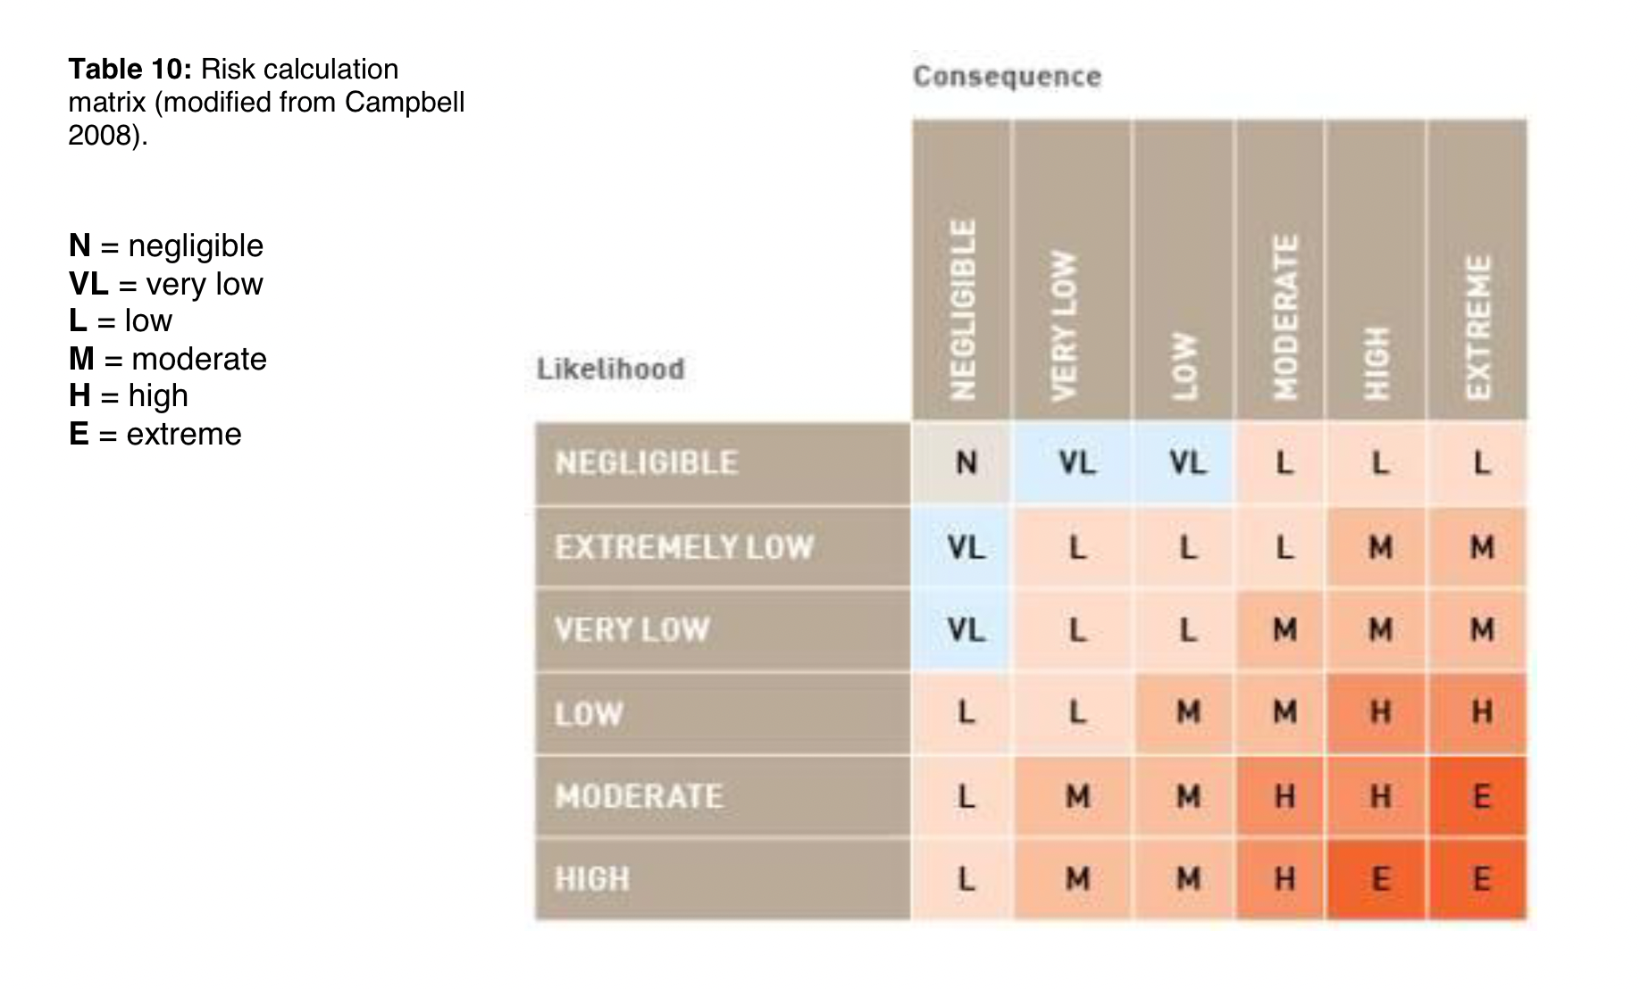
Risk analysis
and decision support
Notes:
Risk is calculated as the combination of the likelihood and the impact of a certain outcome. Risk levels can be used to allocate resources, depending on risk tolerance.

Slide 3
Risk analysis
and decision support

Slide 4
Risk analysis
and decision support

Slide 5
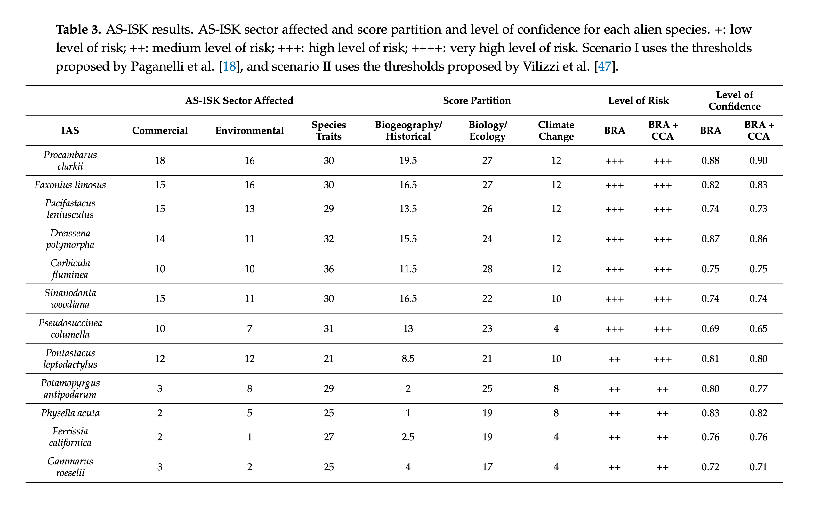
Risk analysis
and decision support
UK Cefas Aquatic Species
Invasiveness Screening Kit
(AS-ISK) results from
Paganelli et al. 2021

Slide 6
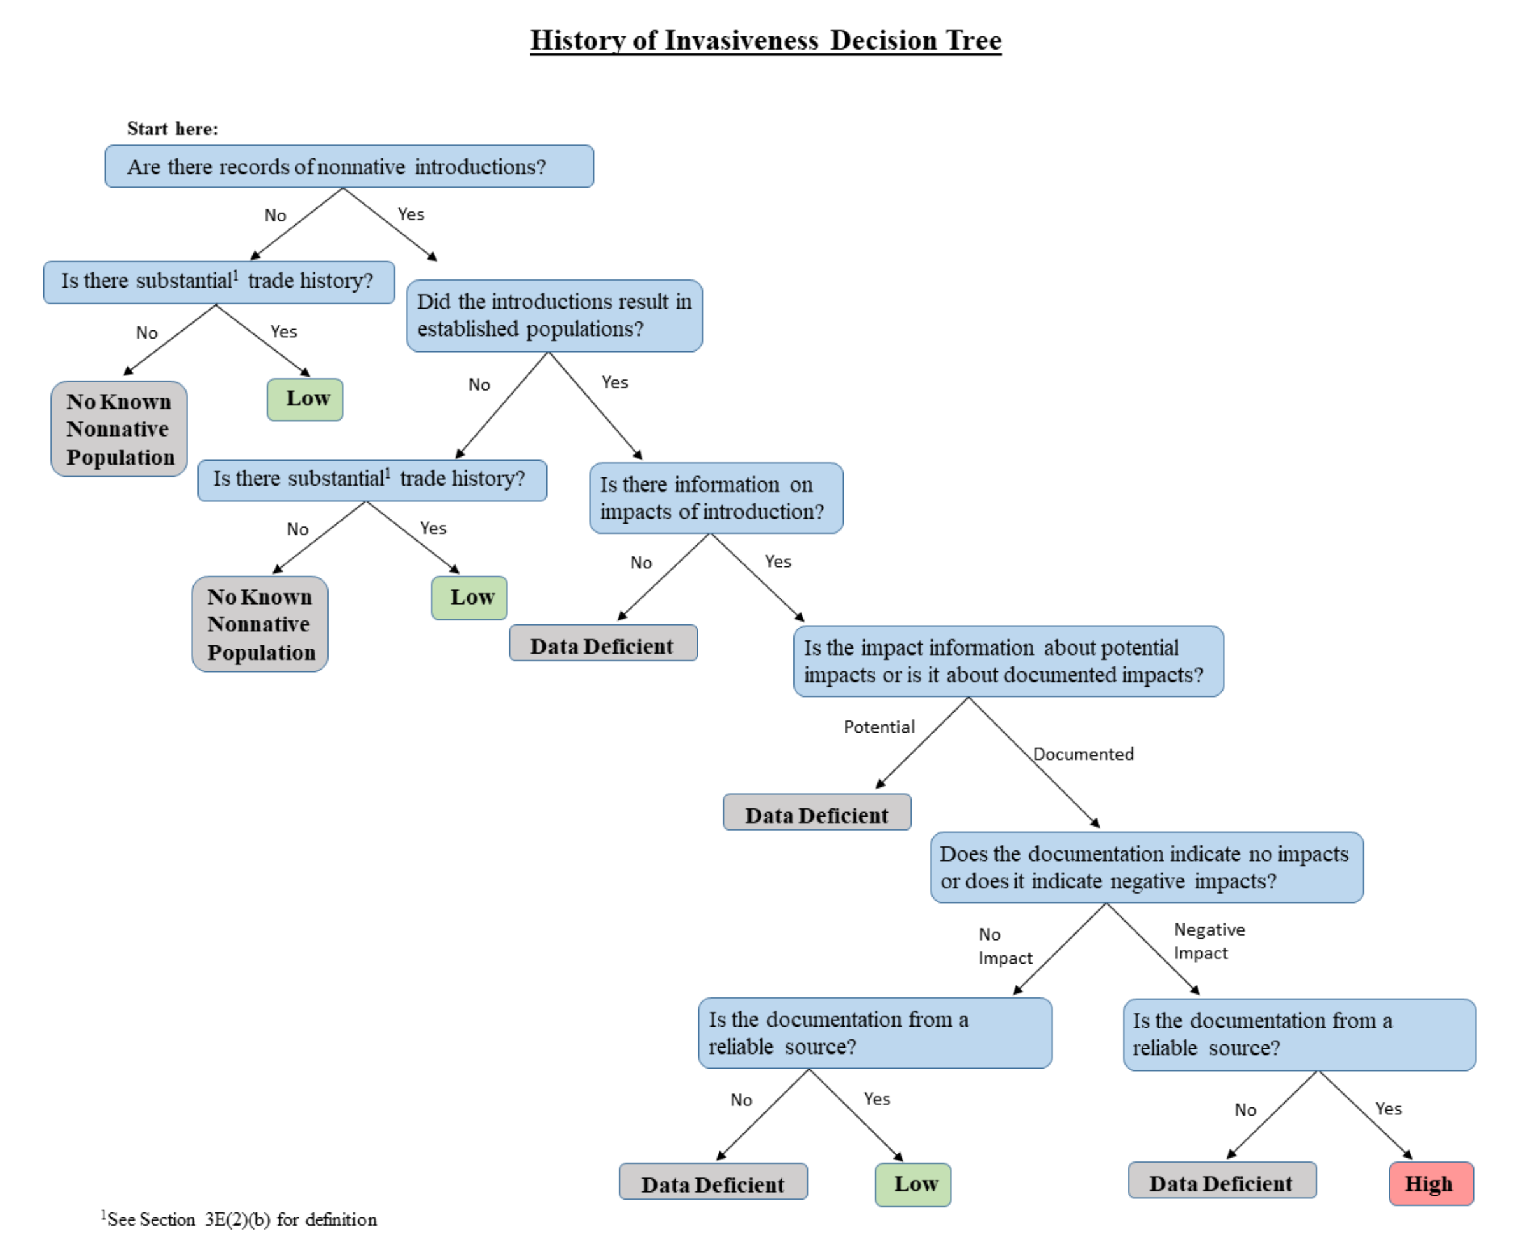
Risk analysis
and decision support
US Fish & Wildlife Service
Ecological Risk Screening Summaries (ERSS)
decision tree and risk ranking

Slide 7
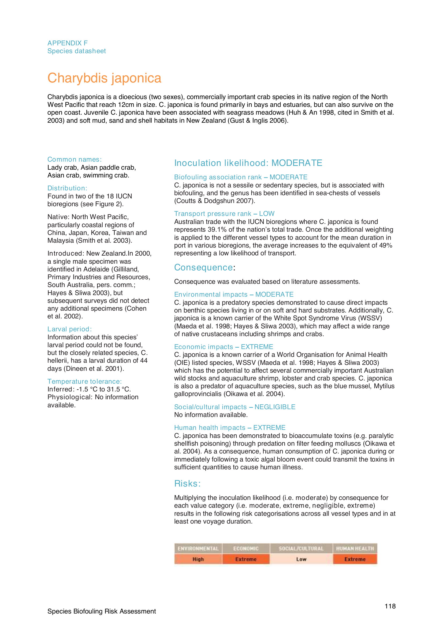
Risk analysis
and decision support
Australian Government
Department of Agriculture,
Fisheries & Forestry (DAFF)
Species biofouling risk assessment

Slide 8
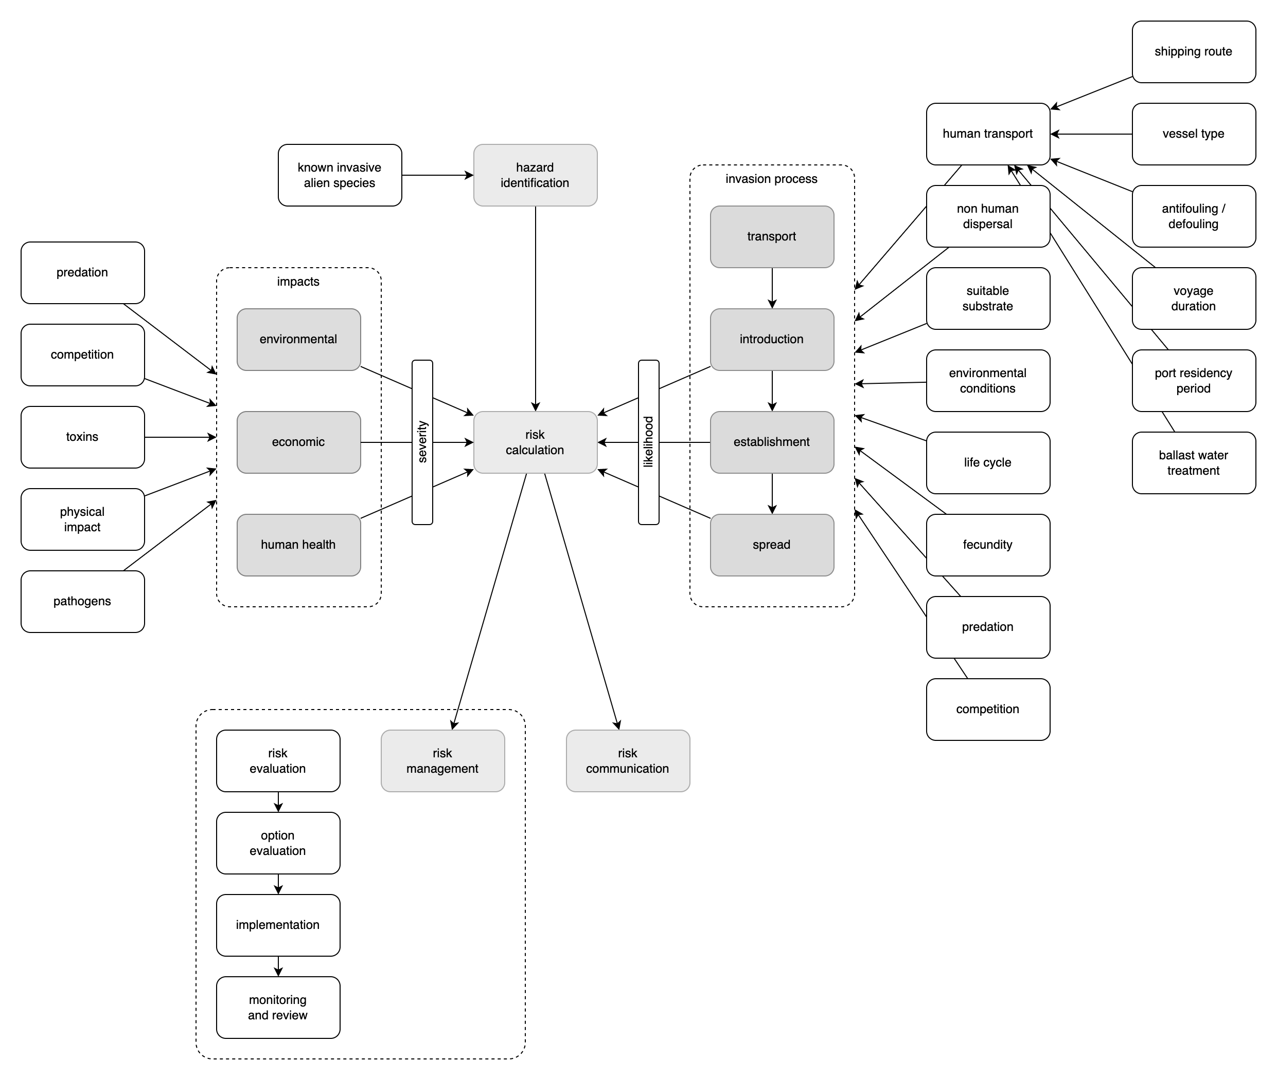
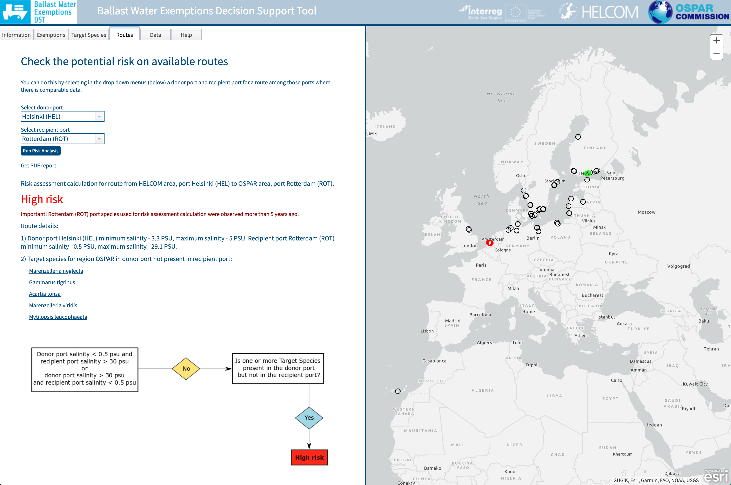
Risk analysis
and decision support
OSPAR HELCOM Ballast Water Exemptions
Decision Support Tool

Slide 9
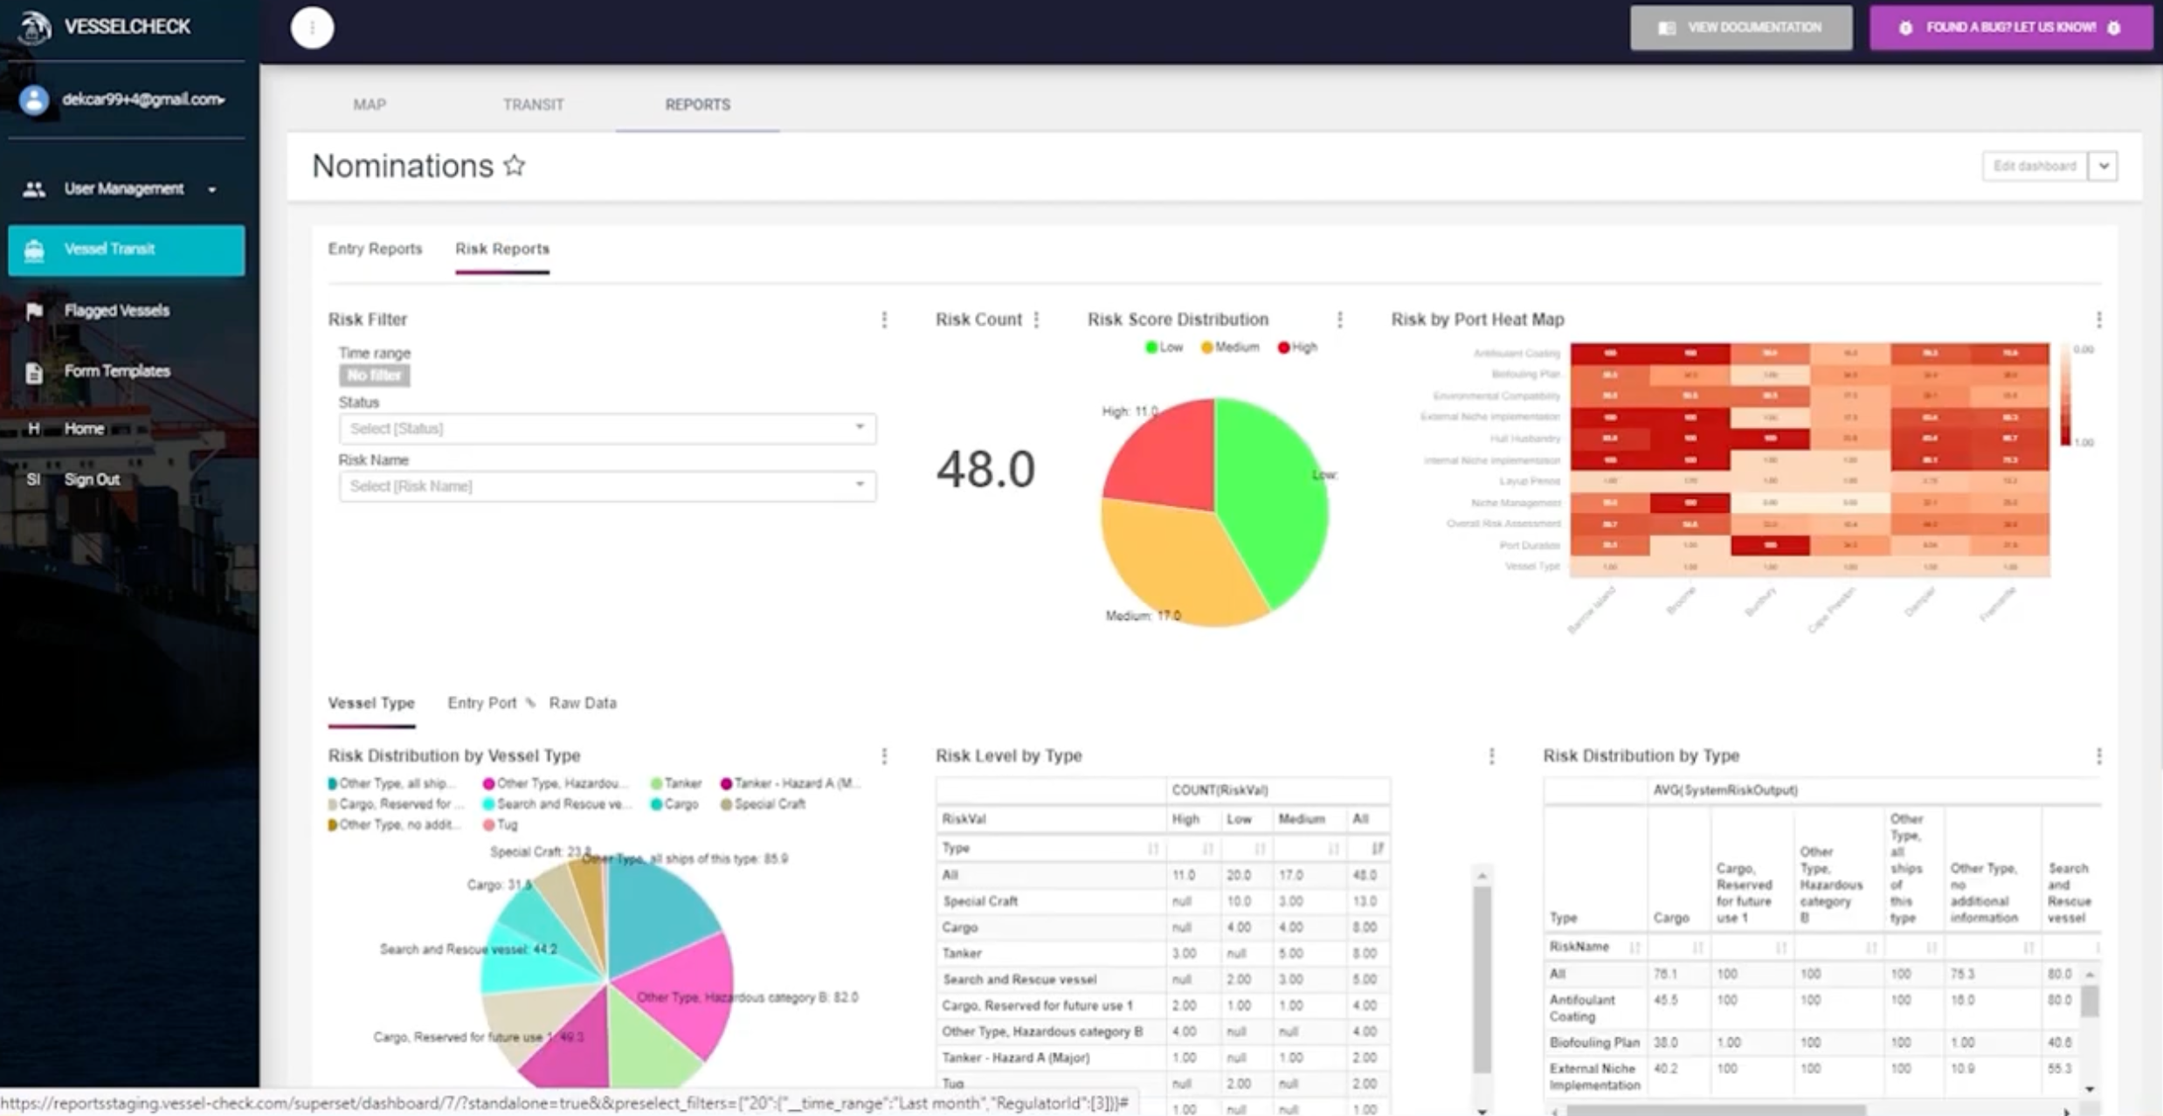
Risk analysis
and decision support
Vessel-Check
Notes:
Data driven systems.

Slide 10
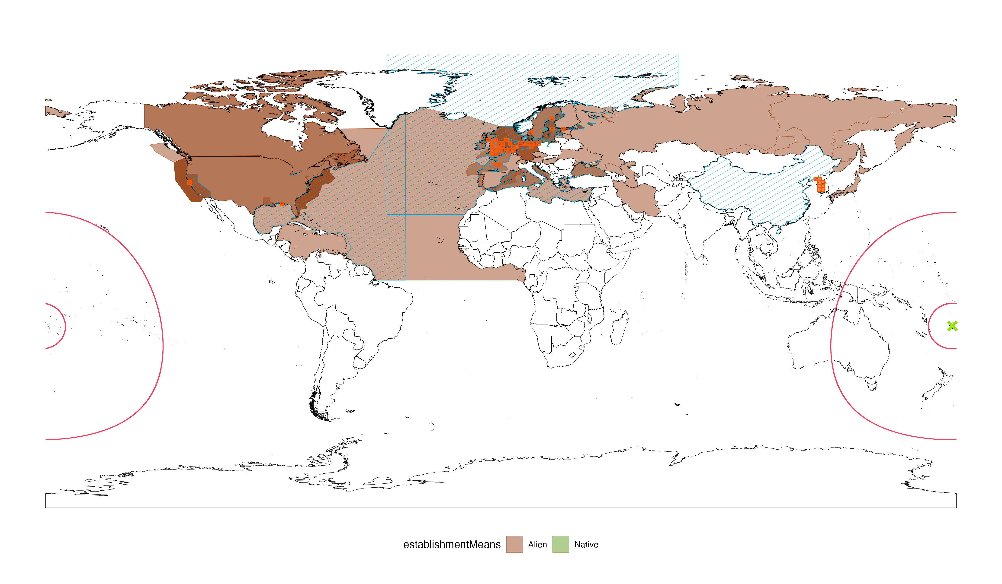
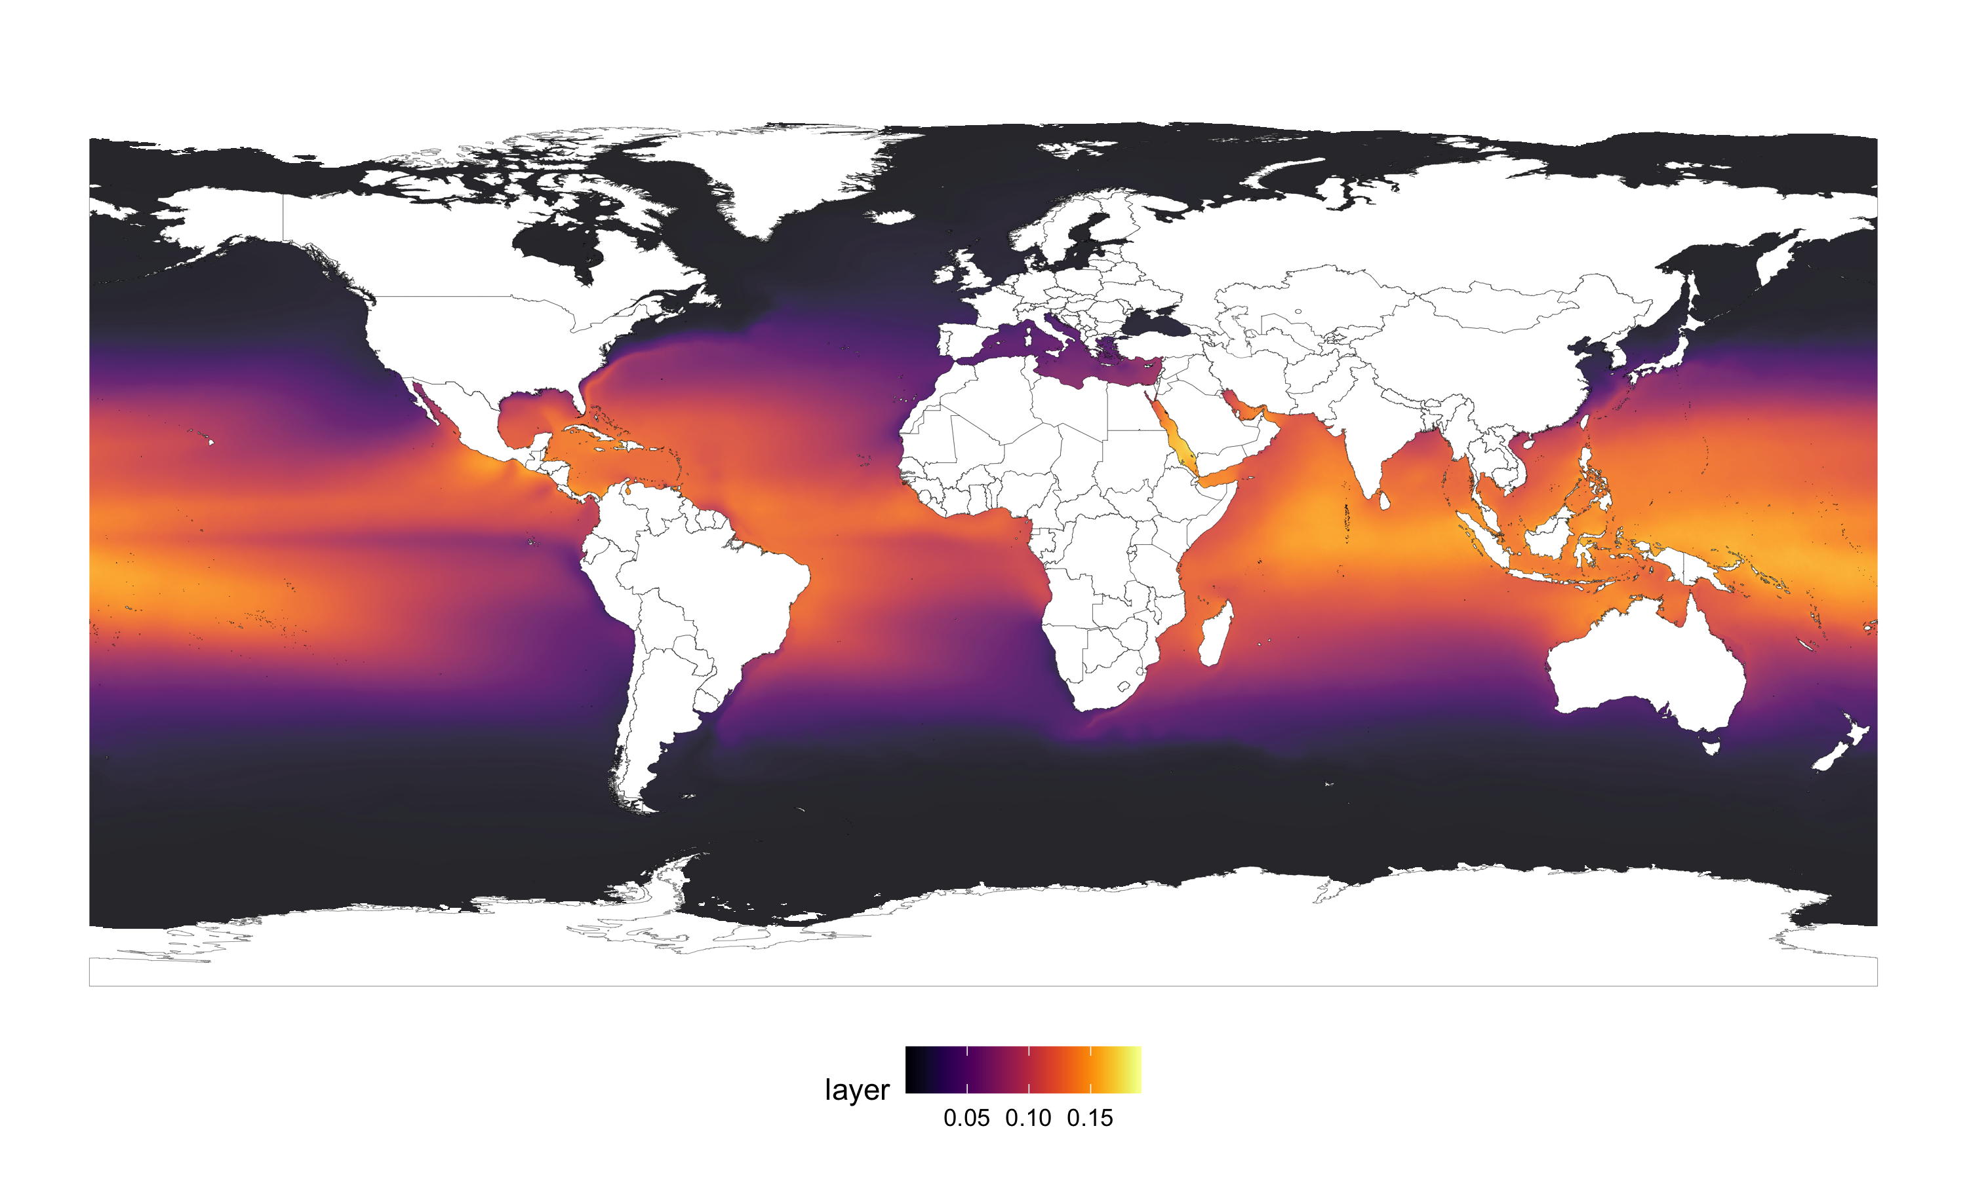
detections
Risk analysis
and decision support

Slide 11
detections
Risk analysis
and decision support

Slide 12
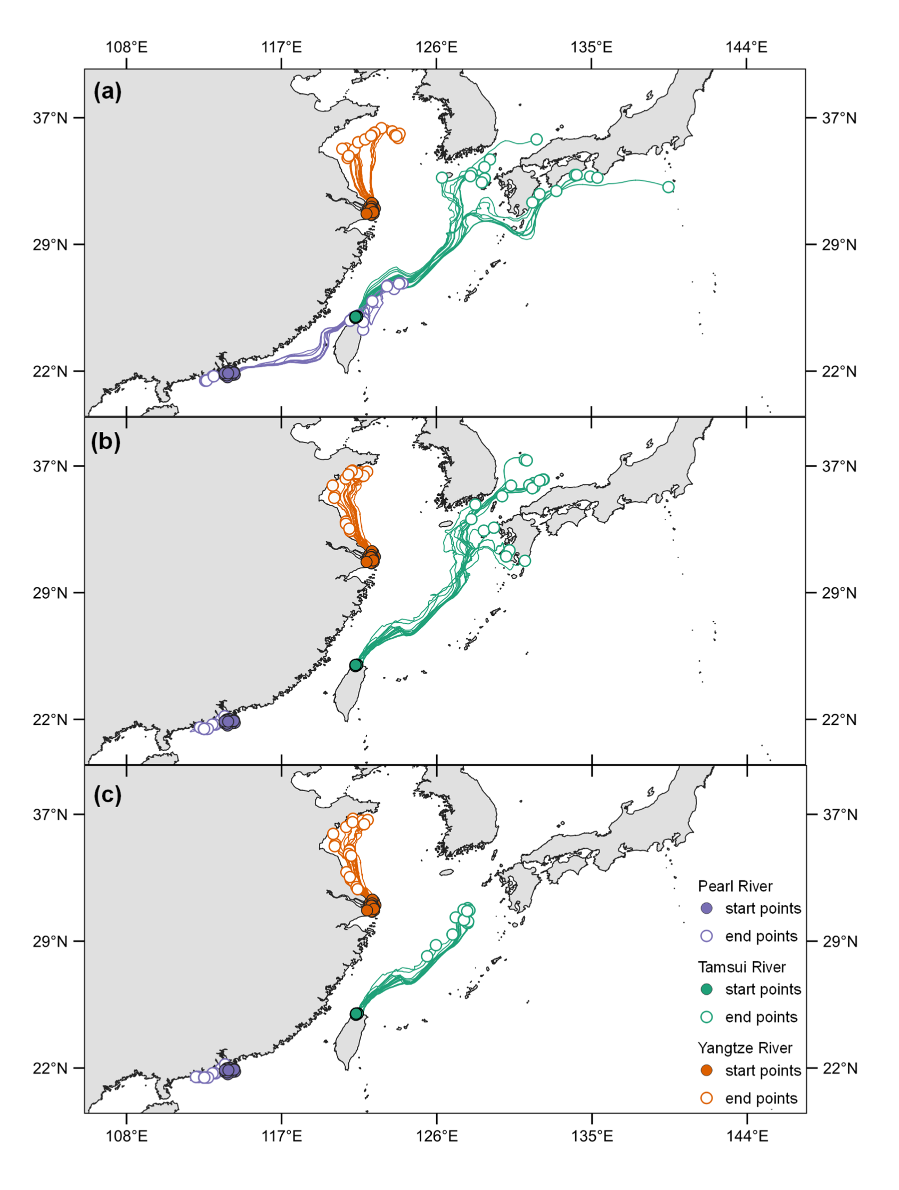
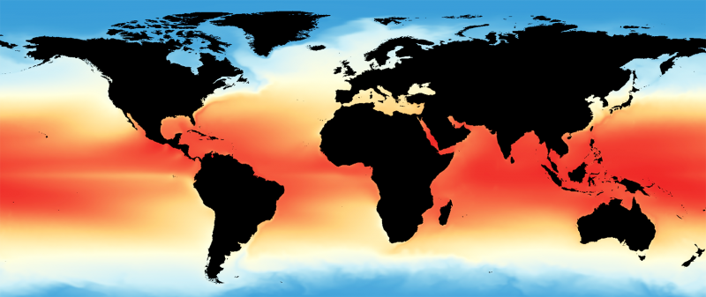
Risk analysis
and decision support
Data sources
Distribution data (detections): OBIS (including PacMAN detections), GBIF
Distribution data (literature) + native/introduced ranges: WRiMS, GISD
Environmental layers: Bio-ORACLE, Copernicus Climate Data Store
Port connectivity / AIS / port call data: UN Global Platform, commercial
Hydrodynamics: Lagrangian trajectories from OLTraj

Slide 13
Risk analysis
and decision support
Discussion points
What types of risk analyses or signals would you like to get from the system? For example: high risk species for a particular area or the wider region, high risk vessels based on port of origin, just detections in or near your area.
Do you expect alerts to be vetted by an expert or do you prefer receiving machine generated alerts which may need verification?
How would you like to integrate the PacMAN decision support system into your operational processes?
Is there an interest in tracking management action through the decision support system?
Is there any need for managing information related to alien invasive species which is not covered by existing databases such as WRiMS, GISD, and the CABI Invasive Species Compendium?
Are there any other features which the PacMAN decision support system could deliver but we haven't thought of?

Slide 14
Risk analysis
and decision support
Notes on the PacMAN decision support system, including data exploration for some target species and distribution model code, are available from:
https://iobis.github.io/pacman-decision-support/

Slide 15
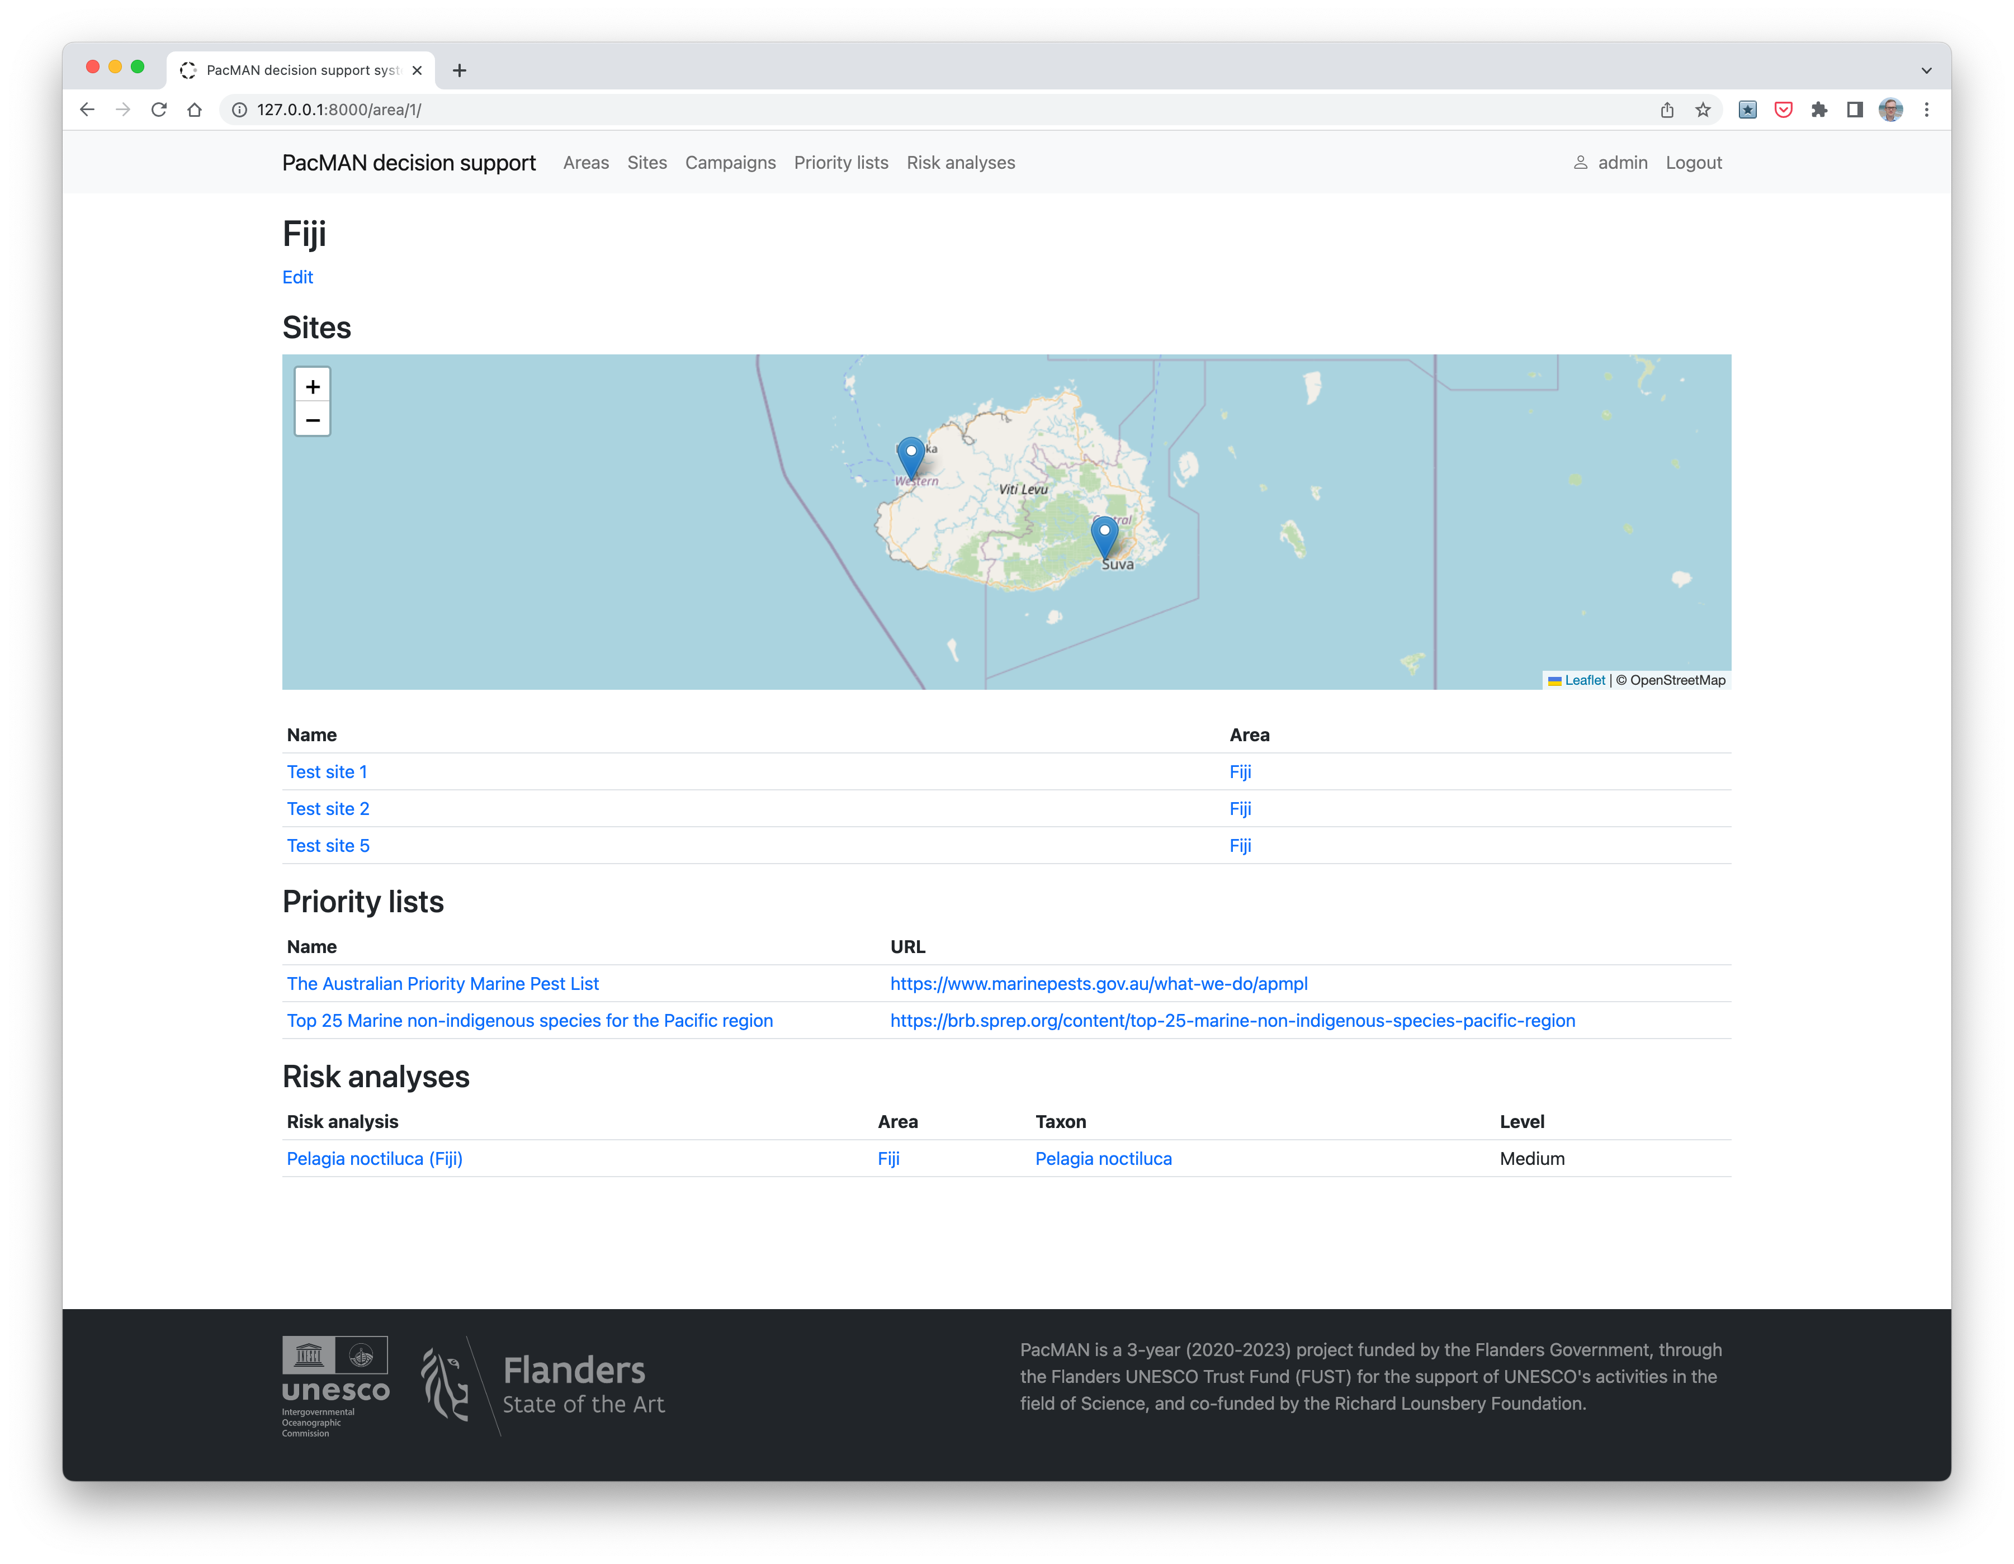
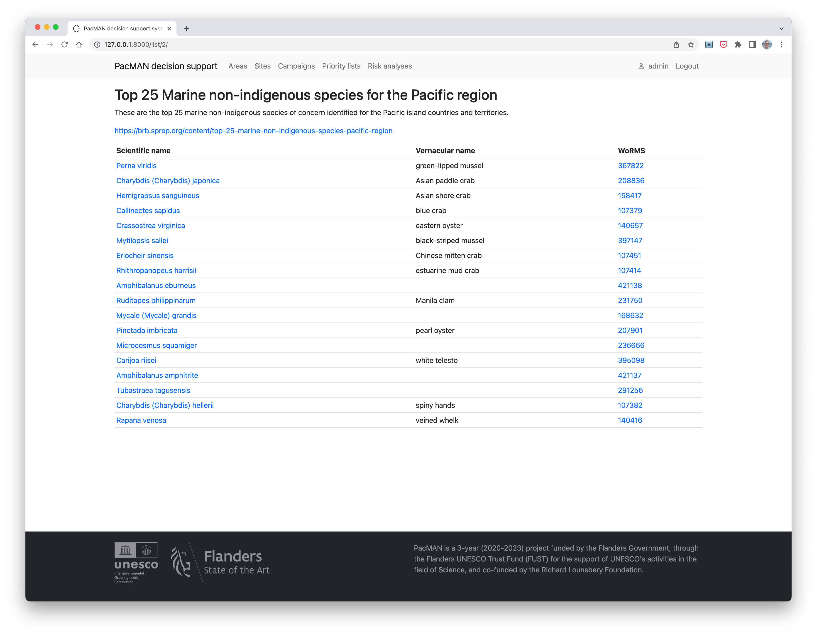
Risk analysis
and decision support

