Slide 1
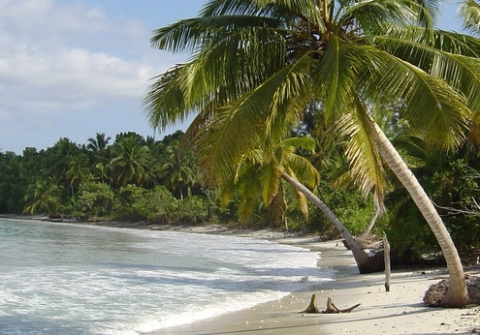
The project results framework
Céline Tiffay, Programme and project assistant, Tsunami Unit

Slide 2
Project results framework
GOAL
Strengthen climate change resilience in coastal and island Biosphere Reserves by developing preparedness for coastal hazards and enhancing ocean management, governance and policies.
IMPACT
Reduce risk, increase safety and enhance the resilience of vulnerable coastal communities to the increasing risk of inundation from coastal hazards due to climate change, and to protect and leverage the unique ecosystems of Biosphere Reserves, as well as their local socio-economic activities.
COPMPONENTS
1. Strengthening national capacity to measure and monitor climate change impacts on coastal hazards and climate change
4. Quantify and develop monitoring indicators for impacts from climate change and coastal hazards on ecosystem services and local socio-economic activities
2. Develop and establish local measures for multi-hazard preparedness against inundation from coastal hazards in selected Biosphere Reserves
5. Strengthen ocean governance and policies to enhance climate resilience of selected Biosphere Reserves
3. Strengthen early warning systems at the local, national, and regional level for selected countries
6. Strengthen communication and collaboration between coastal and island Biosphere Reserves to leverage learning and experiences and support expansion of the IOC/MAB approach

Slide 3
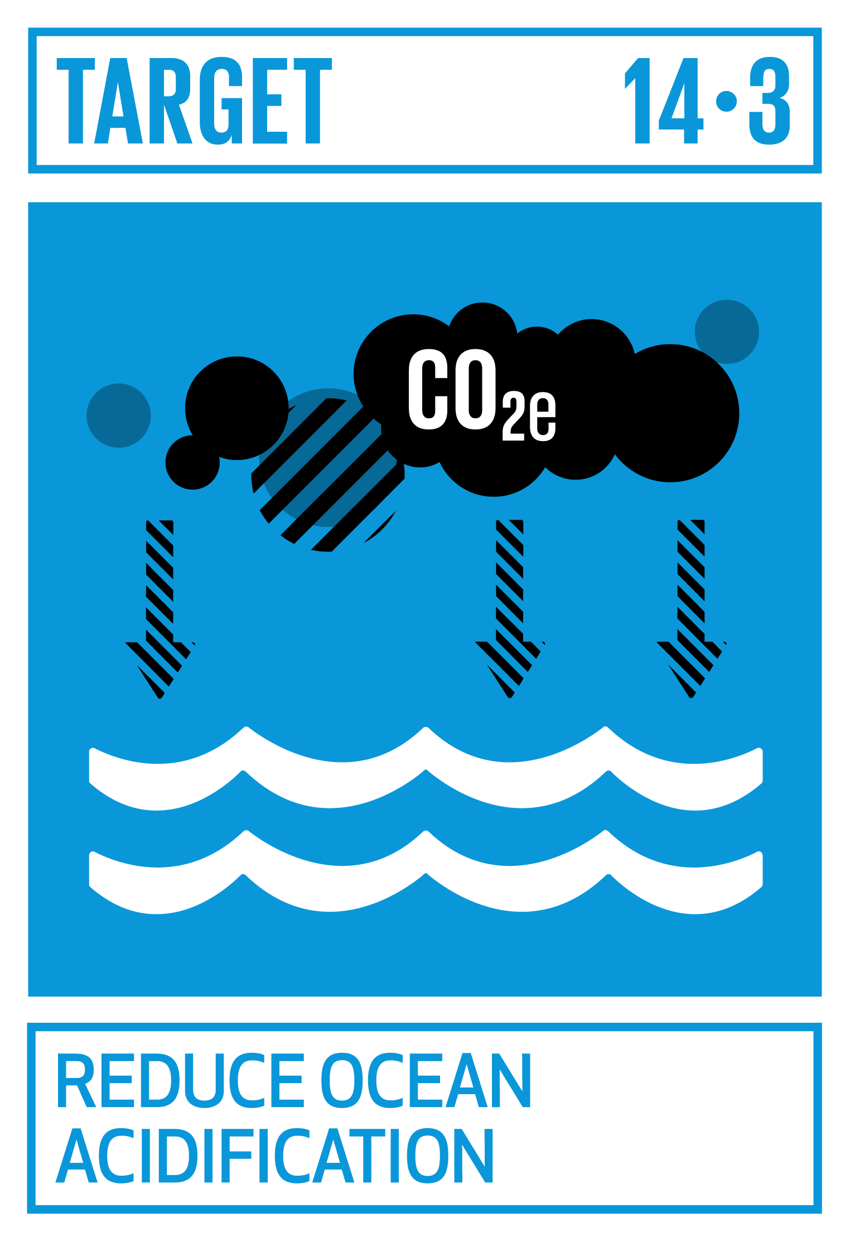
Component 1
Strengthening national capacity to measure and monitor climate change impacts on coastal hazards and climate change
Output 1.1: Data and information about the biogeochemical changes, caused by direct human activities and climate change, affecting climate change resilience in the selected Biosphere Reserves
Output 1.2: Data, quantitative and qualitative information about marine/coastal life, incl. biodiversity, degradation, related carbon stocks and fluxes in the selected Biosphere Reserves
Output 1.3: Data and information obtained within the project are freely available.
1.1.1 Identification of existing capacities to observe and monitor
1.1.2 Capacity development on observation and monitoring
1.1.3 Establish regular observation throughout the project period
1.1.4 Development of a publication
1.2.1 Identification of existing capacities to observe
1.2.2 Capacity development on monitoring, applying best practices
1.2.3 Establish regular observation throughout the project period
1.2.4 Development of a publication
1.3.1 Development of a data management plan
1.3.2 Metadata, data and products accessible, interoperable and openly shareable

Slide 4
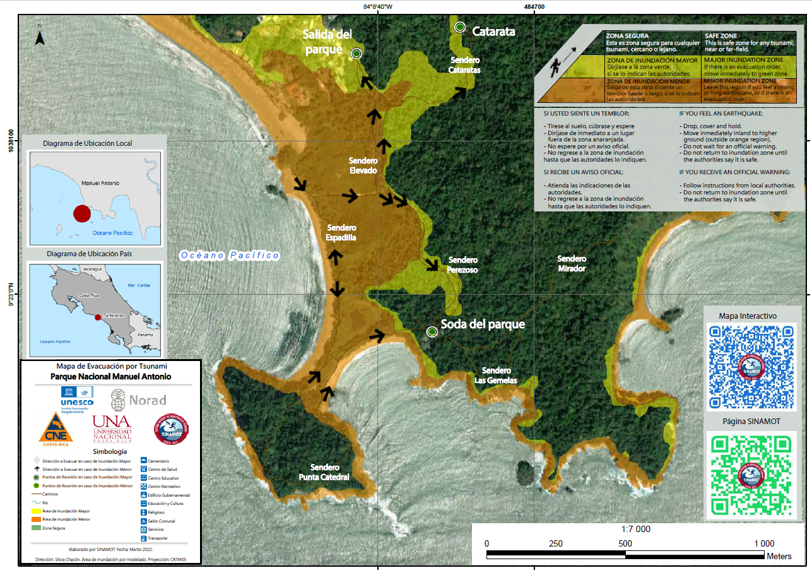
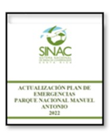
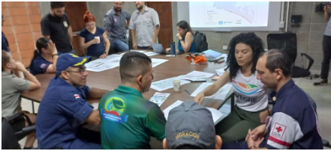
Component 2
Develop and establish local measures for multi-hazard preparedness against inundation from coastal hazards in selected Biosphere Reserves
Output 2.1: Comprehensive survey of community environmental, social, and economic vulnerability to inundation.
Output 2.2: Comprehensive assessment and documentation of relevant coastal hazards (e.g. tsunamis, storm surges, etc.)
Output 2.3: Evacuation maps for tsunamis and other coastal hazards based on community co-creation created
Output 2.4: Updated and enhanced ERPs and SOPs in all target Biosphere Reserve, in line with national plans, procedures, and processes
Output 2.5: At least one drill and/or simulation exercise successfully completed in all target Biosphere Reserves

Slide 5
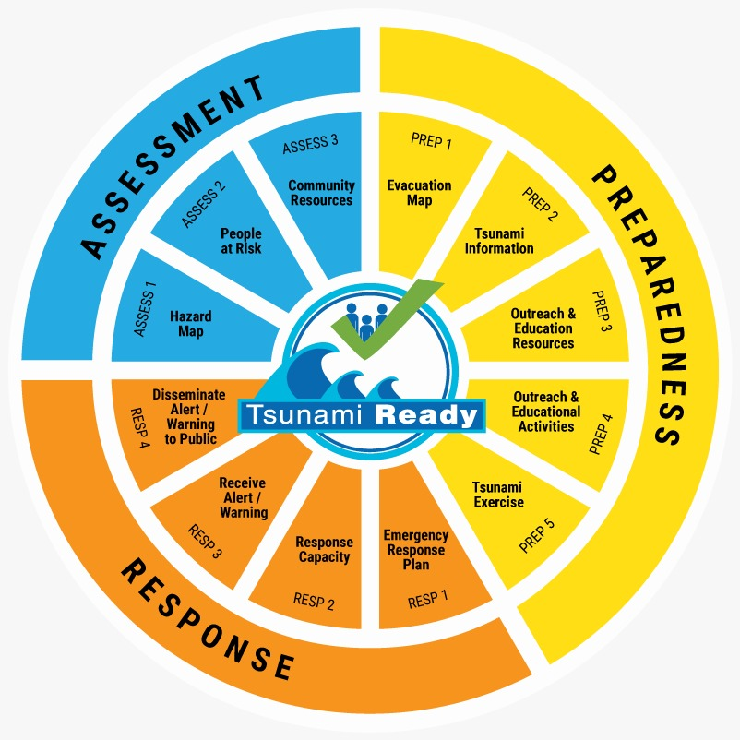
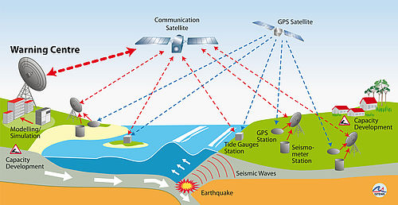
Component 3
Strengthen early warning systems at the local, national, and regional level for selected countries
Output 3.1: Communication strategy on early warning for coastal hazard established within all selected Biosphere Reserves
Output 3.2: Organization and administrative structure created or enhanced for processing/applying for Tsunami Ready recognition at the national level in all countries containing the target Biosphere Reserves
Output 3.3: Communities in target Biosphere Reserves have successfully achieved Tsunami Ready recognition

Slide 6
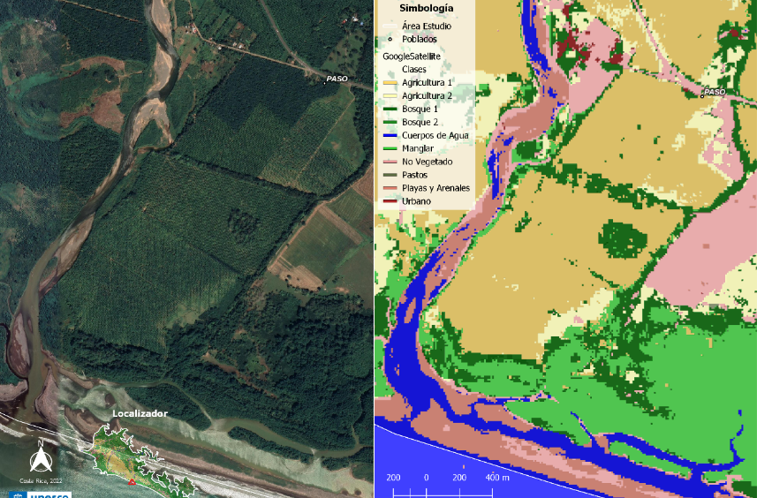
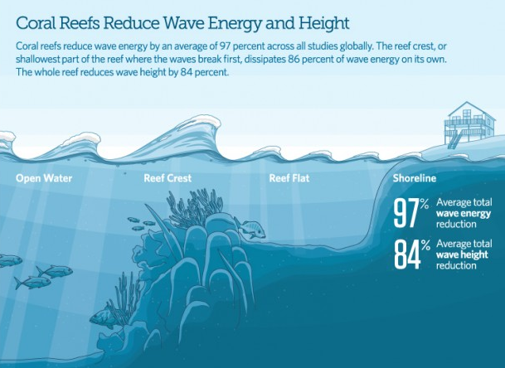
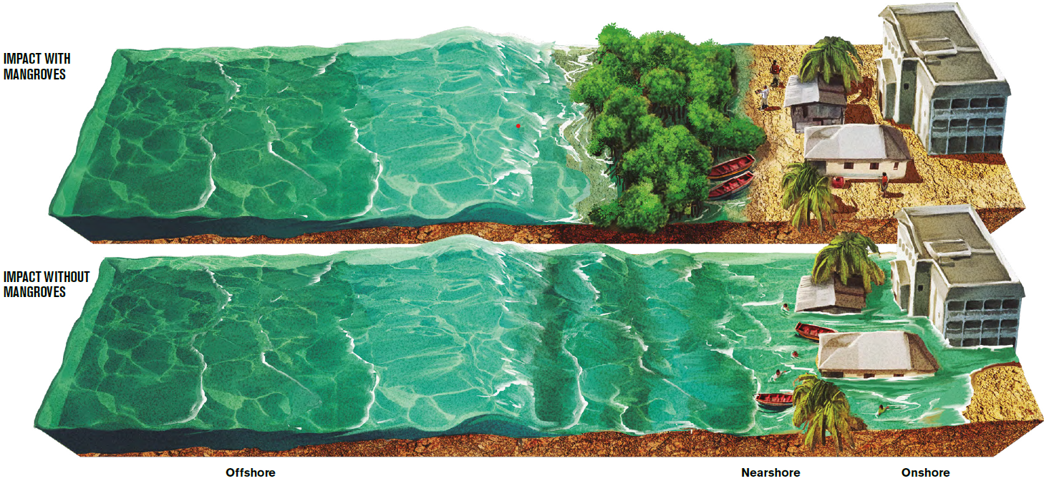
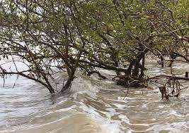
Component 4
Quantify and develop monitoring indicators for impacts from climate change and coastal hazards on ecosystem services and local socio-economic activities
Output 4.1: A comprehensive assessment and analysis of the ecosystem services and the impacts of climate change and coastal hazards for all project Biosphere Reserves
4.1.1 Assessment of ecosystem services
4.1.2 Create shapefiles with zonation
4.1.3 Technical analysis of the impact of climate change on ecosystem services
4.1.4 Analysis on the relationship between coastal hazards, CC and ecosystem services
4.1.5 Recommendations for mitigating the impact of coastal hazards and CC through nature-based solutions
Notes:
Shapefiles linked to step 1 of MSP

Slide 7
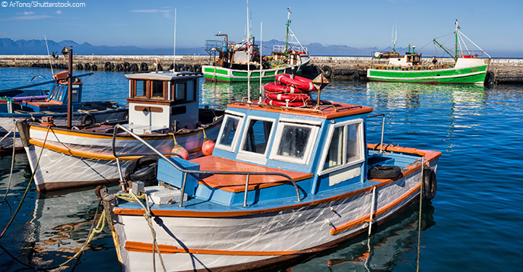
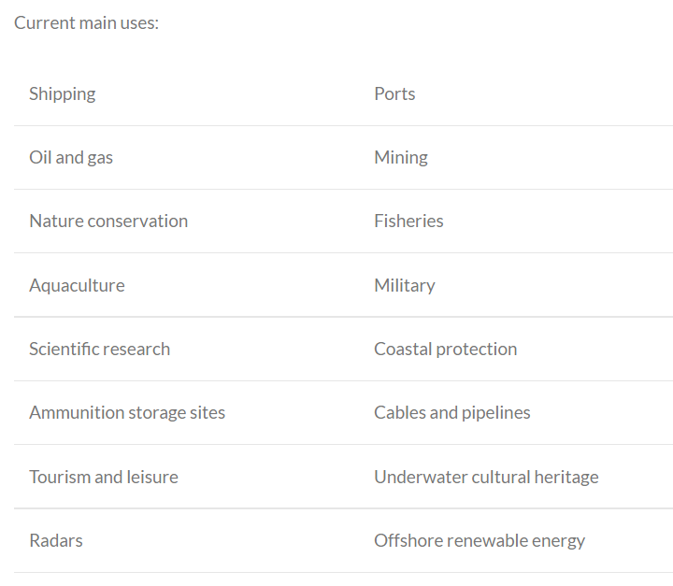
Component 4
Quantify and develop monitoring indicators for impacts from climate change and coastal hazards on ecosystem services and local socio-economic activities
Output 4.2: A comprehensive assessment of local socio-economic activities and the impacts of coastal hazards on relevant economic sectors for all project Biosphere Reserves, using a Marine Spatial Planning (MSP) approach
Output 4.3: A set of indicators and recommended approach for measuring and monitoring impacts of coastal hazards on ecosystem services and baseline measurements for all project Biosphere Reserves
4.2.1 Development of institutional capacity for mapping environmental, socio and economic spatial data
4.2.2 Comprehensive multi-sectoral characterization of conditions, using an MSP approach
4.2.3 Analysis of potential impacts from coastal hazards in the key economic sectors and develop related recommendations.
MSP in Indonesia: Several plans has been organized as a nested approach, integrating land and marine spatial planning.
For additional information on MSP in Indonesia: https://www.mspglobal2030.org/msp-roadmap/msp-around-the-world/asia/indonesia/
Notes:
Shapefiles linked to step 1 of MSP

Slide 8
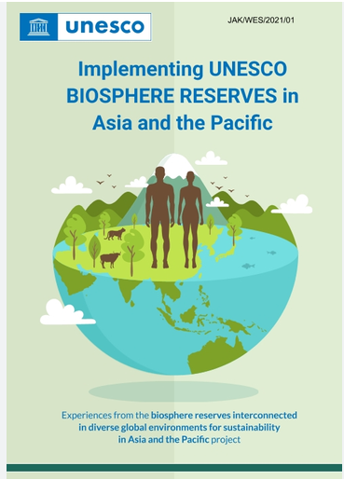
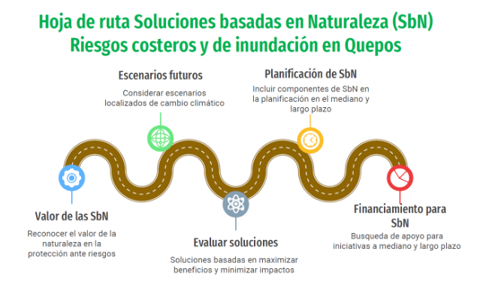
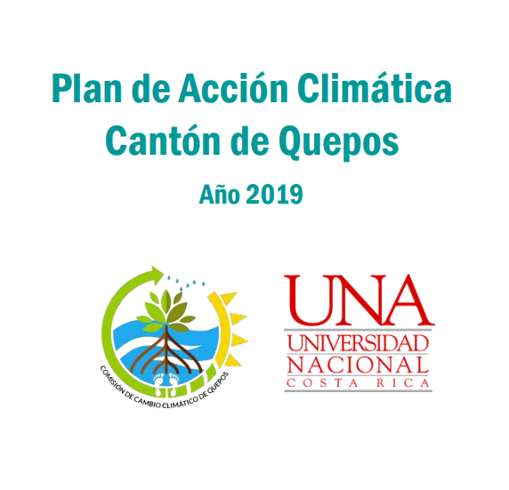
Component 5
Strengthen ocean governance and policies to enhance climate resilience of selected Biosphere Reserves
Output 5.1: Dynamic and inclusive Biosphere Reserve Management Committees and MAB National Committees that ensure effective governance of selected Biosphere Reserves linked with overall national and local ocean governance.
Output 5.2: Policies expanded or established to include relevant nature-based solutions to coastal hazards in selected Biosphere Reserves informed by regional and international best practice and frameworks on climate change, climate change resilience, biodiversity and sustainable development.

Slide 9
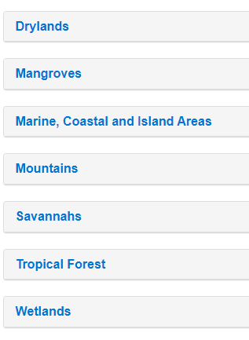
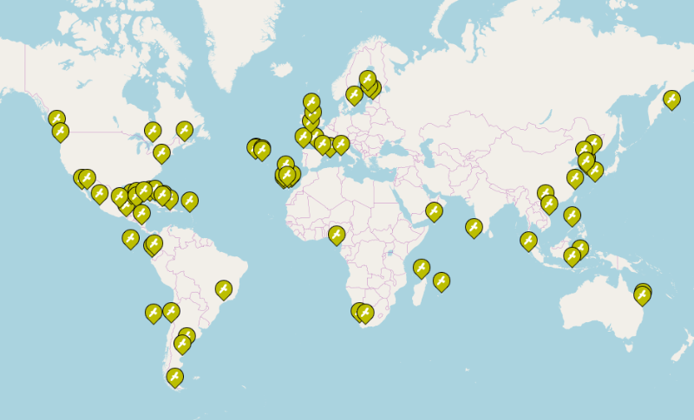
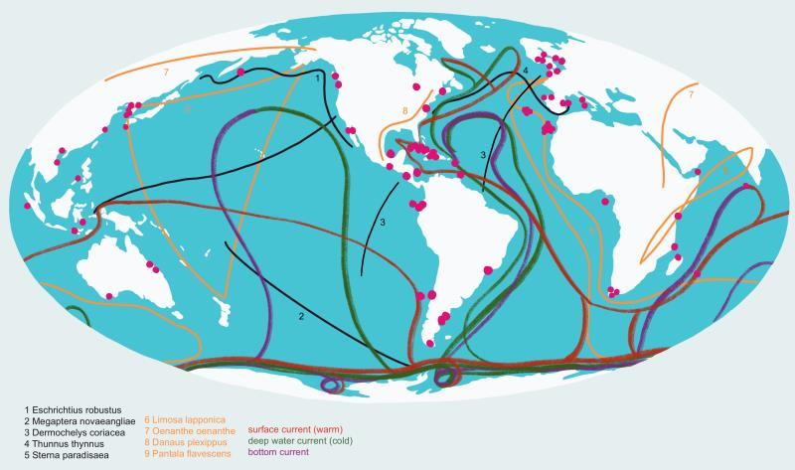
Component 6
Strengthen communication and collaboration between coastal and island Biosphere Reserves to leverage learning and experiences and support expansion of the IOC/MAB approach
Output 6.1: Package of materials including the IOC/MAB project Guidelines, project templates for project timelines and plans, sample consultant Terms of Reference, Guiding Committee Terms of Reference description in EN, SP, FR and required local languages
Output 6.2: A robust and active network of coastal and island Biosphere Reserves sharing learning and experiences on coastal hazard preparedness and climate resilience

Slide 10
Contacts:
Bernardo Aliaga, Head of the Tsunami Unit, b.aliaga@unesco.org
Kirsten Isensee, Programme Specialist for Ocean Science Section, k.isensee@unesco.org
Celine Tiffay, Programme and project assistant, Tsunami Unit, c.tiffay@unesco.org
Thank you!

