Slide 1
The project implementation strategy
Céline Tiffay, Programme and project assistant, Tsunami Unit

Slide 2
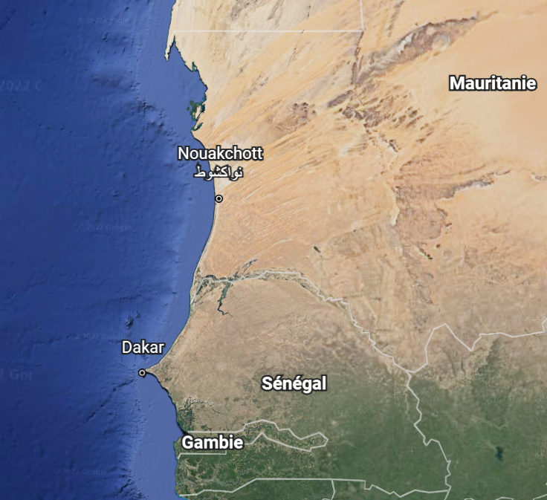
Implementation strategy
Project coordination and arrangements will be implemented through existing UNESCO regional and national offices, thereby leveraging existing coordination and management structures for cost-effectiveness.
In the case of a regional proposal, UNESCO Headquarters will coordinate the overall running of the project through a designated Project Appointment. In addition, to coordinate implementation of specific Biosphere Reserve projects within countries, UNESCO will hire national consultants to oversee the site- and country-specific projects. This will both build national and local capacity as well as contribute to sustainability at the national level.

Slide 3
Implementation strategy
Implementation agency
Task
Overall project monitoring, technical advice, including dissemination and training on IOC/MAB guidelines, promotion of the approach at global and regional levels, sharing of experiences between countries, evaluation and updating of lessons learned throughout the project, and support for the identification and implementation of national, regional and international collaborations
UNESCO
Project manager and administrative assistant
Project Steering Committee established by the national consultant for all or each biosphere reserve project.
Implementation of work at the community level, including risk and vulnerability assessment, coordination of data collection and monitoring, participatory community workshops, updating and strengthening of policy and management plans. Close collaboration with national and local experts, government, environmental organisations, emergency response agencies, MAB Councils and key local stakeholders.
National consultant
Local and regional stakeholders
Local, national and regional stakeholders
Support the coordination and implementation of relevant project activities, get involved in the activities and participate in the steering of the project.
Notes:
Les activités du projet seront mises en œuvre en étroite collaboration avec les organisations environnementales régionales et nationales, les organisations d'urgence, le gouvernement local, les experts techniques (y compris les universités/académiques nationales ou régionales), et les conseils et représentants du MAB nationaux et spécifiques aux sites, coordonnés par des consultants nationaux. La participation et l'engagement de ces groupes essentiels permettront au projet de bénéficier de l'expertise et des meilleures pratiques régionales et nationales, et de promouvoir l'appropriation nationale et régionale, contribuant ainsi à la durabilité du projet.
Au niveau de la communauté, le consultant national ou régional veillera également à collaborer avec les représentants des principaux groupes de parties prenantes de la communauté, notamment les groupes de femmes, les groupes de jeunes, les groupes environnementaux, les agences touristiques et toutes les autres parties prenantes importantes. La participation de diverses parties prenantes de la communauté garantira que les efforts de préparation couvrent les segments pertinents de la communauté et soutiendra ainsi le succès du projet. En outre, la participation de la communauté permettra de renforcer son appropriation du projet.
Le suivi et l'évaluation du processus seront assurés par des réunions hebdomadaires ou bimensuelles du comité directeur de chaque site.

Slide 4
Partners and stakeholders
Local emergency organizations
Local government
Site-specific MAB Board
Other relevant groups
Local women’s group (where relevant)
Local environmental groups
Regional emergency organizations
National Consultant
National MAB Board
National emergency organizations
National tsunami warning focal point
National tsunami warning centre
National academic institutions
National implementation entity (CCAF)
HQ- UNESCO/IOC MAB program
HQ – UNESCO/IOC Tsunami Unit
UNESCO regional and national offices
Tsunami Information Centres

Slide 5
Plenary discussion on stakeholder mapping

