Slide 1
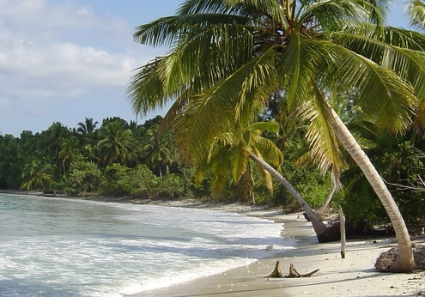
Intergovernmental Oceanographic Commission (IOC)
Bernardo Aliaga, Chief of section, Tsunami Unit
Kirsten Isensee, Programme specialist, Ocean Sciences Section

Slide 2
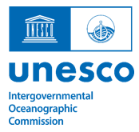
Introduction
UNESCO is the home of the Intergovernmental Oceanographic Commission (IOC) which is responsible for supporting global ocean science and services.
The IOC enables its 150 Member States to work together to protect the health of our shared ocean by coordinating programmes in areas such as ocean observations, tsunami warnings and marine spatial planning.
ADG/IOC Office General Policy and Coordination
Ocean Observations and Services
Ocean Sciences Section
Tsunami Programme

Slide 3
Tsunami Programme
Bernardo Aliaga
Head of Tsunami Unit
IOC-UNESCO

Slide 4
ACCESS TO MULTI-HAZARD WARNING SYSTEMS AND DISASTER RISK INFORMATION AND ASSESSMENTS
Newly adopted IOC Ocean Decade Tsunami Programme
Making 100% of communities at risk of tsunami prepared for and resilient to tsunamis by 2030 through the implementation of the UNESCO/IOC Tsunami Ready Recognition Programme.

Slide 5
IOC’s work on Marine Spatial Planning:
International guidance & Capacity development
Julian Barbière
Head of Marine Policy and Regional Coordination Section
IOC-UNESCO
Notes:
IOC

Slide 6
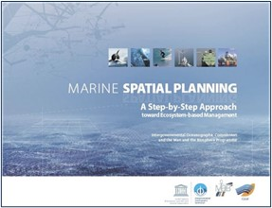
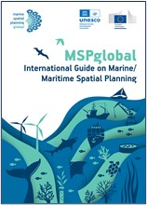
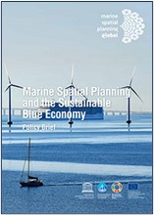
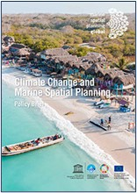
Marine Spatial Planning (MSP)
IOC-UNESCO definition:
“The public process of analyzing and allocating
the spatial and temporal distribution of human activities
to achieve ecological, economic, and social objectives
that are usually specified through a political process.”
Notes:
IOC-UNESCO definition of Marine Spatial Planning (which is globally adopted by many countries): “The public process of analyzing and allocating the spatial and temporal distribution of human activities to achieve ecological, economic, and social objectives that are usually specified through a political process.”
IOC has produced several guidelines to support the development and implementation of MSP
IOC is also engaged in capacity development activities on MSP

Slide 7
Integrating marine ecosystem services into MSP
FROM TO
Individual species | Ecosystems
Small spatial scale | Multiple scale, incl. transboundary
Short-term perspective | Long-term perspective
Humans: independent of ecosystems | Humans: integral part of ecosystems
Management divorced from research | Science informed, adaptive planning and management, including CC
Managing commodities and economic sectors | Sustaining productions potential for goods and services
Benefits:
Reduce conflicts among uses
Increased predictability and certainty
Facilitate compatible uses
Preserve critical ecosystem services
Notes:
As we build knowledge and technical capacity on marine ecosystem services, it is also important that ocean management frameworks evolve to integrate the sustaining of ecosystem goods and services as management goals per se.
One of these frameworks is Marine Spatial Planning, for which IOC-UNESCO has developed a methodological approach and provided technical support to many coastal nations in developing their national plans over the last 15 years.
At the heart of the MSP, is the concept of ecosystem based management which requires a paradigm change:
We need to move
From looking at individual species to looking at the entire ecosystem
From examining only small spatial scales to examining multiple scales
From the short-term perspective to a long-term perspective
From considering humans as being independent from marine ecosystems to recognizing humans as being an integral part of them
From having management divorced from research to using an adaptative case by case approach
And from managing commodities to focusing on sustaining production potential for both goods and services
MSP has become the preferred approach of many coastal countries to manage increasing conflicts among the multiple uses of their exclusive economic zones.

Slide 8
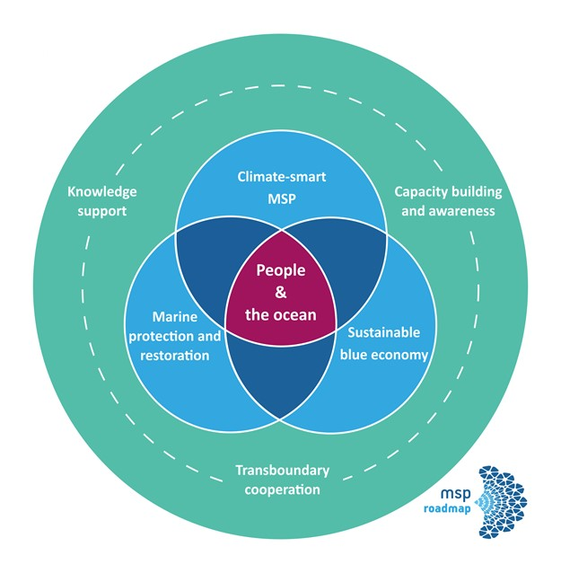
Joint Roadmap to accelerate MSP processes worldwide
MSP can integrate adaptation and mitigation measures to build the resilience of marine ecosystems, and reduce exposure and vulnerability of coastal communities and maritime activities to climate change
MSP as an enabler of the sustainable ocean/blue economy
MSProadmap target:
Support the achievement of covering at least 1/3 of the global maritime areas under national jurisdictions with marine spatial plans by 2030.
Notes:
The MSProadmap is a joint initiative by IOC-UNESCO and the European Commission
It is a framework that guides IOC’s work on MSP
An updated version was launched on 22 November 2022 during the 3rd Intl Conference on MSP (Barcelona, Spain)
3 cross-cutting pillars:
Knowledge support
Capacity development and awareness
Transboundary cooperation
3 thematic pillars (which are connected with this IOC/MAB project proposal):
Climate-smart MSP
Marine protection and restoration
Sustainable blue economy

Slide 9
Ocean Science Section
Kirsten Isensee
Spécialiste de programme, Section des sciences océaniques
COI-UNESCO
Notes:
IOC

Slide 10
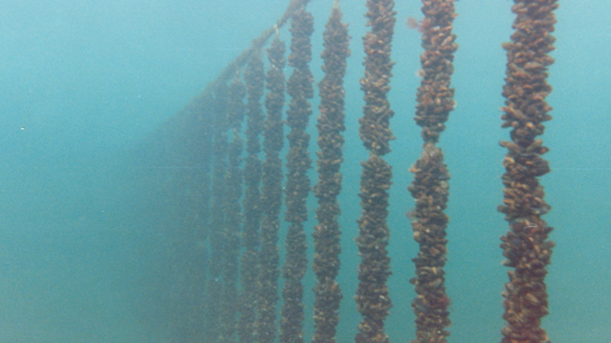
Seafood safety and sustainable aquaculture
Harmful/toxic microalgae poses a risk for seafood safety and establishment of / sustainable aquaculture;
Distribution patterns and frequencies of harmful algal events may change when coastal ecosystems change;
IOC has, for three decades, built capacity for better monitoring and data collection, especially in light of greater societal reliance on coastal marine resources;
IOC also addresses the challenge of macro-algal blooms of Sargassum through providing better understanding of the driving forces behind mass occurrences.

Slide 11
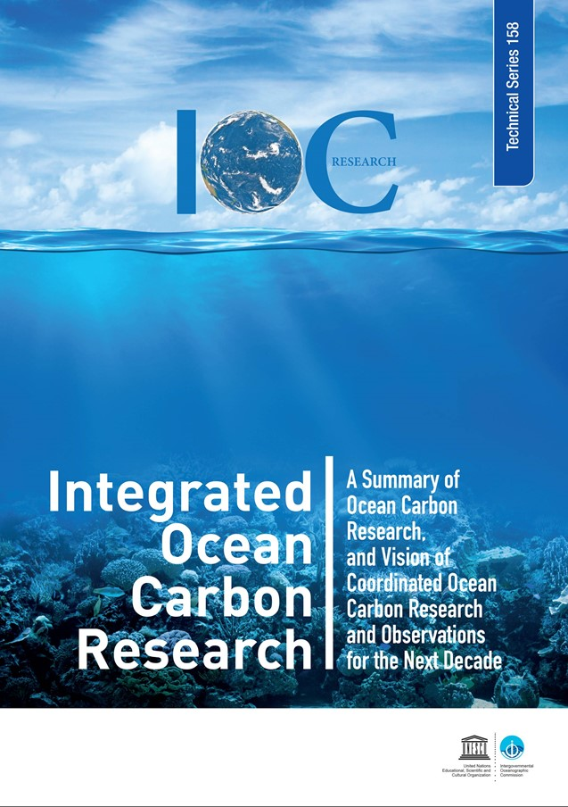
Ocean Carbon
Since the industrial revolution, the ocean has evolved into a major sink for carbon generated by human activities. Without oceanic and terrestrial sinks, atmospheric CO₂ levels would be close to 600 ppm (parts per million), well above the level compatible with a global warming target limited to 2 ̊C.
In the context of climate change, however, it is still unclear to scientists if the ocean will continue to help mitigate the effects of global warming, or its capacity to absorb carbon from the atmosphere will be altered as a consequence of the numerous human-induced ocean changes.
Faced with the urgent need to find answers to this and other crucial scientific questions, five international research programmes on ocean and climate interaction have joined the Intergovernmental Oceanographic Commission (IOC) of UNESCO to agree on a roadmap for future research, with the ultimate goal of providing decision-makers with the knowledge needed to implement effective climate change mitigation and adaptation policies in the next ten years.

Slide 12
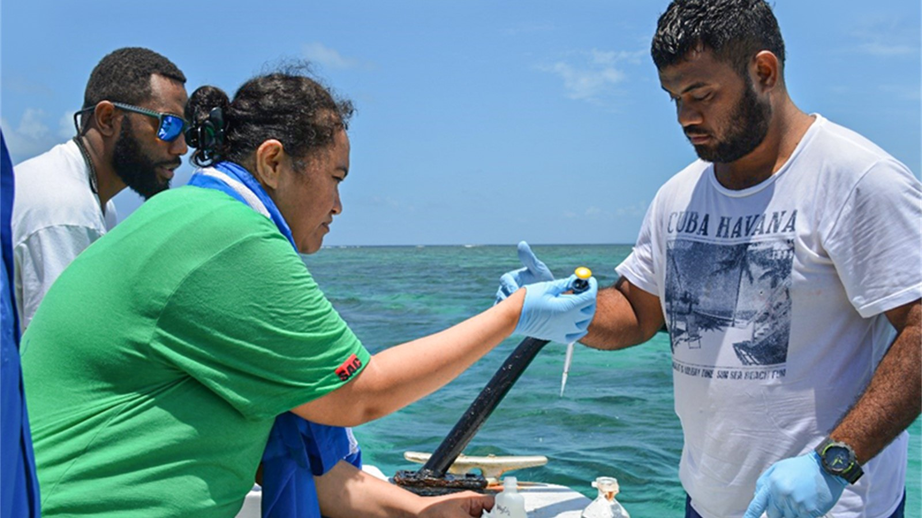
Ocean Acidification (and the Decade)
The ocean decade proposal lead by GOA-ON and supported by IOC-UNESCO, Ocean Acidification Research for Sustainability (OARS) has been formally recognized as an UN Ocean Decade programme. Through OARS, and with our continued, the scientific community will work effectively together to provide MS, society and decision makers with the scientific evidence they need in order to sustainably monitor, mitigate and adapt to the threats of ocean acidification; from our local coasts and estuaries to the open oceans.
@Alexis Valauri-Orton, The Ocean Foundation, ocean acidification water sampling in Suva Harbor during 2017 training in Fiji

Slide 13
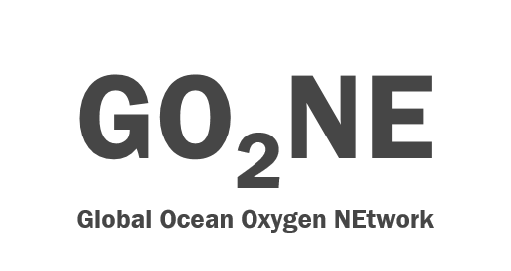
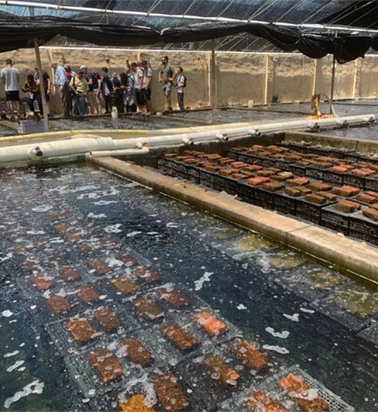
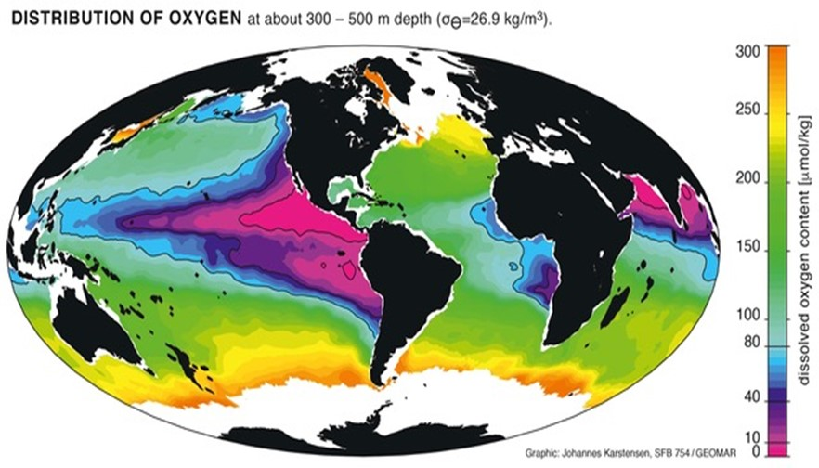
Deoxygenation (and the Decade)
© Johannes Karstensen /GEOMAR
Stakeholder engagement (© Kirsten Isensee, GO2NE)
In the framework of GOOD, the recently endorsed ocean decade programme focusing on deoxygenation lead by the IOC working group GO2NE, we will raise awareness about ocean deoxygenation, provide knowledge for action and, together with stakeholders, co-design and develop mitigation and adaptation measures at regional to global scale.

Slide 14
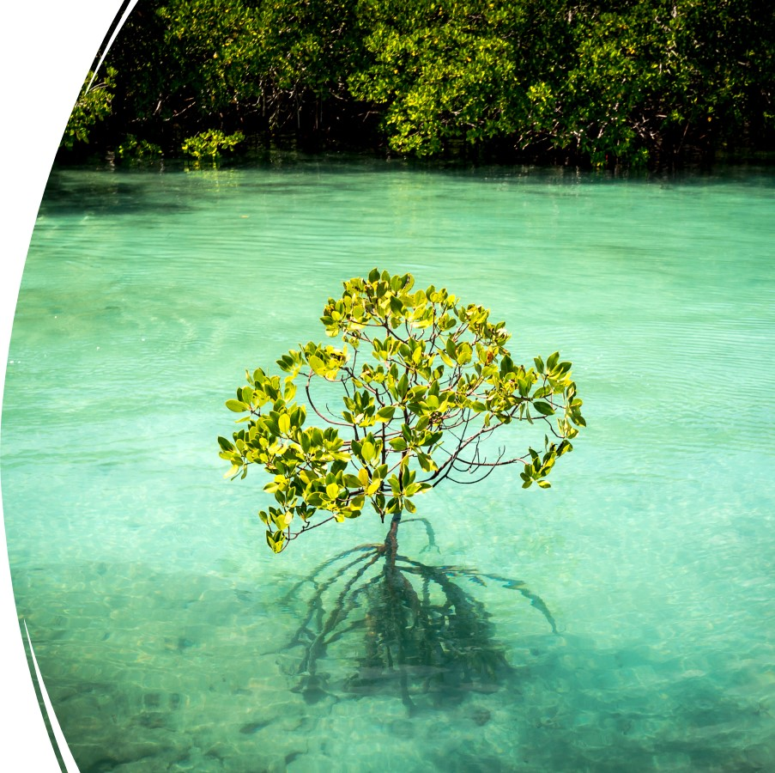
Blue Carbon
IOC has strengthened its role at the interface between blue carbon science and policy by becoming part of the Coordinator Team of the International Partnership of Blue Carbon together with the Australian Government last year. By connecting scientists united under the Blue Carbon Initiative with governments, the IOC is scaling up efforts towards the protection of blue carbon ecosystems, contributing to climate change mitigation, adaptation, biodiversity, ocean economies and livelihoods of coastal communities.
Scaling-up of efforts towards the protection of blue carbon ecosystems through the shared coordination of the Blue Carbon Initiative and the International Partnership for Blue Carbon, contributing to climate change mitigation and adaptation, biodiversity and livelihoods.

Slide 15
Thank you!

