Slide 1
Climate Change Adaptation Fund
Céline Tiffay, Programme and project assistant, Tsunami Unit

Slide 2
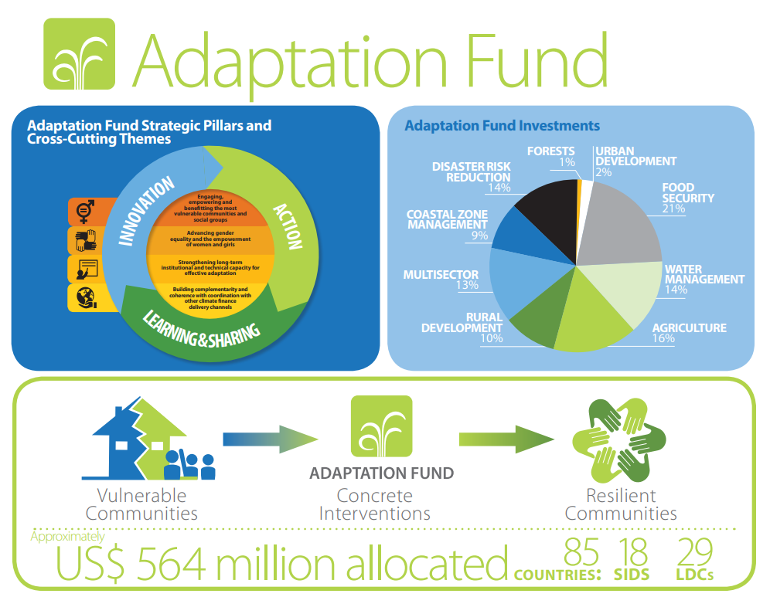
The Adaptation Fund finances projects and programmes to help developing countries adapt to the adverse effects of climate change. The Adaptation Fund is financed in part by governments and private donors, as well as by a two percent share of the proceeds from Certified Emission Reductions (CERs) issued under the Protocol's Clean Development Mechanism projects.
Source: Fond d’Adaptation

Slide 3
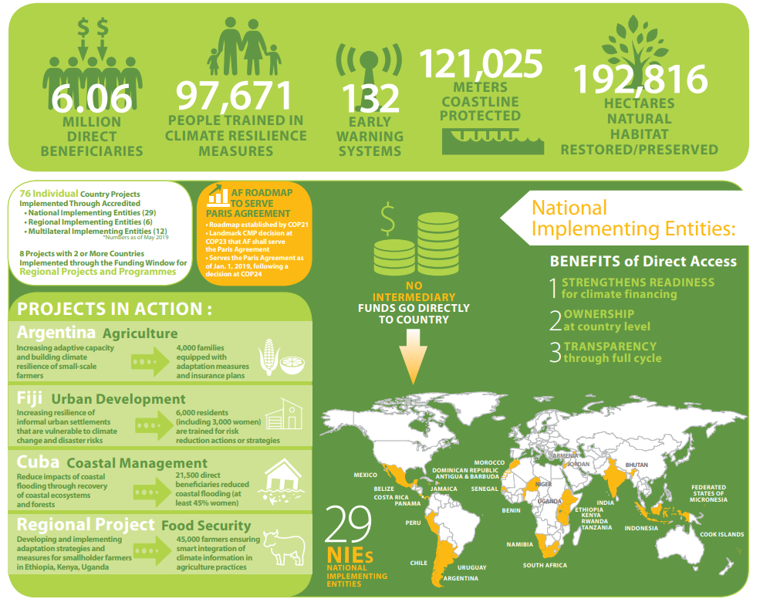

Slide 4
Application for project funding
Once accredited by the Adaptation Fund, an entity may submit a concept or full project proposal. Parties seeking financial resources from the Adaptation Fund must submit their project and programme proposals through accredited national, regional or multilateral implementing entities. Proposals are then screened against specific criteria available in the operational policies and guidelines. Proposals are accepted three times a year.
The Adaptation Fund has also made available several small grants to assist National Implementing Entities (NIEs) to provide support to countries seeking accreditation to the Fund and to build capacity to undertake various climate finance readiness activities. The Adaptation Fund has also made available three new funding windows for accredited National Implementing Entities (NIEs) to access small grants for innovation, learning and scaling up projects.
Source: Fond d’Adaptation

Slide 5
Thank you!

