Slide 1
UNESCO for natural resources management, biodiversity conservation and ecosystem restoration

Slide 2
UNESCO-designated sites
World Heritage
Biosphere Reserves
UNESCO Global Geoparks
2022

Slide 3
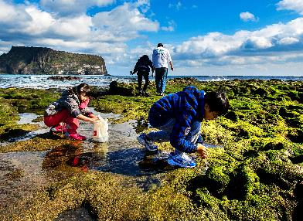
What is the UNESCO-MAB Programme?
Man and Biosphere (MAB) Programme
MAB is an intergovernmental scientific programme which aims to establish a scientific basis for improving the relationship between people and their environment
Vision
A world where people are conscious of their common future and their interactions with the planet, and act collectively and responsibly to build thriving societies in harmony within the biosphere.
Mission
Develop and strengthen models of sustainable development through the WNBR;
Communicate experiences and lessons learned, and facilitate the global diffusion and application of these models;
Support evaluation and high-quality management of biosphere reserves, strategies and policies for sustainable development and planning, and accountable and resilient institutions;
Help Member States and stakeholders to achieve the Sustainable Development Goals by sharing experiences and lessons learned.
2022
2022

Slide 4
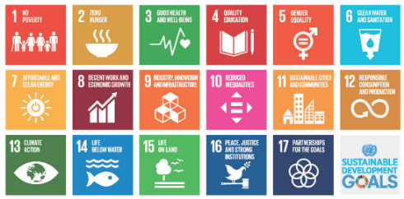
Biosphere Reserves
UNESCO-designated sites
Have experienced significant change and evolution during their 50-year history.
Today, they are learning sites for sustainable development.
They are places where innovative ideas for sustainable development are tested and implemented – through partnerships at the local, national, international and global level.
They combine scientific, local knowledge and participatory governance to:
Reduce loss of biodiversity
Improve livelihoods of local people
Enhance social, economic and cultural conditions for environmental sustainability
2022

Slide 6
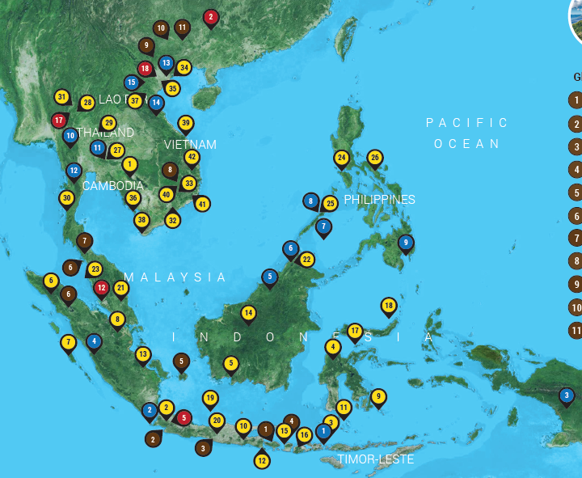
Southeast Asia Biosphere Reserves Network
Southeast Asian Biosphere Reserves Network
50
Biosphere
Reserves
Active for over
25 Years in:
Cambodia
Indonesia
Malaysia
Vietnam
Timor-Leste
Myanmar
Philippines
Thailand
Lao PDR
Japan
2022

Slide 7
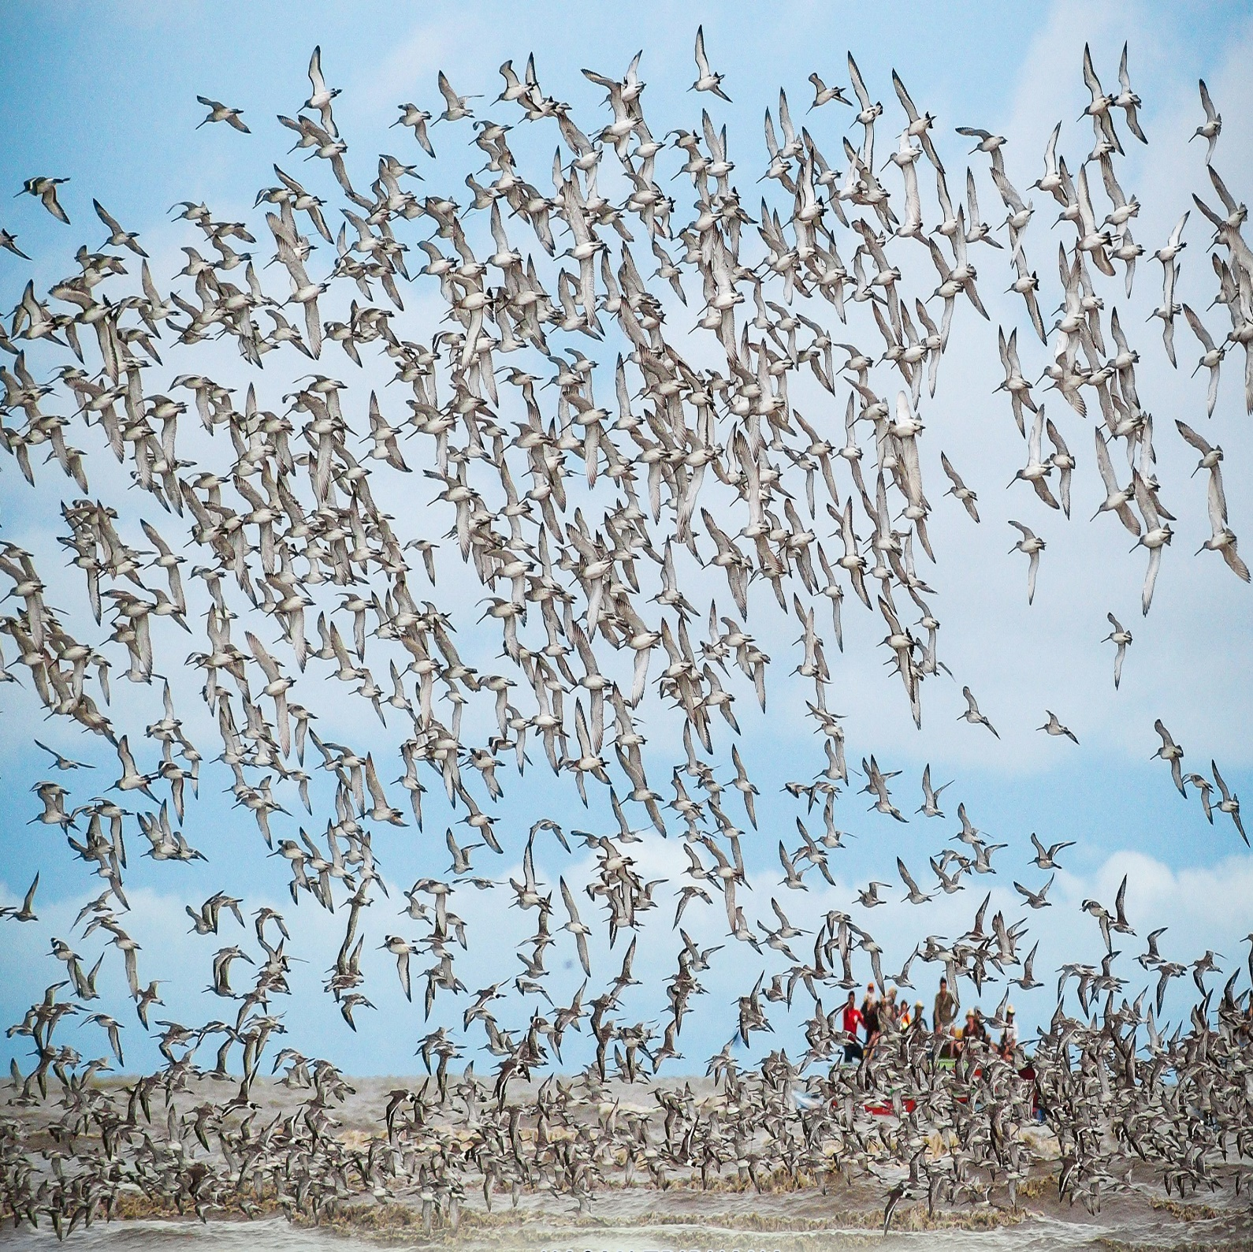

Slide 9
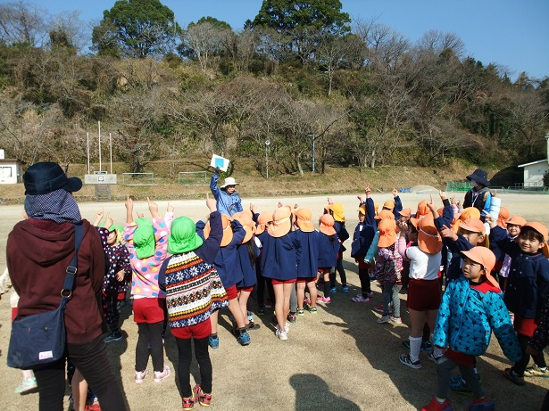
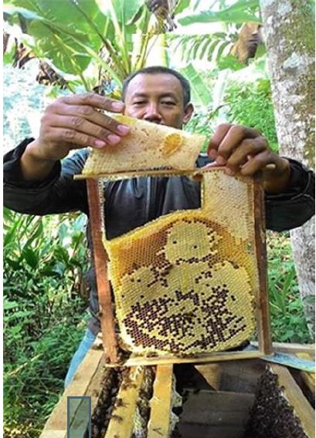
Activities
A Study of Biosphere Reserve Governance in Indonesia, Philippines and Japan
Updating nomination dossier of Nino Konis Santana National Park, Timor-Leste as a future Biosphere Reserve
Assessment for Sustainable Beekeeping Ecosystem:
Tonle Sap Biosphere Reserve, Cambodia:
24 beekeepers in 4 villages
Identifies high-potential practices from more than 56 bee plants
21 UNESCO-Designated Sites in Indonesia:
Identifies 8 potential sites
UNESCO's commitment to biodiversity
Time for reconciliation

Slide 10
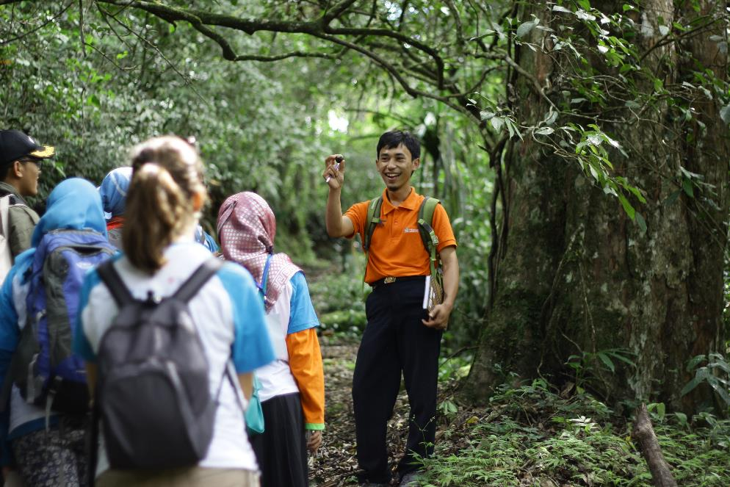
Engaging with Youth
Youth represent the present and the future of the MAB programme, their involvement in the governance of Biosphere Reserves and the Programme itself is extremely relevant.
MAB Young Scientist Award
Since 1989, supporting young researchers each year with awards of up to US$ 5,000 in support of their research on ecosystems, natural resources and biodiversity.
MAB is investing in a new generation of scientists because well-trained and committed young people are key to addressing ecological and sustainability issues.
Awardee:
- 2020, Dr Radisti Praptiwi: Understanding the impact of climate change to cultural ecosystem services in tropical marine biosphere reserve Taka Bonerate Kepulauan Selayar
- 2021, Dr Dian Burhani: The potential of local commodity of macroalgae from Karimunjawa Jepara Muria Biosphere Reserve as mask filter-based cellulose nanofiber in non-medical cloth mask to promote green economy for local community.
UNESCO's commitment to biodiversity
Time for reconciliation

Slide 11
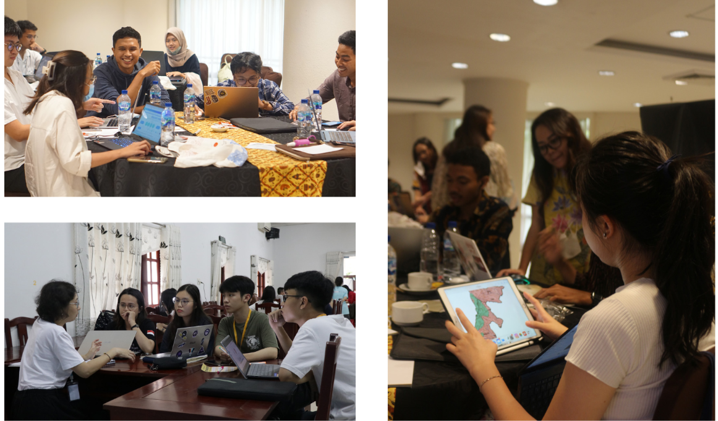
Engaging with Youth
UNESCO Water Resilience Challenge: in Indonesian and Vietnam Biosphere Reserves
Strengthening analytical, presentation, communication and critical thinking skills among young researchers, students and professionals.
Showing potential for realizing innovative ideas into locally implementable projects onsite, but also shows the broader potential for other UNESCO BR to benefit from a more inclusive engagement with youth in achieving other sustainable development goals, especially on SDG 4 and SDG 6.
UNESCO's commitment to biodiversity
Time for reconciliation

Slide 12
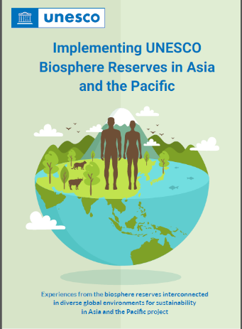
Publications
UNESCO publication based on three practical guidelines on priority issues requested by the MAB community in Asia and the Pacific.
A Standard Framework for Biosphere Reserve Management Informed by Sustainability Science; https://unesdoc.unesco.org/ark:/48223/pf0000373538
Eco-labelling Guidelines for Biosphere Reserve Management. https://unesdoc.unesco.org/ark:/48223/pf0000373540
Biosphere Reserve Zonation in Asia and the Pacific: Legal Context and Perspective https://unesdoc.unesco.org/ark:/48223/pf0000373541
UNESCO's commitment to biodiversity
Time for reconciliation

Slide 13
Thank you! al.wulandari@unesco.org
2022

