Slide 1
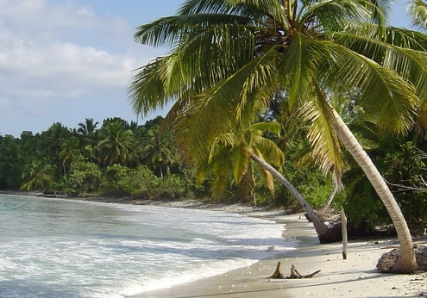
The IOC/MAB Joint Initiative proposal: Background and purpose
Céline Tiffay, Programme and project assistant, Tsunami Unit

Slide 2
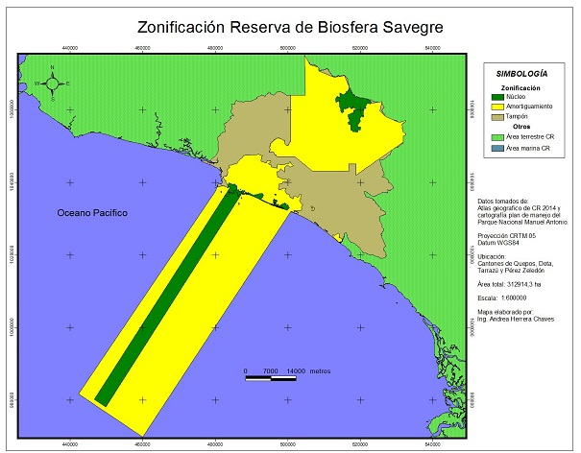
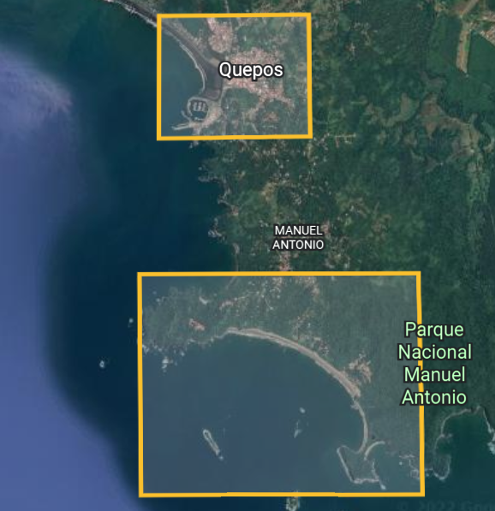
Pilot project in the Savegre Biosphere Reserve
Savegre Biosphere Reserve
Quepos
Manuel Antonio
Parque Nacional Manuel Antonio
Coastal hazards
Tsunamis
Inundation from heavy rainfall
Storm surges
Important population centres and popular tourist destinations

Slide 3
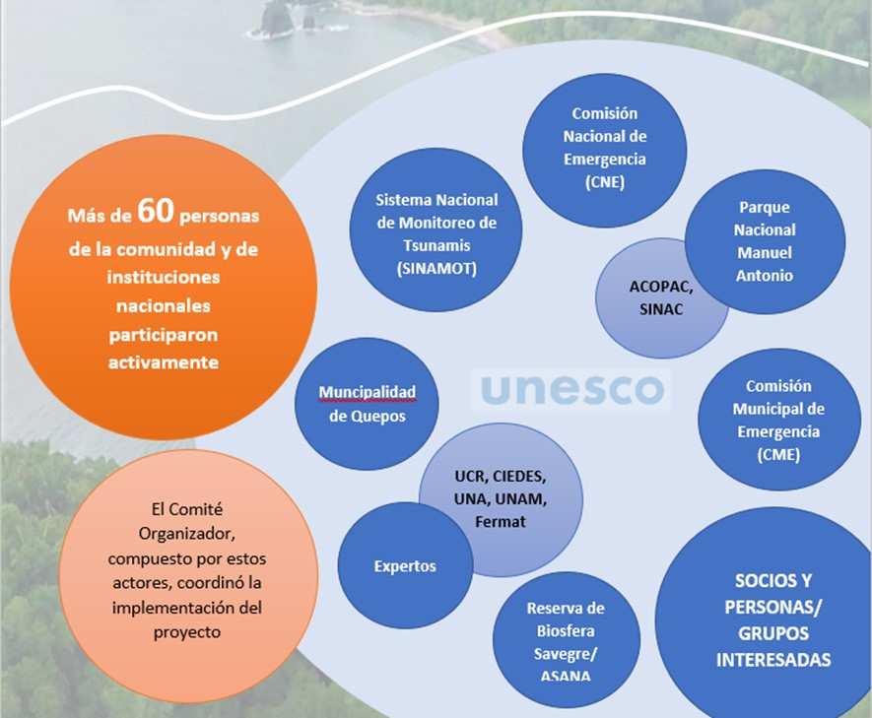
Pilot project in the Savegre Biosphere Reserve
2
Providing guidelines, tools and lessons learned to inform the implementation of tsunami and coastal hazard preparedness in biosphere reserves around the world.
Strengthening the governance and improving the resilience of biosphere reserves in island and coastal areas.
3
1
Developing and establishing preparedness measures against coastal hazard flooding in the Savegre Biosphere Reserve.

Slide 4
Pilot project in the Savegre Biosphere Reserve
Concrete Results

Slide 5
Key challenges addressed by the IOC/MAB Joint Initiative
Flooding from coastal hazards will increase globally due to climate change.
Biosphere reserves are exposed to natural hazards, and this includes coastal hazards or threats.
Sea level rise is one of the main drivers of increased coastal hazard impacts but not the only one (i.e. frequency and intensity of extreme weather events)
Coastal hazards often have a disproportionate impact on developing and island nations, where resilience and preparedness are currently limited.
Destruction of coastal ecosystems increases the likelihood of serious damage and risk during coastal hazard events
DRR plans do not sufficiently address the threat of coastal risks and hazards in biosphere reserves.
84%
of Biosphere Reserves consider natural hazards an important issue
94%
of Biosphere Reserves are exposed to natural hazards
Nature-based solutions are tools for mitigating the impact of coastal hazards, but they are underused.
Links between communities and MAB and emergency management stakeholders are often weak and need to be strengthened.

Slide 6
Key elements of the proposed project
Based on community participation
Multi-hazard
Decentralised approach
MSP approach and nature-based solutions
Based on science
Multi-sectoral

Slide 7
Project results framework
GOAL
Strengthen climate change resilience in coastal and island Biosphere Reserves by developing preparedness for coastal hazards and enhancing ocean management, governance and policies.
IMPACT
Reduce risk, increase safety and enhance the resilience of vulnerable coastal communities to the increasing risk of inundation from coastal hazards due to climate change, and to protect and leverage the unique ecosystems of Biosphere Reserves, as well as their local socio-economic activities.
COPMPONENTS
1. Strengthening national capacity to measure and monitor climate change impacts on coastal hazards and climate change
4. Quantify and develop monitoring indicators for impacts from climate change and coastal hazards on ecosystem services and local socio-economic activities
2. Develop and establish local measures for multi-hazard preparedness against inundation from coastal hazards in selected Biosphere Reserves
5. Strengthen ocean governance and policies to enhance climate resilience of selected Biosphere Reserves
3. Strengthen early warning systems at the local, national, and regional level for selected countries
6. Strengthen communication and collaboration between coastal and island Biosphere Reserves to leverage learning and experiences and support expansion of the IOC/MAB approach

Slide 8
Contacts:
Bernardo Aliaga, Head of the Tsunami Unit, b.aliaga@unesco.org
Kirsten Isensee, Programme Specialist for Ocean Science Section, k.isensee@unesco.org
Celine Tiffay, Programme and project assistant, Tsunami Unit, c.tiffay@unesco.org
Thank you!

