Slide 1
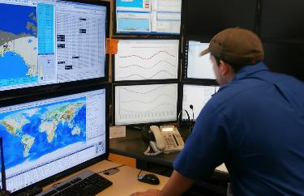
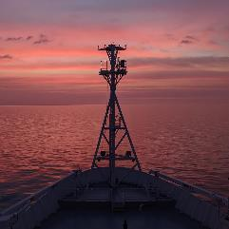
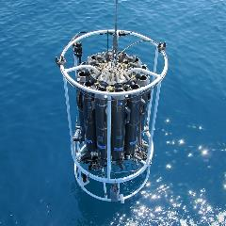
OBPS Workshop VI
www.oceanbestpractices.org
Notes:
Walk you through the OBPS including its main features so that you can use this information throughout the rest of the workshop and in your own work going forward
Most of the information I’m going to talk about it on the website so if you see something that piques your interest, check there and if you can’t find it pop me an email!

Slide 2
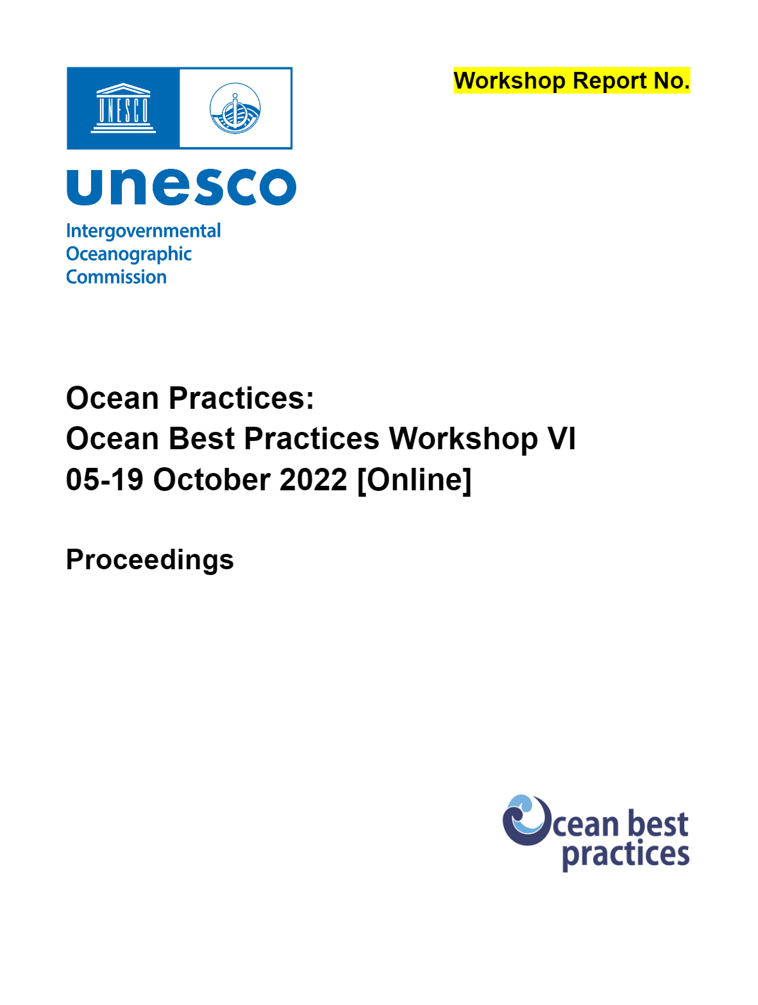

Slide 3
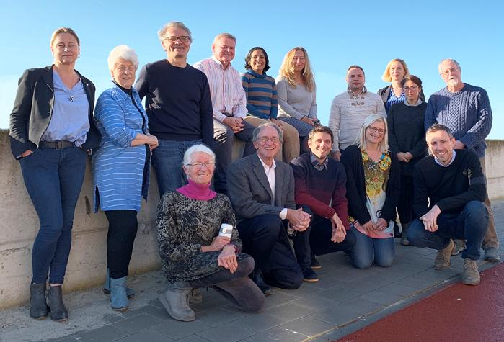
Acknowledgements
US NSF OceanObs Research Coordination Network (NSF grant 1728913)
EC Horizon 2020: JERICO-S3 Project (Grant 871153)
EuroSea Project (Grant 862626), CAPARDUS (Grant 869673), ILIAD (Grant 101037643, and IODE, GOOS and IEEE OES.
Many volunteers helped organize the agenda and sessions
Notes:
(photo of OBPS Steering Group from 2019 – last time we were in person)

Slide 4
Workshop Goals
-To guide the development of best practices and operating practices
-To promote their documentation, and
-To share them widely using the Ocean Best Practices System.
Notes:
(photo of OBPS Steering Group from 2019 – last time we were in person)

Slide 5
Workshop Committees
PLANNING: Muller-Karger, Pearlman, Pearlman, Tan, Simpson, Van Ruth, Zitoun
PROGRAMME: PLANNING + Heslop, Adeoye
PUBLIC RELATIONS: Muller-Karger, Pearlman, Pearlman, Roden, Tan
ECOPS: Zitoun, Horstmann, Woo
REGISTRATION: F. Pearlman, Simpson, Laso Perez
PROCEEDINGS: Simpson, F. Pearlman, Morris, Woo
Technology: B. Roberts
Notes:
(photo of OBPS Steering Group from 2019 – last time we were in person)

Slide 6
Thanks especially to
Pauline Simpson
Paul van Ruth
Rebecca Zitoun
Jay Pearlman
Francoise Pearlman

Slide 7
Plenaries offered in two time zones with keynotes and panel speakers
Theme Sessions held over two weeks
Notes:
(photo of OBPS Steering Group from 2019 – last time we were in person)

Slide 8
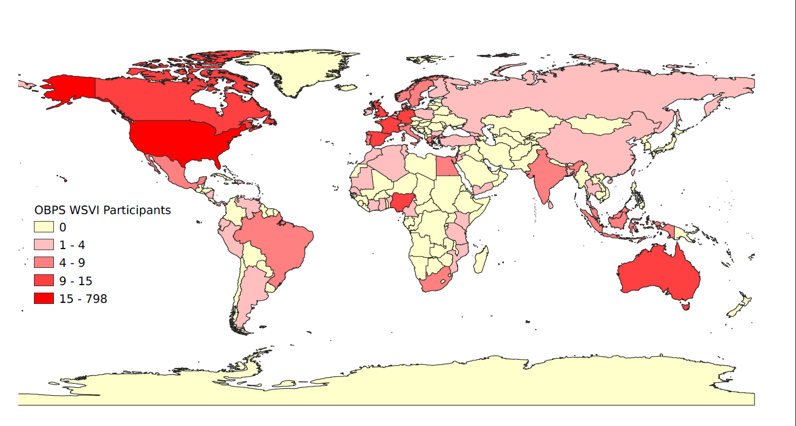
A Community Workshop
More than 500 active participants globally
Two weeks of sessions
19 Themes
Used QiqoChat (Qiqo)
a social wrapper around Zoom
Notes:
(photo of OBPS Steering Group from 2019 – last time we were in person)

Slide 9
Air Sea Interaction
Arctic Practices
Capacity Development
Coastal Observations
Data Interoperability
Decision Trees
Deep Ocean Observations
Early Career Ocean Professionals
eDNA
Environmental Plastics
Fisheries and Aquaculture
Marine Biodiversity
Ocean Decade
Ocean Policy and Best Practices
Operational Forecasting
Organizational Cooperation
QC of Chemical Ocean Profiles
Seagrass Monitoring
Time Series Observations
Transparency and Traceability
“Cafés”
19 Themes
Notes:
(photo of OBPS Steering Group from 2019 – last time we were in person)

Slide 10
OBPS VI Workshop
Key recommendations, common outcomes and lessons learned
www.oceanbestpractices.org
OBPS Workshop VI, Oct 2022 [online]
O

Slide 11
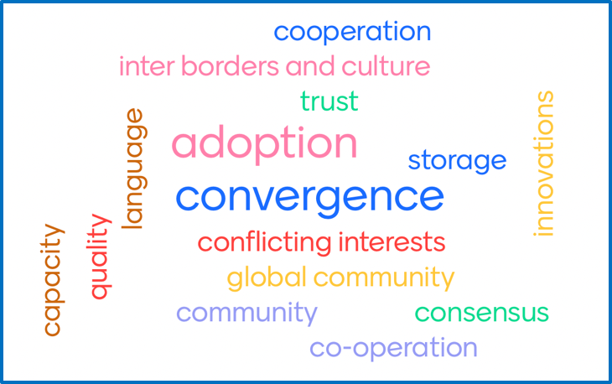
Sessions revealed an emerging ambition:
to move toward global procedures and standards that can be formally documented through best practices guides

Slide 12
Recommendations for the Community
BP should be implemented for broad benefit, considering the value chain for the required observations and weighing benefits and losses
BP should be developed using co-design as a continuous, collaborative, iterative process involving all stakeholders
BP should be standardised at necessary temporal and spatial scales
A single best practice rarely is applicable globally and may need to be adapted locally to infrastructure availability and societal needs.
Decision trees should be used in conjunction with BP
OBPS is already achieving or the strategic plan identifies relevant actions
Created by the community for the community

Slide 13
Recommendations for the Community
BP should be accessible and provided in plain language to promote good quality data which should be FAIR
The capabilities and practices of existing initiatives/programmes provide valuable starting points for BP
Operational needs in modelling and forecasting should be considered in developing BP - we need better, more collaborative links between industry, science, management and operations
Created by the community for the community
OBPS is already achieving or the strategic plan identifies relevant actions

Slide 14
Recommendations for the OBPS
Ensure long-term stewardship of best practices after groups that develop them dissolve
Help networks of communities link and develop strategies for interoperability
Work on approaches to accurately tag, filter, and layer metadata information to easily guide users
Continue to provide a platform where digital assets such as protocols can be open access and FAIR, and provide guidance on the possible endorsement processes available to the community
Promote Community-Based Monitoring (CBM) and Citizen Science (CS)
OBPS is already achieving or the strategic plan identifies relevant actions
Notes:
Repository is an permanent archive as an example OBPS is the only permanent for FIX03 Handbook now that the project website has been taken down

Slide 15
Recommendations on Future Collaborations
Community leaders should continue to
promote communication platforms and workshops to
be attended by experts and ECOPs from across the
globe
The community should plan for activities beyond the Ocean Decade, and promote integration between disciplines, with the goal of maximising societal benefits by strengthening the value chain from co-design to forecasting
It is up to community members to volunteer to lead these efforts and engage with the OBPS to motivate and establish processes to make these changes

Slide 16
Outreach and Capacity Sharing
Capacity Sharing:
Capacity sharing is a two-way street
Bring best practices and standards into a harmonized
international formal education curriculum that serves everyone
Help link the substantial informal education efforts conducted by all groups
Provide support in different languages to facilitate local engagement and BP adoption
Use a broad range of communication styles using innovative digital approaches

Slide 17
To learn more or submit your own best practice, visit
www.oceanbestpractices.org
info@oceanbestpractices.org
@OceanPractices

Slide 18
Backup slides

Slide 19
Why focus on establishing best practices?
Promote efficient and effective operations
Improve system interoperability
Improve data comparability → increase accessibility and ease of use
Provide certainty → promote sensor/hardware development
Build trust → Higher funding success and streamlined regulatory approval
Enable new people to engage from any region on the globe with a high probability of success

Slide 20
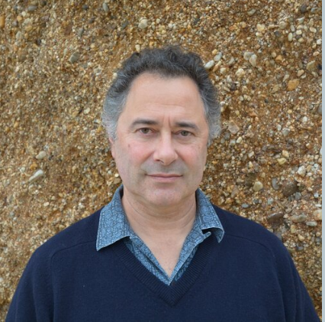
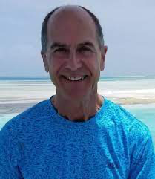
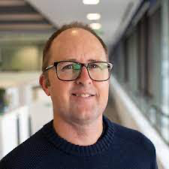
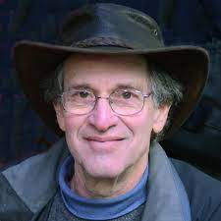
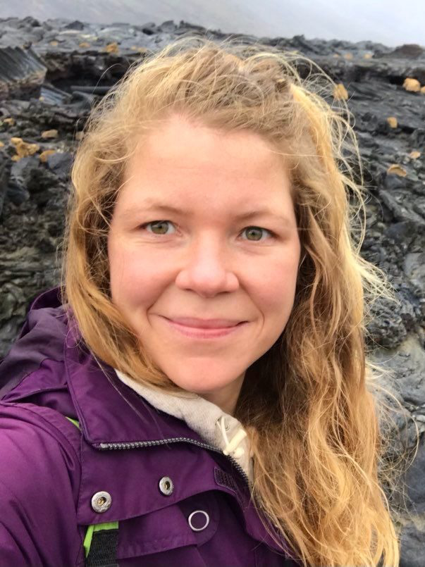
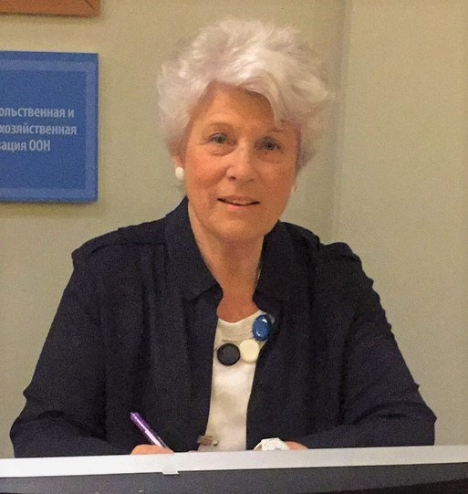
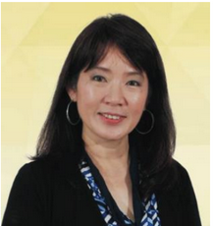
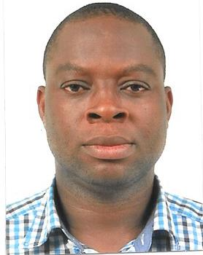
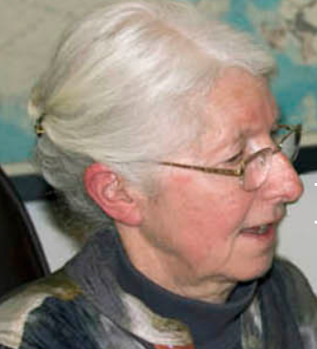
Workshop Committee
Ben Roberts
Frank Muller-Karger
Paul van Ruth
Jay Pearlman
Rebecca Zitoun
Pauline Simpson
Aileen Tan Shau Hwai
Olusola Adeoye
Francoise Pearlman

Slide 21
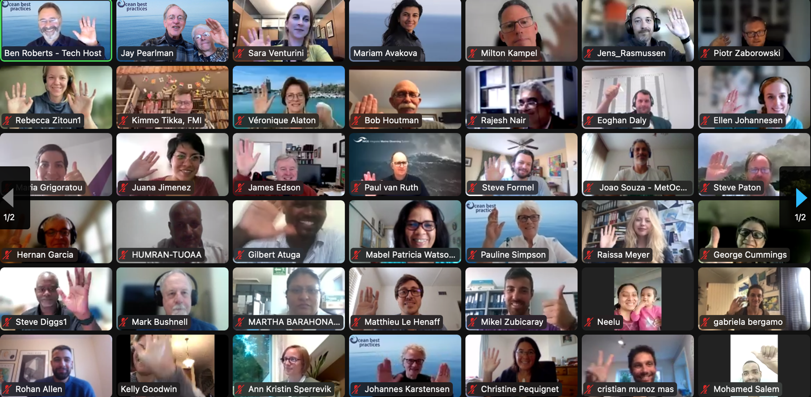
Thank You for Participating

