Slide 1
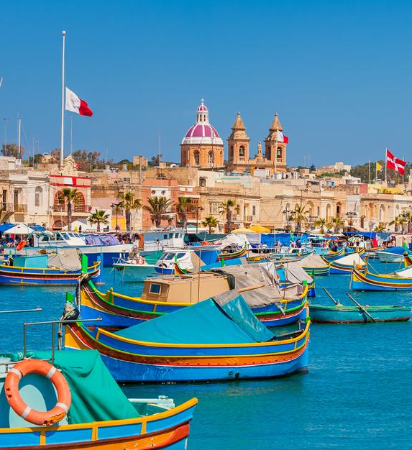
CoastWAVE
MARSAXLOKK, MALTA
Progress on Risk Perception Survey
Progress on SOP Workshops and TR implementation cycle
10th January 2023

Slide 2
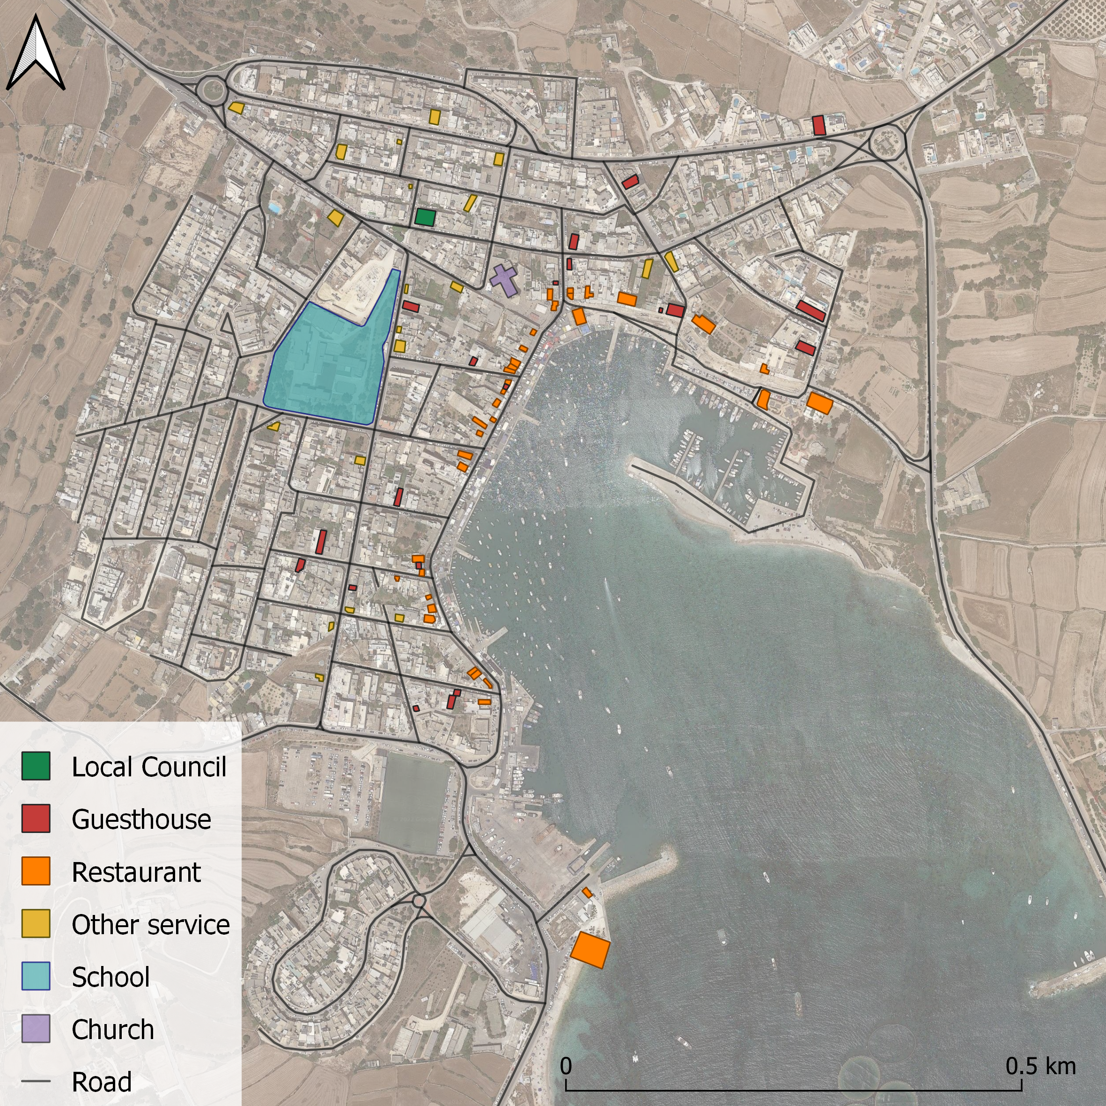
Risk Perception Survey
Contact via email:
  Guesthouses
  Restaurants
  Other Services
  Staff of Marsaxlokk School
  Parents of students at Marsaxlokk School
10th January 2023

Slide 3

Risk Perception Survey
Contact via email
QR code poster:
  Social Media
  Local Council
  Church
  Supermarkets
  Farmacy
  Police station
  School
  Fisherman association
  Sports club
  Retirement home
10th January 2023

Slide 4
Risk Perception Survey
Contact via email
QR code poster.
One-to-one interviews:
  Fishermen
  Locals at market
  Emergency responders
10th January 2023

Slide 5
Risk Perception Survey
Total
141
35
6
2
184
10th January 2023

Slide 6
Timeline
 | Activity | OCT 2022 | NOV 2022 | DEC 2022 | JAN 2023 | FEB 2023 | MAR 2023 | APR 2023 | MAY 2023 | JUN2023 | JUL 2023 | AUG 2023 | SEP 2023 | OCT 2023 | NOV 2023
i | Identify target groups; Design survey protocol; Conduct survey
ii | Upload results and prepare report
iv | Establishment of National Tsunami Ready Board
v | National to community awareness SOP workshop
 | Re-evaluation of tsunami inundation maps
vi | Impact assessment (people. economic, infrastructural, political and social)
vii | Tsunami evacuation maps; Tsunami awareness material
viii | Preparation and installation of displayed tsunami information
ix | Social events; Workshop(s); Distribution of awareness and education resources |  |  |  | Sta Lucia school activity
x | Organize, execute and evaluate a community tsunami exercise
xi | Implementation and monitoring of the Tsunami Ready cycle
10th January 2023

Slide 7


Activities planned
Targeted to +14y.o. students from Marsaxlokk
Help with filling in the survey
Explanation of
Tsunami
Storm surge
Sea level rise
10th January 2023

Slide 8
Current or anticipated issues
National Tsunami Warning Centre
Modality of NTWC still not resolved.
Meeting with national authorities planned on 25th January.
National Tsunami Ready Board
IDSL
We have identified appropriate persons, but still needs discussion.
Dismantling of Cirkewwa station and maintenance of others.
Power storage at one station still giving some problems.
10th January 2023

