Slide 1
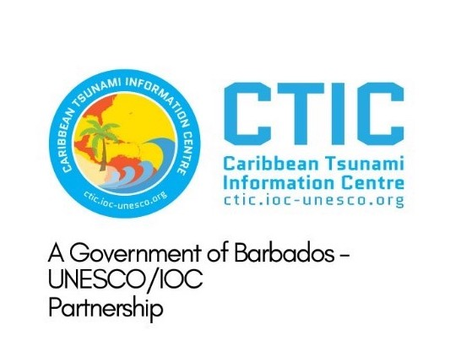
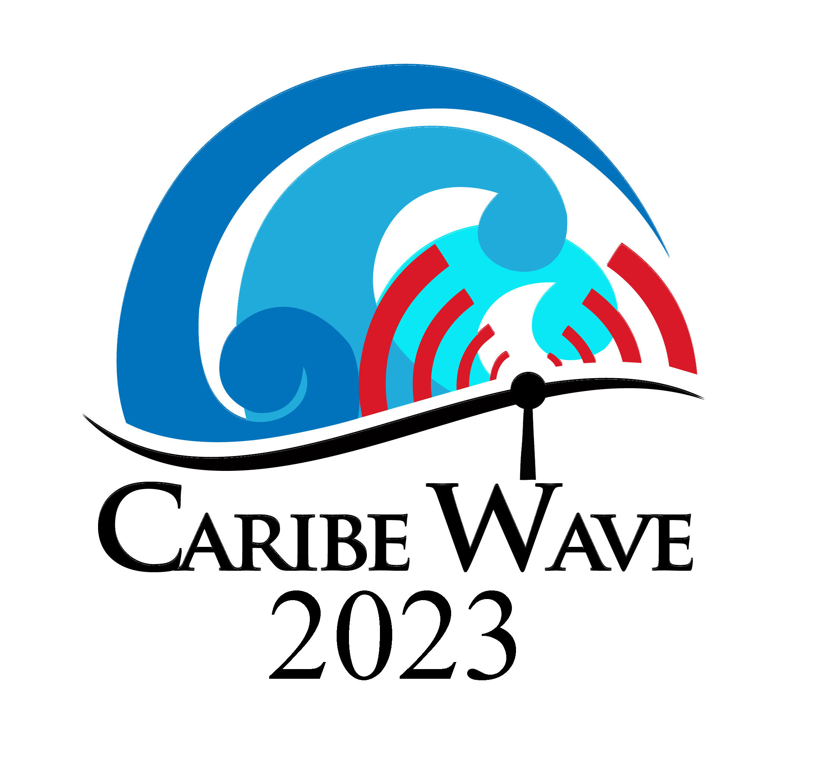
Caribe Wave Exercise Update
Dr. Elizabeth A. Vanacore
Seismologist, Puerto Rico Seismic Network
ICG CARIBE-EWS CARIBE WAVE TT CHAIR
Christa G. von Hillebrandt-Andrade
Manager, ITIC Caribbean Office
ICG CARIBE-EWS WG IV Chair
Stephanie Soto
BS Geology
ITIC Caribbean Office
24 January 2023
#CARIBEWAVE #TSUNAMIREADY

Slide 2
Timeline
ACTION | TIMELINE
Circular Letter Issued by IOC to MS | ✓ November 2022
Handbook Draft Circulated among ICG CARIBE EWS, TWFP/NTWC contacts and TT CARIBE WAVE 23 | ✓ December 2022
Deadline for Comments | ✓ December 2022
Exercise Handbook Available Online | ✓ January 2023
1st Webinar CW (Overview, PTWC Products) | ✓ 24 January 2023 – English ✓ 25 January 2023 – Spanish ✓ 26 January 2023 – French
2nd Webinar CW (Update, Communication Methods, Registration, Questionnaire, Uploading Pictures/Videos ) | 21 February 2023 - English 22 February 2023 - Spanish 23 February 2023 – French
Countries Indicate Selected Scenario | 10 March 2023
Exercise | 23 March 2023
Hot-Wash | 4 April 2023
Exercise Evaluation Due | 13 April 2023
Final Draft Caribe Wave 23 Report 27 April 2023

Slide 3
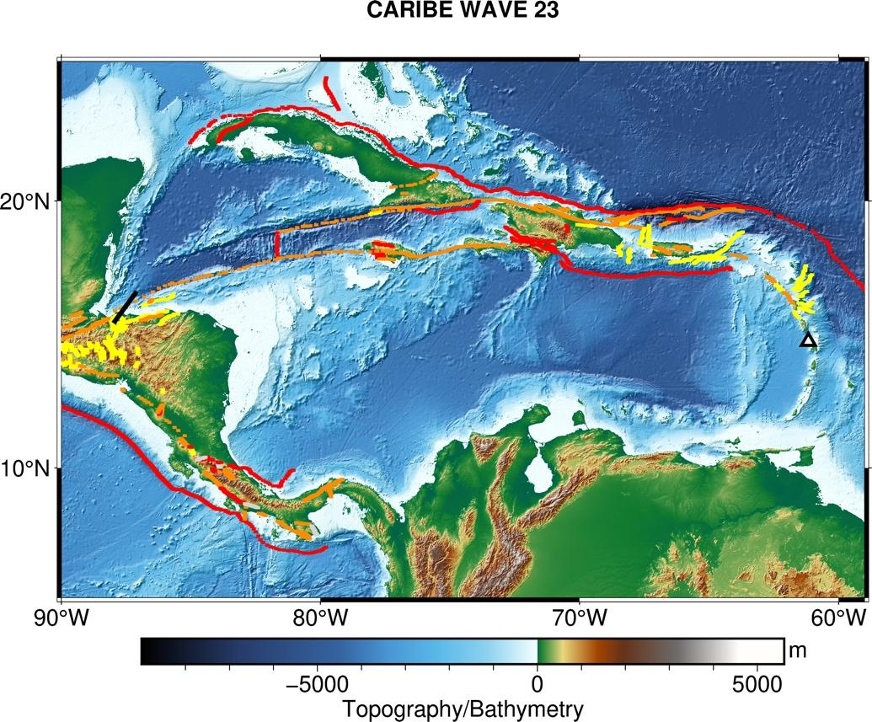
CARIBE WAVE 23 Earthquake and Tsunami Scenarios
Gulf of Honduras
Mount Pelée
Scenario | Origin Time | Mw | Epicenter
Gulf of Honduras | 14:00:00 UTC 23 March 2023 | 7.6 | 16.07⁰N, 87.54⁰W
Mount Pelée |  |  | 14.48⁰N, 61.10⁰W

Slide 4
Message Chronology issued by the PTWC Mount Pelée
Date | Time (UTC) | PTWC
 |  | Type of Product | Transmission Method
3/23/23 | 1400 | - - - - Confirmed Eruption/Tsunami- - - -
3/23/23 | 1400 | Dummy | NWWS, GTS, EMWIN, AISR, Fax, Email
3/23/23 | 1407 | Initial Tsunami Threat Message #1 | Email
3/23/23 | 1430 | Tsunami Threat Message #2 | Email
3/23/23 | 1500 | Tsunami Threat Message #3 | Email
3/23/23 | 1530 | Tsunami Threat Message #4 | Email
3/23/23 | 1600 | Tsunami Threat Message #5 | Email
3/23/23 | 1630 | Final Tsunami Threat Message #6 | Email

Slide 5
PTWC Message #1
ZCZC
WECA41 PHEB 231407
TSUCAX
TEST...TSUNAMI MESSAGE NUMBER 1...TEST
NWS PACIFIC TSUNAMI WARNING CENTER HONOLULU HI
1407 UTC THU MAR 23 2023
...THIS MESSAGE IS FOR THE CARIBE WAVE 23 EXERCISE ONLY...
...TEST TSUNAMI THREAT MESSAGE TEST...
**** NOTICE **** NOTICE **** NOTICE **** NOTICE **** NOTICE *****
THIS IS A TEST MESSAGE. THIS MESSAGE IS ISSUED FOR INFORMATION
ONLY IN SUPPORT OF THE UNESCO/IOC TSUNAMI AND OTHER COASTAL
HAZARDS WARNING SYSTEM FOR THE CARIBBEAN AND ADJACENT REGIONS
AND IS MEANT FOR NATIONAL AUTHORITIES IN EACH COUNTRY OF THAT
SYSTEM.
THIS IS A TEST MESSAGE. NATIONAL AUTHORITIES WILL DETERMINE THE
APPROPRIATE LEVEL OF ALERT FOR EACH COUNTRY AND MAY ISSUE
ADDITIONAL OR MORE REFINED INFORMATION.
**** NOTICE **** NOTICE **** NOTICE **** NOTICE **** NOTICE *****
TEST... TSUNAMI SOURCE EVENT PARAMETERS ...TEST
-------------------------------------------------
* ORIGIN TIME 1352 UTC MAR 23 2023
* COORDINATES 14.8 NORTH 61.2 WEST
* LOCATION MOUNT PELEE VOLCANO... MARTINIQUE
TEST... EVALUATION ...TEST
--------------------------
* THIS IS A TEST MESSAGE. THE OBSERVATORY FOR MOUNT PELEE VOLCANO
ON MARTINIQUE REPORTS A FLANK COLLAPSE OF THE VOLCANO AROUND 1350
UTC WITH MATERIAL ENTERING THE SEA AROUND 1352 UTC ON THURSDAY
MARCH 23 2023.
* THIS IS A TEST MESSAGE. A TSUNAMI HAS BEEN OBSERVED.
* THIS IS A TEST MESSAGE. BASED ON THIS INFORMATION... WIDESPREAD
HAZARDOUS TSUNAMI WAVES ARE POSSIBLE.
* THIS IS A TEST MESSAGE. IT IS NOT POSSIBLE TO FORECAST TSUNAMI
IMPACTS FROM THIS EVENT BUT THIS CENTER WILL CONTINUE TO MONITOR
AND REPORT TSUNAMI OBSERVATIONS UNTIL IT APPEARS THE THREAT HAS
PASSED.
TEST... TSUNAMI THREAT FORECAST ...TEST
-------------------------------------------------
* THIS IS A TEST MESSAGE. HAZARDOUS TSUNAMI WAVES FROM THIS
EVENT ARE POSSIBLE WITHIN THE NEXT THREE HOURS ALONG
SOME COASTS OF
DOMINICA... MARTINIQUE... SAINT LUCIA... GUADELOUPE...
SAINT VINCENT... MONTSERRAT... BARBADOS... SAINT KITTS...
SINT EUSTATIUS... GRENADA... SABA... US VIRGIN IS...
ANTIGUA... BARBUDA... SINT MAARTEN... ANGUILLA... TRINIDAD
TOBAGO... BONAIRE... BR VIRGIN IS... PUERTO RICO... SAINT
MARTIN... SAINT BARTHELEMY... DOMINICAN REP...
VENEZUELA... ARUBA... CURACAO... HAITI... TURKS N
CAICOS... BAHAMAS... CUBA... COLOMBIA... BERMUDA...
PANAMA... CAYMAN ISLANDS AND JAMAICA
TEST... RECOMMENDED ACTIONS ...TEST
-----------------------------------
* THIS IS A TEST MESSAGE. GOVERNMENT AGENCIES RESPONSIBLE FOR
THREATENED COASTAL AREAS SHOULD TAKE ACTION TO INFORM AND
INSTRUCT ANY COASTAL POPULATIONS AT RISK IN ACCORDANCE WITH
THEIR OWN EVALUATION... PROCEDURES AND THE LEVEL OF THREAT.
* THIS IS A TEST MESSAGE. PERSONS LOCATED IN THREATENED COASTAL
AREAS SHOULD STAY ALERT FOR INFORMATION AND FOLLOW
INSTRUCTIONS FROM NATIONAL AND LOCAL AUTHORITIES.
TEST... ESTIMATED TIMES OF ARRIVAL ...TEST
------------------------------------------
* THIS IS A TEST MESSAGE. ESTIMATED TIMES OF ARRIVAL -ETA- OF
THE INITIAL TSUNAMI WAVE FOR PLACES WITHIN THE REGION
IDENTIFIED WITH A POTENTIAL TSUNAMI THREAT. ACTUAL ARRIVAL
TIMES MAY DIFFER, AND THE INITIAL WAVE MAY NOT BE THE
LARGEST, NOR MAY A TSUNAMI BE OBSERVED IN ALL THESE LOCATIONS. A TSUNAMI IS A SERIES OF WAVES AND THE TIME BETWEEN
WAVES CAN BE FIVE MINUTES TO ONE HOUR.
LOCATION REGION COORDINATES ETA(UTC)
------------------------------------------------------------
ROSEAU DOMINICA 15.3N 61.4W 1401 03/23
FORT DE FRANCE MARTINIQUE 14.6N 61.1W 1403 03/23
CASTRIES SAINT LUCIA 14.0N 61.0W 1403 03/23
BASSE TERRE GUADELOUPE 16.0N 61.7W 1411 03/23
KINGSTOWN SAINT VINCENT 13.1N 61.2W 1417 03/23
PLYMOUTH MONTSERRAT 16.7N 62.2W 1423 03/23
BRIDGETOWN BARBADOS 13.1N 59.6W 1432 03/23
BASSETERRE SAINT KITTS 17.3N 62.7W 1435 03/23
SINT EUSTATIUS SINT EUSTATIUS 17.5N 63.0W 1444 03/23
SAINT GEORGES GRENADA 12.0N 61.8W 1444 03/23
SABA SABA 17.6N 63.2W 1446 03/23
AWIPS ID
WMO ID

Slide 6
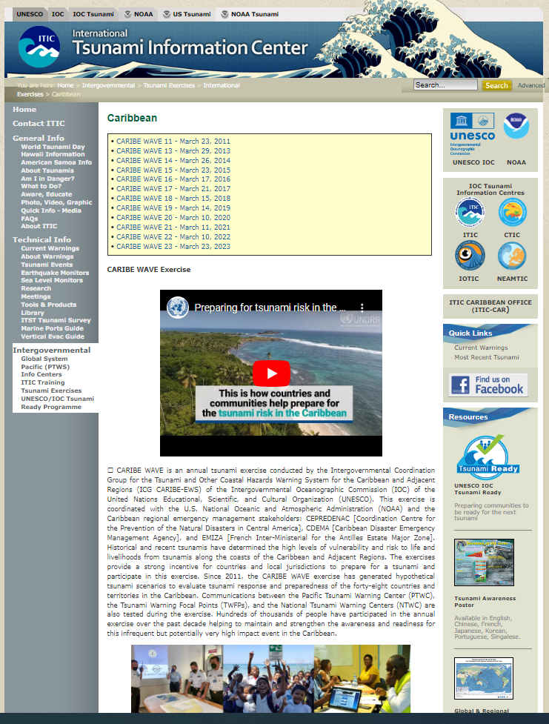
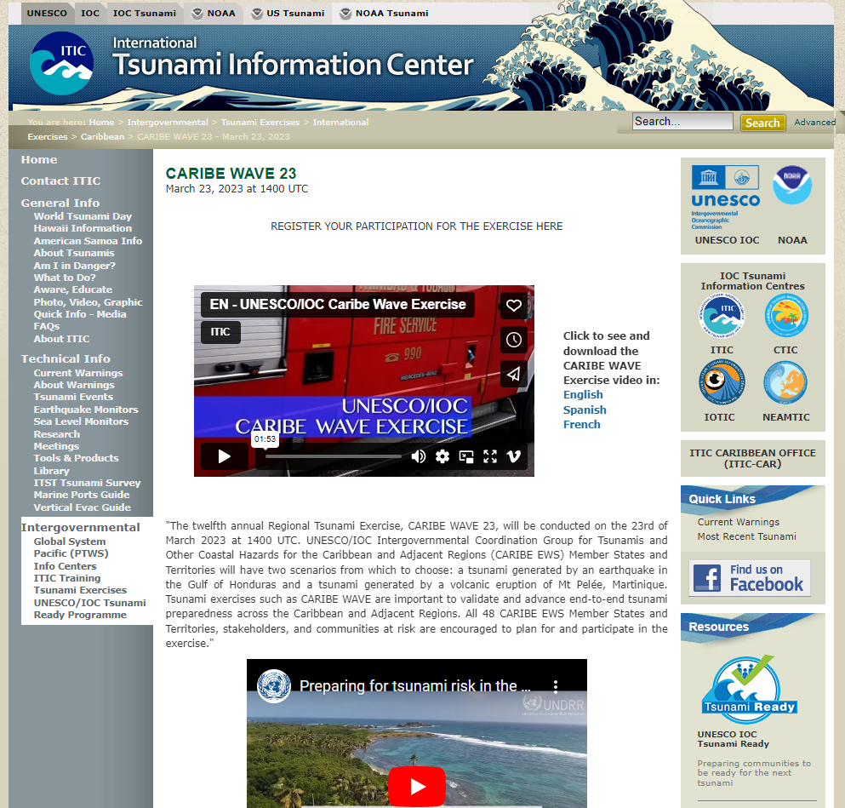
NEW: CARIBE WAVE Website!
Website
http://itic.ioc-unesco.org/index.php?option=com_content&view=category&layout=blog&id=2020&Itemid=2335

