Slide 1
The Global Ocean Observing System
goosocean.org
GOOS Regional Alliances
Revitalization
PI-GOOS, CARIB-GOOS, GOOS-Africa?
Presented by
Denis Chang Seng & Emma Heslop
IOC/UNESCO
Ocean Observation and Services Section, GOOS
Tsunami Unit, Technical Secretary (ICG-NEAMTWS)
Notes:
I'm here to talk to you about what makes a collection of activity into a cohesive and high-performing system - how we can work at global and regional levels to leverage our individual national contributions and make them stronger together

Slide 2
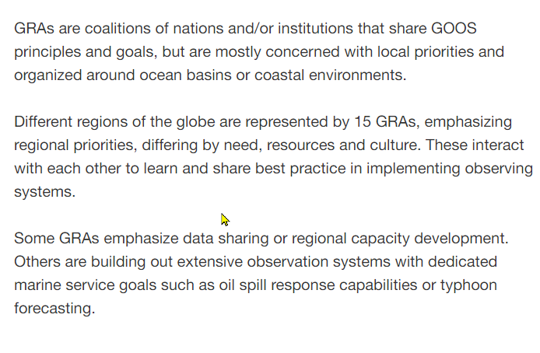
GRA Emphasis &
Focus
Data Exchange/sharing
Capacity Building
Observation systems/ marine services(oil spill, storm forecasting etc.

Slide 3
GRA Governance
Structure | Inter-governmental | Government, Non-Governmental Organizations, institutions | IOC Sub-Commissions | National Marine Agencies
Political consortium | GRASP | EUROGOOS | GOOS AFRICA SEAGOOS
Basins and regions | BLACK SEA GOOS | IOGOOS, MONGOOS
small island developing states (SIDS) |  | PI-GOOS | IOCARIBE-GOOS
Thematic | NEAR-GOOS OCEATLAN
National systems |  |  |  | U.S. IOOS IMOS
Summary of the various structures of the GRAs along with the types of entities each GRA represents.
Governance
Charted as an activity of IOCARIBE, IOC Sub Commission of the Wider Caribbean. Governed by a Steering Committee, with Delegates from member states. Coordinated by a Project Coordinator.

Slide 4
GRAs Black Sea GOOS EuroGOOS GOOS Africa GRASP IOCARIBE-GOOS IMOS IOGOOS MONGOOS NEAR-GOOS OCEATLAN PI-GOOS SEAGOOS U.S.IOOS SOOS|SAON

Slide 5
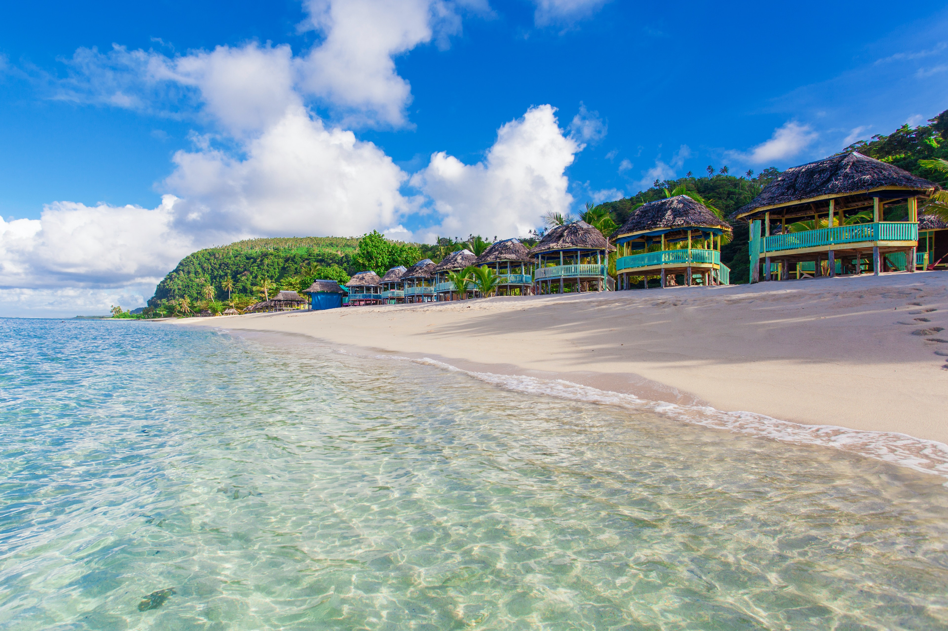
PI-GOOS
PI-GOOS is a network of regional organizations established in 1998 consisting of 21 Pacific Island Countries and Territories and 5 Metropolitan Members.
The Pacific Regional Environment Programme (SPREP) previously hosted the PI-GOOS Secretariat/Office until the departure of the responsible officer in 2019.
PI-GOOS has not been active since.
The GOOS Office at IOC-UNESCO is therefore calling for Expressions of Interest to host and rejuvenate PI-GOOS.
IOC CL-2822 was published on 01/31/2023

Slide 6
Expressions of Interest
Expressions of Interest to host the PI-GOOS Secretariat/Office are expected to demonstrate:
Organization/institution mandate and capacity in the ocean, oceanography, ocean observation and its coordination role in the Pacific Islands States;
Alignment of host organization/institution to the Global Ocean Observing System 2030 Strategy and the Ocean Decade;
Infrastructure and resources to support a PI-GOOS Secretariat/Office;
Expressions of Interest not later than by 28 February 2023.

Slide 7
Expression of Interest Review and Selection Process
GOOS Secretariat in consultation with the GOOS Steering Committee will review of the Expressions of Interest.
Consult with all interested parties in the region to establish an inter-organization or inter-governmental agreement that governs PI-GOOS.
Appropriate institutional arrangements will be pursued then as required.
The announcement of the selected host of the PI-GOOS Secretariat/Office will be made in the first half of 2023.

Slide 8
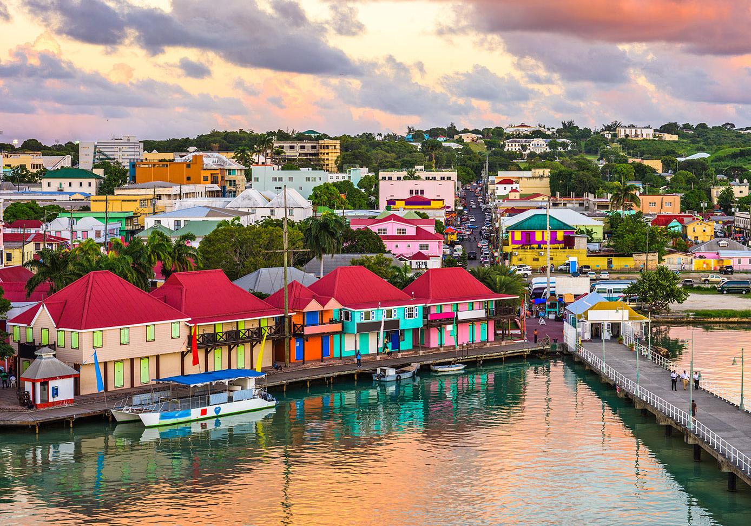
IOCARIBE GOOS
Growing concerns of the current status of IOCARIBE GOOS (Communication with NOAA Officer)
Noted that 'revitalization’ of IOCARIBE GOOS was discussed in 2021, however not much progress has been made to date
Noted the departure of Dr Cesar Toro, Head IOC-UNESCO Regional Secretariat for IOCARIBE, IOC of UNESCO Sub-Commission for the Caribbean and Adjacent Regions in 2022
Noted, IOCARIBE will be on the agenda for the 17th session of IOCARIBE in 2023
Dr Lorna Inniss was appointed in Jan 2023 as the new Head IOC-UNESCO Regional Secretariat for IOCARIBE, IOC of UNESCO Sub-Commission for the Caribbean and Adjacent Regions
Meetings planned with Lorna and partners to discuss IOC CARIBE plans and the future of GOOS CARIB

Slide 9
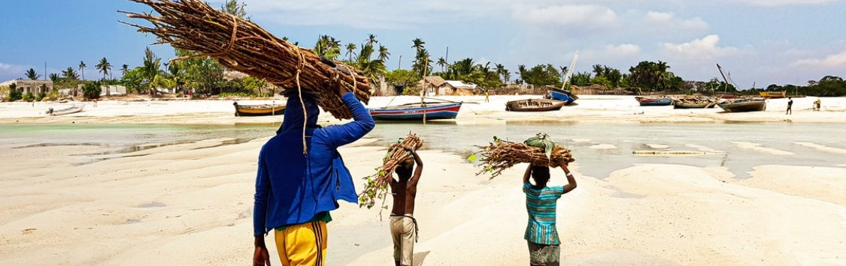
GOOS- Africa
Key recent achievements
AFRICA GOOS has recently crafted a new action plan in line with the GOOS Implementation Plan.
Partnership established with the Global Monitoring for Environment and Security and Africa (GMES & Africa).
GOOS AFRICA is fully involved in the African Decade of Oceans and Seas, and the African Blue Economy Strategy in the broader context of the African Vision’ 2063.
There has been good cooperation with IOC AFRICA for mutual reinforcements towards achieving the goals of the IOC-UNESCO.

Slide 10
GOOS- Africa
Ocean Decade Africa roadmap May 2022 – one of the 9 action areas is ocean observing and forecasting
GMES & Africa and GOOS Africa Workshop Oct 2022, Kigali – identified areas to work together, complementarity, potential support, and focus on user services.
IOC NORAD: focus on Africa, potential in-situ expert [2 years] to support coordination – bring together the many dispersed centres of excellence and develop a coordinated pathway

Slide 11
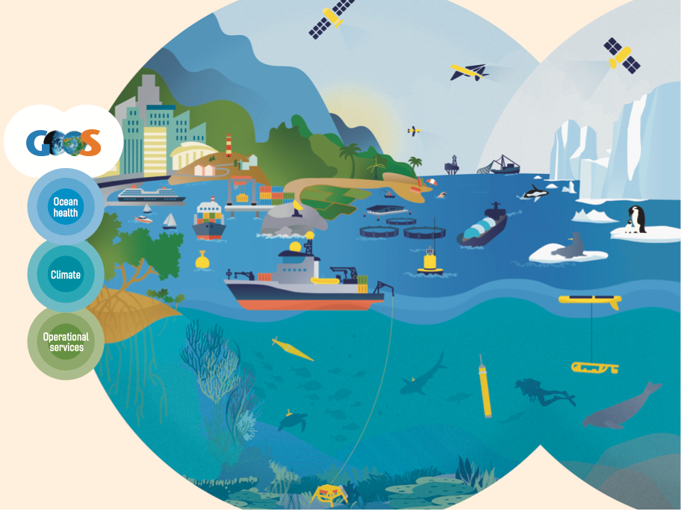
End
www.goosocean.org/join

