Slide 1
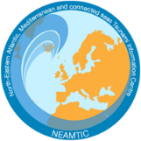
Introduction to Tsunami Ready Recognition Programme
Goals and Benefits
Mr. Bernardo Aliaga Rossel
Head of the IOC-UNESCO Tsunami Unit
IOC-UNESCO EU DG ECHO CoastWAVE Project
IOC-UNESCO Tsunami Ready Recognition Programme (TRRP) Workshop
Online, February 16-17, 2023

Slide 2
IOC-UNESCO Tsunami Ready Recognition Programme (TRRP) Workshop
The Tsunami Ready Recognition Programme is a voluntary international community-based recognition programme developed by IOC-UNESCO. It aims to build resilient communities through awareness and preparedness strategies that will protect life, livelihoods and property from tsunamis in different regions.
By Flaticon - https://www.flaticon.com/free-icon/decision-making_3240872

Slide 3
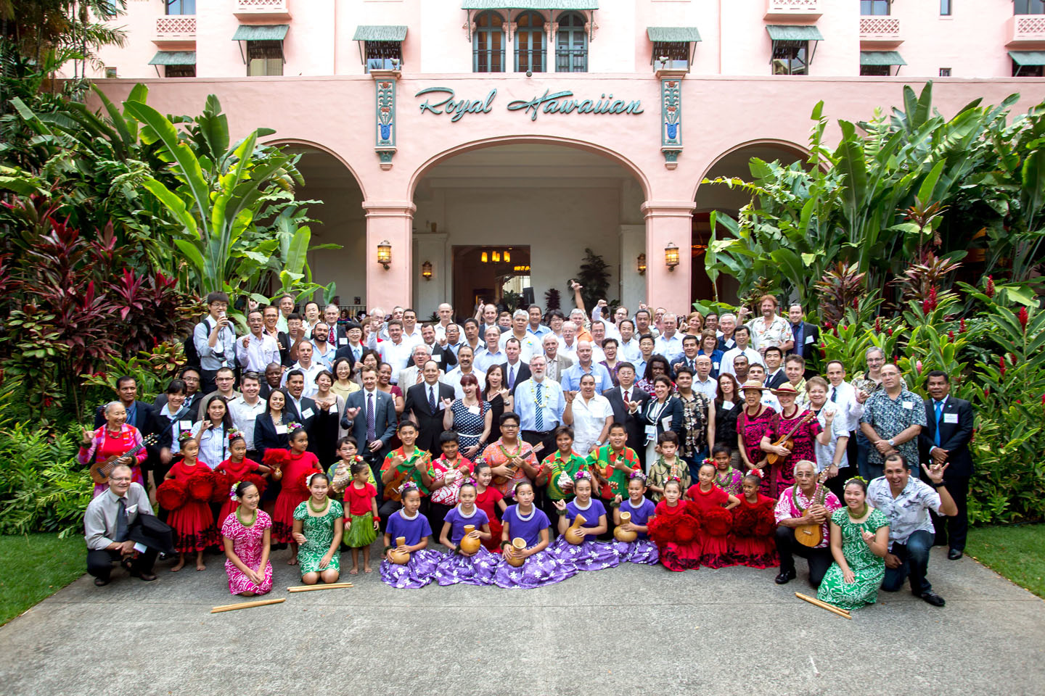
IOC-UNESCO Tsunami Ready Recognition Programme (TRRP) Workshop
The Tsunami Ready Recognition Programme is implemented by Member States. Each Member State is responsible for administering its national programme. Its National Tsunami Ready Board (NTRB) and Tsunami Ready Local Committee (TRLC) provide guidance to the community during the recognition process.

Slide 4
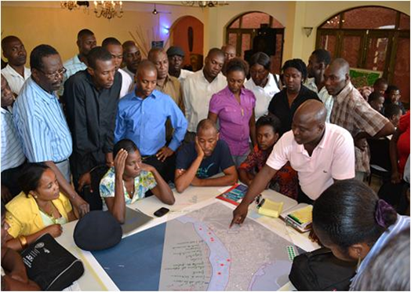
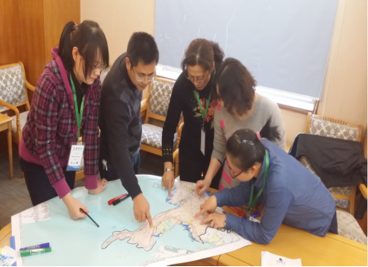
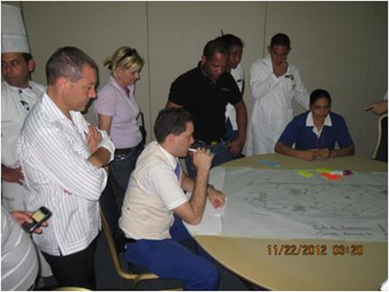
IOC-UNESCO Tsunami Ready Recognition Programme (TRRP) Workshop
The Tsunami Ready Recognition Programme promotes the active participation of local actors, in coordination with local and national authorities, in order to strengthen local capacities to cope with the tsunami risk. As a result, communities will see their coping mechanisms strengthened to deal with tsunami events and to enable an initial response prior to any external assistance.

Slide 5
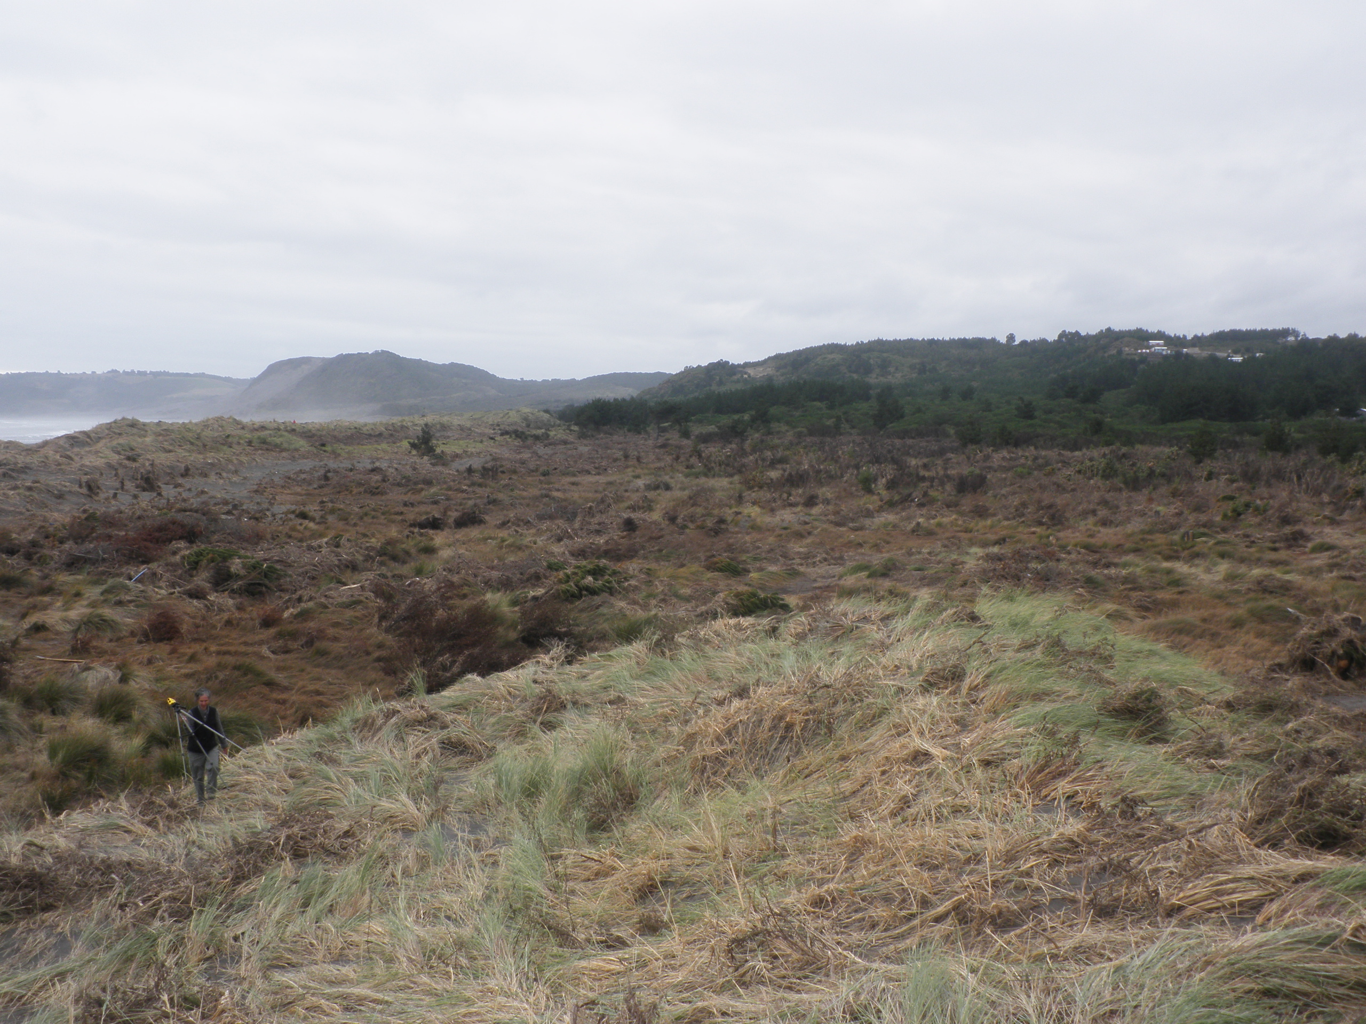
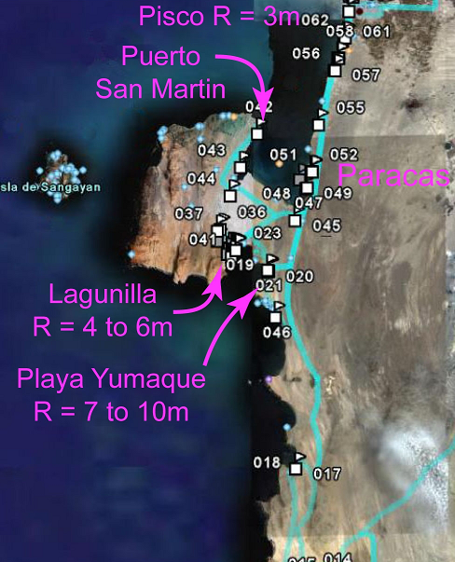
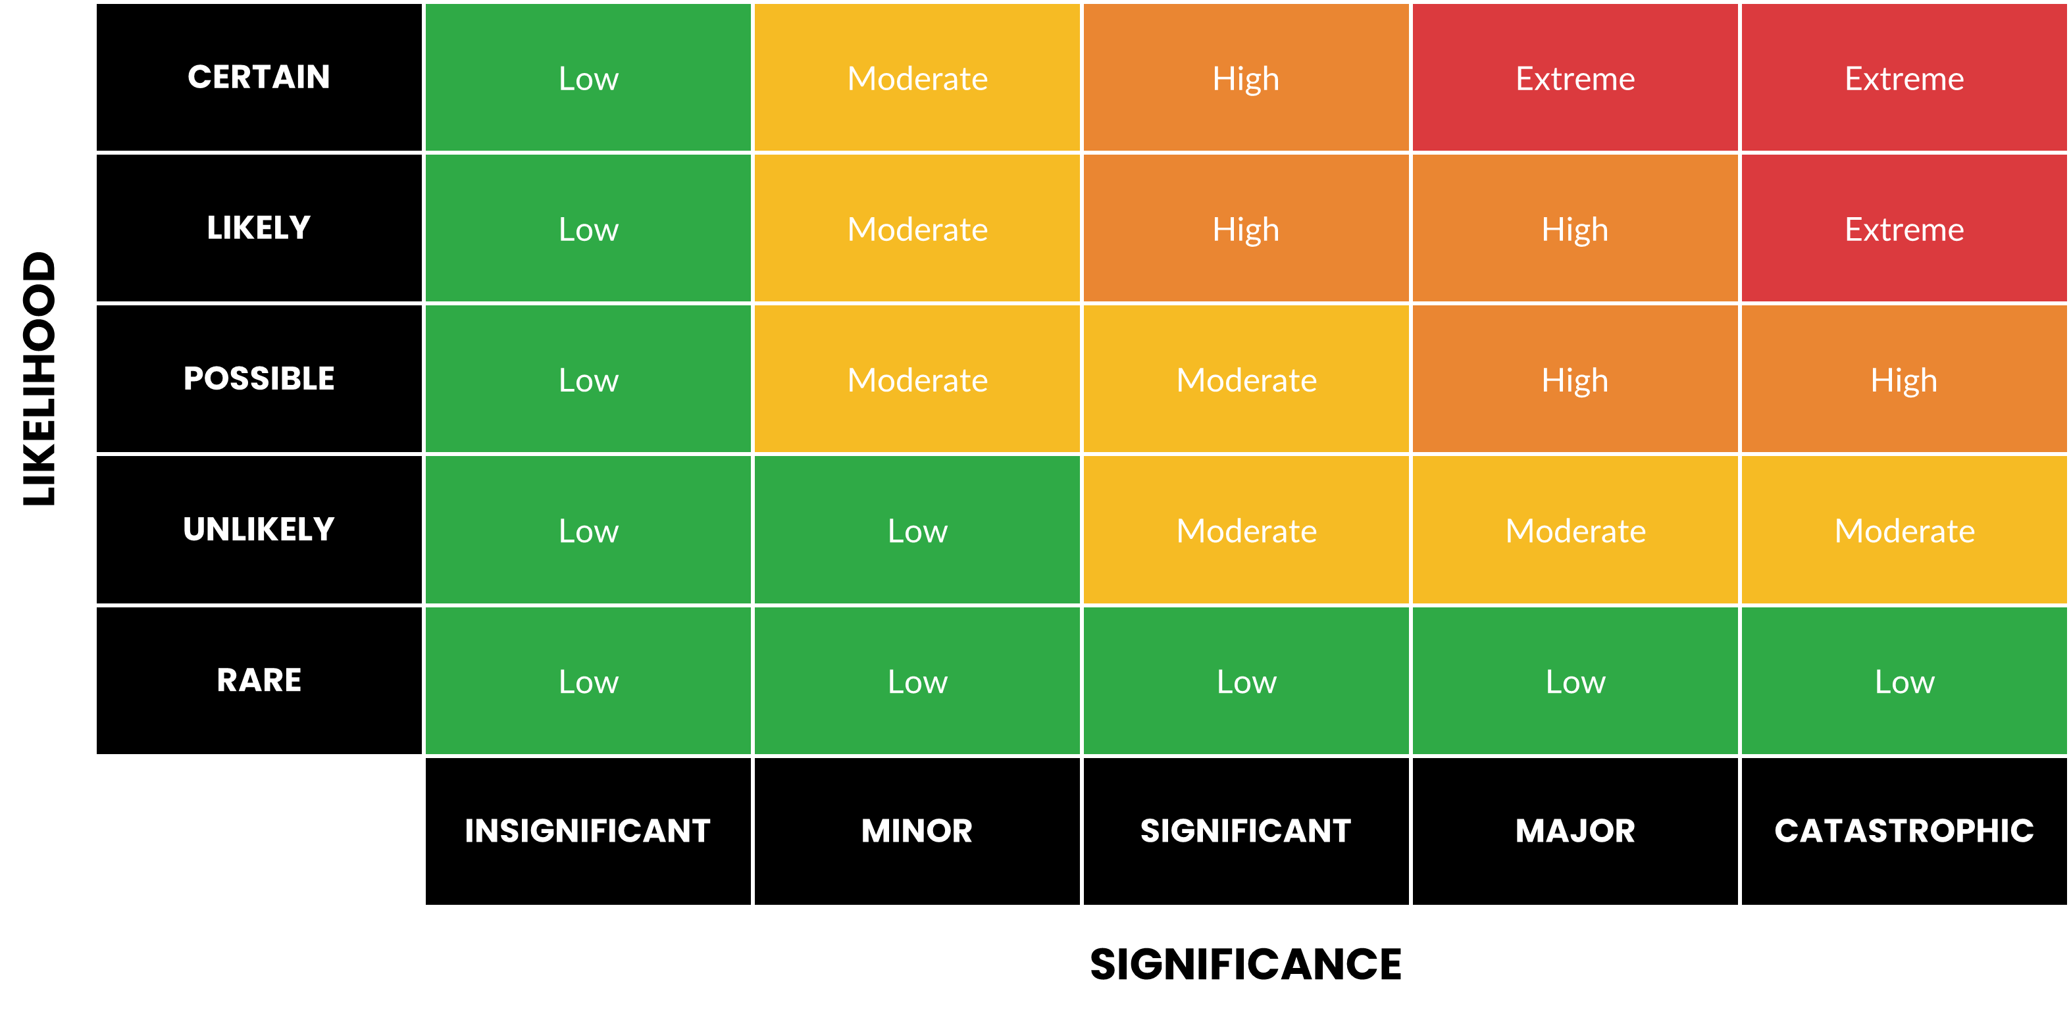
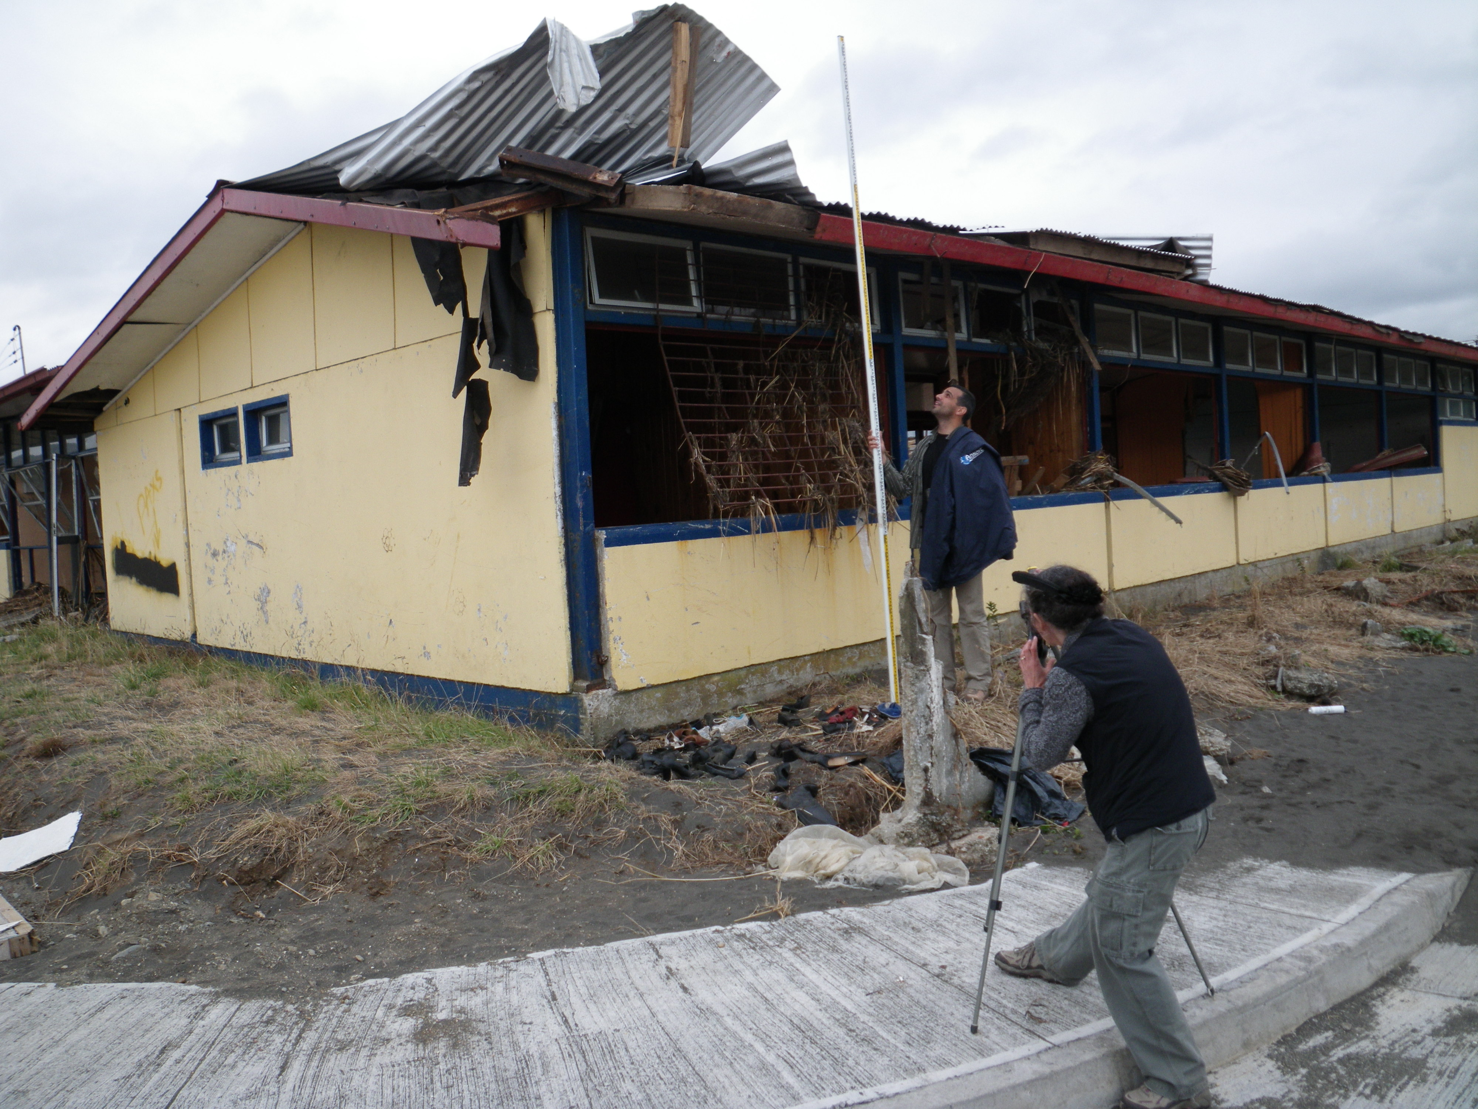
IOC-UNESCO Tsunami Ready Recognition Programme (TRRP) Workshop
What we mean by at risk communities?
Tirua, Chile, 27 Feb 2010
Lagunillas, Pisco, Peru, 15 August 2007, 500 killed by EQ, 3 out of 7 people living in Lagunillas killed by tsunami

Slide 6
History of Tsunami Ready
US TsunamiReady® (2001, US NWS, NTHMP)
Guidelines for standard level of capability to mitigate, prepare for, and respond to tsunamis.
Promote community preparedness – minimize risk through better risk assessment, planning, education, warning communications
16 states, territories, 195 recognized Communities, 14 Supporters (1 Aug 2019). Local, tribal govt, or facility with authority to implement
UNESCO IOC Tsunami Ready (2016, UNESCO IOC TOWS–IX)
Modelled after US TsunamiReady®
Tsunami Ready Programme Guidelines (community performance-based recognition, not certification) available for use / adaption by ICG regions (e.g., Pacific) (adopted by ICG/CARIBE-EWS-X, May 2015)
Global priority to increase focus on awareness in communities and among authorities through communication, exercises, training, information, preparedness and recognition programmes

Slide 7
History of the Implementation of Tsunami Ready
US National Weather Service of NOAA implemented the recognition programme TsunamiReady
IOC Assembly approved UNESCO/IOC Tsunami Ready Recognition Pilot Programme
The IOC Assembly approved the establishment of the IOC Ocean Decade Tsunami Programme including Tsunami Ready
100% At-Risk Communities Tsunami Ready
2001
2015
2021
2030
2011
2017
2022
US NWS provided initial funding to support the joint NWS and UNESCO/IOC TsunamiReady pilot project in the Caribbean and the international community
United Nations declared the Decade of Ocean Science for Sustainable Development would be held from 2021 to 2030
Establishment of the UNESCO/IOC Tsunami Ready Recognition Programme

Slide 8
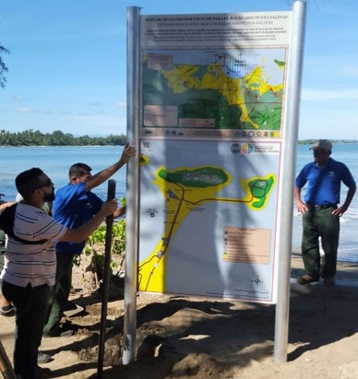
UNESCO IOC Tsunami Ready Approach
Bring the ownership of preparedness to the community
Ensure structural and systematic approach in building community preparedness
A collaborative effort to achieve a level of tsunami preparedness through the fulfilment of a set of established best practice guideline and indicators
Tsunami Ready is implemented on a voluntary basis and entails a “bottom-up” process with the community taking the initiative to build its own capacity. This approach ensures ownership of the process that strengthens its sustainability

Slide 9
Benefits of Tsunami Ready Programme
Strengthens tsunami preparedness of coastal communities
Improved assessments of Hazards, Risk, Inundation, and Evacuation
Improved early warning systems/warning chain
Improved public awareness, understanding of tsunami threat and preparedness
Tests awareness and preparedness through regular exercises
Strengthens preparedness for other hazards
Improves community planning
Encourages a consistent and sustainable approach to disaster risk reduction
Contributes to the aims of the Sendai Framework for Disaster Risk Reduction and Sustainable Development Goals
International recognition from UNESCO IOC as Tsunami Ready Community

Slide 10
UNESCO
Intergovernmental Oceanographic Commission (IOC)
IOC-UNESCO DG ECHO CoastWAVE project
UNESCO IOC Sector Tsunami Unit
d.chang-seng@unesco.org
CoastWAVE project website

