Slide 1







Assess-1: Tsunami Hazard Zones are Mapped
and Designated
Alessandro AMATO, Fabrizio ROMANO
National Institute of Geophysics and Volcanology (INGV)
Tsunami Warning Center (Italy)
Pio DI MANNA
Istituto Superiore per la Protezione e la Ricerca Ambientale (ISPRA)
IOC-UNESCO EU DG ECHO CoastWAVE Project
IOC-UNESCO Tsunami Ready Recognition Programme (TRRP) Workshop
Online, February 16-17, 2023

Slide 2

IOC-UNESCO Tsunami Ready Recognition Programme (TRRP) Workshop
Ingredients for a recipe to inundation mapping
Tsunami Ready A1 Indicator
The primary source for mapping potential tsunami hazard zones is inundation modelling, which illustrates expected areas to be flooded by the tsunami. The result of an inundation modelling study is the tsunami inundation map depicting the tsunami hazard zone.
Hazard curves
Disaggregation
Nonlinear Shallow Water
Boussinesq
NH
PTHA
Data
Propagation
Inundation
Green’s law
Amplification Factors
Bathtub, Attenuation
Energy grade line
Explicit numerical modeling (SW, Navier Stokes 3D )
Bathymetry
Topography
Friction coeff.
2

Slide 3
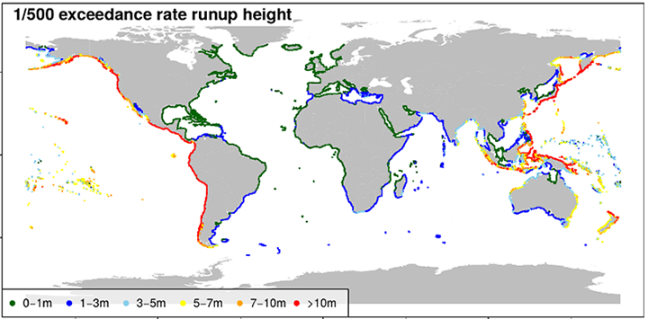
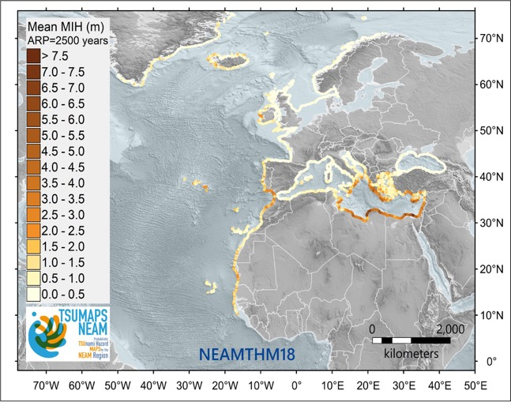
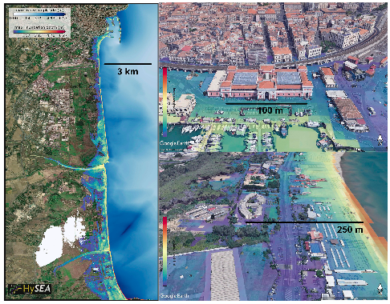
The Italian evacuation and long-term coastal planning
Different scales
Probabilistic Tsunami Hazard Analysis (PTHA)
Computational & human resources, accuracy, time, cost
Davies et al., 2018
NEAMTHM18
Basili et al., 2021
Global
Regional
Local
3

Slide 4
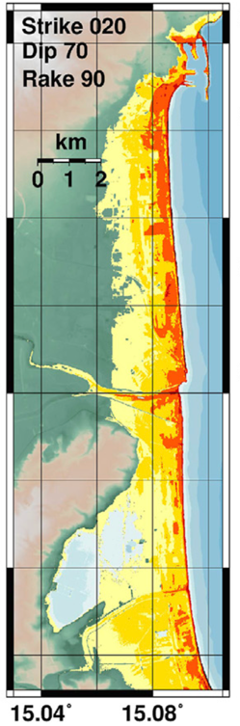
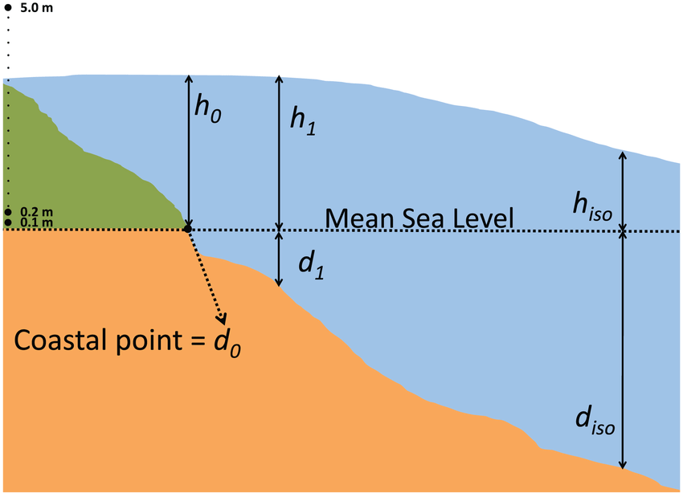
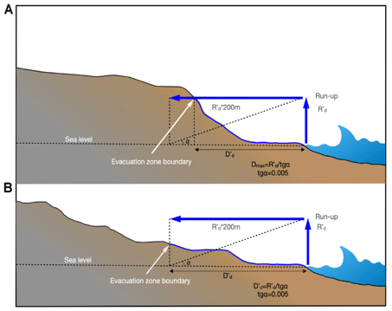
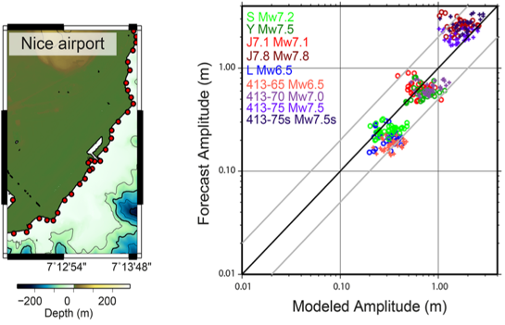
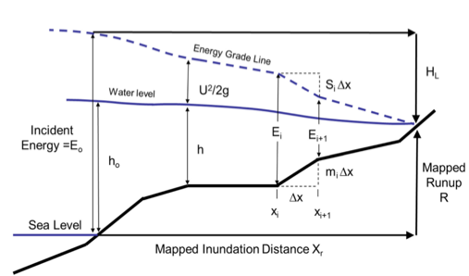
Different ways to compute/estimate the tsunami inundation
Synolakis, 1991
Kamigaichi, 2014
Leonard et al., 2008
Tonini et al., 2021
Green’s Law
Bathtub/Attenuation
Gailler et al., 2017
Calibrated Green’s Law
Increasing complexity
Amplification factors
Energy Grade Line
Numerical modeling
Gibbons et al., 2022
Lovholt et al., 2012
Glimsdal et al., 2019
Kriebel et al., 2017
Tada et al., 2018
4

Slide 5
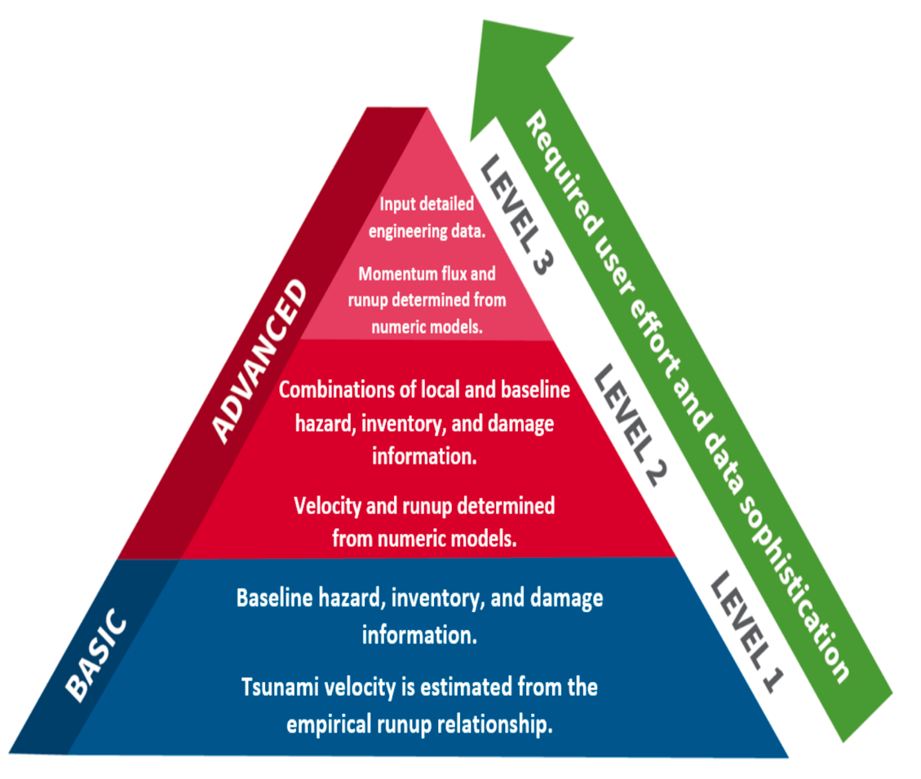
Level of the analysis for different methods
Accuracy & Data resolution (e.g. topo/bathy)
Computational & human resources, time, cost
Level of metrics
Levels depend on available Data and Resources
Numerical modeling
Attenuation rule
Bathtub
Calibrated GL
AF
GL
5
https://www.fema.gov/flood-maps/products-tools/hazus

Slide 6
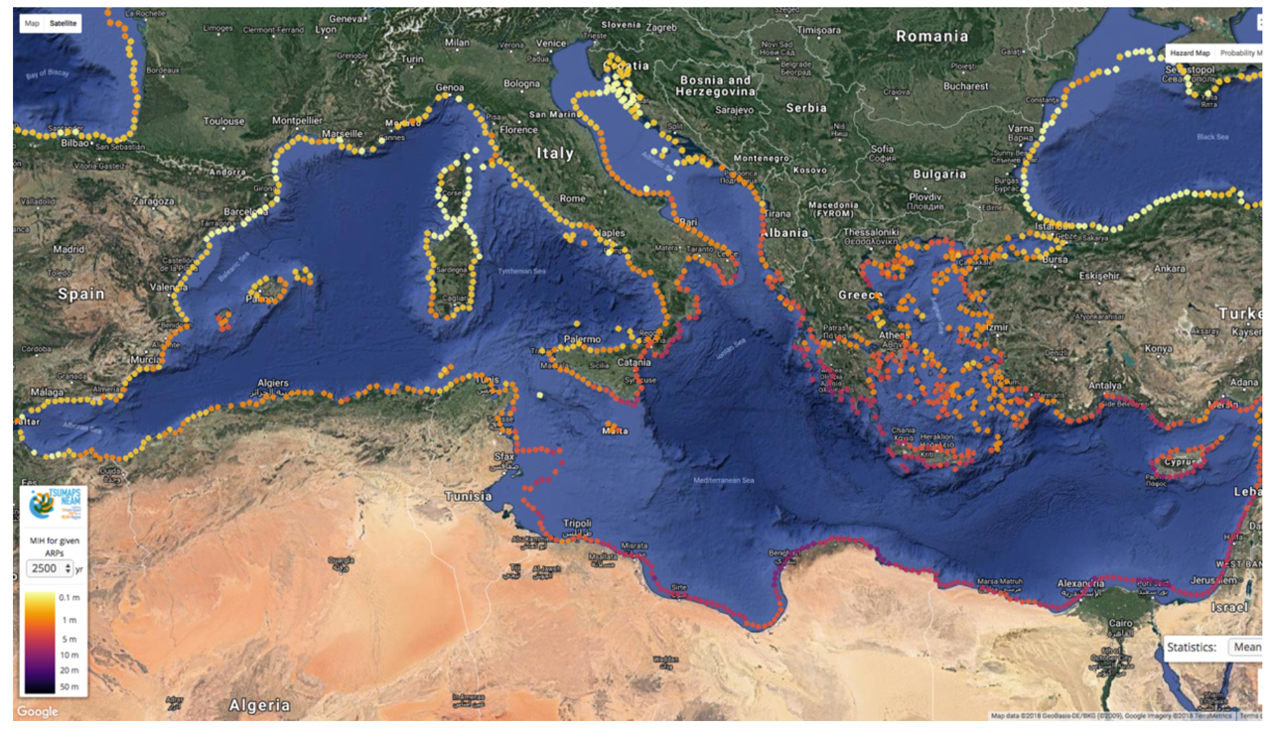
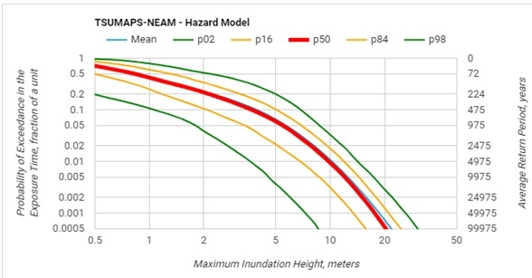
The Italian evacuation and long-term coastal planning
The Hazard Curves
Probabilistic Tsunami Hazard Analysis (PTHA)
The model uncertainty in each POI is estimated by means of a variety of hazard curves, one for each alternative model obtained by adopting different assumptions, data, parameters, modelling. The distribution of these curves opportunely weighted describes the epistemic uncertainty associated to the hazard model
http://www.tsumaps-neam.eu/

Slide 7
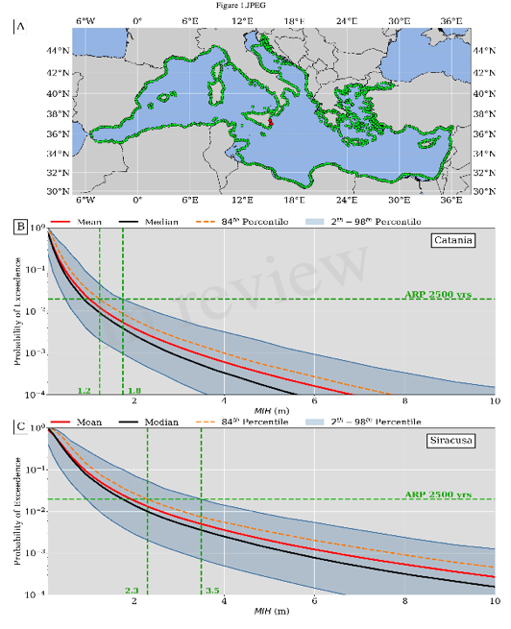

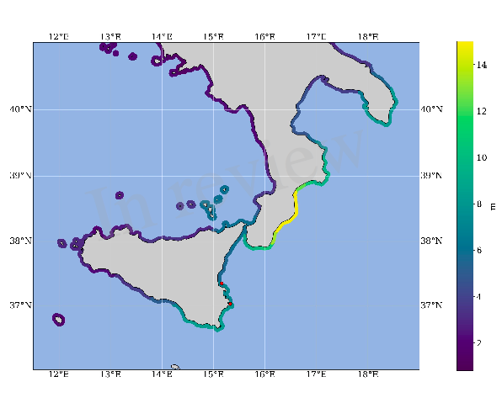
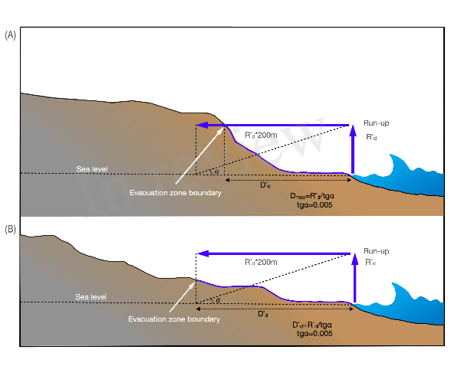
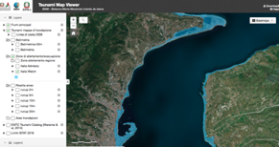
The Italian evacuation and long-term coastal planning
From Regional to Local scale
Alert Levels
Advisory: runup up to 1m
Watch: runup exceeding 1m
Hazard curves
MIH → Runup max
DirPC SiAM; DPC, 2018
Regional Hazard (NEAMTHM18)
2500 yr ARP + 84th percentile
Safety factors
Coastal dissipation
Runup max → Inundation
Inundation Maps
7

Slide 8
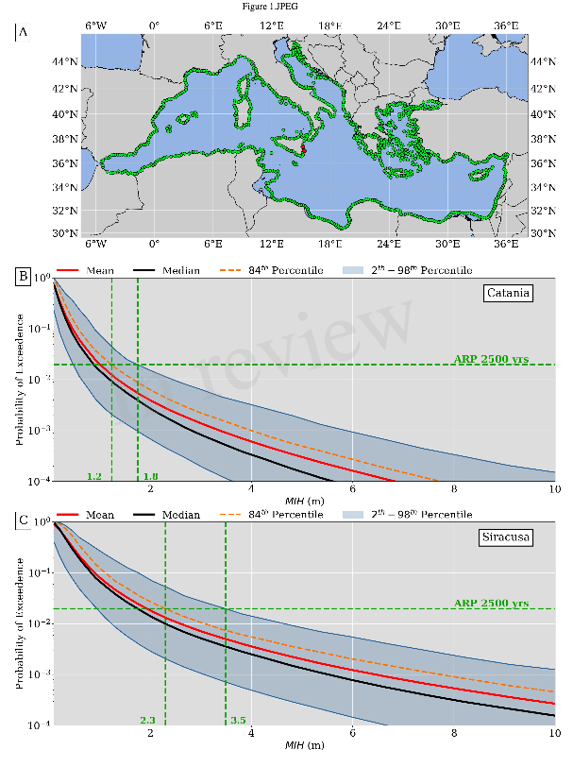
The Italian evacuation and long-term coastal planning
From Regional to Local scale
Alert Levels
Advisory: runup up to 1m
Watch: runup exceeding 1m
DirPC SiAM; DPC, 2018
Hazard curves
Regional Hazard (NEAMTHM18)
2500 yr ARP + 84th percentile
Safety factors
Coastal dissipation
MIH values at POIs
~2% in 50 yr (design probability)
For inundation we need to switch from MIH at POIs to Max Runup for stretch of coast
8

Slide 9
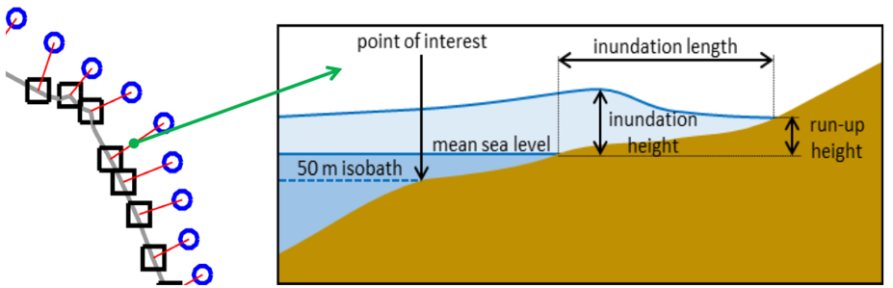
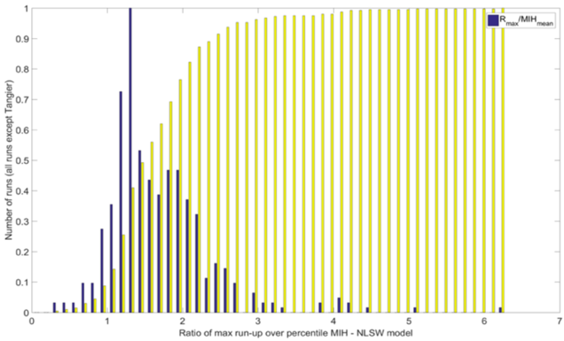
The Italian evacuation and long-term coastal planning
From Regional to Local scale
From MIH at POIs to Max Runup for stretch of coast
MIH is a mean value in the inland area corresponding to a specific POI → none 2D perspective
Alert Levels
Advisory: runup up to 1m
Watch: runup exceeding 1m
Hazard curves
Comparison w/ 2D inundation modeling
DirPC SiAM; DPC, 2018
Regional Hazard (NEAMTHM18)
2500 yr ARP + 84th percentile
Safety factors
Coastal dissipation
MIH → Runup max (R_{max})
To account the tsunami variability along the coast, R_{max} on the coast is the maximum value within 40 km
MIH can be 3-4x larger!!!
R_{max}=MIH*3
3 is the safety factor
9

Slide 10
SiAM – Italian Tsunami Early-Warning System
SiAM alert/hazard zones
Summary of the presentation
Methodology: GIS approach and empirical rule application
Input data and processing
Results: inundation maps/alert zones
Tsunami Map Viewer: availability and accessibility of inundation maps
Future goals - improving the maps and the methodology

Slide 11
Methodology: empirical approach for inundation maps
We adopted a GIS- based approach following an empirical model of propagation and inundation.
Following Fraser & Power (2013), a linear attenuation rule between the R (run-up) values and D ( maximum expected inland inundation distance) is applied.
Fraser & Power, 2013
The empirical relationship between run-up and inland wave penetration is based on the filed surveys and observations following recent and historic tsunami events, especially in the Pacific area, in particular that of Tohoku (Japan) in 2011.
Calculation of dry/wet pixels by GIS tools

Slide 12
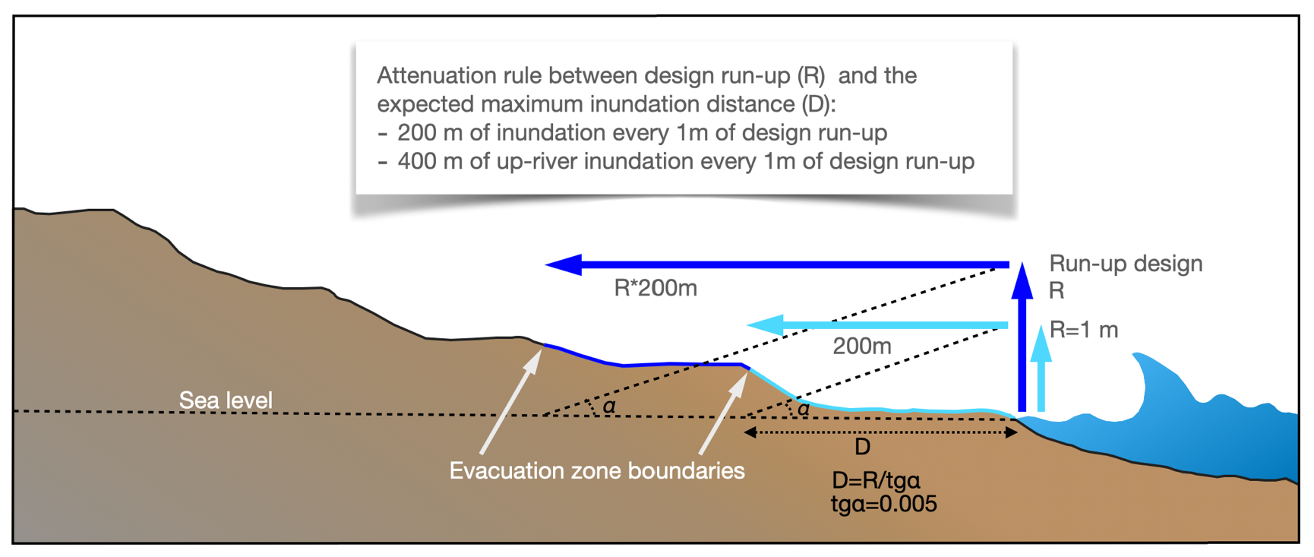
Empirical relationship between run-up and inundation distance
Section (not in scale) shows the definition of the boundary of the alert zones corresponding to the Advisory e Watch levels
D=R*f
f=1/tgα
D=R*200
tgα=0.005
f=1/tgα=200
R is the calculated design run-up for each coastal sector
D is the maximum expected inundation distance - D(R)

Slide 13
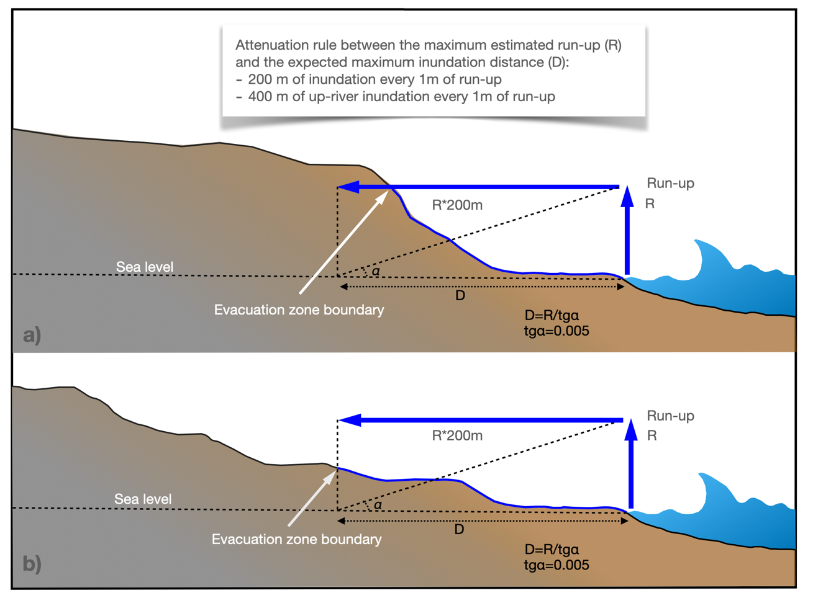
Inundation zones boundary and coastal morphology
This sketch (not in scale) shows the method used to draw inundations maps in different coastal morphology .
Steep morphology - coastal scarp
Flat morphology - coastal plain

Slide 14
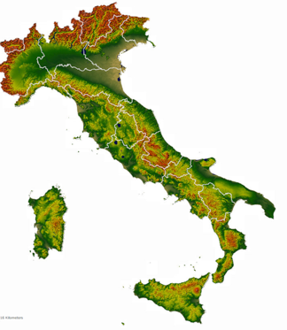
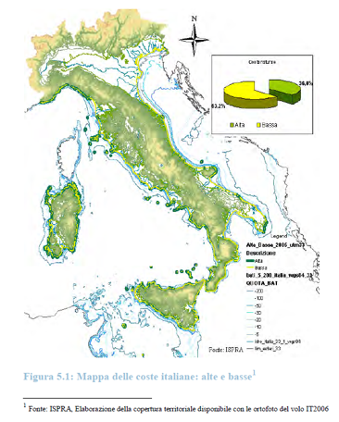
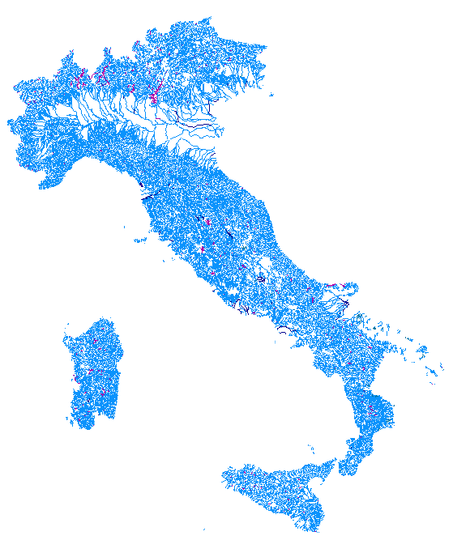
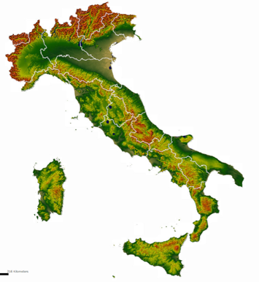
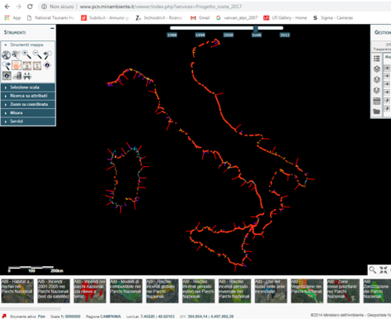
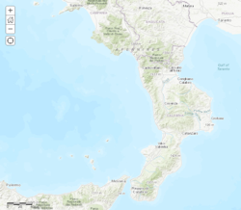
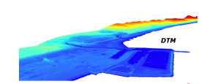
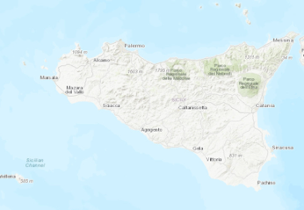
Input data: collected elevation and morphological dataset
8.300 km in lenght
River network
ISPRA – 250k (updated at 10.000 scale)
DEM tinitaly
DEM IGM 20m
Coast Line 2006
High resolution LIDAR data
Regional DTMs 1-2-5 meters resolution
Coast Line 2009
Elevation accuracy up to 15cm

Slide 15

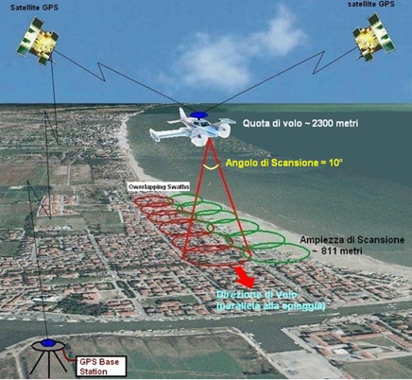
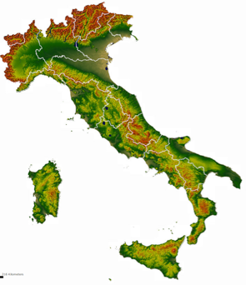
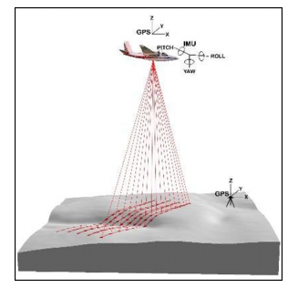
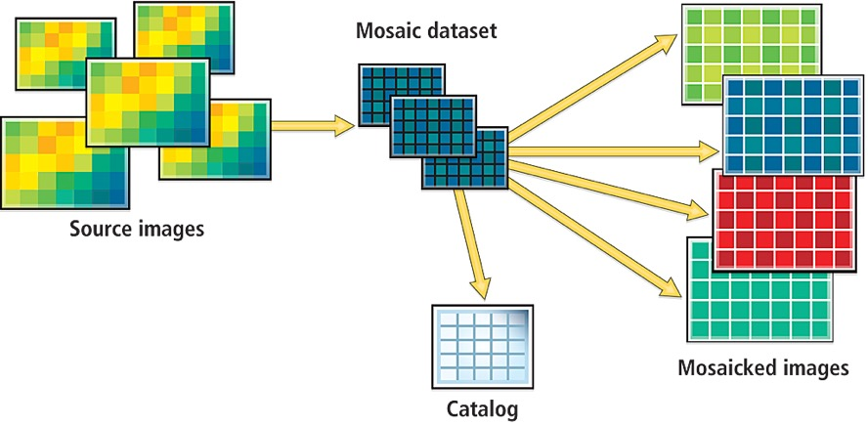
Input data: mosaicking and the harmonization
High resolution
LIdar data
DEM IGM 20m
DEM tinitaly
New mosaicked homogeneous raster covering
the whole potential
inundation area
Elevation accuracy up to 15cm
DTM 1-2-5-10 meters res.

Slide 16
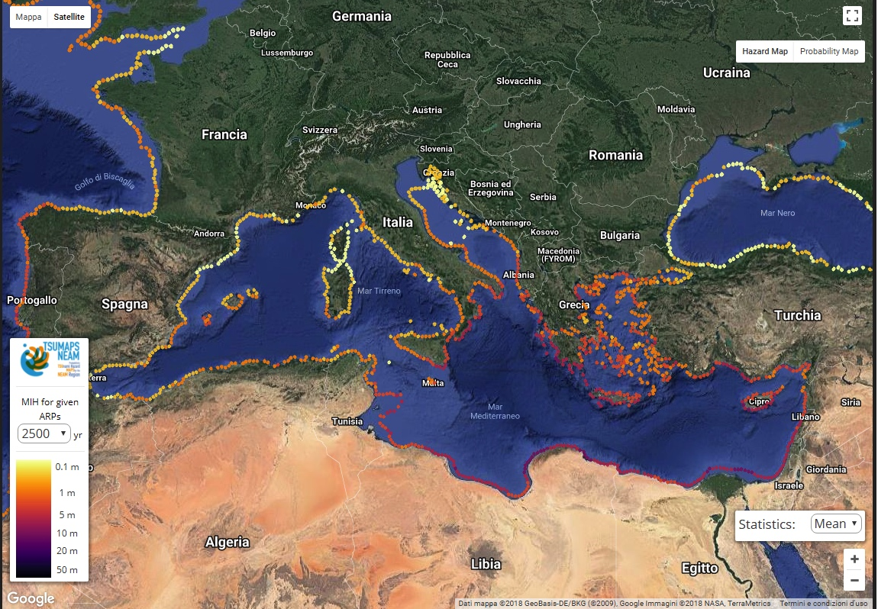
Input data: run-up values
Regional Hazard Model
The Project provides MIH values for POIs. MIH values have been converted in run-up values for every coastal sector and used for the definition of the evacuation zones
MIH from SPTHA (Seismic Probabilistic Tsunami Hazard Analysis),

Slide 17
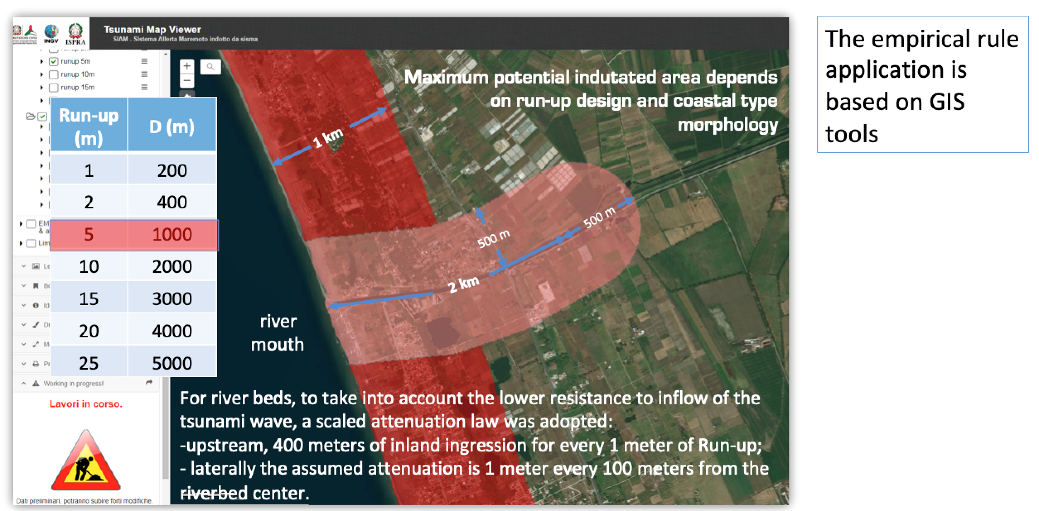
Attenuation rule application and data processing
river
mouth

Slide 18
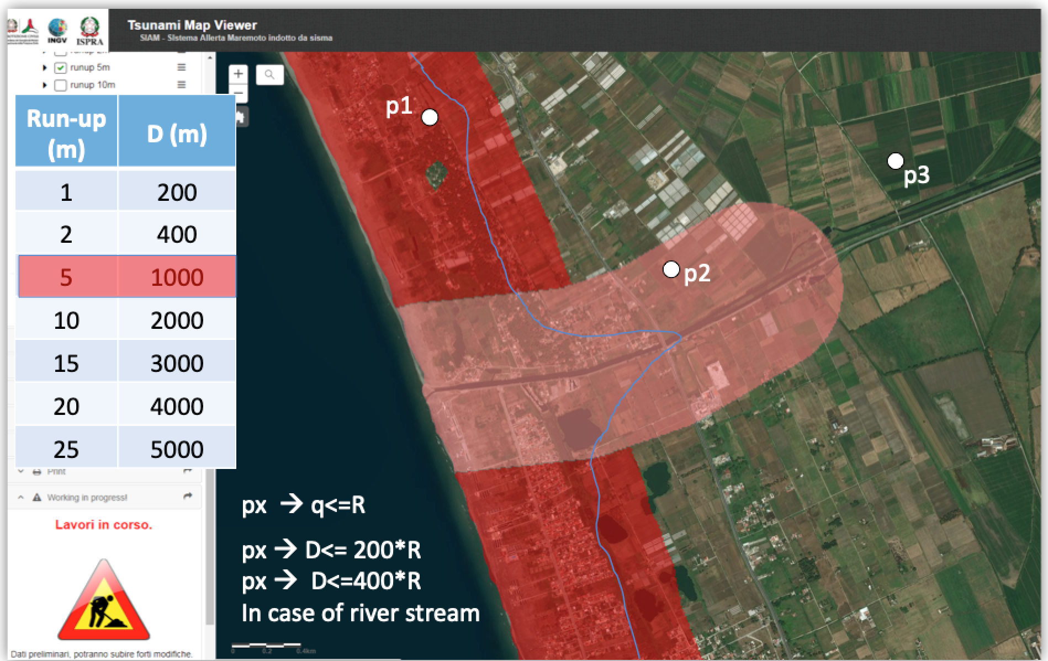
Calculation of dry/wet pixels by GIS tools
Raster calculation of dry/wet pixels by GIS tools based on the application of the D=Rf empirical rule
Both the conditions are satisfied for the point p1 only
The blue line is the inundation boundary
river
mouth
Wet pixels necessary conditions:
1) The position of a generic point x is inside the maximum potential inundation area;
2) The elevation of a generic point x is less than or equals to the R value

Slide 19
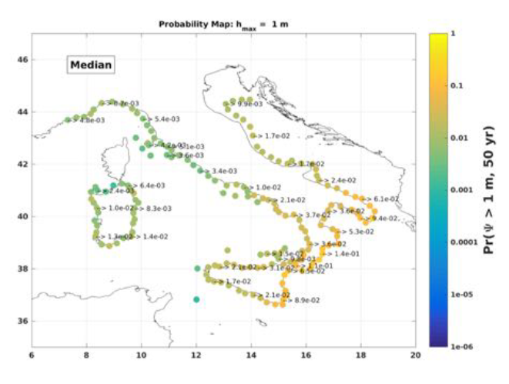

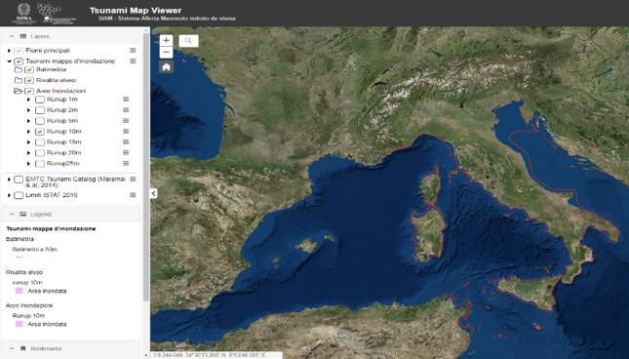
Definition of alert/hazard zones
Combining the run-up values and the related inundation maps we elaborated the alert/evacuation zones for the Italian coastal regions
Definition of alert/evacuation zones
based on
Tsunami hazard model- INGV
Inundations maps - ISPRA
+

Slide 20
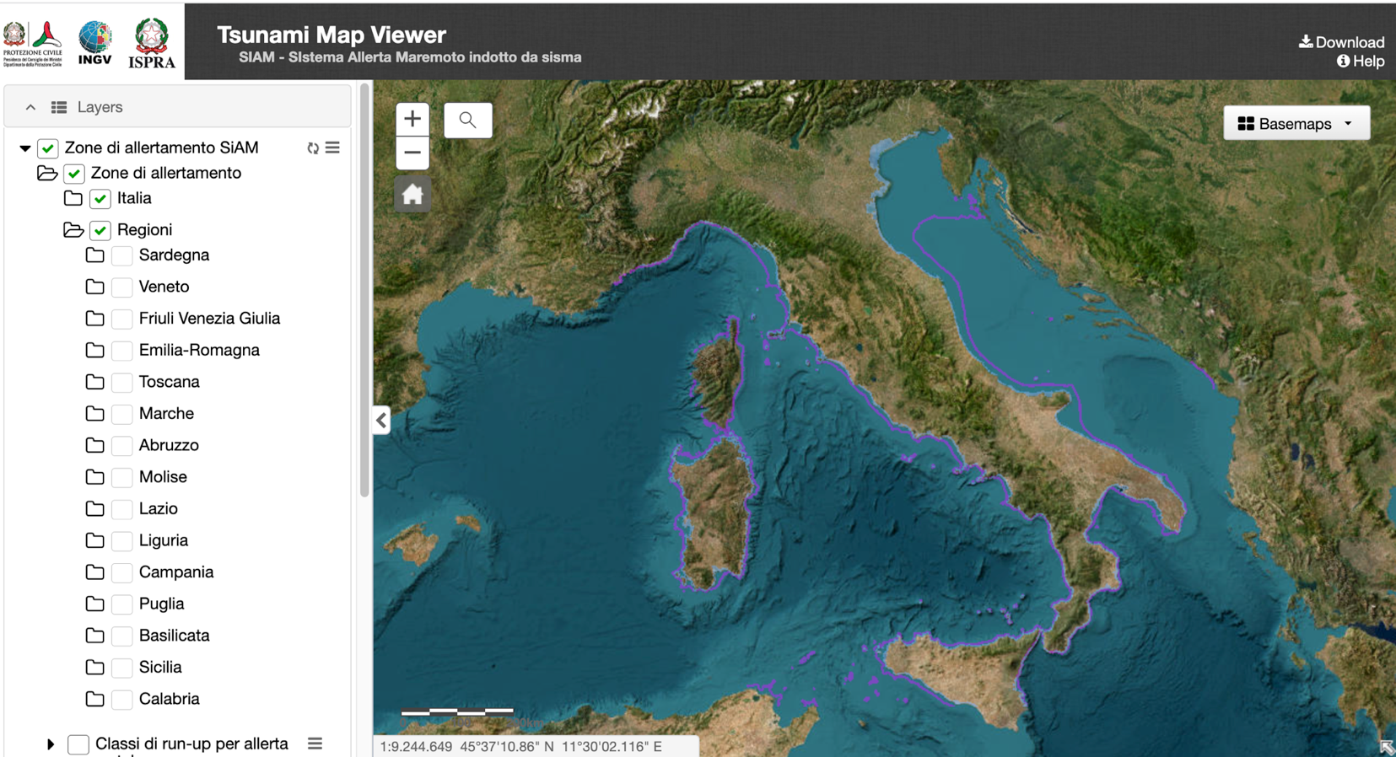
Tsunami Map Viewer – evacuation maps accessibility
The alert zones are available at the link: http://sgi2.isprambiente.it/tsunamimap/

Slide 21
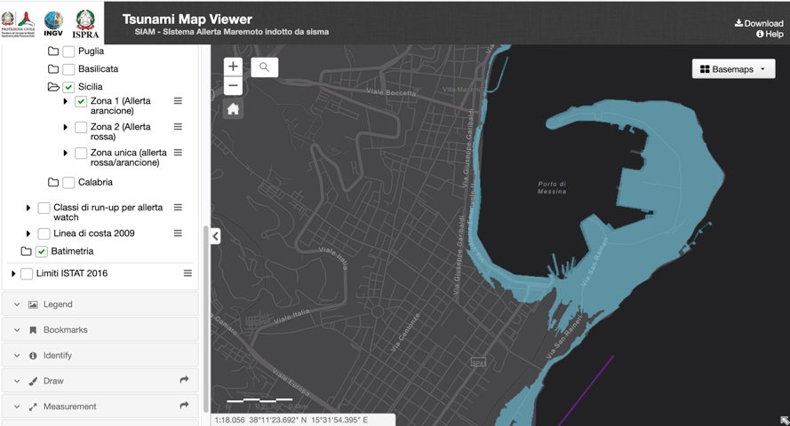
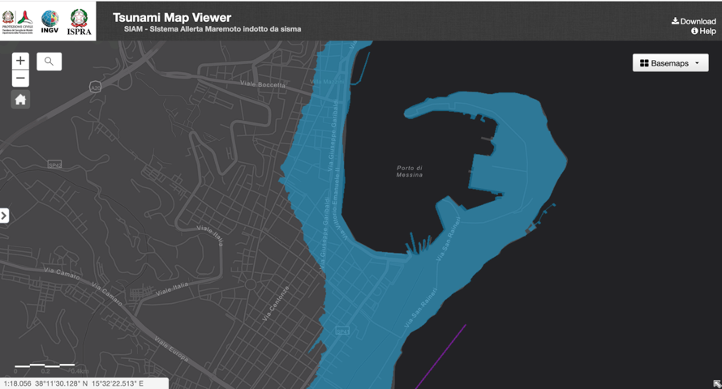
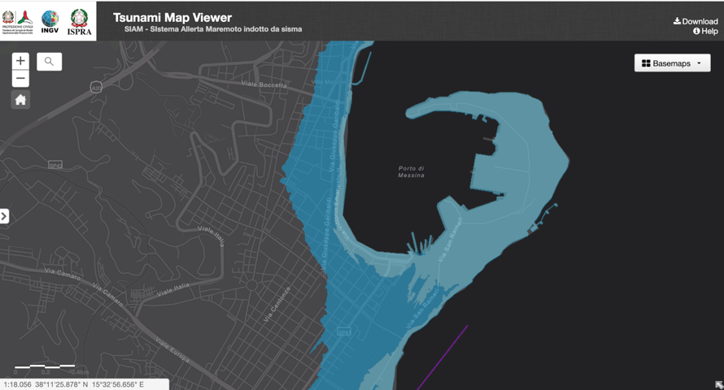
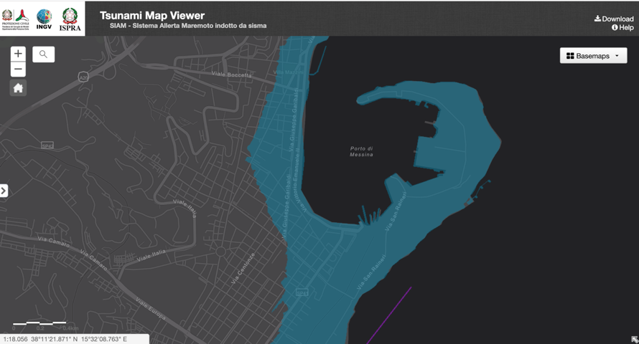
Tsunami Map Viewer – SiAM alert zones
Advisory----zone 1
Watch ---- zone 2
Messina
Messina
Watch and Advisory
Single zone
Messina
Messina

Slide 22
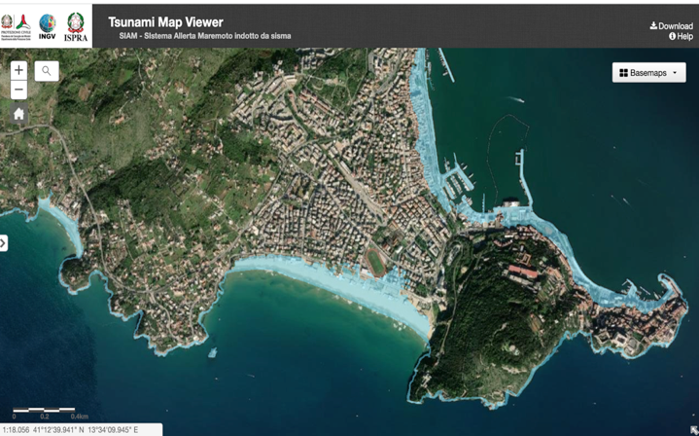
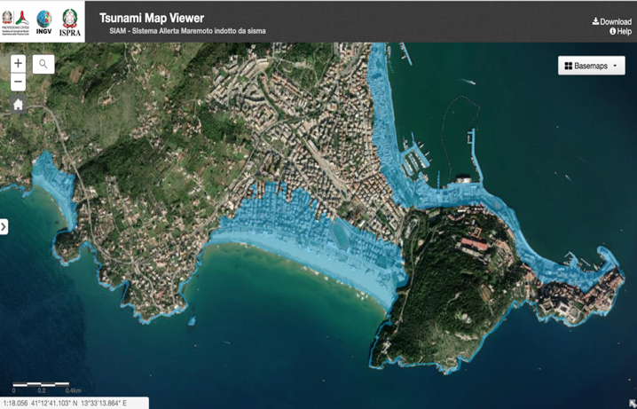
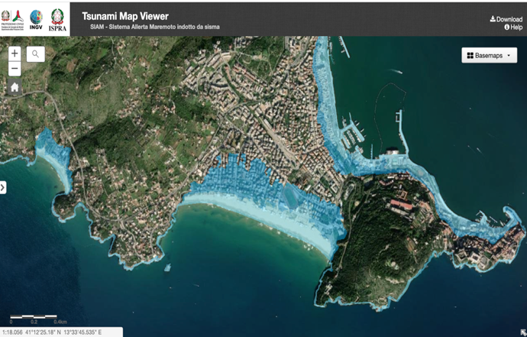
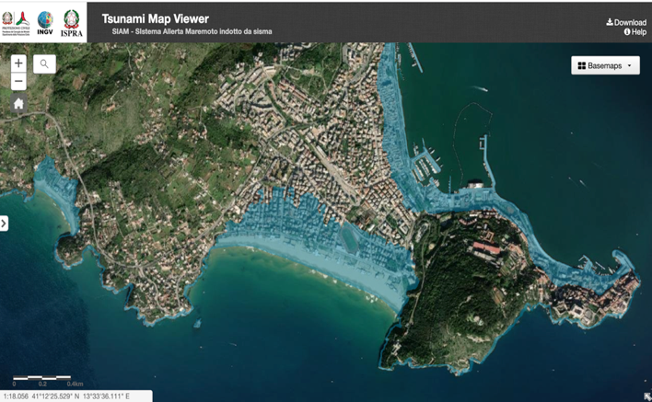
Tsunami Map Viewer – SiAM alert zones
Advisory----zone 1
Watch ---- zone 2
Watch and Advisory
Single zone

Slide 23
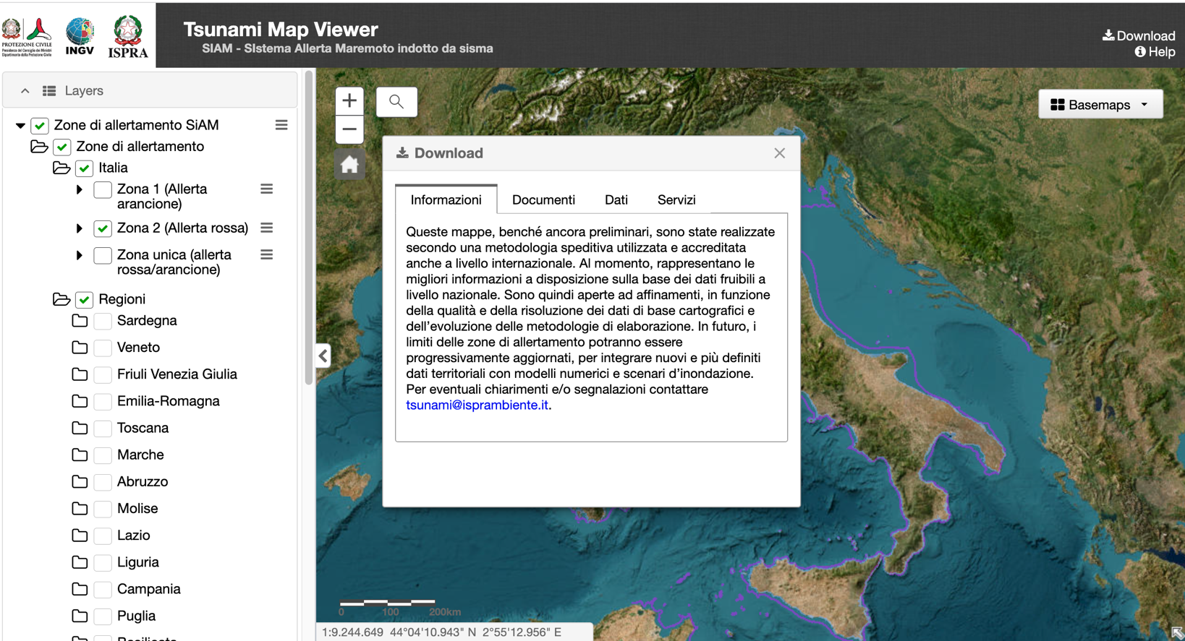
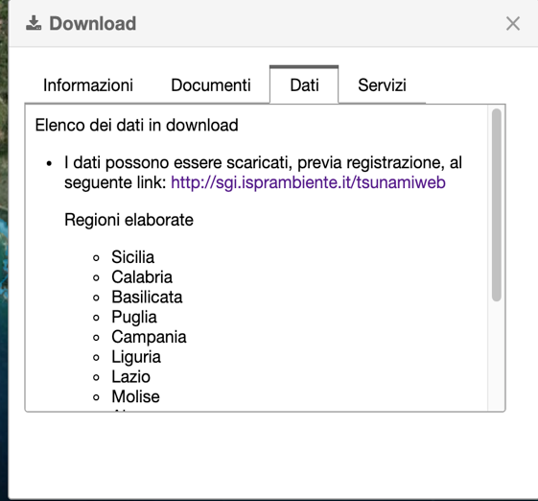
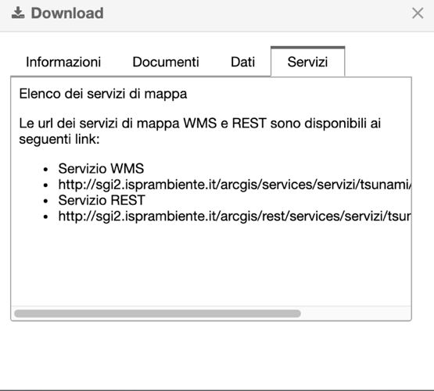
Tsunami Map Viewer – information, web services and download

Slide 24
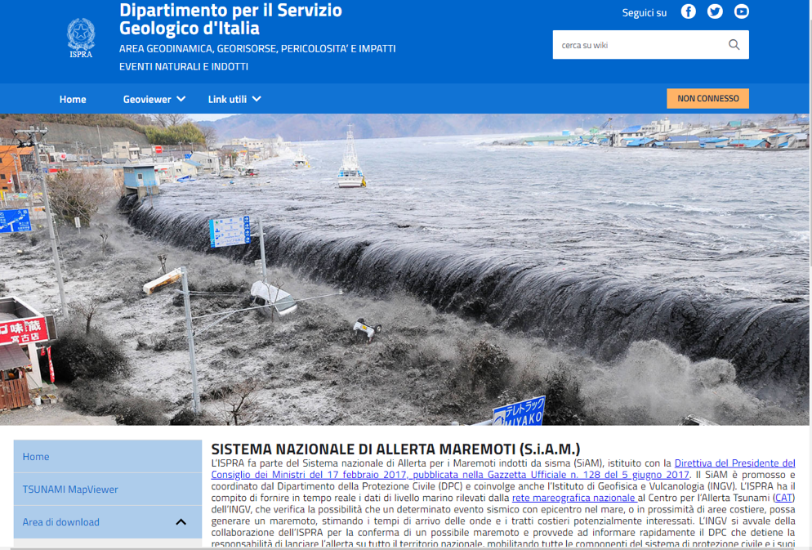


Tsunami Map Viewer – download
Login
https://sgi.isprambiente.it/tsunamiweb/

Slide 25
Future goals: improving inundation maps
The now available SiAM evacuation maps could be considered as a preliminary version, subject to improvement and periodical updates and changes
New version and release
based on
Availability of new input data
High resolution DTM coverage
Increase of LIDAR data coverage through new acquisition
Updating data on coast line and river network
Detailed coastal bathymetry data
Detailed 3D data on coastal protection works, easy to flow ways, etc.
Progress in the methodology
Use of specific factors as function of the morphology and of the land use
Use of attenuation factors associated with protective structures/barriers
Contextualization of the analyses, considering local conditions (barriers and easy to flow ways, typical in urbanized areas)
Integration with the results of numerical modelling for relevant coastal sectors
Uncertainty estimation improvement

Slide 26

What we need for inundation and evacuation maps

Slide 27

UNESCO
Intergovernmental Oceanographic Commission (IOC)
Questions: alessandro.amato@ingv.it - fabrizio.romano@ingv.it - pio.dimanna@isprambiente.it
IOC-UNESCO DG ECHO CoastWAVE project
UNESCO IOC Sector
Tsunami Unit
d.chang-seng@unesco.org
CoastWAVE project website

