Slide 1

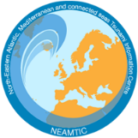




Prep-1: Easily Understood Tsunami Evacuation Maps are Approved
Mr. Ignacio AGUIRRE AYERBE
Researcher at the Environmental Hydraulics Institute - IHCantabria
(Universidad de Cantabria, Spain)
IOC-UNESCO EU DG ECHO CoastWAVE Project
IOC-UNESCO Tsunami Ready Recognition Programme (TRRP) Workshop
Online, February 16-17, 2023

Slide 2
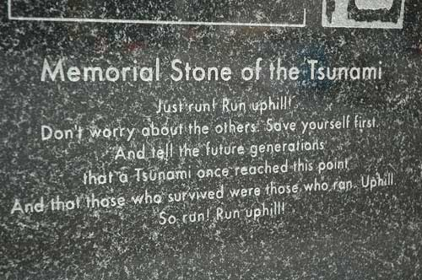
IOC-UNESCO Tsunami Ready Recognition Programme (TRRP) Workshop
WHY EVACUATION MAPS AND PLANS ARE IMPORTANT
Reducing tsunami exposure is crucial
Evacuation modelling, planning and mapping is one of the most important strategies to reduce potential loss of life due to tsunami events and thus for effective tsunami risk reduction
Surviving a tsunami is a matter of getting out of the reach of the waves and floodwaters in time.
(Ardito M. Kodijat)
Source: BGS
Source: UNESCO-IOC IOTIC

Slide 3
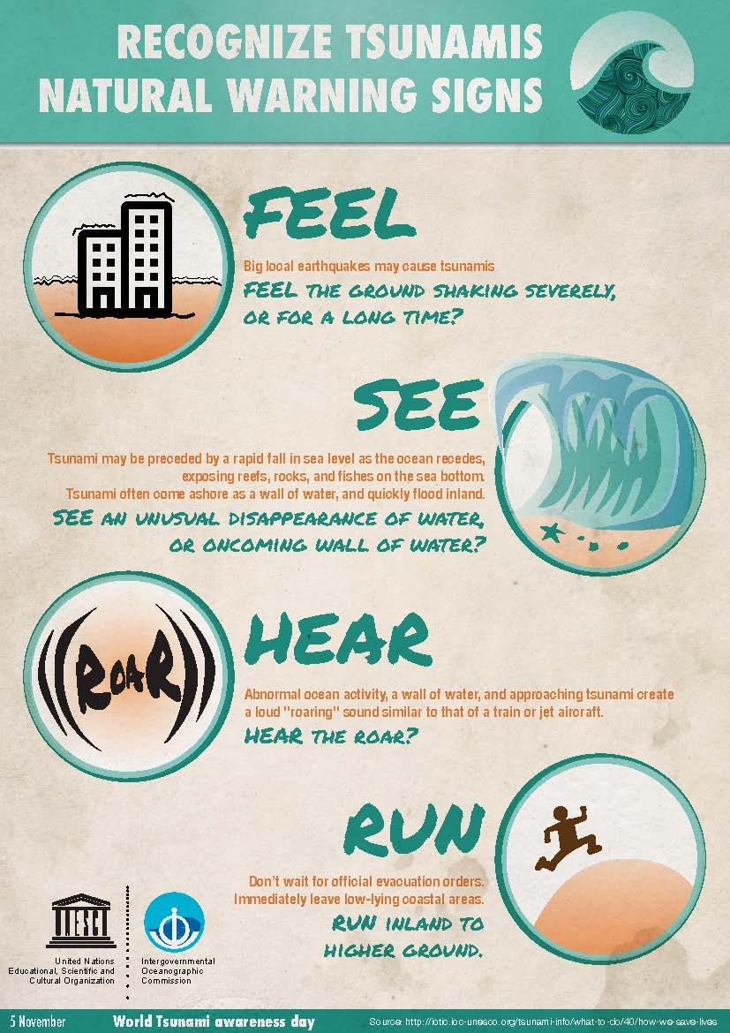
IOC-UNESCO Tsunami Ready Recognition Programme (TRRP) Workshop
EVACUATION MAPS AND PLANS AND EDUCATION
Comprehensive evacuation planning must include education, training and knowledge transfer.
Education and training are essential to improve tsunami preparedness. This includes understanding how to respond to an evacuation order and understanding a natural warning sign to self-evacuate.
Source: IOC-UNESCO. World Tsunami Awareness Day 2016

Slide 4
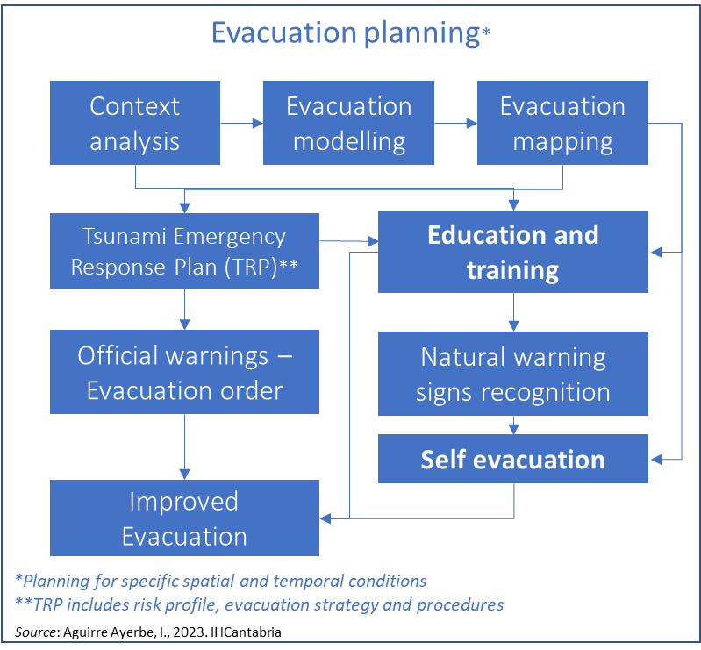
IOC-UNESCO Tsunami Ready Recognition Programme (TRRP) Workshop
EVACUATION MAPS - EVACUTION PLANNING
The development of an evacuation map is one component of an articulated evacuation planning process that goes beyond the production of the map

Slide 5

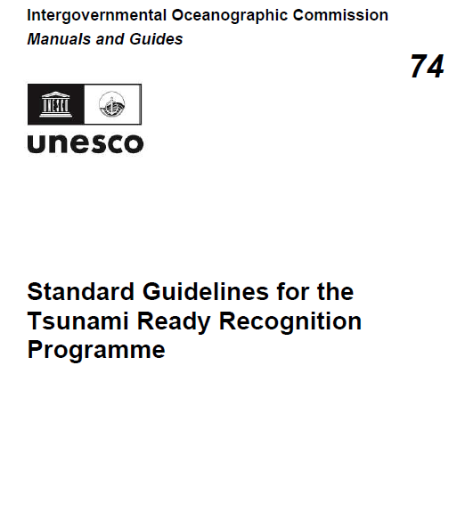
IOC-UNESCO Tsunami Ready Recognition Programme (TRRP) Workshop
PREP-1. Easily understood tsunami evacuation maps are approved
Tsunami evacuation maps should depict tsunami evacuation routes and assembly areas. Maps should be based on tsunami hazard zone mapping and in accordance with the community’s TRP. Maps should be made available via appropriate print and/or digital media (see: TEMPP, and guidance in Preparing for Community Tsunami Evacuations: from inundation to evacuation maps, response plans and exercises (UNESCO IOC MG82, 2020).
Notes:
Communities should be involved in the preparation of evacuation maps to incorporate local knowledge (e.g. accessibility/difficulties to reach or to take certain evacuation routes).
The hazard maps should be the basis for preparing evacuation maps (see: ASSESS-1).
For communities for which there is no inundation modelling, a baseline tsunami hazard zone can be used to prepare the evacuation map.
Example:
An evacuation map illustrates the evacuation zones, routes and safer areas as higher ground
or tsunami shelter, assembly areas and critical and sensitive facilities.

Slide 6
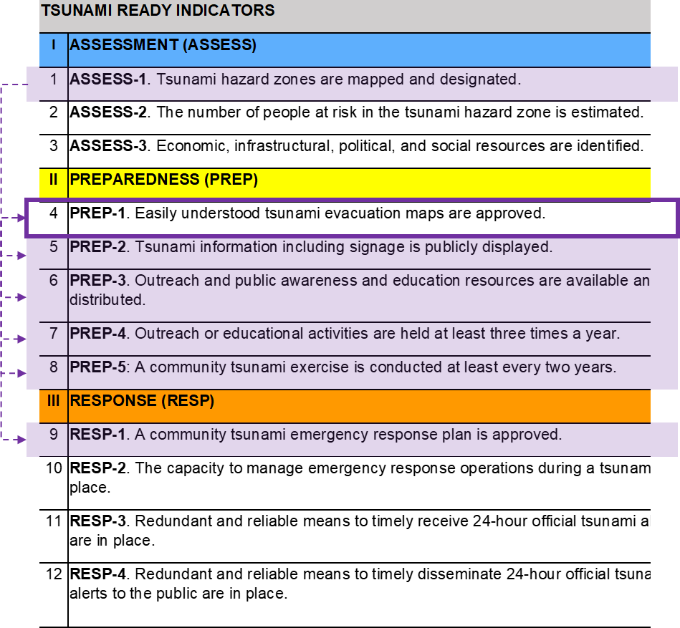
IOC-UNESCO Tsunami Ready Recognition Programme (TRRP) Workshop
PREP-1. Easily understood tsunami evacuation maps are approved

Slide 7
IOC-UNESCO Tsunami Ready Recognition Programme (TRRP) Workshop
OBJECTIVE OF EVACUATION PLANS AND MAPS
Protecting the lives of people at risk, by:
  Identifying areas that need to be evacuated
  Designating safe areas for first response
  Establishing the most appropriate paths/routes to reach them

Slide 8
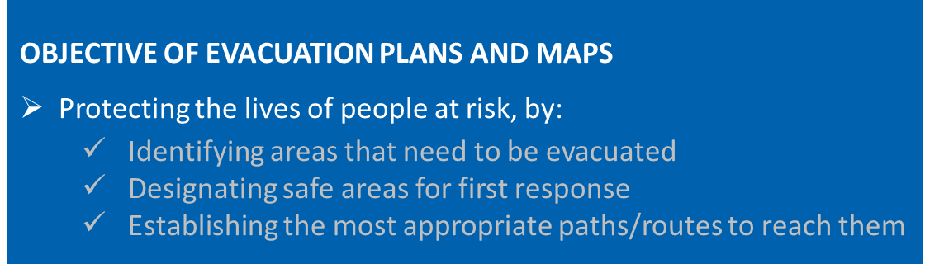
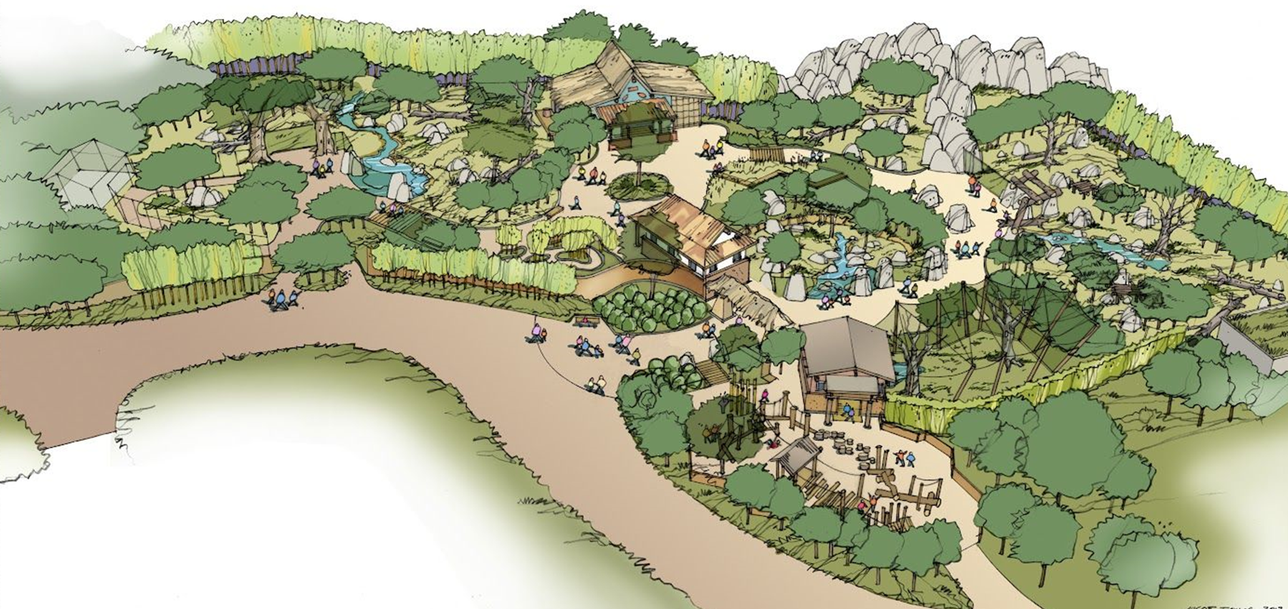
IOC-UNESCO Tsunami Ready Recognition Programme (TRRP) Workshop
KEY ELEMENTS TO BE CONSIDERED
  Tsunami potential inundation area and arrival time
  Number of people at risk and their characteristics
  Physical data from the community
  Identification of assembly areas
    Accessibility
    Capacity of safe assembly areas
    Optimal physical conditions
  Identification of optimal evacuation routes
  Design easy to read evacuation maps
  Participatory process
    Key local stakeholders / emergency managers
    Local knowledge
    Community involvement
    Usefulness of results through ownership of the evacuation maps
  Evacuation plan and maps must be approved by the competent authority that has the mandate to authorize the evacuation.

Slide 9

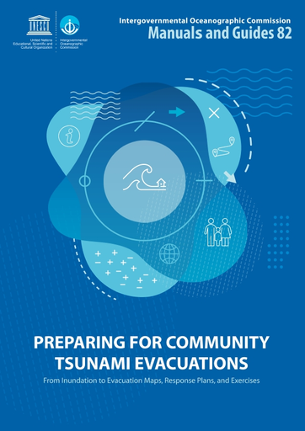
IOC-UNESCO Tsunami Ready Recognition Programme (TRRP) Workshop
PREP-1. Easily understood tsunami evacuation maps are approved
DEVELOPING TSUNAMI EVACUATION MAPS. IOC-UNESCO. 2020. MG - 82
‘What to do’ → evacuate to a safer place
‘Where to go’ → is answered using a tsunami evacuation map
STEPS
Source: IOC-UNESCO. 2020. Manual and Guides 82.

Slide 10
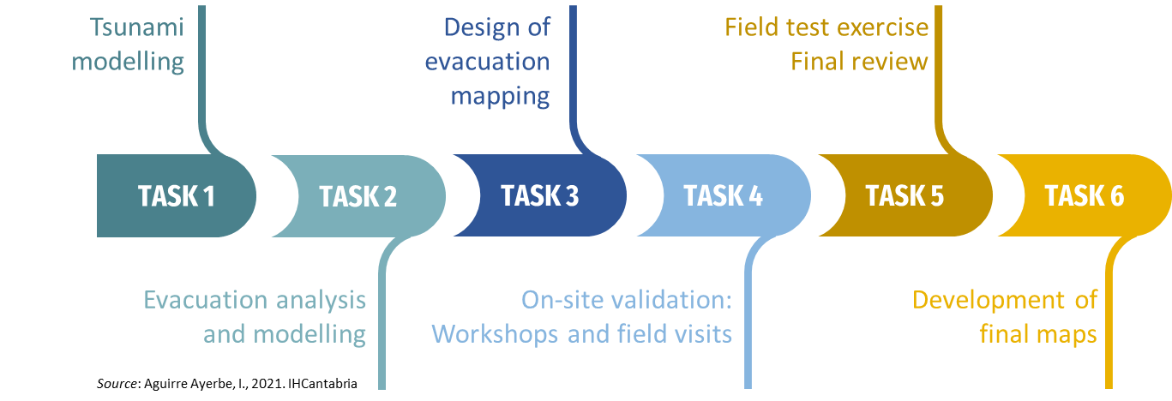
IOC-UNESCO Tsunami Ready Recognition Programme (TRRP) Workshop
PREP-1. Easily understood tsunami evacuation maps are approved. Chipiona (Spain) Case Study
Chipiona (Spain) Case Study

Slide 11

IOC-UNESCO Tsunami Ready Recognition Programme (TRRP) Workshop
PREP-1. Easily understood tsunami evacuation maps are approved
Chipiona (Spain) Case Study
TASKS 1, 2, 3
TASK 4
TASK 3, 4, 5, 6
Source: IOC-UNESCO. 2020. Manual and Guides 82.

Slide 12
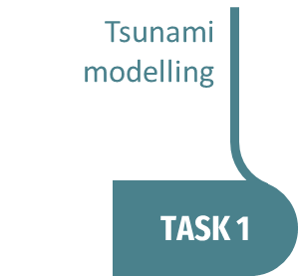
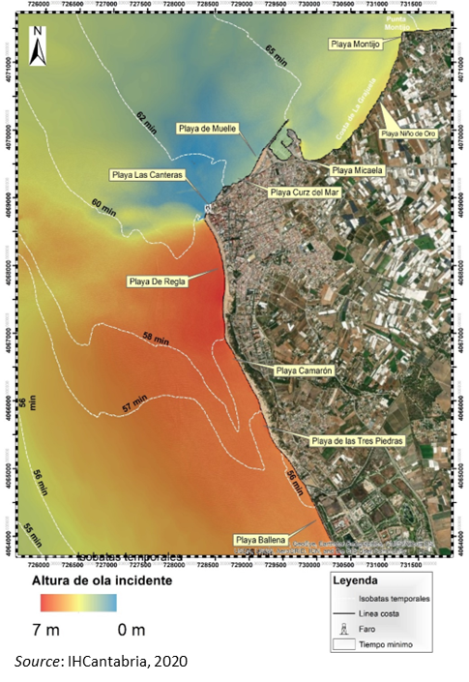
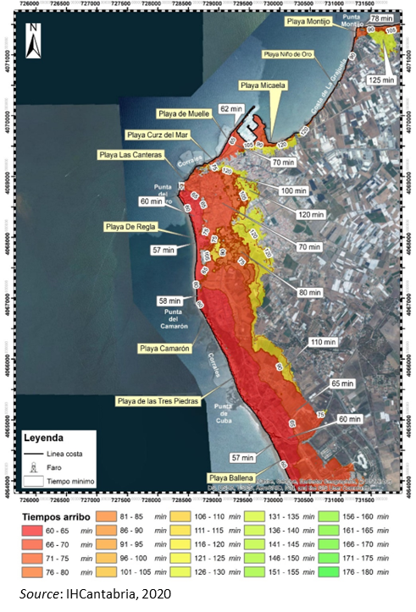
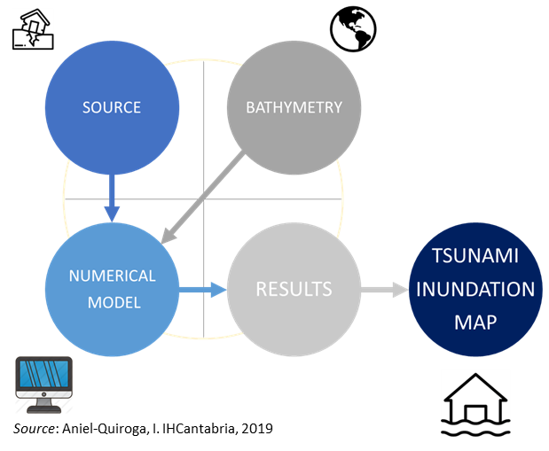
IOC-UNESCO Tsunami Ready Recognition Programme (TRRP) Workshop
PREP-1. Easily understood tsunami evacuation maps are approved. Chipiona (Spain) Case Study

Slide 13
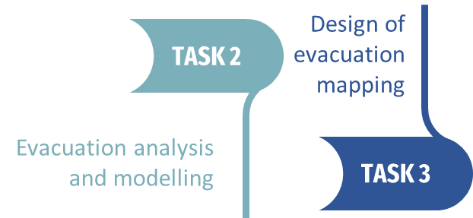
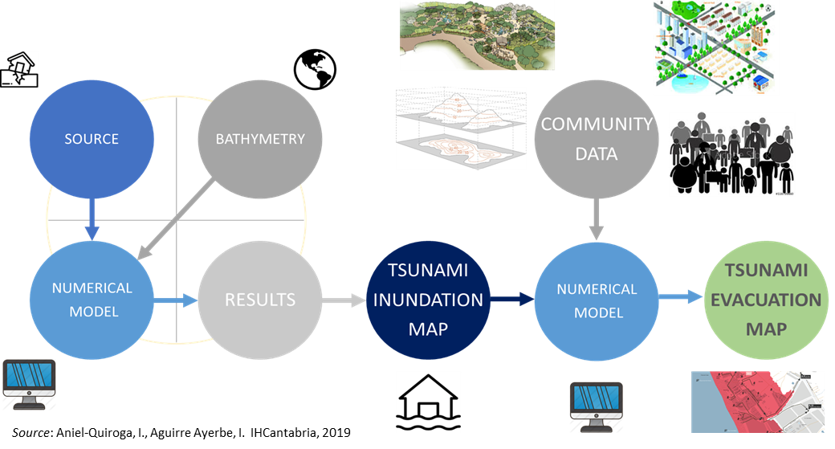
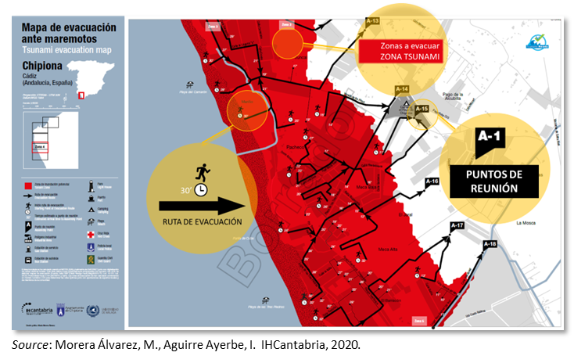
IOC-UNESCO Tsunami Ready Recognition Programme (TRRP) Workshop
PREP-1. Easily understood tsunami evacuation maps are approved. Chipiona (Spain) Case Study

Slide 14
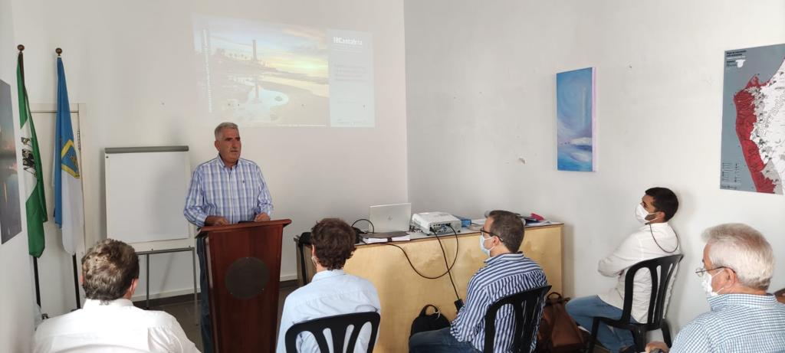

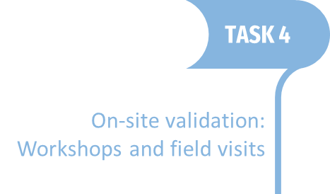
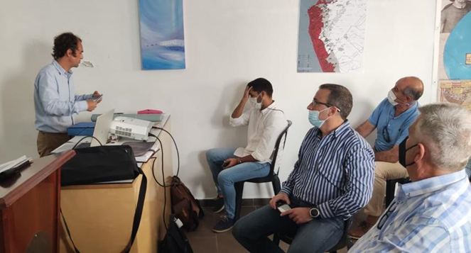
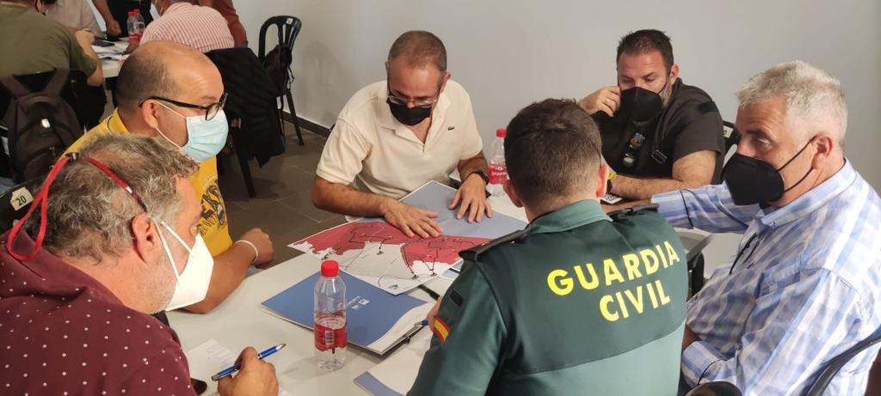
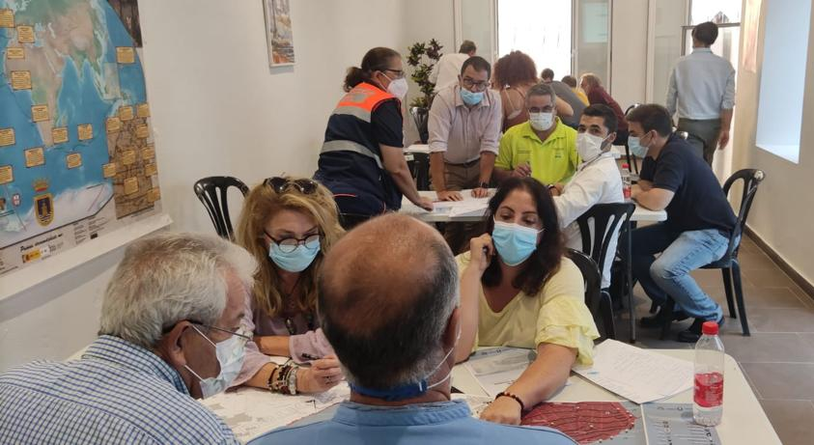
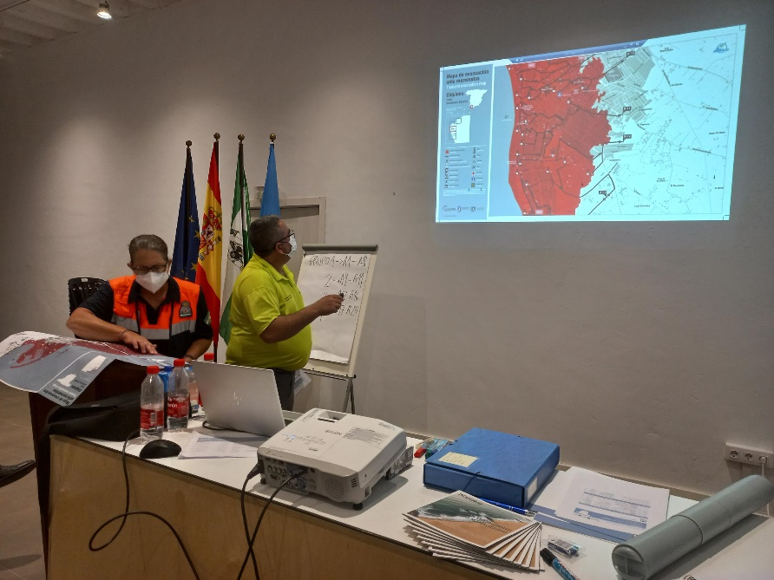
IOC-UNESCO Tsunami Ready Recognition Programme (TRRP) Workshop
PREP-1. Easily understood tsunami evacuation maps are approved. Chipiona (Spain) Case Study
Photos and content: IHCantabria

Slide 15
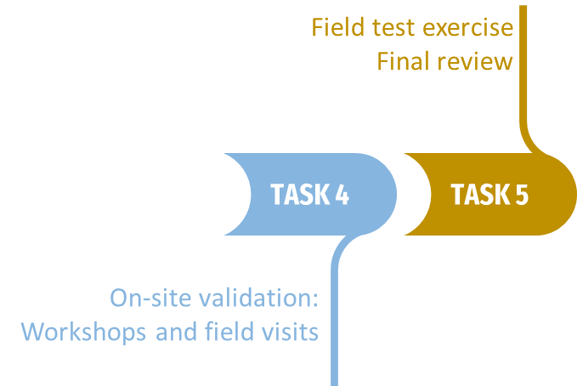
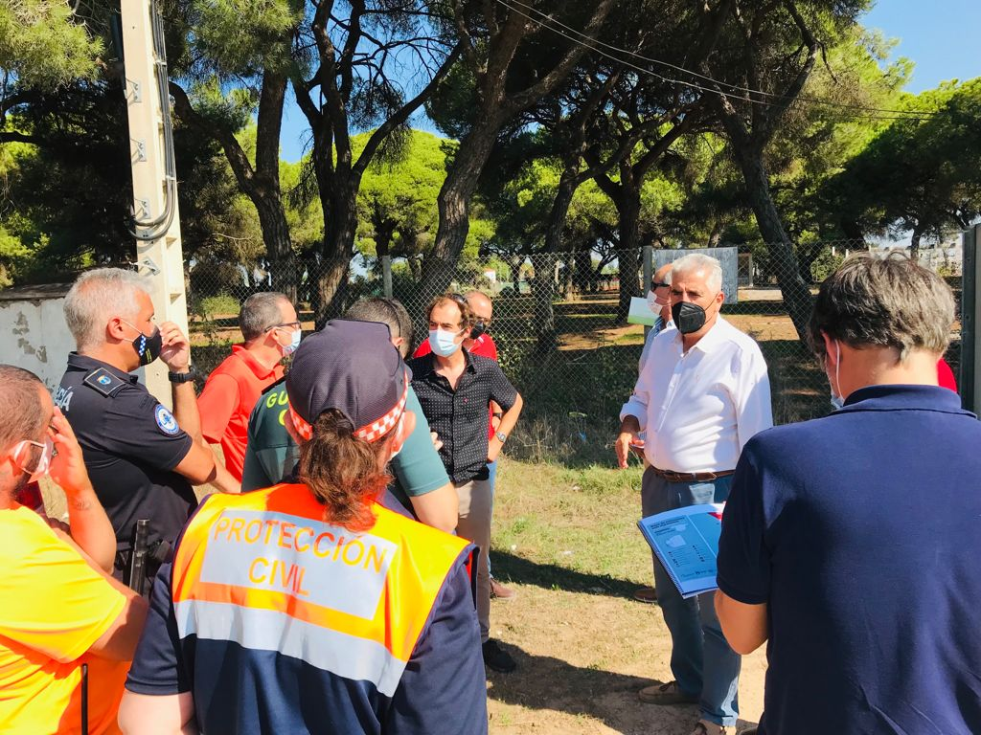
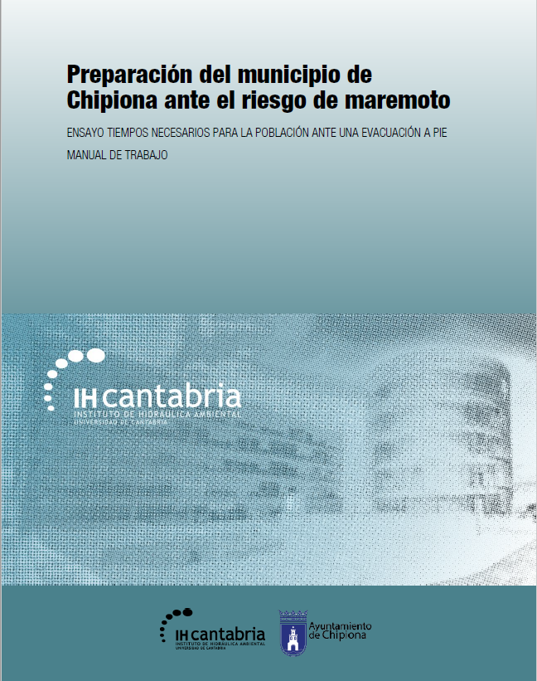
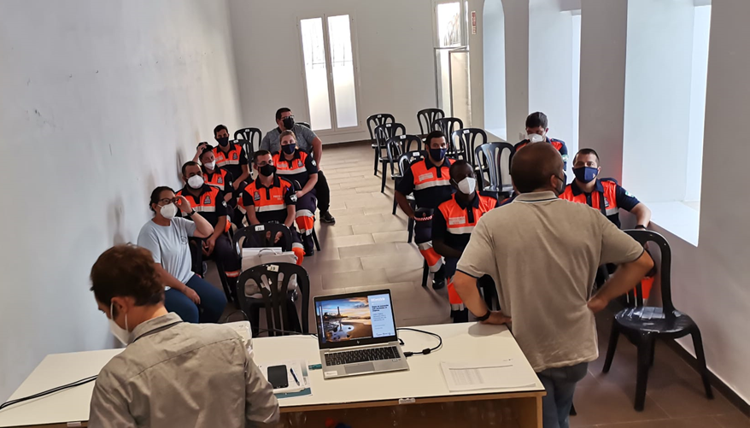
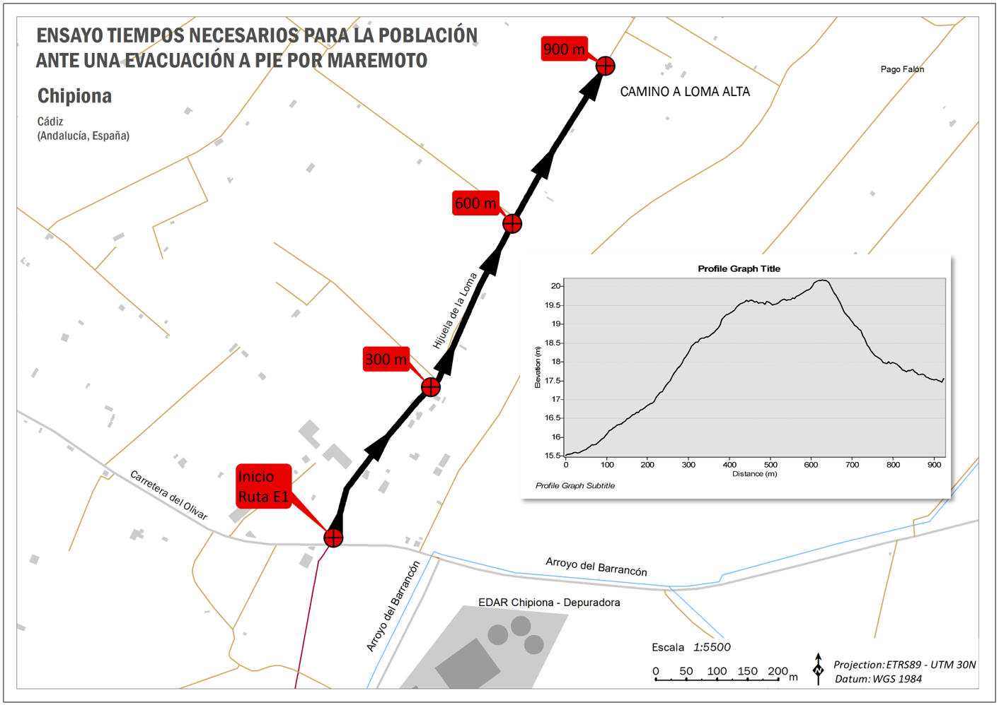
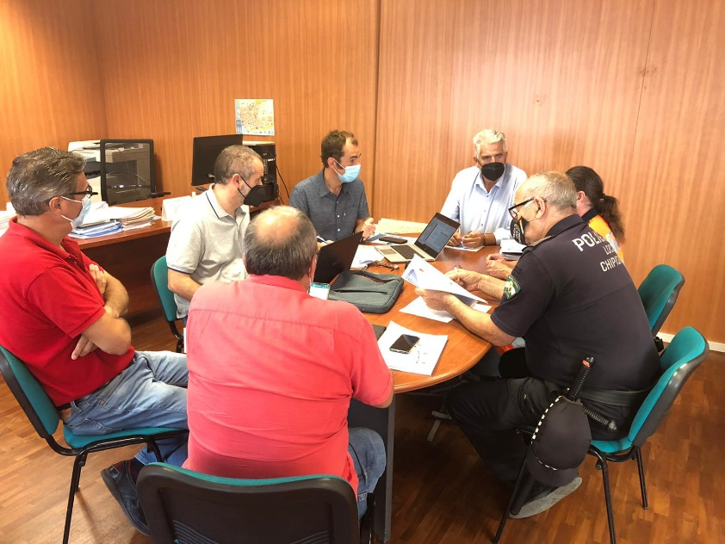
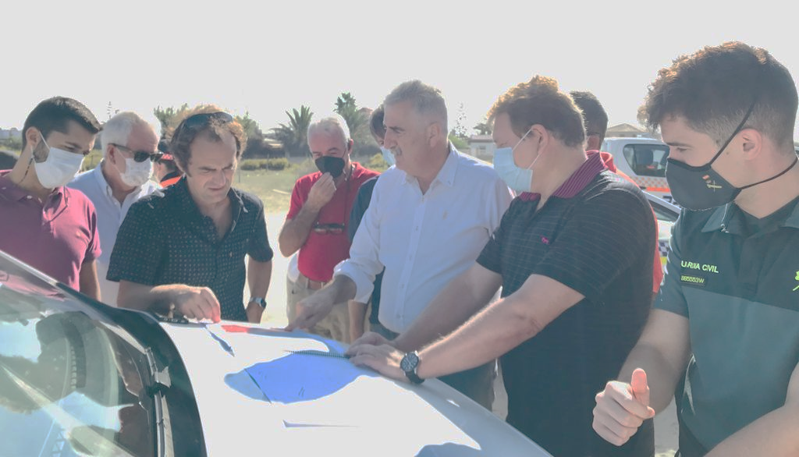
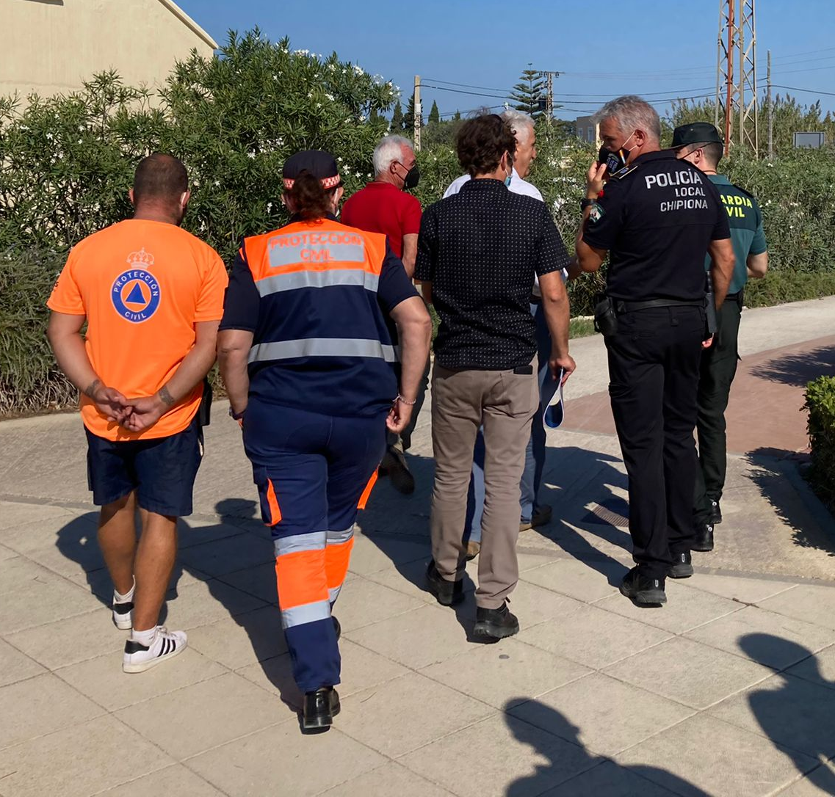
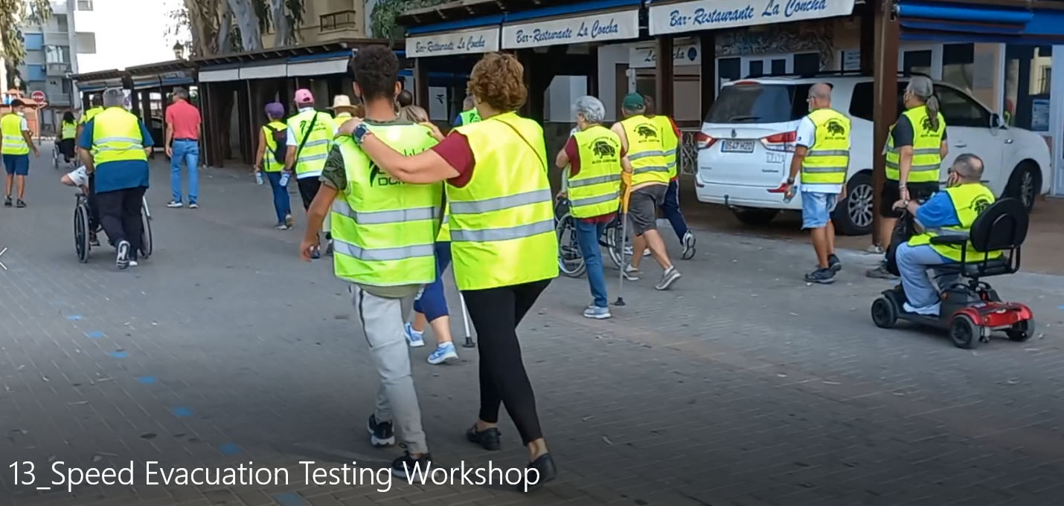
IOC-UNESCO Tsunami Ready Recognition Programme (TRRP) Workshop
PREP-1. Easily understood tsunami evacuation maps are approved. Chipiona (Spain) Case Study
Photos and content: IHCantabria and TVChipiona.

Slide 16
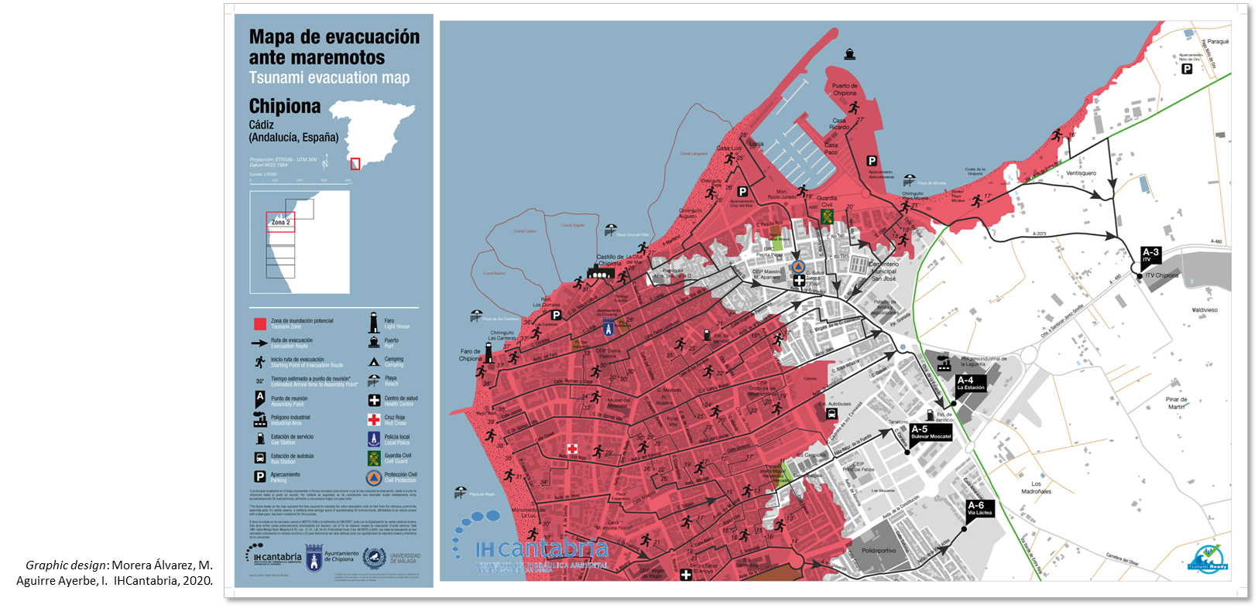
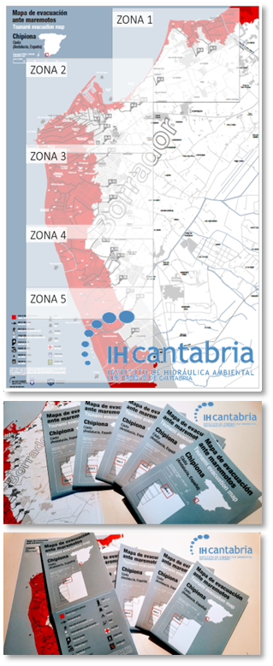
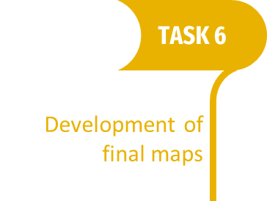
IOC-UNESCO Tsunami Ready Recognition Programme (TRRP) Workshop
PREP-1. Easily understood tsunami evacuation maps are approved. Chipiona (Spain) Case Study

Slide 17
IOC-UNESCO Tsunami Ready Recognition Programme (TRRP) Workshop
PREP-1. Easily understood tsunami evacuation maps are approved.
WHAT CHALLENGES ARE WE FACING IN NEAM REGION?
SHOULD WE SET A SPECIFIC STANDARD FOR DEVELOPING AND DESIGNING TSUNAMI EVACUATION MAPS IN THE NEAM REGION?

Slide 18
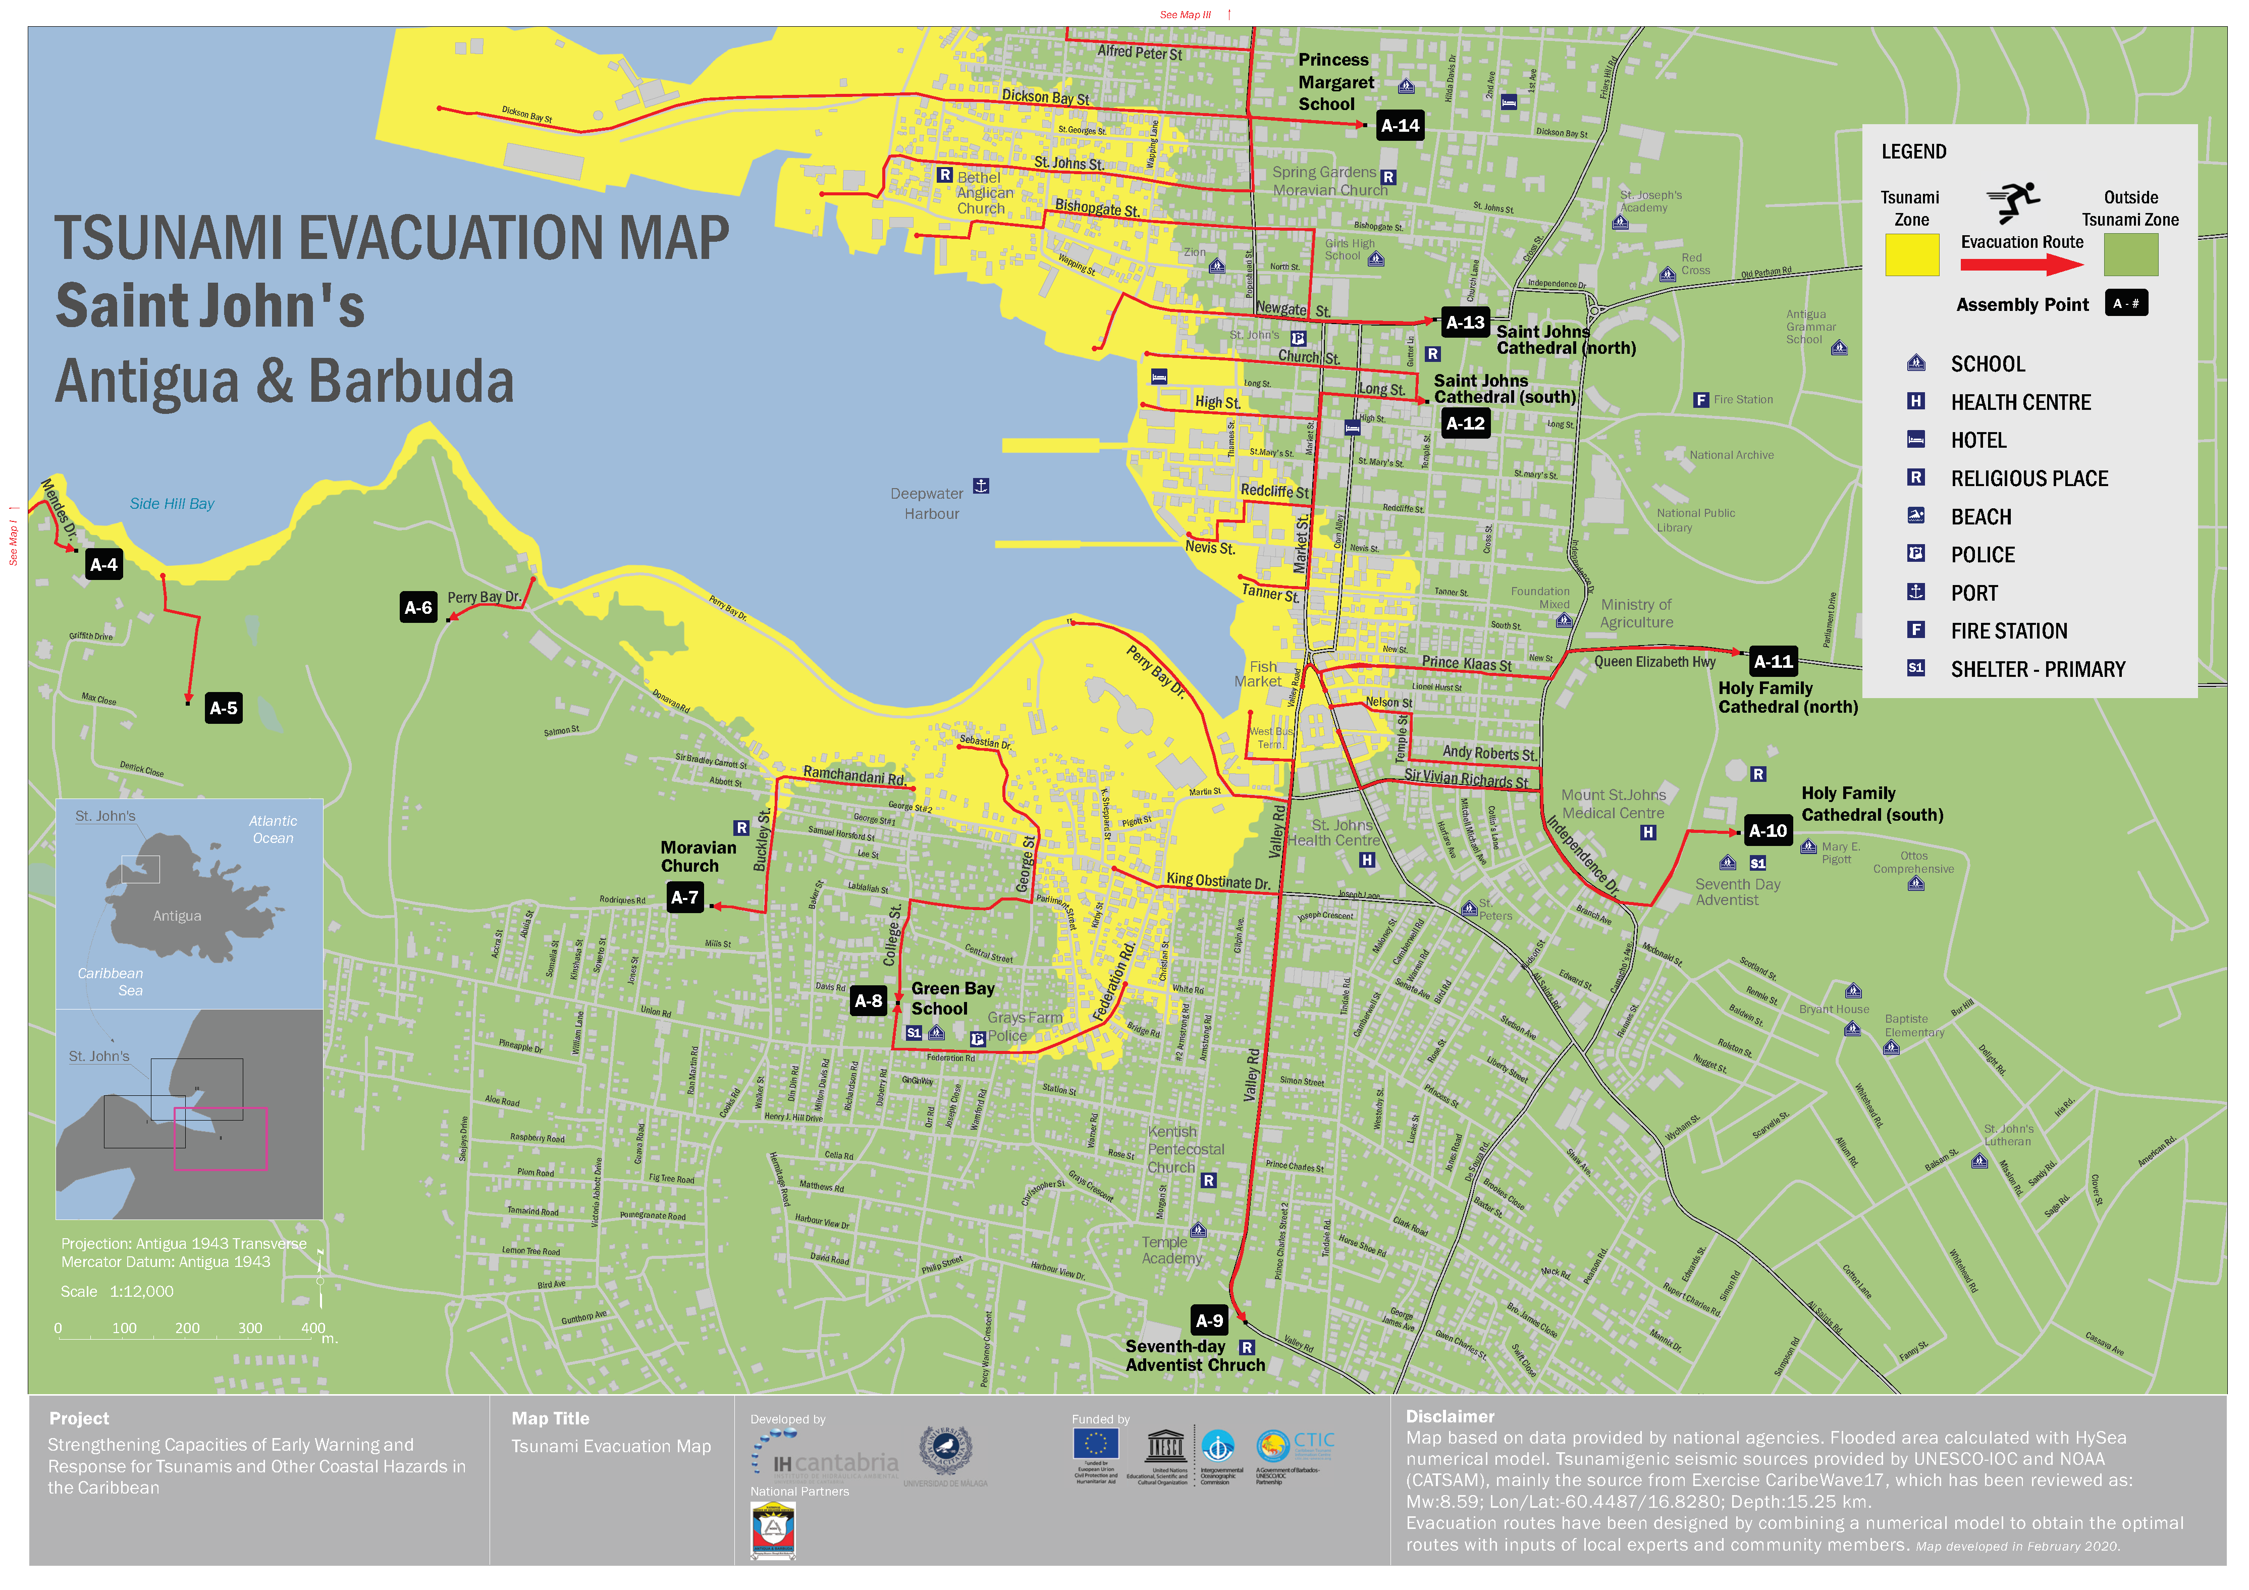
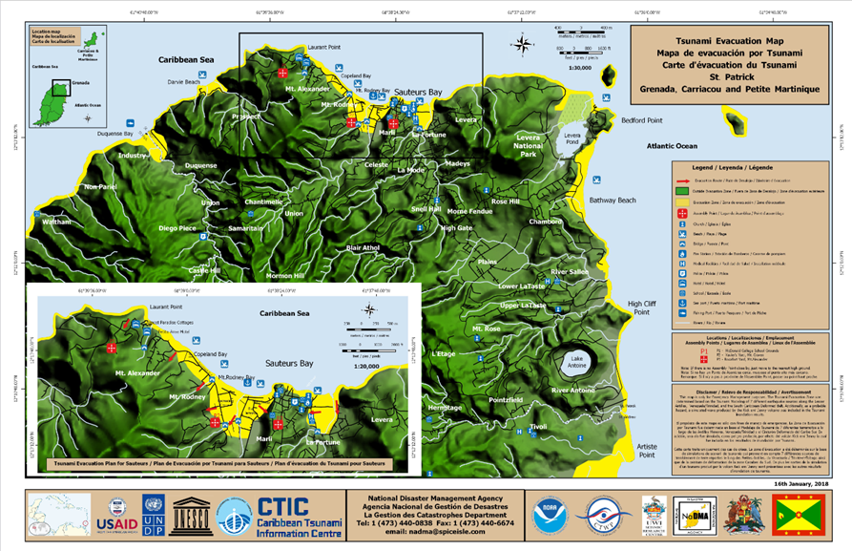
IOC-UNESCO Tsunami Ready Recognition Programme (TRRP) Workshop
PREP-1. Easily understood tsunami evacuation maps are approved.
EXAMPLES OF TSUNAMI EVACUATION MAPS - CARIBBEAN
Saint John’s Antigua & Barbuda
Grenada

Slide 19
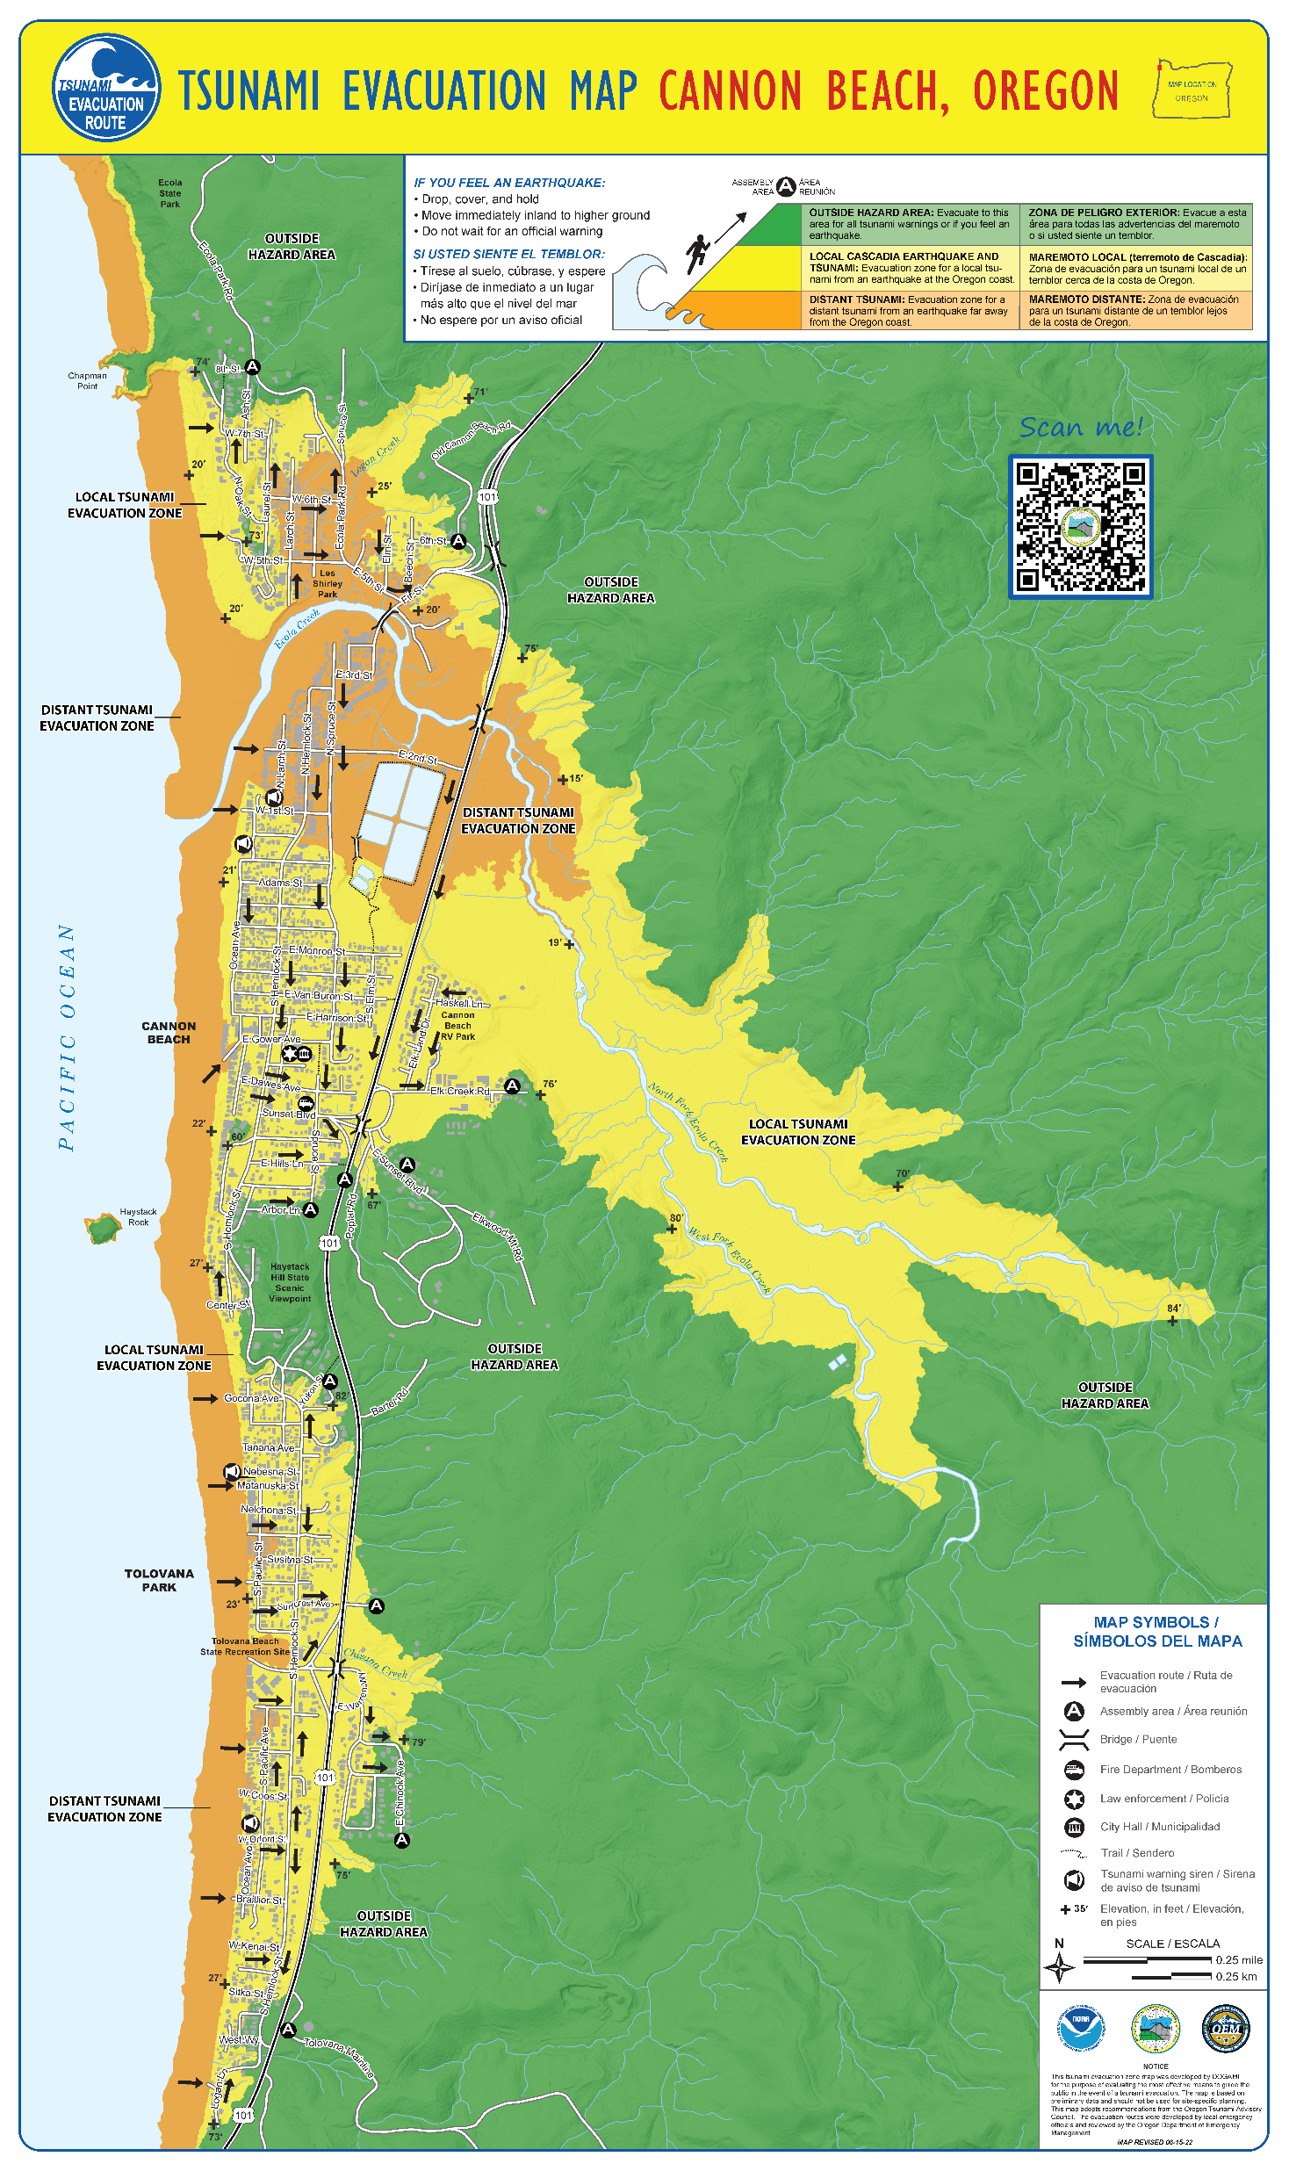
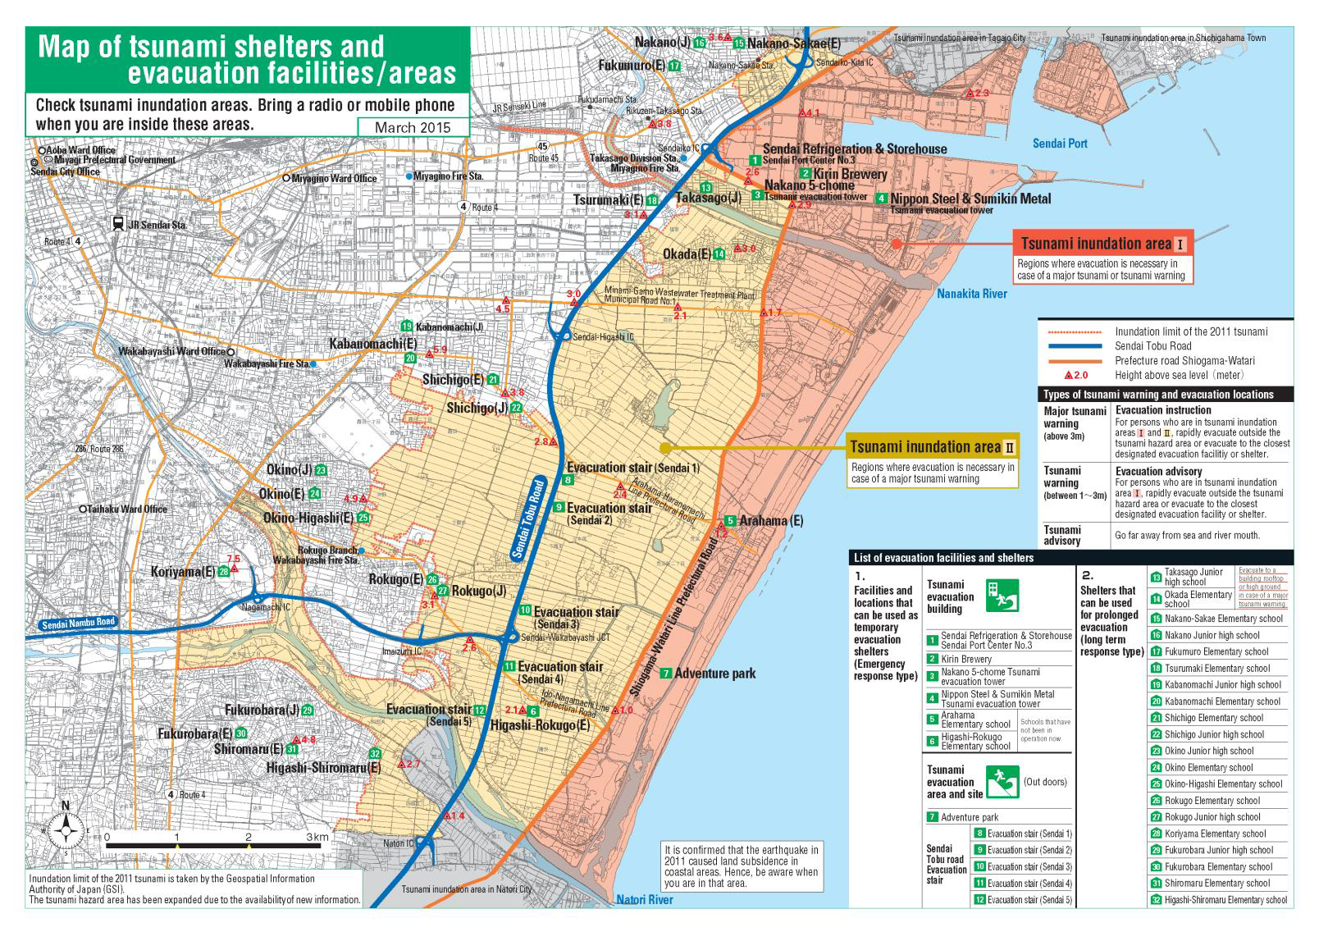
IOC-UNESCO Tsunami Ready Recognition Programme (TRRP) Workshop
Oregon, USA
PREP-1. Easily understood tsunami evacuation maps are approved.
EXAMPLES OF TSUNAMI EVACUATION MAPS. PACIFIC
Sendai, Japan

Slide 20
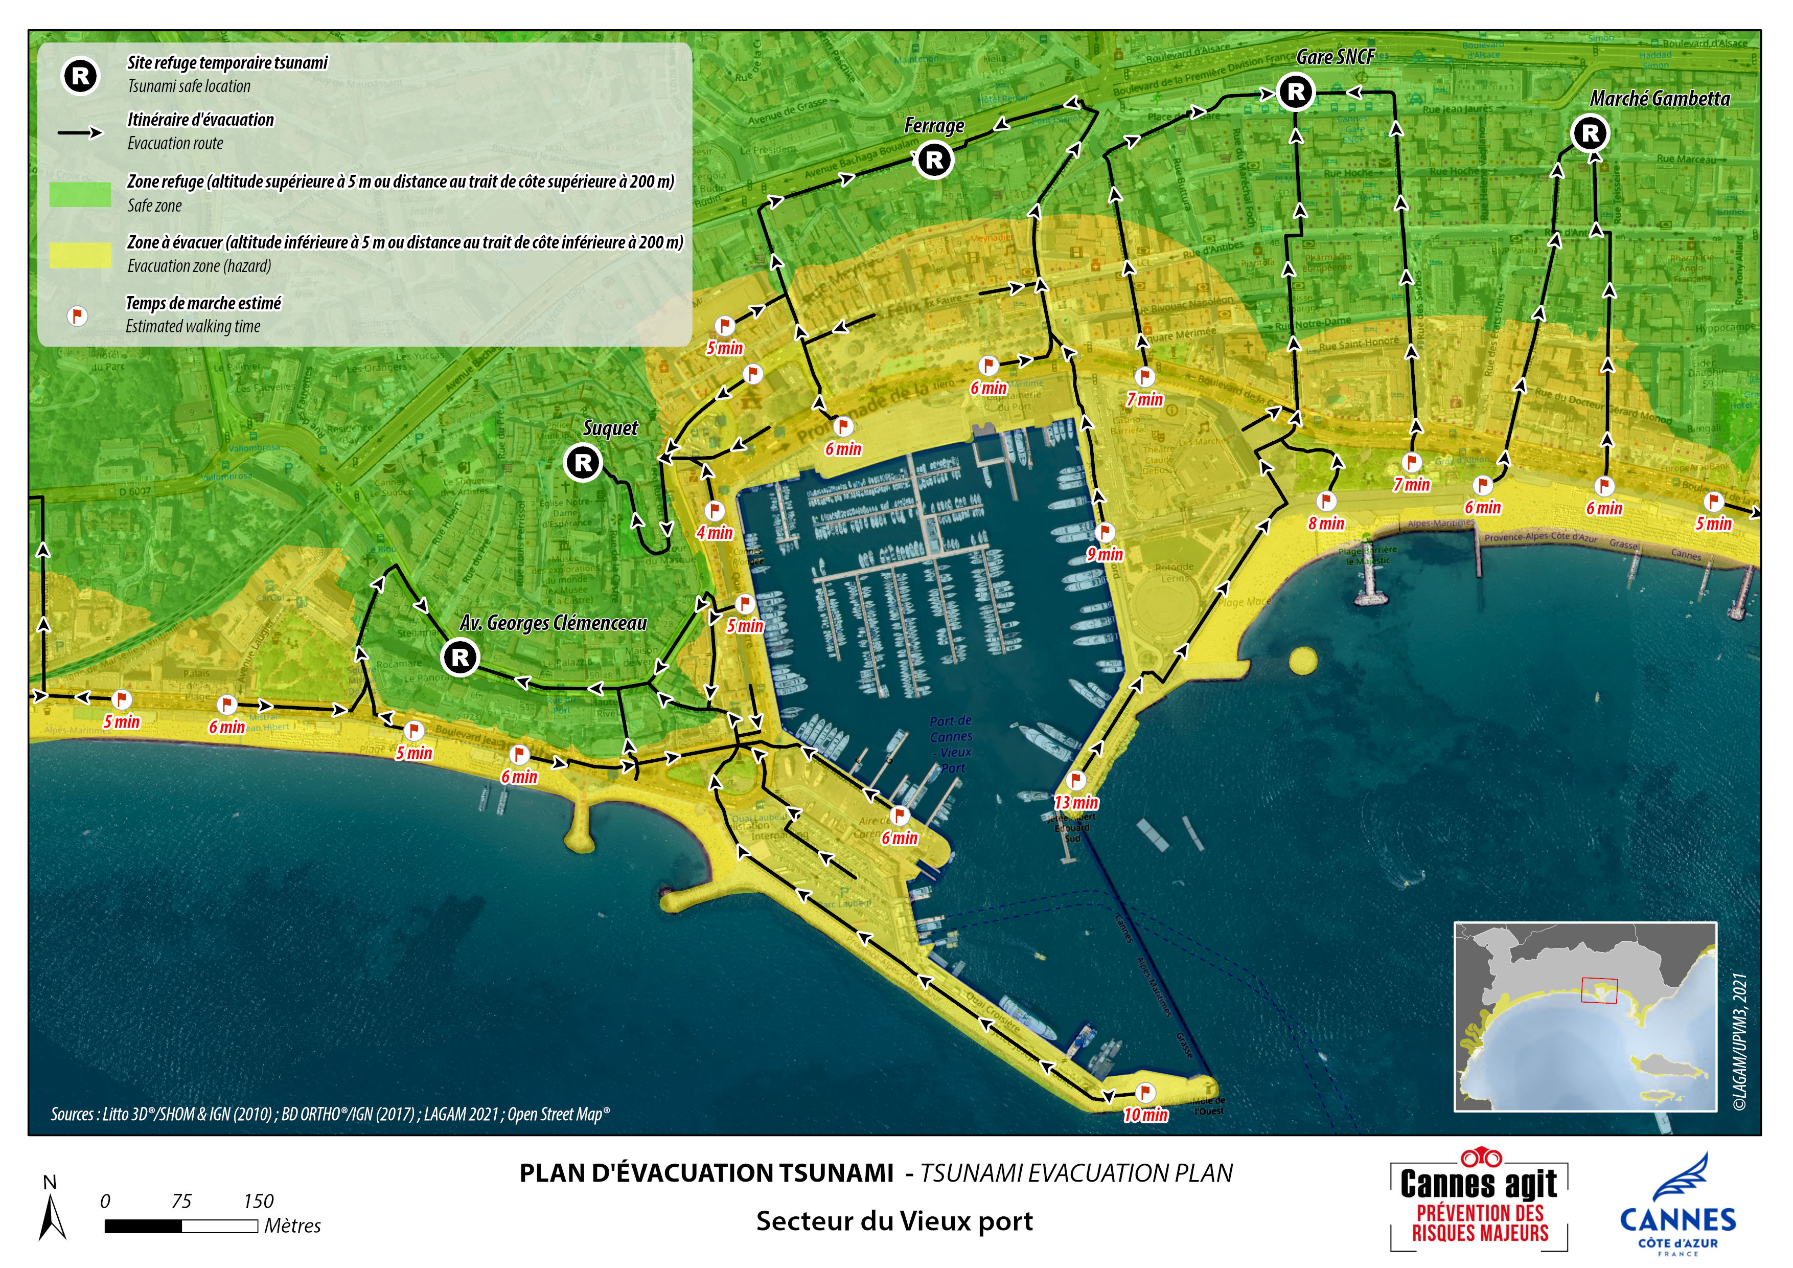
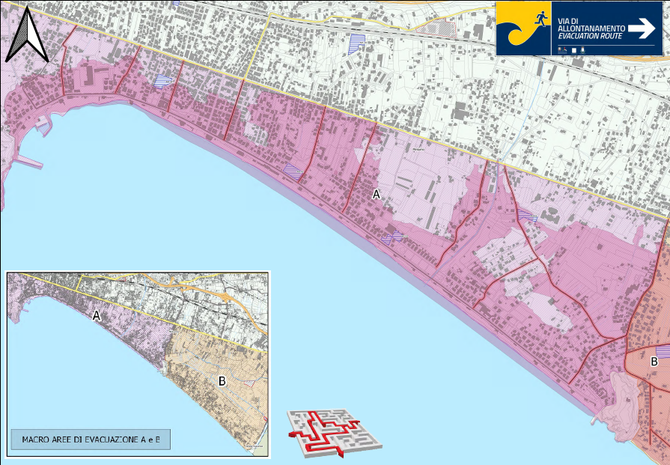
IOC-UNESCO Tsunami Ready Recognition Programme (TRRP) Workshop
PREP-1. Easily understood tsunami evacuation maps are approved.
EXAMPLES OF TSUNAMI EVACUATION MAPS NEAMTWS
Cannes, France
Minturno, Italy

Slide 21
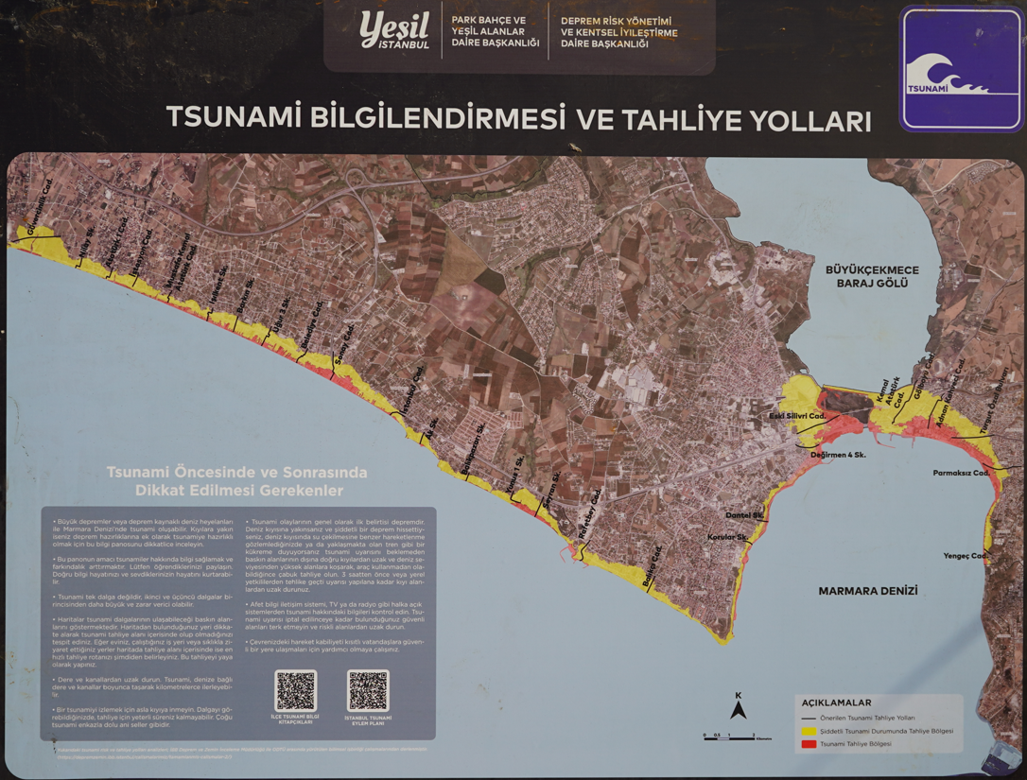
IOC-UNESCO Tsunami Ready Recognition Programme (TRRP) Workshop
PREP-1. Easily understood tsunami evacuation maps are approved.
EXAMPLES OF TSUNAMI EVACUATION MAPS NEAMTWS
Istanbul, Turkey
Chipiona, Spain

Slide 22
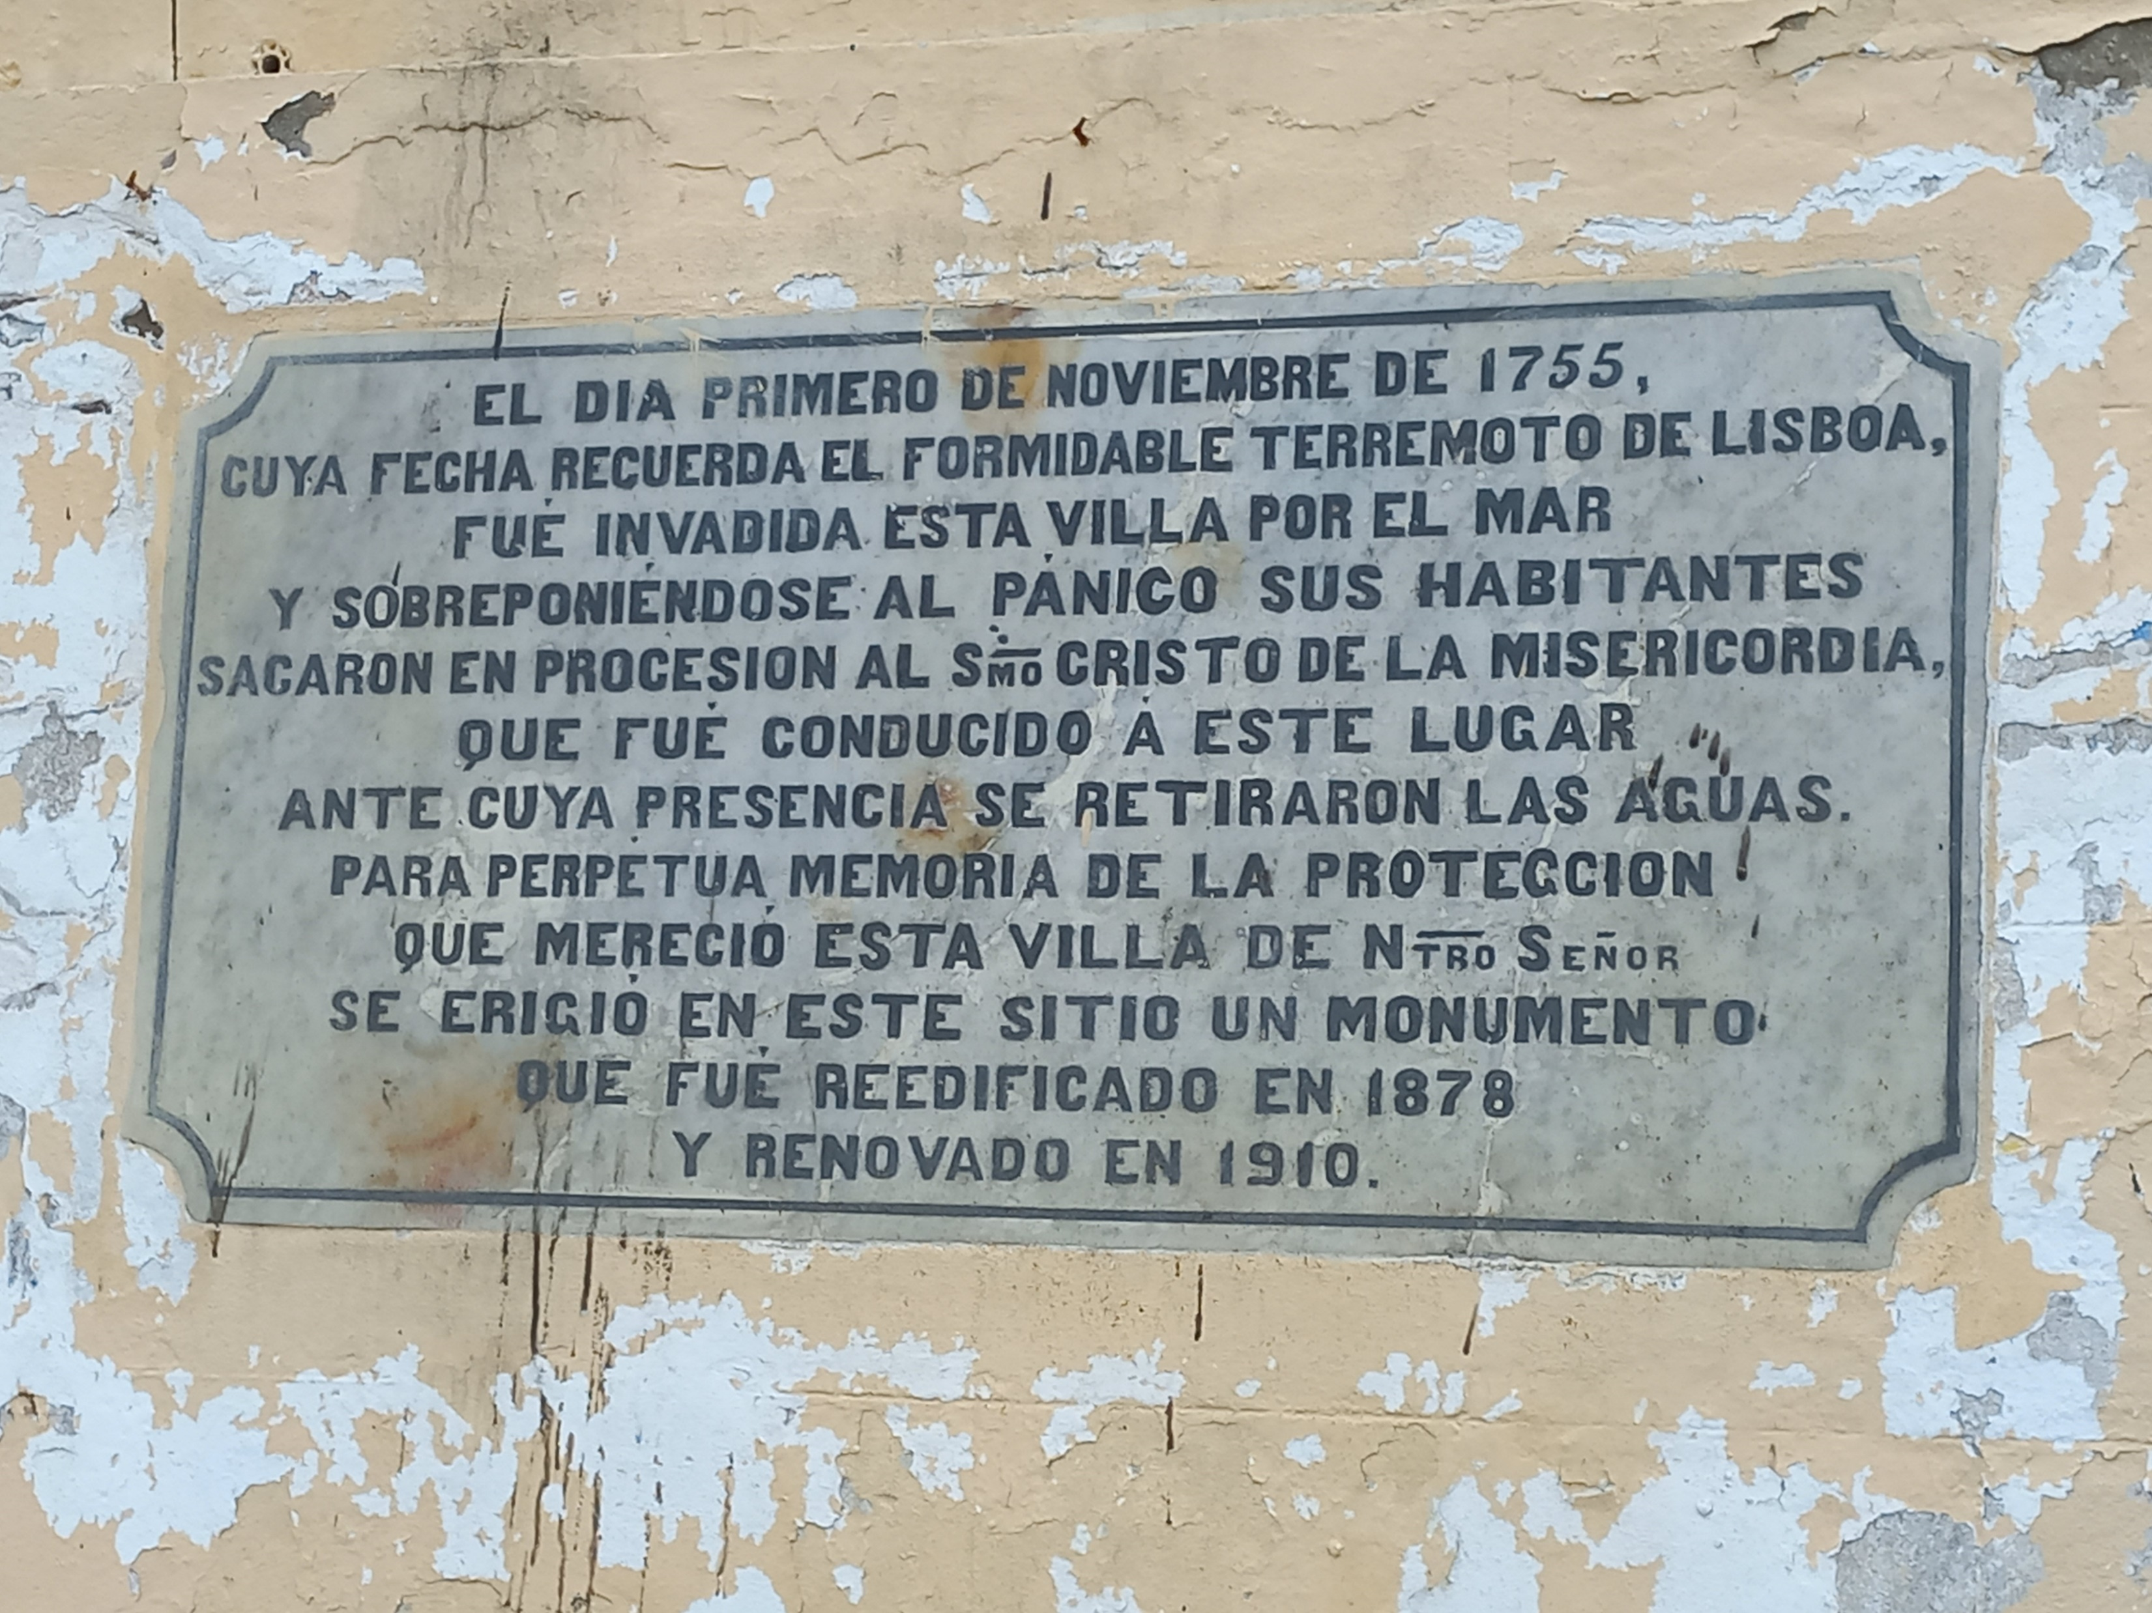

Thank you
Source: UNDRR. World Tsunami Awareness Day 2016

Slide 23
UNESCO
Intergovernmental Oceanographic Commission (IOC)
IHCantabria
Environmental Hydraulics Institute
IOC-UNESCO DG ECHO CoastWAVE project
UNESCO IOC Sector
Tsunami Unit
d.chang-seng@unesco.org
CoastWAVE project website
Coastal Management and Engineering Group
Ignacio Aguirre Ayerbe
Ignacio.aguirre@unican.es

