Slide 1
Prep-2: Tsunami Information Including Signage is Publicly Displayed
Dr. Musavver Didem CAMBAZ, Prof. Dr. Haluk ÖZENER
Kandilli Observatory and Earthquake Research Institute (Türkiye)
IOC-UNESCO EU DG ECHO CoastWAVE Project
IOC-UNESCO Tsunami Ready Recognition Programme (TRRP) Workshop
Online, February 16-17, 2023

Slide 2
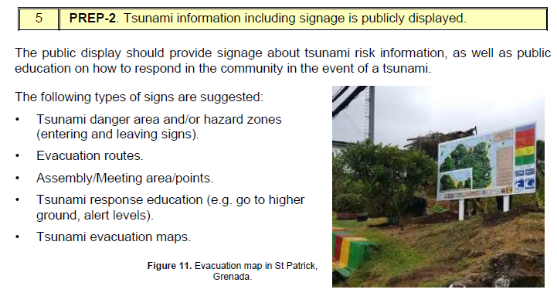
IOC-UNESCO Tsunami Ready Recognition Programme (TRRP) Workshop
http://itic.ioc-unesco.org/index.php?option=com_content&view=article&id=1645&Itemid=2322

Slide 3
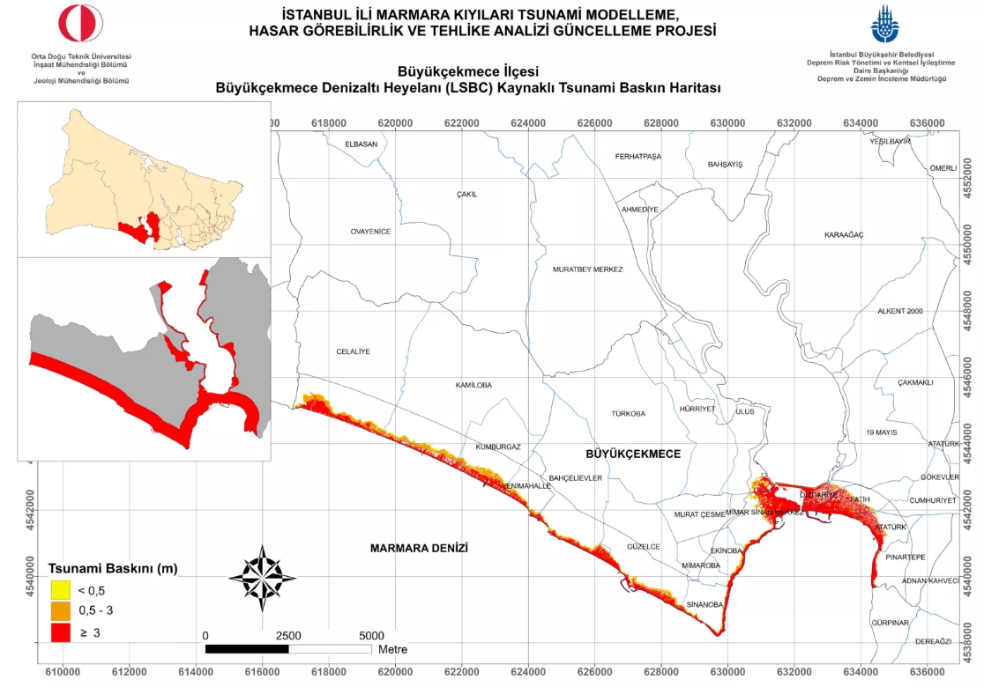
IOC-UNESCO Tsunami Ready Recognition Programme (TRRP) Workshop
https://depremzemin.ibb.istanbul/guncelcalismalarimiz/#le-tsunam-blg-ktapiklari

Slide 4
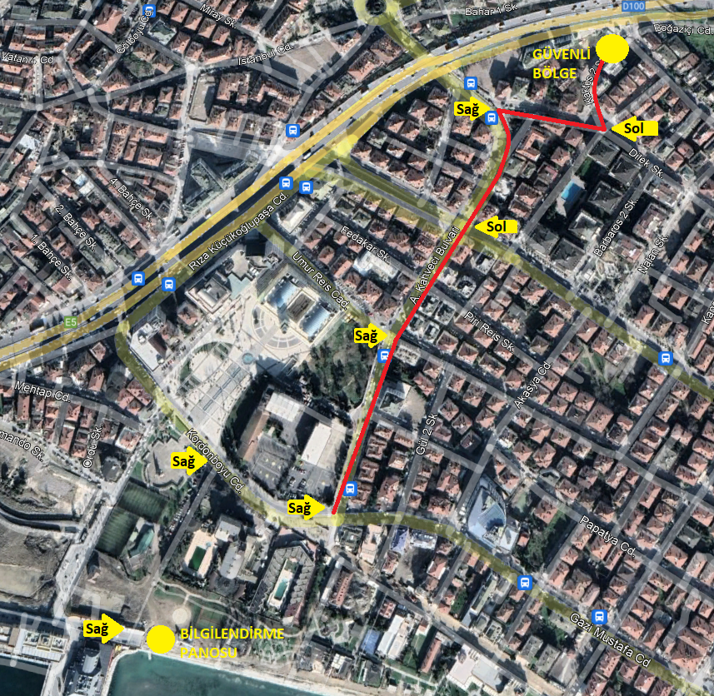
IOC-UNESCO Tsunami Ready Recognition Programme (TRRP) Workshop
Installation of Tsunami Boards and Signage;
Determination of the road properties,
Determination of the width of the roads,
Population of the district,
Density and the quality of the buildings in the district,
Soil condition in the district,
Alternative roads…
Evacuation Route to the Tsunami Safe Zone (IMM)

Slide 5
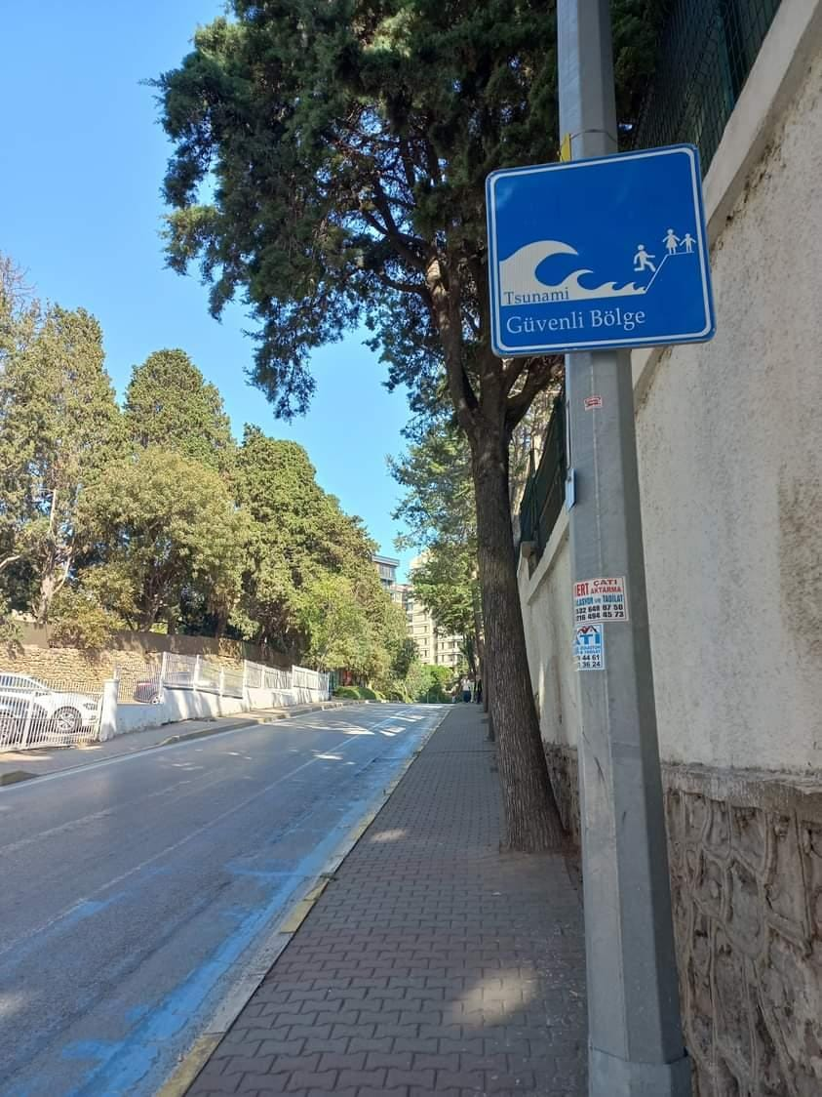
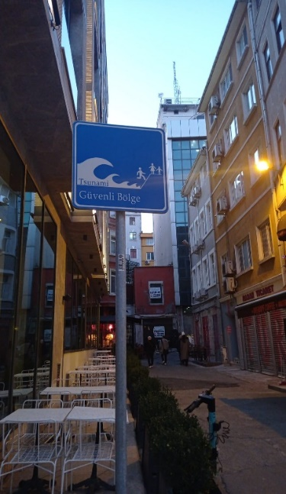
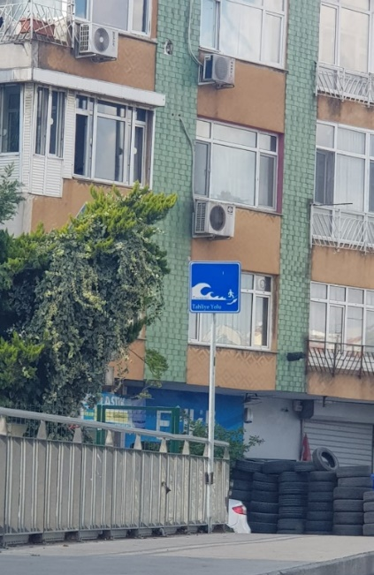
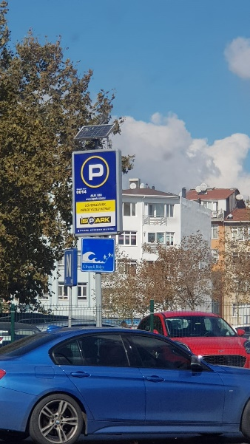
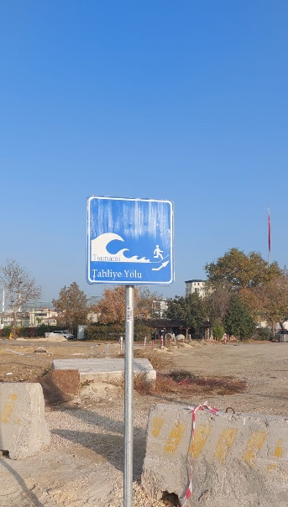
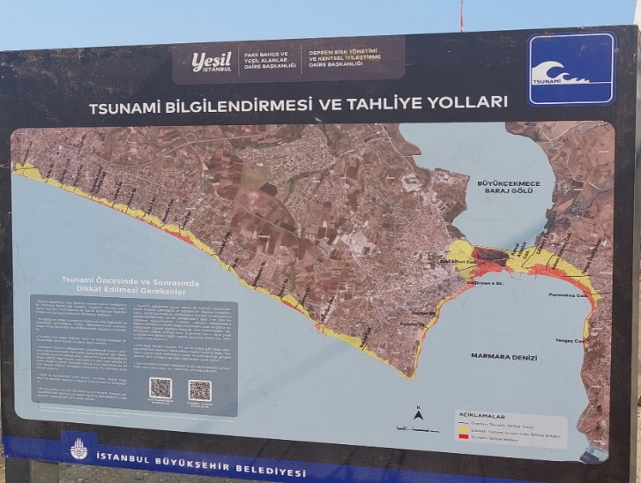
IOC-UNESCO Tsunami Ready Recognition Programme (TRRP) Workshop
Tsunami Information Board and Tsunami Evacuation Route signage in Istanbul:
130/130 information board, (%100 completed)
437/640 signage
(%68 completed)
installed by
Istanbul Metropolitan Municipality, IMM
(https://twitter.com/kemald_deprem/status/1584432000160919553)

Slide 6
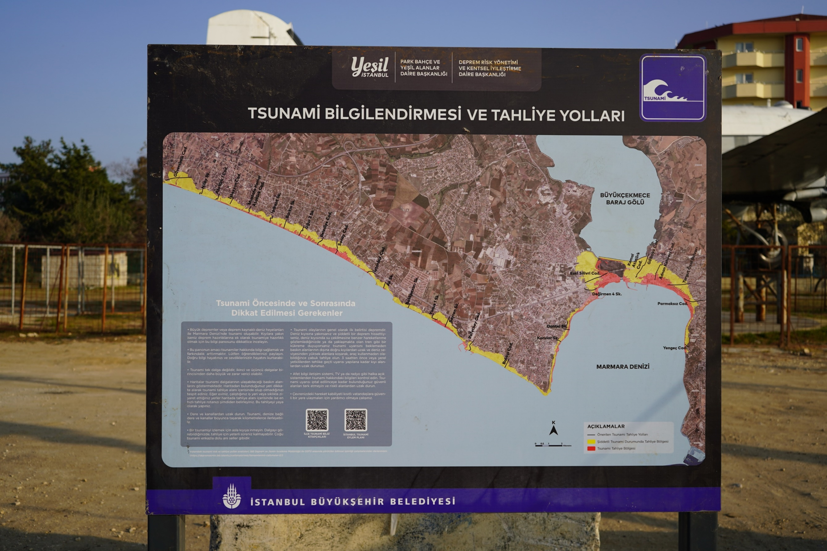
IOC-UNESCO Tsunami Ready Recognition Programme (TRRP) Workshop
Tsunami signs are designed by considering UNESCO ITIC Standards and National signage standards.
Recognition and better understanding of general public is also considered in collaboration with IMM.

Slide 7
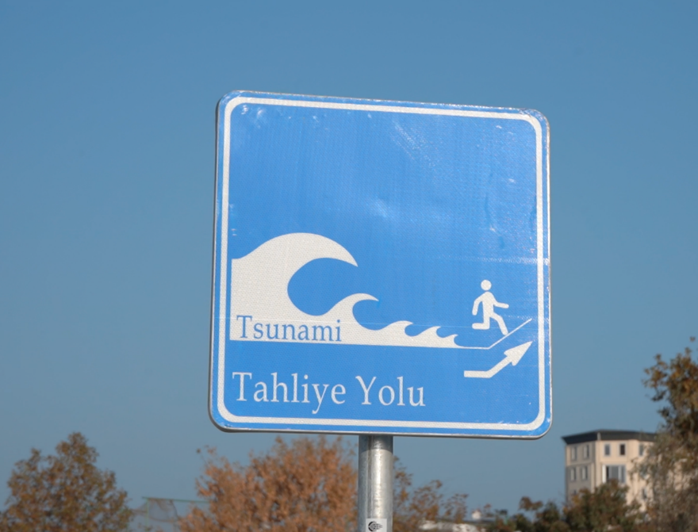
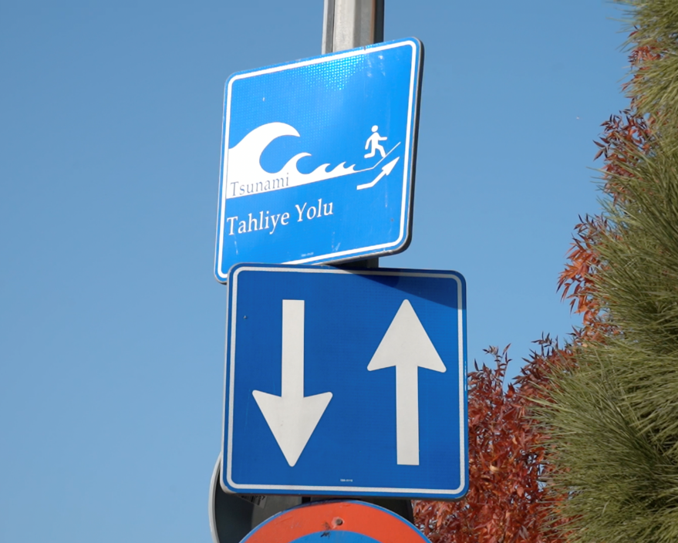
IOC-UNESCO Tsunami Ready Recognition Programme (TRRP) Workshop
Problems & Results:
Many problems solved with the collaboration of IMM with UKOME (Directorate General of Transportation and Coordination )
i. Objections to the installation of the signage at Büyükada district solved by UKOME.
ii. Infrastructure problems during the installation of signage at Beylerbeyi solved by ISKI.
iii. Installations cut by the complaints due to the excavation waste. IMM solved the problems by performing some additional landscape design in some regions.

Slide 8
IOC-UNESCO Tsunami Ready Recognition Programme (TRRP) Workshop
Problems & Results (continue…):
iv. Complaints received from the local community during the installation of the signage at Karaköy region, which is mainly caused by the concerns of the community due to the degradation of their property.
(IMM faced with the concerns of the local people which accused IMM, wasting money for useless efforts due to the belief that there is not any risk of tsunami in Istanbul ).
v. Some other difficulties occurred during the information of signage and IMM faced with the enforcement of some local authority (muhtarlık) in order to change the place of the installed signage. Problem solved with personal communication.

Slide 9
IOC-UNESCO Tsunami Ready Recognition Programme (TRRP) Workshop
Ongoing Problems to Solve:
Some of the signage takes place in earthquake assembly area.
This problem will be discussed with AFAD.
According to the ongoing regulations Schools can bot be evacuated to any area rather than the schoolyard. However some of the schools are inside the tsunami inundation area (eg. Büyükçekmece Anadolu Lisesi). This problem will be discussed with AFAD.

Slide 10
UNESCO
Intergovernmental Oceanographic Commission (IOC)
IOC-UNESCO DG ECHO CoastWAVE project
UNESCO IOC Sector Tsunami Unit
d.chang-seng@unesco.org
CoastWAVE project website

