Slide 1
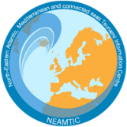
Prep-3: Outreach and public awareness and education resources are available and distributed
Dr. Derya I. VENNIN
Project Coordinator of CoastWAVE
Associate Project Officer at UNESCO-IOC Tsunami Unit
IOC-UNESCO EU DG ECHO CoastWAVE Project
IOC-UNESCO Tsunami Ready Recognition Programme (TRRP) Workshop
Online, February 16-17, 2023

Slide 2
IOC-UNESCO Tsunami Ready Recognition Programme (TRRP) Workshop
Outreach and public awareness and education resources should include:
tsunami evacuation maps, evacuation routes, safe areas, assembly points
safety tips- What to do before, during and after a tsunami
information about when and how to respond to warnings (including natural warnings for regions with a local tsunami threat).

Slide 3
IOC-UNESCO Tsunami Ready Recognition Programme (TRRP) Workshop
All schools within the community requesting recognition should receive a copy of the materials.

Slide 4
IOC-UNESCO Tsunami Ready Recognition Programme (TRRP) Workshop
Three or more outreaching methods should be selected to distribute:
Brochures and flyers distributed
Newspaper inserts.
Public utility/service industry bill safety notices.
Local faith-based and civic organization bulletins/mailings.
Local radio and television.
Billboard, roadside, highway or educational signs.
Historical markers and interpretative signs.
Informational or safety videos.
Public service announcements (voice, video).
Websites/social media.
Games
Bulk email.
The list is also in MG 74.

Slide 5
IOC-UNESCO Tsunami Ready Recognition Programme (TRRP) Workshop
Examples of education and outreach materials
Public awareness and education brochures and flyers

Slide 6
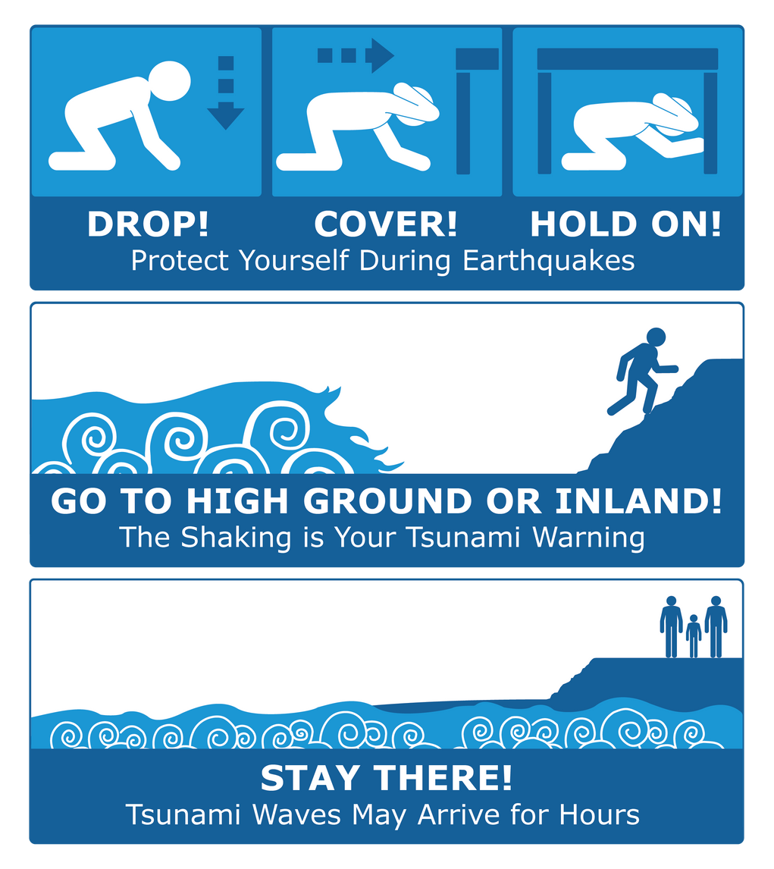
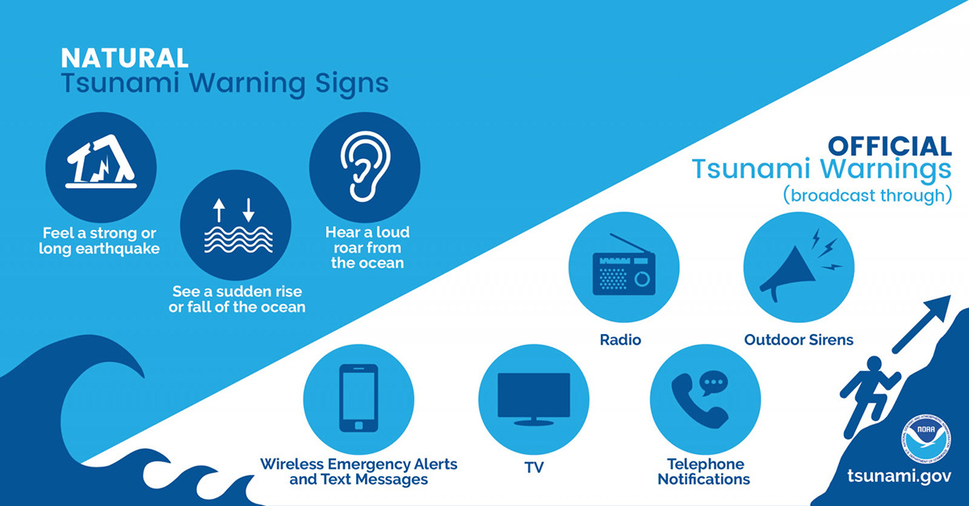
IOC-UNESCO Tsunami Ready Recognition Programme (TRRP) Workshop
Examples of education and outreach materials
Public awareness and education brochures and flyers

Slide 7
IOC-UNESCO Tsunami Ready Recognition Programme (TRRP) Workshop
Examples
Websites/Social Media

Slide 8
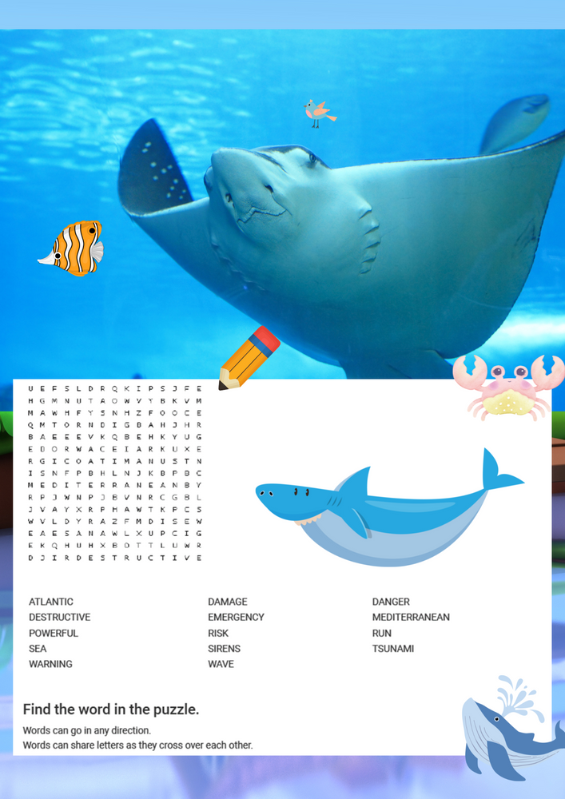
IOC-UNESCO Tsunami Ready Recognition Programme (TRRP) Workshop
Examples of education and outreach materials
Public awareness and education materials for kids (games, puzzles, toys etc.)

Slide 9
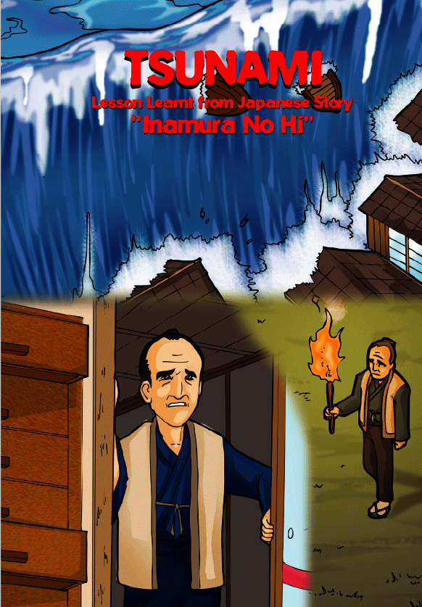
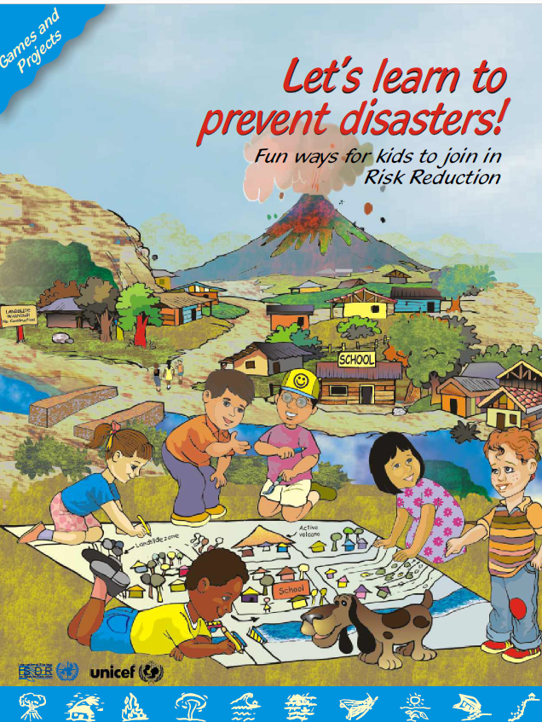
IOC-UNESCO Tsunami Ready Recognition Programme (TRRP) Workshop
Examples of education and outreach materials
Public awareness and education materials for kids (games, puzzles, toys etc.)

Slide 10
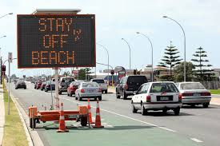
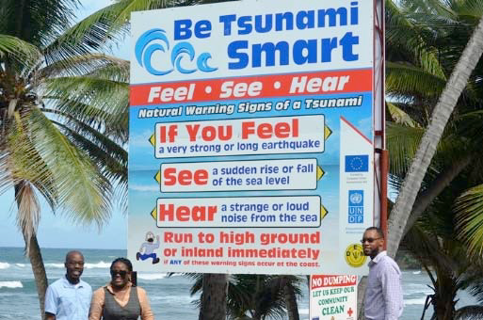
IOC-UNESCO Tsunami Ready Recognition Programme (TRRP) Workshop
Examples of education and outreach materials
Billboard/road signs, highway or educational signs
Signs should be: simple, clear, quick to read and easy to understand

Slide 11
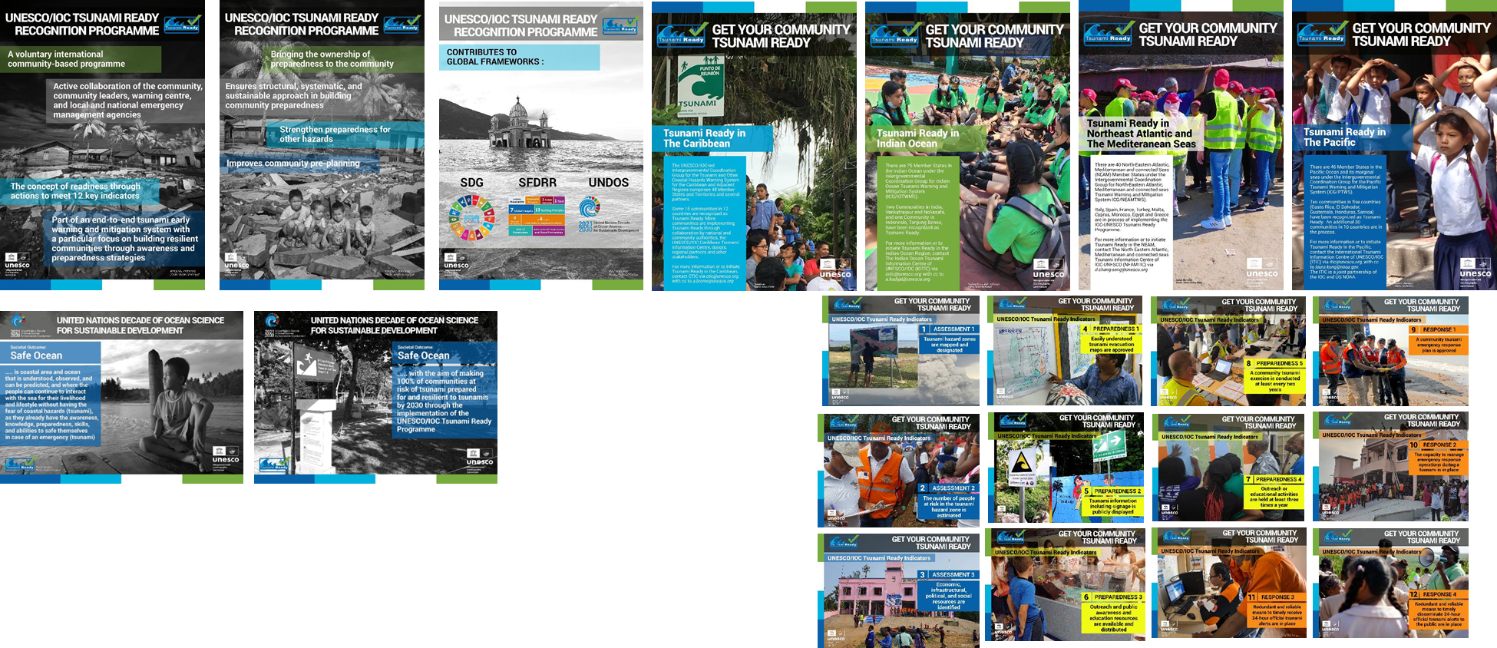
IOC-UNESCO Tsunami Ready Recognition Programme (TRRP) Workshop
Examples of education and outreach materials
(Tsunami Ready)
Ref: IOTIC

Slide 12
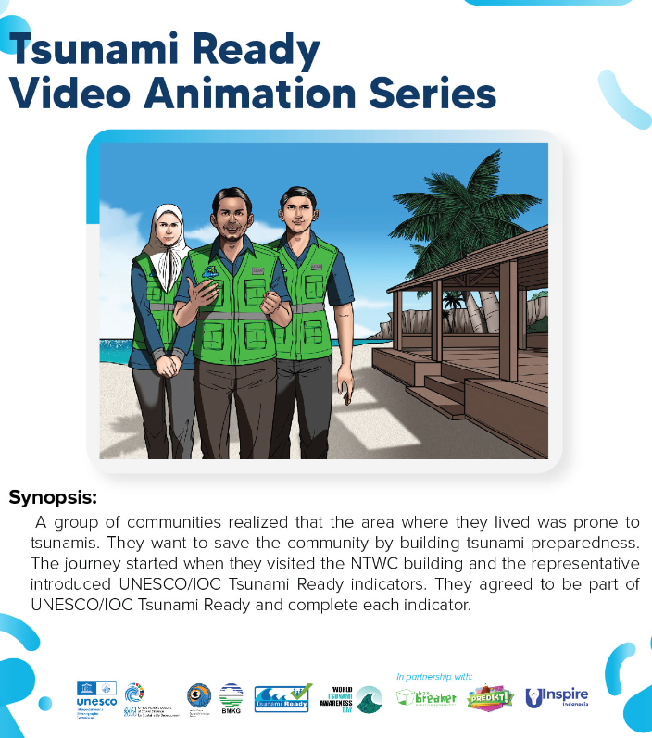
IOC-UNESCO Tsunami Ready Recognition Programme (TRRP) Workshop
Examples of education and outreach materials
(Tsunami Ready)
Informational /Safety Videos
Ref: IOTIC

Slide 13
IOC-UNESCO Tsunami Ready Recognition Programme (TRRP) Workshop
Examples of education and outreach materials
(Tsunami Ready)
Public awareness and education materials for kids (games, puzzles, toys etc.)

Slide 14
Pop-up Question
Name a location/place to distribute outreach materials

Slide 15
IOC-UNESCO Tsunami Ready Recognition Programme (TRRP) Workshop
Where to distribute ?
Schools
Visitor centres and local tourist businesses (e.g. restaurants, bars)
Hotels, motels and campgrounds
Public libraries
Community centres, recreation centres
Kiosks or information centres (e.g. malls, stores, etc.)
Childcare centres
Banks
Utility companies
Health centres
Transportation centres (bus, train, transit stops or central stations)
Ports of entry (airports, harbors)

Slide 16
IOC-UNESCO Tsunami Ready Recognition Programme (TRRP) Workshop
Remarks
Find the most effective ways according to the local circumstances (culture, communication etc.)
Select a Location for physical distribution of outreach materials that can give the maximum awareness raising impact.
Ex: schools, hotels, visitor centres, public libraries, community centres, health centres

Slide 17
UNESCO
Intergovernmental Oceanographic Commission (IOC)
IOC-UNESCO DG ECHO CoastWAVE project
UNESCO IOC Sector Tsunami Unit
d.chang-seng@unesco.org
CoastWAVE project website
@coastwaveproject

