Slide 1
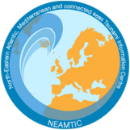
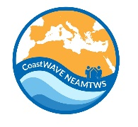
Prep-4: Outreach or Educational Activities are Held at Least
Three Times a Year
Ms. Elena DASKALAKI
Earthquake/Tsunami Analyst at the National Observatory of Athens (NOA)
IOC-UNESCO EU DG ECHO CoastWAVE Project
IOC-UNESCO Tsunami Ready Recognition Programme (TRRP) Workshop
Online, February 16-17, 2023

Slide 2
IOC-UNESCO Tsunami Ready Recognition Programme (TRRP) Workshop
The Tsunami Ready Recognition Programme Guidelines include five indicators for Preparedness (PREP).
PREP-1. Easily understood tsunami evacuation maps are approved
PREP-2. Tsunami information including signage is publicly displayed
PREP-3. Outreach and public awareness and education resources are available and distributed.
PREP-4. Outreach or educational activities are held at least three times a year.
PREP-5. A community tsunami exercise is conducted at least every two years.
PREP-4. Outreach or educational activities are held at least three times a year
(IOC Manuals and Guides, 74, 17-18 p.)
Public outreach and educational activities should be conducted annually in the community.
The aim is to educate community residents, businesses, and visitors, with an emphasis on those in the tsunami hazard zone, on tsunami hazards, evacuation routes, how warning information will be received (including natural warnings for regions with a local tsunami threat), safety, and response.
These activities may be multi-hazard as long as they include tsunamis in the content. The number of activities required for a given community will be three, where at least one is a community-wide event. The TRB may determine another amount.

Slide 3
IOC-UNESCO Tsunami Ready Recognition Programme (TRRP) Workshop
Acceptable activities include, but are not limited to:
Leveraging of national, state and regional campaigns, including use of social media.
Multi-hazard events or presentations.
Booths at community events and fairs.
Community tsunami safety workshops, town hall or similar public meetings.
Presentations or workshops for faith-based or cultural organizations, community or civic groups.
Local public safety campaigns, such as “Tsunami Preparedness” week/month.
Media workshops.
Local business workshops to help them develop response and business continuity plans.
Information for business owners for employee training, outreach or education that targets high-occupancy businesses in tsunami hazard zones (e.g. hotels, restaurants, fisheries, industrial sites).
Door-to-door safety campaigns targeted to residents and businesses living or working in the community’s tsunami hazard zone.

Slide 4
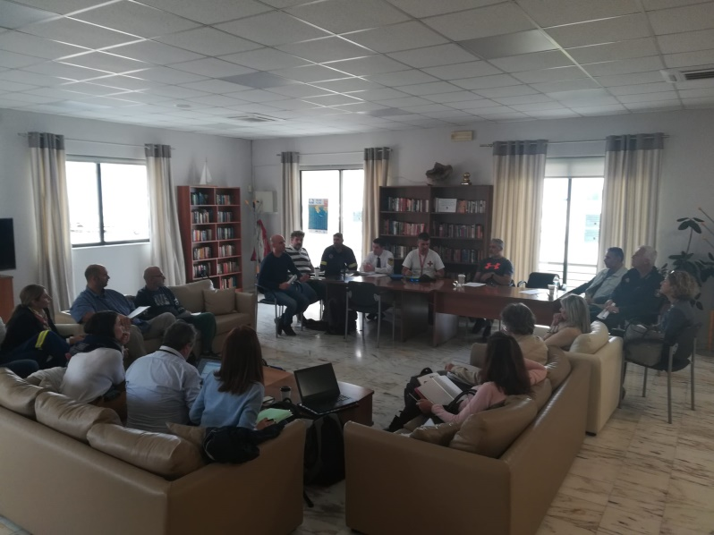
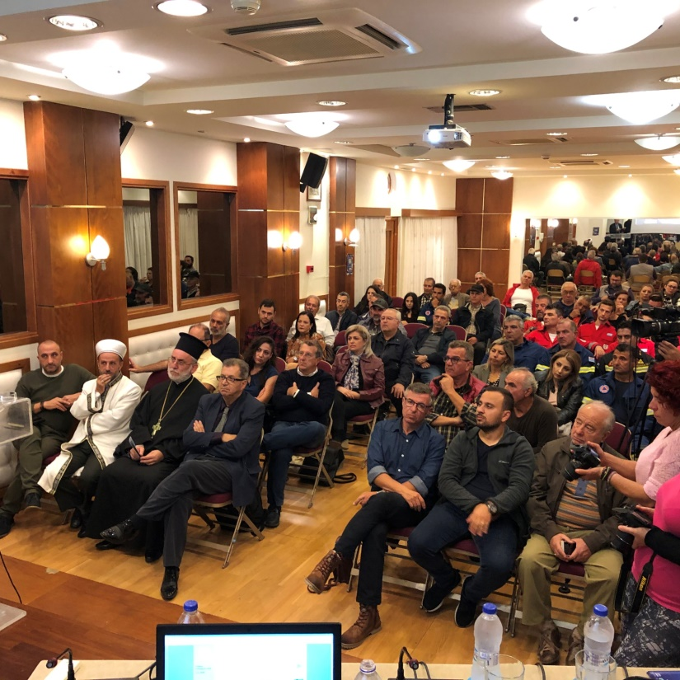
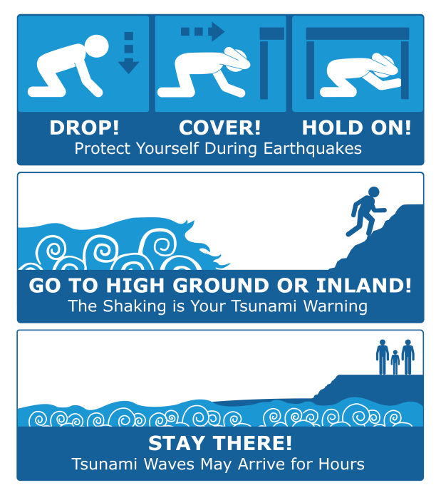
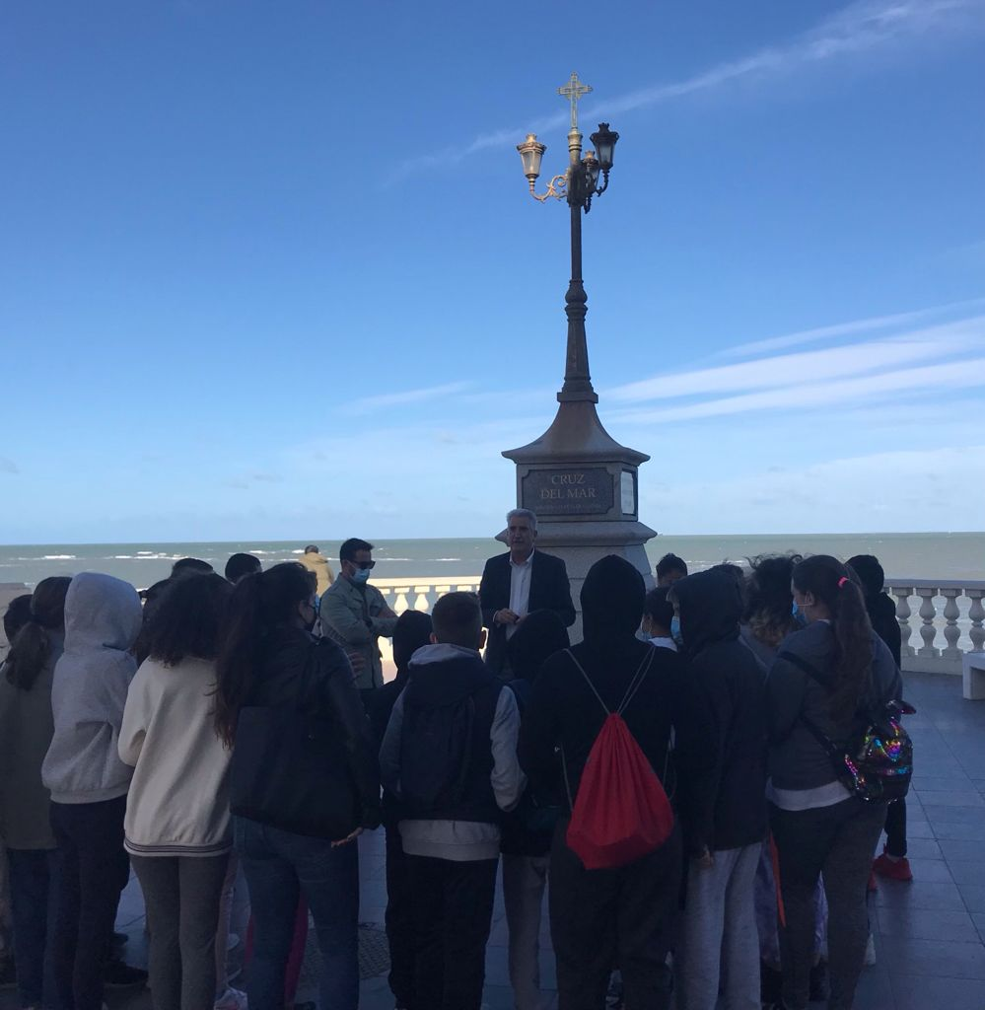
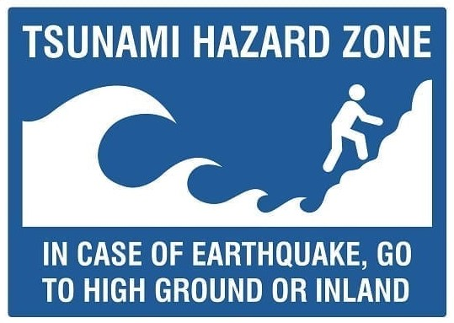
IOC-UNESCO Tsunami Ready Recognition Programme (TRRP) Workshop
Examples of Community Educational Outreach Activities
Presentations in Schools
Community talks / Table talks
Posters / Flyers
Local Knowledge
Understanding of signs

Slide 5
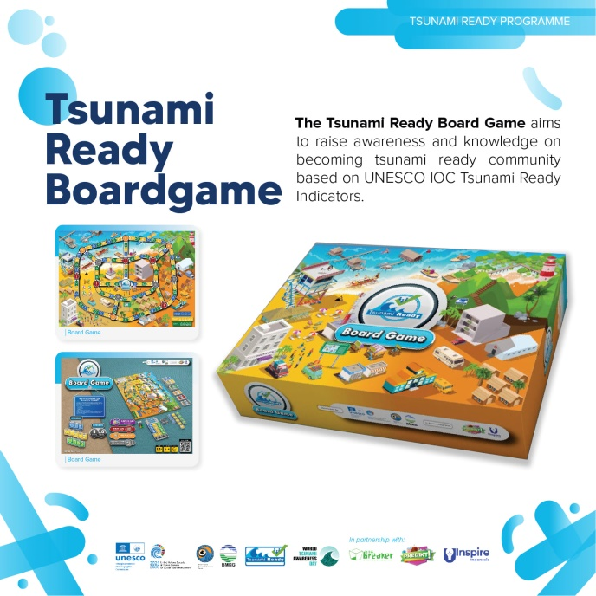
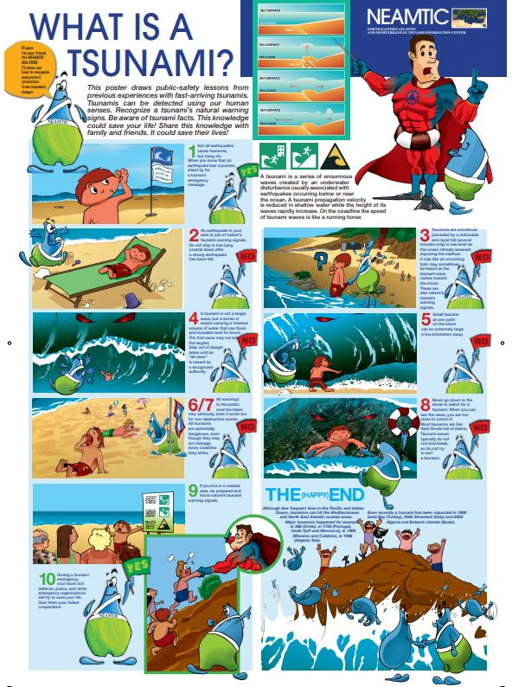
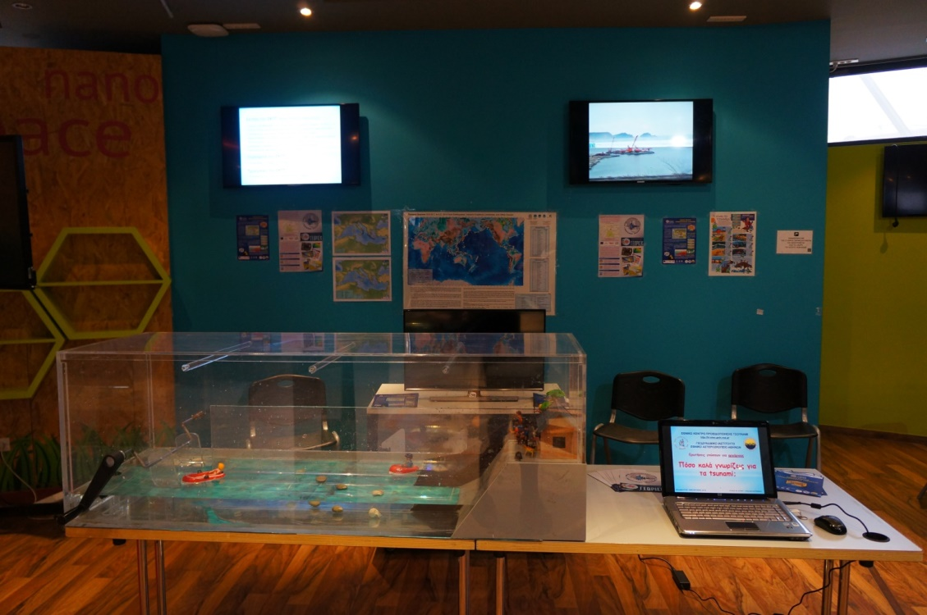
IOC-UNESCO Tsunami Ready Recognition Programme (TRRP) Workshop
Educational material
Tsunami and earthquake videos
Interactive tsunami quiz-game
Water-tank for simplistic tsunami simulation
Printed material

Slide 6
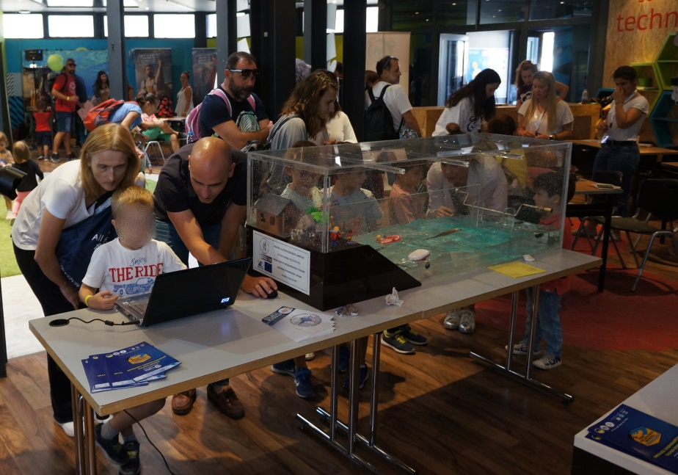
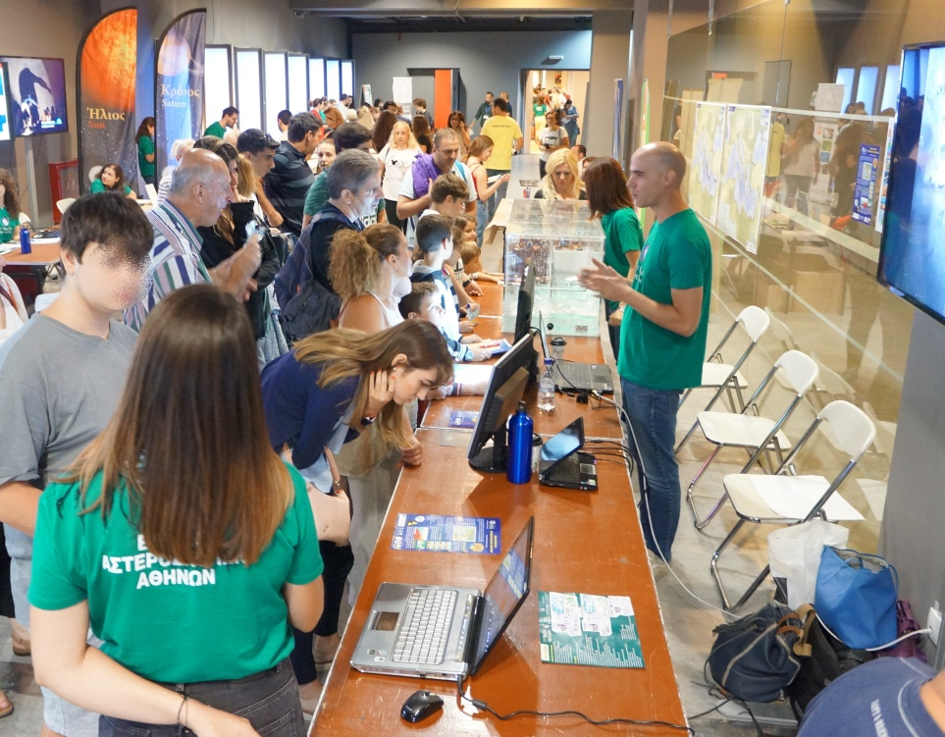
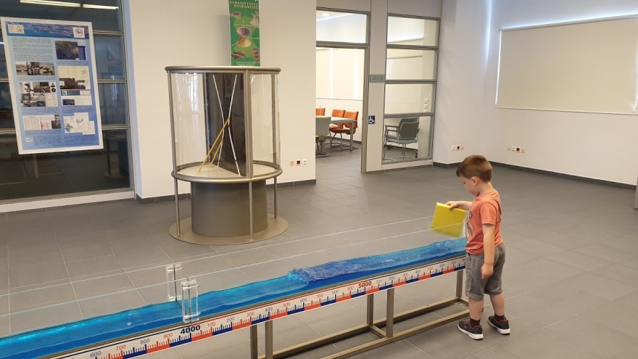
IOC-UNESCO Tsunami Ready Recognition Programme (TRRP) Workshop
Public Awareness Sessions
Exhibitions for public
Play based education for kids
Multi-hazard events or presentations
Social Media

Slide 7
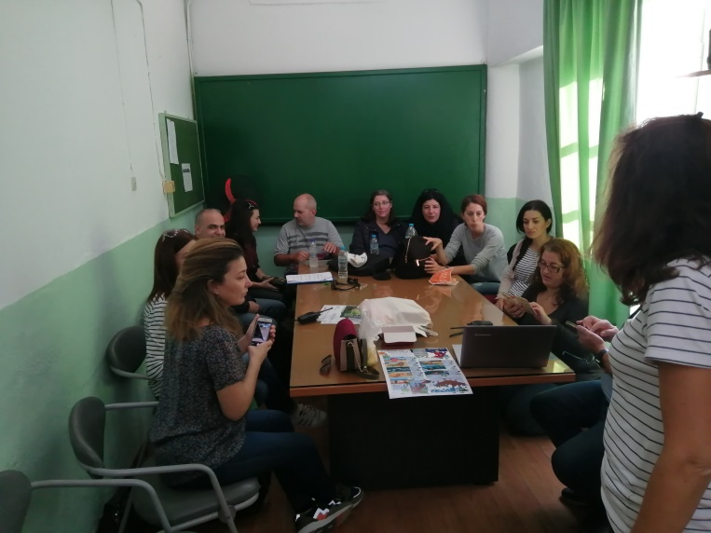
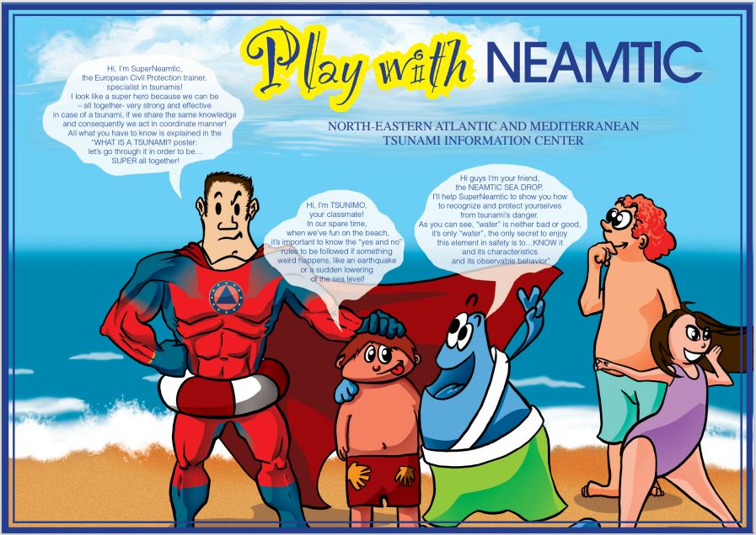
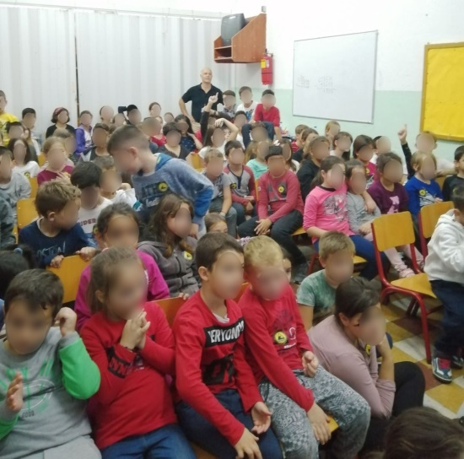
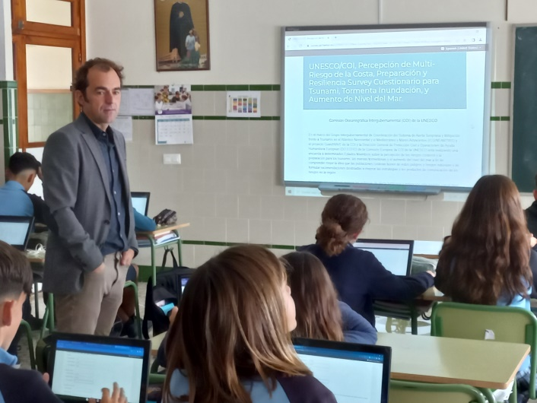
IOC-UNESCO Tsunami Ready Recognition Programme (TRRP) Workshop
Presentations in Schools
Lectures to pupils/students
Lectures to teachers
Comic books
Colouring pages
Let’s get creative!

Slide 8
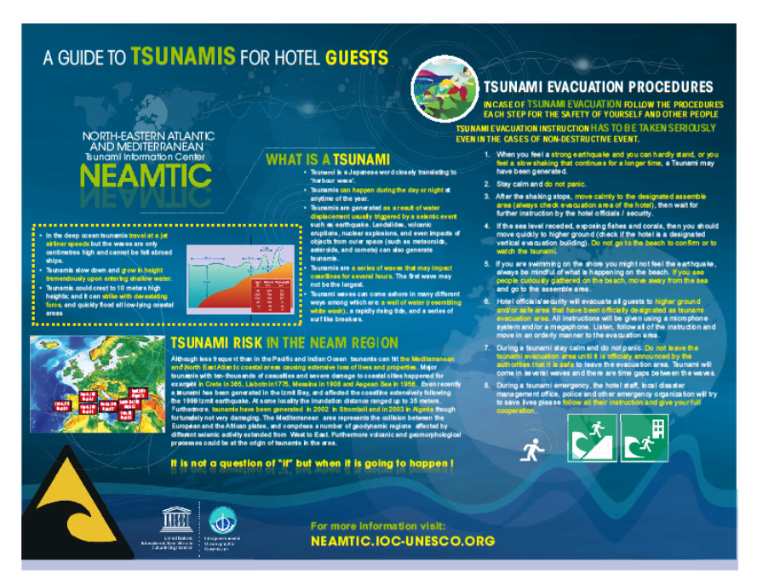
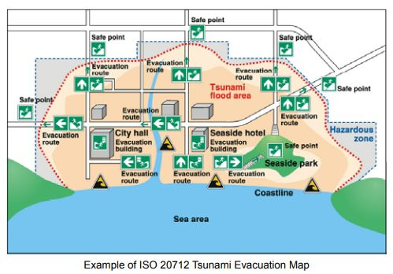
IOC-UNESCO Tsunami Ready Recognition Programme (TRRP) Workshop
Tourist Information
Multi-hazard information board and flyers
Multi-hazard events or presentations
Evacuation Strategy
Webpages
Source: A GUIDE TO TSUNAMIS FOR HOTELS, Tsunami Evacuation, Procedures Evacuation Strategy

Slide 9
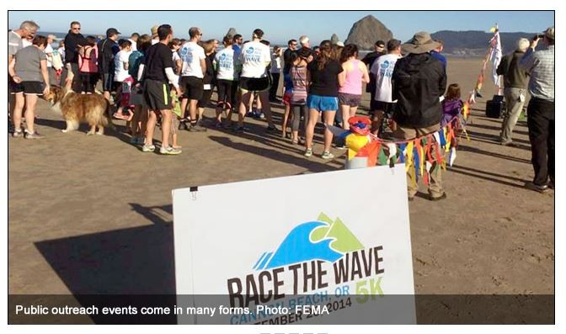
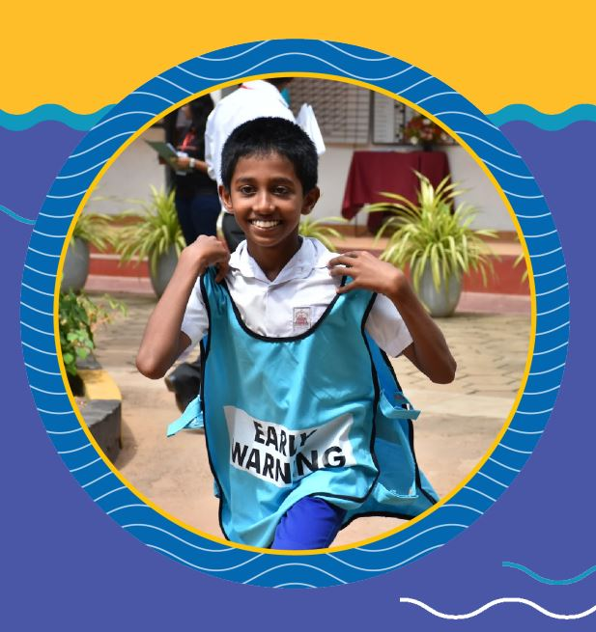
IOC-UNESCO Tsunami Ready Recognition Programme (TRRP) Workshop
Tsunami Walk - Tsunami Run
Organize in a community level a tsunami Walk
Organize in a community level a tsunami Run
PREPARE. PRACTICE. REPEAT.

Slide 10
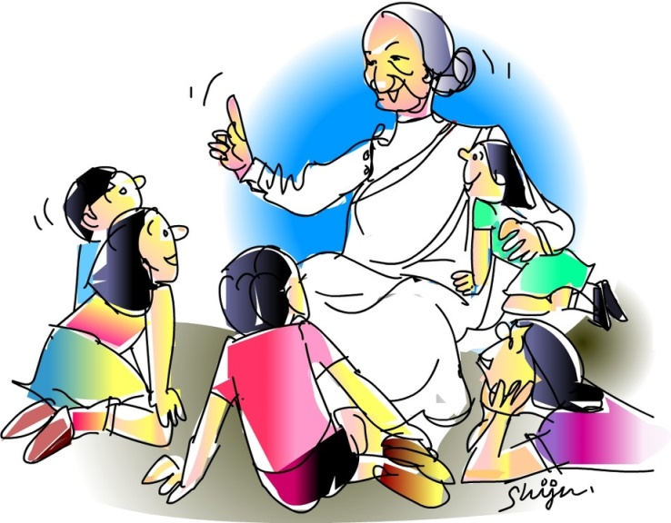
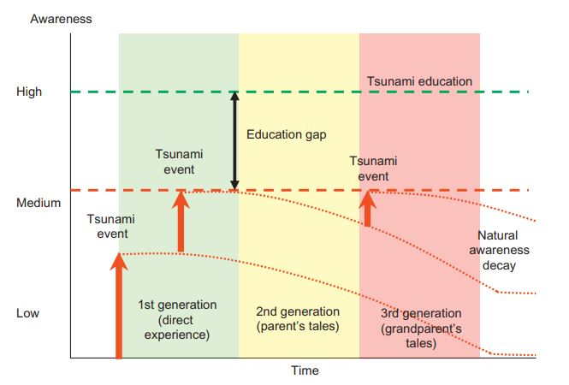
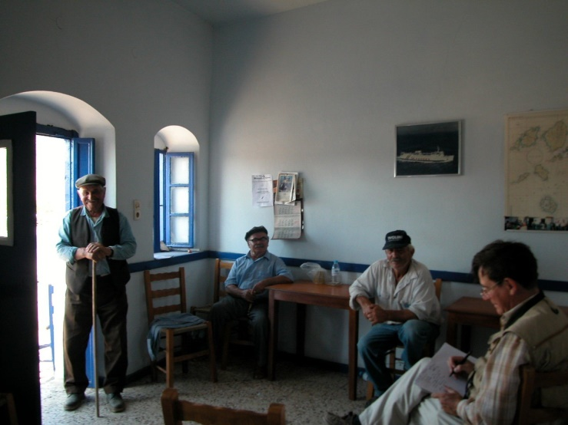
IOC-UNESCO Tsunami Ready Recognition Programme (TRRP) Workshop
Decay of Tsunami Awareness in time
Source: “The Emergence of Global Tsunami Awareness: Analysis of Disaster Preparedness in Chile, Indonesia, Japan, and Vietnam” Esteban, M et al. (2015) https://doi.org/10.1016/B978-0-12-801060-0.00011-3
Prof. Emile Okal interview eyewitnesses of 1956 Amorgos tsunami. Photo credit: [Prof. C. Synolakis]

Slide 11
UNESCO
Intergovernmental Oceanographic Commission (IOC)
IOC-UNESCO DG ECHO CoastWAVE project
UNESCO IOC Sector Tsunami Unit
d.chang-seng@unesco.org
CoastWAVE project website

