Slide 1
Prep-5: A Community Tsunami Exercise is Conducted
at Least Every Two Years
Mr. Matthieu PÉROCHE
Lecturer in Geography at the Paul Valery Montpellier 3 University
IOC-UNESCO EU DG ECHO CoastWAVE Project
IOC-UNESCO Tsunami Ready Recognition Programme (TRRP) Workshop
Online, February 16-17, 2023

Slide 2
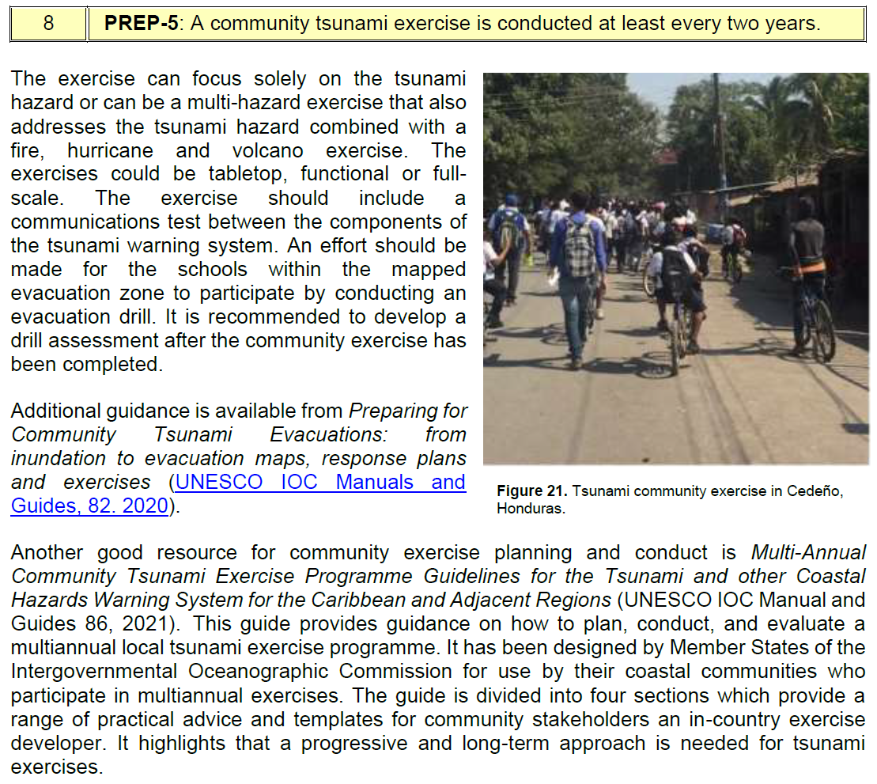
IOC-UNESCO Tsunami Ready Recognition Programme (TRRP) Workshop
TSUNAMI READY INDICATORS
II PREPAREDNESS (PREP)
PREP-1. Easily understood tsunami evacuation maps are approved.
PREP-2. Tsunami information including signage is publicly displayed.
PREP-3. Outreach and public awareness and education resources are available
and distributed.
PREP-4. Outreach or educational activities are held at least three times a year.
8 PREP-5: A community tsunami exercise is conducted at least every two years.

Slide 3
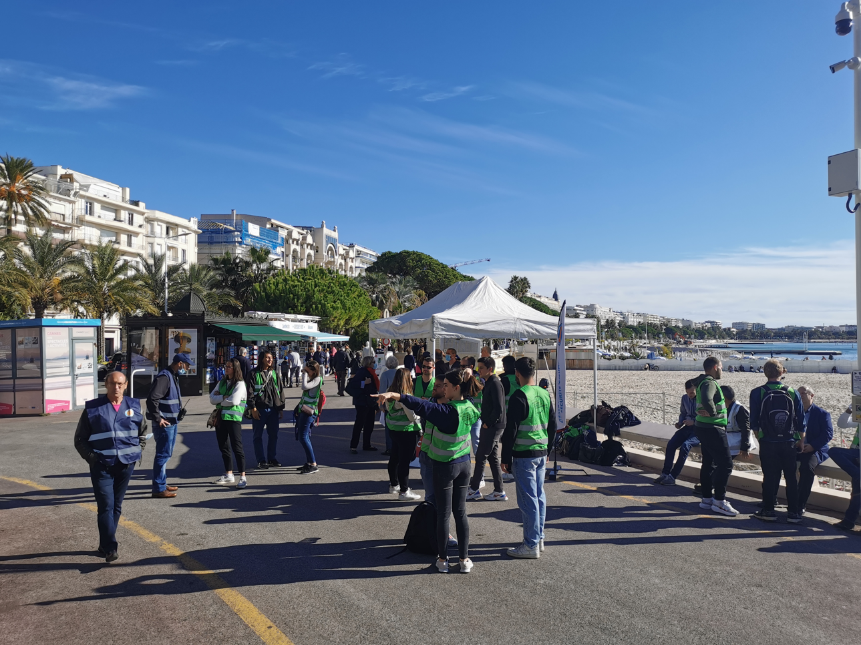
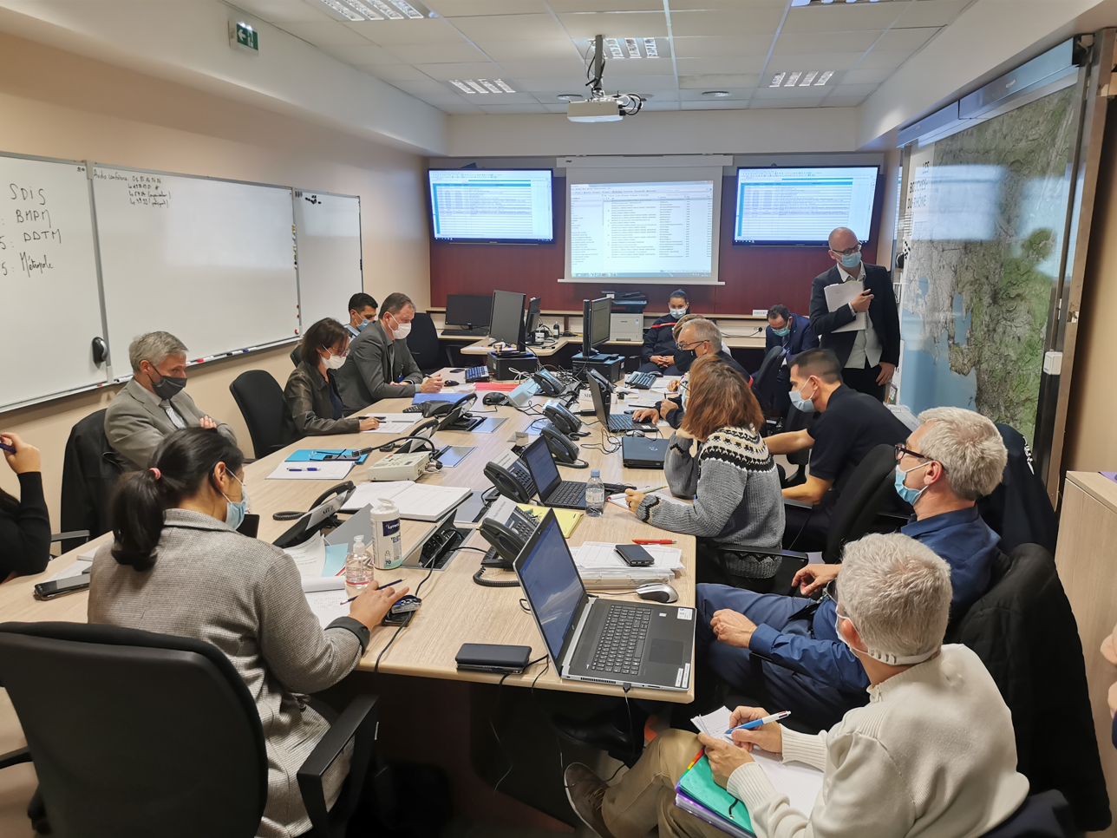
IOC-UNESCO Tsunami Ready Recognition Programme (TRRP) Workshop
Tsunami hazard requires a simultaneous response by national, regional and local emergency services
Tsunami exercises bring every Tsunami Ready criteria to practice
Cannes – Tsunami Awarness Day 2021
A progressive and long-term approach is needed for tsunami exercices
Cannes – Tsunami Awarness Day 2021

Slide 4
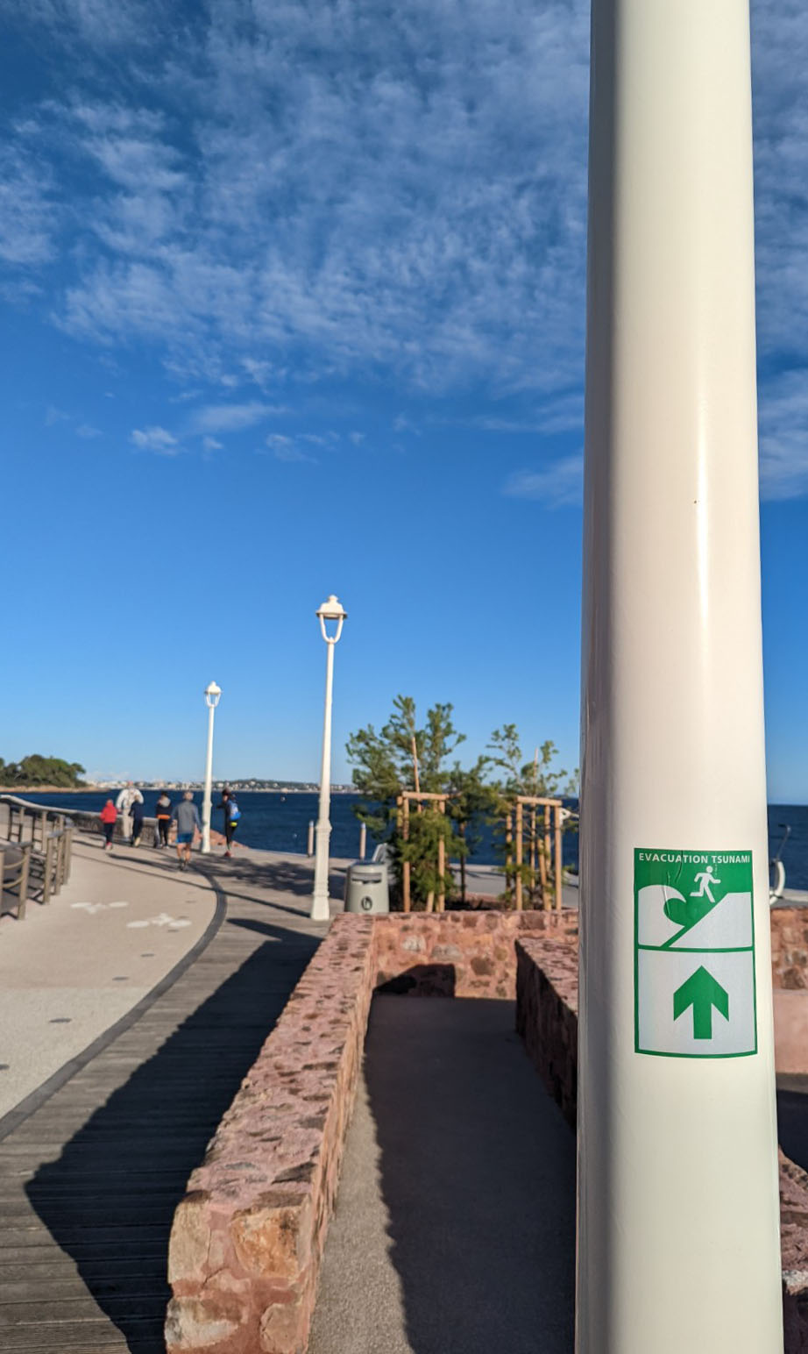
IOC-UNESCO Tsunami Ready Recognition Programme (TRRP) Workshop
COMMUNITY TSUNAMI EXERCISE : OBJECTIVES
To test the effectiveness of tsunami warnings, evacuation maps, plans and procedures
To identify improvements to be made
To train actors of crisis management and local representatives
To promote public awareness and preparedness.
Cannes – France - Mediterranean sea – 2022

Slide 5
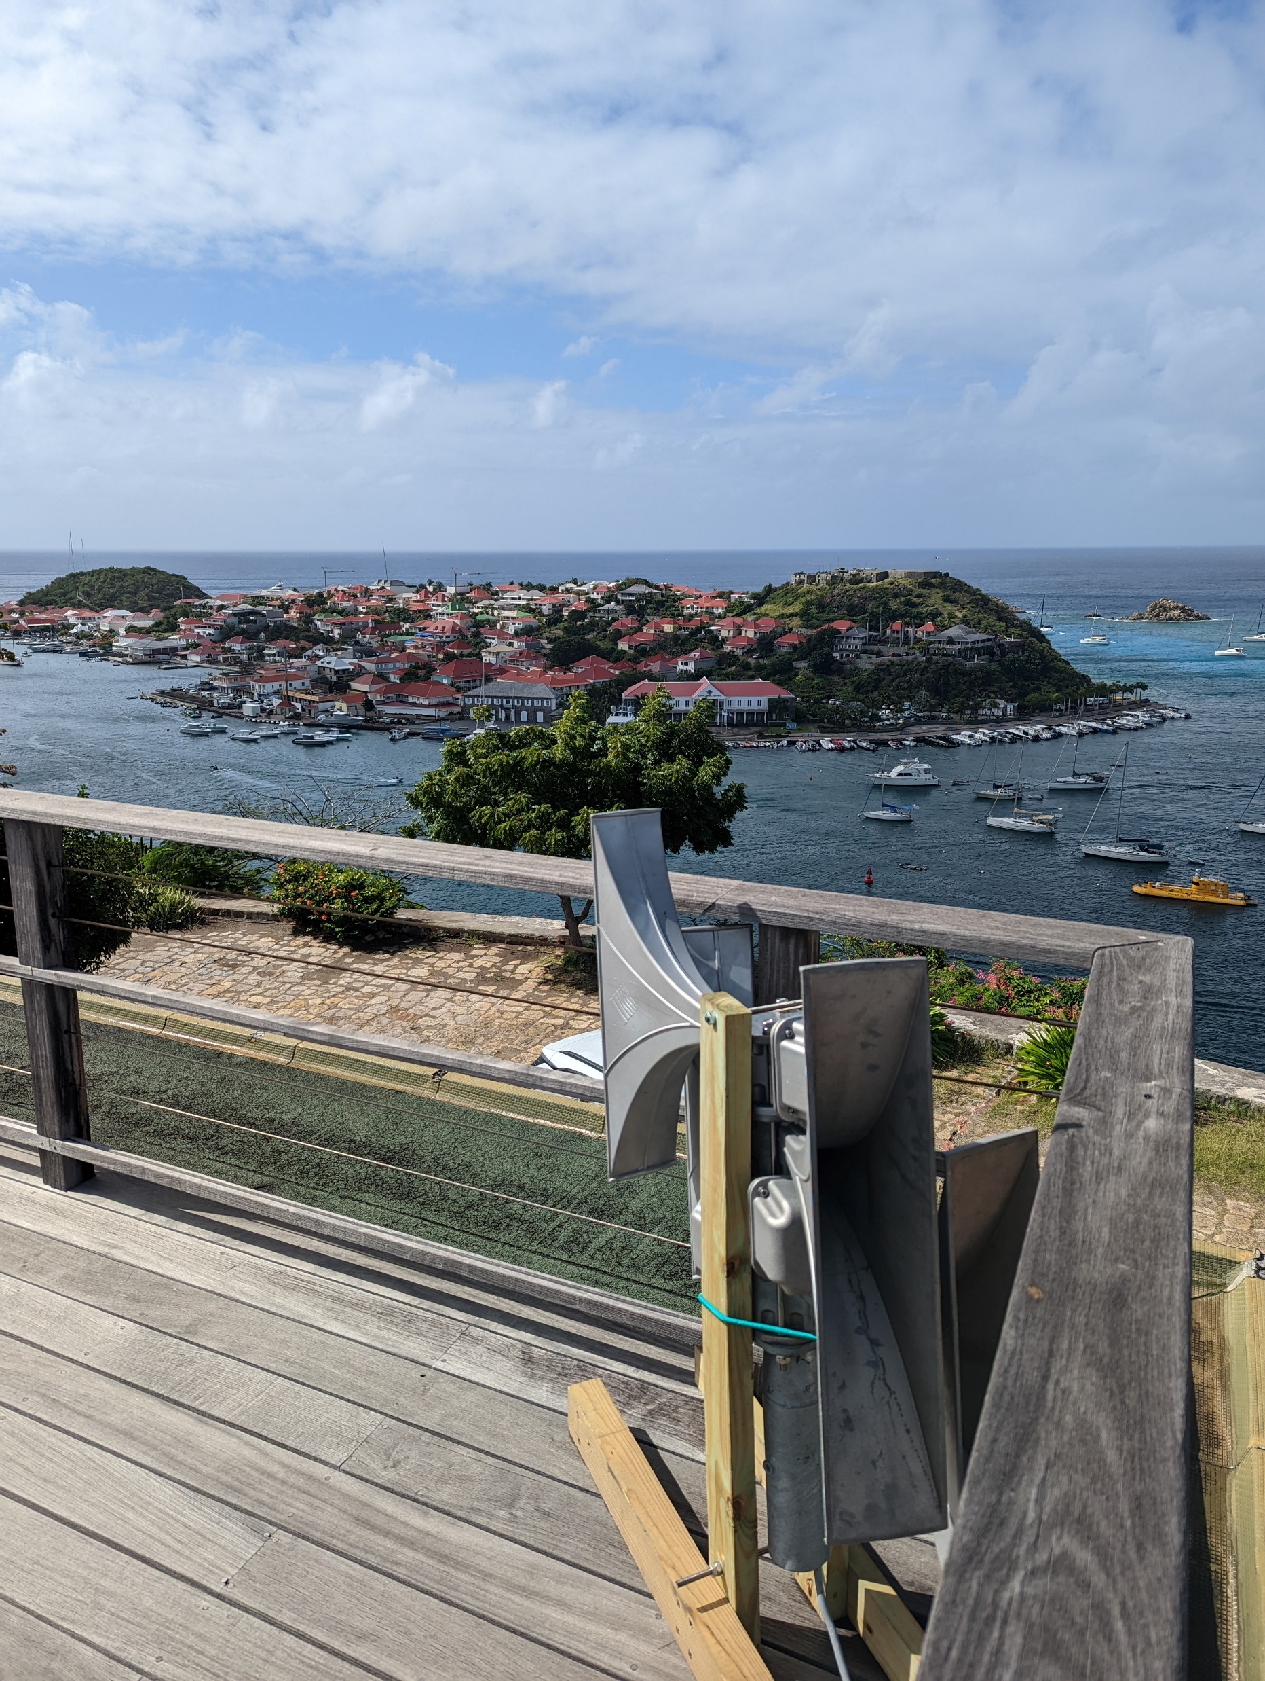
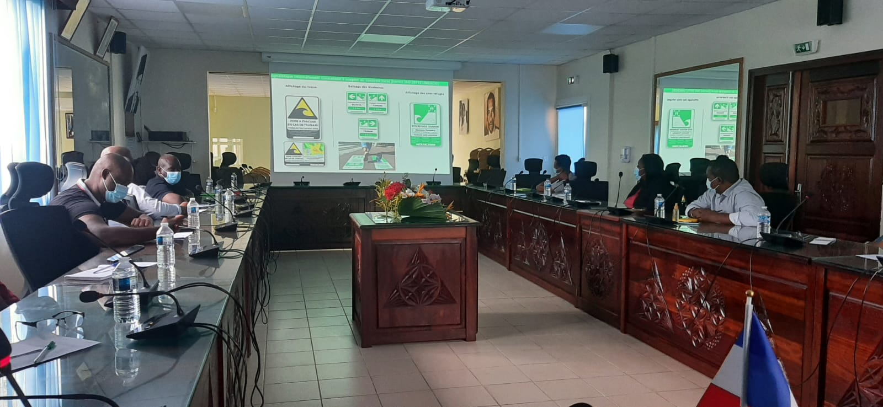
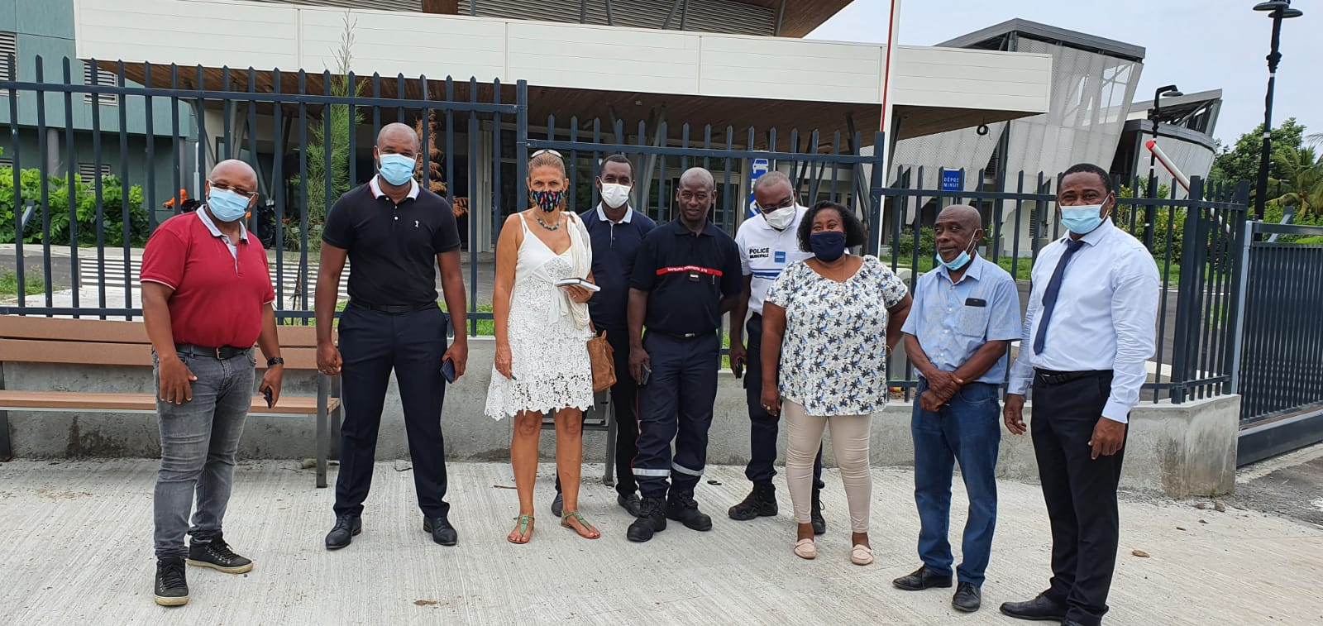
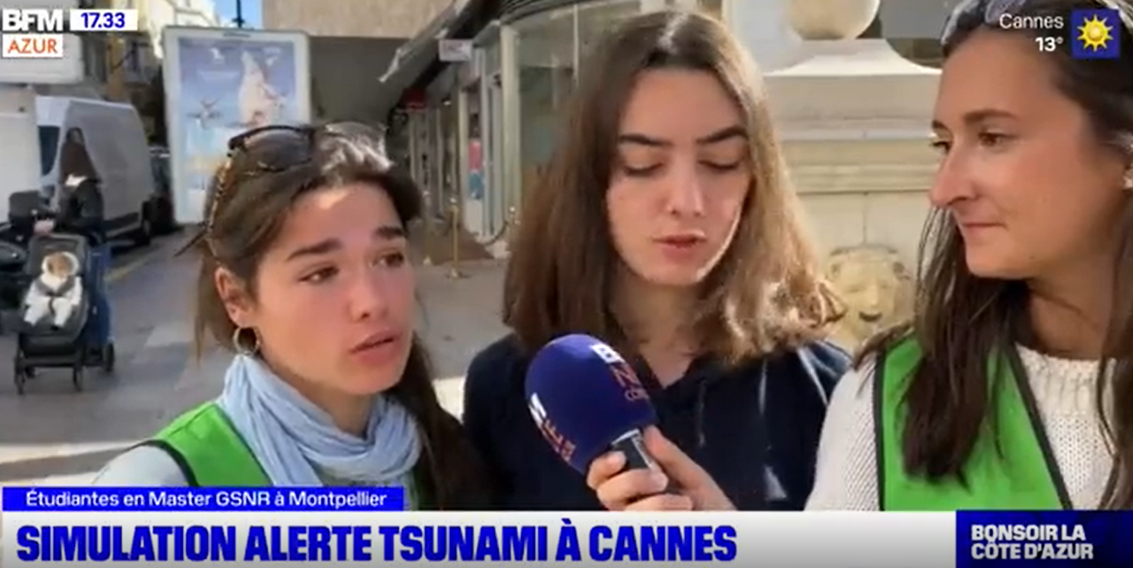
IOC-UNESCO Tsunami Ready Recognition Programme (TRRP) Workshop
MAIN TYPES OF EXERCISES
Testing the new electronic sirens
DRILL
Drill exercice focus on detailed arrangements for testing specific operation or function in a single organization, facility, or agency such as a hotel, school, village, etc.
Testing the loud speakers
Saint Barthelemy – FWI – Caribbean Sea
CaribeWave 2022
Mayotte – Indian Ocean
2022
Testing evacuation plan (routes, refuge sites)
Cannes - Mediterranean sea – Tsunami Awarness Day 2021

Slide 6
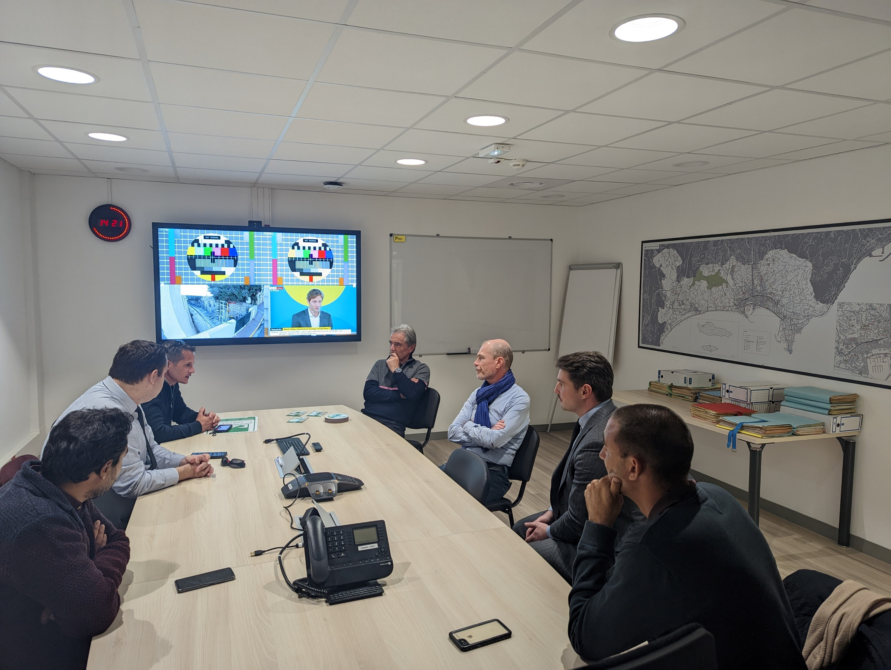
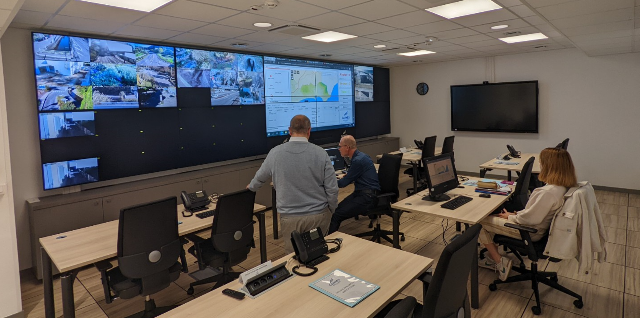
IOC-UNESCO Tsunami Ready Recognition Programme (TRRP) Workshop
MAIN TYPES OF EXERCISES
DRILL
TABLETOP
A tabletop exercise may be referred to a discussion exercise which are desk-based activities.
This type of exercise is intended to generate discussion of issues related to the state of emergency.
New crisis centers in the municipality of Cannes

Slide 7
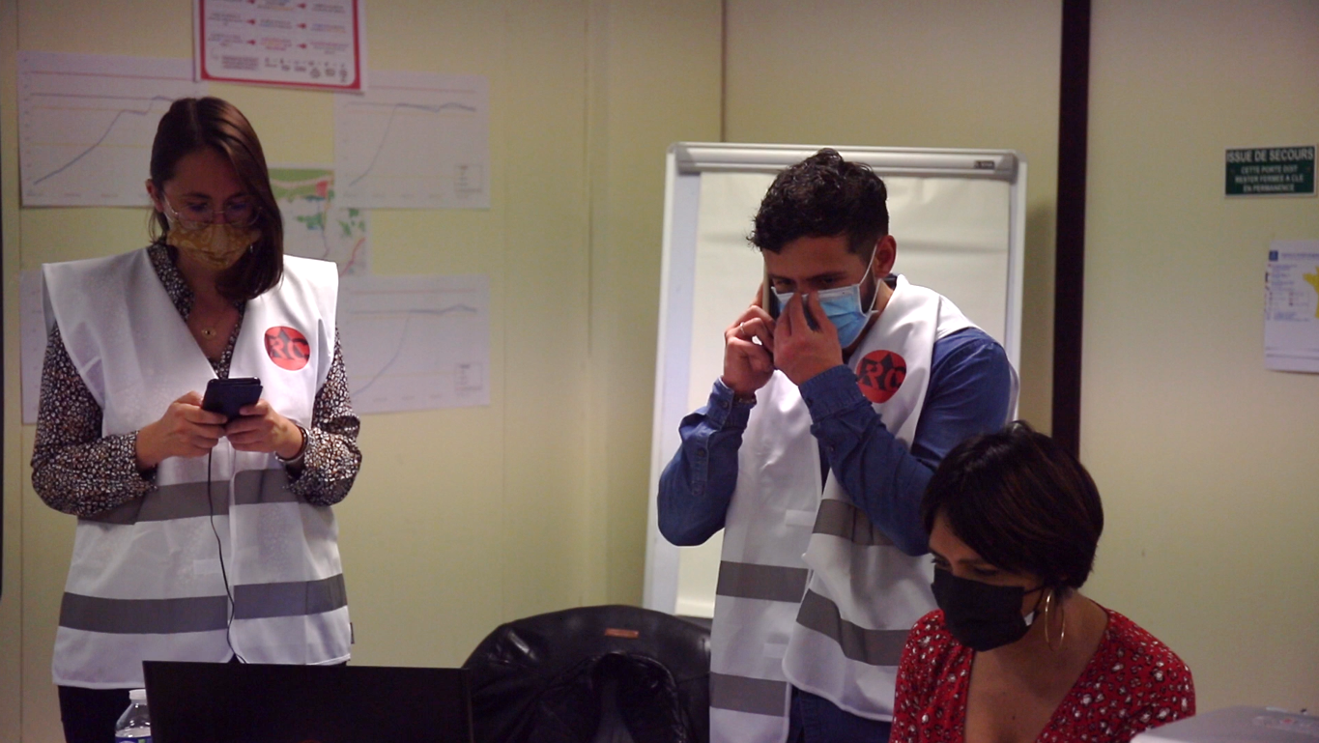
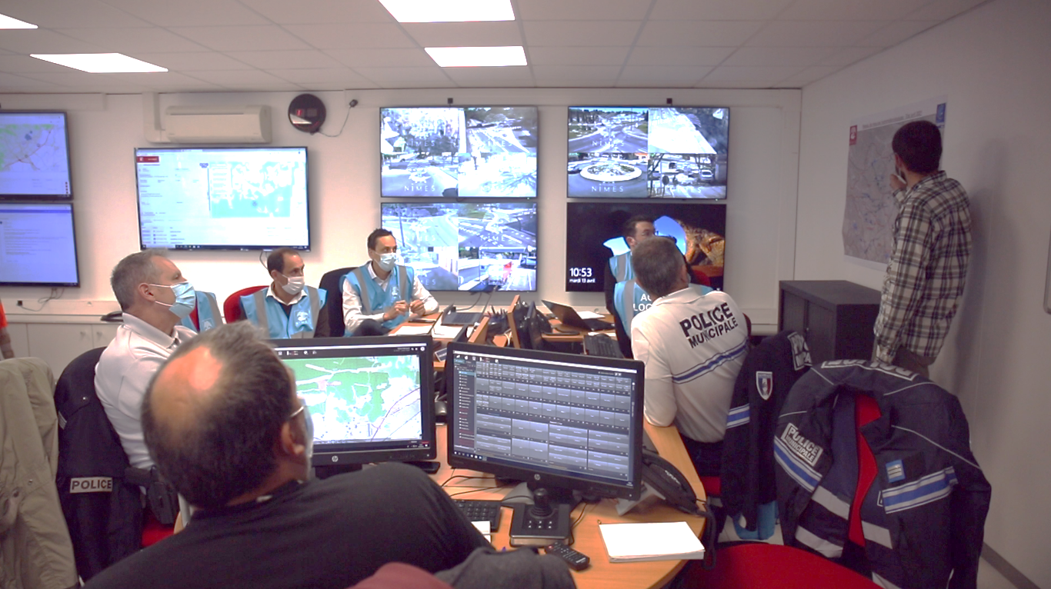
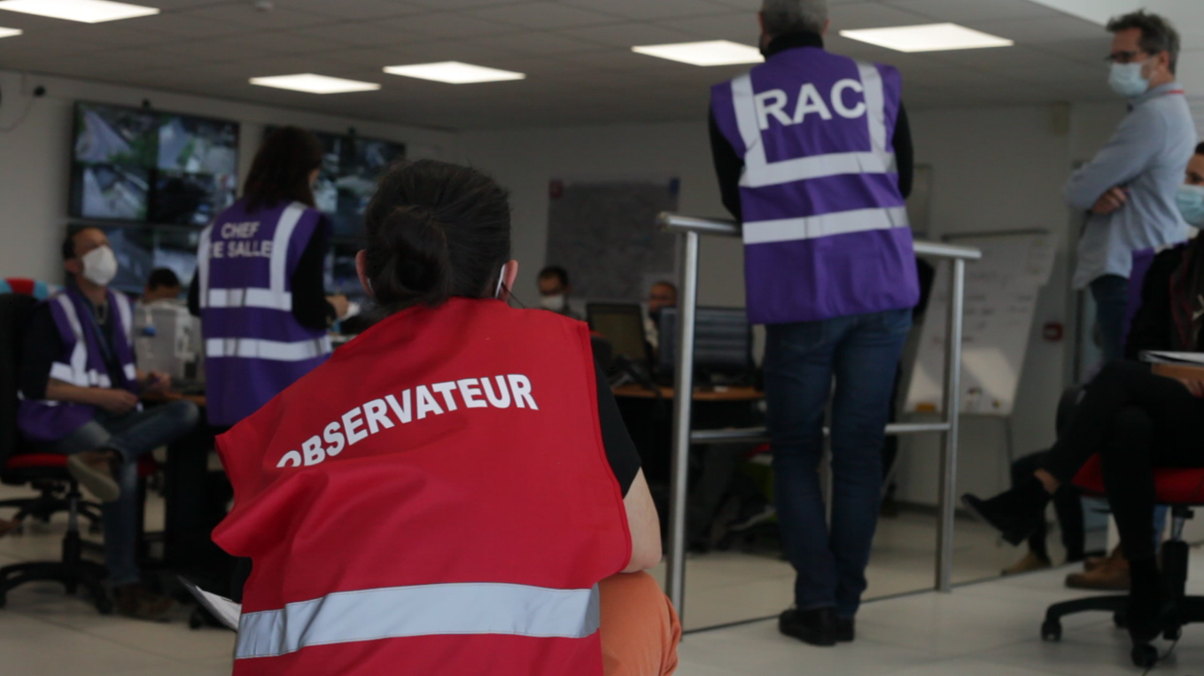
IOC-UNESCO Tsunami Ready Recognition Programme (TRRP) Workshop
MAIN TYPES OF EXERCISES
DRILL
TABLETOP
FUNCTIONAL
Functional exercise is simulated and takes place in an operational environment that requires participants to perform the functions of their roles. These participants interact with the exercise control group who provide prewritten injects and respond to questions and task developing out of the exercise. Functional exercises usually focus on testing plans, policies, and procedures.
DELIVERY TEAM
PARTICIPANTS
EVALUATION TEAM
Photo credits : RisCrises

Slide 8
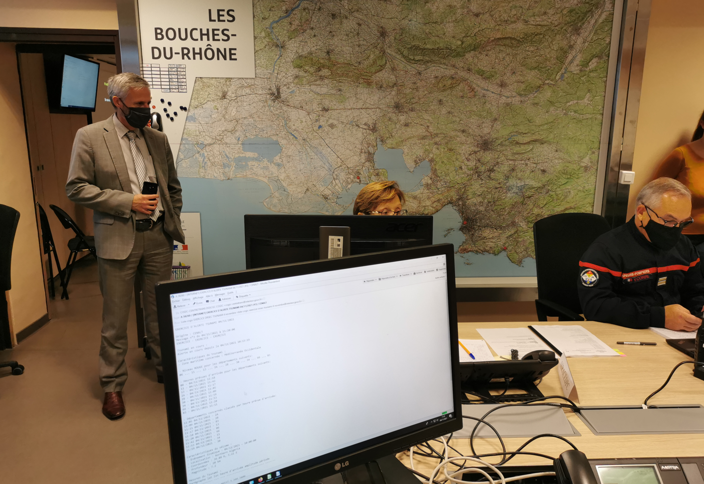
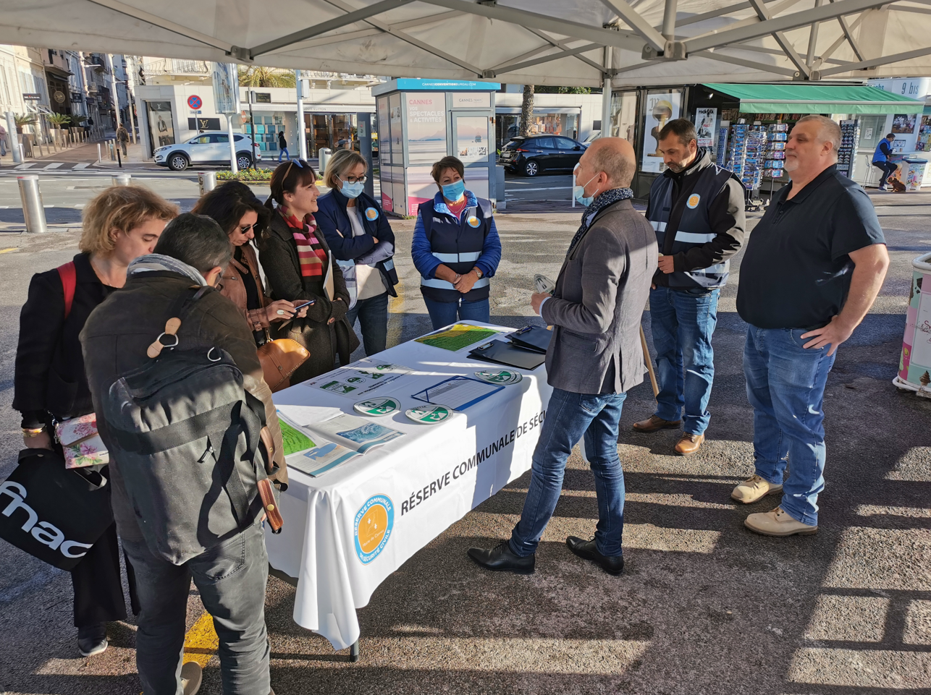
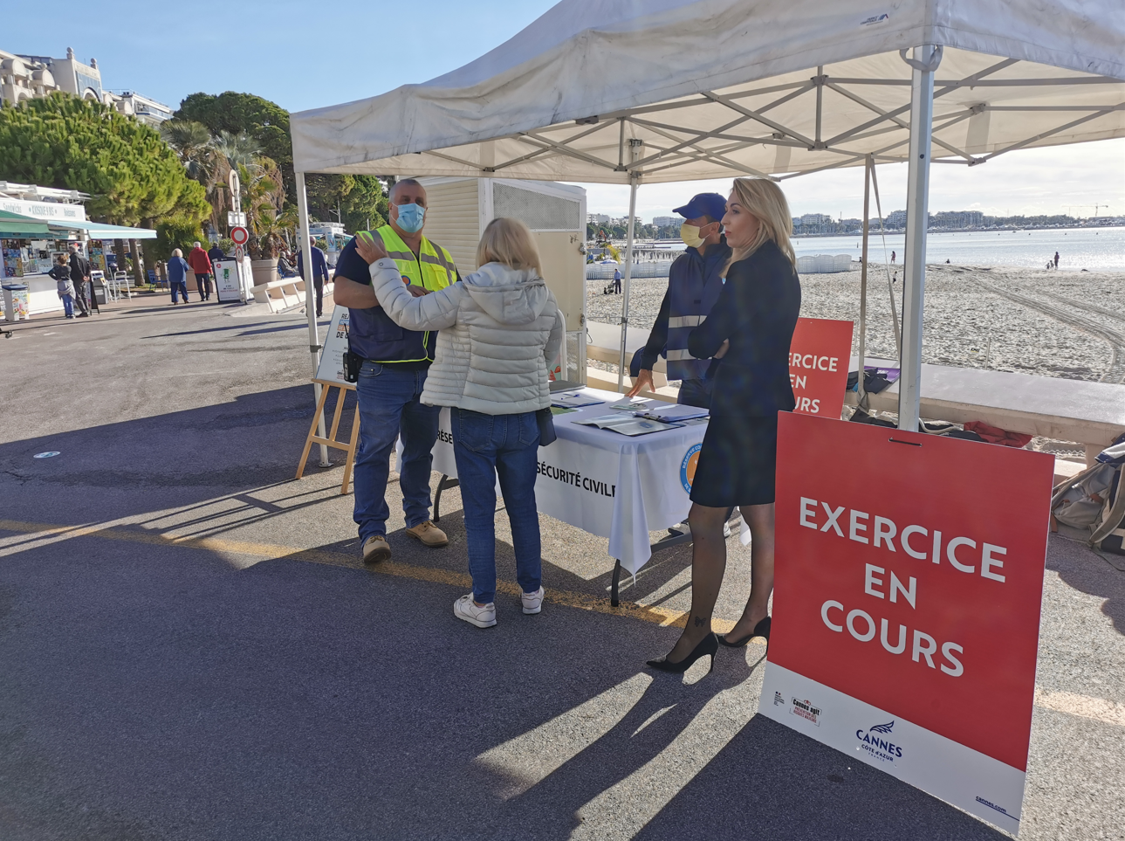
IOC-UNESCO Tsunami Ready Recognition Programme (TRRP) Workshop
MAIN TYPES OF EXERCISES
DRILL
TABLETOP
FUNCTIONAL
FULL-SCALE (or field exercice)
These exercises are used to test all aspects of the warning and emergency management systems and processes, such as the practicality and communication methods. They are useful to assess and improve operational activity, interagency cooperation, testing resources and personal allocation, manage the public and media, and test equipment capabilities.
Bouche du Rhône prefecture – 4 novembre 2021
Cannes municipality – 5 novembre 2022

Slide 9
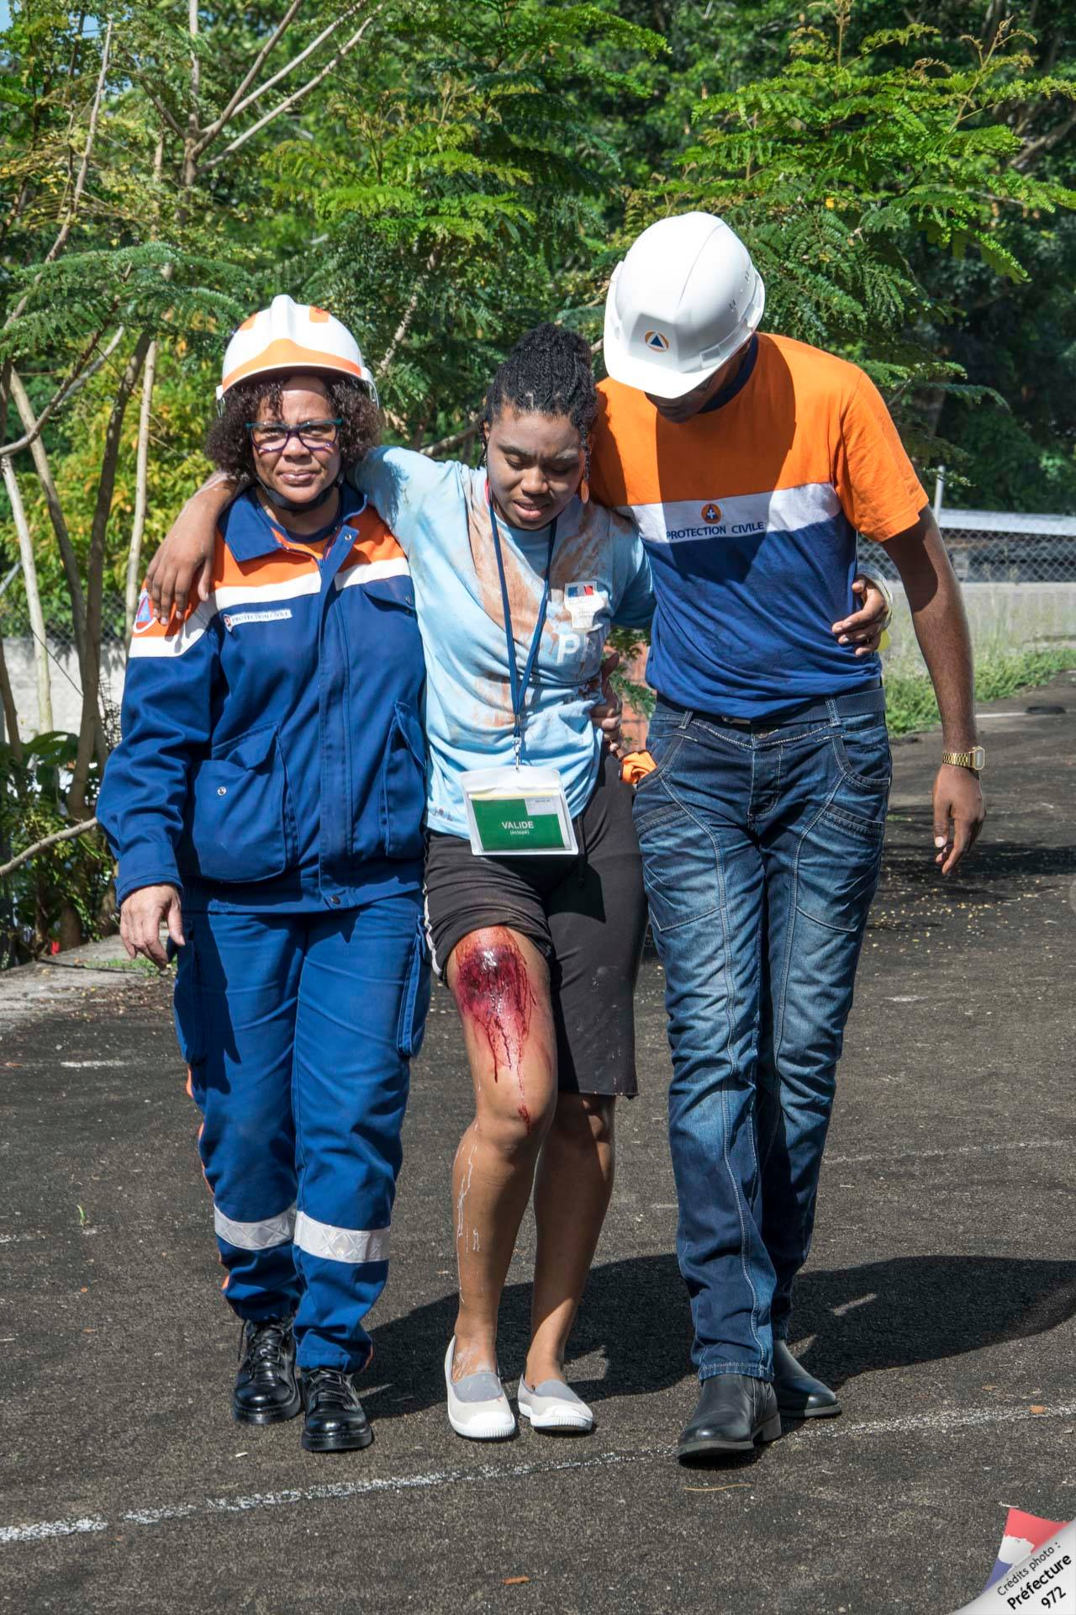
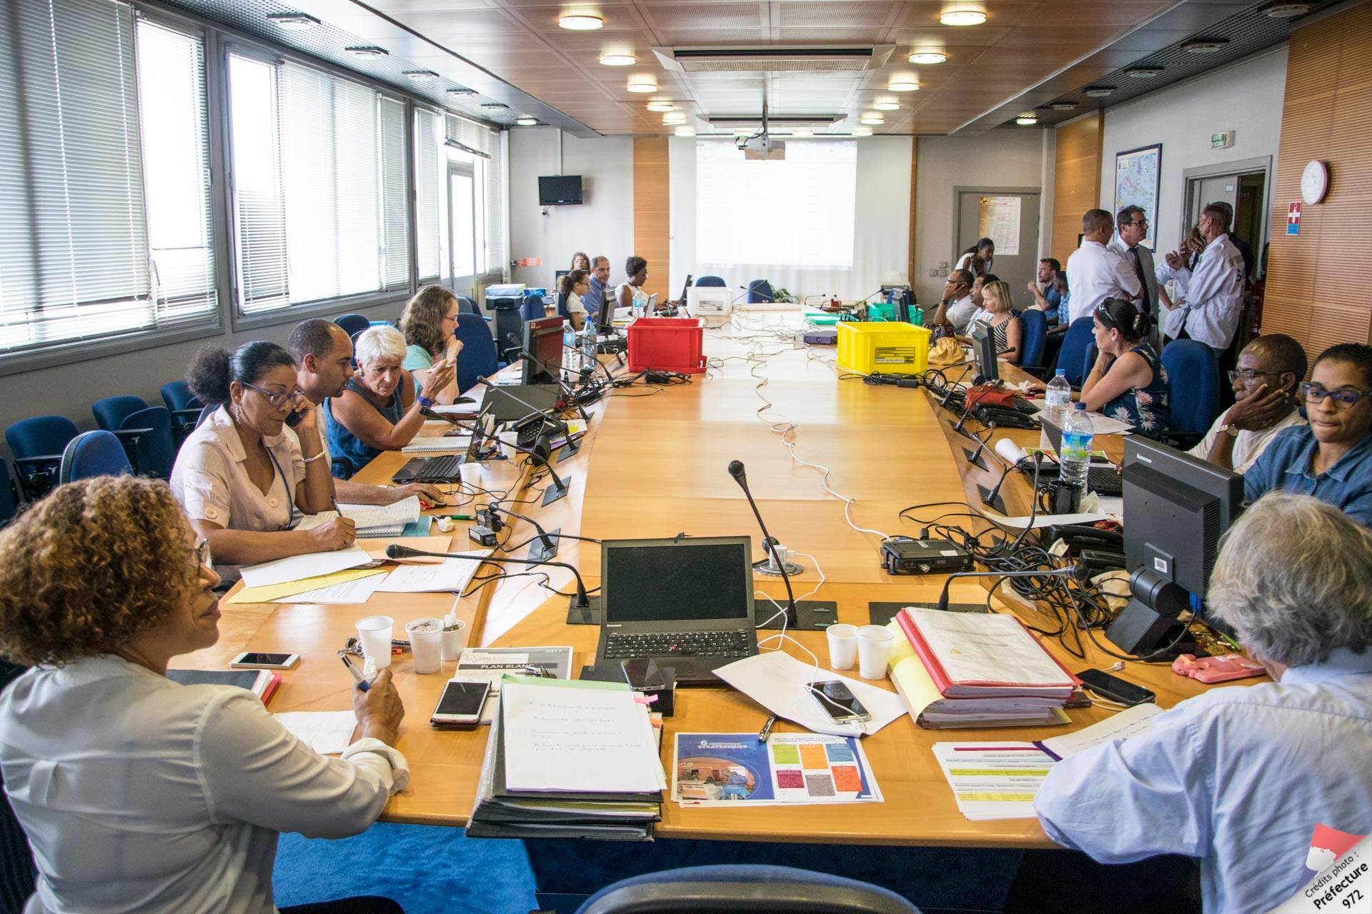
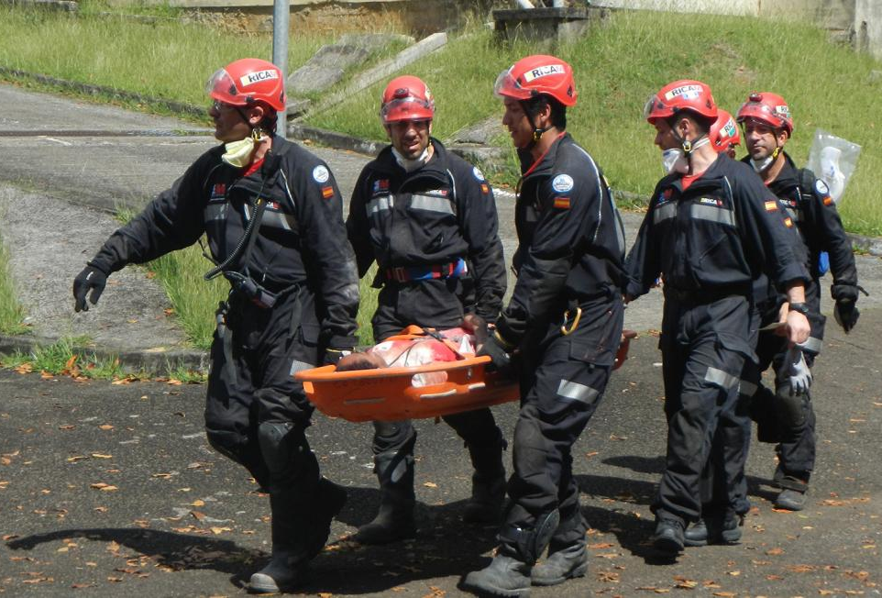
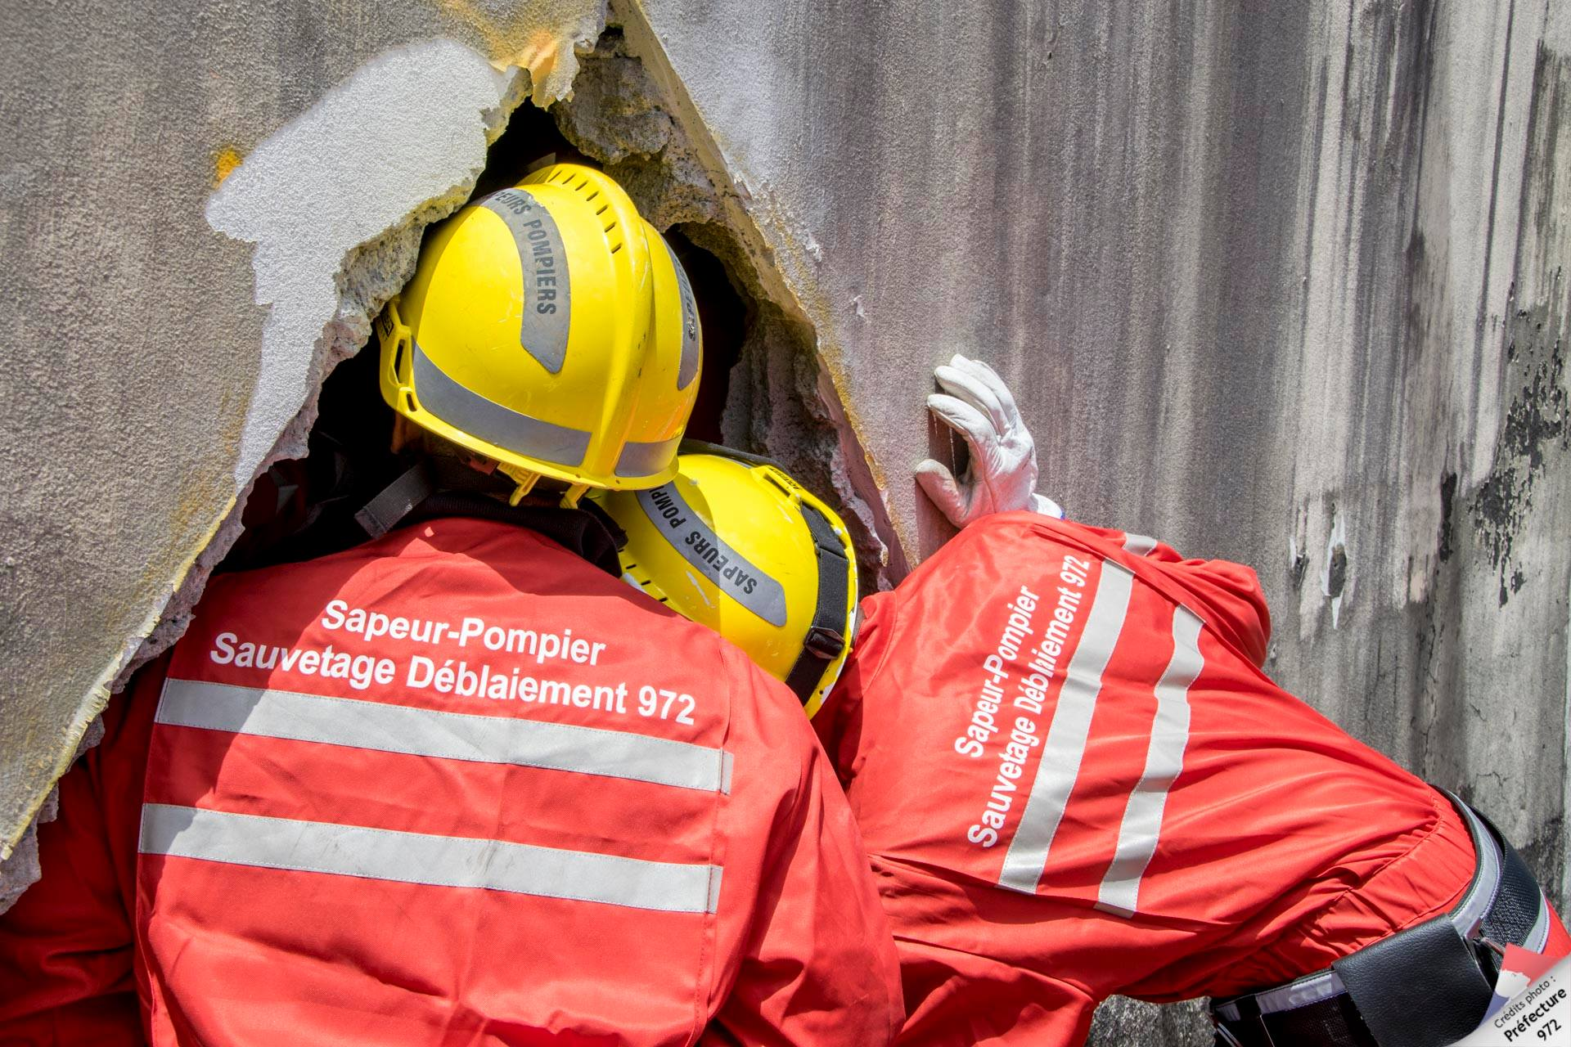
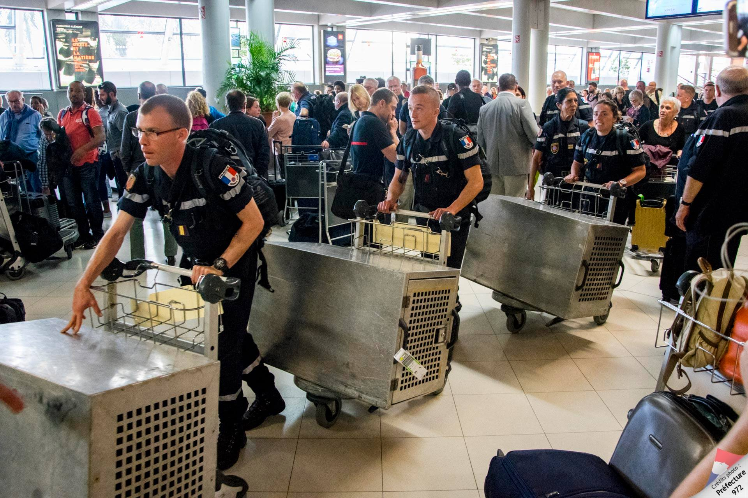
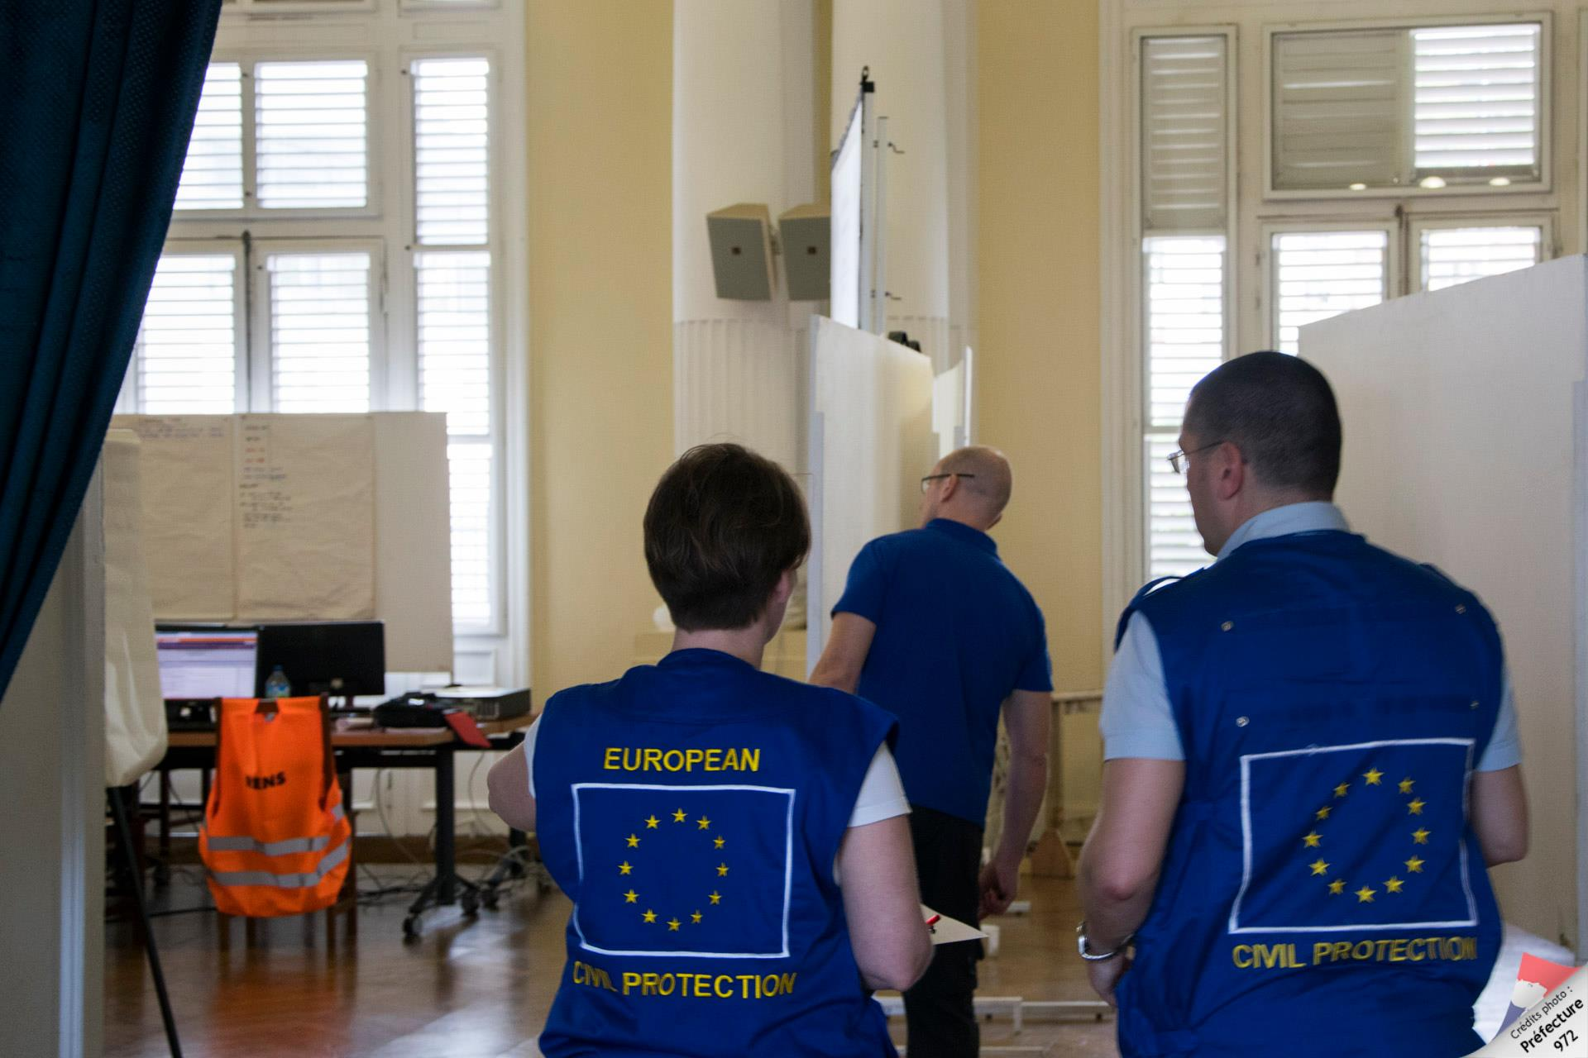
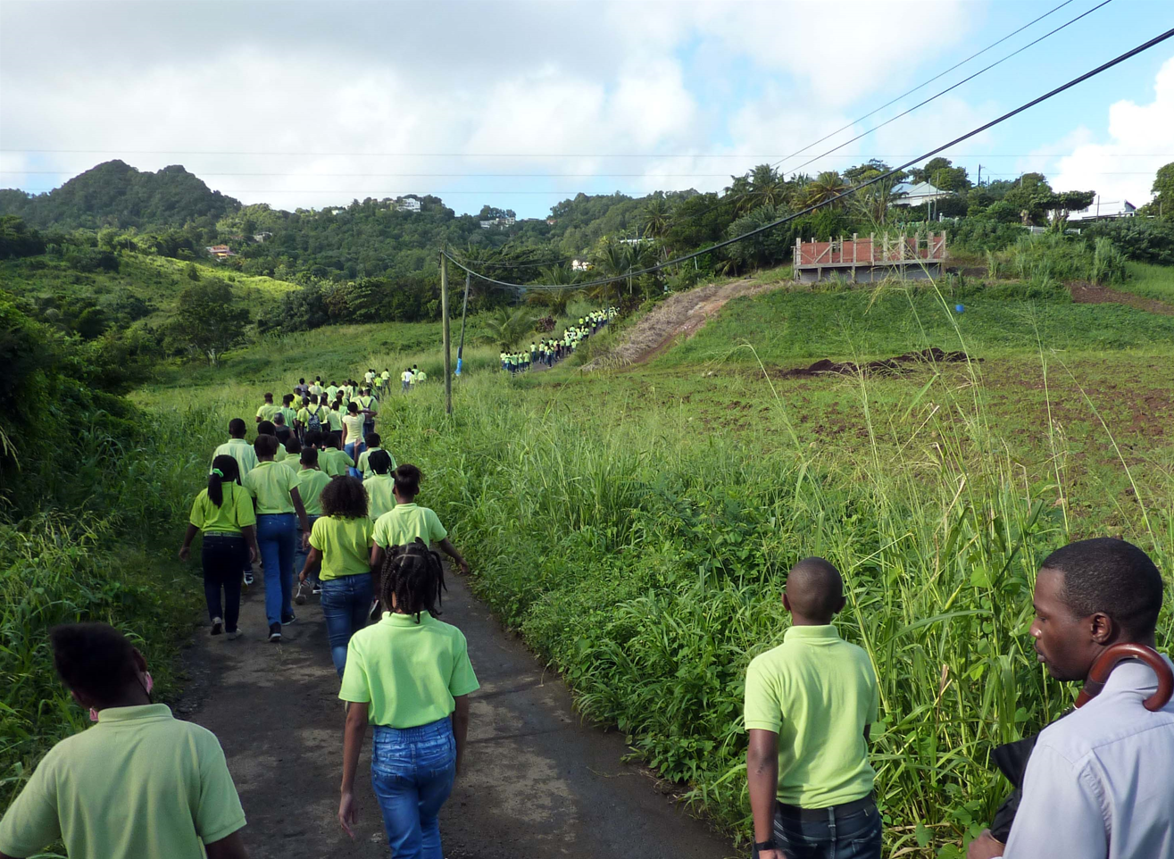
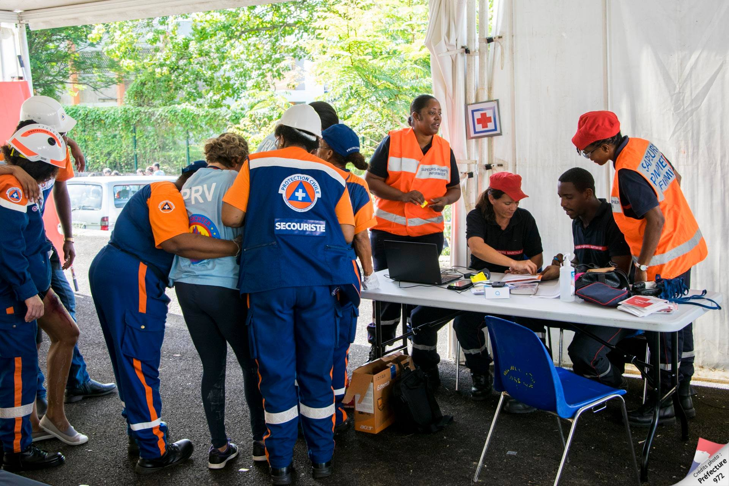
IOC-UNESCO Tsunami Ready Recognition Programme (TRRP) Workshop
MAIN TYPES OF EXERCISES
FULL-SCALE (or field exercice)

Slide 10
IOC-UNESCO Tsunami Ready Recognition Programme (TRRP) Workshop
MAIN TYPES OF EXERCISES
DRILL
TABLETOP
FUNCTIONAL
FULL-SCALE (or field exercice)
EXERCISES CAN BE ANNOUNCED OR UNANNOUNCED

Slide 11
IOC-UNESCO Tsunami Ready Recognition Programme (TRRP) Workshop
KEYS TO SUCCESS : CHOOSING THE RIGHT TYPE OF EXERCISE
THE LEVEL OF REQUIRED KNOWLEDGE OF THOSE TAKING PART.
Knowing about good ways to respond to a tsunami event is an essential prerequisite for those taking part in a field exercise.
OBJECTIVES.
Some objectives cannot be tested in a tabletop setting, such as “test the time taken for an evacuation to be completed”
RESOURCES.
When performing these exercises take into consideration the resources available (including finance and personnel) to identify and resources gaps.
ALLOCATED TIME.
Tabletop exercises save time when preparing and running an exercise. A functional or full-scale exercise will take more hours to prepare, conduct, and evaluate.

Slide 12
IOC-UNESCO Tsunami Ready Recognition Programme (TRRP) Workshop
KEYS TO SUCCESS : CHOOSING THE RIGHT TYPE OF EXERCISE
THE LEVEL OF REQUIRED KNOWLEDGE OF THOSE TAKING PART.
Knowing about good ways to respond to a tsunami event is an essential prerequisite for those taking part in a field exercise.
OBJECTIVES.
Some objectives cannot be tested in a tabletop setting, such as “test the time taken for an evacuation to be completed”
RESOURCES.
When performing these exercises take into consideration the resources available (including finance and personnel) to identify and resources gaps.
ALLOCATED TIME.
Tabletop exercises save time when preparing and running an exercise. A functional or full-scale exercise will take more hours to prepare, conduct, and evaluate.
A progressive and long-term approach is needed for tsunami exercices

Slide 13
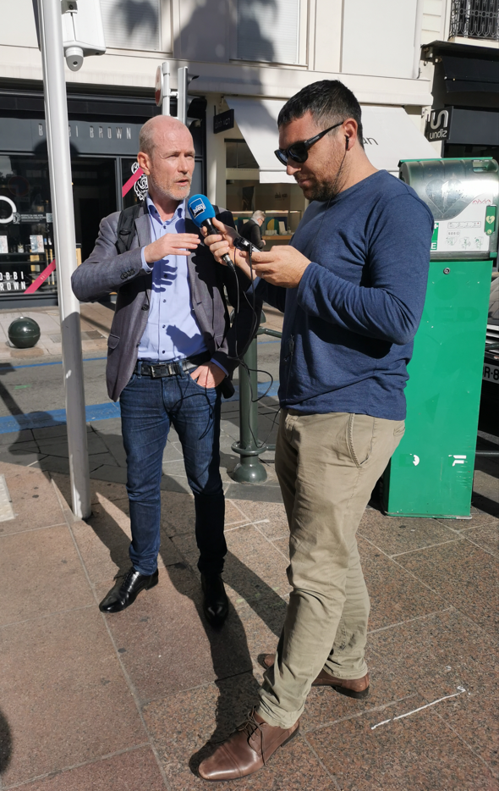
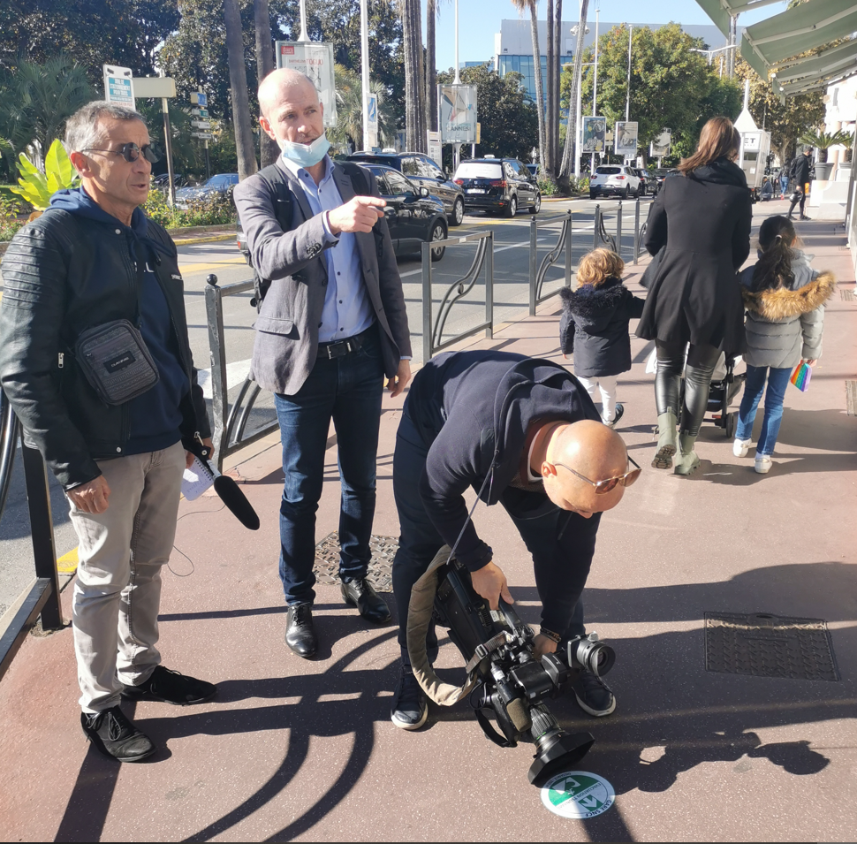
IOC-UNESCO Tsunami Ready Recognition Programme (TRRP) Workshop
SPECIFIC CONSIDERATIONS:
Anticipate the communication with local representatives
Ensure good coordination between the different levels of crisis management, especially with regard to the transmission of the alert.
Check the scenario, the tools and the conditions of implementation of the exercise to avoid technical problems on the day of the exercise.
Conduct a post-exercise evaluation (hot wash AND cold wash few weeks later)
Manage the media coverage of the exercise (dedicate time or a person)

Slide 14
IOC-UNESCO Tsunami Ready Recognition Programme (TRRP) Workshop
EXEMPLE OF MULTI-ANNUAL EXERCISE PROGRAMME IN FRANCE
Monthly test of the national communication portion
Quarterly tests national communication portion with municipality
Support on request for municipalities wishing to carry out a tsunami functinonal exercise
Encourages departmental authorities to conduct exercises
Coordinates national exercises and even contributes to European exercises

Slide 15
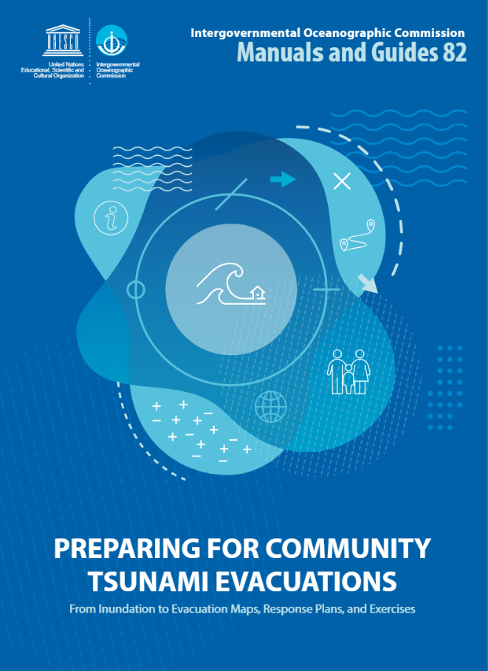
IOC-UNESCO Tsunami Ready Recognition Programme (TRRP) Workshop
ADDITIONAL GUIDANCE IS AVAILABLE FROM
Preparing for community tsunami evacuations: from inundation to evacuation maps, response plans and exercises
2021
298 pages
Langages : English, Espanol
https://unesdoc.unesco.org/ark:/48223/pf0000373019?1=null&queryId=23faed34-f9d0-4fa3-baf7-a38957a36ccb

Slide 16
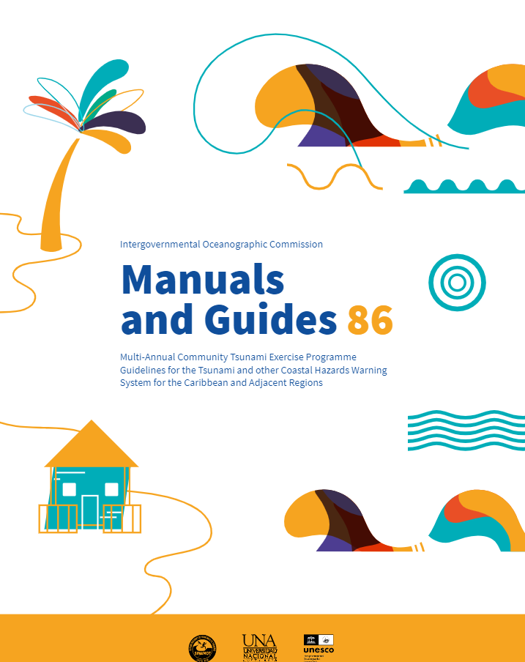
IOC-UNESCO Tsunami Ready Recognition Programme (TRRP) Workshop
ADDITIONAL GUIDANCE IS AVAILABLE FROM
Multi-annual community tsunami exercise programme: guidelines for the tsunami and other coastal hazards warning system for the Caribbean and Adjacent Regions
2021
64 pages
Langages : English, French
https://unesdoc.unesco.org/ark:/48223/pf0000380540.locale=en

Slide 17
UNESCO
Intergovernmental Oceanographic Commission (IOC)
IOC-UNESCO DG ECHO CoastWAVE project
UNESCO IOC Sector Tsunami Unit
d.chang-seng@unesco.org
CoastWAVE project website

