Slide 1
Resp-3: Redundant and Reliable Means to Timely Receive 24-hour Official Tsunami Alerts are in Place
Dr. Nikos KALLIGERIS
Principal Researcher at the National Observatory of Athens (NOA)
IOC-UNESCO EU DG ECHO CoastWAVE Project
IOC-UNESCO Tsunami Ready Recognition Programme (TRRP) Workshop
Online, February 16-17, 2023

Slide 2
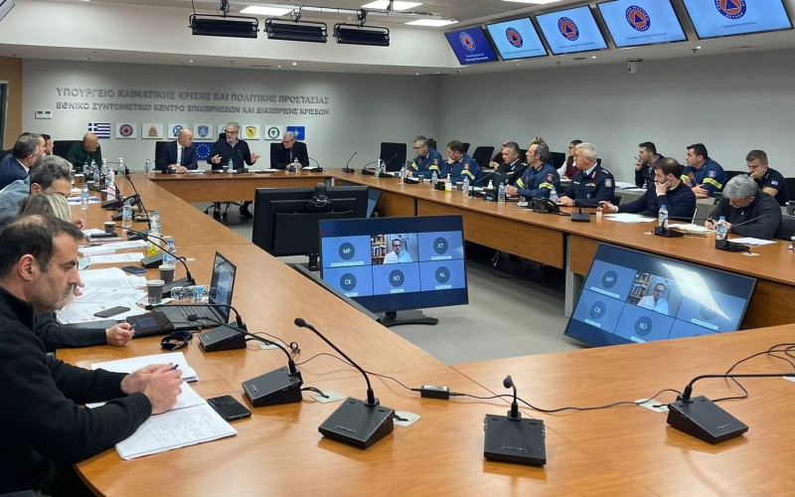
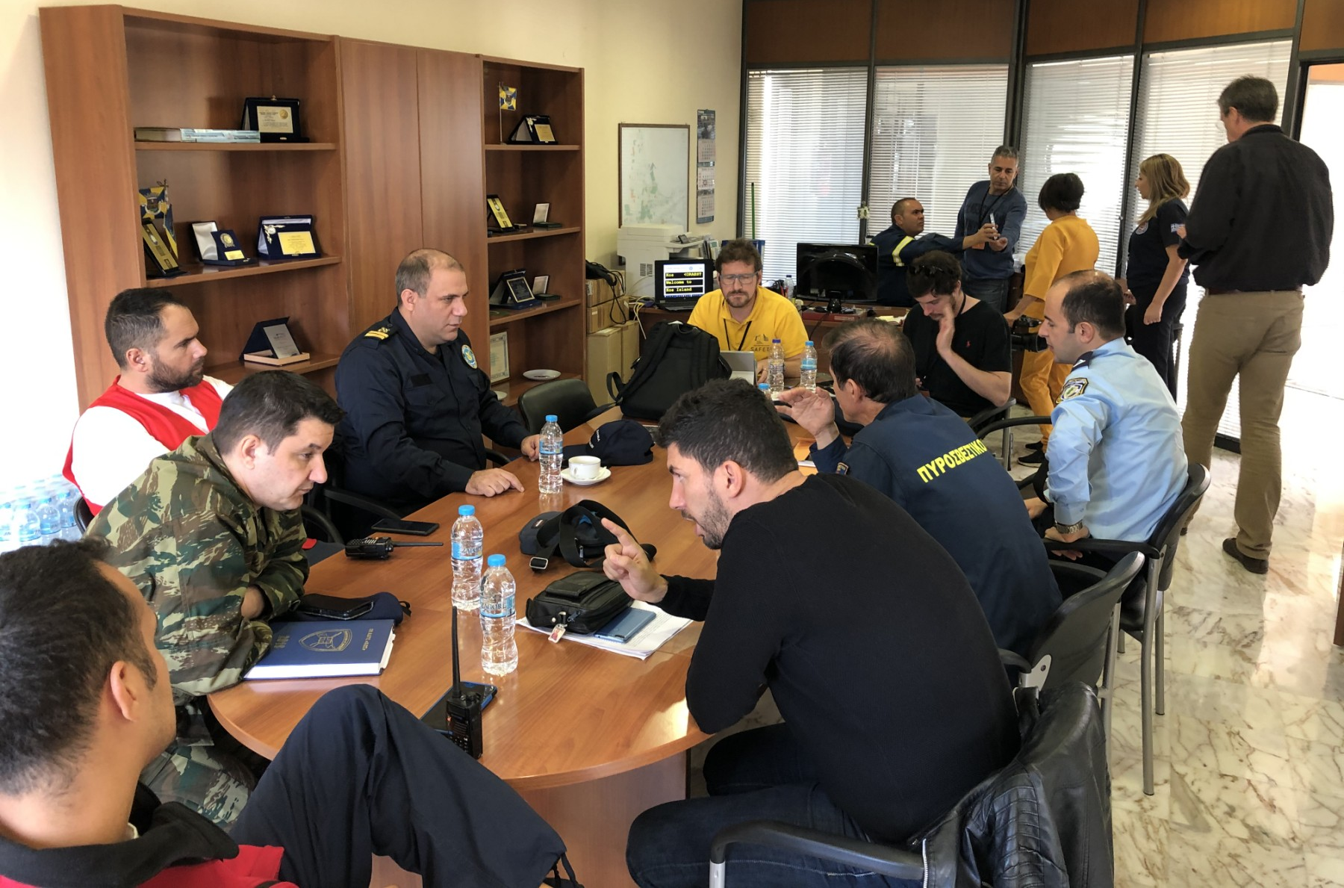
IOC-UNESCO Tsunami Ready Recognition Programme (TRRP) Workshop
Introduction
The community must have redundant and reliable means for a 24x7 warning point to receive official tsunami threat notifications from NTWCs and/or the DMO or other officially recognized alerting authorities such as local Emergency Management Agencies (EMA).
Source: civilprotection.gr
Dissemination/receipt redundancy is required to ensure that the alert is received if one method fails.
Alerts must be able to reach the 24x7 receipt point by at least 3 communications channels.

Slide 3
IOC-UNESCO Tsunami Ready Recognition Programme (TRRP) Workshop
Notifications must be able to reach the 24-hour receipt point by at least three of the following methods:
Public Alert Radio Systems, like Radio Digital Signals (RDS).
National/Territorial warning call-out tree system (documented in writing with backup indicated).
Instant messaging programmes available via the Internet used by operational personnel to share critical warning decision expertise and other significant information.
Amateur Radio transceiver: Potential communications directly to NTWC or TWFP or Emergency or Disaster Management Office or other official alerting authority.
Through a third-party provider: Typically received via phone, email and/or a texting service to a smartphone, tablet, or computer.

Slide 4
IOC-UNESCO Tsunami Ready Recognition Programme (TRRP) Workshop
Notifications must be able to reach the 24-hour receipt point by at least three of the following methods (continued):
Local Radio: Emergency Alert System (EAS).
Active Internet monitoring capability, including social media such as Facebook, Twitter, WhatsApp, Viber, Signal, others.
Direct email from NTWC, TWFP and/or Disaster Management Office.
Direct fax from NTWC, TWFP and/or Disaster Management Office.
Text message, direct pager or social media message from NTWC, TWFP and/or Disaster Management Office.
Coast Guard (CG) or other maritime agency official broadcasts: warning point monitoring of CG marine channels.

Slide 5
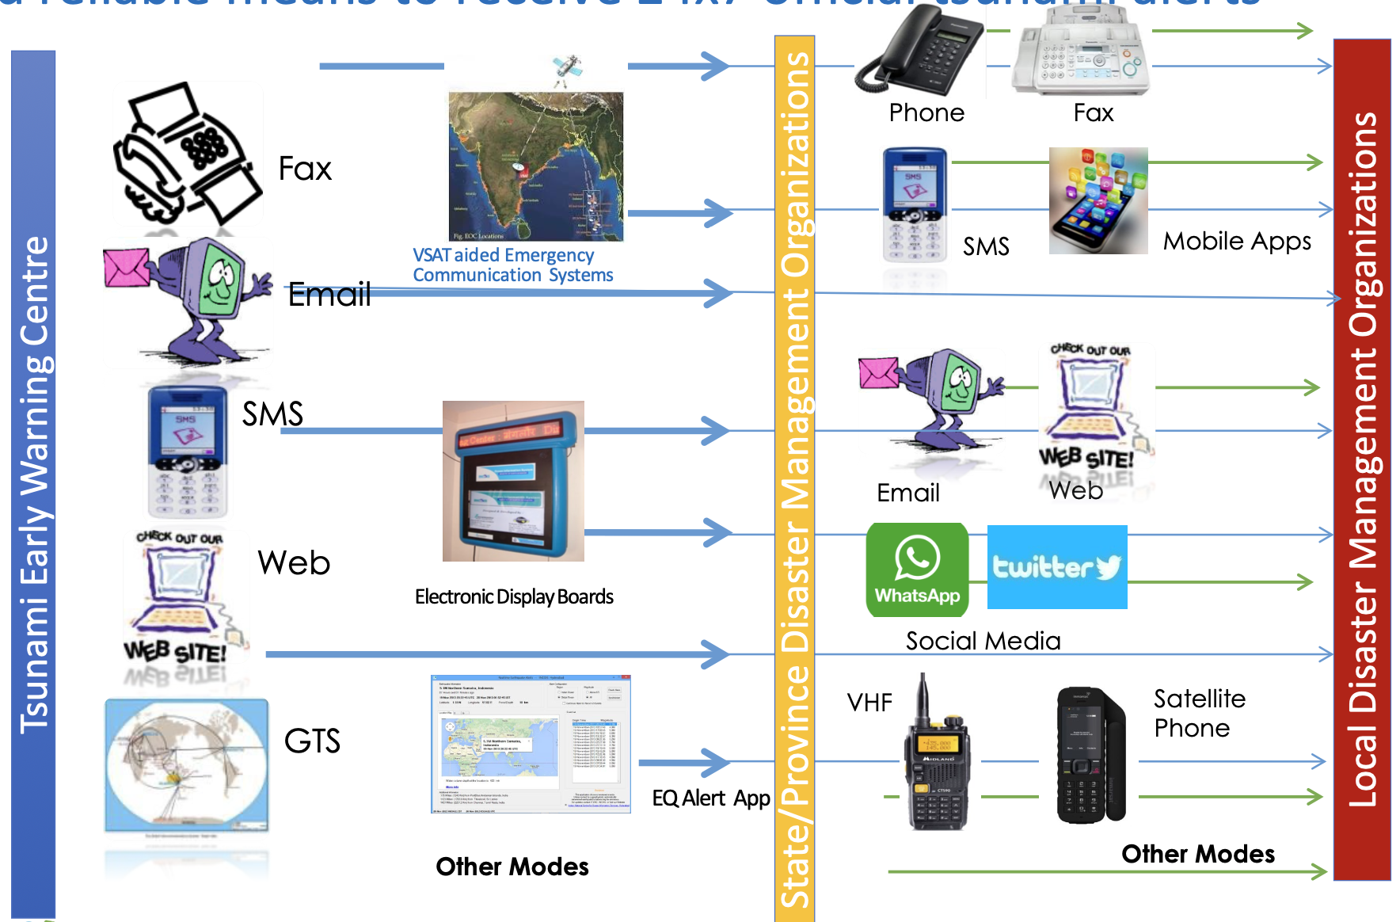
IOC-UNESCO Tsunami Ready Recognition Programme (TRRP) Workshop
Redundant means for 24x7 warning point to receive official tsunami threat notifications:
Image source: IO TR Workshop, IOTWS Secretariat, Nora Gale

Slide 6
IOC-UNESCO Tsunami Ready Recognition Programme (TRRP) Workshop
The example of the Greek Integrated Public Alert & Warning System:

Slide 7
IOC-UNESCO Tsunami Ready Recognition Programme (TRRP) Workshop
Summary of TR indicator Resp-3
The community must have redundant and reliable means for a 24x7 warning point to receive official tsunami threat notifications from NTWCs and/or the DMO or other officially recognized alerting authorities such as local Emergency Management Agencies (EMA).
Alerts must be able to reach the 24x7 receipt point by at least 3 communications channels.

Slide 8
UNESCO
Intergovernmental Oceanographic Commission (IOC)
IOC-UNESCO DG ECHO CoastWAVE project
UNESCO IOC Sector Tsunami Unit
d.chang-seng@unesco.org
CoastWAVE project website

