Slide 1
Tsunami Ready
Establishment of the National Tsunami Ready Board
Denis Chang Seng. PhD
Programme Specialist
ICG/NEAMTWS Technical Secretary
UNESCO IOC

Slide 2
Establishment
M & G 74, (5.2.2) States that a National Tsunami Ready Board (NTRB) has to be established.

Slide 3
Steps in the Tsunami Ready process
Seven main steps
Review the Tsunami Ready Guidelines
Establish a National Tsunami Ready Board
Fill and Submit the Application forms
Review of the Tsunami Ready Application
Recognition process
Renewal procedure
Establish a Tsunami Ready Local Committee
(if needed)
Implement / build capacity based on the Tsunami Ready Indicators
Field Verification
(if needed)
First Steps
To be Recognized…

Slide 4
The National Tsunami Ready Board (NTRB)
The National Tsunami Ready Board is comprised of, but not limited to, and depending on each country’s settings:
Function, role, and responsibility:
General oversight of the national Tsunami Ready program
Advocate, supervise, and support activities to implement Tsunami Ready programme
Manage resources for the Tsunami Ready programme
Maintain consistency of the Tsunami Ready guidelines
Coordinate and liaise and link Tsunami Ready activities with technical institutions and organizations
Directs and oversees service improvements to the Tsunami Ready programme
Oversees national Tsunami Ready database
National and Local Disaster Management Office (NDMO and LDMO)
National Tsunami Warning Centre (NTWC)
Ministries, national agencies, institutions and other relevant organizations,
NGOs for Community Based Disaster Risk Reduction (DRR) or Disaster Risk Management (DRM)
Tsunami National Contact (TNC)
Community Representatives (Non-decision Member)
NTRB should be formal
Need to look into the mandate of the relevant agencies for hazard preparedness and civil protection
Notes:
The establishment of the NTRB should be informed to the UNESCO/IOC ICG Technical Secretary of the region (Pacific, Indian, North-eastern Atlantic and Mediterranean, and Caribbean) and the corresponding Tsunami Information Centre (TIC).

Slide 5
Members are responsible:
1
2
3
4
To guide the community
To review and approve the TR application of the community
To oversee the TRRP and its administrative paperwork and implementation.
To review existing and proposed changes

Slide 6
The NTRB should inform UNESCO/IOC ICG Technical Secretary of the North-eastern Atlantic and Mediterranean, and the corresponding Tsunami Information Centre (TIC).

Slide 7
In the case of small countries and territories, the Tsunami Ready recognition may be granted at the national/territorial level.
In this case, the Regional Tsunami Ready Board (RTRB), it would
be responsible for reviewing and approving recognition.
The RTRB for each region consists of
The ICG Chair (serves as the RTRB Chair), TIC Director, ICG Working Group Chairs that cover the topics of tsunami warning and dissemination, disaster management, preparedness and risk reduction, the ICG Technical Secretary, and other guests at the discretion of the RTRB Chair.

Slide 8
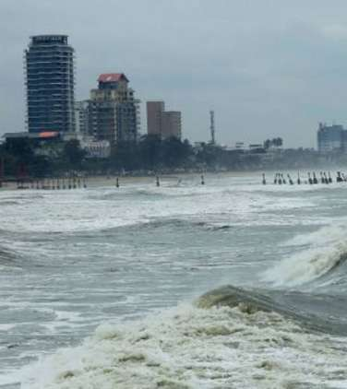
INDIA NTRB
Members
Chair: Director, INCOIS
Representatives from: Ministry of Home Affairs, Ministry of Earth Sciences, DMO
Secretary: Head TWG, INCOIS
Odisha becomes first state to get 'tsunami ready' tag
Image Source : PTI

Slide 9
Roles of India NTRB (Cont)
To implement and monitor TRRP and IOWave Exercises
Review, advocate, approve tsunami recognition request
Regularly monitor and evaluate approved tsunami ready community
Recommend tsunami ready community for regional recognition
General oversight of the national Tsunami Ready Programme
Maintain consistency of the Tsunami Ready guidelines
Review proposed tsunami ready application
Monitor and evaluate existing Tsunami Ready community
Review existing and proposed changes to the Tsunami Ready Guidelines and publish updates as needed
Monitor IOWave related activities
Assess probabilistic Tsunami Hazard

Slide 10
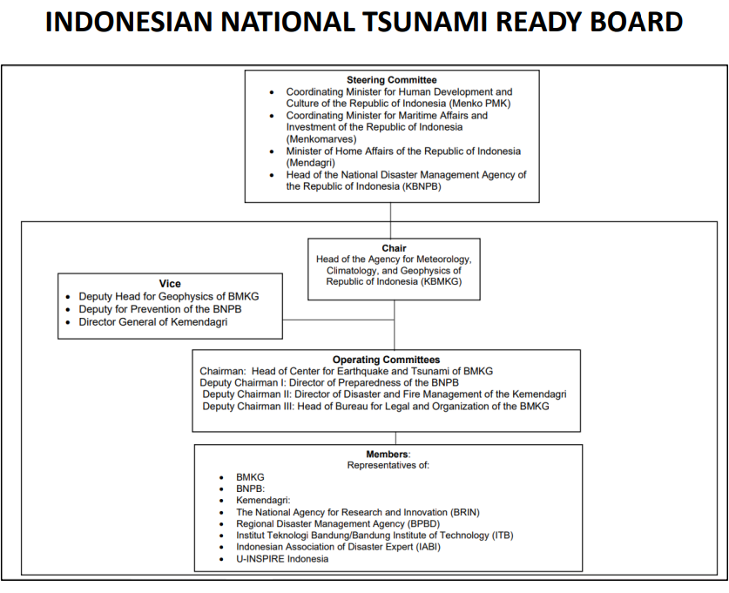
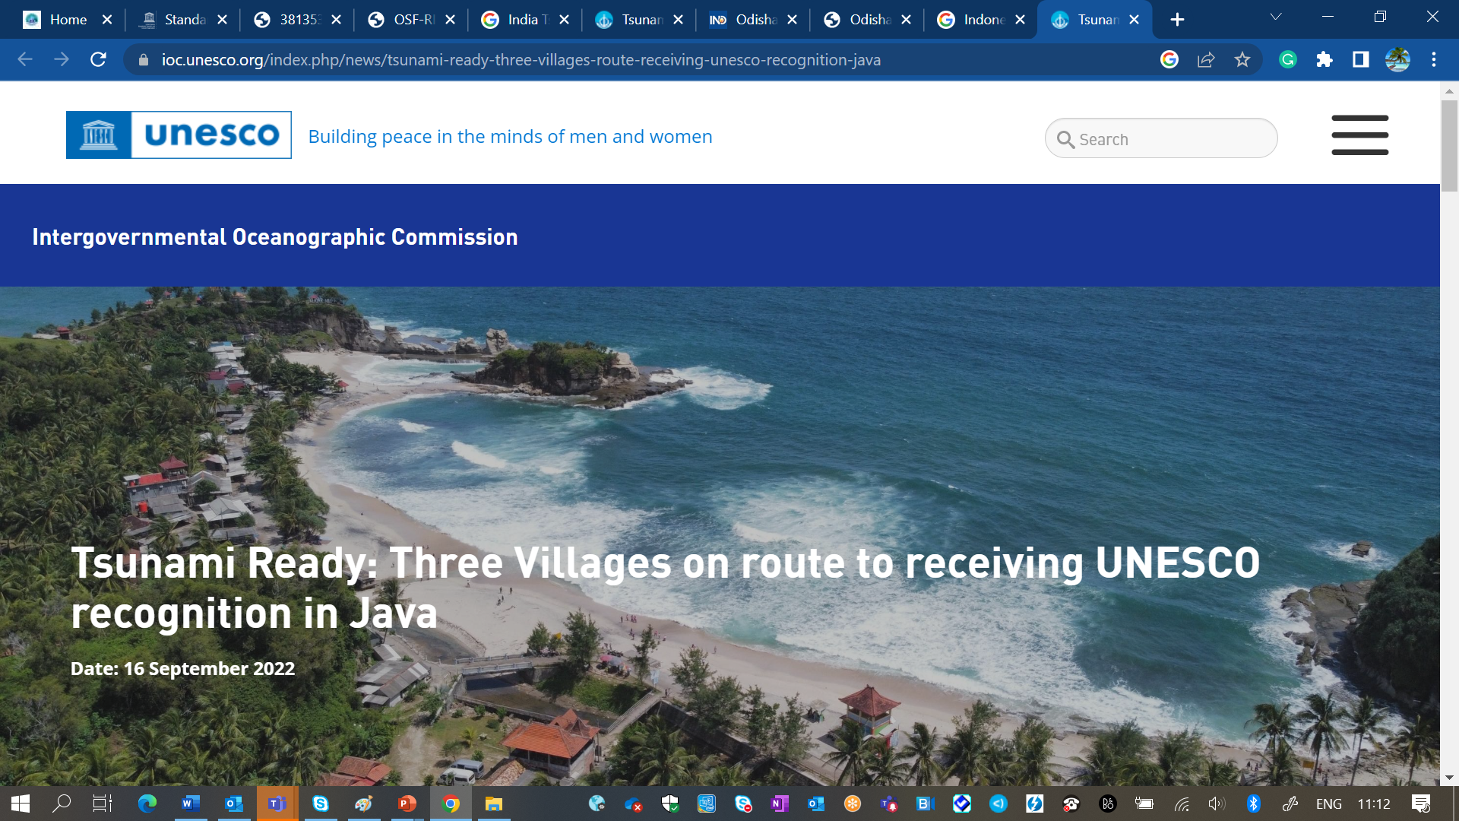
INDONESIA NTRB
Members of Steering Committee
Chair and vice chair
Operating Committees
Members
Flowchart is taken from the slides of Dwikorita Karnawati, IO TR Workshop (Nov, 2022), OceanExpert

Slide 11
Roles of Indonesia NTRB
Coordinating the implementation of the Tsunami Ready Community through advocacy, promotion, and socialization
Encourage the implementation of UNESCO-IOC Tsunami Ready guidelines and indicators.
Ensuring consistency in the implementation of guidelines and UNESCO-IOC Tsunami Ready indicator
Checking and providing direction on assessments Tsunami Ready Community on the national level for the proposed coastal communities prone to tsunami;
Review, evaluate, and approve requests Tsunami Ready Community Recognition at the national level in accordance with UNESCO-IOC Tsunami Ready guide and indicators
Yogyakarta. ©UNESCO/Ardito M Kodijat

Slide 12
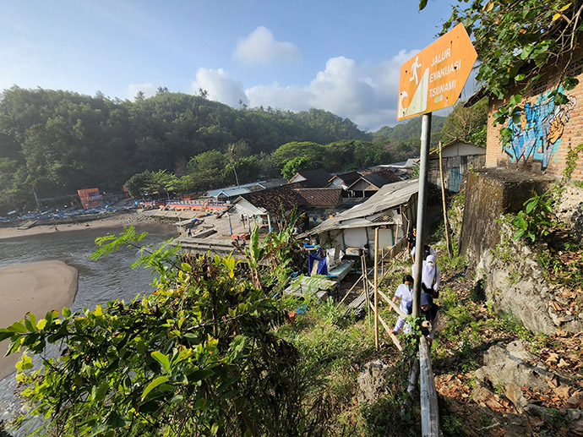
Roles of Indonesia NTRB (Con’t)
Monitor, collect reports, and evaluate Tsunami Ready Community which has received recognition annually;
Recommend the Tsunami Ready Community to gain UNESCO-IOC Tsunami Ready Recognition,
Monitor and report on annual activities Tsunami Ready Community which has been recognized as UNESCO-IOC Tsunami Ready Community to ICG/IOTWMS and IOTIC;
Monitor the changes and propose improvements of UNESCO-IOC Tsunami Ready Community guidelines.
Coordinate, disseminate, monitor, and reporting on the implementation of IOWave activities in Indonesia.
©UNESCO/Ardito M Kodijat

Slide 13
The Italian NTRB
Members
TNC, Head of the Emergency Management Office
Head of NTWC of the Italian National Institute of Geophysics and Volcanology
National Center for Coastal Protection, Maritime Climatology and Operational Oceanography , Italian Institute for Environmental Protection and Research ( ISPRA)
Responsibility/role
NTRB are responsible for the review and approval of the community Tsunami Ready application

Slide 14
Greece NTRB
Members
Dr. Dimitrios Alexandris, Head of the Emergency & Response Planning Directorate of the Secretary General for Civil Protection, and deputy Dr. Andreas Antonakos as head of the Natural Disasters Department of the same Directorate;
Dr. Marinos Charalampakis, Greek TNC and operational head of NOA
Dr. Christos Evangelidis as representative of the Institute of Geodynamics of the National Observatory of Athens and member of the scientific community.
Responsibilities/Role
Monitoring and approval of the results of the Tsunami Ready Recognition Program in accordance with the "Standard Guidelines for the Tsunami Ready Recognition Program - no 74" IOC/UNESCO document.
Documentation
A decree for the Establishment, formation and appointment of members of the NTRB
Publication in the Government Gazette (both documents in Greek).

Slide 15
END

