Slide 1
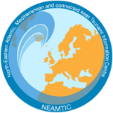
TR Logo Usage
Dr. Derya I. VENNIN
Project Coordinator of CoastWAVE Project
Associate Project Officer at IOC-UNESCO Tsunami Unit
IOC-UNESCO EU DG ECHO CoastWAVE Project
IOC-UNESCO Tsunami Ready Recognition Programme (TRRP) Workshop
Online, February 16-17, 2023

Slide 2
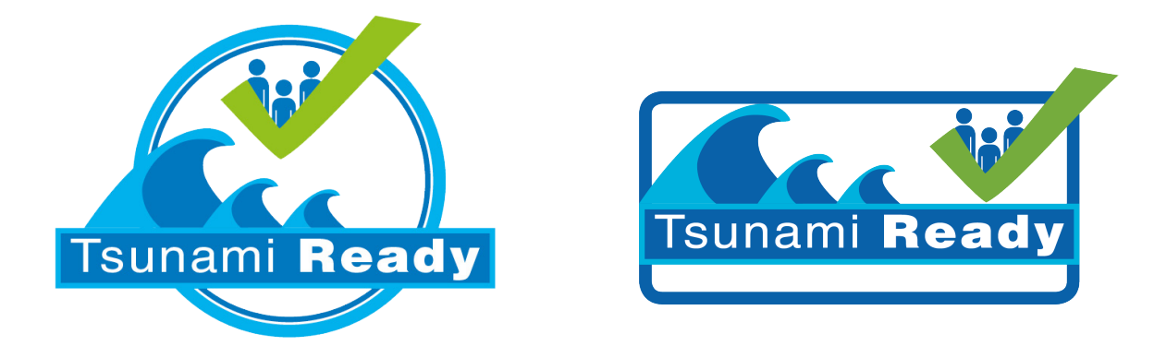
IOC-UNESCO Tsunami Ready Recognition Programme (TRRP) Workshop
Logo Formats
Two logo formats, circle or rectangle shape:

Slide 3
IOC-UNESCO Tsunami Ready Recognition Programme (TRRP) Workshop
The Logo Graph-What does it represent?
Checks all indicators have been completed.
Indicates this logo is for tsunami hazards
TR is based on community preparedness
Indicates the programme is global is for tsunami hazards
Name

Slide 4
IOC-UNESCO Tsunami Ready Recognition Programme (TRRP) Workshop
Colors of the Logo Graph
Colored logos are the top priority.

Slide 5
IOC-UNESCO Tsunami Ready Recognition Programme (TRRP) Workshop
Combined Logo
Locate it at the end of the sequence and colored

Slide 6
IOC-UNESCO Tsunami Ready Recognition Programme (TRRP) Workshop
Sequence (external)
Request permission to use the logo from ioc-tsu@unesco.org
Place your logo between UNESCO and Tsunami Ready logos:
With TIC Logo:

Slide 7
IOC-UNESCO Tsunami Ready Recognition Programme (TRRP) Workshop
Example of Logo Usage:

Slide 8
IOC-UNESCO Tsunami Ready Recognition Programme (TRRP) Workshop
Logo Usage in Presentations
Placed at the top right corner of presentation format.
Place your logo between UNESCO and Tsunami Ready logos:

Slide 9
UNESCO
Intergovernmental Oceanographic Commission (IOC)
IOC-UNESCO DG ECHO CoastWAVE project
UNESCO IOC Sector Tsunami Unit
d.chang-seng@unesco.org
CoastWAVE project website
@coastwaveproject

