Slide 1
Steps in the Tsunami Ready Certification Process, Tsunami Ready Workflow of IOC-UNESCO
Denis Chang Seng, PhD
Programme Specialist/NEAMTWS Technical Secretary (ICG/NEAMTWS)
IOC UNESCO

Slide 2

PHASE 1:Expressions to Establish UNESCO IOC Tsunami Ready Community
Members and roles of the NTRB
  The TNC and or NTRB
Informs the respective Technical Secretary of IOC/ TSU through a Letter copy to TIC
Filing
Nominated communities included in Tsunami Ready Data Base and Viewer
Communities Nominated or in the process of becoming TR
Expressions of interest of communities interested to join is very important because it helps planning e.g., training, staff and resource planning
Notes:
If the community is determined not to be Tsunami Ready as defined in the indicators, the application will be returned to the community with information about what is missing. Once these issues are addressed, an updated application should be submitted following the same steps as in the first application.
The NTRB approves the application and informs the UNESCO/IOC ICG Technical Secretary, with copy to the TIC, of the region.

Slide 3
PHASE 2:
Community Ready to Apply for Recognition after having achieved all 12 Indicators
  If NTRB approves application it informs UNESCO IOC via the ICG Technical Secretary for the region
NTRB reviews application form.
Sets date for site verification visit and review meeting
Completes the application form and submits to the NTRB
  TRLC
Notes:
If the community is determined not to be Tsunami Ready as defined in the indicators, the application will be returned to the community with information about what is missing. Once these issues are addressed, an updated application should be submitted following the same steps as in the first application.
The NTRB approves the application and informs the UNESCO/IOC ICG Technical Secretary, with copy to the TIC, of the region.

Slide 4
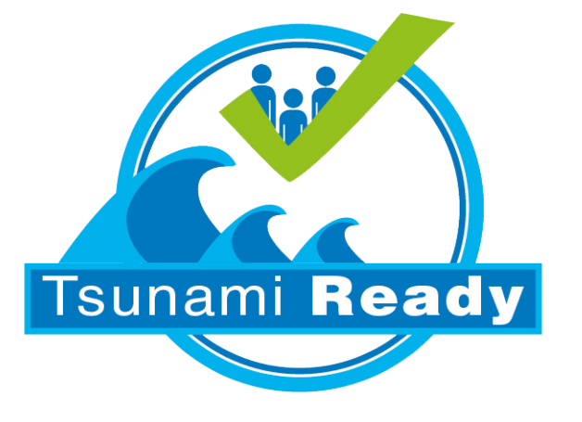
Workflow for Certification
IOC Informs TICs and Technical Secretaries and send TR summary and documentation files for web posting
IOC post on website a news article on the community that has been recognized
NTRB writes summary text with images on TR recognized community and send to IOC (Tec Sec) copied to TIC
NTRB organize certificates delivery
IOC (Tec Sec/TICs) request the chair of NTRB to nominate a contact point for the process and to provide the list of certificates (recognition and appreciation) copied to TIC
IOC (Tec Sec) prepares a first draft of the required certificate/sign and send them for revision to the National Tsunami ready contact point, copied to TIC.
Once the files are validated , IOC send certificates for IOC signature.
After signed, they are sent to NTRB , copied to TICs
TICs /Tech Sec Verifies
IOC (Tech Sec/ TICs)receives the final support documentation from NTRB and the endorsed submission form copied to TIC
IOC (Tech Sec/TICs) receives from NTRB the letter and signed application form copied to TIC
NTRB

Slide 5
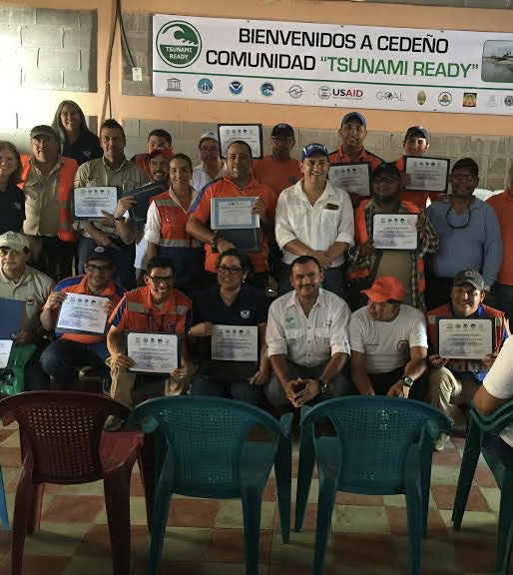
International Recognition by UNESCO/IOC
The Tsunami Ready Recognition certificate is signed by the UNESCO IOC Executive Secretary, the ICG Chair for the region and the NTRB chair
A Tsunami Ready recognition ceremony may be held to celebrate the accomplishment and recognize local stakeholders
Tsunami Ready recognition is not a certification of readiness
Tsunami Ready recognition appreciates and acknowledges the community that has built their capacity and implemented measures in accordance with the agreed indicators of the Tsunami Ready Recognition Program.

Slide 6
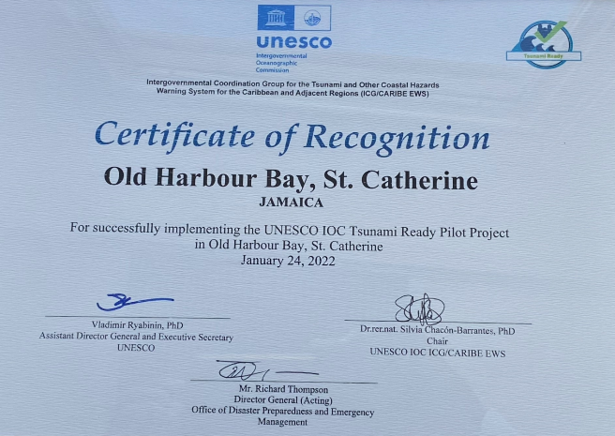

Slide 8
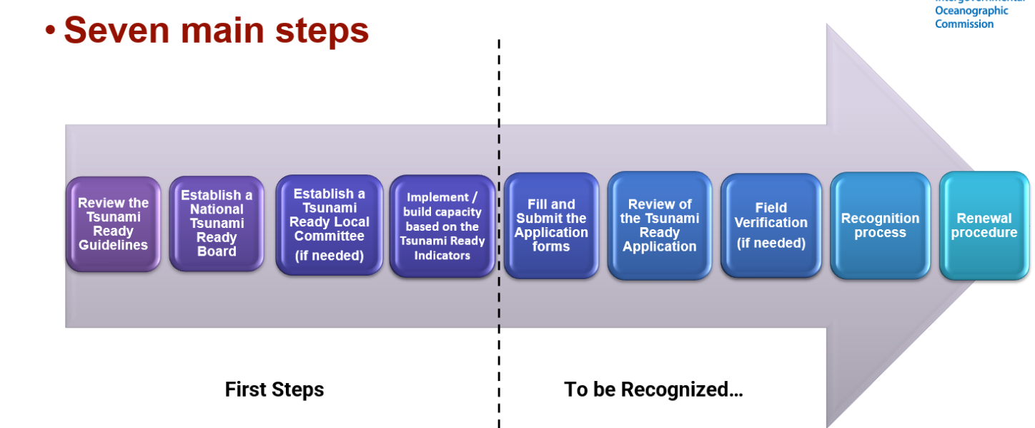

Slide 9
Organization and naming of files for the Repository and Website.

Slide 10
END
THANK YOU

