Slide 1
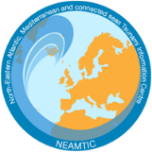
Example:
A Case Example from Tsunami Ready Recognized Communities
in the Indian Ocean
Mr. Ardito Kodijat
Head of the Indian Ocean Tsunami Information Centre (IOTIC)
IOC-UNESCO EU DG ECHO CoastWAVE Project
IOC-UNESCO Tsunami Ready Recognition Programme (TRRP) Workshop
Online, February 16-17, 2023

Slide 2
Tsunami Ready Implementation
In Indian Ocean

Slide 3
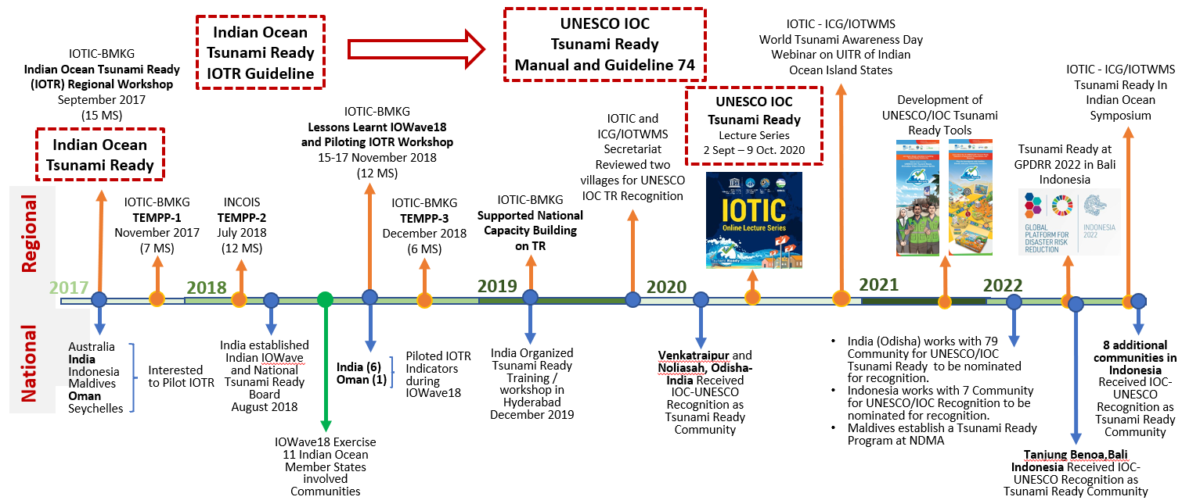
IOC-UNESCO Tsunami Ready in Indian Ocean

Slide 4
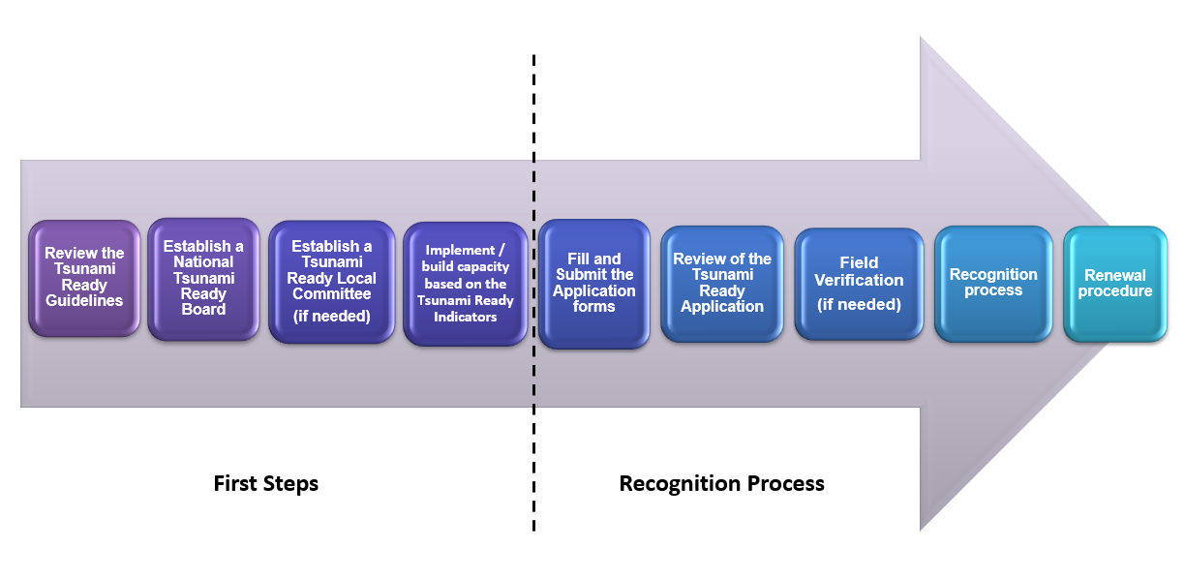
IOC-UNESCO Tsunami Ready Recognition Programme Process

Slide 5
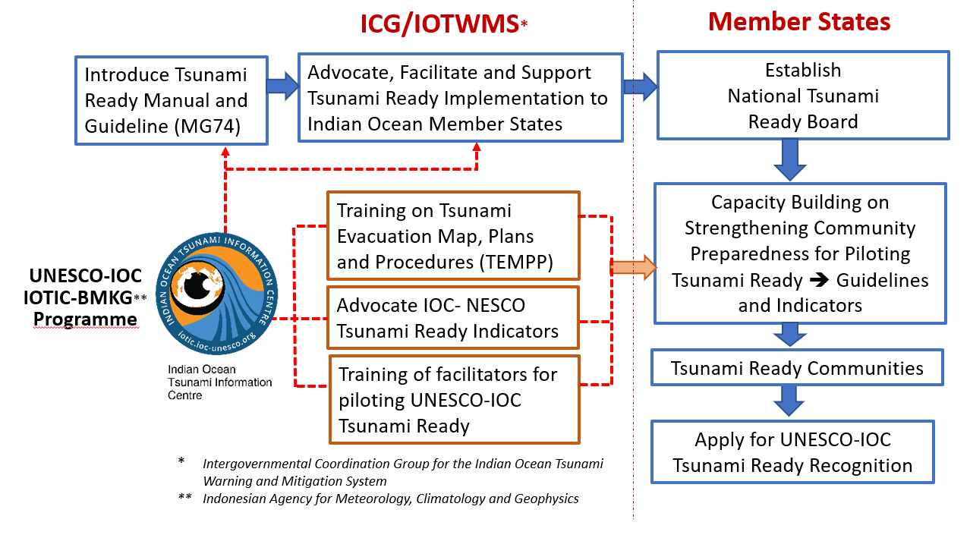
Tsunami Ready Implementation Process – Indian Ocean

Slide 6
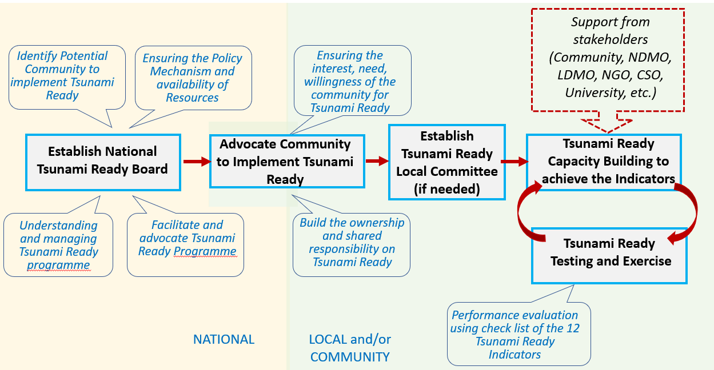
Tsunami Ready Implementation Process – Indian Ocean

Slide 7
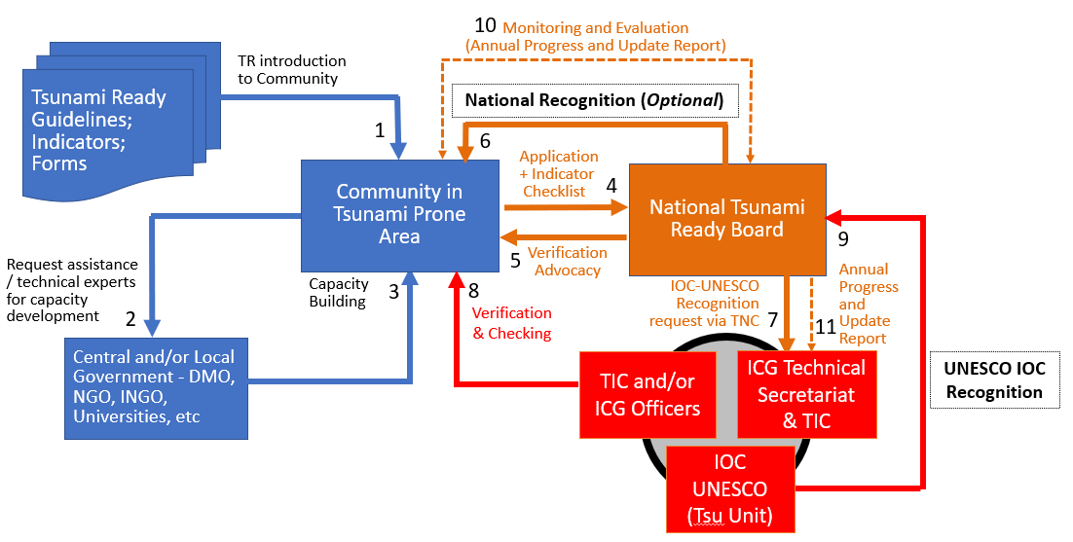
Tsunami Ready Recognition Process – Indian Ocean

Slide 8
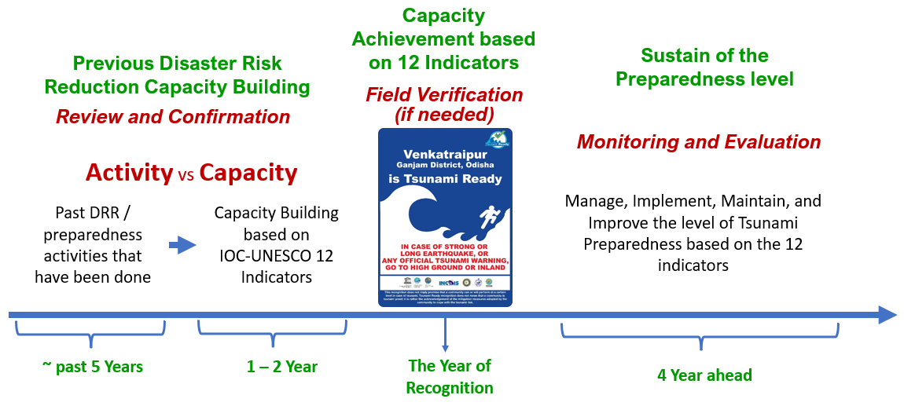
Implementing Tsunami Ready based on Existing National Programme

Slide 9
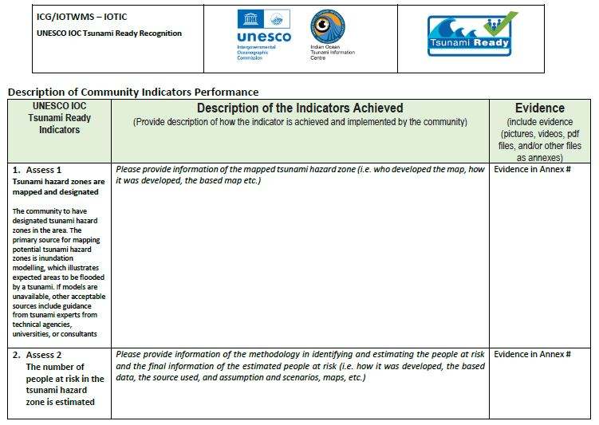
Tsunami Ready Recognition Review and Monitoring

Slide 10
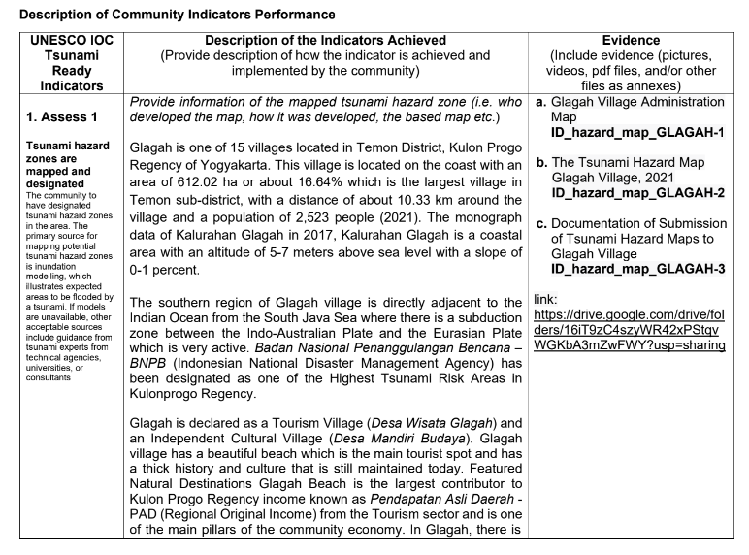
Tsunami Ready Recognition Review and Monitoring

Slide 11
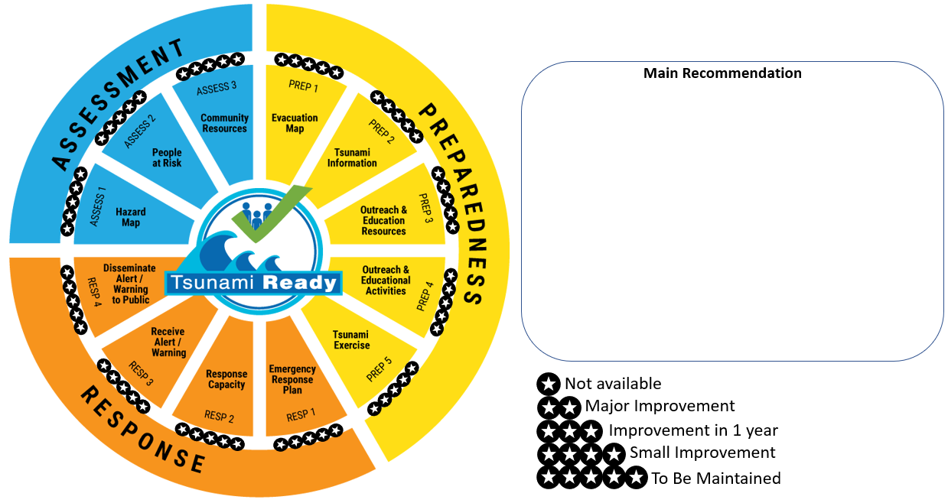
Tsunami Ready Indicator Assessment

Slide 12
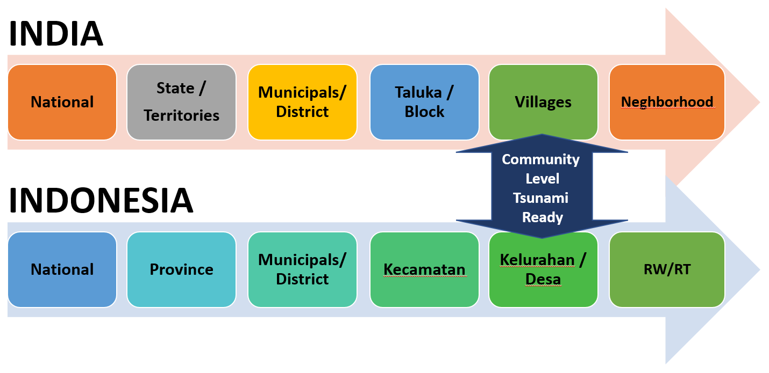
Tsunami Ready Community in Indian Ocean

Slide 13
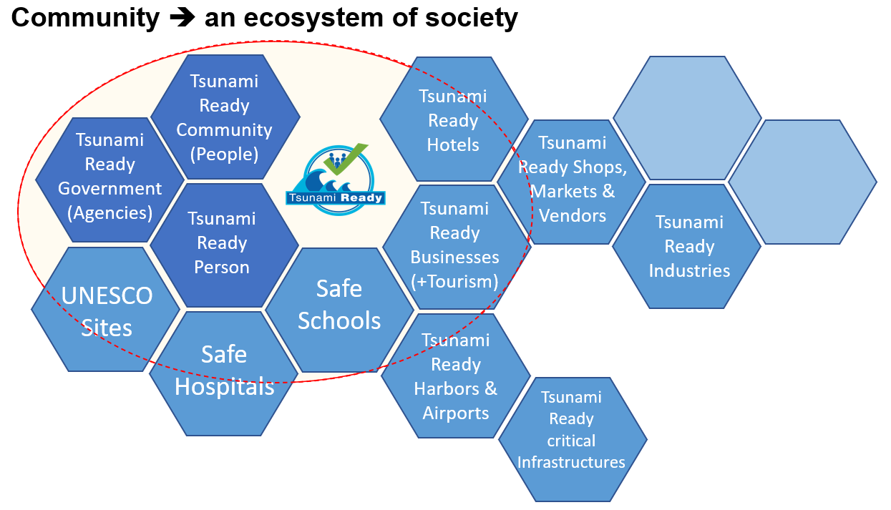
Tsunami Ready Community in Indian Ocean

Slide 14
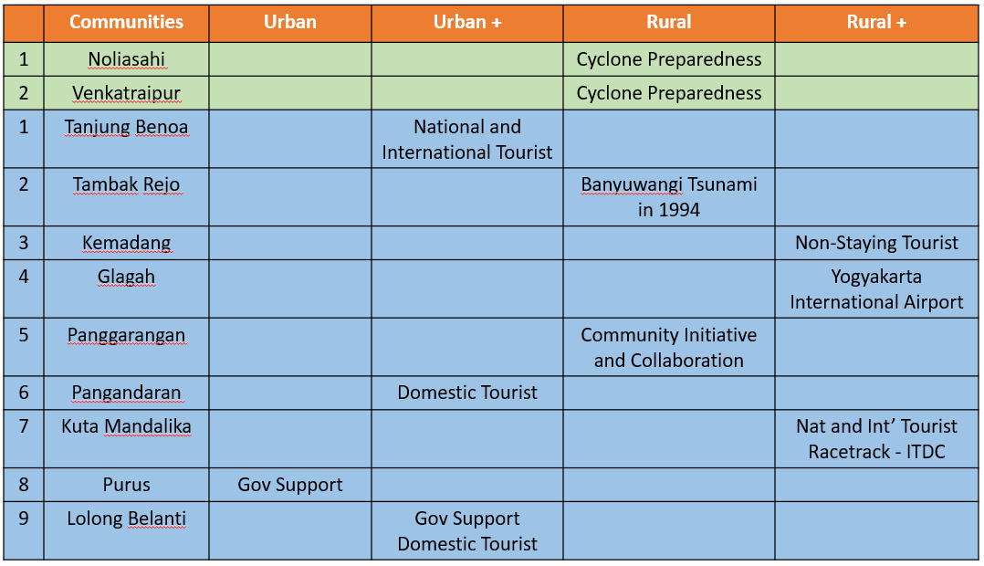
Tsunami Ready Community Characteristics in India and Indonesia

Slide 15
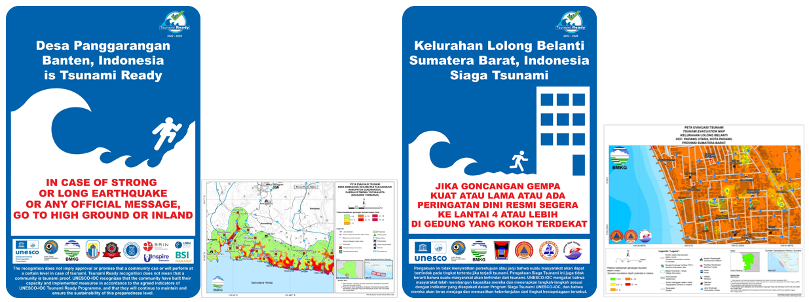
Tsunami Ready Board Signages

Slide 16
Tsunami Ready Implementation
Lessons From India

Slide 17
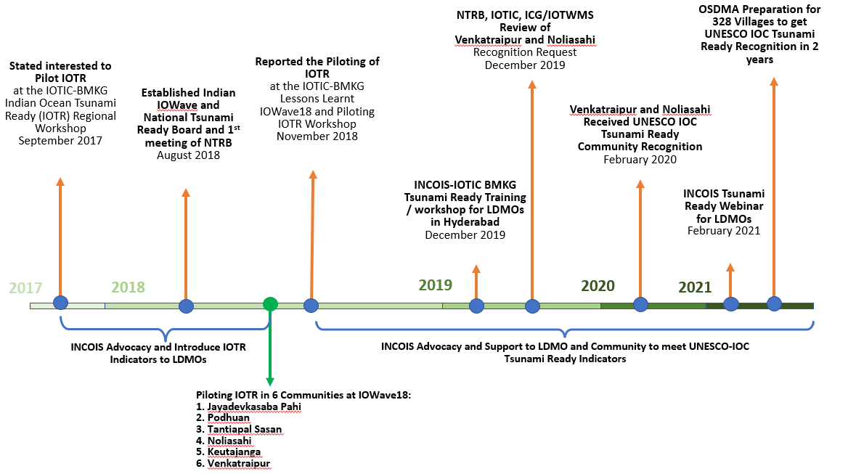
India Tsunami Ready Implementation Timeline

Slide 18
India National Tsunami Ready Board

Slide 19
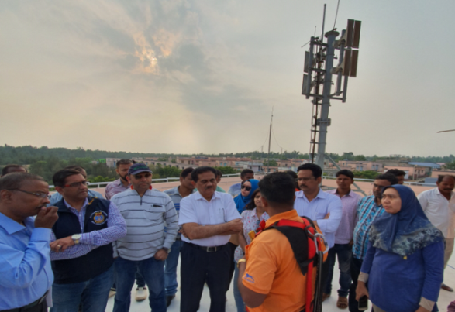
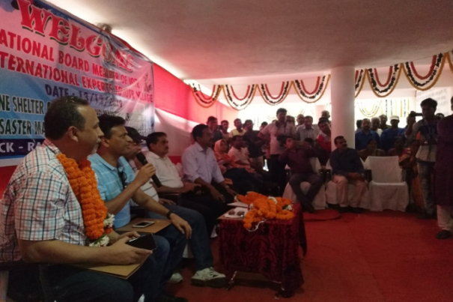
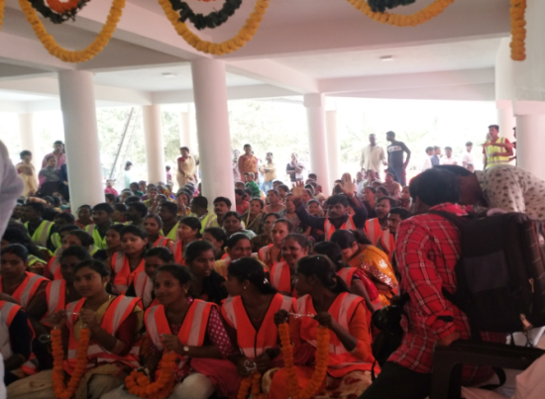
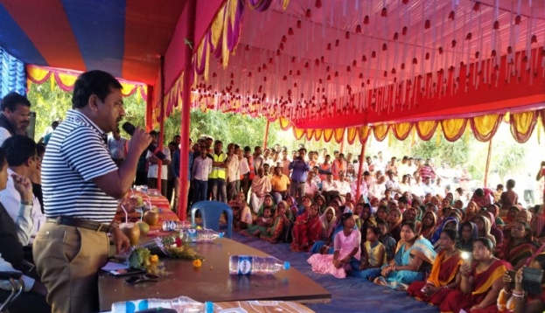
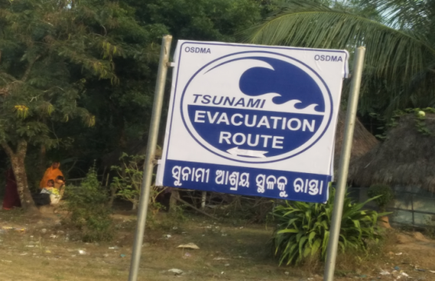
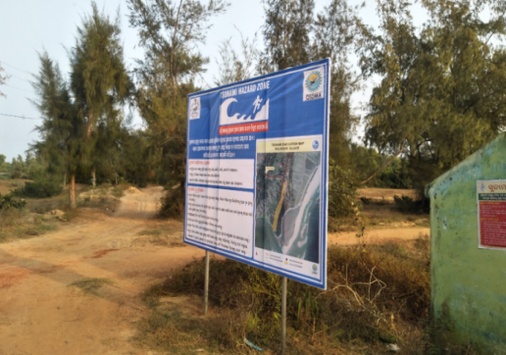
Key Success Factors on Tsunami Ready in India
Strong advocacy by the UNESCO-IOC through IOTIC and IOTWMS
INCOIS - as NTWC taking the lead in creating the right framework conditions for implementing TR by setting up of the NTRB
Background work (Cyclone Preparedness) already undertaken in Odisha in the past decades
Strong involvement of the provincial DMO (OSDMA) and the political leadership in Odisha
Strong community ownership of DRR activities in villages
Opportunity to leverage financial resources
Notes:
Strong advocacy by the UNESCO-IOC through IOTIC and IOTWMS on the Tsunami Ready initiative through organization of Regional TEMPP trainings, preparation of IOTR guidelines, Regional IOWave drills, post-IOWave and IOTR lessons learnt workshops, etc.
INCOIS - as NTWC taking the lead in creating the right framework conditions for implementing TR by setting up of the NTRB chaired by the TNC with members from NDMO and LDMO, as well as technical support and training by the NTWC to the DMOs for preparation of hazard and inundation maps, etc.
Background work (Cyclone Preparedness) already undertaken in Odisha in the past decades in developing DRR policies and plans for Cyclone, Tsunami and other Hazards, setting up Provincial/District/Block level EOCs, establishing multi-level communication systems, participation in IOWave drills, NGO work in training of community volunteers, etc
Strong involvement of the provincial DMO (OSDMA) and the political leadership in Odisha due to the benefits they see in implementing Tsunami Ready in enhancing preparedness for other frequent hazards such as cyclones
Strong community ownership of DRR activities in villages due to their horrifying experience of the 1999 super cyclone .
Opportunity to leverage financial resources for implementation of Tsunami Ready from already existing national and provincial DRR programmes.

Slide 20
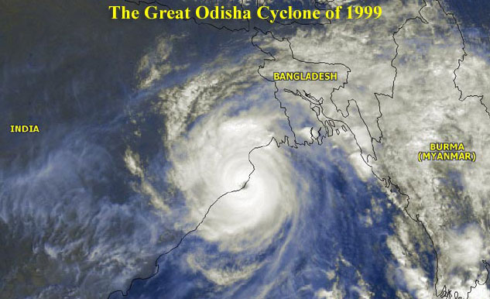
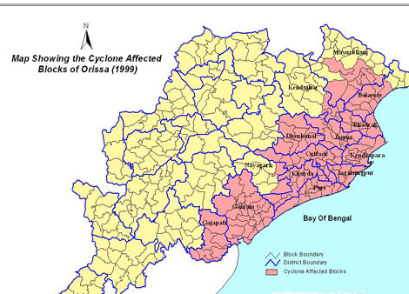
India – Odisha Cyclone Preparedness
The Great Odisha Super Cyclone of 1999
Human Lives Lost 10.086
Person Injured: 12.507
Population Affected: 15.6 Million
Houses Damaged or washed away 1.8 million

Slide 21
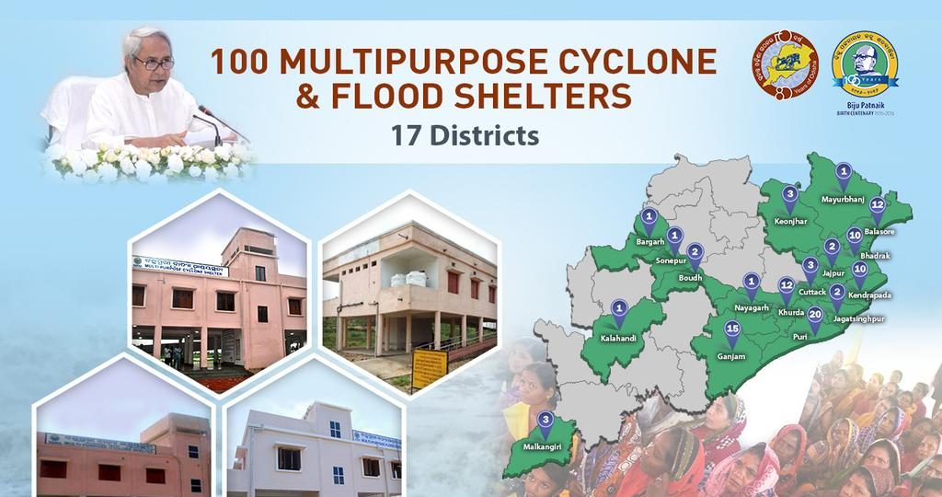
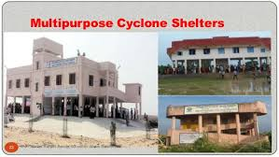
India – Odisha Cyclone Preparedness
Preparedness Action Post Odisha Super Cyclone of 1999
Construction of Multi-purpose Cyclone Shelters
Cyclone Resistant Building Construction Technology for Houses
Community Awareness Program
Disaster management and Managers at Community
Central, State, District, Block and Community Disaster Management Plan

Slide 22
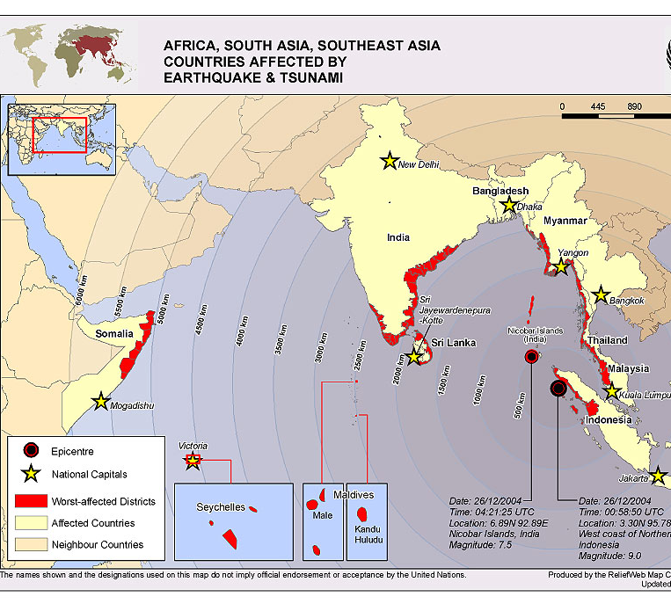
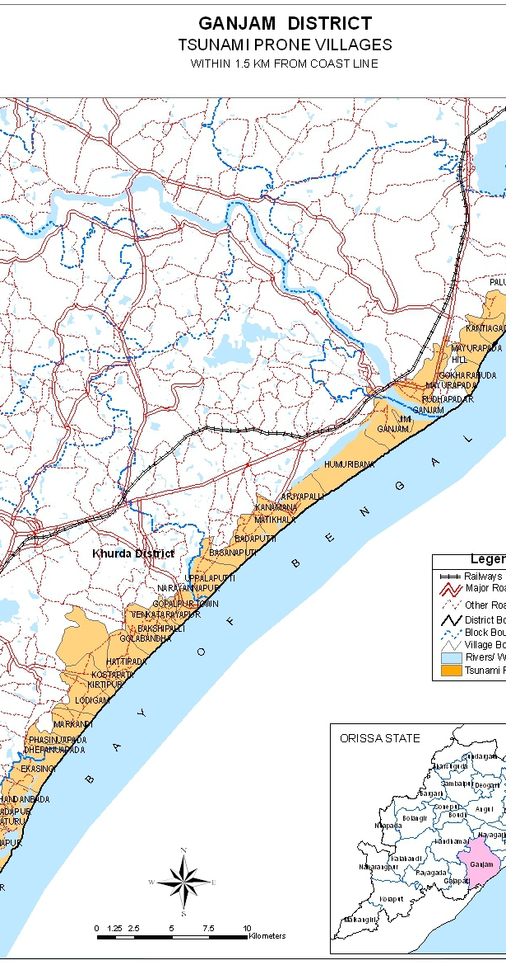
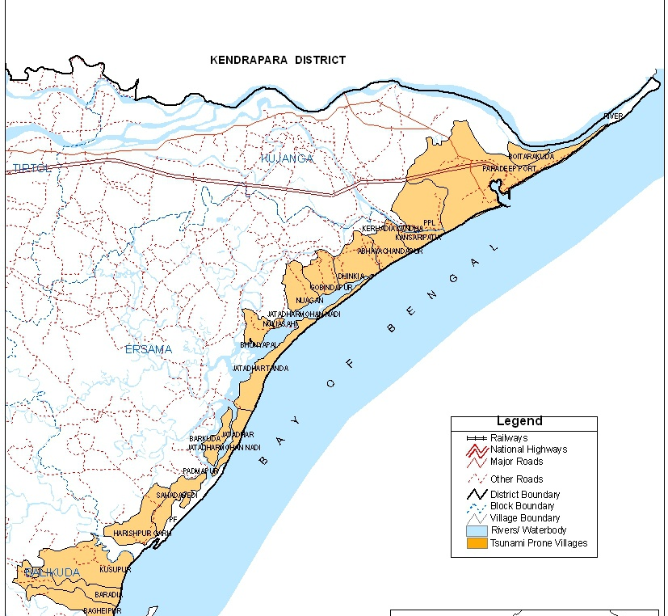
From Cyclone to Tsunami Hazard
Tsunami Hazards in Odisha
Tsunami Preparedness
UNESCO-IOC
IOWave Exercises
2011
2014
2016
2018
2020

Slide 23
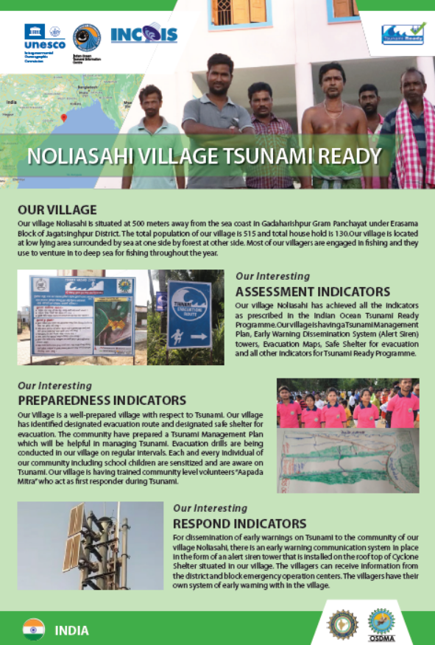
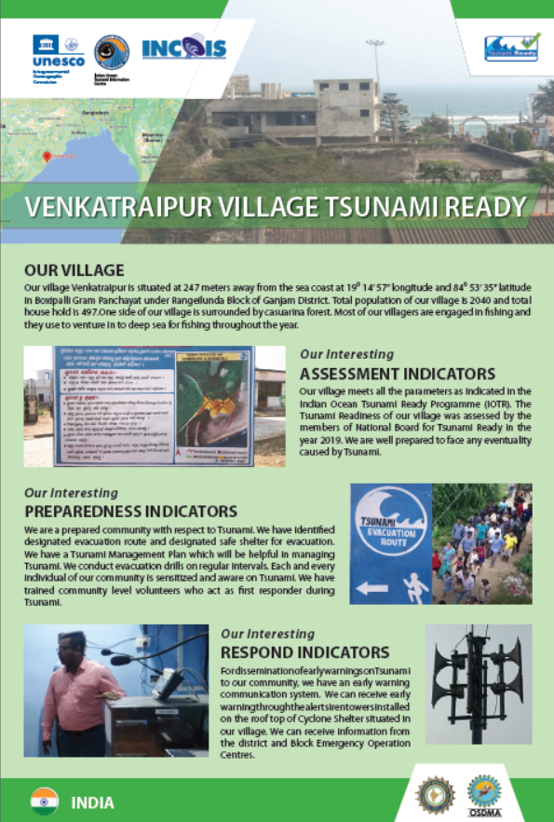
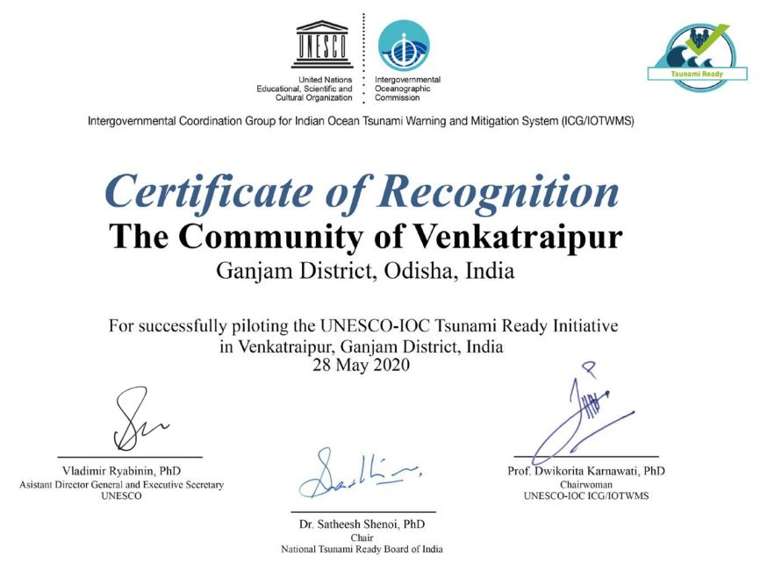
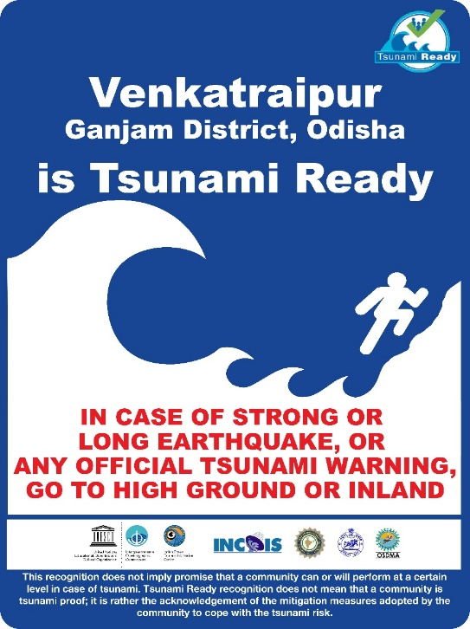
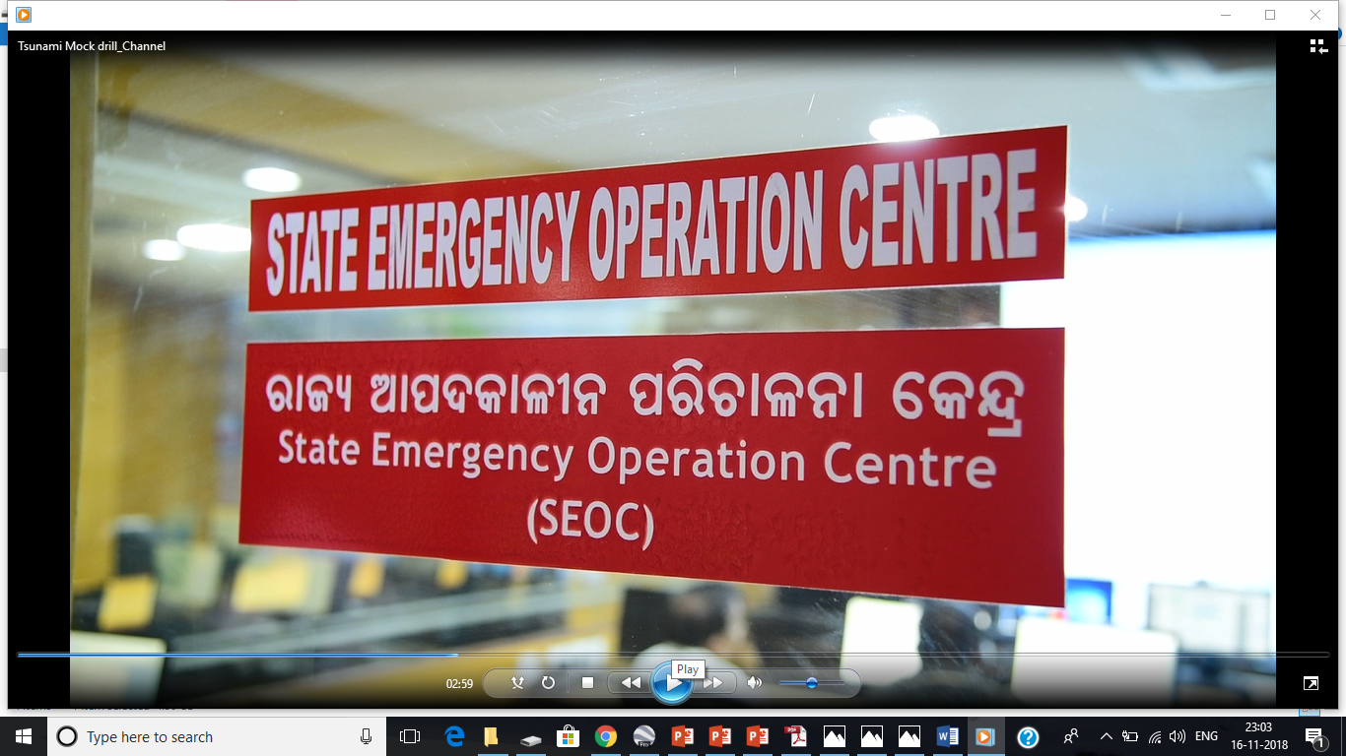
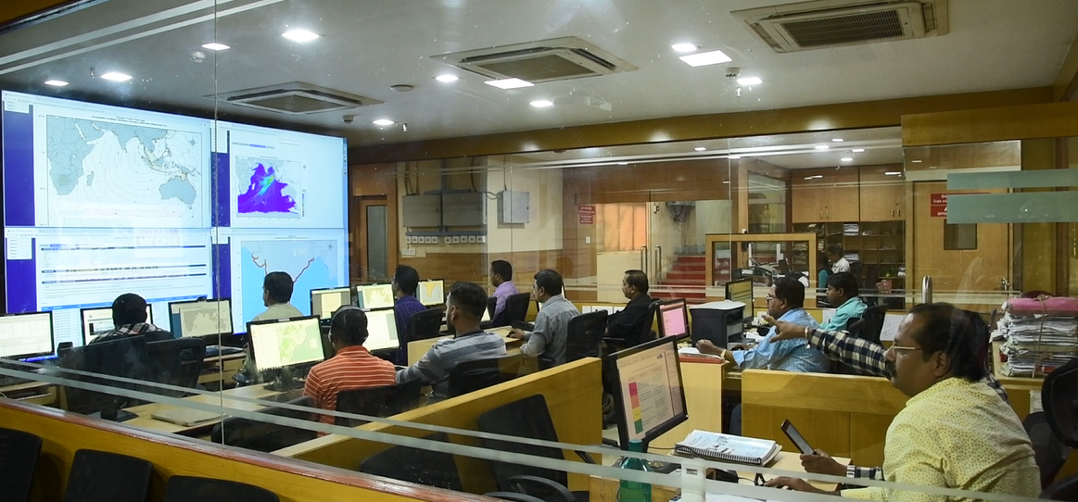
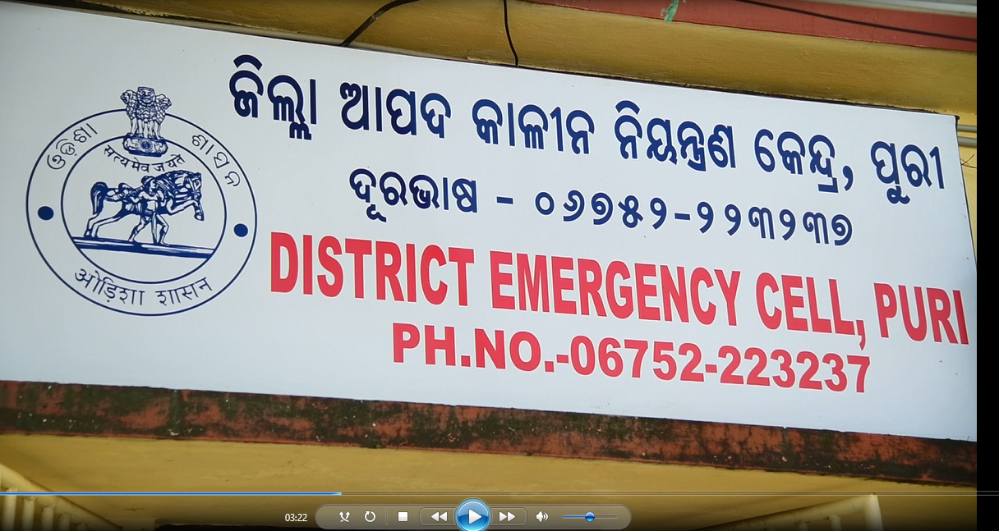
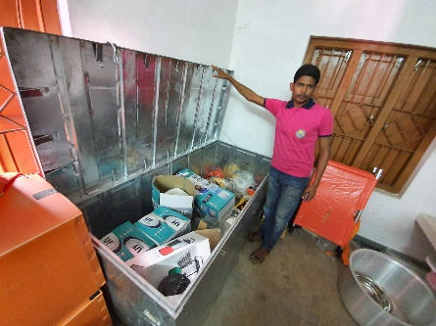
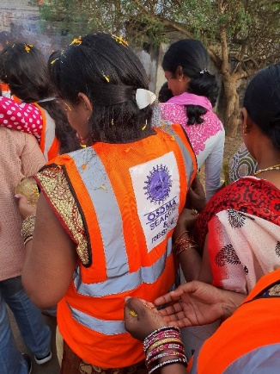
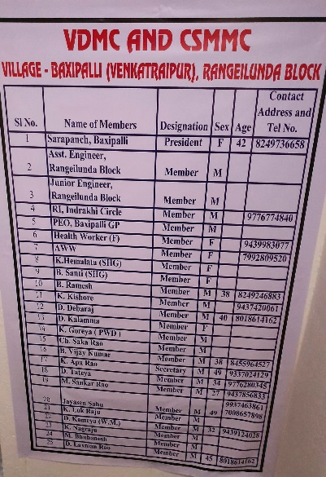
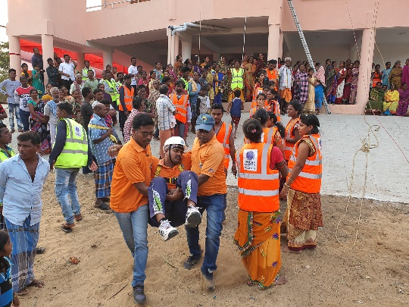
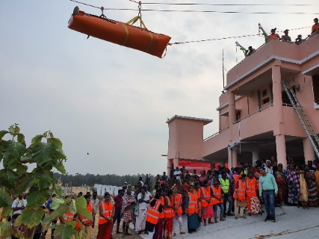
India-Odisha Recognized Tsunami Ready Villages
The State of Odisha targeted additional 324 Villages in Odisha received UNESCO-IOC Tsunami Ready Recognition in the next few years
Notes:
2020

Slide 24
Tsunami Ready Implementation
Lessons From Indonesia

Slide 25
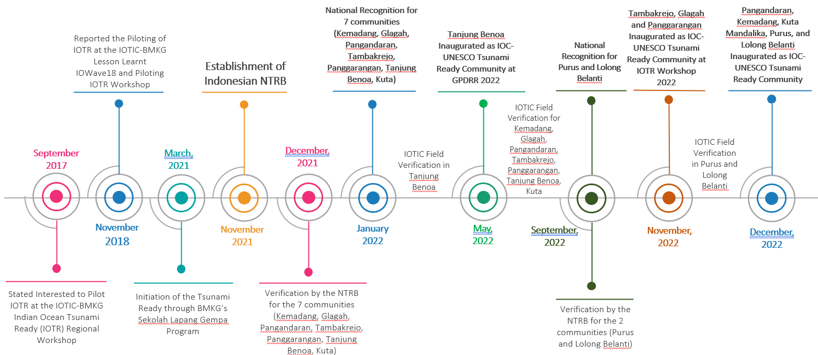
Indonesian Tsunami Ready Implementation Timeline

Slide 26
Indonesian National Tsunami Ready Board

Slide 27
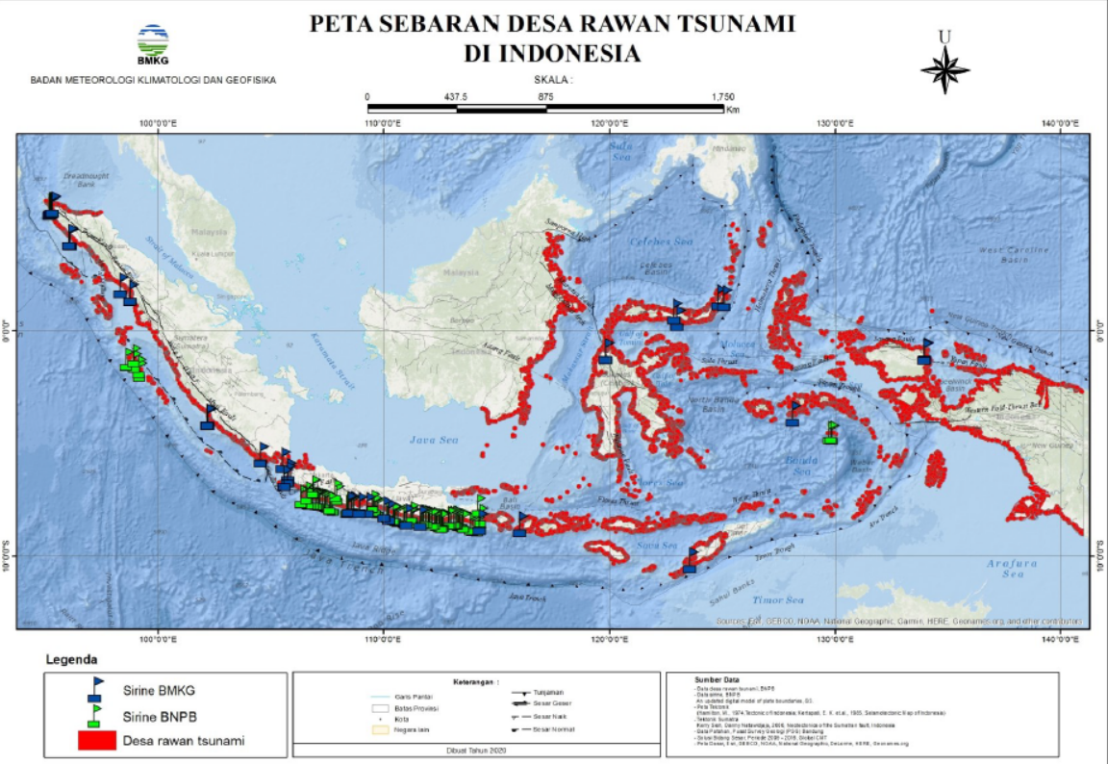
Coast with Tsunami Risk in Indonesia ➔ Near Field Tsunamis

Slide 28
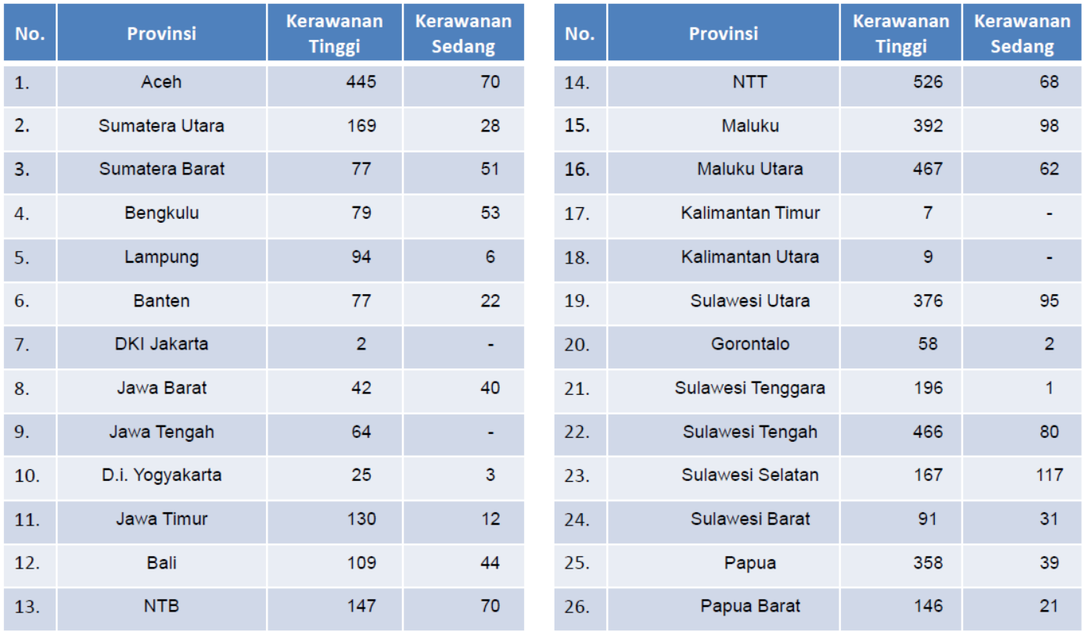
Vulnerable Villages in Indonesia
There 5732 villages are prone to tsunami
4719 villages are in high risk
1013 villages are in moderate risk

Slide 29
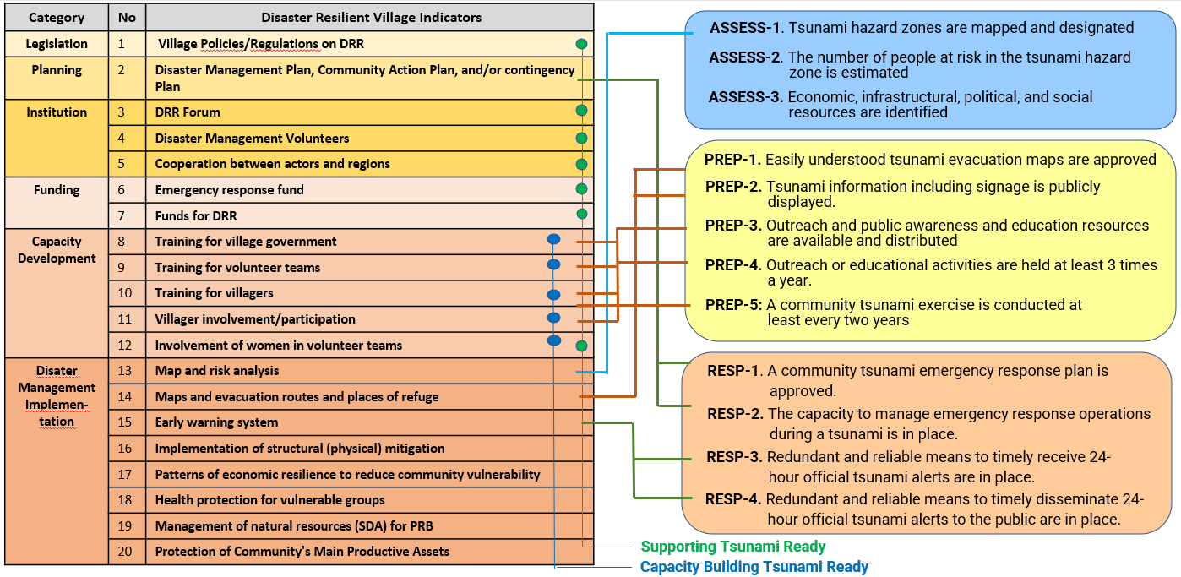
Aligning Tsunami Ready with National Programme

Slide 30
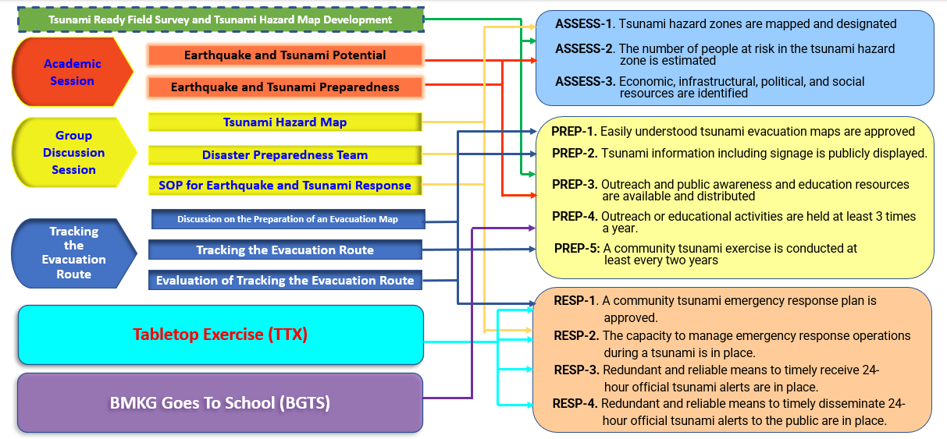
Aligning Tsunami Ready with National Programme

Slide 31
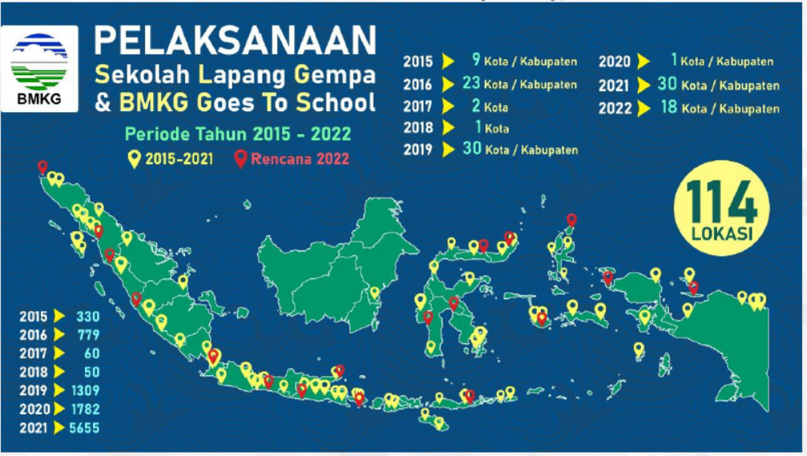
Aligning Tsunami Ready with National Programme

Slide 32
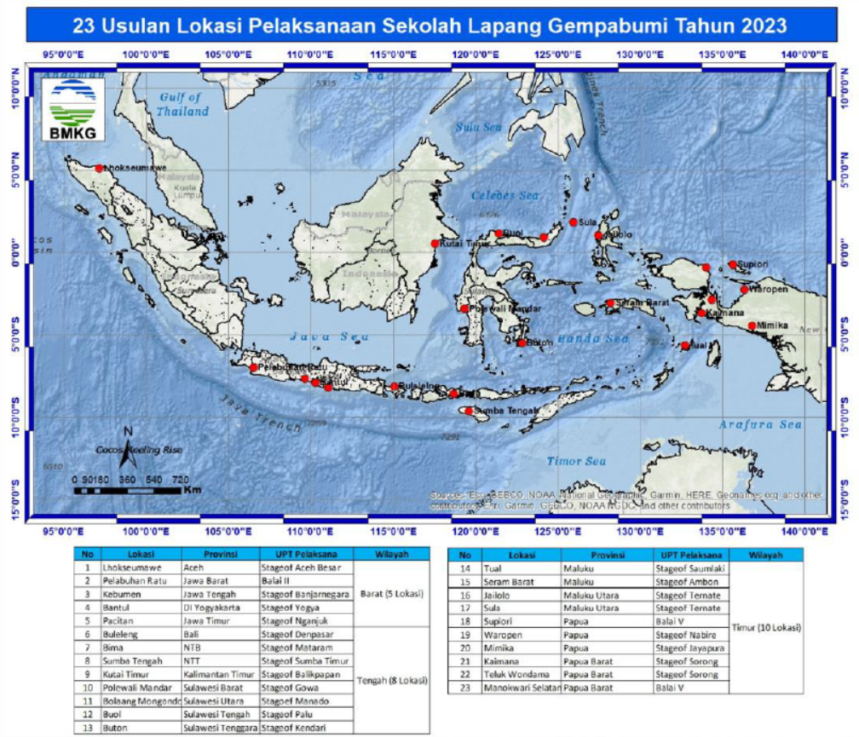
Aligning Tsunami Ready with National Programme

Slide 33
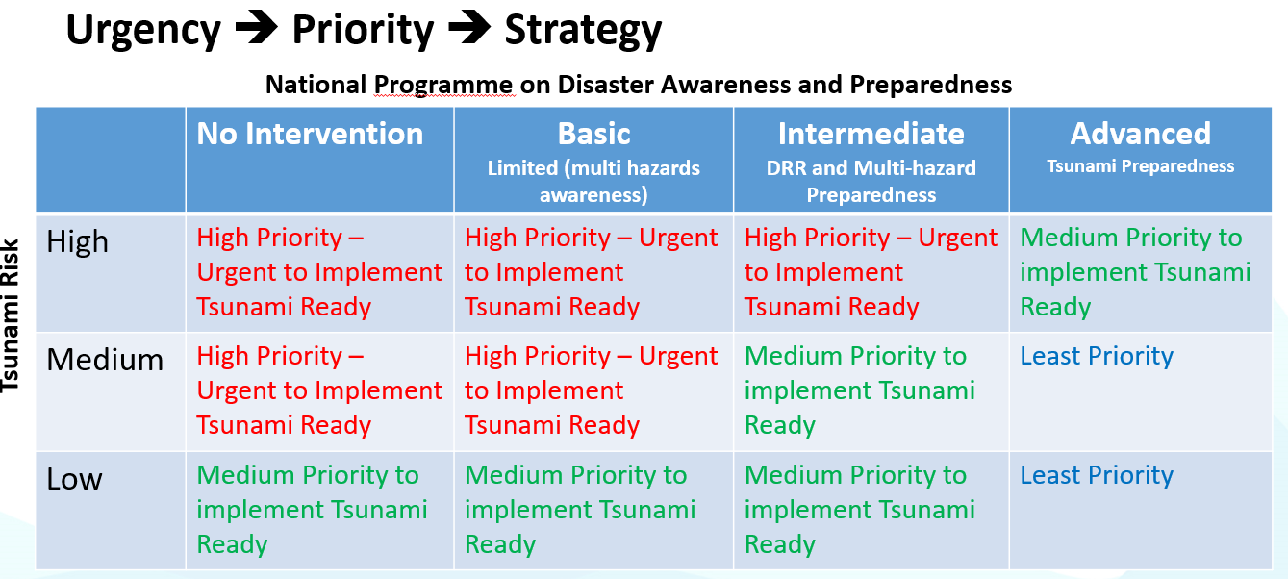
Recommendation for Tsunami Ready Implementation

Slide 34
Indonesian Recognized Tsunami Ready Communities

Slide 35
Field Verification of a Tsunami Ready Community

Slide 36
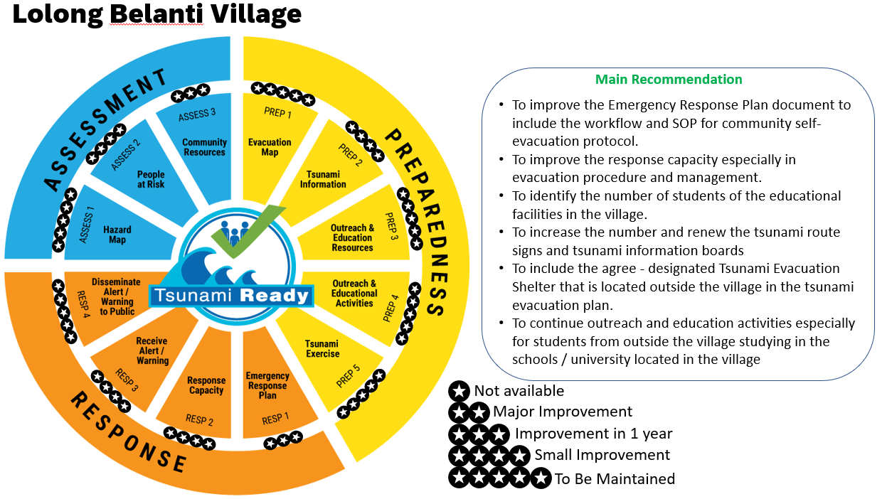
Field Verification of a Tsunami Ready Community

Slide 37
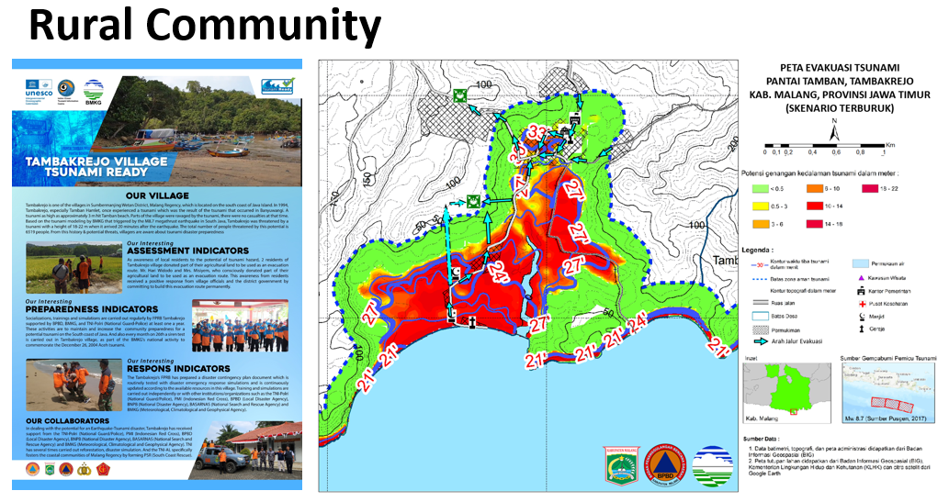
Good Practices 1
2 Community members grant their land (rice field) to ensure faster and shorter evacuation route
Hit by 1994 Banyuwangi Tsunami

Slide 38
Good Practices 2
Support from the Race Track Development and Activities for Community DRR

Slide 39
Good Practices 3
Special Emergency Access Gate for Community Evacuation

Slide 40
Good Practice 4
Memorandum of Understanding with Hotels as vertical evacuation shelter for community and schools

Slide 41
Good Practices 5

Slide 42
Summary of the TR Indicators in 9 Communities
Notes:
Most of these communities have had tsunami hazard map, emergency plan, and emergency response team. This was established from previous interventions they had from different organizations. The existence of some of these information that link to the tsunami ready indicators made the advocacy relatively easier. However,
In general, the tsunami hazard maps were not based on the latest earthquake and tsunami studies. An assistance from experts are needed to improve the tsunami hazard map and evacuation map.
The community’s understanding of the potential and characteristic of the earthquake and tsunami in the area as well as their understanding of the principles of preparedness and response are still limited. For example, many of the temporary evacuation points are still located in the hazard zone and does not meet the criteria as a safe point.
The community needs the support from the local government to establish or revitalize their evacuation facility. Many of the agreed evacuation place needs to be repaired and maintained, the evacuation signages were worn-out and unclear, the evacuation routes is not appropriate, and the lack of tsunami evacuation shelter.
A comprehensive survey/study based on UNESCO-IOC Tsunami Ready Indicators needs to be done to understand the already established capacity within the communities from the previous interventions. The survey/study is not only to know and acknowledge the efforts, initiatives, or readiness of the community toward the 12 indicators, but also to review the quality and actual capacity of the community according to the expectation of the 12 indicators.

Slide 43
Key Success Lessons from TR Implementation in 9 Communities

Slide 44
What Tsunami Ready Recognition Means to the Community

Slide 45
UNESCO
Intergovernmental Oceanographic Commission (IOC)
IOC-UNESCO DG ECHO CoastWAVE project
UNESCO IOC Sector Tsunami Unit
d.chang-seng@unesco.org
CoastWAVE project website

