Slide 1
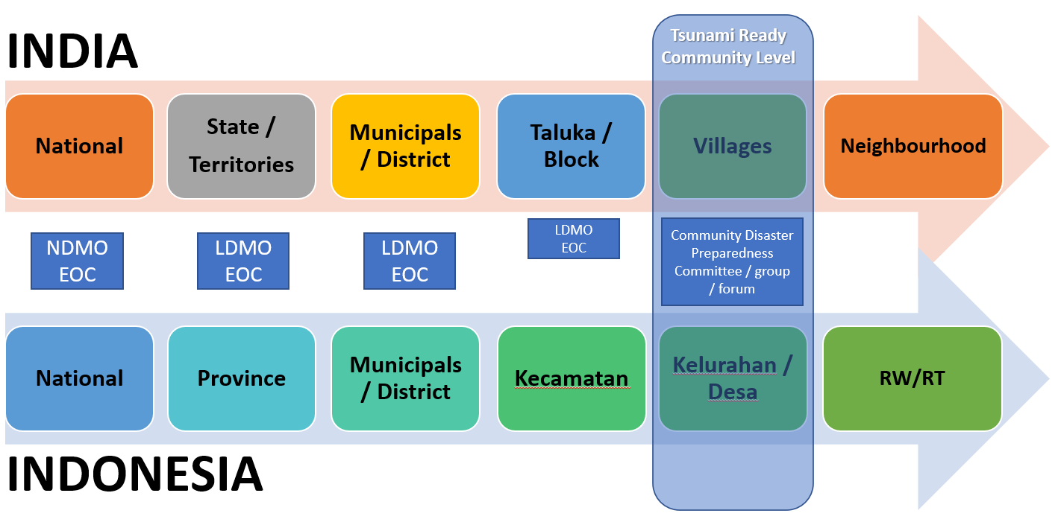
Tsunami Ready Community in Indian Ocean

Slide 2
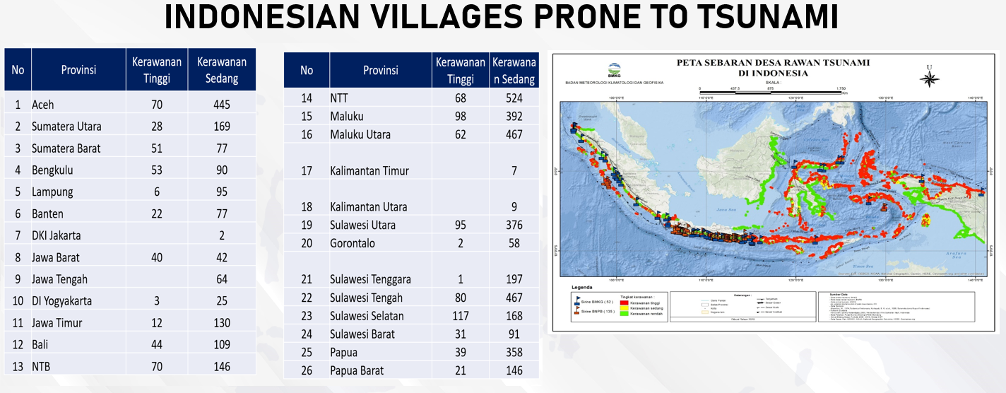

Coast with Tsunami Risk in Indonesia ➔ Near Field Tsunamis
There 5744 villages are prone to tsunami (1013 villages in high risk, and 4731 villages are moderate)

Slide 3
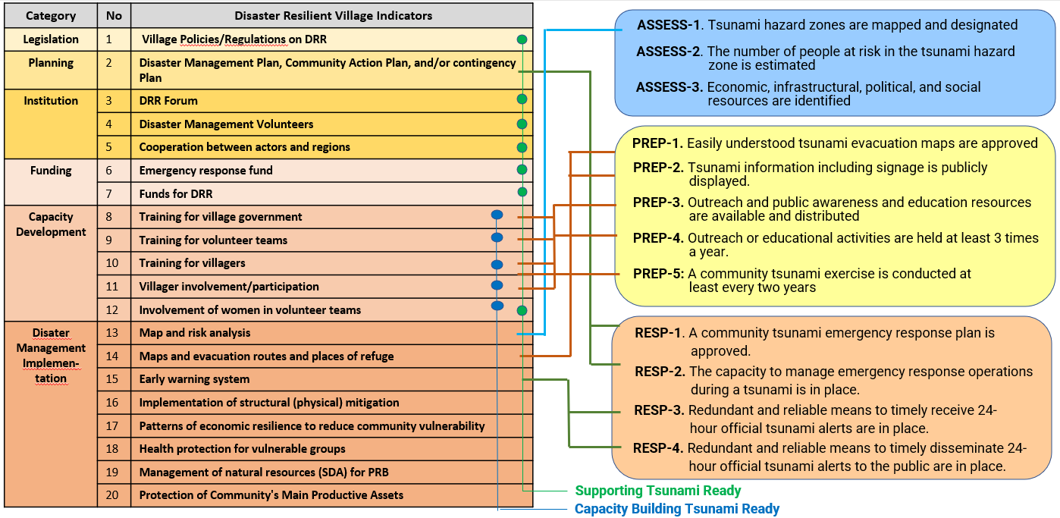
Aligning Tsunami Ready with National Programme

