Slide 1
UNESCO IOC Tsunami Ready Communication Tools
Ardito M Kodijat
Indian Ocean Tsunami Information Centre - IOC UNESCO

Slide 2
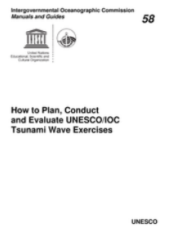
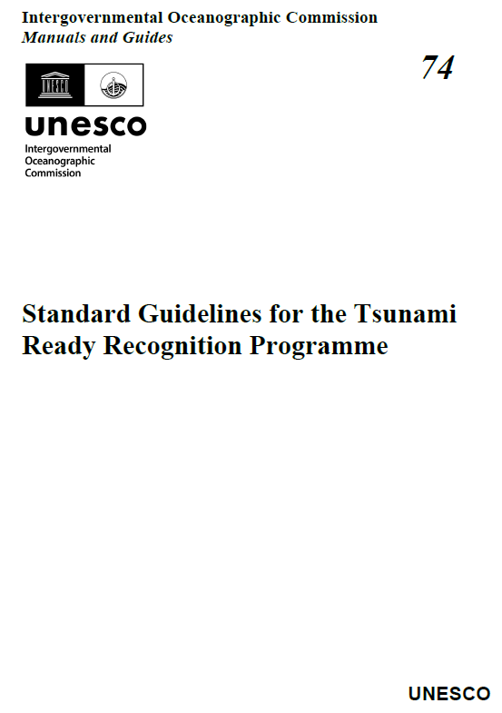
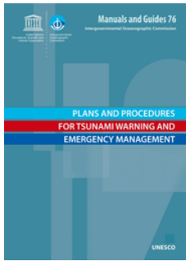
Manual and Guides
1
Manual and Guide No 58
Manual and Guide No 74
Manual and Guide No 76
https://unesdoc.unesco.org/ark:/48223/pf0000218967
https://oceanexpert.org/downloadFile/50068
https://unesdoc.unesco.org/ark:/48223/pf0000256552

Slide 3
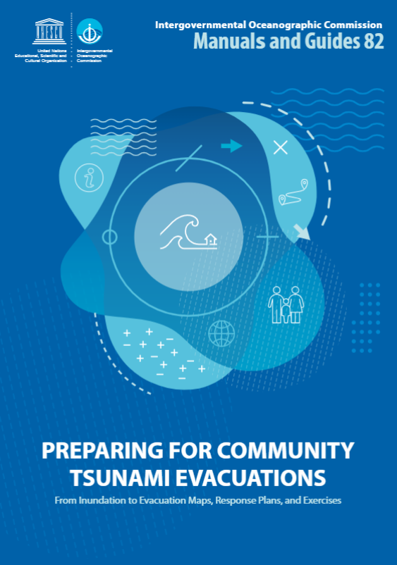
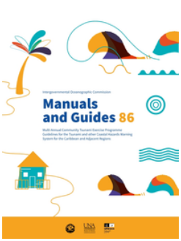
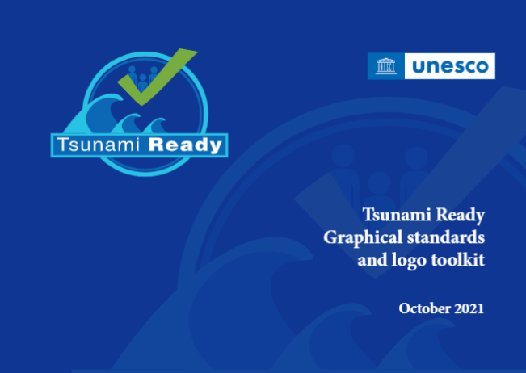
Manual and Guides
Manual and Guide No 82
Manual and Guide No 86
Use of the Tsunami Ready logo would need to request the approval from UNESCO/IOC Tsunami Unit. Please contact: ioc-tsu@unesco.org for permission.
Multi-annual community tsunami exercise programme: guidelines for the tsunami and other coastal hazards warning system for the Caribbean and Adjacent Regions
https://unesdoc.unesco.org/ark:/48223/pf0000373019?posInSet=17&queryId=947ca611-1880-4ded-bb5a-4bd61c93c161
https://unesdoc.unesco.org/ark:/48223/pf0000380936
https://unesdoc.unesco.org/ark:/48223/pf0000380540.locale=en

Slide 4
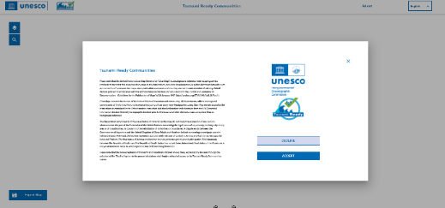
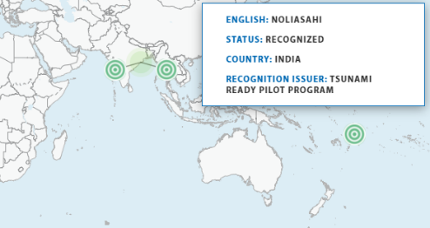
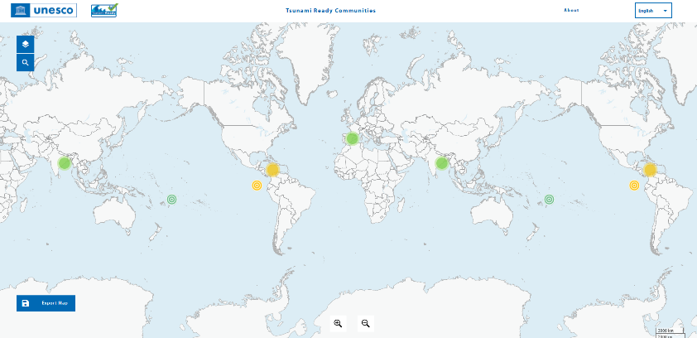
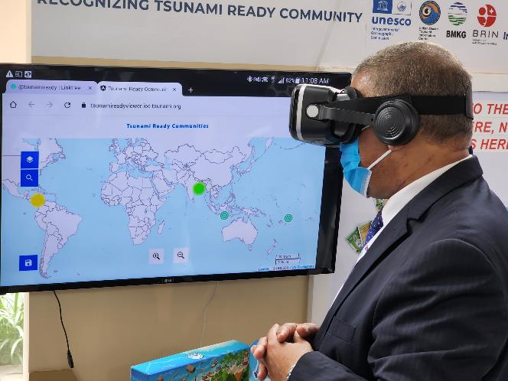
Global Tsunami Ready Map
2
https://tsunamireadyviewer.ioc-tsunami.org/

Slide 5
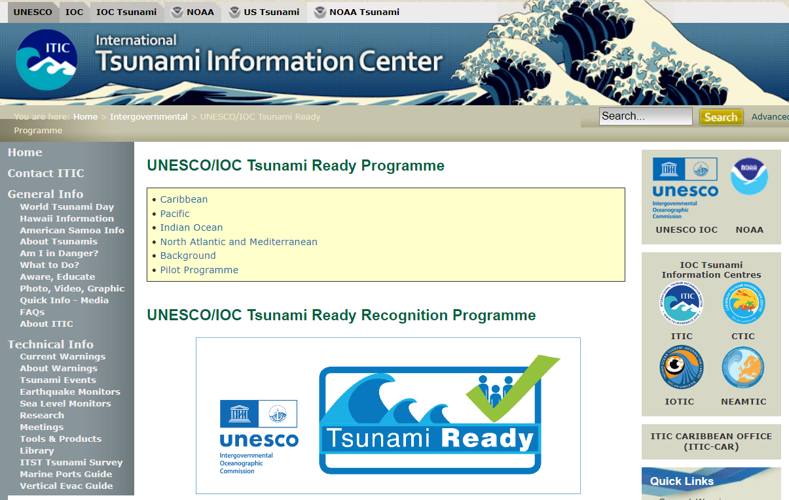
Tsuami Ready Website
3
http://itic.ioc-unesco.org/index.php?option=com_content&view=category&id=2234&Itemid=2758

Slide 6
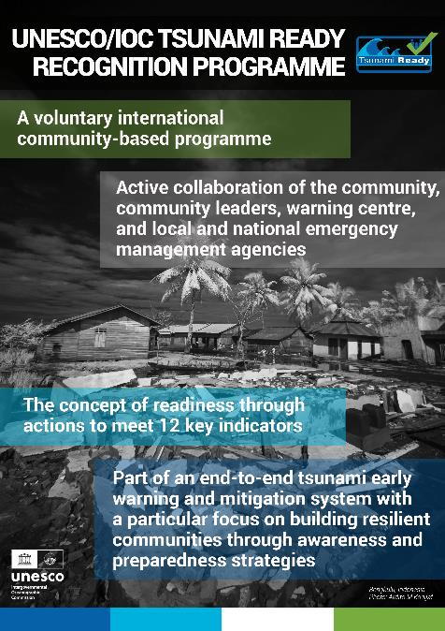
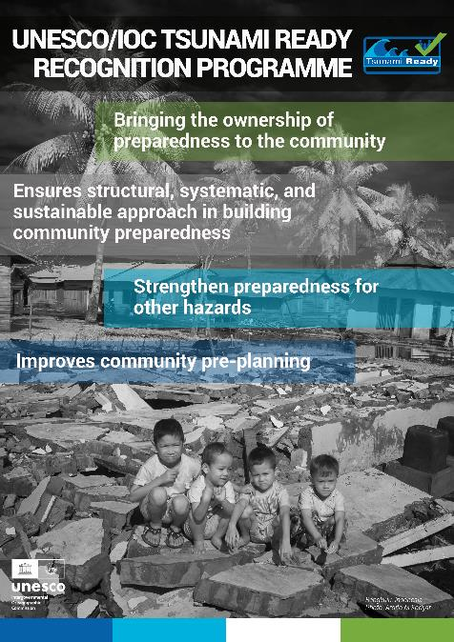
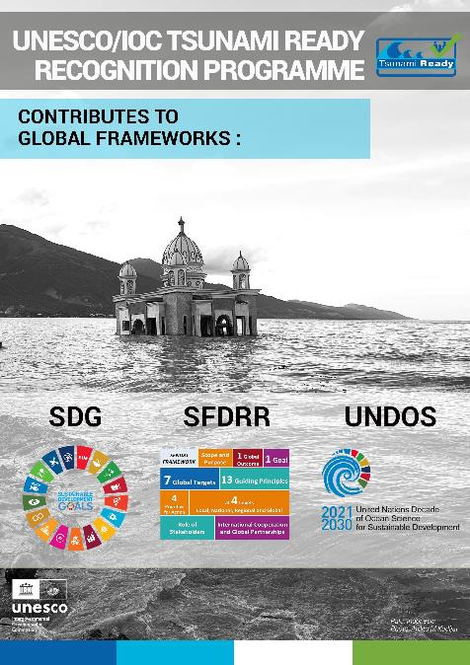
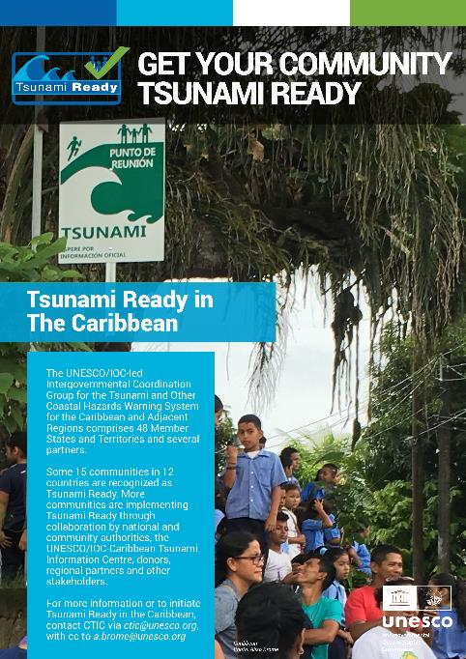
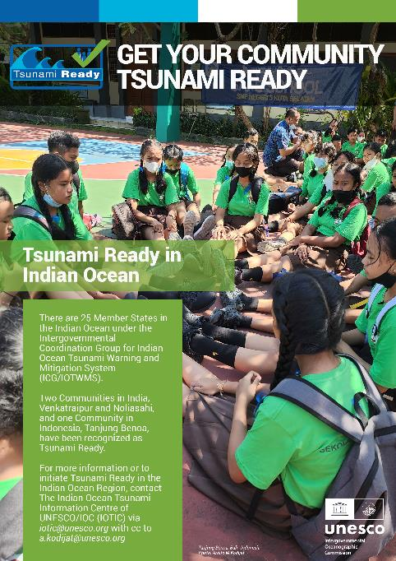
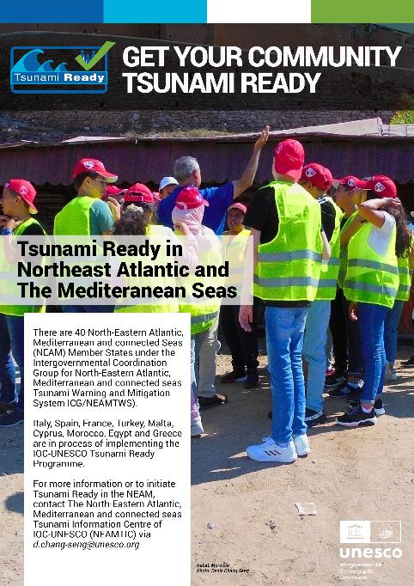
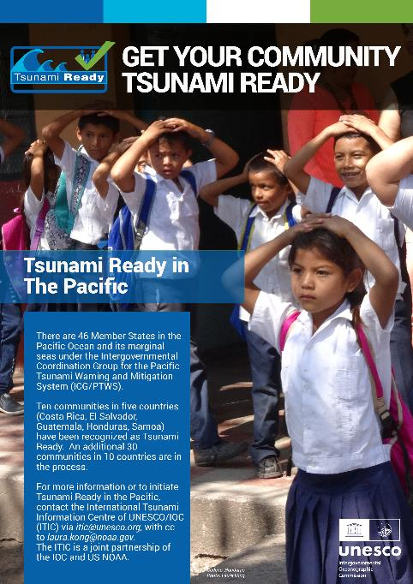
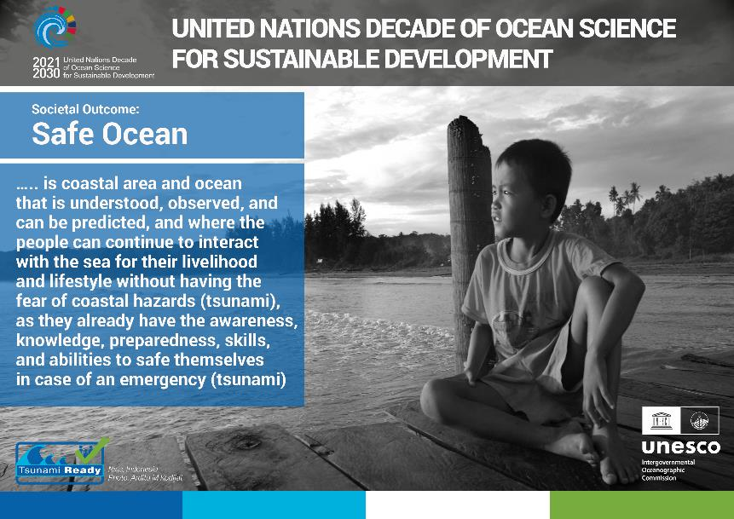
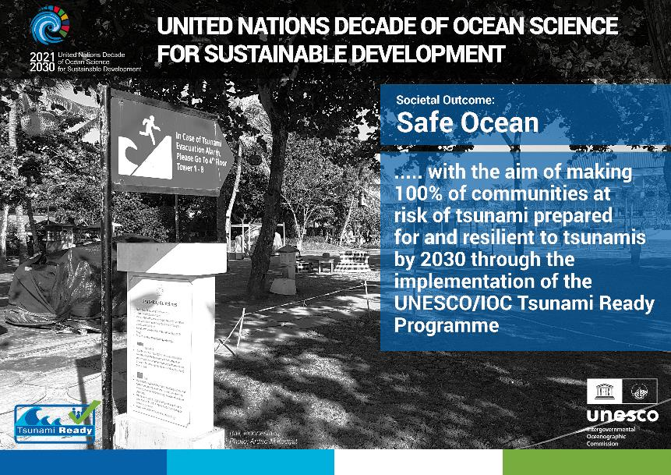
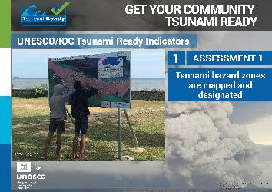
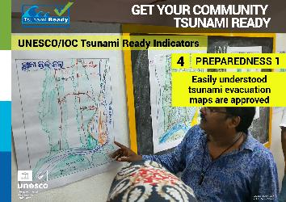
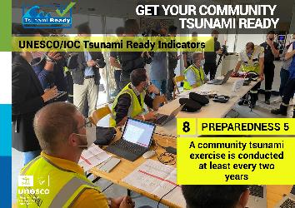
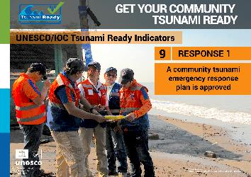
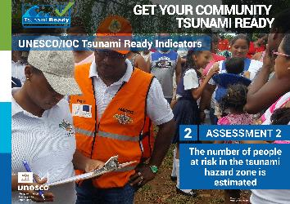
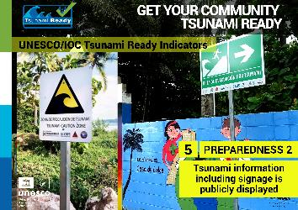
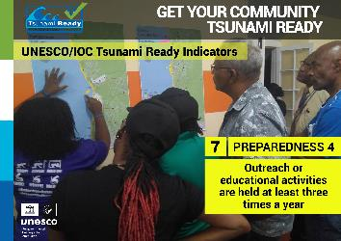
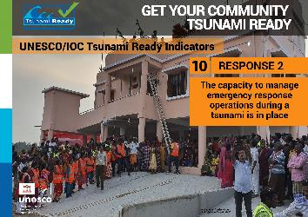
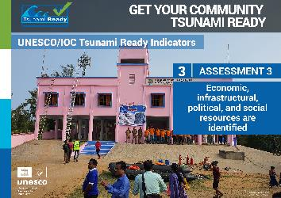
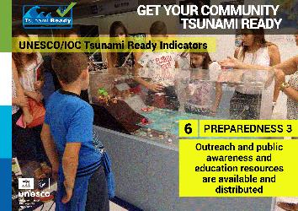
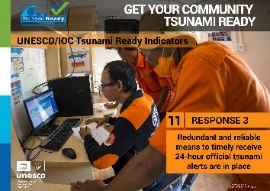
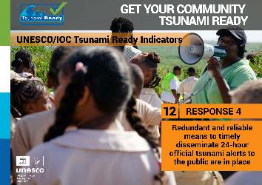
Tsunami Ready Posters
4
21 E-Posters Tsunami Ready

Slide 7
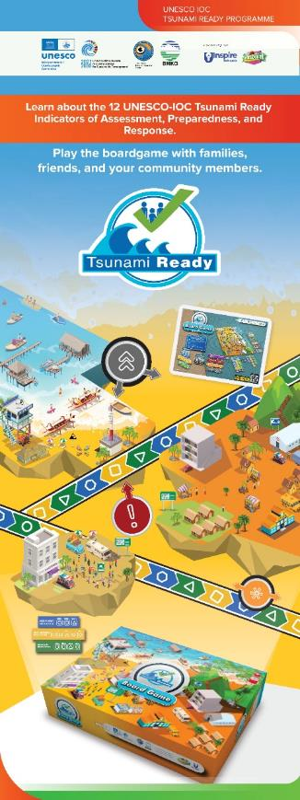
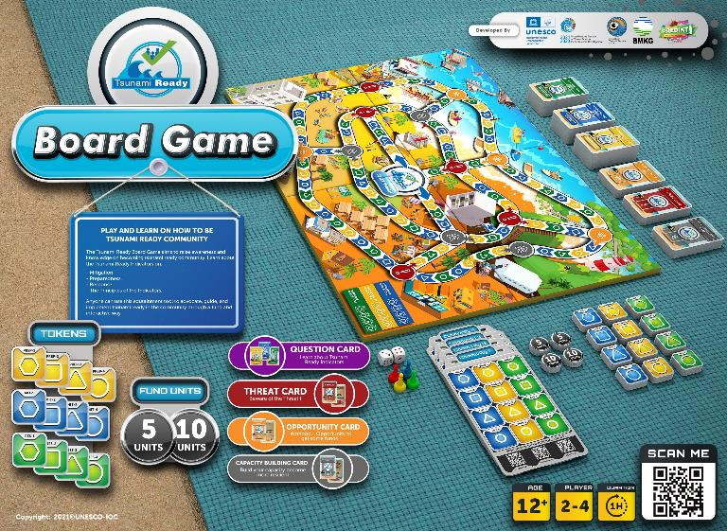
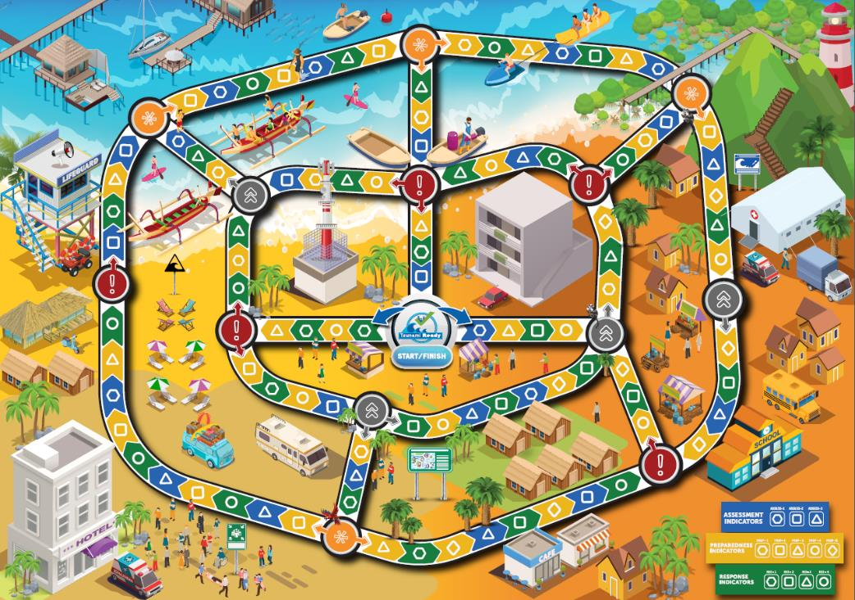
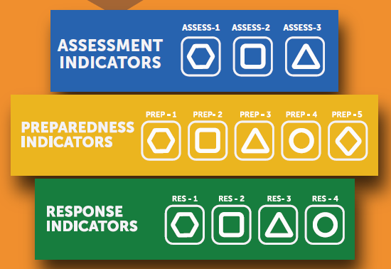
Tsunami Ready Game
5
Could be played in different levels
Beginner (+ 1 hour)
Middle (+ 2 hours)
Advanced (> 2 hours)
Cards 375 (+ 300 questions, 75 instructions)
To introduce the 12 Tsunami Ready Indicators to the stakeholders
(12 + years)

Slide 8
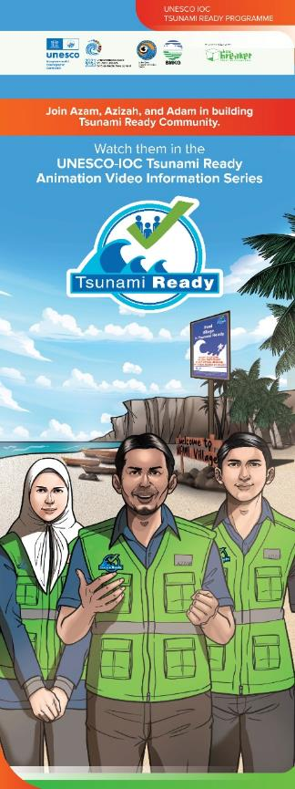
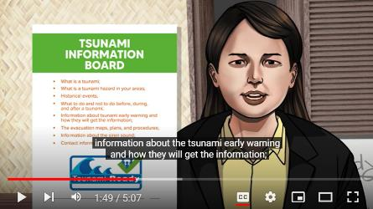
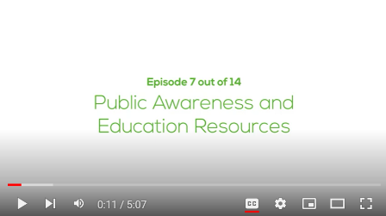
Tsunami Ready Videos
6
Story line:
Following the journey of Azam, Azizah, and Adam in building their Village “Nami” to be a Tsunami Ready Community based on UNESCO-IOC Tsunami Ready Indicators
Video 1: Tsunami Ready (an introduction) + 7:10 minutes
Video 2: Tsunami Hazard for Tsunami Ready Community + 8:02 minutes
Video 3: Knowing people at risk of tsunami + 4:48 minutes
Video 4: Resource and capacity for Tsunami Ready Community + 6:57 minutes
Video 5: Public Tsunami Information in Community + 5:32 minutes
Video 6: Tsunami Evacuation Map for the community + 5:15 minutes
Video 7: Public Awareness and Education Resources + 5:07 minutes
Video 8: Outreach Activities in Tsunami Ready Community + 4:39 minutes
Video 9: Community Tsunami Exercise + 6:49 minutes
Video 10: Community Tsunami Emergency Operation Plan + 5:28 minutes
Video 11: Building Capacity in community for Emergency Response + 7:50 minutes
Video 12: Linking the Community to the Tsunami Warning Chain + 4:40 minutes
Video 13: Providing warning to the community + 5:27 minutes
Video 14: Getting Tsunami Ready Recognition + 6:50 minutes
IOTIC YouTube Channel: https://www.youtube.com/channel/UCFSPN4dJXOvFrMIkmlQdumQ
Playlist: https://www.youtube.com/playlist?list=PLDzuUvIHTe3BLFcgDGXOAkwcCdTQ6VngH

Slide 9
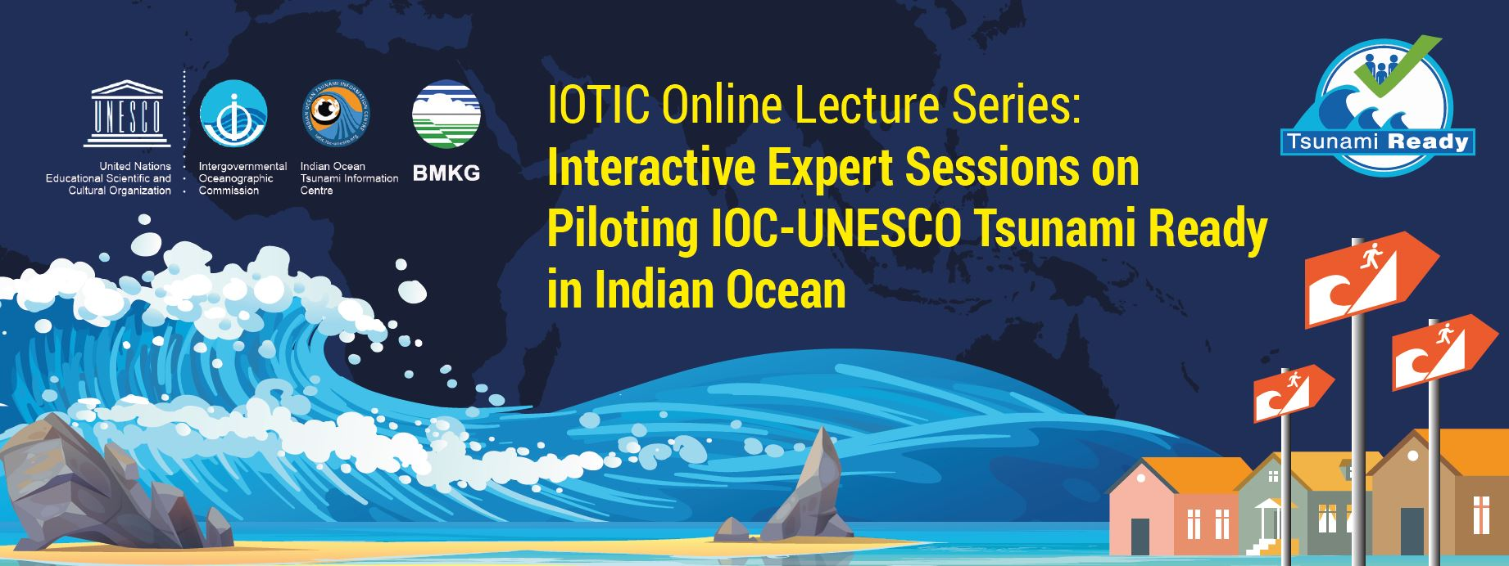
Tsunami Ready Online Lecture Series
7
Tsunami Ready Online Lecture Series Recording
FB IOTIC : https://www.facebook.com/iotsunami
IG IOTIC : https://www.instagram.com/iotsunami/
YouTube IOTIC : https://www.youtube.com/user/iotsunami
Twitter IOTIC : https://twitter.com/iotsunami

Slide 10
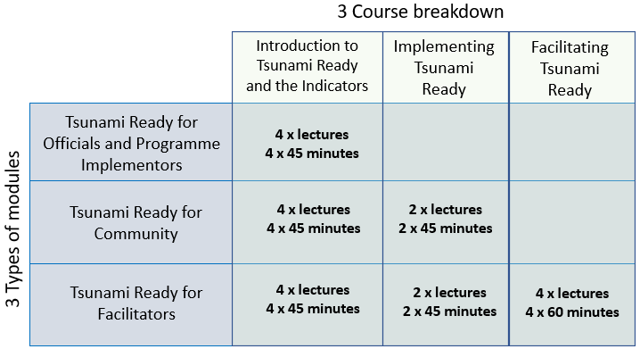

Tsunami Ready Courses (available in 2023/2024)
8
The training is targeted for Government Officials (i.e. from National or Local Disaster Management Offices, National Tsunami Warning Centres, Gov Institutions) and Programme / Project planner and implementor (Donors, Funding agencies), etc.
Module 1
Tsunami Ready for Officials and Programme Implementors
(1 Course)
The training is targeted for Community leaders, Non-Governmental Organizations (NGOs), Civil Society Organizations (CSOs), Academics and Scientists, Community members, Private, Business, etc.
Course 1
Introduction to Tsunami Ready
& the Indicators
What is Tsunami Ready
Why is it important
What is the benefit of implementing TR
What are the indicators
Why are these indicators
Module 2
Tsunami Ready for Community
(2 Courses)
Course 2 Implementing Tsunami Ready
What do community do to start to implement TR
Who are the stakeholder and the technical organization
How to approach the organizations
The training is targeted for Disaster Risk Reduction Facilitators for Disaster risk reduction workers and volunteers who are interested in assisting the community in capacity building for tsunami preparedness, etc.
Module 3
Tsunami Ready for Facilitators
(3 Courses)
Course 3 Facilitating Tsunami Ready
What does each of these indicator means and the relation of each indicators
How to work on each of the Indicators

Slide 11


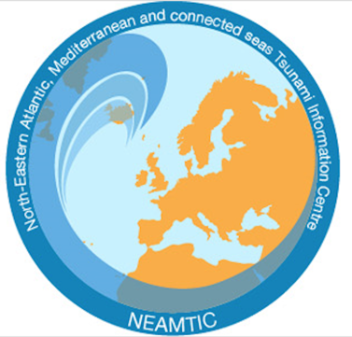

Tsunami Ready Supports
Tsunami Information Centers
PTWS - ITIC
USA NOAA – IOC Partnership 1965
Chile SHOA Associate Director 1998
NEAMTWS - NEAMTIC
EC DG ECHO
France, Greece, Italy, Portugal 2011-13
TIC to advocate, facilitate, guide, and support the member states in the Tsunami Ready Implementation through trainings, workshops, or capacity building as needed (regional and/or national).
IOTWMS- IOTIC
Indonesia BMKG – IOC Partnership 2012 (formerly JTIC since 2006)
CARIBE-EWS - CARIBETIC
Barbados– IOC Partnership 2015
(approved 2007)

Slide 12







Please follow us on:
iotic.ioc-unesco.org
www.iotsunami.org
facebook.com/iotsunami
iotsunami
Ardito Kodijat
a.kodijat@unesco.org
@iotsunami
IOC/UNESCO Indian Ocean Tsunami Information Centre
IOTIC-BMKG Programme Office
UNESCO Office Jakarta
youtube.com/iotsunami
iotic@unesco.org

