Slide 1
TR Cross Crediting for Countries not implementing TR TOWS Task Team Disaster Management and Preparedness
Christa von Hillebrandt-Andrade
ITIC Caribbean Office
David Coetze
National Emergency Management Agency
New Zealand
February 27, 2023

Slide 2
Background Points
ODTP Goal is that 100% of at risk communities are prepared and resilient through programmes like Tsunami Ready
Some countries do not have plans to implement Tsunami Ready
Of these, some have programmes and initiatives to get at risk communities prepared and resilient
How can they be accounted and noted? This has been brought up and/or noted as an issue for some Member States, eg. New Zealand, USA, Chile….
Communities that have similar tsunami assessment, preparedness and reponse standards feel left out being showcased
The similar national programs may receive more resources if recognized as being recognized by UNESCO/IOC

Slide 3
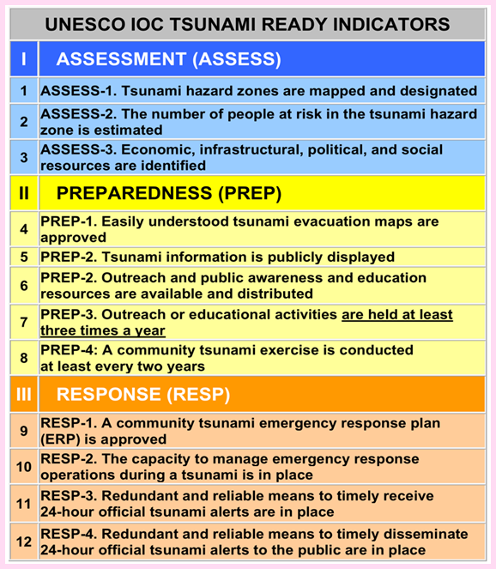
Suggested Action by Member State
Cross crediting approach
Compare the National Programme against TR Programme and its 12 Indicators
Inform UNESCO/IOC (would TOWS need to approve the cross crediting approach?)
MS inform status of implementation of its program
UNESCO/IOC records and notes in reporting

Slide 4
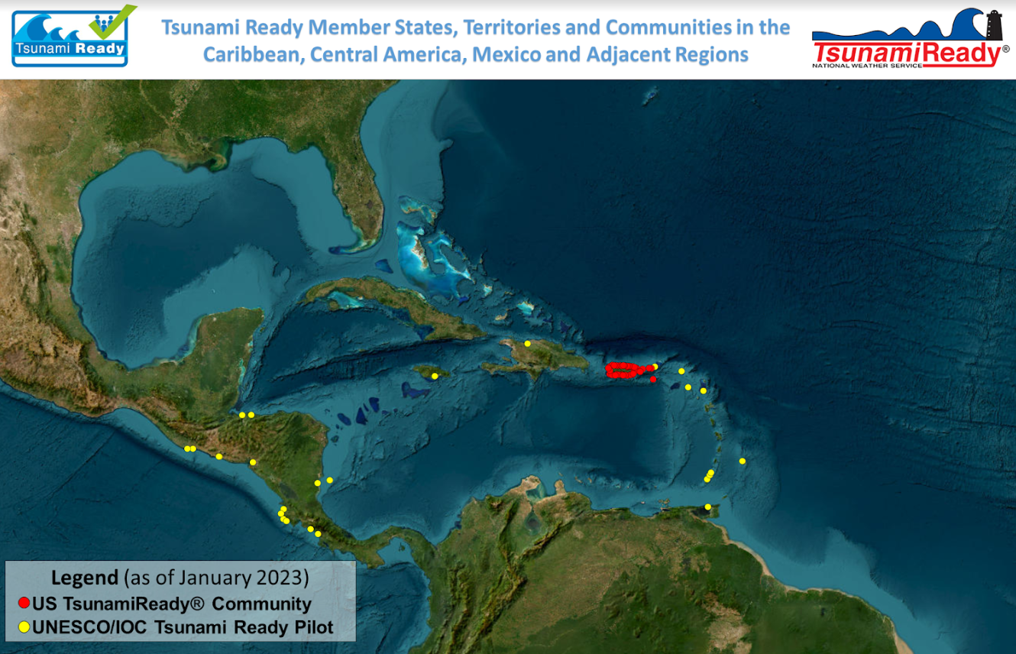
Instead of labeling the red dots as US TsunamiReady®, indicate cross credited Tsunami Ready Communities

Slide 5
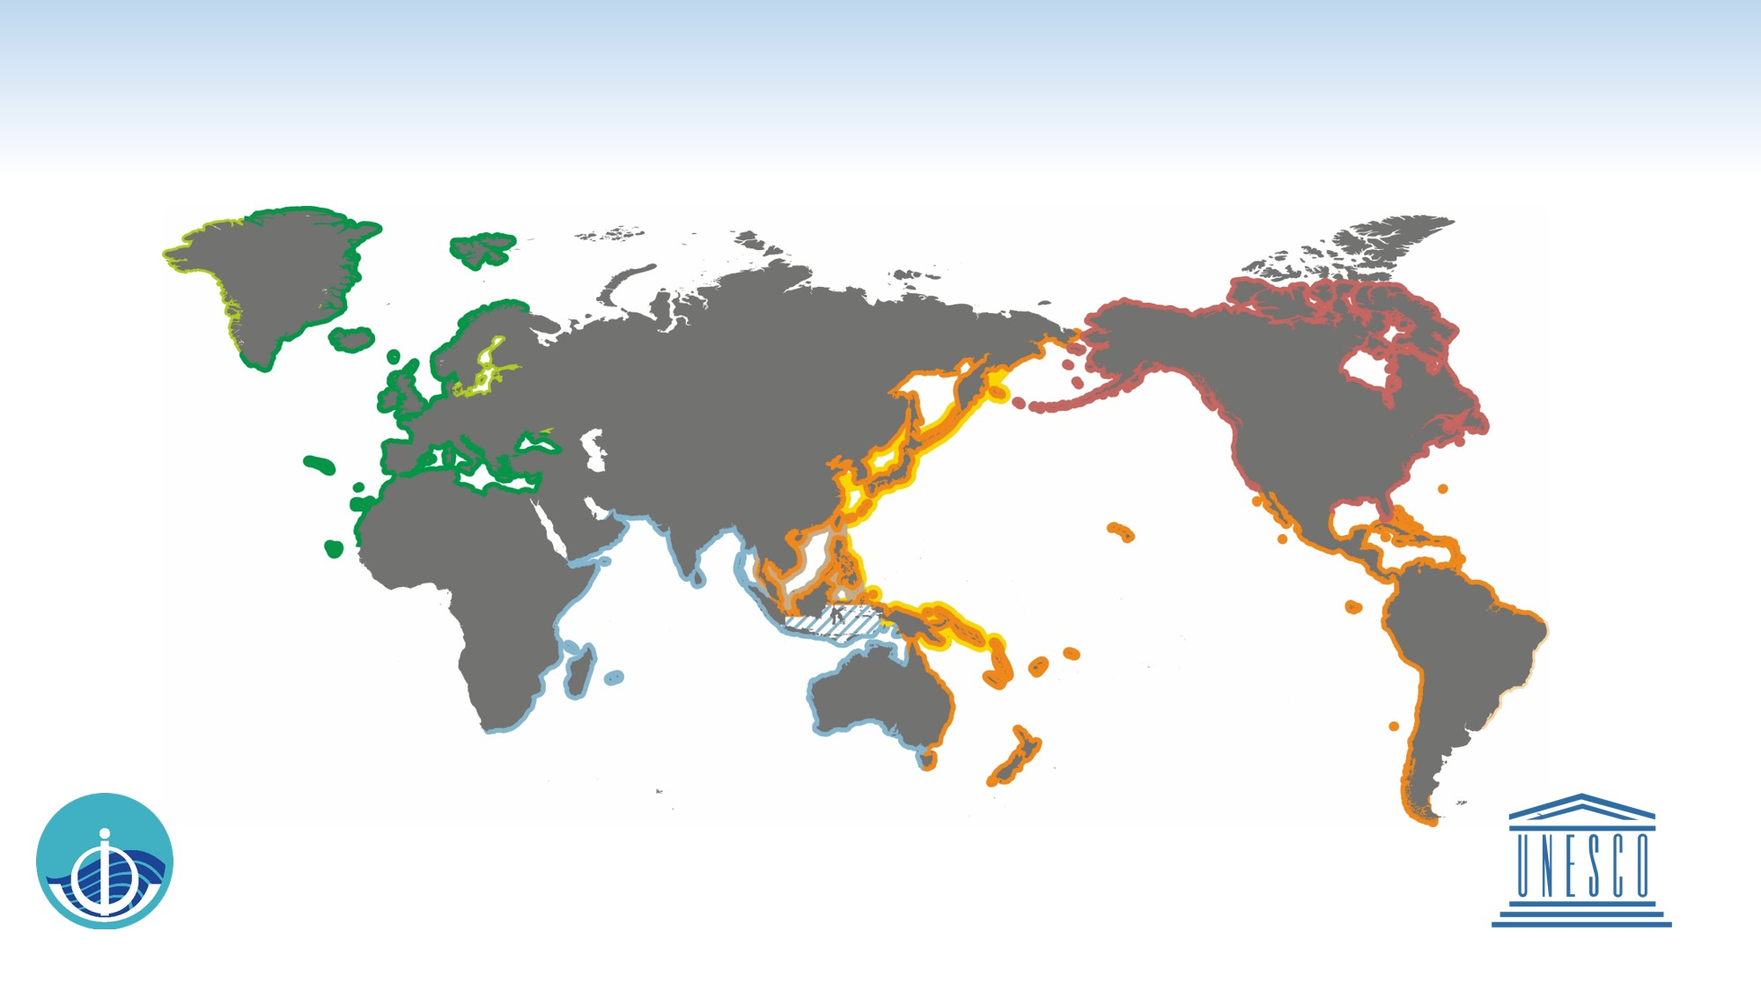
Use zones instead of points, to highlight preparedness and resilience programs (not points)
EXISTING SERVICES OF THE GLOBAL TSUNAMI WARNING SYSTEM
Intergovernmental Oceanographic Commission of UNESCO
2021 www.ioc-tsunami.org
The services provided by the
US National Tsunami Warning Center
are outside the framework of the IOC
coordinated tsunami warning systems
CARIBE-EWS
Tsunamis and Other Coastal Hazards Warning System for the Caribbean and Adjacent Regions
International Tsunami Information Centre, Caribbean Office (Puerto Rico)
Operational Tsunami Service provided by
PTWC Pacific Tsunami Warning Center /
NWS/NOAA of USA
CATAC, Nicaragua (in process)
NEAMTWS
North Eastern Atlantic, Mediterranean
and connected seas Tsunami Warning and Mitigation System
Accredited TSPs:
CENALT Centre d'Alerte aux Tsunamis of France
IPMA Instituto Portugues do Mar e da Atmosfera
of Portugal
INGV Istituto Nazionale di Geofisica e Vulcanologia of Italy
KOERI Kandilli Observatory and Earthquake Research Institute of Turkey
NOA National Observatory of Athens of Greece
Planned
Caribbean Tsunami Information
Centre (Barbados, IOC)
NEAM Tsunami
Information Centre (IOC)
PTWS
Pacific Tsunami Warning and Mitigation System
NWPTAC/JMA
Northwest Pacific Tsunami Advisory Center /
Japan Meteorological Agency
PTWC
Pacific Tsunami Warning Center /
NWS/NOAA of USA
SCSTAC/NMEFC
South China Sea Tsunami Advisory Center /
National Marine Environmental Forecasting Center of P. R. China
International Tsunami
Information Centre (USA, Chile, IOC)
IOTWMS
Indian Ocean Tsunami Warning and Mitigation System
InaRTSP
Indonesian Regional Tsunami Service Provider
ITEWC
Indian Tsunami Early Warning Centre
JATWC
Joint Australian Tsunami Warning Centre
Indian Ocean Tsunami
Information Centre (Indonesia, IOC)
Service is provided by the
InaTEWS
Indonesian Tsunami Early Warning System at the BMKG, outside the framework of the IOC-coordinated tsunami warning systems

Slide 6
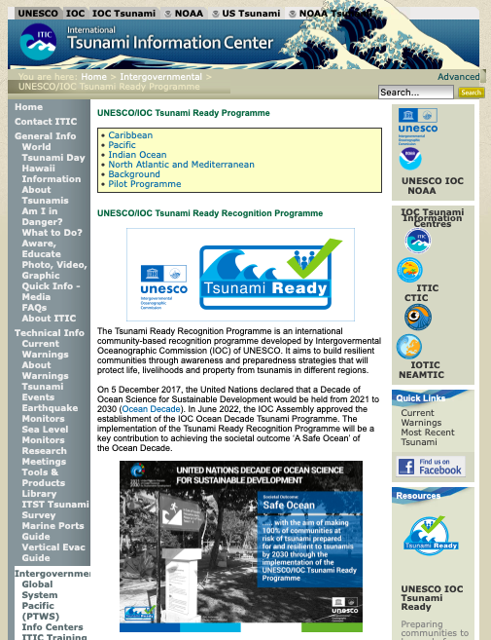
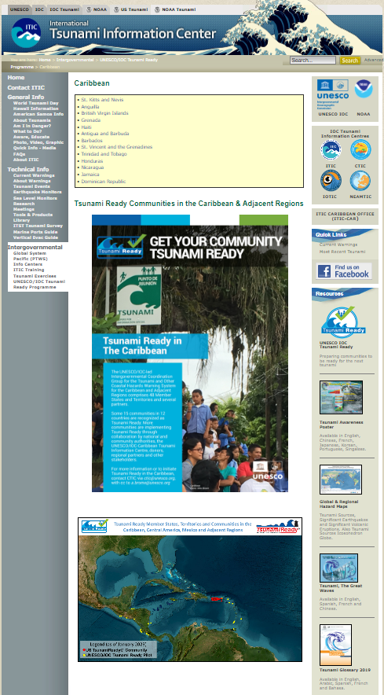
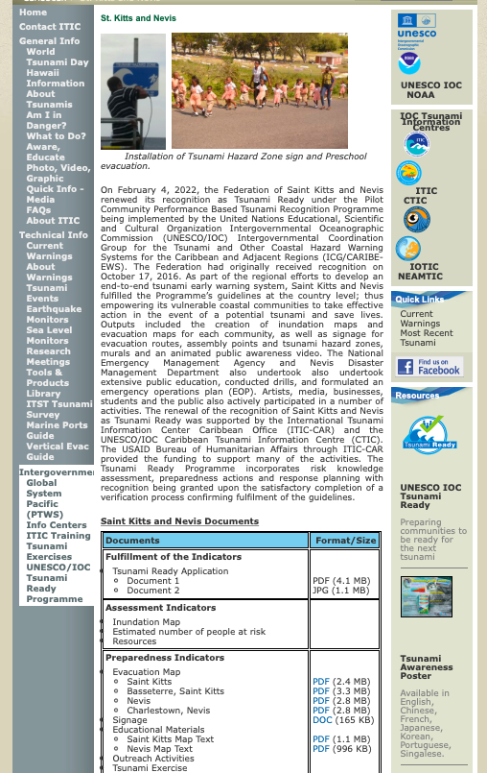
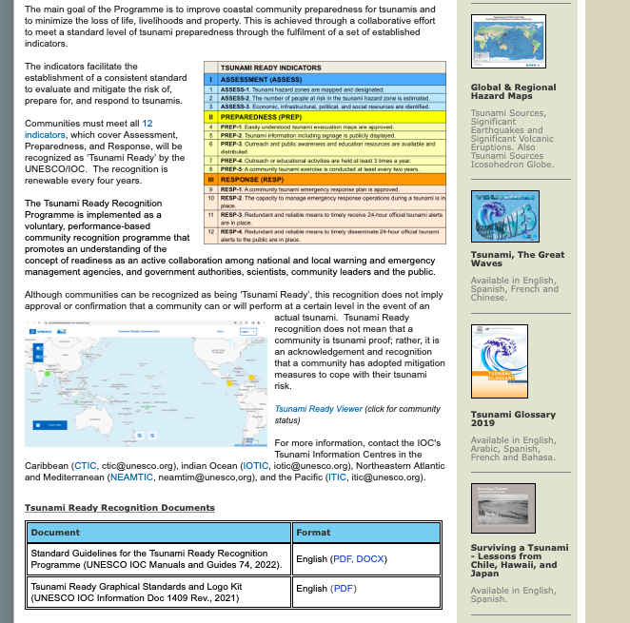
UNESCO IOC Tsunami Ready web site
www.tsunamiready.org
Tsunami Ready Viewer

Slide 7
THANK YOU
Christa von Hillebrandt-Andrade
christa.vonh@noaa.gov
[Presenter]
[Email address]

