Slide 1
Report from IODE
Sixteenth Meeting of the Working Group on Tsunamis and Other Hazards related to Sea Level Warning and Mitigation Systems (TOWS-WG-XV) - Online
2 – 3 March 2022

Slide 2
International Ocean Data Conference 2022 & 2023
expected outcome: guidance for the international ocean data and information community aimed at realizing the implementation of the ocean data and information “global commons”by 2030.
2022: Sopot, Poland, 14-16 February 2022 (hybrid event)
hybrid event and was attended by over 200 online and 60 on-site participants
organized jointly by the Government of Poland, the IODE Programme of the IOC and the Decade Coordination Unit
2023: Paris, France, 20-21 March 2023 (hybrid event)
  Expected: 200 onsite, 120 online

Slide 3
2021-2023: Revision of IOC Manuals and Guides
No. 5 - Guide for Establishing an IODE National Oceanographic Data Centre, IODE Associate Data Unit or IODE Associate Information Unit (3rd revised edition)
No. 67 - IODE Quality Management Framework for National Oceanographic Data Centres and Associate Data Units (Revised edition)
No. 73 - Guidelines for a Data Management Plan

Slide 4
Outcome of IOC-31 (2021)
The Assembly adopted Decision A-31/3.4.2 (International Oceanographic Data and Information Exchange. 26th Session of IODE, 20–23 April 2021:
Establishment of the
IOC Ocean Data and Information System Project (ODIS)
ODIS Regional implementation and proof of concept: Ocean InfoHub

Slide 5
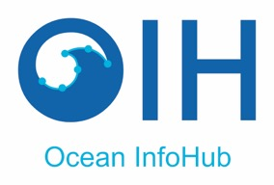

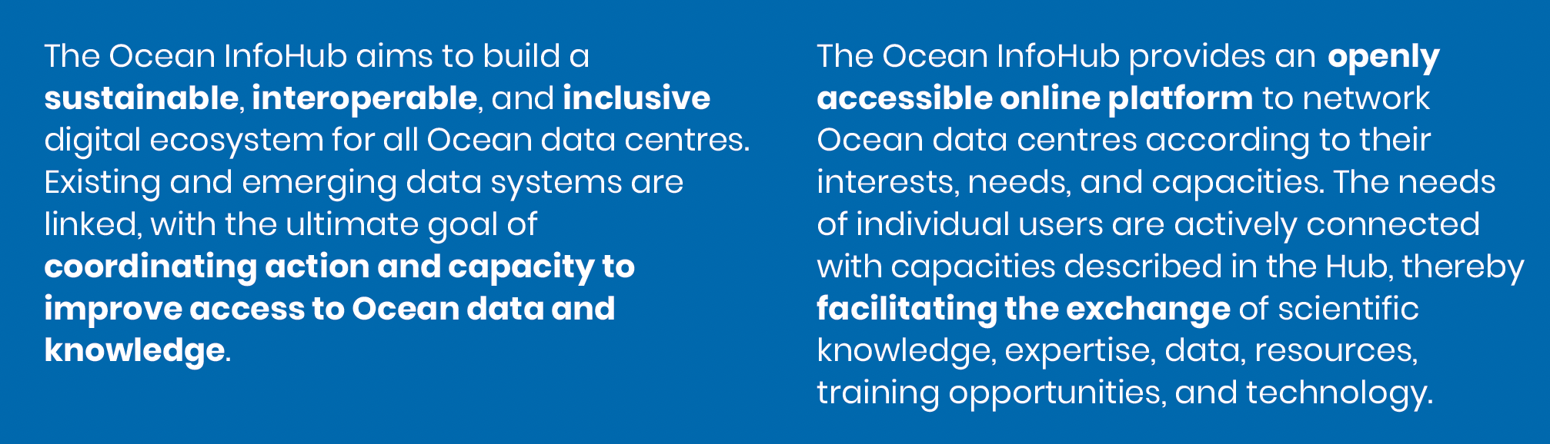
The IOC Ocean InfoHub Project

Slide 6
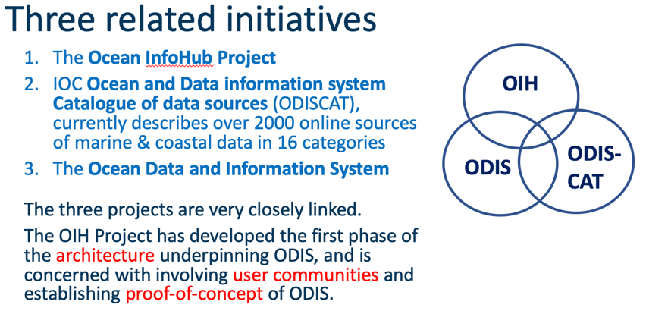
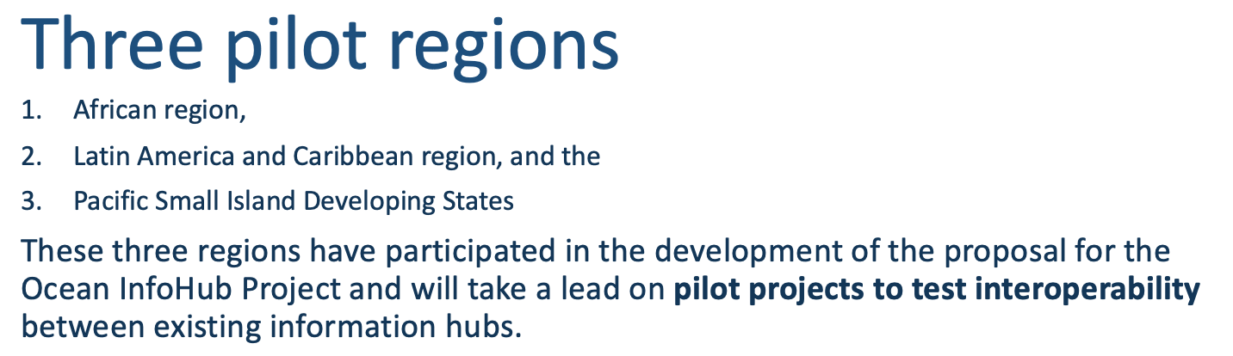
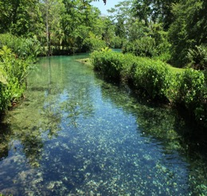
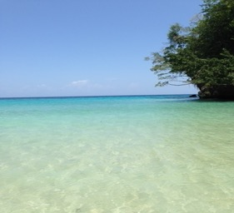
OIH links IOC databases
The OIH will first work with global IOC-associated online resources – including:
  OceanExpert : People
  AquaDocs : Documents and Publications
  The GOOS/IODE Ocean Best Practices System (OBPS)
  Data: the Ocean Biodiversity Information System (OBIS)
  Data: the World Ocean Database (WOD)
extended by partnerships with EurOcean, Marinetraining.eu, EMODNET, and other sources in the IOC ODIS Catalogue of Sources (ODIScat).

Slide 7
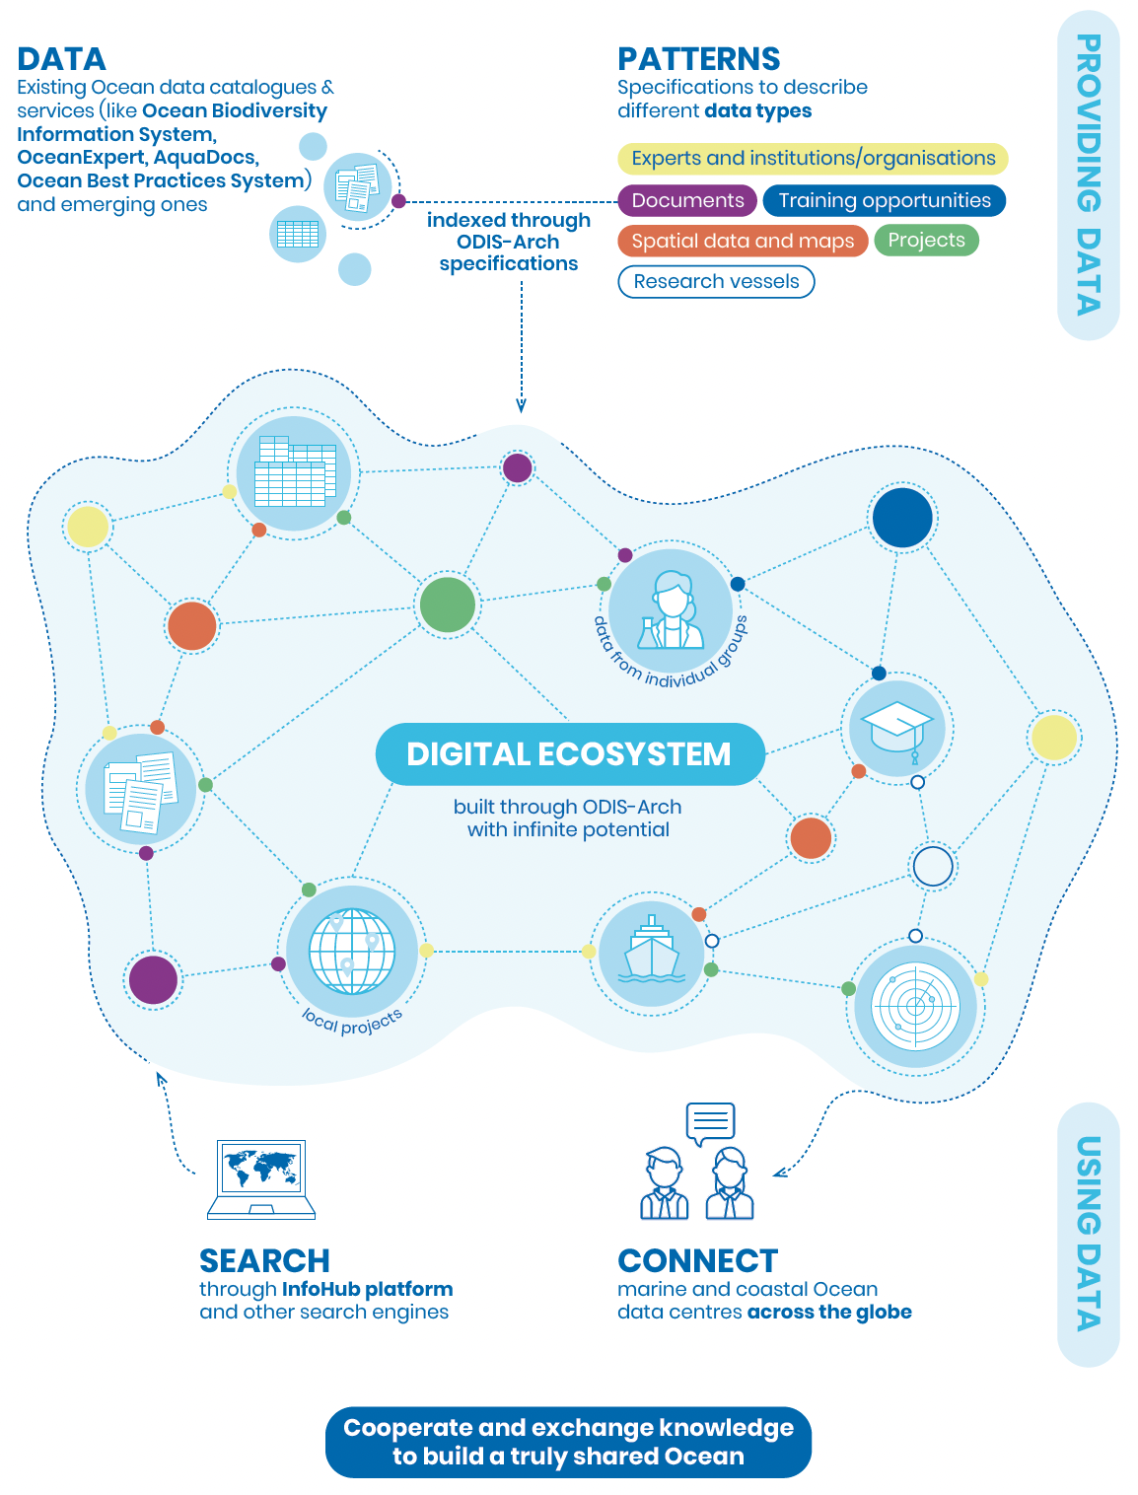
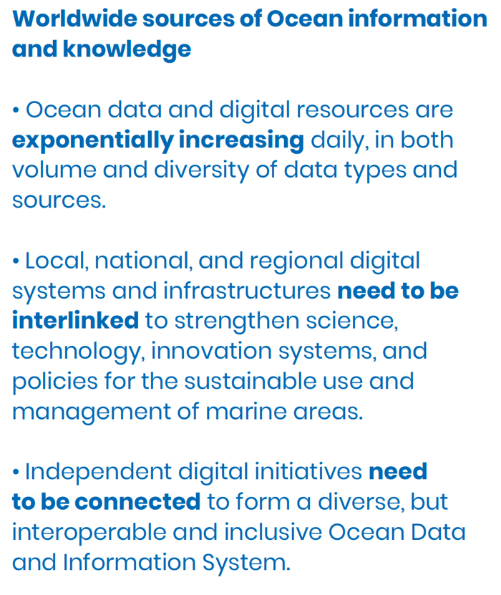

Slide 8
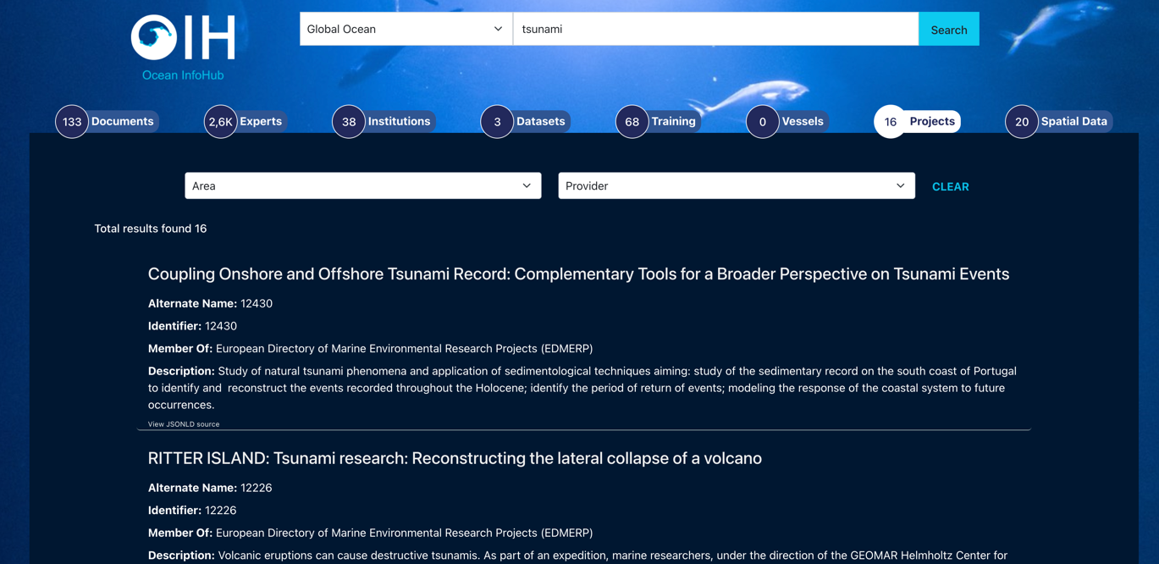
Mission: To build a sustainable, interoperable, and inclusive digital ecosystem for all ocean stakeholders
Each partner is in charge of their own contribution and partners co-develop the ODIS-Arch as new needs arise
Multiple entry points and levels of commitment to the ODIS network; Project and IOC-independent
Support communities of practice such as the Tsunami Warning and Mitigation systems through improved access to information, and or generation of bespoke portals.

Slide 9
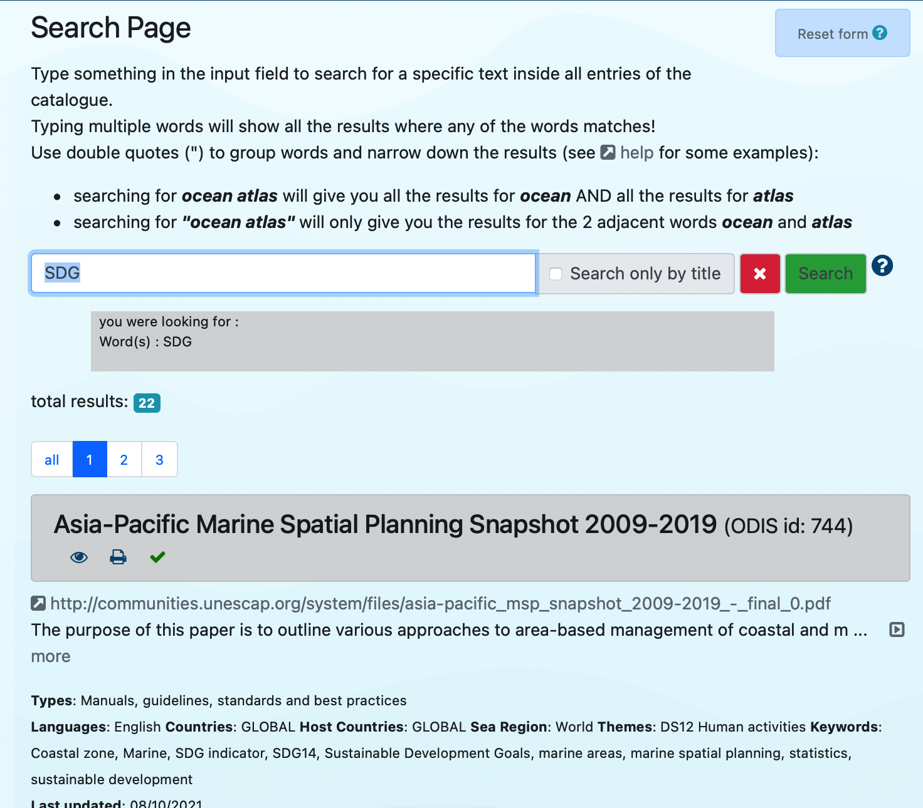
Discovering online
data sources: ODISCat
The ODIS "Catalogue of Sources" aims to be an online browsable and searchable catalogue of existing ocean related web-based sources/systems of data and information as well as products and services. It will also provide information on products and visualize the landscape (entities and their connections) of ocean data and information sources.

Slide 10
2023: Revision of the IOC data policy
December 2021 - December 2022: 6 steps completed
IOC Data Policy and Terms of Use (2023) to be submitted to IODE-XXVII for approval (step 7), then submitted to IOC Assembly, June 2023 (step 8)
The Policy:
  Section 1. Preamble
  Section 2. Purpose
  Section 3. FAIR & CARE principles
  Section 4. Conditions of use
  Section 5. Data Repositories and the ioc ocean data and information system (ODIS)
  Section 6: Secure long-term data archives
  Section 7. Access restrictions
  Section 8. Data sharing policies of Member States
  Section 9. Data and metadata sharing guidelines
  Section 10. Definitions

Slide 11
2023: Revision of the IOC Capacity Development Strategy
Output | Activity
1. Human resources developed at individual and institutional levels | 1.1 Academic and higher education
 | 1.2 Continuous professional development
 | 1.3 Sharing of knowledge and expertise including through community building
 | 1.4 Integration of ocean science in basic education
 | 1.5 Improving gender, generational and geographic diversity
2. Access to technology, physical infrastructure, data and information established or improved | 2.1 Facilitating access to technology and infrastructure
 | 2.2 Facilitating equitable access to and sharing of ocean data and information
3. Global, regional and sub-regional mechanisms strengthened | 3.1 Further strengthening and supporting secretariats of regional commissions
 | 3.2 Enhancing effective communication between regional sub-commission secretariats and global programmes as well as other communities of practice (incl. other organisations) 3.3 Identifying specific national and regional capacity development needs through regular needs assessment 3.4 Encouraging regional and sub-regional organisations to be leaders in, and amplifiers of capacity development
4. Development of ocean research policies in support of sustainable development objectives promoted | 4.1 Fostering the development of ocean research policies
5. Visibility, awareness and understanding on the roles and values of the ocean and ocean research in relation to human wellbeing and sustainable development increased | 5.1 Fostering the development of ocean related public information and communication services
 | 5.2 Fostering the development of ocean literacy
6. Sustained resource mobilization reinforced | 6.1 Enhancing sustained support (in-kind and financial) to the IOC for its international coordination role 6.2 Promoting sustained bilateral and multilateral support among Member States
The vision statement of IOC’s Capacity Development Strategy:
Through international cooperation, IOC will assist its Member States to collectively achieve the IOC’S high-level objectives (HLOs), and in doing so support the delivery of the societal outcomes of the United Nations Decade of Ocean Science for Sustainable Development (2021-2030), with particular attention to ensuring that all Member States have the capacity to meet them.
Revision to be submitted for adoption to June 2023 Assembly

Slide 12
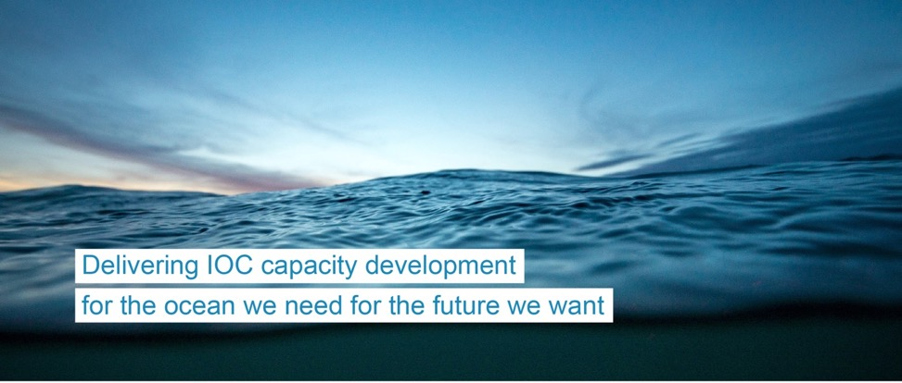


OceanTeacher
Global Academy
Delivering as One
www.ioc-cd.org
www.oceanteacher.org
ioc.training@unesco.org
Notes:
The second phase of the OceanTeacher Global Academy started in April 2020. It’s a 3-year project, funded by the Government of Flanders, Belgium.
Its main goals are to:
1) Develop a portfolio of packaged courses (related to the needs of IOC and other partners and stakeholders)
2) Deliver courses online and/or blended learning, on demand
It builds on the legacy of the previous project and includes new initiatives and challenges now in place, such as the 2030 Agenda and its SDGs and the UN Decade of Ocean Science for Sustainable Development.
New, ready to deliver course topics are being made available online. And the network of Training Centres is expanded.
OTGA-2 fosters collaborations beyond UNESCO/IOC to position itself as the training platform for ocean related topics within the UN and beyond.

Slide 13
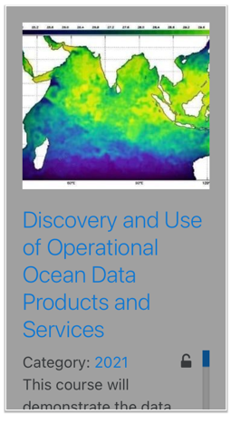
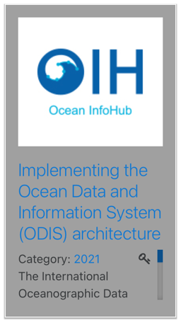
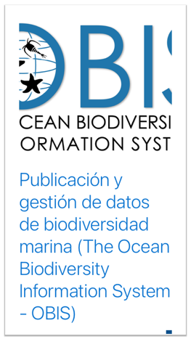
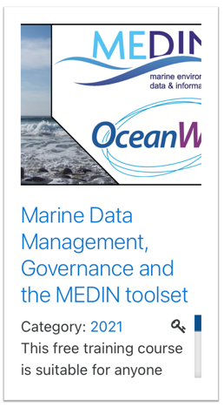
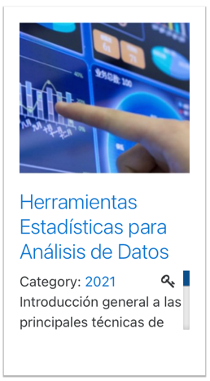
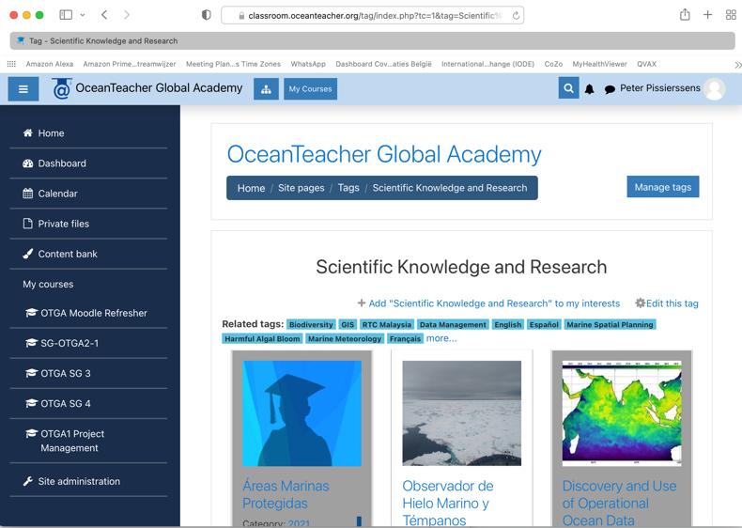
OceanTeacher Courses in data and information management
20 different courses related to D&IM

Slide 14

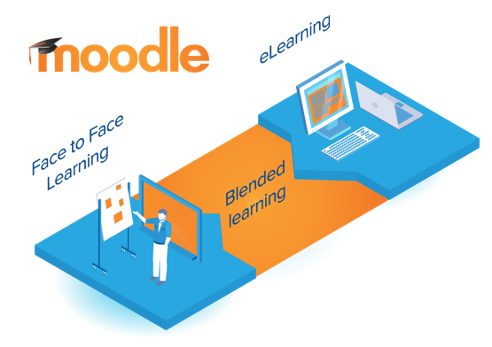
OceanTeacher Global Academy
Building human capacity
Open Access
Learn anywhere,
anytime
Moodle:
Modular
Object
Oriented
Dynamic
Learning
Environment
Notes:
The e-Learning Platform is the backbone of OTGA. As a Learning Management System, it facilitates Face to face learning, blended and online learning.
The platform allows
Sharing content and learning between organisations / stakeholders
Co-creating content and knowledge
Recognition for the organisations as well as course developers
Widely available (learn anywhere, anytime)
Enables creation of a community of practitioners and learner collaboration

Slide 15
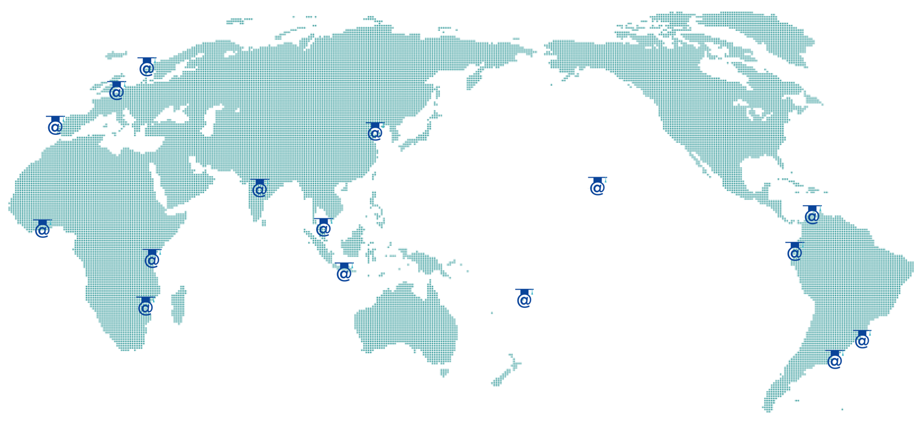

OceanTeacher Global Academy:
Network of Regional and Specialized Training Centres
Notes:
An essential component of the OTGA approach to training is its global network of Training Centres.
OTGA works in partnership with the IOC Member States and its institutions, and it’s now a network of 16 Regional and Specialised Training Centres. These RTCs and STCs play an essential role, as they help tailoring courses to the regional specific needs and they host the face-to-face courses in the languages that are relevant to the Regions and focus on relevant regional needs and topics.

Slide 16
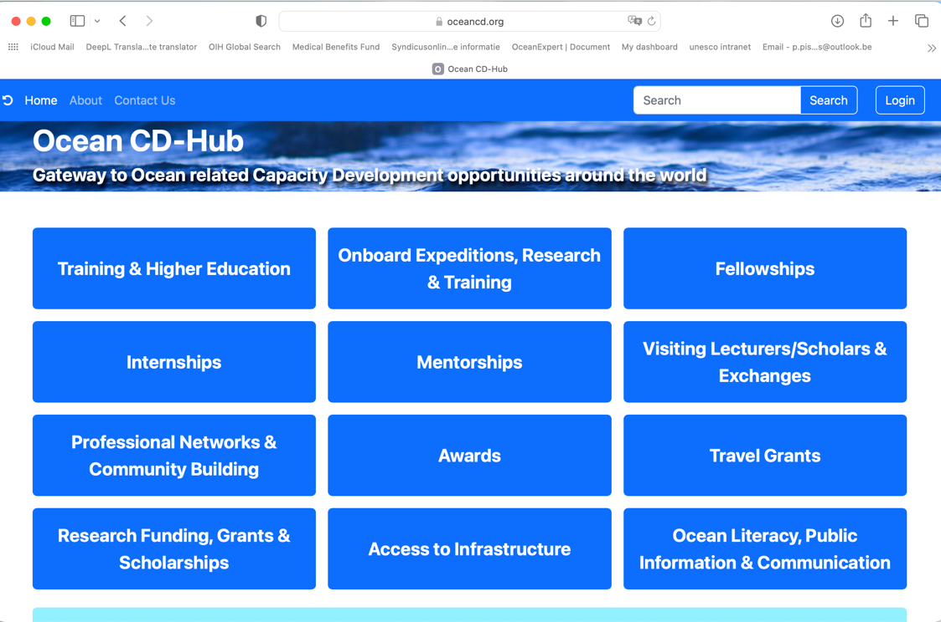
2023: launch of Ocean CD-Hub
https://oceancd.org
Database of CD opportunities provided by Member States and organizations (UN, non-UN)
Startup set of 416 records
Call for more entries to MS and organizations planned
Complementary service to ODISCat (ocean related web-based sources/systems of data and information as well as products and services)

Slide 17
Thank you

Slide 18
Opportunities for cooperation 2023-…
Data sourcing and data sharing: ODIS, OIH, ODISCat
Sharing IODE network as NODC or ADU
Joining ODIS as data provider or data user
Benefiting from OTGA for training and education:
  create/share courses,
  use platform for training as user or provider,
  establish RTC or STC
Promote your CD activities through the Ocean CD-Hub

