Slide 1
INTER-ICG TASK TEAM ON DISASTER MANAGEMENT AND PREPAREDNESS Report and Recommendation
Harkunti P. Rahayu – Chair
Denis Chang Seng and All Team of TTDMP
IOC UNESCO, Sixteenth Meeting of the Working Group on Tsunamis and Other Hazards related to Sea Level Warning and Mitigation Systems (TOWS-WG-XVI) , 2 March 2023

Slide 2
Members of TOWS TTDMP
Harkunti Pertiwi Rahayu (Chair) - ICG IOTWMS
Laura Kong - ITIC, ICG/PTWS
David Coetze – ICG/PTWS
Ardito Kodijat - IOTIC, ICG/IOTWMS
Cecilia Valbonesi (online) - ICG/NEAMTWS
Marinos Charalampakis - ICG/NEAMTWS
Christa von Hillebrandt Andrade - ICG/CARIBE-EWS
Alison Brome - CTIC; ICG/CARIBE-EWS
Denis Chang Seng - IOC Secretariat / TT- DMP Secretariat / ICG/NEAMTWS
Jamel Ben Abdallah - CoastWave Project Consultant
Regina Khanbekova (Observer) - UNDRR/ Invited Guest
Silvia Chacón-Barrantes (Observer) - ICG/ CARIBE-EWS
Emilie Crochet (Observer) - ICG/NEAMTWS
Ignacio Aguirre Ayerbe (Observer) (Online) - ICG/NEAMTWS
Alejandro Rojas Aldana (observer) - ICG/NEAMTW
Derya Vennin (observer) - ICG/NEAMTWS /CoastWave Project

Slide 3
REFLECTION ON TT- DMP RECOMMENDATIONS TO TOWS-WG XV (2022)
Noted that a number of recommendations have been addressed
Appreciate the translation of the IOC MG 86 Multi-Annual Community Tsunami Exercise Programme: Guidelines for the Tsunami and other Coastal Hazards Warning System for the Caribbean and Adjacent Regions into French and Spanish.
Noted that the TT-DMP will need to consider a mechanism to equate those programmes to Tsunami Ready. The mechanism was discussed under sub-agenda 3 on Tools aligned with TR indicators (Non-implementation of TRR).
Noted that:
Updated TOR of the Indian Ocean Tsunami Inforamtion Center (IOTIC) was approved by the ICG/IOTWMS at its 13th session which took place in Bali (28 November to 1 December 2022).
The ICG/PTWS-XXIX (4 December 2021) mandates the International Tsunami Information Center (ITIC) to facilitate implementation of and documentation collation for UNESCO IOC Tsunami Ready Programme and other like initiatives in the PTWS;

Slide 4
TSUNAMI READY MANUAL, GUIDES AND SUPPORT TOOLS
UNESCO IOC Tsunami Ready Guidelines
Noted there are no new updates concerning UNESCO IOC Tsunami Ready Guidelines MG 74 is currently under implementation in all four ocean basins.
Appreciate MG 74 is being implemented in CoastWAVE project countries. The experiences in NEAM region will be shared and reported to the TOWS Task Teams for consideration of any future revision of the Manual and Guide.
Tsunami Ready (TR) Communication Tools
Noted there are no new Tsunami Ready Communication tools from the Indian Ocean and the Pacific beyond those reflected in MG 74,
Appreciate CTIC is developing a management tool for communication.

Slide 5
TSUNAMI READY MANUAL, GUIDES AND SUPPORT TOOLS
Tsunami Ready Procedures and Workflow
Welcomes the development of a questionnaire in the Caribbean to receive feedbacks from the Tsunami Ready communities.
Recommends sharing of the survey questionnaire to all ICGs and feedback forms to receive information from the TRR communities
Update on Tsunami Ready Interactive Map Viewer
Laura Kong provided an update of the Tsunami Ready Map Viewer and Tsunami Ready website. Work is in progress to improve the organization and timeliness of documentation updates. She pointed out the challenges of the TR Map viewer for countries with many Tsunami Communities.
Requests the Secretariat to more timely update the TR database.

Slide 6
TSUNAMI READY MANUAL, GUIDES AND SUPPORT TOOLS
What is a community?
Christa von Hillebrandt addressed the question concerning what is a community in the context of Tsunami Ready as and important aspects both for the implementation of Tsunami Ready and the Ocean Decade Tsunami Programme goal of “100% of at-risk communities are prepared for and resilient to tsunamis through programmes like Tsunami Ready.” Among the many community definitions, for Tsunami Ready, it would be most appropriate to use those that have an identifiable geographical boundary, either administrative/political boundaries and/or disaster management areas of responsibility.
Ardito Kodijat reported in the Indian Ocean implemention of Tsunami Ready, the decision of the community needs to consider: clear boundaries (administratively or natural boundaries), the size of the community, and the characteristics of the community (rural, urban, agriculture, industrial, tourism, etc).
Recommend developing a community flow chart/guide and flyers to support the implementation of Tsunami Ready.

Slide 7
TSUNAMI READY MANUAL, GUIDES AND SUPPORT TOOLS
Tsunami and Critical Infrastructures
Harkunti Pertiwi Rahayu presented important aspect of building resilient critical infrastructure to response SFDRR global target in “reducing disaster damage to critical infrastructure and disruption of basic services, among them health and educational facilities, including through developing their resilience”. Key lessons learned from Japan Sendai Airport in 2011, and Indonesia initiatives to include airport and Air Traffic Control impacted by earthquakes and tsunami 2018.
Denis Chang Seng noted that a resilience emphasis on the robustness of critical infrastructures, to minimize and prevent failures, however, critical infrastructure resilience also includes redundancy and rapid restoration time respectively when a system is unable to accommodate and absorb shocks.
Recommend TT-DMP preparing a guideline for critical infrastructures from tsunami impacts such as AirportGetReady to Tsunami

Slide 8
TSUNAMI READY MANUAL, GUIDES AND SUPPORT TOOLS
Making Cities Resilient (MCR2030)
Denis Chang Seng provided a report on the progress made towards developing partnership and future opportunities concerning Making Cities Resilient (MCR2030).
Recommends that TICs join the MCR2030 to explore potential regional and city interest and opportunities in tsunami preparedness and UNESCO-IOC Tsunami Ready Recognition Programme.

Slide 9
TSUNAMI READY MANUAL, GUIDES AND SUPPORT TOOLS
Hotel Resilience
Bijan Khazai, CEO of Hotel Resilient presented the Hotel Resilient Programme, i.e. a benchmarking and certification of hotels and resorts for disaster risk management (multi-hazard including tsunami) and climate change adaptation.
TTDMP noted that previously discussion and elaborating on existing materials for hotel tsunami response, including the availability of “A guide to tsunamis for Hotels” (MG 69) in 2012, and the 2013 ITIC “Tsunami Response Workshop for Businesses: Preparing hotels and businesses for the next tsunami: Tsunami Response - Guidance and Templates”.
Recommends secretariat updating the Tsunami Hotel guide developed by NEAMTWS in 2012 and translate in other languages, including other lessons learned.
Further recommends to consider for the future to integrate into the UNESCO IOC Tsunami Ready Recognition Programme other options to recognize entities other than Communities.
Recommends sharing and establishing stronger links between Hotel Resilience initiative with the UNESCO/IOC Tsunami Ready Programme.

Slide 10
TSUNAMI READY MANUAL, GUIDES AND SUPPORT TOOLS
Inclusion of Other National Programmes and Initiatives in the UNESCO IOC Tsunami Ready Recognition Programme (Non-implementation of TRR) - 1
Christa von Hillebrandt introduced the topic of how countries with strong existing tsunami preparedness programmes can be included in the UNESCO IOC Tsunami Ready Recognition Programme, noting that the UN Ocean Decade Tsunami Programme’s goal is that 100% of communities at risk from tsunami should be prepared and resilient by 2030.
Ardito Kodijat raised the question on who will decide if a national programme and/or initiatives are similar to UNESCO/IOC Tsunami Ready, or are an acceptable programme that will contribute the goal of 100% of at-risk communities prepared for and resilient to tsunami.
For these initiatives, the Tsunami Ready Map Viewer could use different colors or symbols to show distinguish the different initiatives, and still capture the overall tsunami ‘readiness’ around the world.

Slide 11
TSUNAMI READY MANUAL, GUIDES AND SUPPORT TOOLS
Inclusion of Other National Programmes and Initiatives in the UNESCO IOC Tsunami Ready Recognition Programme (Non-implementation of TRR) - 2
Notes that some Member States already have similar tsunami hazard mitigation programmes in place, encourages Member States that apply other programmes, to confirm alignment with the twelve UNESCO IOC Tsunami Ready Indicators in relevant communities and report outcomes.
Appreciates the progress by the PTWS and TTs to explore mechanisms of how to include other tsunami preparedness and readiness programmes and initiatives in the UN Ocean Decade Tsunami Programme “tsunami readiness” goal.
Recommends the TOWS TT-DMP to work with the PTWS Working Group 3 to propose mechanisms by which National tsunami preparedness and readiness programmes and initiatives will be able to fully participate and contribute to the the UN Ocean Decade Tsunami Programme’s UN Ocean Decade Tsunami Programme’s “prepared for and resilient to Tsunamis” goal. This reflects EW4ALL

Slide 12
IMPLEMENTATION STATUS OF TSUNAMI READY PILOT PROGRAMMES, PROGRESS AND CHALLENGES
NEAM
Ms Cecilia Valbonesi reported on the recent developments concerning piloting Tsunami Ready in Italy.
Derya Venin and Denis Chang Seng reported on the progress of IOC DG ECHO CoastWAVE project on Strengthening the Resilience of Coastal Communities in the North East Atlantic, Mediterranean Region to the Impact of Tsunamis and Other Sea Level-Related Coastal Hazards. The project is implementing Global Tsunami Ready Standards and Guidelines and pilot Tsunami Ready at seven communities in seven countries: Morocco, Spain, Egypt, Malta, Cyprus, Greece, and Turkey. Overall 70 % of indicators can be considered as work in progress or completed.

Slide 13
IMPLEMENTATION STATUS OF TSUNAMI READY PILOT PROGRAMMES, PROGRESS AND CHALLENGES
Indian Ocean
Mr Ardito Kodijat reported on the progress in implementing TRR in the Indian Ocean. In 2022 there are nine communities in Indonesia recognized by UNESCO/IOC in the Indian Ocean. There is no additional community in India. Therefore, up to present, 11 communities of 2 countries in the Indian Ocean (2 from India and 9 from Indonesia) are UNESCO/IOC Recognised Tsunami Ready communities. Maldives as a SIDs has indicated interest to start the TRRP in 2023.
The meeting also suggested being cautious on the signage messages not to be confusing, such as instead of using the number of floors of the building, just to convey a simple message such as “go to the designated building for vertical evacuation”.

Slide 14
IMPLEMENTATION STATUS OF TSUNAMI READY PILOT PROGRAMMES, PROGRESS AND CHALLENGES
Pacific
Laura Kong of ITIC reported official recognition (all under the pilot programme) of 10 communities in 4 countries (Honduras; El Salvador, Costa Rica, and Samoa); confirmation of plans to become recognized in 1 community (Panama); and progress in the implementation in 14 communities from 6 countries (Ecuador, Costa Rica, Marshall Islands, Federated States of Micronesia). Recognition is expected to be completed in the latter 14 communities in 2023 or early 2024.
A total of 5 member states have expressed interest to implement Tsunami Ready: Vanuatu, Solomon Islands, Tonga, Samoa, and France (French Polynesia and Caledonia). Most countries have already achieved some of the TR indicators.
ITIC and IOTIC conducted a 3-day Regional Tsunami Ready Training based OTGA Material for Pacific Island Countries and Territories (PICT) 30 January to 1 February 2023, bringing together 11 countries and participants from disaster management offices, tsunami warning centres, and geological services.

Slide 15
IMPLEMENTATION STATUS OF TSUNAMI READY PILOT PROGRAMMES, PROGRESS AND CHALLENGES
Caribbean
Alison Brome reported a total of 15 communities from 12 countries have been recognized. Renewals discussions have started in 2 communities in Grenada and 1 in Anguilla, whereas, there are pending discussions for renewals to be initiated in 2 communities from Nicaragua, 2 from Honduras, and 1 from Haiti.
In addition, projects are contributing to the implementation of Tsunami Ready mainly: 1. Strengthening capacities for tsunami early warning in Grenada; 2. Towards a safer ocean in the Caribbean through tsunami-ready communities (NORAD project communities); 3. UNESCO-IOC EWS Dominican Republic; 4. and ITIC-CAR USAID/BHA project in four communities (Barbados, Dominica, Saint Lucia and Saint Vincent and the Grenadines, Dominica)

Slide 16
IMPLEMENTATION STATUS OF TSUNAMI READY PILOT PROGRAMMES, PROGRESS AND CHALLENGES
Appreciates the progress in implementing Tsunami Ready in the Caribbean, Indian Ocean, Pacific and NEAM region.
Recommends TICs clarifying the renewal process of Tsunami Ready and learning about the renewal experience in the United States.
Recommends TICs to organize an online meeting on the renewal of Tsunami Ready.
Notes that to properly inform the public on the validity of the recognition, the period of recognition is indicated on the Tsunami Ready Recognition Certificate under the Tsunami Ready logo.
Notes the new tsunami signage developed by IOTIC for vertical evacuation when there is no high ground and/or could not go inland.
Recommends avoiding confusion, the text in the tsunami ready signage for vertical evacuation to be simplified such as Go to the designated building for vertical evacuation
Request secretariat to explore how to develop an automated application system for Tsunami Ready application and renewal.

Slide 17
TRAINING AND GUIDANCE
Appreciates the efforts and progress in developing the training materials for the Tsunami Awareness and Tsunami Ready
Recommends expedites the finalization of the OTGA training materials.
Request Secretariat to explore the possibilities to organize tsunami ready expert meetings to finalize the OTGA training programme.

Slide 18
WTAD 2023
Notes the activities undertaken by the respective regions for WTAD 2022, and the success achieved by the UNDRR, in particular the GetTo HighGround campaign in Portugal, Japan and Mauritius.
Further notes to build connections with EW4A, Multi- Hazard approach and coastal risk and Making Cities Resilient (MCR2030)
Welcomes the continued interest of strong collaboration between the UNESCO/IOC and UNDRR for the 2023 WTAD highlighting among other initiatives the UN Ocean Decade Tsunami Program goal for 100% Global Tsunami Ready for highly vulnerable communities
Requests the UNDRR to strengthen collaboration with respective ICGs and corresponding TICs, and synergizing the Hashtag #TsunamiReady

Slide 19
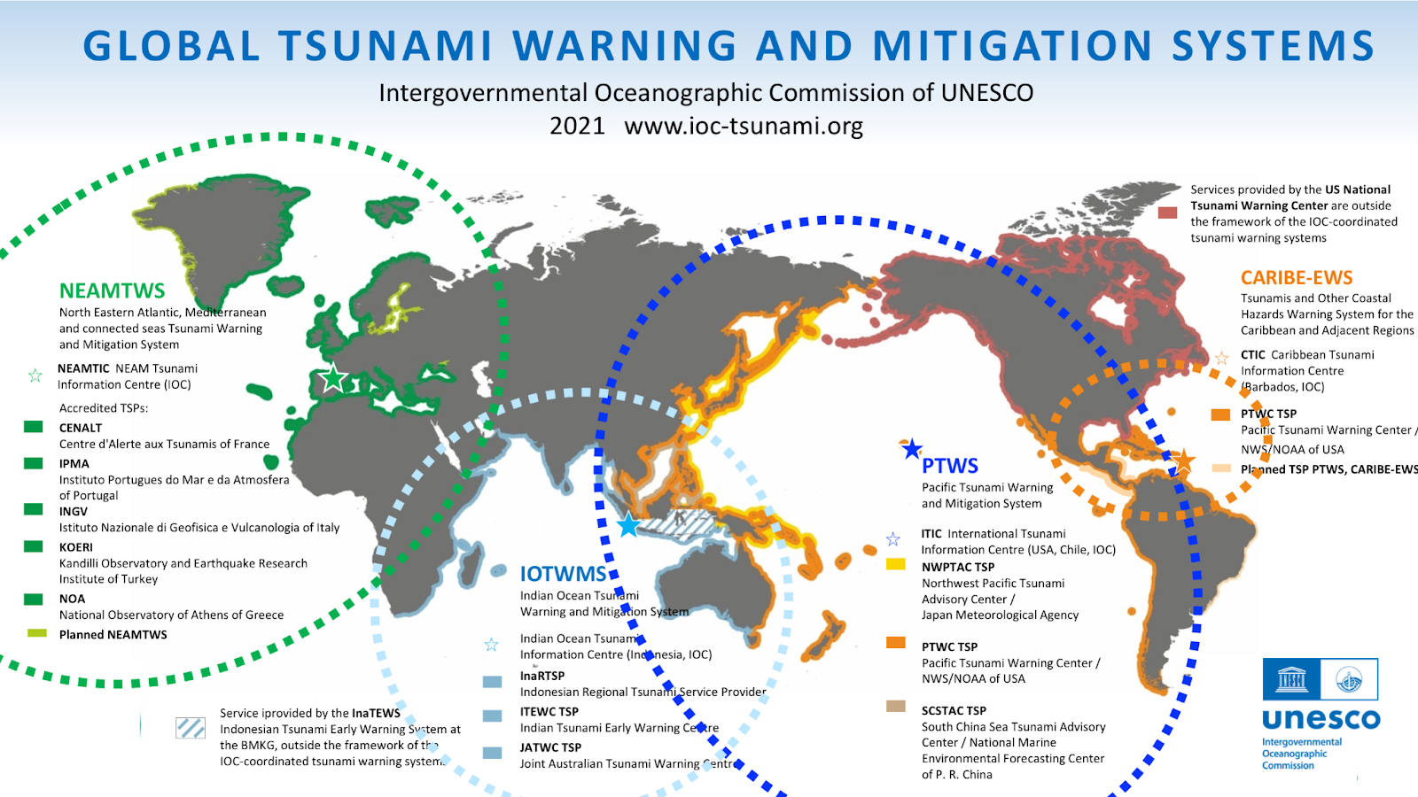
TEN YEAR RESEARCH, DEVELOPMENT, AND IMPLEMENTATION PLAN FOR ODTP
Recommends expanding on the role of the ICGs, their Working Groups, Tsunami National Contacts, National Tsunami Warning Centers, Tsunami Warning Focal Points, Tsunami Service Providers, and Tsunami Information Centres in the Governance and Implementation chapters as the pathway for achieving the goals of UN ODTP Science Development and Implementation Plan.
Requests to include the map of the Global Tsunami Warning and Mitigation System map in the Governance chapter to clearly illustrate the components.

Slide 20
COASTAL URBAN DEVELOPMENT PLANNING
Notes the important of mainstreaming disaster risk reduction in urban planning to respond to the global commitment, i.e. Sendai Framework for Disaster Risk Reduction, SDGs Goal no 11 building resilient cities, and Paris Agreement and strengthening one of the UN ODTP targets on mitigation as presented by DR. Harkunti P. Rahayu. It is the key to preventing systemic disaster impacts on development using a cross-sectoral development effort that is currently being pursued globally since 2007.
Recommends preparing a guideline for mainstreaming tsunami disaster risk reduction for coastal urban development planning.

Slide 21
PLANNING FOR OCEAN DECADE
Plans for the 2nd IOC UNESCO Science Symposium on advances in tsunami warning to enhance community responses
Note Indonesia proposal for hosting 2nd IOC UNESCO Science Symposium on advances in tsunami warning to enhance community responses as part of or back to back with Two Decade Commemoration of Indian Ocean Tsunami in Banda Aceh First Week of December 2024.
Recommends the nomination of a tsunami Symposium vice-chair and members of the committee.

Slide 22
IUGG UPDATE
Notes the recent EGU 2022 meetings on Tsunamis from source processes to coastal hazard and warning.
Notes the publication of IUGG concerning the Sulawesi/Palu (2018) and Anak/Krakatau (2018) Tsunamis.
Further notes the support provided by IUGG to IOC on the tsunami glossary update in 2019 and report on meteotsunamis.
Welcomes the engagement of TTs member at the 28th IUGG General Assembly will be held 11-20 July 2023 at the Messe Berlin – City Cube, Berlin, Germany.
Further welcomes the proposed IUGG meetings in September 2023 in Tonga and the IUGG JTC - IOC 2nd International Tsunami Symposium in December 2024

Slide 23
EMERGENCY WARNING SERVICE IN GALILEO
Notes the satellite services to be offered by Galileo in 2024 for the dissemination of alerts to the population.
Further notes the Galileo demonstration examples to be carried out in France, Germany, Cyprus, and Belgium and the workshop planned in February 2024.
Welcomes the offer of the Galileo Programme to provide relevant documents, storylines, protocols, guidelines and manuals to support the design of the demonstration example

Slide 24
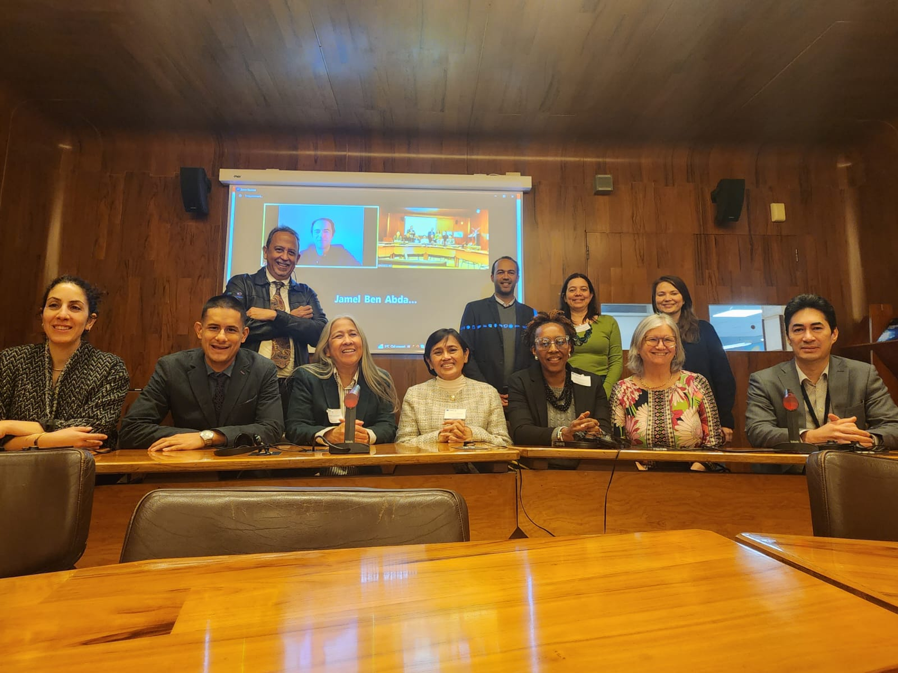
DISCUSS OUTCOMES OF THE JOINT MEETING
Recommends organizing TOWS Task Team meeting over a full 3-days, with one full day on Joint agenda discussions.

Slide 25
Thank you …

